Slide 1
What’s next for Engage? What makes the project meaningful?
Bieke Abelshausen & Michiel Van Oudheusden
2019 RICOMET Conference - Barcelona

Slide 2
Engage project
What have we done thus far?
Where are we now?
→ Slides CT
What’s next?

Slide 3
Opening and closing ‘engagement’
Keeping open
Ongoing dialogue and reflexive learning
Dissensus: doing justice to a diversity of perspectives (meanings)
Process
Closing down
Recommendations towards policy makers, scientists, others
Consensus to enable joint action
Product
Nature, Dec 2010

Slide 4
Adhere to the complexity
No to recommendations
SSH researchers do not have the role of advisors
Question
Conduct research
Present findings – do not simplify, but present complexity
Question
Share knowledge
Decision makers make the recommendations
Bi-directional – make them together

Slide 5
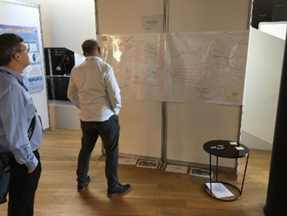
Search for middle ground: temporary closure (MVO)
A false dichotomy:
Yes to recommendations – ‘enlightened consultancy’ (A. Rip)
Logic of successive steps: Slowing down ‘engagement’ → temporary closure
SSH researchers: multiple roles
Observe + analyze
Question
Facilitate
Prescribe (based on 1-2-3)
Seek meaningful (re)combinations
Recommendations in the form of plural, conditional advice, making explicit where these recom. come from, how they were established
e.g., who or what was left out? non-human ‘actants’ / stakeholders + technical scientists

Slide 6
Meaningful engagement in/for Engage
Findings that present the reality and not a simplified, pragmatic version
2 examples:
Contextualize engagement by examples: allow to include not only the middle ground, but also the outliers
Engagement should be presented in a non-normative, nuanced manner
Engagement could be good in a specific case
Recommendations that make ‘stakeholders’ part of the experience
2 examples:
Define ‘engagement’ clearly but use it flexibly: allow for pluralism, look for middle ground
Look for meaning in unintended implications of ‘engagement’
e.g., skeptical and uninvited responses to engagement

