Slide 1
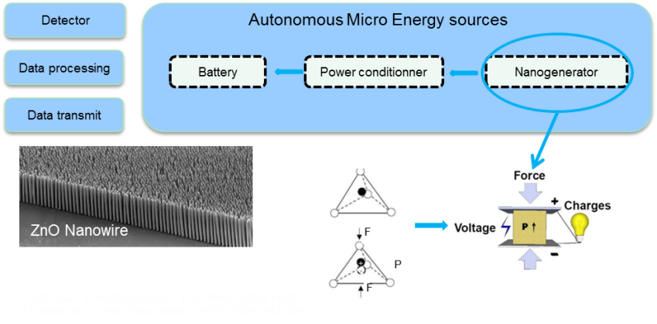
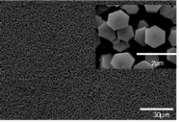
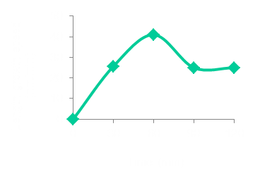
Kinetic Optimisation of Zinc Oxide Nanowire Growth For Piezoelectric Nanogenerator Applications Through A Sol-Gel Process
Chellda Exantus, Christelle Alié, Dimitri Liquet, Nathalie Job
Chemical Engineering – Nanomaterials, Catalysis, Electrochemistry
Institut de Chimie B6a, Sart-Tilman, B-4000 Liège, Belgium
(Contact: cexantus@ulg.ac.be)
One-dimensional Zinc Oxide Nanowires (ZnO NWs) have attracted a lot of attention due to their remarkable physical and chemical properties for electronic and optical devices, like chemical sensors, field effect transistors and nanogenerators. Piezoelectric materials, for instance zinc oxide, exhibit an induced voltage under applied stress. This piezoelectric property has interesting applications in energy harvesting systems, like autonomous micro-devices.
The synthesis process needs to be suitable for large-scale manufacturing (i.e. 20 nm/min growth speed), and provide a micrometric layer of well-aligned nanowires with good crystallinity. Therefore, a combined process (coating of a substrate using a sol-gel process, i.e. seed deposition, followed by growth of ZnO nanowires using wet chemistry) is under development at the University of Liège and has to be improved for real exploitation.
Objectives
The objective of this project is to build a nanogenerator based on piezoelectric systems such as well aligned ZnO Nws.
This nanogenerator will use the energy from the mecanical stress and transform it into electricity.
This ability of ZnO Nws to harvest energy comes from the asymmetric crystalline structure that leads to creation of the dipole moment.
Innovative combined process for the synthesis of ZnO NWs
1st step coating the substrate with a seed layer via a sol-gel process.
2nd step growth of the nanowires using chemical bath deposition process.
Influence of the coating on the growth
Influence of the number of layers on the growth
Spin-coated seed layer
This figure shows the influence of the number of coating layers of the seed on the growth of the nanowires, cross section and top view (a) 1, (b) 2, (c) 3, (d) 4 and (e) 5 layers. (E-SEM)
Dip-coated seed layer
Kinetic study of ZnO NWs growth
The reaction has been stopped at different times according to the appearance of the precursor solution (a).
Nanowires have been characterised by SEM (b).
The growth speed goes through a maximum around 60 minutes of reaction time (c).
a
b
30 min
1h
1h30
2h
c
Conclusions: The coating conditions of the seed layer needs to be monitored in order to obtain a good quality of nanowires. In order to reach the desired growth speed (20 nm/min), the synthesis conditions need to be controlled and will be adapted to realize the ZnO NWs growth in the area of maximum speed growth.

