Slide 1
Contraception in the equine
Jérôme Ponthier
DMV, M. Sc., Ph. D., Diplomate ECAR
ECAR Summer School 2018, München

Slide 2
Plan
Aim of the contraception in the horse
Glass balls
Common hormonal therapy
Dealing with GnRH secretion
In the mare
In the stallion
Surgeries:
Castration
Ovariectomy
Conclusions

Slide 3
1. Aim of the contraception in the horse
Not dealing with pregnancy prevention!
Management of the sexual comportment to help sport & performance:
In stallion: decreasing the “aggressive and hot” behaviour
In mares: decrease/delete oestrus compartmental signs

Slide 4
1. Aim of the contraception in the horse
Important foreword:
In the equine world, all is related to sex…
Pissing mare syndrom (french translation…)
Who is pissing who?
But sometimes, it’s not true: don’t forget the entire animal:
Orthopaedics!
Uro-genital tract is not only ovaries and hormonal production:
Vaginitis
Bladder

Slide 5
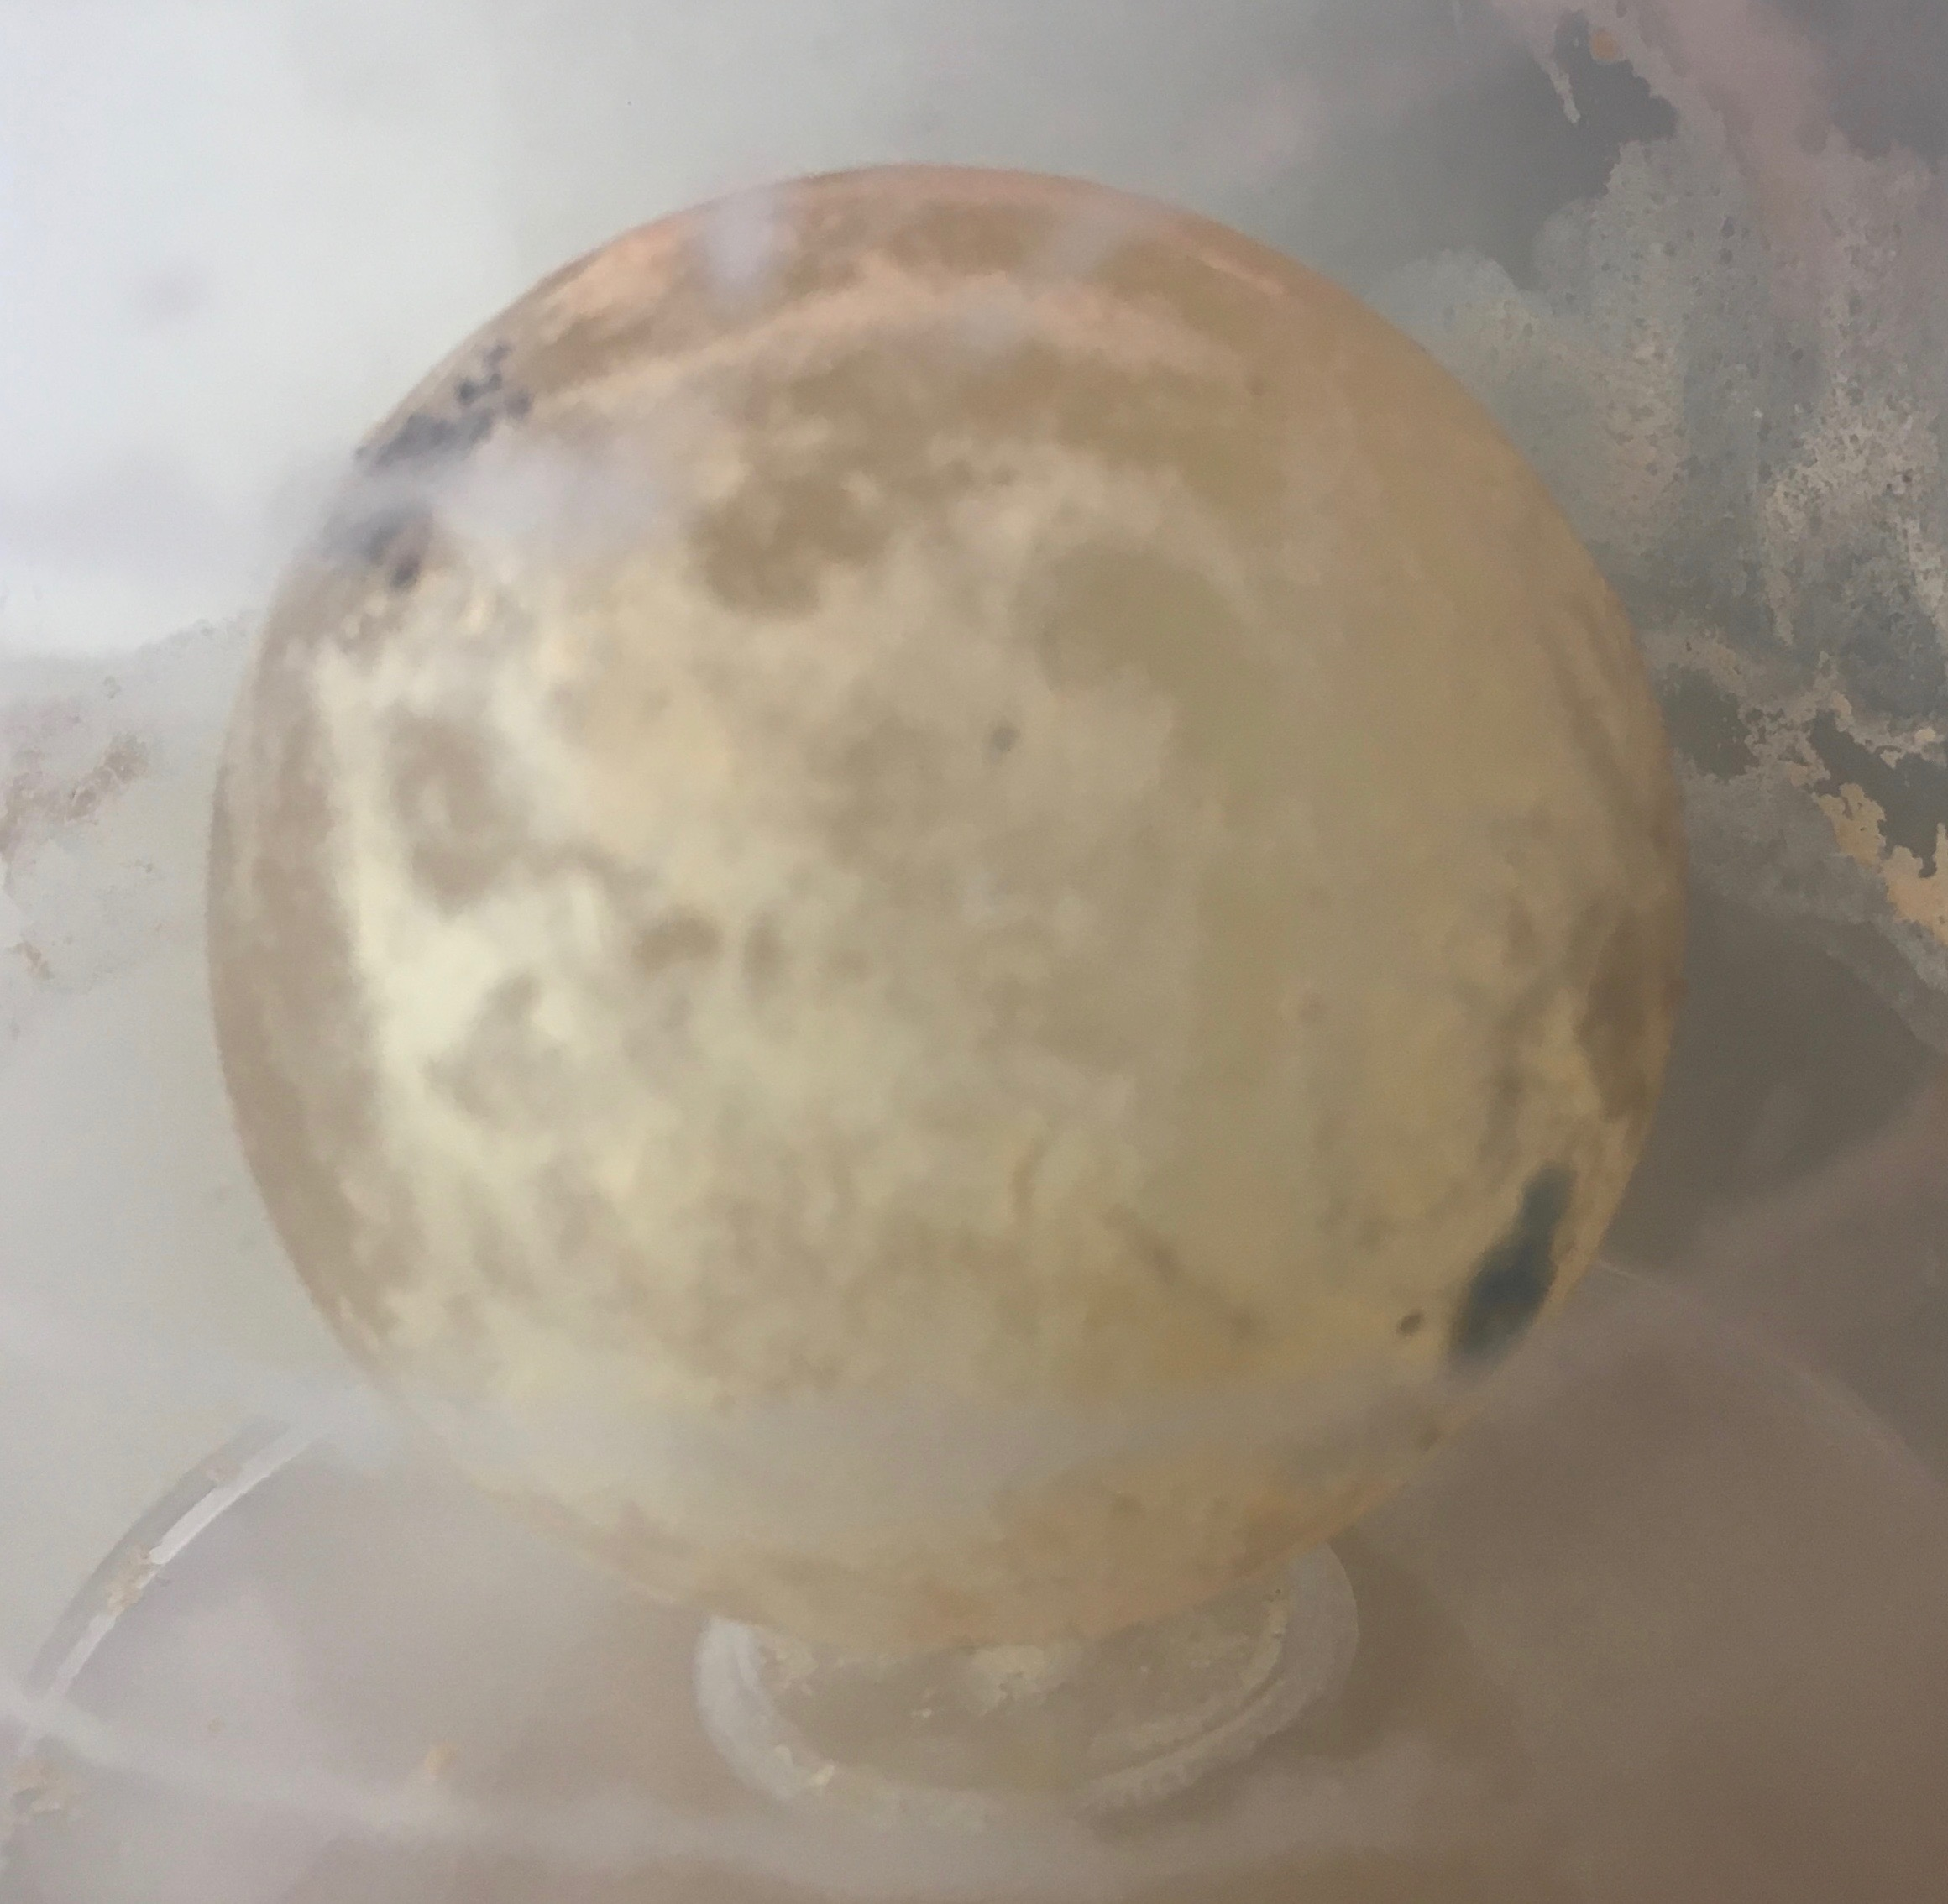
2. Glass Balls

Slide 6
2. Glass Balls
How to do that?
Sterile 35mm glass ball
When the mare is in heat (cervix opened)
Sterile implantation of the glass ball trough the cervix
US: antibiotics instillation (?)
Per rectum manipulation to bring the glass ball in a horn
Give hCG or Deslorelin to induce quick ovulation
First cause of glass ball failure = loss of the glass ball

Slide 7
2. Glass Balls
What to expect?
If the glass ball hasn’t be lost:
2/3 of mares with extended dioestrus (2-3month)
CL is visualised with US!
What are the risks?
Cases (rare, reported n=3) of uterine hematoma/pyometra if glass ball breaks or is not smooth
No effect
So the next question is…

Slide 8
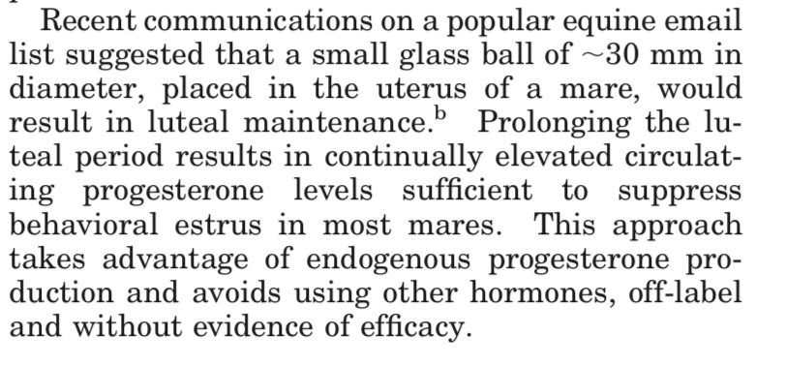
2. Glass Balls
How does it work?
2001, first scientific study:
41,7% efficiency to increase duration of P4 secretion

Slide 9
2. Glass Balls
How does it work?
2007, first attempt to explain:
“ Prolonged endometrial inflammation decreases the cells ability to produce PG, stopping the luteolysis”
Decrease of the PG production in the mares with good response to glass ball
Increase of the uterine activity (d11-16) in:
Non-responding mares
Control mares
But, no inflammation observed at the end of study

Slide 10
2. Glass Balls
How does it work?
New attempts to explain:
2010, Argo: No changes (E2, P4, LH, testosterone, follicular growth, behavior)
2016, Klein: Prolonged luteal phase (embryo or glass ball): angiosclerosis, decrease of E2 & P4 R
2016, Vanderwall: Oxytocin alone ? 60 UI IM SID d7-D14 Post OV (Prolonged DO in 60-70% mares)

Slide 11
3. Common Hormonal Therapy
Progestins:
In the equine: Altrenogest, PO, 0.044mg/kg, SID, Regumate®
Decrease of the follicular growth
!!! BUT !!!
Momentary (1-3 cycles)
E2 et P4 together?
Doping agent (FEI, races)

Slide 12
3. Common Hormonal Therapy
hCG:
During dioestrus, when follicle >30mm
3000 UI hCG
Prolonged Dioestrus (>58d)

Slide 13
4. Dealing with GnRH Secretion
GnRH agonsists:
Poor use in the equine
No doping agent
However, remember the delsorelin implant side effects
Equine residents will tell you...
Because they are supposed to know…
;-)
;-)
;-)

Slide 14
4. Dealing with GnRH Secretion
GnRH vaccination:
History: pigs!
In the equine:
Male & female
In most of European county: not registered for horses
3ml Improvac® SC:
Booster after 1 month
Booster every 6 month
Local reaction at the injection point!
My advices: 2 injection points (1.5ml) in chest, between forelimbs

Slide 15
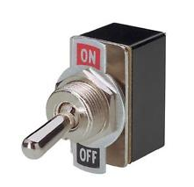
4. Dealing with GnRH Secretion
GnRH vaccination:
Hope of the owner:
Switch off: Sport
Switch on: Reproduction
But, in real life…

Slide 16
4. Dealing with GnRH Secretion
GnRH vaccination:
In the mare
When stopping the boosters
No effect on ongoing repro performance
Median resumption of cycle: 344d
Effect of:
Age of mare
Duration of vaccination
> 2 years in some mares
Imboden et al, Therio, 2006
Botha et al, ARS, 2010
Schulman et al, EVJ, 2013

Slide 17
4. Dealing with GnRH Secretion
GnRH vaccination:
In the stallion
Same observations for the mare
(Stout & Colenbrander, 2003)

Slide 18
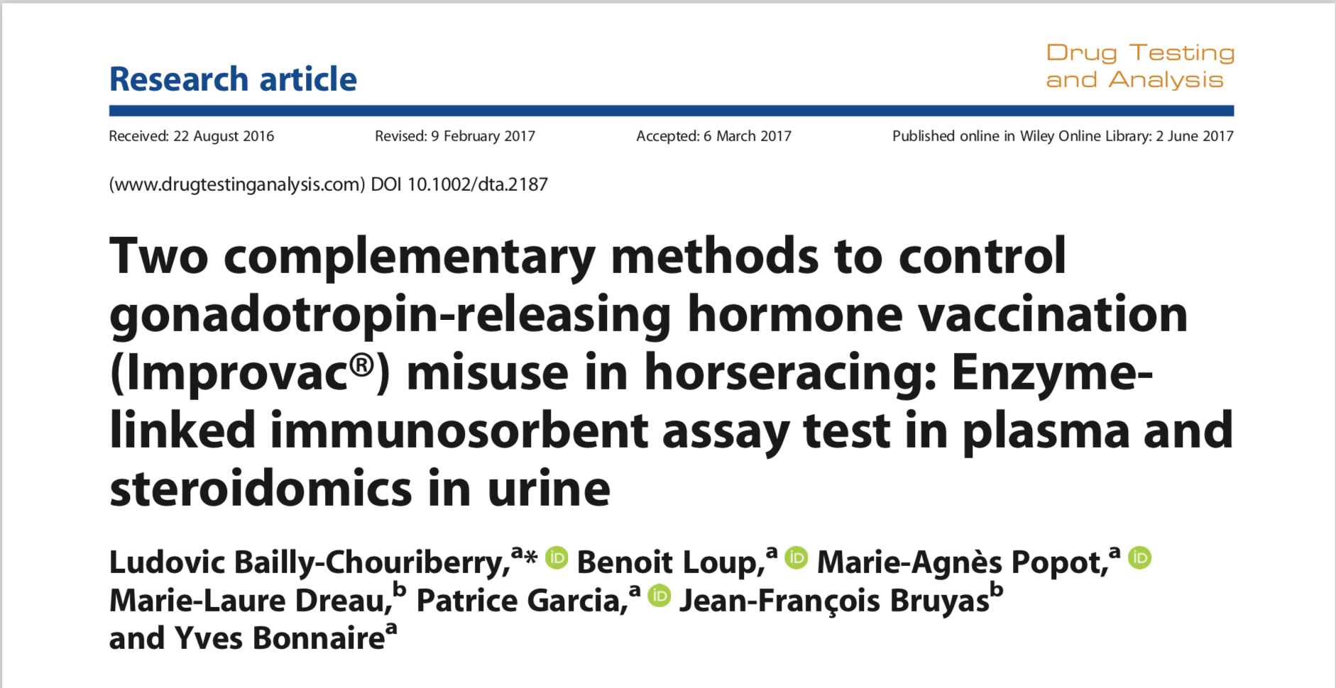
4. Dealing with GnRH Secretion
GnRH vaccination:

Slide 19
5. Surgery
Castration:
No more behaviour problem
No more offspring
Semen freezing before castration?
Cloning?
It has been developed for that!

Slide 20
5. Surgery
Ovariectomy (bilateral):
No further fertility ;-)!
Except as embryo recipient (see studies about that)
Never again in heat?
Not so easy…
10% of mares after ovariectomy: constant heat behaviour

Slide 21
6. Conclusions
No ideal solution to minimize repro behaviour:
Reversible
Easy to use
No doping
No danger

Slide 22
6. Conclusions
No ideal solution to minimize repro behaviour:
 | Reversible | Easy to use | No doping | No danger | Duration
Glass balls | + | + | OK | +/- | +/- 60d
Oxytocin (in DO) d7-d14 | + | +/- | OK | + | +/- 60d
Altrenogest | + | +/- | KO | +/- | 2 cycles
hCG (during DO, foll>30mm) | + | +/- | OK | + | +/- 58d
Anti-GnRH | - | + | KO | +/- | ???
Surgery | - | - | OK | - | life

Slide 23
6. Conclusions
No ideal solution to minimize repro behaviour:
 | Reversible | Easy to use | No doping | No danger | Duration
Glass balls | + | + | OK | +/- | +/- 60d
Oxytocin (in DO) d7-d14 | + | +/- | OK | + | +/- 60d
Altrenogest | + | +/- | KO | +/- | 2 cycles
hCG (during DO, foll>30mm) | + | +/- | OK | + | +/- 58d
Anti-GnRH | - | + | KO | +/- | ???
Surgery | - | - | OK | - | life
Depends on your surgery skills

Slide 24
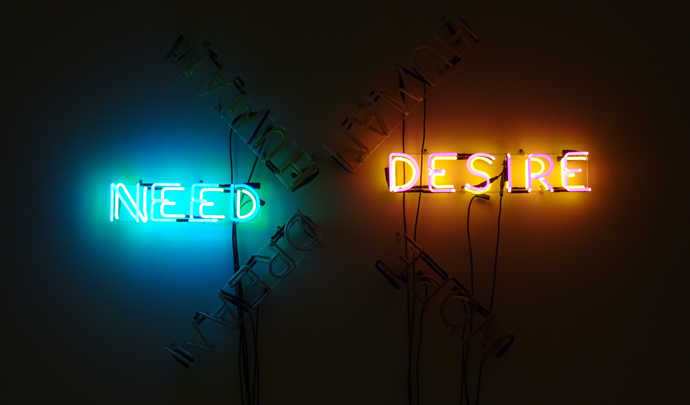
6. Conclusions

