Slide 1
Equine Clinical Case A Mare In Heat
Jérôme Ponthier
DMV, M. Sc., Ph. D., Diplomate ECAR
ECAR Summer School 2018, München

Slide 2
History 05/07/2018 AM:

Slide 3
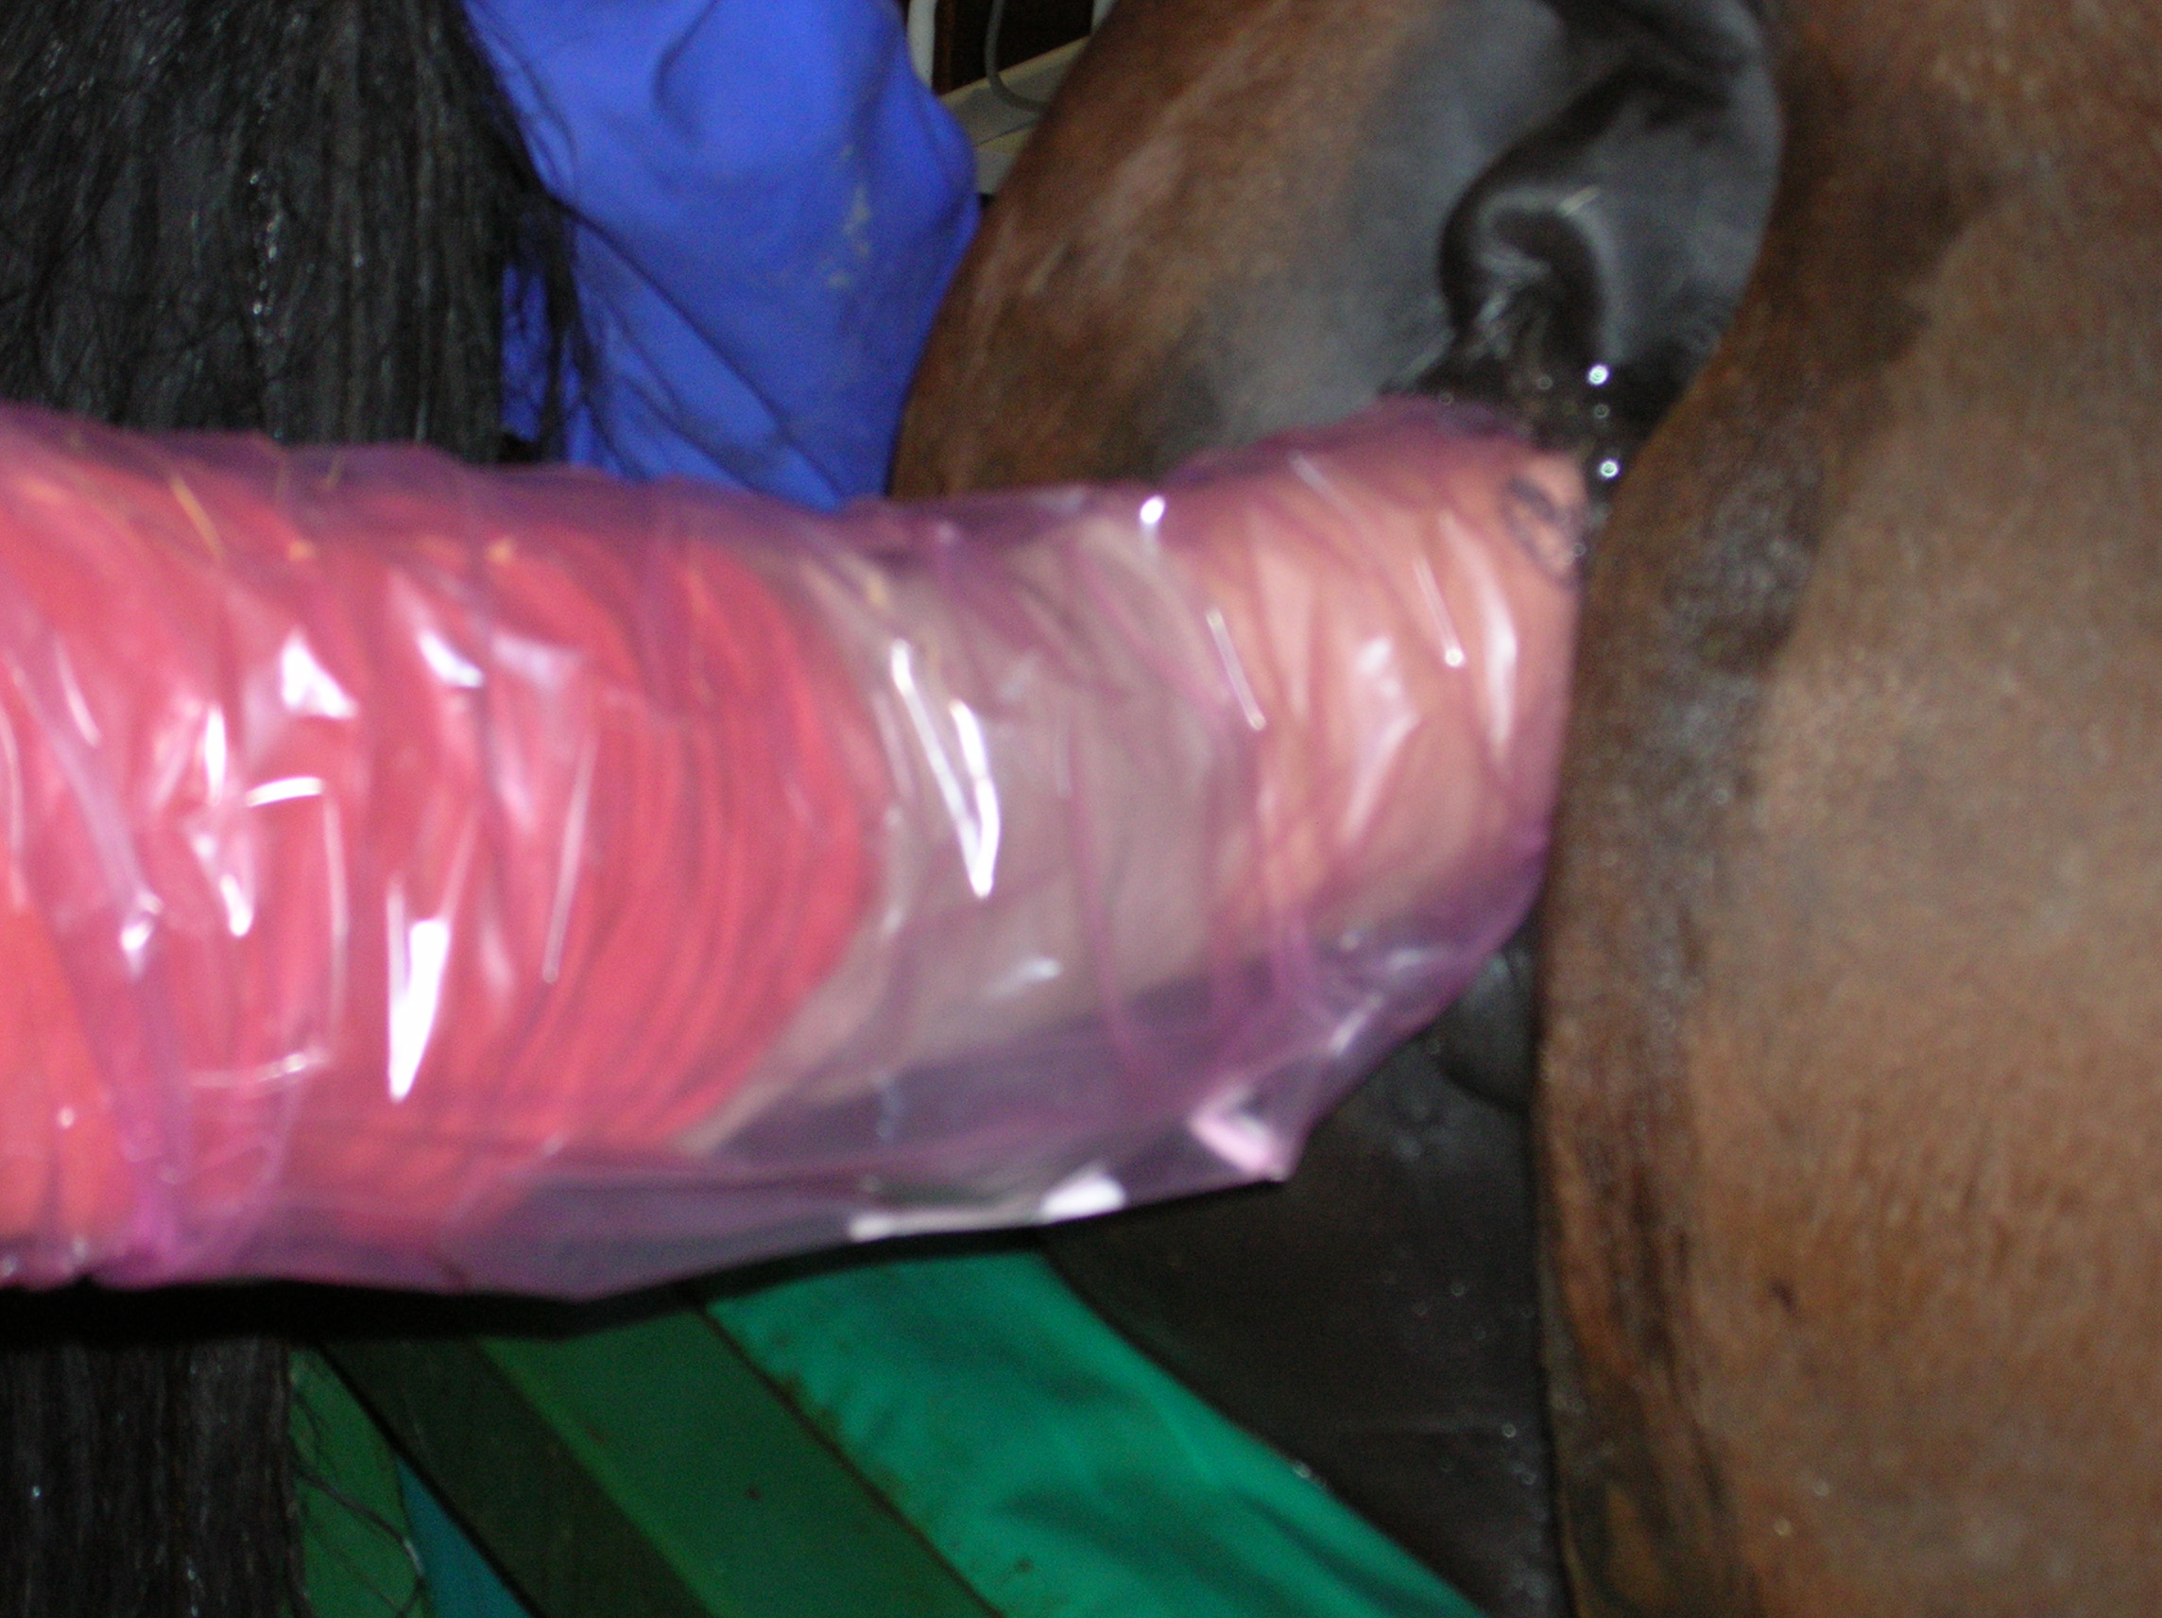
History 05/07/2018 PM:

Slide 4
History 06/07/2018 AM:

Slide 5
When will you come back?
06/07/2018 (Now): to treat endometritis
10/06/2018: Uterine US at end of heat
16/07/2018: d10 pregnancy diagnosis
20/07/2018: d14 pregnancy diagnosis

Slide 6
When will you come back?
06/07/2018 (Now): to treat endometritis
10/06/2018: Uterine US at end of heat
16/07/2018: d10 pregnancy diagnosis
20/07/2018: d14 pregnancy diagnosis

Slide 7
What if endometrial cysts?
Uterine map of cysts before pregnancy diagnosis!

Slide 8
When will you come back?
10/07/2018 (Now): to squeeze the cyst
13/07/2018: Entrance of embryo in the uterus
16/07/2018: d10 pregnancy diagnosis
20/07/2018: d14 pregnancy diagnosis

Slide 9
When will you come back?
10/07/2018 (Now): to squeeze the cyst
13/07/2018: Entrance of embryo in the uterus
16/07/2018: d10 pregnancy diagnosis
20/07/2018: d14 pregnancy diagnosis

Slide 10
20/07/2018: d14 pregnancy diagnosis

Slide 11
Physiology of pregnancy in the equine
Twin pregnancy:
Frequent cause of abortion, dystocia
If 2 foals alive, no chance to get sport horses
Treatment:
Squeezing of 1 embryo:
The smallest?
The easier?
!!! Confusion with Cysts !!!

Slide 12
When will you come back?
After NSAIDs IV and 2 hours
2 hours
Tomorrow
On d28 (03/08/2018)

Slide 13
When will you come back?
After NSAIDs IV and 2 hours
2 hours
Tomorrow
On d28 (03/08/2018)

Slide 14
20/07/2018: d14 pregnancy diagnosis +2h and Finadyne®

Slide 15
When will you come back?
2 hours
Tomorrow
d18 (24/07/2018)
On d28 (04/08/2018)

Slide 16
When will you come back?
2 hours
Tomorrow
d18 (24/07/2018)
On d28 (03/08/2018)

Slide 17
Physiology of pregnancy in the equine
d6,5-7: embryo in the uterus
>d16-17: embryo migration in the uterus (2 horns and body):
Pregnancy recognition
d16-17: Fixation
This is not Implantation! (d32-35)
Hypertrophy of uterine glands on top of the embryo
Squeezing more difficult!

Slide 18
What to do if you observe this on d18 (24/07/2018)?

Slide 19
What to do if you observe this on d18 (24/07/2018)?
2 options:
Try to squeeze again and again (and again) (and again)
PGF_{2alpha} injection: luteolysis and new cycle
My advice:
Try to squeeze again
And again
And again
And again
And again
And again
Worst case scenario: squeezing causes endometrial tears, PG release and you loose both embryos
As with PG…

Slide 20
When will you come back?
Never
On d28 (03/08/2018)

Slide 21
When will you come back?
Never
On d28 (03/08/2018)

Slide 22
Physiology of pregnancy in the equine
d32-35: implantation
Endometrial cups formation
PMSG (=eCG) production until day 132-135
Even in case of embryonic loss
Secondary CL until d150-160
No heat again => Breeding season lost
Every decision about a risk pregnancy has to be taken before d28
Twin pregnancy, body pregnancy

Slide 23
What to do if you observe twins on d28 (03/08/2018)?
3 options:
Try squeezing one last time (and control the day after)
Give PG
Let it go and be optimist:
Resorption of 1 embryo could happen:
If embryos are both in the same corn: high probability
If embryo are in different horns: lower probability
Economic & individual factors (price of semen, season, difficulty to get this mare pregnant,…)

Slide 24
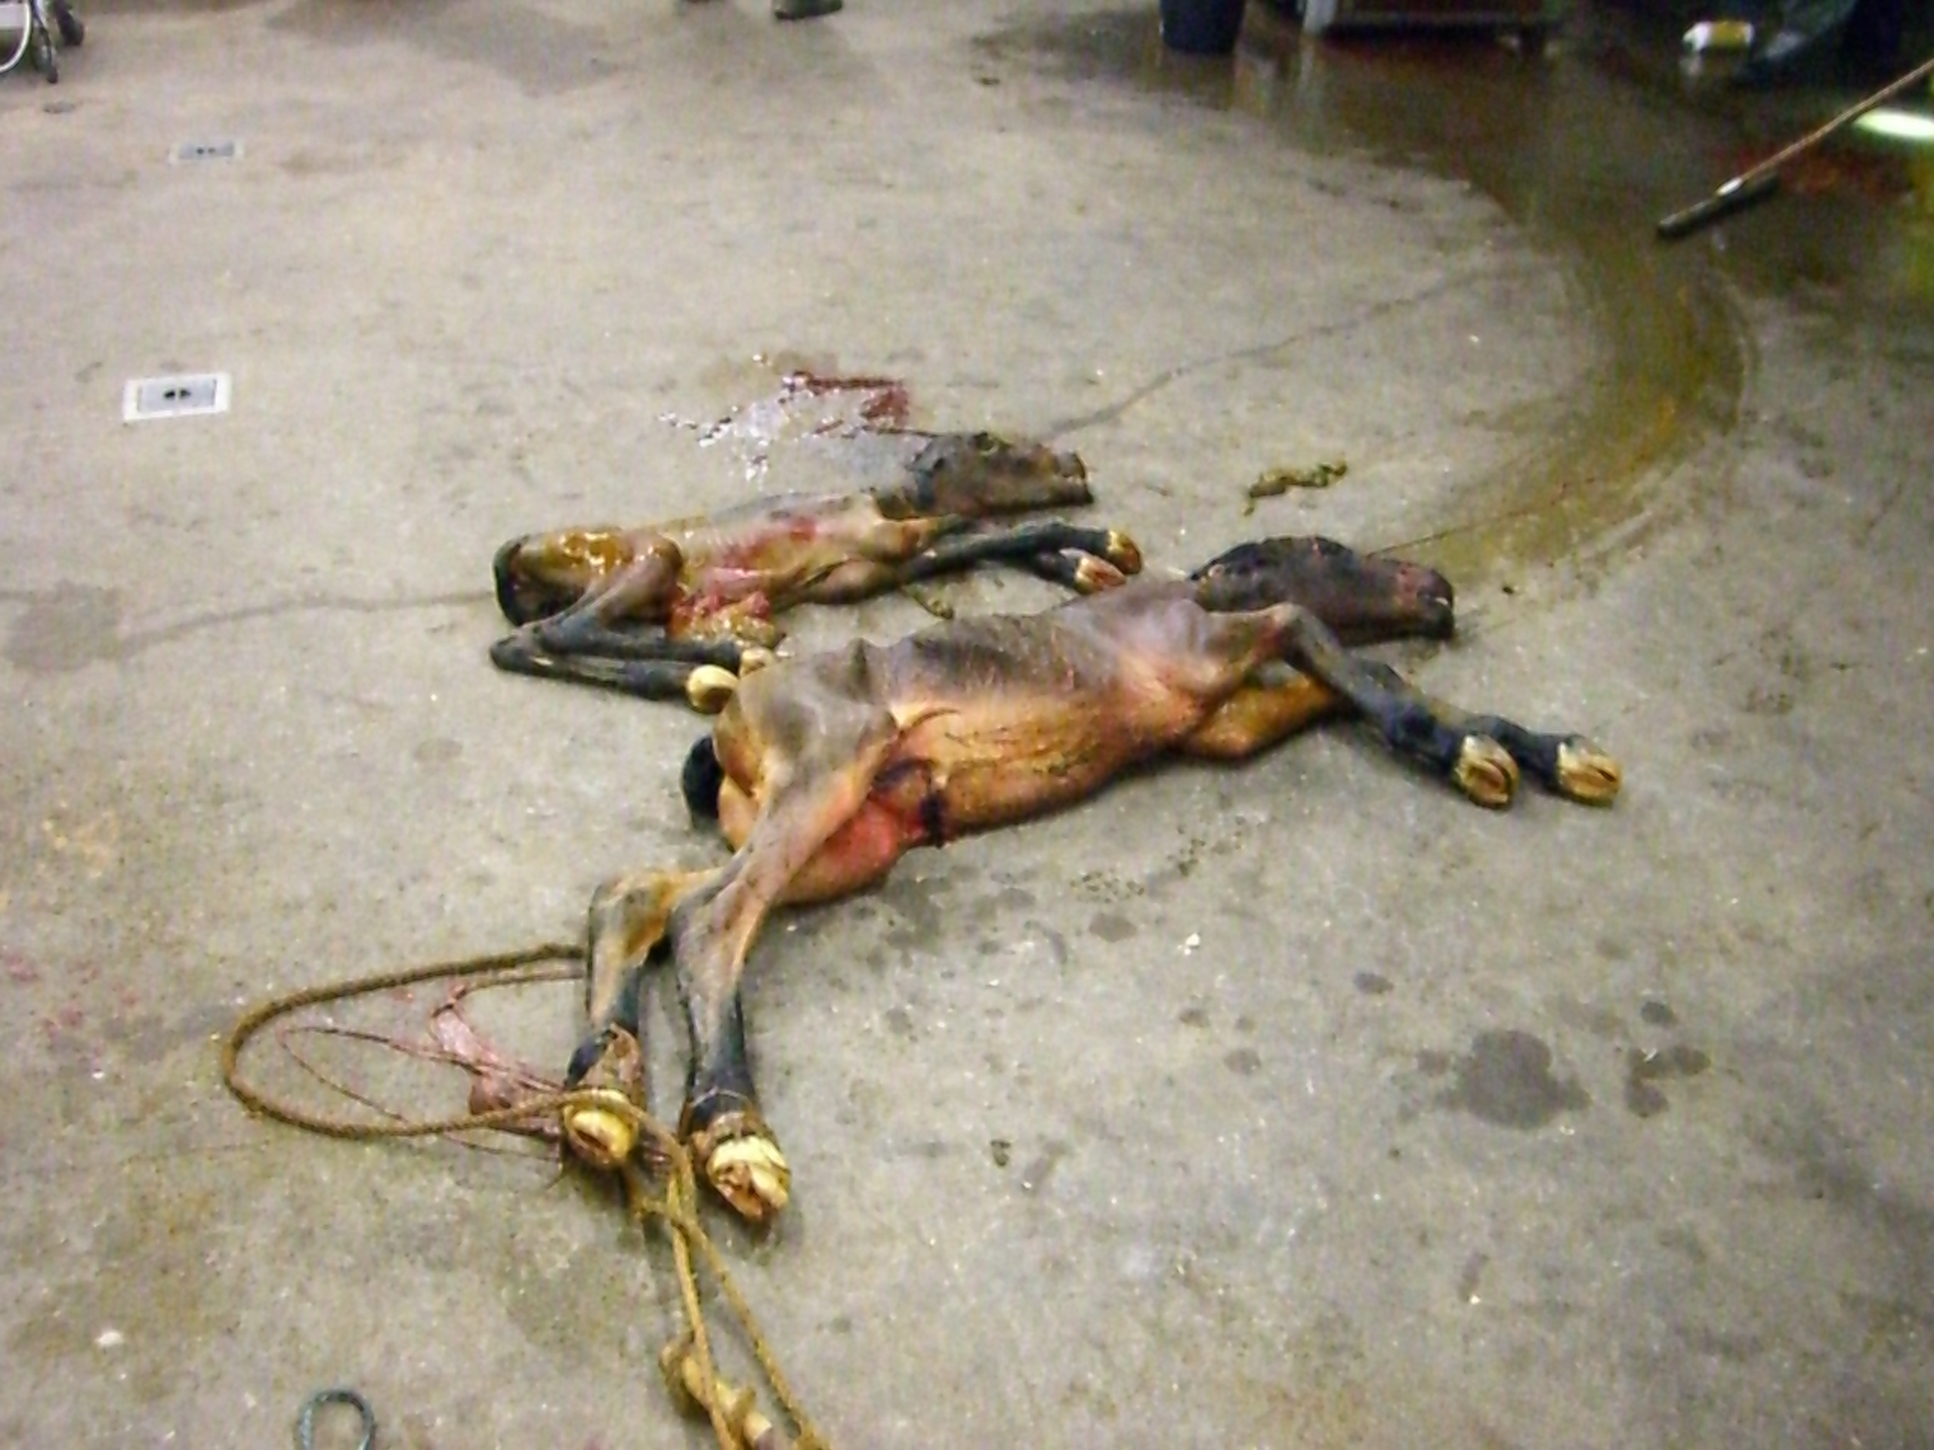
Questions?

