Slide 1
Embryo Transfer in Mares Why? When? How?
Jérôme Ponthier
DMV, M. Sc., Ph. D., Diplomate ECAR
ECAR Summer School 2018, München

Slide 2
Summary
Why?
What are the indications of embryo transfer?
When?
Early pregnancy in mares
Synchronisation of mares and its consequences
How?
Direct embryo transfer
Embryo freezing in the equine

Slide 3
Embryo Transfer: Why?
Because it’s fashion!
Because it’s smart!
Because the neighbour did it!
Because this mare will produce many foals this year (10-20-200?)!

Slide 4
Embryo Transfer: Why?
All Bad Reasons!!!
Very expensive: 3500€ only for embryo collection, embryo transfer and recipient mare!
Efficiency estimation with common results:
10 heats during a breeding season
Embryo recovery rate = 50%
Pregnancy rate after embryo transfer = 70%
(10 x 0.5) x 0.7 = 3.5 foals per breeding season

Slide 5
Embryo Transfer: Why?
Superovulation?
For Review: Roser & Meyers-Brown, 2012, J-EVS
EPE (Equine Pituary Extract):
88.9% of mare with 2 OV or +
2.1 embryos/cycle
pFSH: 2.9 OV
eFSH:
2.1 to 2.4 embryos/cycle if alone
2.5 to 3.5 embryos/cycle with RE-LH
Others?
Very far from 6 to 8 foals expected on some internet web sites!

Slide 6
Embryo Transfer: Why?
Infertility in donor mare – old donor mare:
Fertilization OK and embryo inside uterus d7,8
Uterine function damaged (nutrition, migration, implantation, placentation) => Uterine biopsy
Increased embryo loss!
Old mares: decrease of embryo production & quality
High performance donor mare:
Sports => no pregnancy
Embryo recovery rates in high performance mares?
Donor mare nb of foal increased (3-4 foals/y)
+ Filly reproduction (when development is not complete vs. puberty)

Slide 7
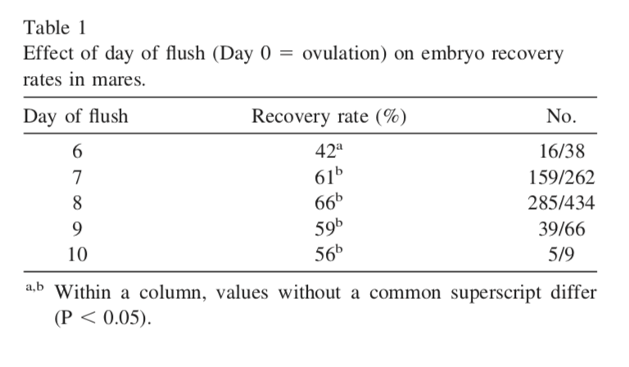
Embryo Transfer: When?
Early pregnancy in the mare:
Jacob et al., Therio, 2012

Slide 8
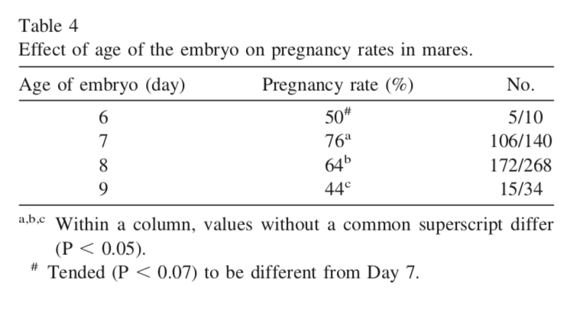
Embryo Transfer: When?
Early pregnancy in the mare:
Jacob et al., Therio, 2012

Slide 9
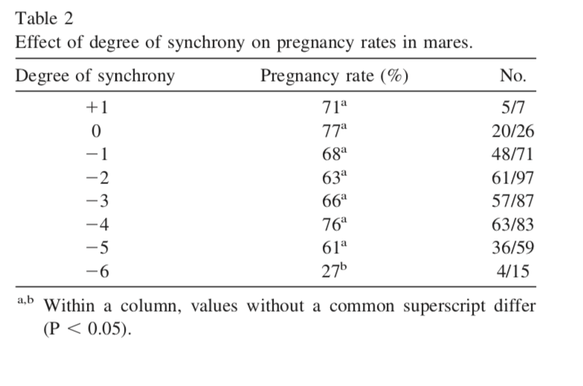
Embryo Transfer: When?
Synchronisation of mares and consequences:
Jacob et al., Therio, 2012

Slide 10
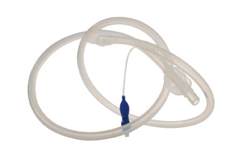
Embryo Transfer: How?
Direct embryo transfer:
Embryo collection: uterine flush
Procedure:
Emcare or Ringer-Lactate

Slide 11
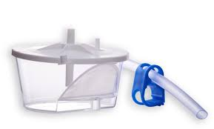
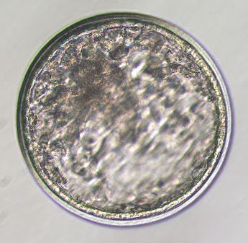
Embryo Transfer: How?
Direct embryo transfer:
Embryo collection: embryo isolation
Sedimentation or filter
Assessing embryo quality
 | Quality | Microscopic aspect
1 | Excellent | Round, cells of same size, color and texture
2 | Good | Irregular form, some blastomeres outside, space between capsule & trophoblast
3 | Moderate | Blastomeres outside, irregular shape, squeezed blastocoele
4 | Poor | Many blastomeres outside and degenerating cells, no more blastocele, inner mass cells still alive
5 | Dead/No fertilisation | Non fertilised oocytes, totally degenerated embryo

Slide 12
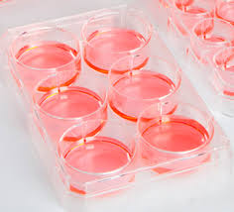
Embryo Transfer: How?
Direct embryo transfer:
Embryo washing:
Washing 6 times in Emcare

Slide 13
Embryo Transfer: How?
Direct embryo transfer:
0.25ml straw
0.05ml
0.03ml
0.08ml
0.03ml
0.05ml
Cotton plug
Emcare
Air
Emcare + embryo
Air
Emcare

Slide 14
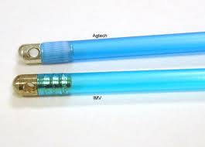
Embryo Transfer: How?
Direct embryo transfer:
Re-implantation:
Synchorinsation of recipient mare
Surgical or non-surgical?
Non-traumatic & less-invasive transcervical
NSAIDs – Progestins?

Slide 15
Embryo Transfer: How?
Embryo freezing:
Some rules:
Equine embryo limitation to cryopreservation =
Capsule
Fluids in the blastocele
Early collection (embryo <300μm)
Early: d6.5 – 7
Measure?
Try only with 1st quality embryos
(for review: Squirres et al., 2016, VCNA)

Slide 16
Embryo Transfer: How?
Embryo freezing:
In practice:
Vitrification is the most effective
Embryo in 3 solutions with increasing concentration of cryoptrotective agents
Glycerol & ethylene glycol
Embryo in straw
Short exposition to nitrogen vapor (1 min)
Straw in liquid nitrogen
Commercial media available in Europe, US,…
(for review: Squirres et al., 2016, VCNA)

Slide 17
Embryo Transfer: How?
Embryo freezing:
Results: 2/3
10 heats during a breeding season
Embryo recovery rate = 50%
Pregnancy rate after embryo transfer = 70%
(10 x 0.5) x 0.7 x 0.6 = 2.1 foals per breeding season
Why?
Not to deal with synchronicity of the recipient
Twins
Overseas trading
Embryo banking
…

