Slide 1
CLINICAL CASE: EQUINE
Jérôme PONTHIER, ULg
DVM, M. Sc., Ph. D., Diplomate ECAR

Slide 2
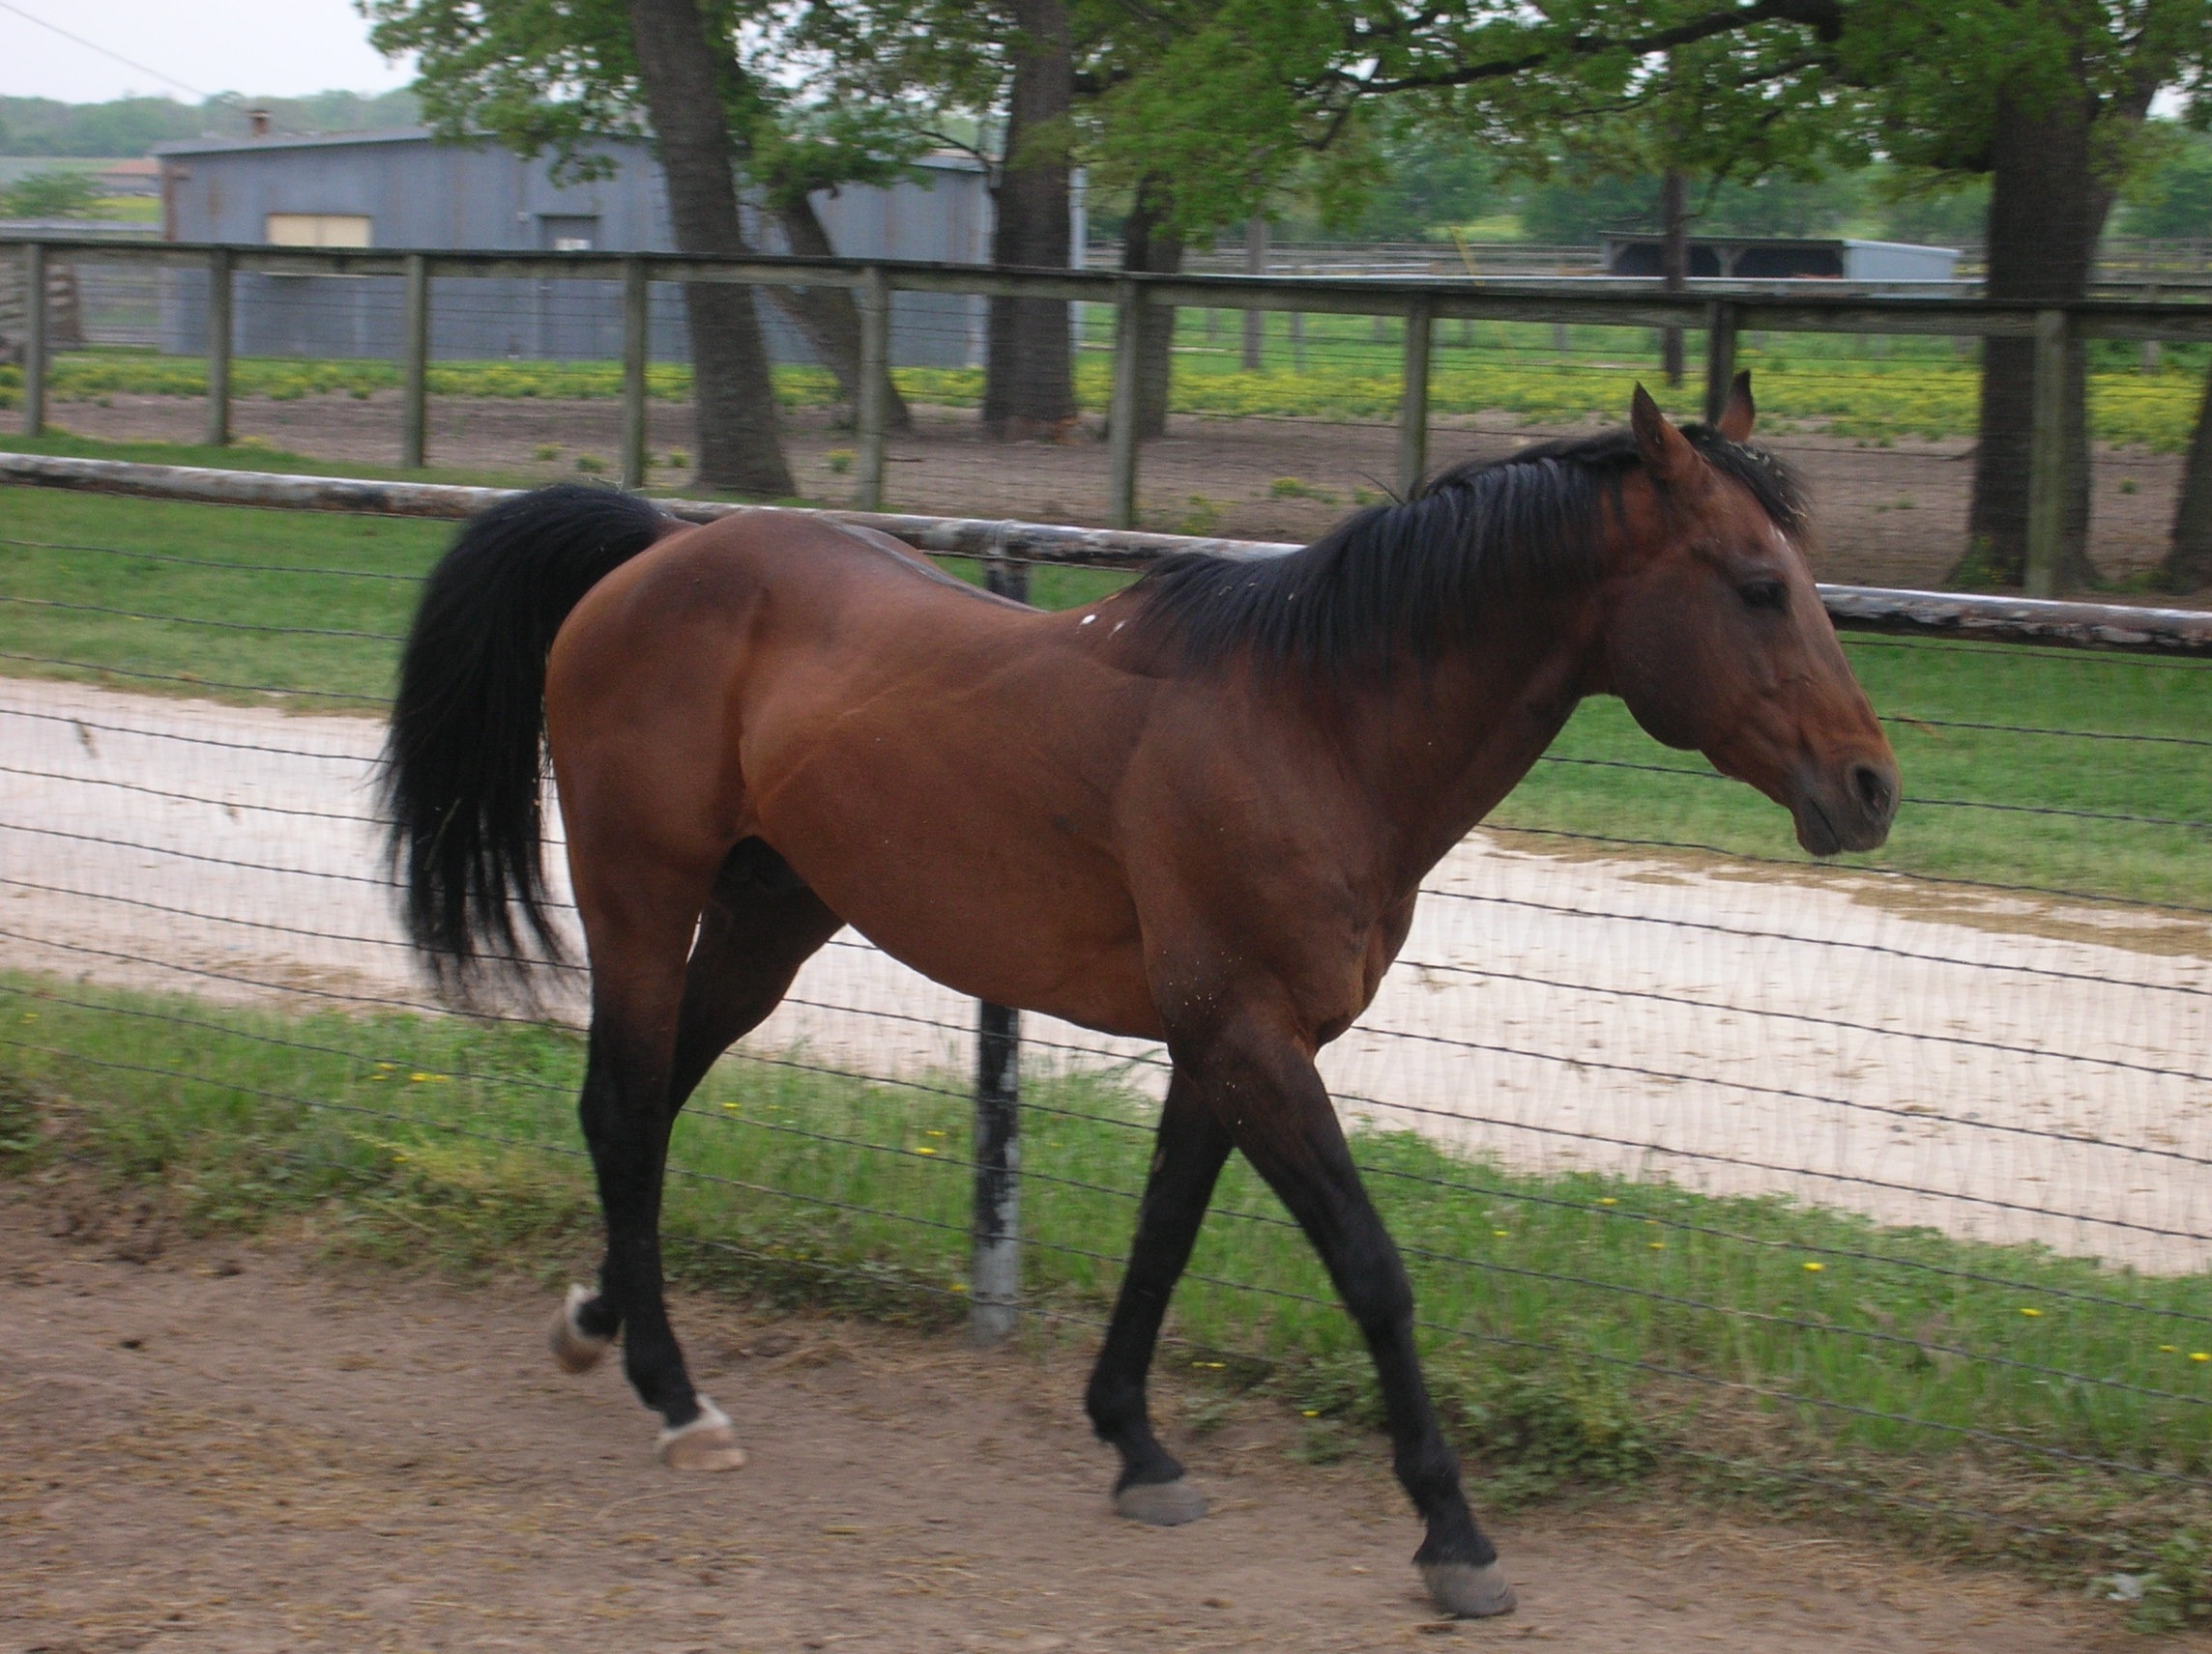
Quarter horse stallion
History:
4 years, bought for $$$€$€$$!$€€$$!€ at auction
Then send in Europe…
No history of pathologies
Aim: batche$ of frozen semen during 2 month
Then, work!
500kg, good body condition, try to bites you

Slide 3
Question:
How do you call this condition?
Discussion…

Slide 4
MCQ1:
Among those propositions, which is the less common in the differential diagnosis?
Retrograde ejaculation
Testicular degeneration/hypoplasia
Obstruction of the ampullae
Non-ejaculation after collection (aborted)

Slide 5
MCQ1:
Among those propositions, which is the less common in the differential diagnosis?
Retrograde ejaculation
Testicular degeneration/hypoplasia
Obstruction of the ampullae
Non-ejaculation after collection (aborted)

Slide 6
Quarter horse stallion
Clinical examination:
Left testis | Right testis
3.3cm width 4.5cm high 6.6cm long Soft Tail of epididymis: caudal | 3.0cm width 5.0cm high 6.2cm long Soft Tail of epididymis: cranial

Slide 7
Question:
What is the normal size of stallion testis?
Discussion…
What is the normal age for puberty?
Discussion…

Slide 8
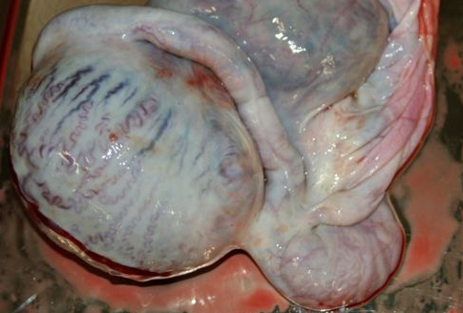
MCQ2:
What is the physiological orientation of the tail of the epididymis in horses?
Cranial
Caudal
Dorsal
Ventral

Slide 9
MCQ2:
What is the physiological orientation of the tail of the epididymis in horses?
Cranial
Caudal
Dorsal
Ventral

Slide 10
Question:
Discuss the testicular torsion symptoms in horse

Slide 11
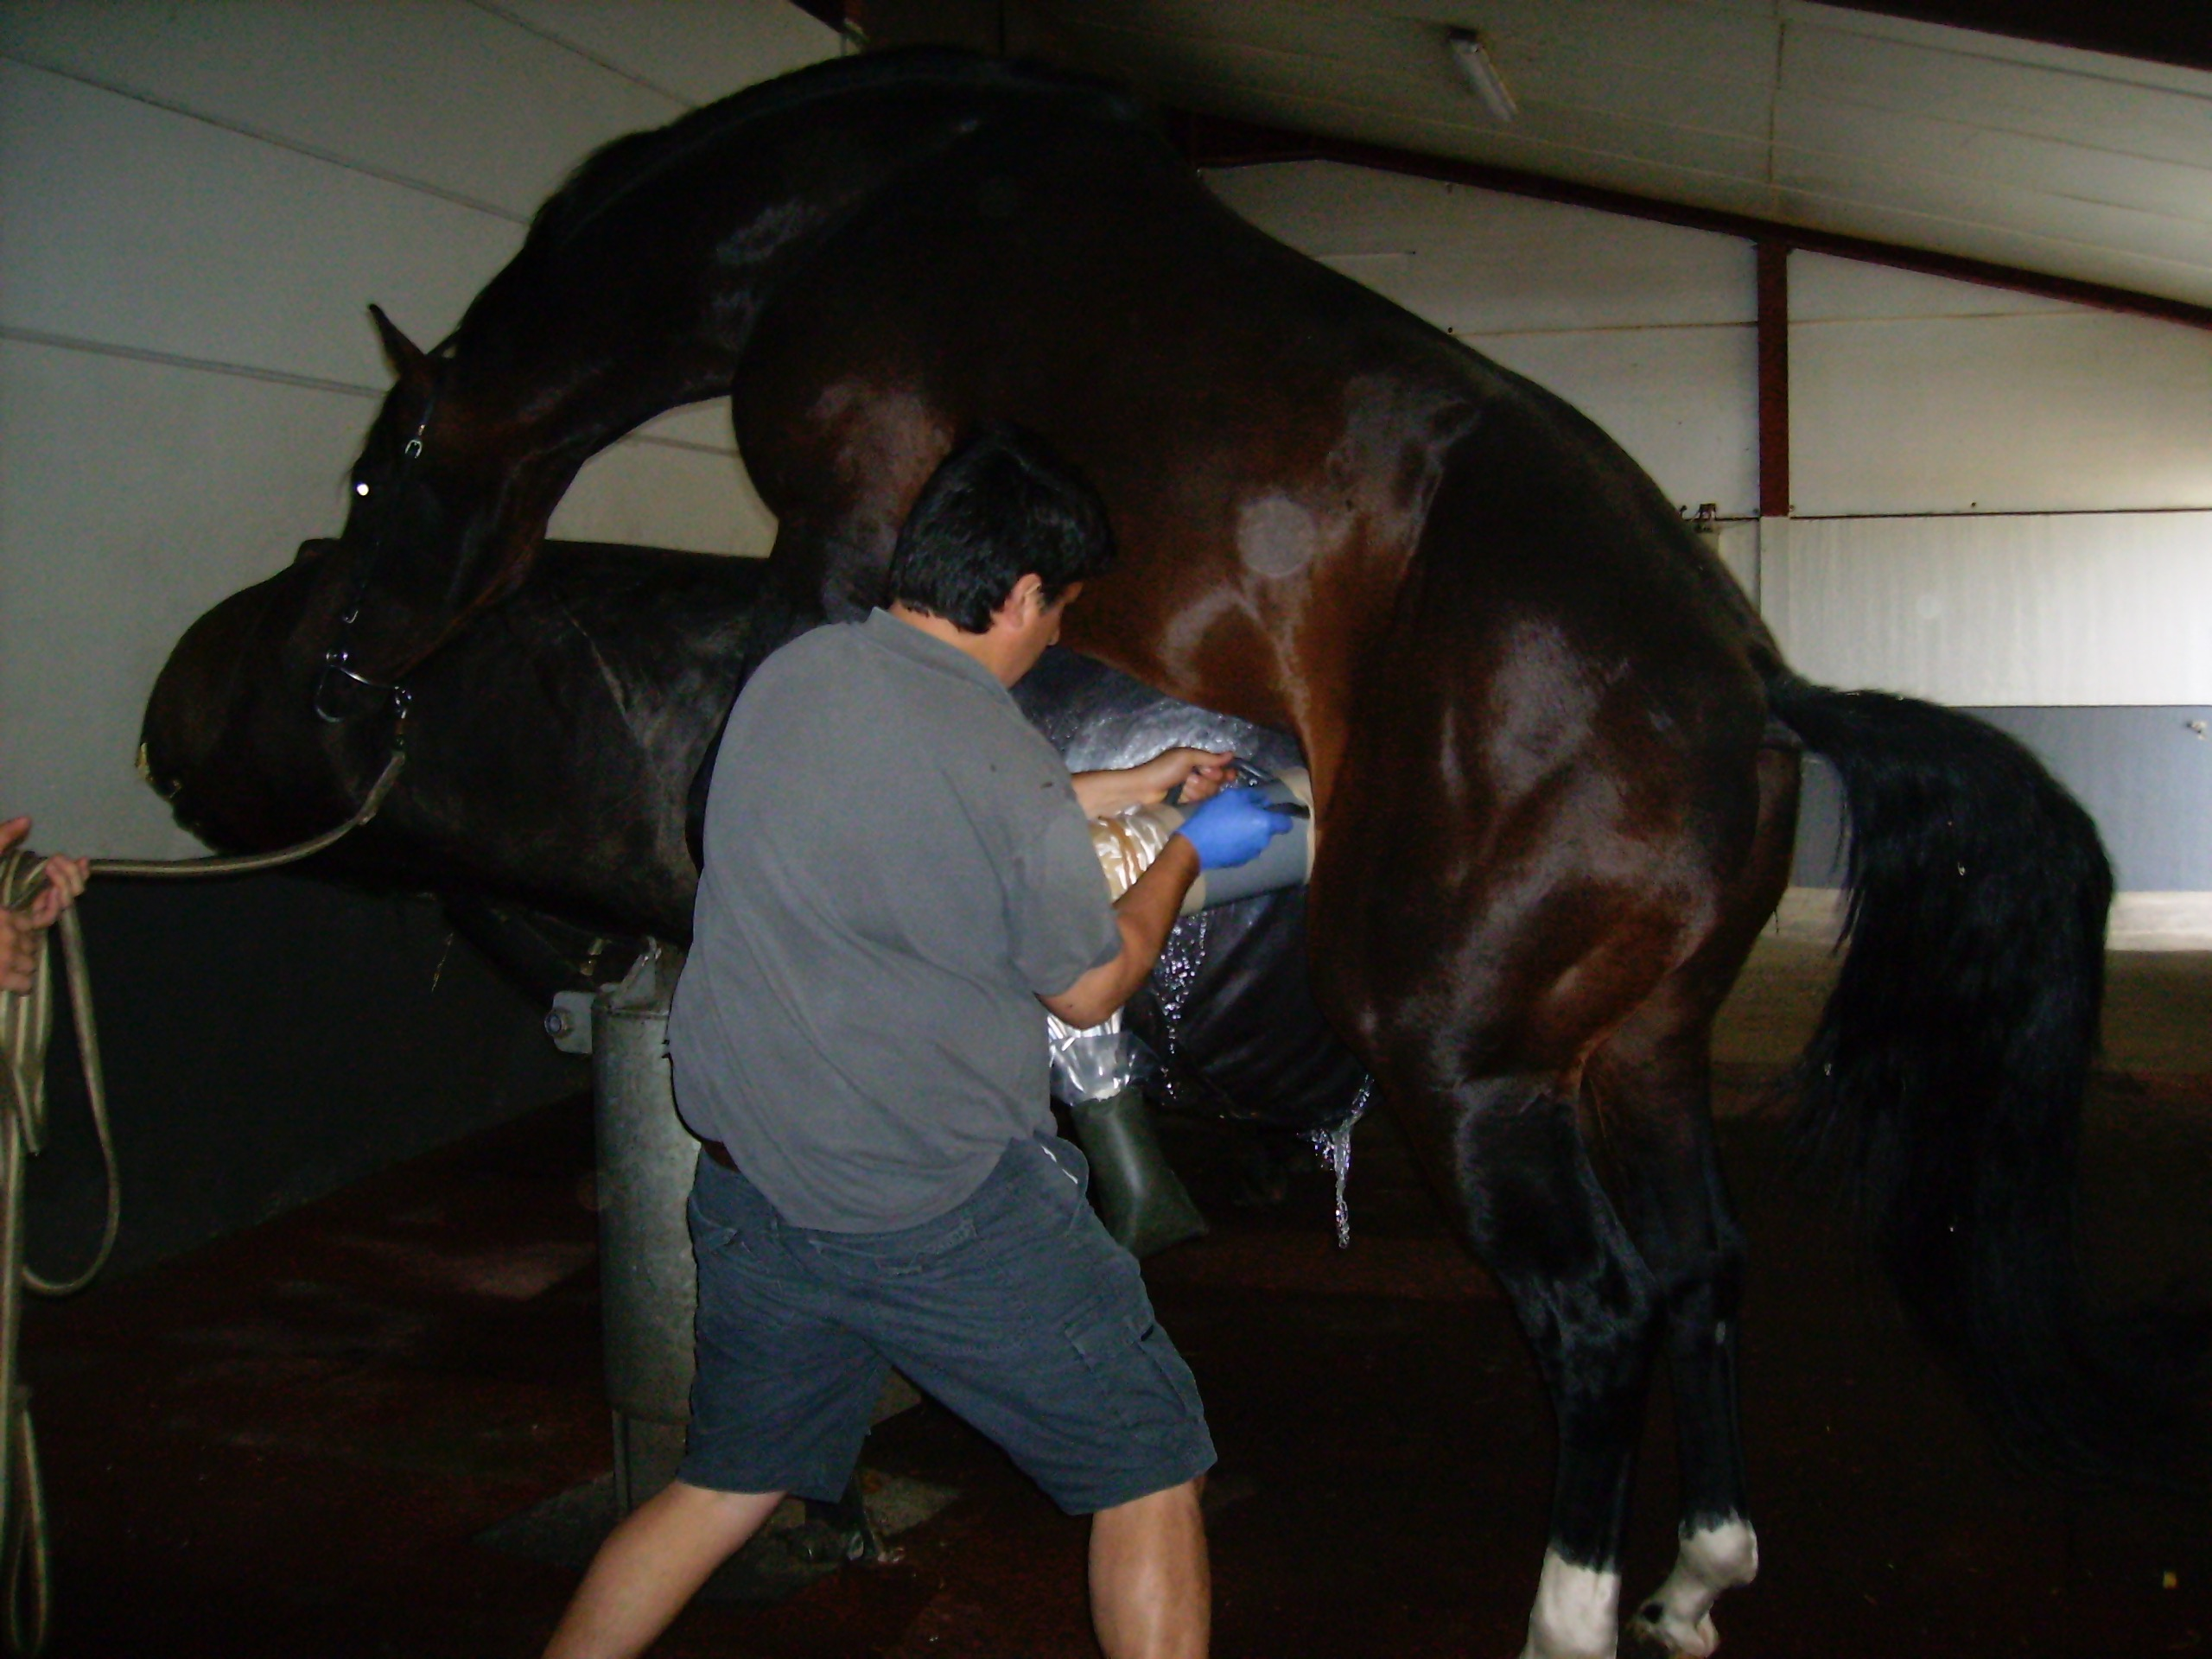
Quarter horse stallion
Semen collection:

Slide 12
Quarter horse stallion
Semen collection:
Good libido
Ejaculation palpated after first attempt
Clear liquid collected
50mL
No spermatozoa seen after gross microscopic examination
?

Slide 13
MCQ3:
What is the type of Artificial Vagina used on the picture?
Missouri
New-Jersey
Botucryo
Colorado

Slide 14
MCQ3:
What is the type of Artificial Vagina used on the picture?
Missouri
New-Jersey
Botucryo
Colorado

Slide 15
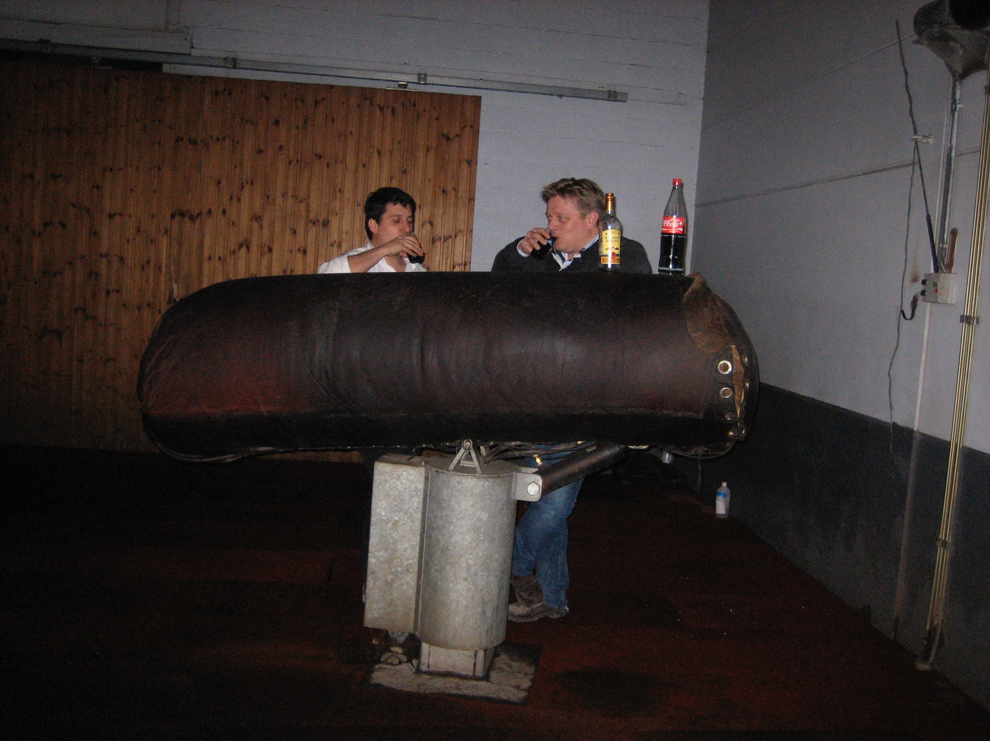
Question:
What are the external signs of ejaculation of stallions?

Slide 16
Question:
What are the external signs of ejaculation of stallions?
Tail flagging
Anus pumping
Thrill of urethra

Slide 17
MCQ4:
Which biochemical assay in semen could assess ejaculation occurred?
Anti-Mullerian Hormon (AMH)
Creatinin
Alkaline phosphatase (AP)
Gamma glutamyl transferase (GGT)

Slide 18
MCQ4:
Which biochemical assay in semen could assess ejaculation occurred?
Anti-Mullerian Hormon (AMH)
Creatinin
Alkaline phosphatase (AP)
Gamma glutamyl transferase (GGT)

Slide 19
Question:
Explain the rational of PAL assay in equine semen:
Where is it produced in the genital tract?
What are the normal values?

Slide 20
Quarter horse stallion
Day of collection | Collection conditions | Volume | AP in semen
14.06.2016 | 1st attempt | 50ml | 10278 UI/L
15.06.2016 | 2nd attempt | 100ml | 51567 UI/L
16.06.2016 | 1st attempt | 65ml | 42983 UI/L

Slide 21
MCQ5:
Among those propositions, which is your favourite hypothesis?
Retrograde ejaculation
Testicular degeneration/hypoplasia
Obstruction of the ampullae
Non-ejaculation after collection (aborted)

Slide 22
MCQ5:
Among those propositions, which is your favourite hypothesis?
Retrograde ejaculation
Testicular degeneration/hypoplasia
Obstruction of the ampullae
Non-ejaculation after collection (aborted)

Slide 23
Question:
How could you precise the diagnosis & the prognosis (complementary exams)?
Discuss the association with testicular torsion (non strangulated) observed in this horse.

