Slide 1
EQUINE PLACENTAL PHYSIOLOGY
Jérôme PONTHIER, ULg
DVM, M. Sc., Ph. D., Diplomate ECAR

Slide 2
Plan
Equine placenta
Placental development
Placental endocrinology
Placental evaluation

Slide 3
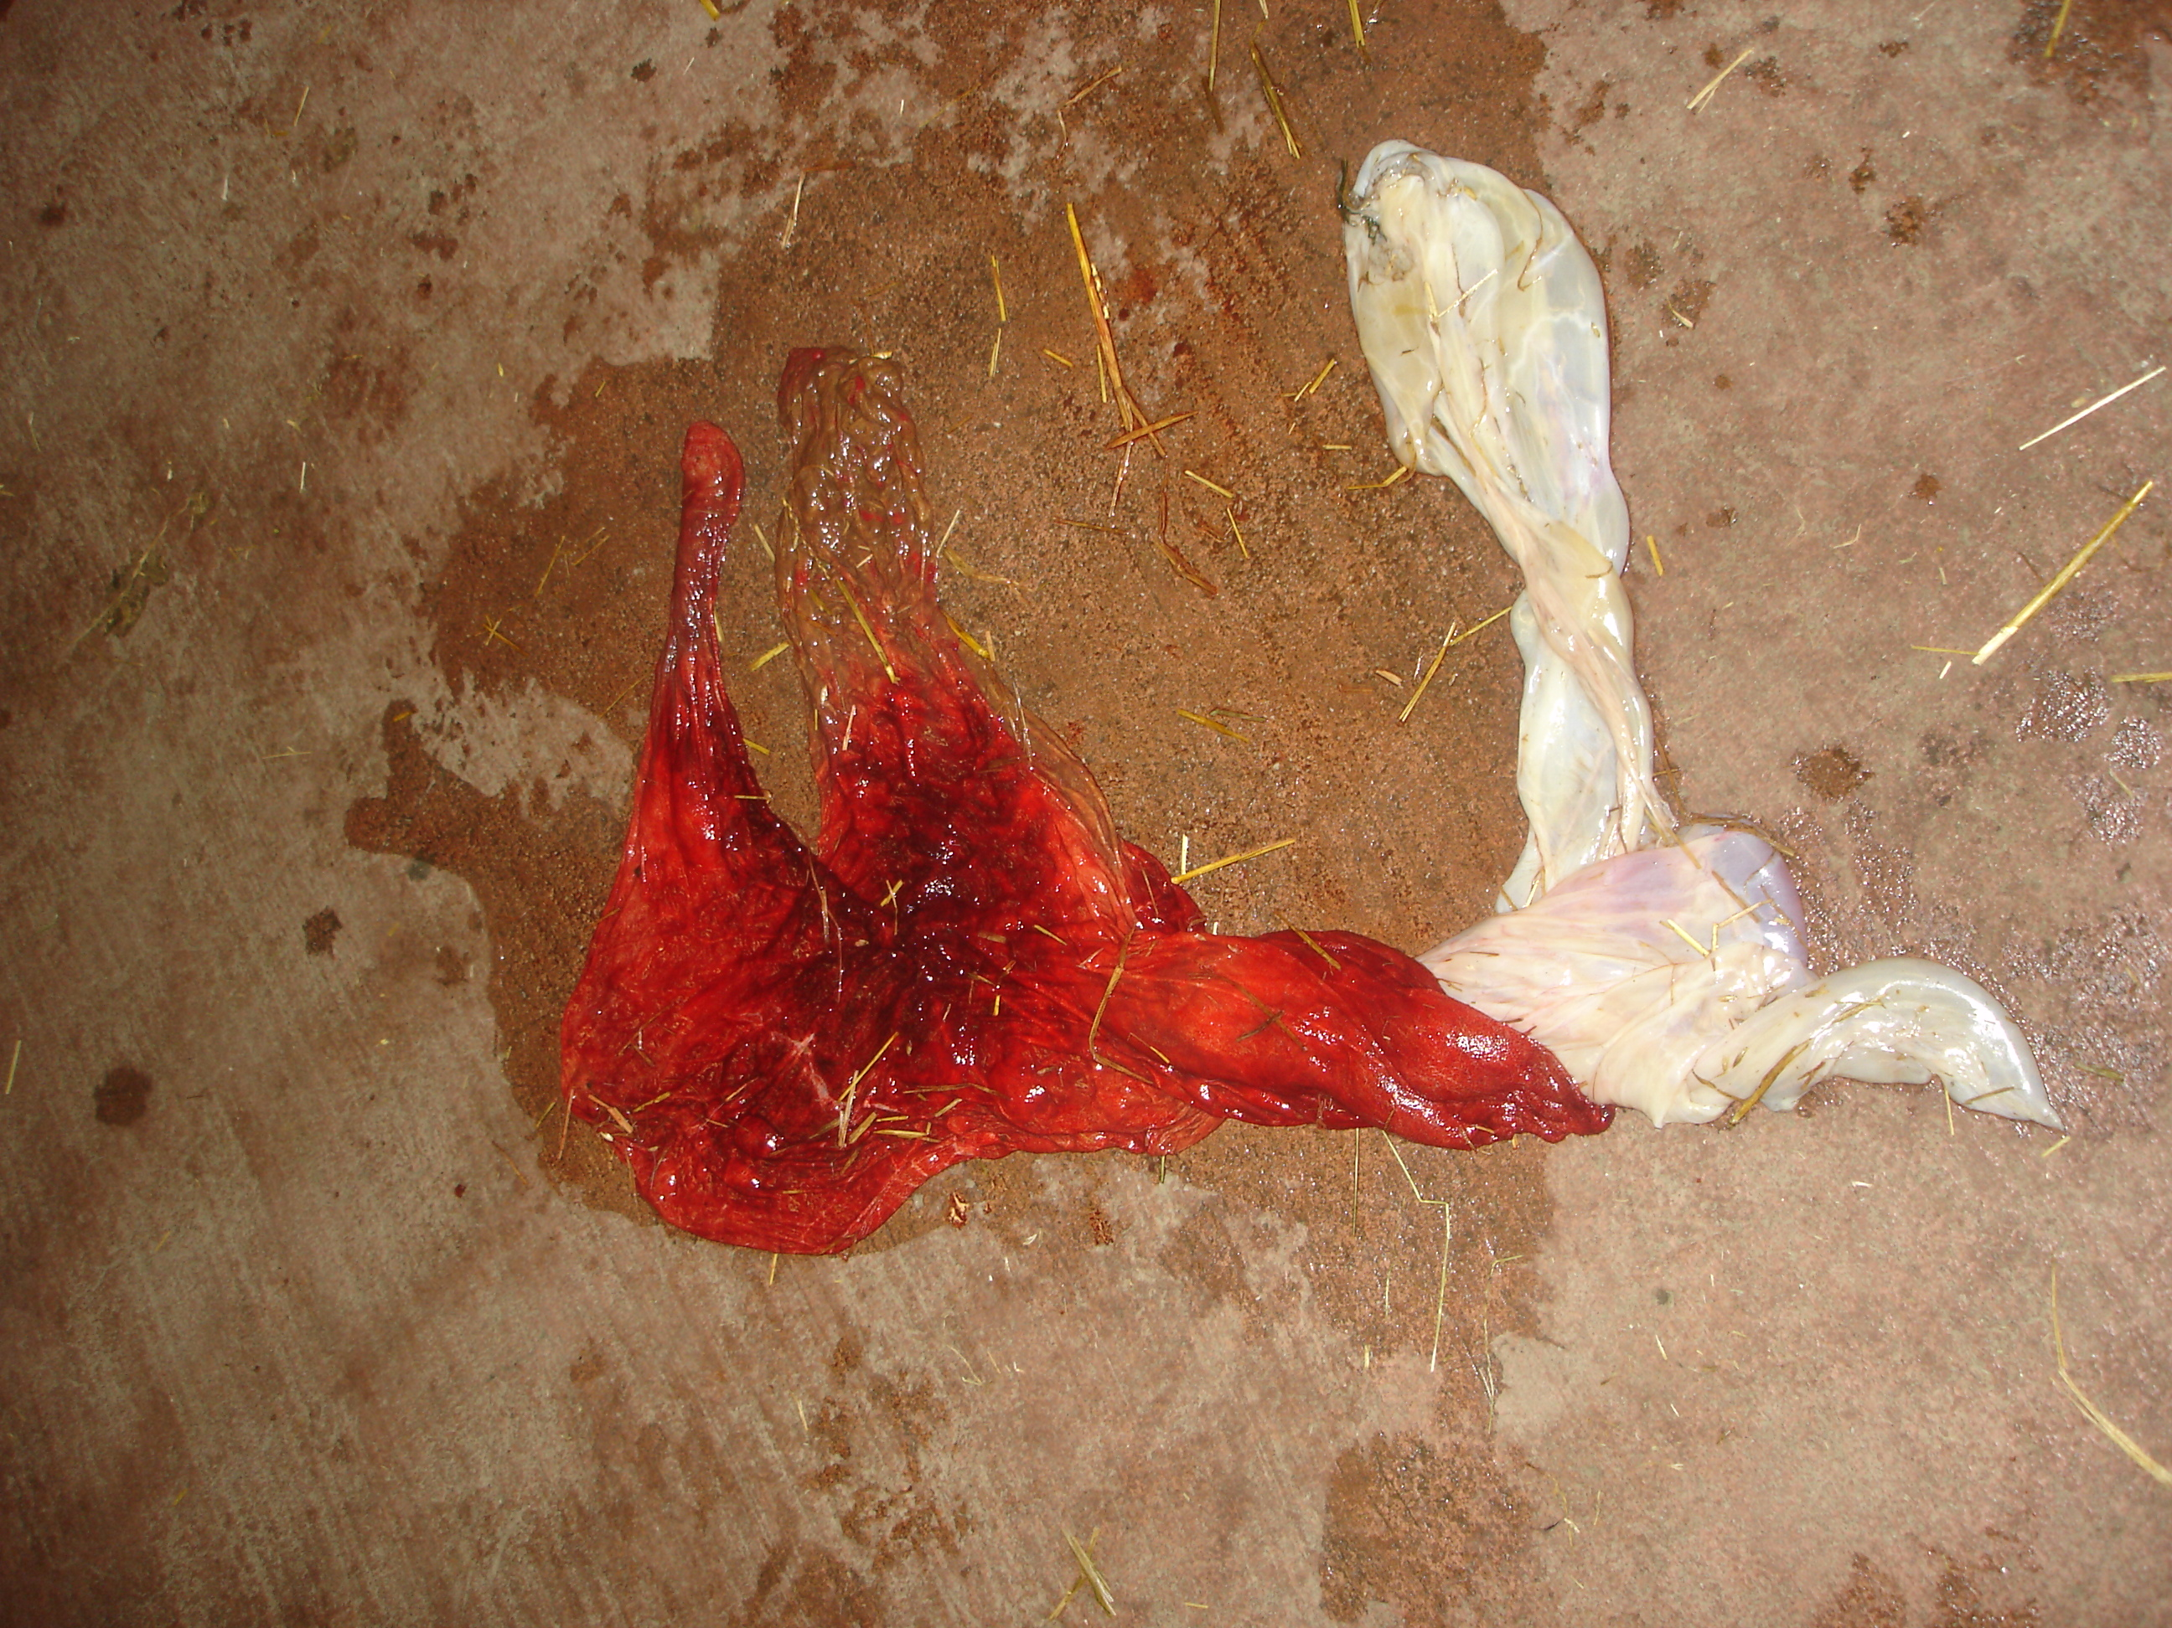
1. Equine placenta
Epithéliochorial
The longest way for O₂, nutrients (and medications)
Microcotyledons
Fractal
Diffuse
Exceptions:
Oviducts
Cysts
Cervical star (torn at foaling)
All placental surface necessary for foetal nutrition (No twins)
Chorionic face (red)
F-shaped
Pregnant horn
Non-pregnant horn
Cervix star
Amnios

Slide 4
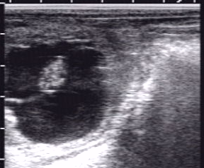
2. Placental development
d10
d14
d21
d30
d35
Vitellus
Embryo
Allantoïde

Slide 5
2. Placental development
Beginning of the placental development
Implantation:
What is that?
Placental formation
New foetal pathway for nutrition
Uterine Milk > Maternal/foetal blood exchange
Delayed in horse : d32-35
Endometrial cups formation (>PMSG=eCG)

Slide 6
2. Placental development
Placental maturity
Question of definition:
Endocrine autonomy: j70- j100
Secondary CLs necessary > day 70
Placenta autonomous > day 100
Studies on ovariectimised mare during pregnancy
Nutrition autonomy:
j50 (?): Umbilical chord
J90 (?): Microtcotyledons cover the whole endometrial surface

Slide 7
3. Placental endocrinology
Primary CL
Ovulation
Placenta
Progestins
PMSG
Secondary CL
Progesterone
d0
d32-35
d40-50
d80-90
d132-135

Slide 8
3. Placental endocrinology
Progestagens
Low P4 blood level at the end of pregnancy
High P4 levels inside placental unit
Metabolism of progegestins inside the placenta
Direct effect on PG production & oxyt receptors
Metabolism:

Slide 9
3. Placental endocrinology
Fetus
Utero-placental unit
Mare
Cholesterol
Cholesterol
Surrenal glands?
Pregnolone (P5)
Pregnanediol (P5ββ)
Pregnanediol (P5ββ)
P5
Progesterone (P4)
5αPregnane (5αDHP)
5αDHP
20αhydroxy-5αPregnane (20α5P)
20α5P
Other progestagens
Other progestagens
Other progestagens
To cortisol way (end of pregnancy)
17-αOH

Slide 10
3. Placental endocrinology
Estrogens
Increase of blood flow (fetal nutrition)
Uterotonic agent
Not produced by fetus
Fetal gonads
Utero-placental unit
Mare
P5
Testosterone
17αOH Pregnenolone
Androstendione
Dehydroepiandrosterone (DHEA)
Oestrogens-Sulfate
Oestrone
Oestradiol
7-dehydro DHEA
Equilin, Equilenin, derivates

Slide 11
3. Placental endocrinology
Relaxin:
Prod: d80 > end of pregnancy
Effect on uterus: myorelaxation ?

Slide 12
4. Placental evaluation
CTUP
Combined thickness of uterus & placenta
Evaluation of Placental separation
Days of pregnancy | CTUP thickness
D271-300 D301-330 >D330 | <8mm <10mm <12mm

Slide 13
EqPlacenta: MQC1
Implantation in the equine begins at:
D14
D16-17
D32-35
D70-90

Slide 14
EqPlacenta: MQC2
Implantation in the equine begins at:
D14
D16-17
D32-35
D70-90

Slide 15
EqPlacenta: MQC2
Oestrogen production during end of equine pregnancy is localised in:
Foetal gonads
Mare ovaries
Utero-placental unit
Surrenal glands

Slide 16
EqPlacenta: MQC2
Oestrogen production during end of equine pregnancy is localised in:
Foetal gonads
Mare ovaries
Utero-placental unit
Surrenal glands

