Slide 1
C-SECTION IN THE MARE
Jérôme PONTHIER, ULg
DVM, M. Sc., Ph. D., Diplomate ECAR

Slide 2
Plan
Procedure
Surgery
Post-surgery care
Mare
Foal
Results and prognosis
Emergency C-section
Elective C-section

Slide 3
1. Procedure
Surgery
Standing – Recumbent
Flank – Paramedian abdominal line – Median line

Slide 4
1. Procedure
Surgery
Main difference when compared to our Bovine bro’s:
Placenta: epithelial, diffuse, mycrocotyledons,
Incision line
On the hindlimb: between fetlock and hock
No need to avoid cotyledons
Suture:
Placenta separation from uterus on 2cm
Haemostatic suture (controversies)
2 impermeable and invaginante suture (Cushing > Lambert)
No abdominal contamination with uterine fluids

Slide 5
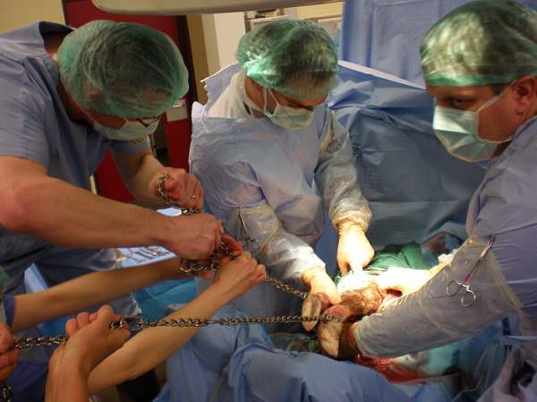
1. Procedure

Slide 6
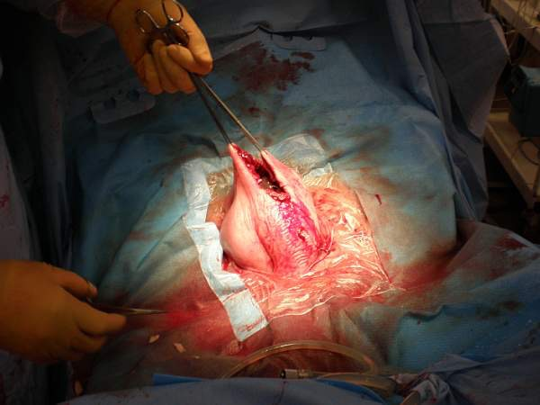
1. Procedure

Slide 7
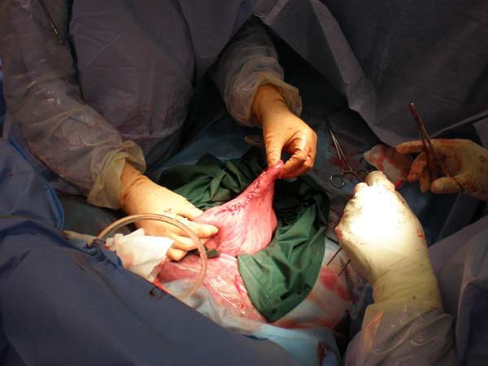
1. Procedure

Slide 8
1. Procedure
Post-surgery care
Mare
Placental retention > Metritis > Laminitis!!!!!
Evidence of decreased risk with fractionated heparins
General broad spectrum antibiotics
Wound management

Slide 9
1. Procedure
Post-surgery care
Foal
EXIT during procedures?
Palmer et al
See neonatology procedures
Pre/dys maturity
Hypoxemia syndrom
…

Slide 10
2. Results & prognosis
Forecasted C-section:
Surgery is planned when Milk electrolyte attest maturity
Rapid C-section:
Foaling has began and as the foal is not seen
C-section is immediately decided
Second intention C-section:
Foaling has began
Obstetrical manipulations have been tried (<20-30 minutes)
Foetus is alive and owners wants to save it
Second intention C-section:
Foaling has began,
Obstetrical manipulations have been tried (<20-30 minutes)
Foetus is not alive
Owners don’t want to take risk for the mare/have no money
Other obstetrical manipulations have been done at the clinic
Last Chance C-section: long and hard obstetrical manipulations didn’t succeeded

Slide 11
2. Results & prognosis
Elective C-section
Indications:
Maternal abnormalities, pathologies (e.g.: uterine torsions diagnosed at term)
Foetal pathologies
Why not Parturition induction?
When:
Foetal maturity assessment : Ca, Na, K in Milk

Slide 12
2. Results & prognosis
Elective C-section
Results:
Mare survival = ± 100%
Foal survival :
After surgery = ± 100%
At discharge >85%
Prognosis:
Owner bank account survival = ± 0%

Slide 13
2. Results & prognosis
Emergency C-section
Indications
Dystocia:
Involving foetal viability (timing to resolve would be too long for foal)
20-40 minutes of foetal viability once foaling started?
Impossible to be resolved by natural ways
Don’t forget 3Ps (Presentation, Position, Posture)
Monstrosity
Maternal abnormalities: uterine torsion diagnosed at the foaling time, abnormal pelvis

Slide 14
2. Results & prognosis
Emergency C-section
Results & prognosis:
Mare survival: >80%
Foal survival: >30%

Slide 15
2. Results & prognosis
Why theses differences between Emergency en Elective C-section?
Long obstetrical manipulations:
⬆ uterine contamination
⬇ general parameters of the mare
⬇ placental perfusion (> Foal)

Slide 16
EqC-Section: MQC1
What is the first suture to do on a uterus during a C-section in the mare?
Lambert suture
Cushing suture
Haemostatic suture
Blair-Donati suture

Slide 17
EqC-Section: MQC1
What is the first suture to do on a uterus during a C-section in the mare?
Lambert suture
Cushing suture
Haemostatic suture
Blair-Donati suture

Slide 18
EqC-Section: MQC2
Best outcome rates for mares after C-section are achieved after:
Elective C-section
C-section performed for transverse presentation
C-section performed for uterine torsion
C-section performed on a dead foetus

Slide 19
EqC-Section: MQC2
Best outcome rates for mares after C-section are achieved after:
Elective C-section
C-section performed for transverse presentation
C-section performed for uterine torsion
C-section performed on a dead foetus

