Slide 1
ANDROLOGY EQUINE
Dr. Jérôme PONTHIER
DVM, M. Sc., Ph. D., Diplomate ECAR

Slide 2
SUMMARY
Anatomy
Physiology
Normal values of the equine spermogram
Semen management
Pathologies

Slide 3
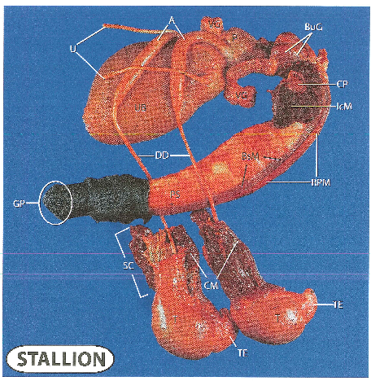
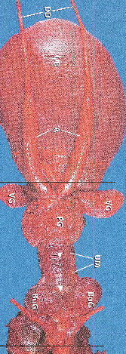
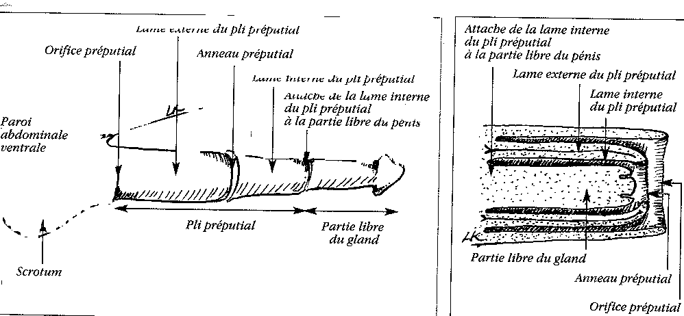
1. Anatomy

Slide 4
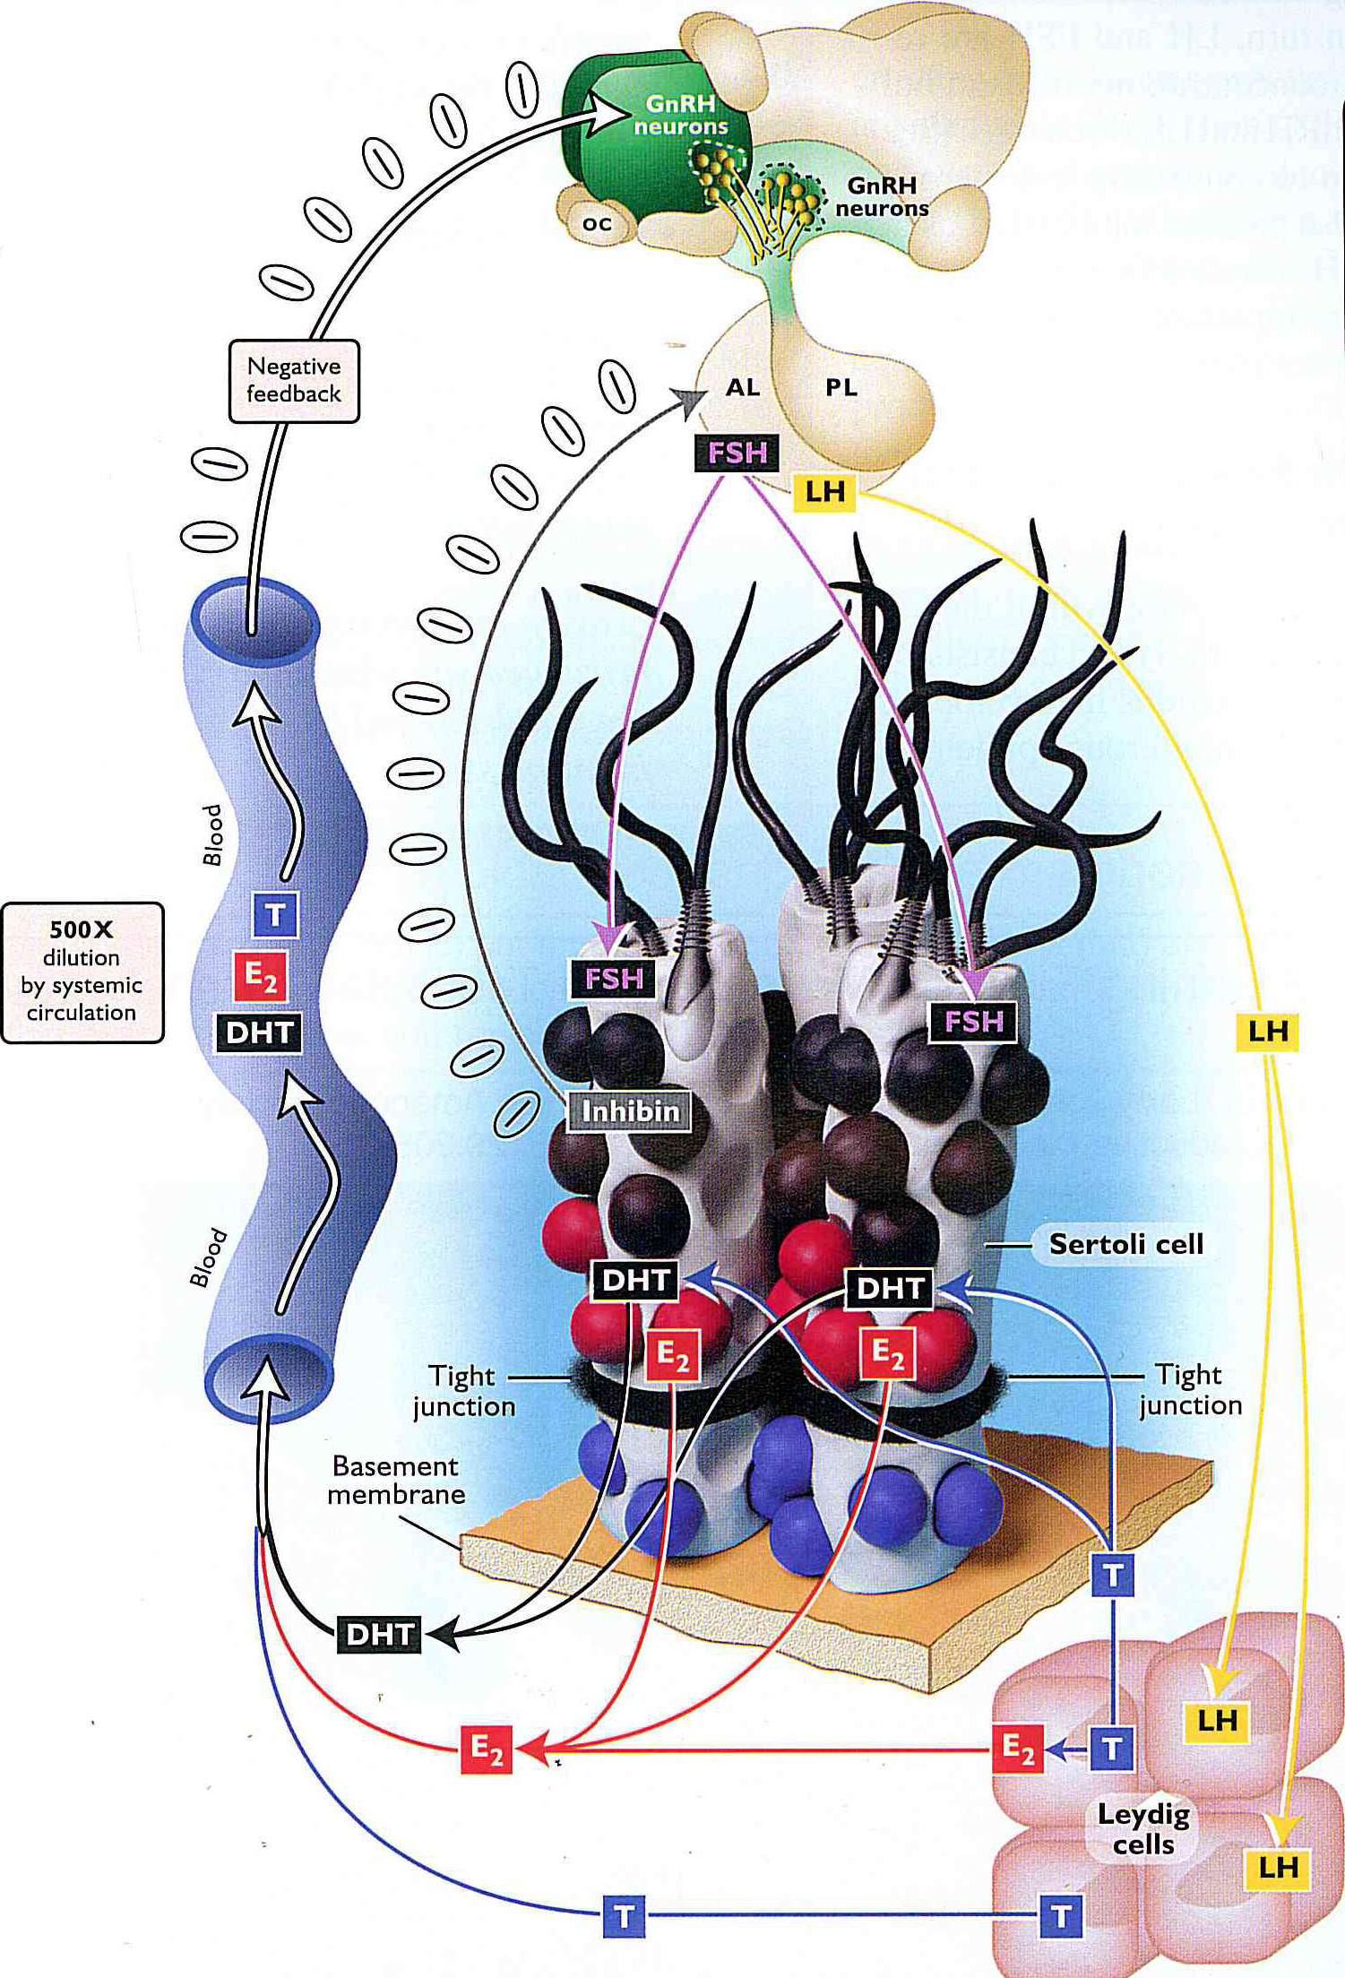
2. Physiology

Slide 5
3. Normal values of the equine spermogram
Color (concentration & pathologies), odor
Volume & Concentration
10 to 200ml & 50 to 800x10⁶ spz/ml
TSN is +/- constant (9-12x10⁹spz)
Seminal plasma:
Accessory glands (vesicular glands)
Production during sexual excitation periods
Short excitation, 1 jump and direct ejaculation:
⬇volume ⬆concentration
Long excitation and many jumps before ejaculation
⬆volume ⬇concentration

Slide 6
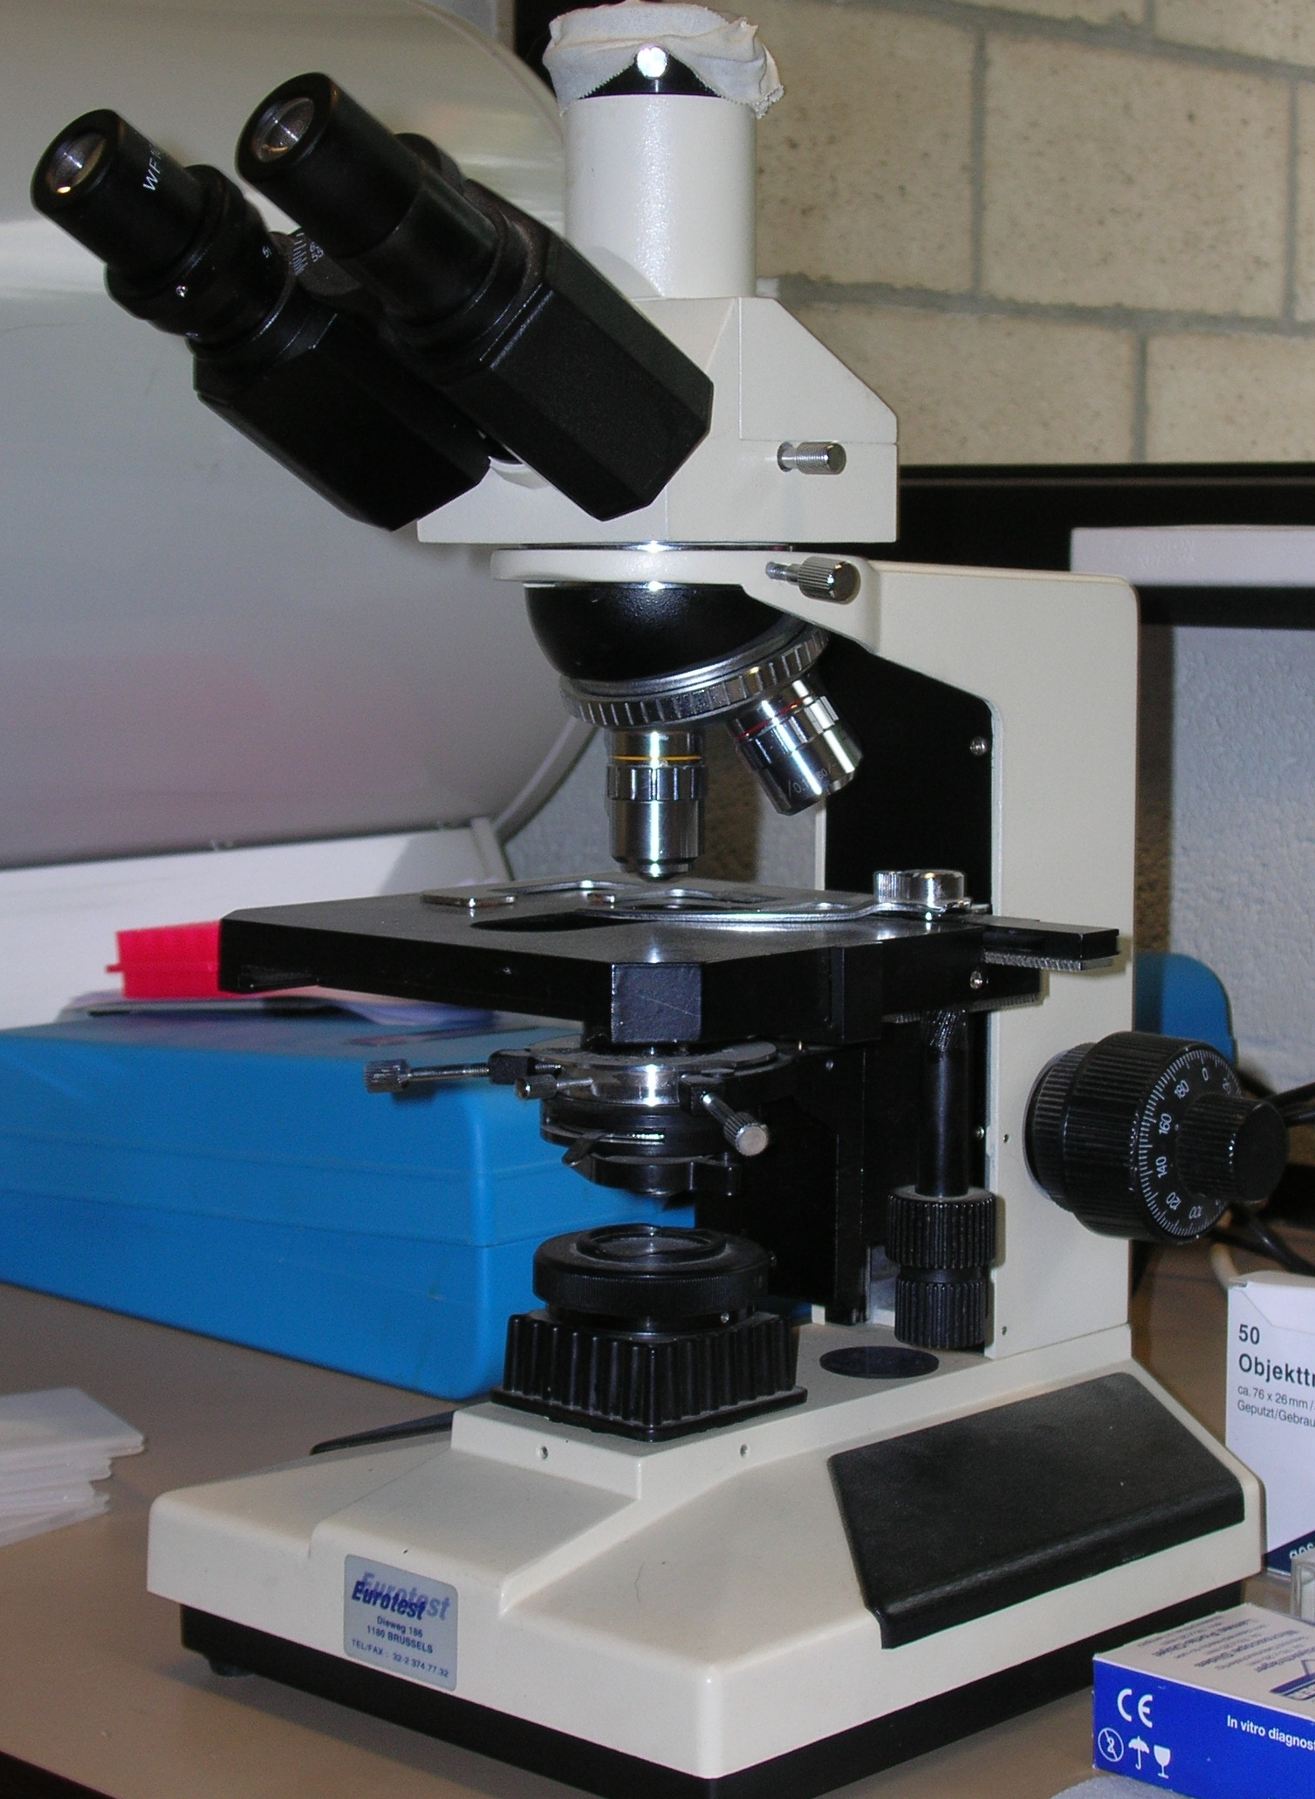
3. Normal values of the equine spermogram
Motility
Non motile | Motile | Progressive
x

Slide 7
3. Normal values of the equine spermogram
Motility
 | Definition
VCL | Velocity Curvilinear Path
VSL | Velocity Straight Line Path
VAP | Velocity Average Path
LIN | VSL/VCL
STR | VSL/VAP
WOB | VAP/VCL
Straight Line Path
Average Path
Real Path
Lateral Head Displacement
Centroïde position
Curvilinear path

Slide 8
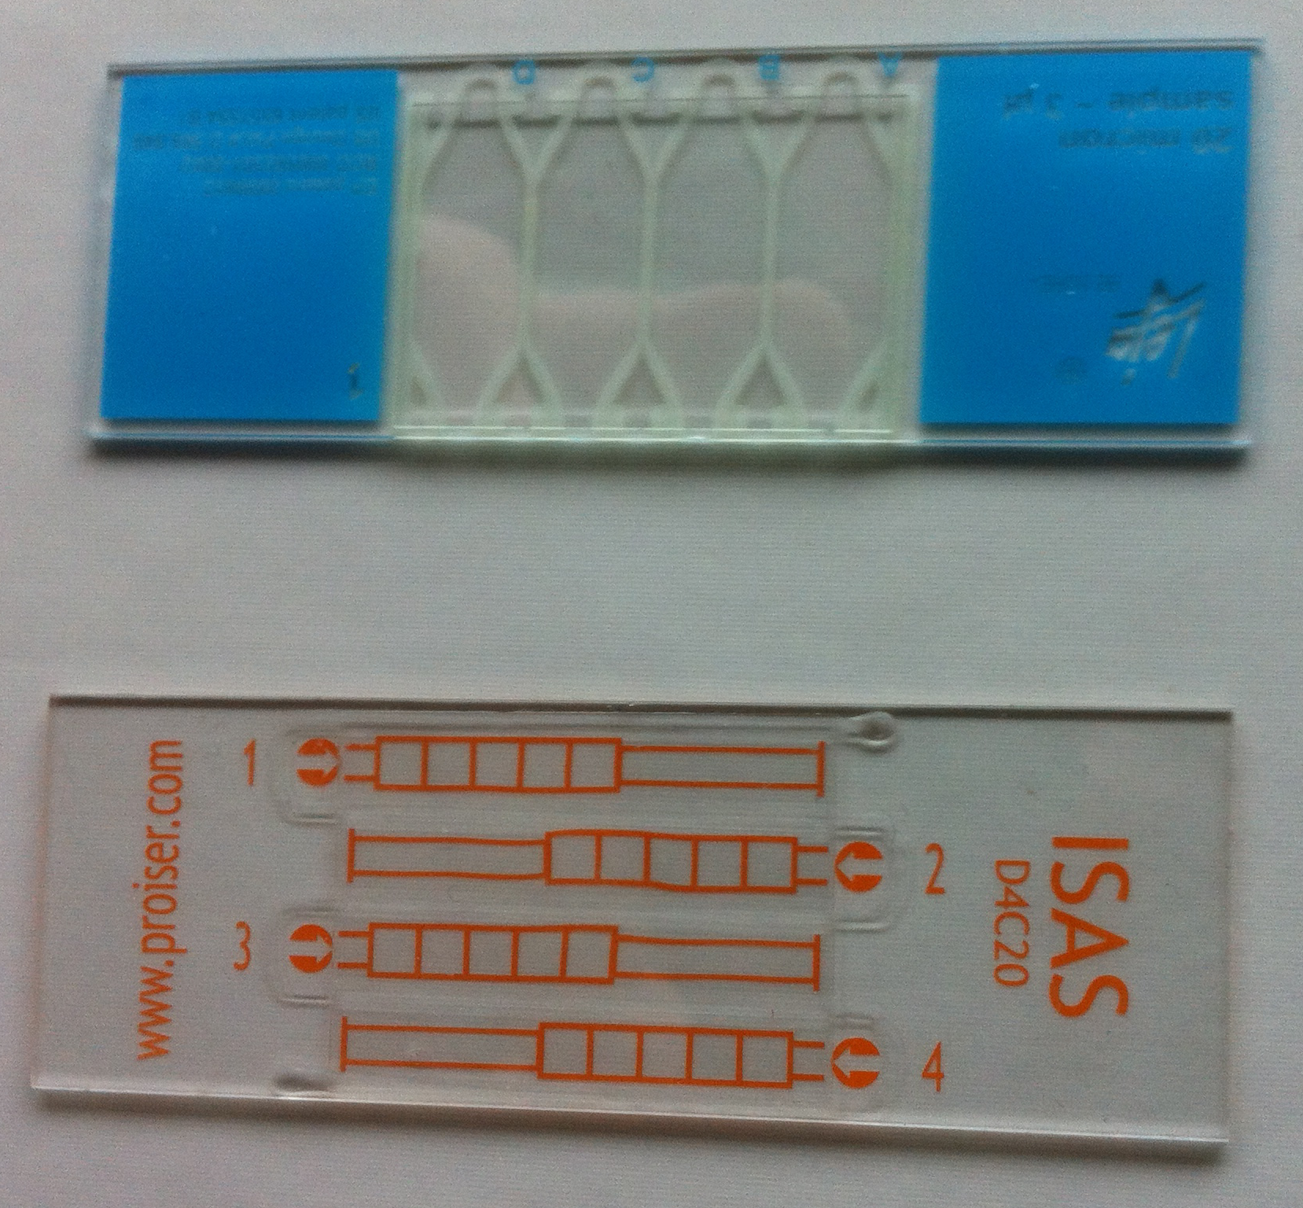
3. Normal values of the equine spermogram
Motility
 | Direct filling | Capillarity filling
Total Motility | VAP >10-15µm/s VAP >20µm/s | VAP >15µm/s
Progressive Motility | VAP >10-15µm/s & STR >100% VAP >40µm/s & STR >80% | VAP >30µm/s & STR >50%

Slide 9
3. Normal values of the equine spermogram
Motility
With common literature parameters and in milky medium:
Total motility >70-80%
Progressive motility > 50-60%
But, only one spermatozoa is enough…
% of motility himself is a information about testicular health, but not about fertility
Depending on what you want to do…

Slide 10
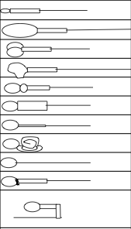
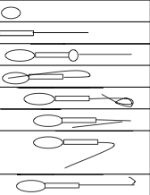
3. Normal values of the equine spermogram
Morphology
Primary abnormalities
Secondary abnormalities

Slide 11
4. Semen management
Rules:
Fresh semen: (300) 500 progressive spz/dose
Frozen semen: 140 (250) progressive spz/dose
Ways:
Centrifugations
Density gradient centrifugations
Abnormal spz
Non sperm cells
Bacteria (virus)
Semen extenders

Slide 12
5. Pathologies
Testis & epididymis:
Pathology | Hot point(s)
Cryptorchidy | LARI Estron sulfate & diagnosis
Tumors
Degeneration | Effects of temperature
Orchitis & epidiymitis
Testicular torsion | Strangulated or not
Inguinal hernia | Closure of inguinal rings & semen quality

Slide 13
5. Pathologies
Penis:
Pathology | Hot point(s)
Seminal vesiculitis | Local antibiotherpay by endoscopy?
Ampulla obstruction | Diagnosis & PAL assay in semen

Slide 14
5. Pathologies
Penis:
Pathology | Hot point(s)
Hematoma, paraphimosis | Specific treatments in equine (vs dog)
Phimosis | Foals & tumors
Parasitism - infections | EHV3, Habronema, …
Papilloma | EPV
Sarcoïds | BPV
Carcinoma | EPV2

Slide 15
ANDROLOGY EqQ1
What is the actually described etiologic cause of squamous cell carcinoma of the penis in the equine :
BPV
EPV1
EPV2
EHV3
All
None

Slide 16
ANDROLOGY EqQ1
What is the actually described etiologic cause of squamous cell carcinoma of the penis in the equine, :
BPV
EPV1
EPV2
EHV3
All
None

Slide 17
ANDROLOGY EqQ1
What should be the mean volume and concentrations in an equine ejaculate:
100ml 100x10⁶spz/ml
10ml 800x10⁶spz/ml
50 ml 200x10⁶spz/ml
150ml 150x10⁶spz/ml
All
None

Slide 18
ANDROLOGY EqQ1
What should be the mean volume and concentrations in an equine ejaculate:
100ml 100x10⁶spz/ml
10ml 800x10⁶spz/ml
50 ml 200x10⁶spz/ml
150ml 150x10⁶spz/ml
All
None

