Slide 1
PREGNANCY DIAGNOSIS
Dr. Jérôme PONTHIER
DVM, M. Sc., Ph. D., Diplomate ECAR

Slide 2
Pregnancy diagnosis in the equine
Hormonal assays
Physical methods
Progesterone
eCG (=PMSG)
Oestrone-sulfate
Relaxine
Others?
Palpation
Transrectal US
Transabdominal US

Slide 3
Hormonal assays
Primary CL
Ovulation
Placenta
Progestagens
PMSG
Secondary CL
Progesterone
d0
d32-35
d40-50
d80-90
d132-135

Slide 4
Hormonal assays
Progesterone:
d4 > d±160 (end of secretion of secondary CL)
Never after: placenta produces Progestagens and very few progesteron
A cyclic mare will spend 2/3 of her life under progesterone (oestrus=5-7d; dioestrus =14-15j)
The worst pregnancy diagnosis
Repeat the assays? 3 bloods samples at 5d intervals
If one sample with low progesterone: not pregnant
If all samples with low progesterone: no conclusion

Slide 5
Hormonal assays
eCG (=PMSG):
d40(50) > d100(110) (small concentrations are not detected by assays)
Produced by endometrial cups (see your specific physiology)
If embryo dies after day 37:
Endometrial cups will produce eCG until day 135-140
FALSE POSITIVE (no embryo viability assessement)
The only relevant information: « At day 32, your mare was pregnant… »

Slide 6
Hormonal assays
Estrone-sulfate:
d90(100) to the end of pregnancy (Quite late)
Produced by fetal gonades (even if it’s a male)
Fetal viability
High oestrogen concentrations in equine late pregnancy
Cubboni test
Effect on pregnancy pathologies?

Slide 7
Hormonal assays
Relaxine:
d80(90) to the end: quite late
Relaxine is produced by the placenta (and in a small proportion by corpus luteum)
Fetal viability !!!!
Quite late hormonal assay
Commercial quick assays (ELSIA sandwich) are not recognizing equine Relaxine

Slide 8
Hormonal assays
Others:
PAG: not definitively isolated in the equine, moreover in blood!!!

Slide 9
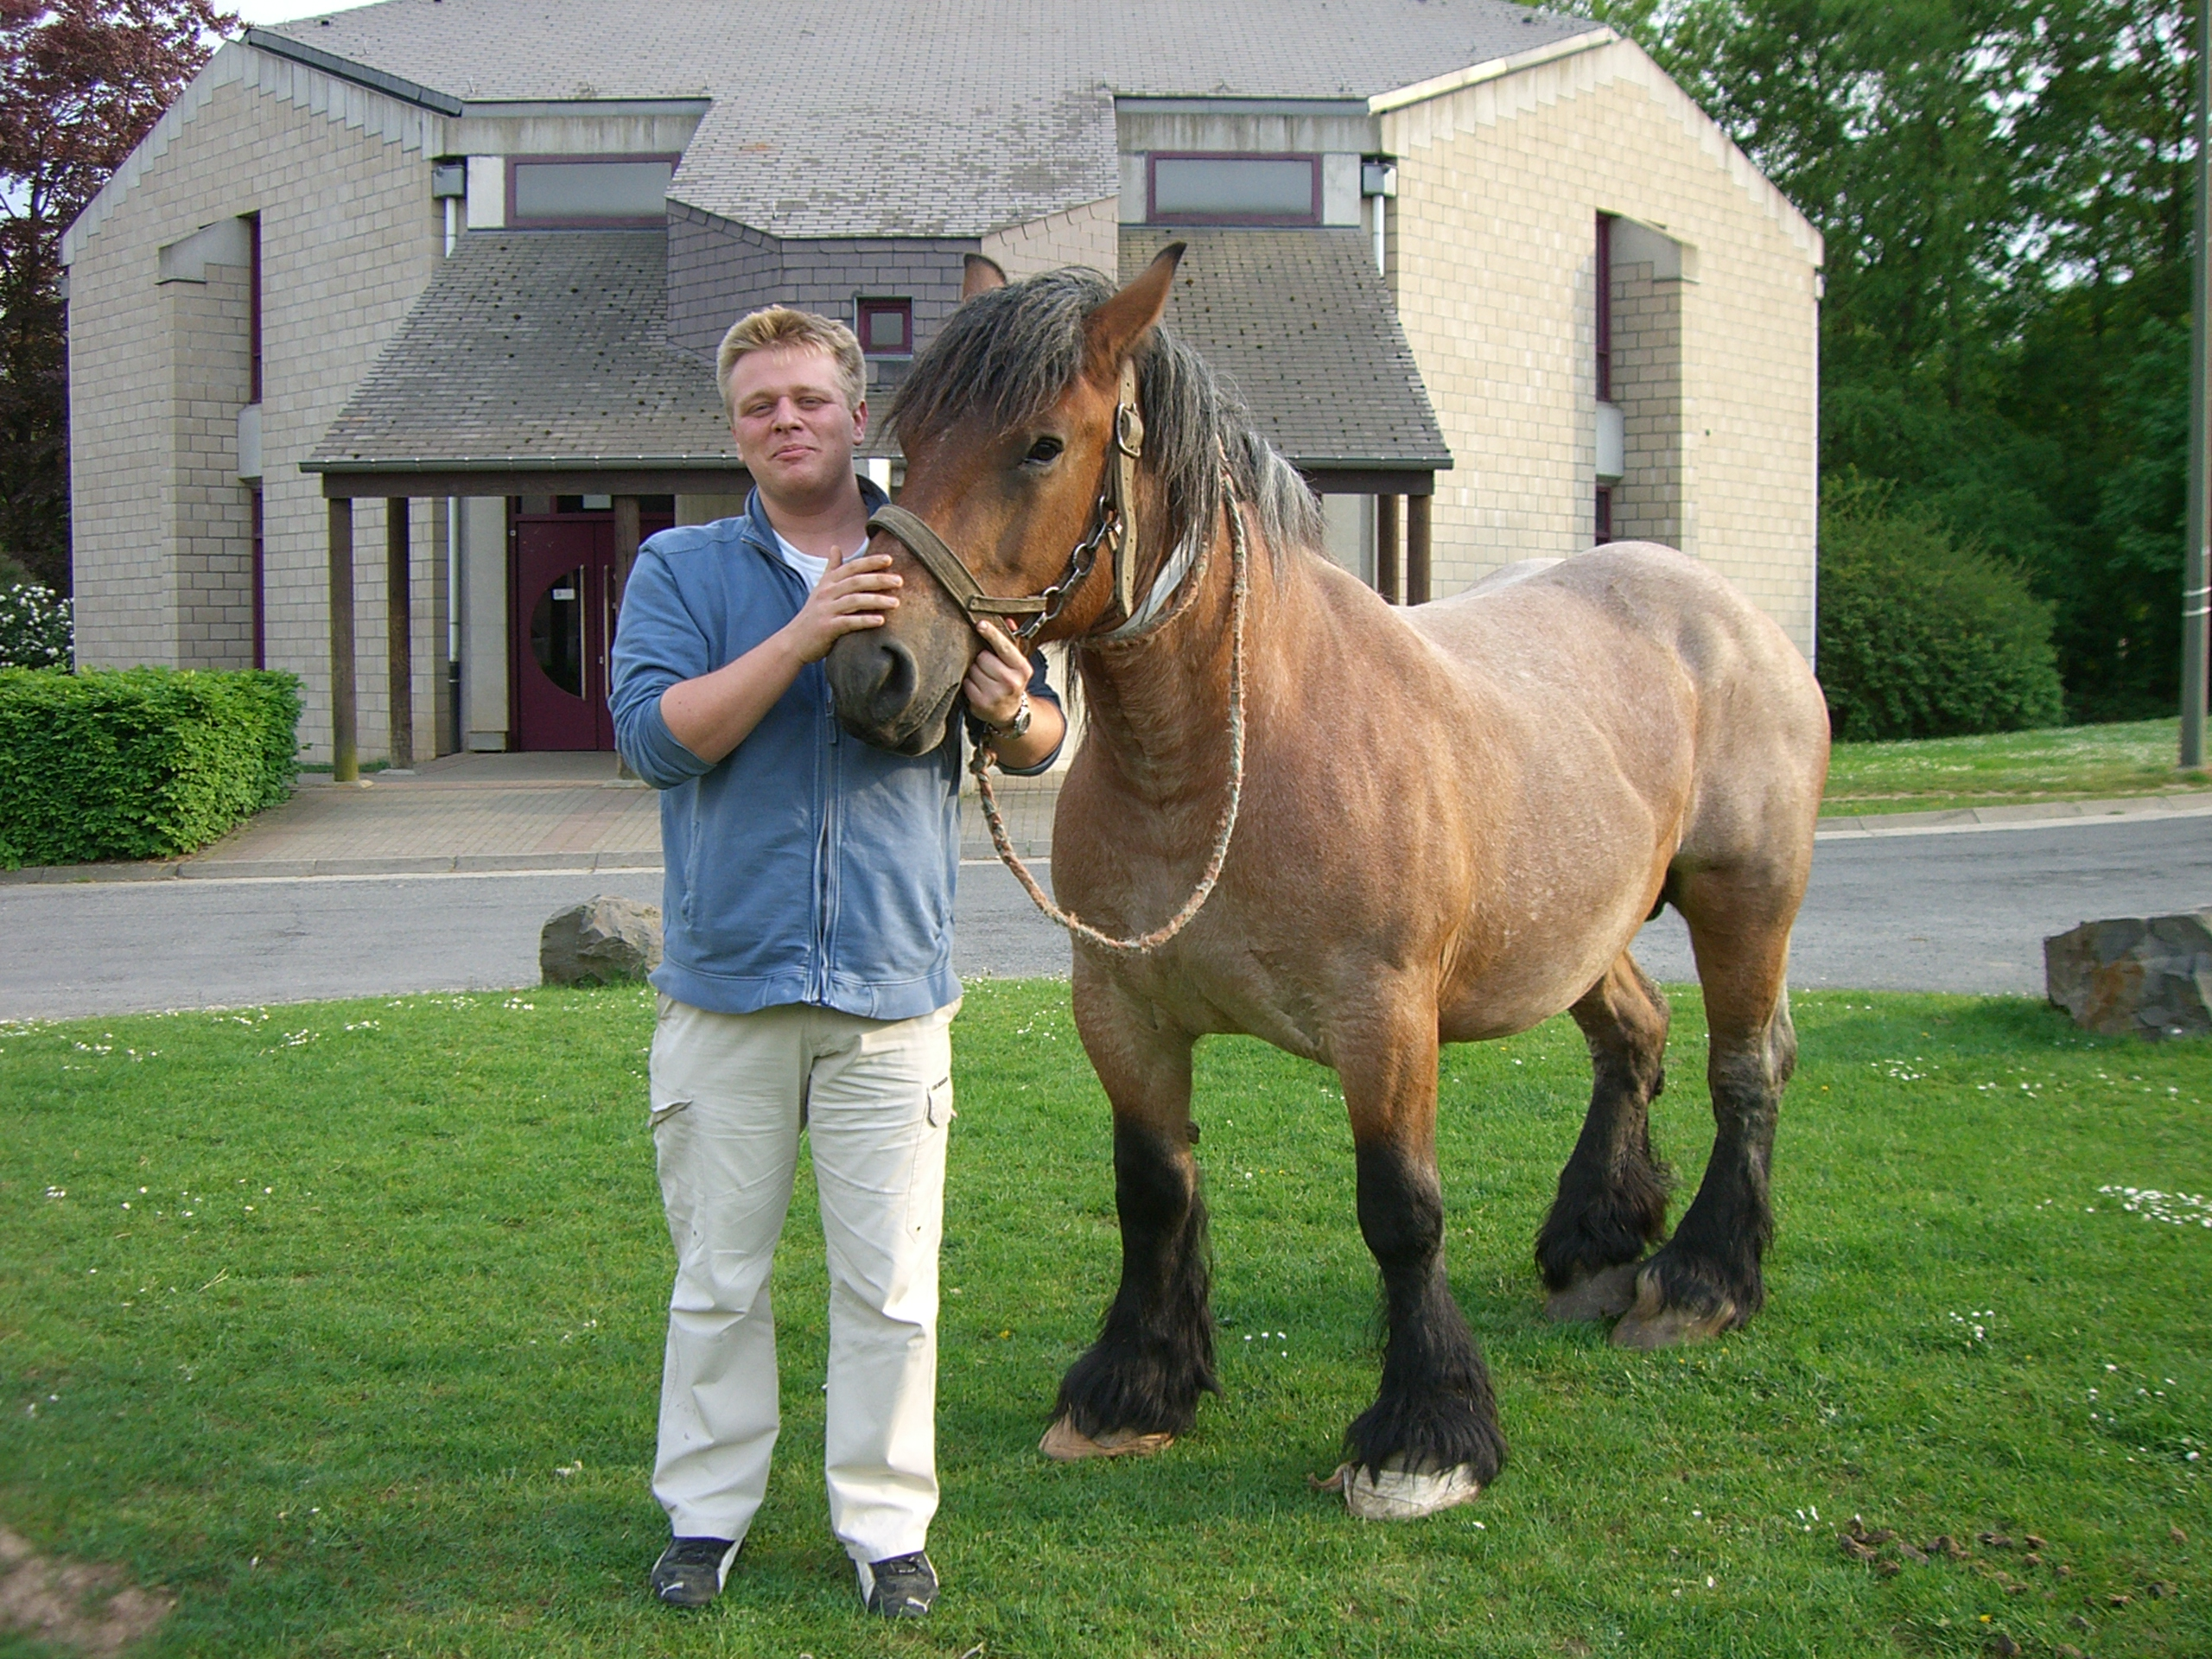
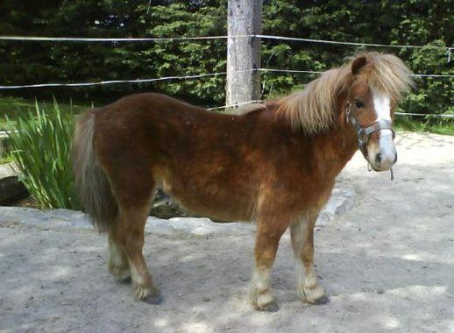
Physical methods
Palpation:
All the uterus (!body and horns!)
d28 to the end
No blind period (unlike cows)
Movements > Viability (?)
Fetal age: 110cm at 11 months
OK for me
NOT for me!

Slide 10
Physical methods
Transrectal US:
d6 | Embryo inside the uterus
d10 | Early pregnancy diagnosis
d14 | Classical pregnancy diagnosis (14mm)
d16-17 | Fixation
d21 | Embryo appears in the vesicle
d28 | Heart beatings (28mm)
d30 | Embryo goes up on allantoïd vesicle
d35 | Embryo at the middle of the vesicle Implantation (endometrial cups formation)
d40 | Embryo at the top of the vesicle
d45-50 | Embryo goes down with umbilical chord and surrounded by amnios vesicle
d10

Slide 11
Physical methods
Transrectal US:
d6 | Embryo inside the uterus
d10 | Early pregnancy diagnosis
d14 | Classical pregnancy diagnosis (14mm)
d16-17 | Fixation
d21 | Embryo appears in the vesicle
d28 | Heart beatings (28mm)
d30 | Embryo goes up on allantoïd vesicle
d35 | Embryo at the middle of the vesicle Implantation (endometrial cups formation)
d40 | Embryo at the top of the vesicle
d45-50 | Embryo goes down with umbilical chord and surrounded by amnios vesicle
d14
Scan of Body & Horns!
Ddx with endomtrial cysts
Gemellity!!!! (ovaries may help in diagnosis)

Slide 12
Physical methods
Transrectal US:
d6 | Embryo inside the uterus
d10 | Early pregnancy diagnosis
d14 | Classical pregnancy diagnosis (14mm)
d16-17 | Fixation
d21 | Embryo appears in the vesicle
d28 | Heart beatings (28mm)
d30 | Embryo goes up on allantoïd vesicle
d35 | Embryo at the middle of the vesicle Implantation (endometrial cups formation)
d40 | Embryo at the top of the vesicle
d45-50 | Embryo goes down with umbilical chord and surrounded by amnios vesicle
d21

Slide 13
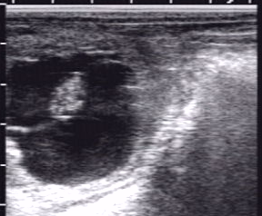
Physical methods
Transrectal US:
d6 | Embryo inside the uterus
d10 | Early pregnancy diagnosis
d14 | Classical pregnancy diagnosis (14mm)
d16-17 | Fixation
d21 | Embryo appears in the vesicle
d28 | Heart beatings (28mm)
d30 | Embryo goes up on allantoïd vesicle
d35 | Embryo at the middle of the vesicle Implantation (endometrial cups formation)
d40 | Embryo at the top of the vesicle
d45-50 | Embryo goes down with umbilical chord and surrounded by amnios vesicle
D35-40
Vitellus
Embryo
Allantoïde

Slide 14
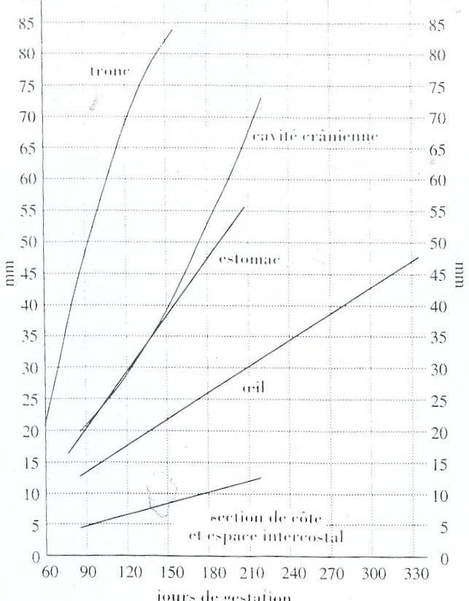
Physical methods
Transabdominal US:
3.5MHz Probe
d90 to the end
Gemellity = ???
Viability (heart beating,…)
Timing of mating (if unknown)
Orbital diameter (trans-rectal)
Stomach diameter (trans-abdo)
Posterior aorta diameter (trans-abdo)
Intercostal space length (trans-abdo)

Slide 15
Hormonal assays
Type | Precocity | Viability | Practical use
Palpation | ++ d28 | ++ | ++
Trans-rectal US | +++ d14(10) | + | +++
Trans-abdo US | + d90 | +++ | +++
Progesterone | + d6 | - | 0
PMSG (=eCG) | + d40 | - | ++
Oestrone sulfate | - d90 | + | ++
Relaxine | - d80 | + | 0

