Slide 1
ENDOMETRITIS
Dr. Jérôme PONTHIER
DVM, M. Sc., Ph. D., Diplomate ECAR

Slide 2
ENDOMETRITIS
In my mind, in the equine:
Endometritis ≠ Metritis:
 | Timing | General signs
Endometritis | - NOT after foaling | - NO, (except vuvlar discharge)
Metritis | - After foaling | Temperature Weakness, anorexia Modified blood analysis Laminitis,…

Slide 3
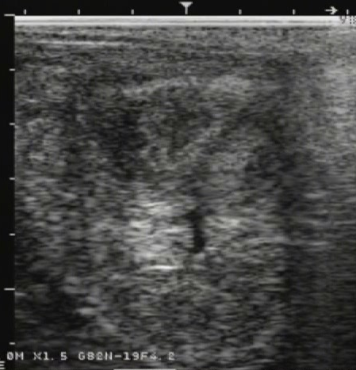
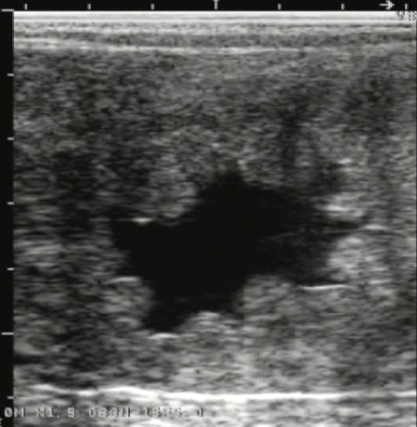
ENDOMETRITIS
Diagnosis:
External signs: vulvar discharge?
Speculum exam: cervical discharge?
US: « free liquid inside uterine lumen »

Slide 4
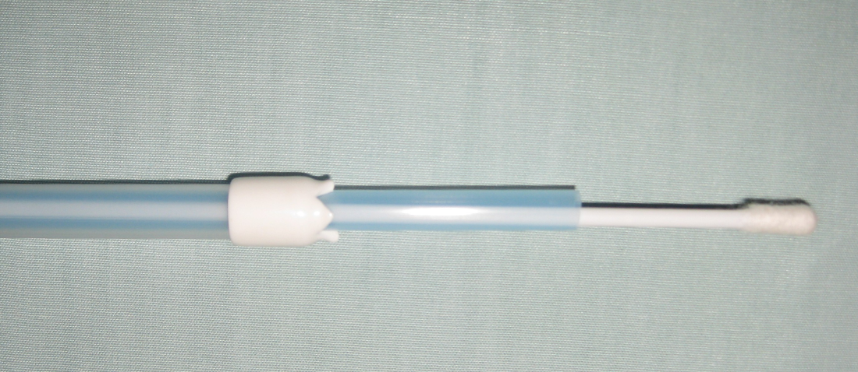
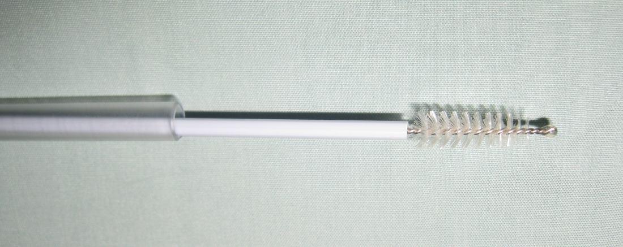
ENDOMETRITIS
Diagnosis:
Endometrial swabs:
Cottons or Brushes?
Small volume uterine lavage
Uterine biopsies

Slide 5
ENDOMETRITIS
Diagnosis:
Conclusions about cytology and bacteriology:
Swabs & small volume uterine lavage
In litterature, 2 ways of slides interpretation
Classical: >5 Neutro or Eosino/x400 field (?)
New: >5% Neutro or Eosino
 | Bacterio + | Bacterio -
Cytology + | Endometritis Etiologic agent is probably the isolated bacteria | Endometritis Etiology: Post mating/Post AI, Mycosis
Cytology - | No endometritis Contamination of the sample | ☺

Slide 6
ENDOMETRITIS
Diagnosis:
Conclusions about about biopsies
Endometritis & Endometrosis
Kenney > Prognosis (see practical)

Slide 7
ENDOMETRITIS
Etiology:
Not related to specific pathogenic agent:
Post mating/AI endometritis
Related to specific pathogenic agent:
Veneral transmission:
Taylorella equigenitalis, Pseudomonas aeruginosa, Klebsiella pneumonia, Sptreptococcus equi equi (?)
Opportunistic agents
Bacterias: Streptococcus spp, Staphylococcus spp, E. coli,…
Mycosis: Candida spp, Aspergillus spp,…

Slide 8
ENDOMETRITIS
Rational: uterine clearance
Mechanisms involved:
Cervix opening
Mucus
Muscular contractions (oxytocin & PG)
Lymphatic drainage
Inflammatory cells & immunity

Slide 9
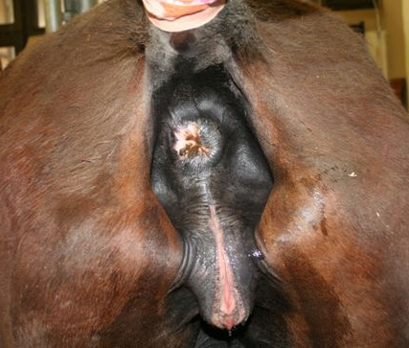
ENDOMETRITIS
Rational: predisposing factors
Vulvar conformation: « No vulva nor mare »
Vertical (max 20° deviation)
Closure (no apparent mucosa)
Length (max 15-20cm)
Supra/Infra ischial proportion = 2/3
Poor vulvar conformation
Pneumovagina
Urovagina
Endometritis

Slide 10
ENDOMETRITIS
Rational: predisposing factors
Cervical abnormalities (post-foaling tears?)
Mucus thickeness (?)
Lymphatic vessels obstruction (endometrosis)
Pendular uterus
New surgeries of the broad ligament

Slide 11
ENDOMETRITIS
Treatment: old school
Oxytocin alone
Uterine lavage:
Sterile physiologic liquid
Sterile tube with balloon (filled after cervix entrance)
No antiseptics
Oxytocin at the endof the uterine lavage
Contamination risks (> oxytocine alone)
Uterine lavage and antibiotic infusion after

Slide 12
ENDOMETRITIS
Treatment: new ways
Systemic antibiotics
Systemic coticoïds (Post/pre AI)
Plasma infusions
Others?

