Slide 1

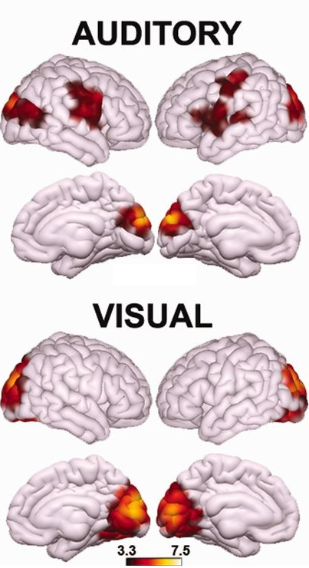
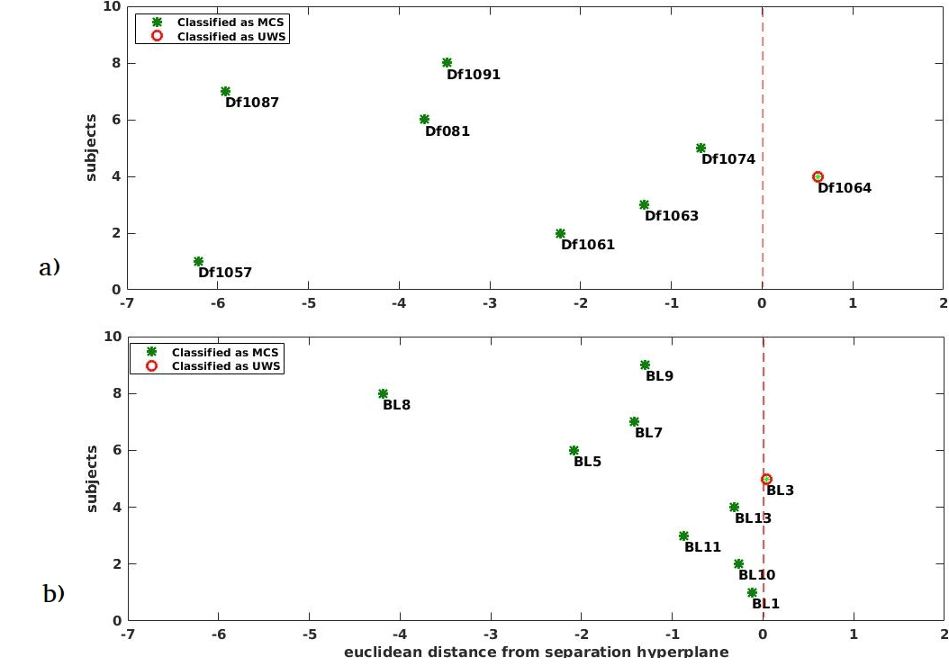

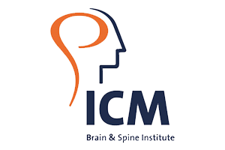
M512
Joint temporo-occipital connectivity reflects
higher-order function associated with conscious states
Georgios Antonopoulos (1), Ron Kupers (2, 3, 4), Laurent Cohen (5,6), Sami Abboud (6), Steven Laureys (1), Athena Demertzi (1,6,7)
Coma Science Group, GIGA Consciousness, GIGA Research Institute, University of Liège, Belgium
BRAINlab, Department of Neuroscience, Panum Institute, University of Copenhagen, Copenhagen, Denmark
Unité COSY, Institute of Neuroscience, Université Catholique de Louvain, Brussels, Belgium
Harland Sanders Chair in Visual Science, School of Optometry, University of Montreal, Montreal, Quebec, Canada
Neurology Department, Hôpital de la Salpêtrière, Paris, France
PICNIC Lab, Institut du Cerveau et de la Moelle épinière, Hôpital de la Salpêtrière, Paris, France
Physiology of Cognition Research Lab, GIGA Consciousness, GIGA Research Institute, University of Liège, Belgium
Introduction
We have previously used machine learning to separate minimally conscious from unconscious patients based on network-level resting state fMRI connectivity^{1.}
By means of a Support Vector Machine (SVM) classifier we correctly classified 20/22 patients when validated on an independent dataset¹.
The discriminative features encompassed averaged connectivity values from bilateral auditory and occipital cortex (Fig 1).
We aimed at investigating whether the classifier is capturing sensory information (auditory, visual). We therefore tested the classifier on subjects deprived of such sensory information.
Hypothesis: Subjects will be classified as minimally conscious, suggesting that the joint temporo-occipital connectivity represents higher-order cognitive processing.
Methods
Fig 1. The used features were extracted from bilateral auditory and occipital regions. Functional connectivity in these regions were previously able to separate minimally conscious from unresponsive/ vegetative state patients.
Resting state fMRI volumes
Three connectivity values per subjects were used as features (Fig 1) using a linear-SVM (C=1).
Training dataset: 45 patients with disorders of consciousness (26 in minimally conscious state, 19 in unresponsive wakefulness syndrome/ vegetative state)¹.
Test dataset: 9 congenitally blind, 8 congenitally deaf subjects.
Results
7/8 congenitally deaf subjects classified as MCS, one was placed in the class of unconscious patients.
8/9 congenitally blind subjects classified as MCS and 1 was classified as unconscious patients
Conclusions
Joint temporo-occipital functional connectivity appears to exceed mere sensory perception.
This cross-modal connectivity pattern might represent higher-order functional organization.
Our findings assist to better comprehend aspects of conscious processes, which are further informative to evaluate covert cognition in noncommunicating conditions.
References
Demertzi, Antonopoulos, Heine, Voss, Crone, de Los Angeles, Bahri, Di Perri, Vanhaudenhuyse, Charland-Verville, Kronbichler, Trinka, Phillips, Gomez, Tshibanda, Soddu, Schiff, Whitfield-Gabrieli, and Laureys. Intrinsic functional connectivity differentiates minimally conscious from unresponsive patients, Brain 2015, 138, 2619–263
Georgios.antonopoulos@uliege.be; a.demertzi@uliege.be
Notes:
1

