Slide 1
Amélioration des performances des briques en terre comprimées à travers une réaction pouzzolanique
NSHIMIYIMANA Philbert, MESSAN Adamah, COURARD Luc
SustainEng2018: 12-14/12/2018, Ouagadougou-Burkina Faso

Slide 2
Compressed earth blocks for construction of modern housing
Notes:
1/3 of global population live in earth based housing
Healthy and comfortable in-door environnement

Slide 3
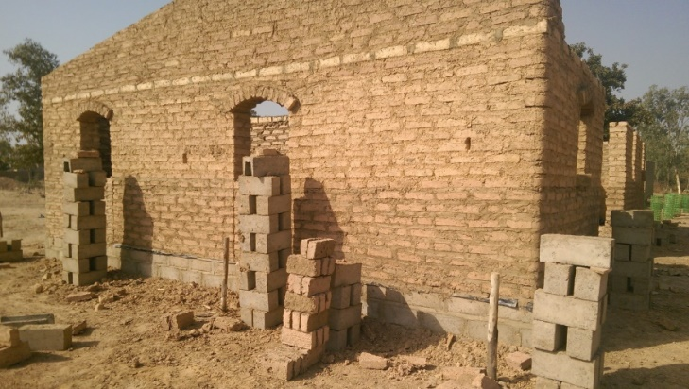
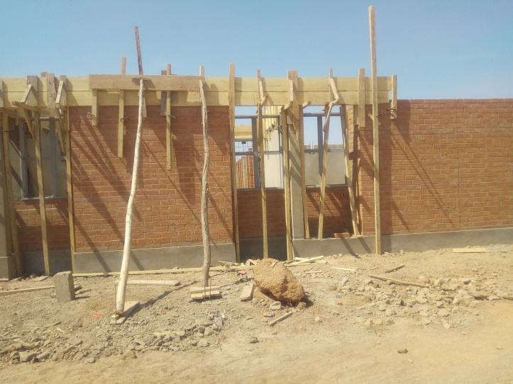
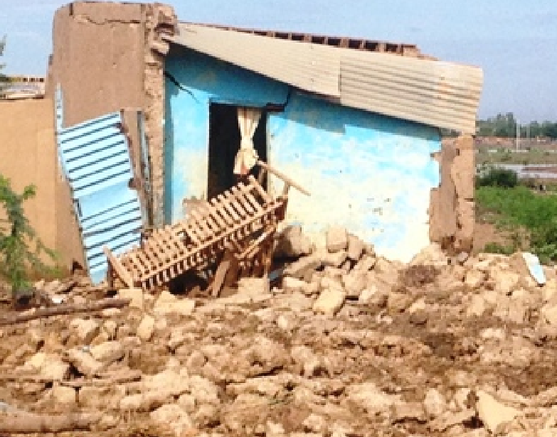
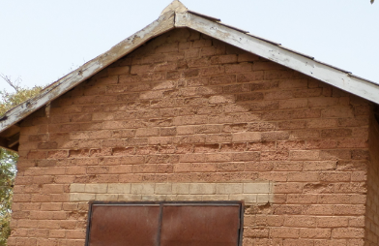
Compressed earth blocks for construction of modern housing
Modern compressed earth blocks (CEBs) ($\sim$2 MPa)
Traditional adobe bricks ($\sim$1 MPa)
Houben and Guillaud, 2006; Bogas et al. 2018
Notes:
1/3 of global population live in earth based housing
Healthy and comfortable in-door environnement

Slide 4
Chemical stabilization improves the performances of CEBs in saturated and dry conditions
1. Cement: hydration reaction requires $\sim$28 days of curing.
2. Lime: pozzolanic reaction requiring >28 days of curing.
3. Geopolymer: geopolymerization of aluminosilicates by activation with alkaline solutions.
Houben & Guillaud, 2006; Bogas et al. 2018; Al-Mukhtar et al. 2010, 2014; Sore et al. 2018

Slide 5
Calcium carbide residue (CCR) and rice husk ash (RHA) for improving the performances of CEBs
Kinetic of reaction in solutions of mixtures :
Earth + CCR (calcium carbide residue)
Earth + CCR:RHA (rice husk ash)
2. Mechanical performances:
CEBs stabilized with CCR
CEBs stabilized with CCR:RHA
3. Mineral changes in cured mixtures.

Slide 6
EXPERIMENTAL APPROACH

Slide 7
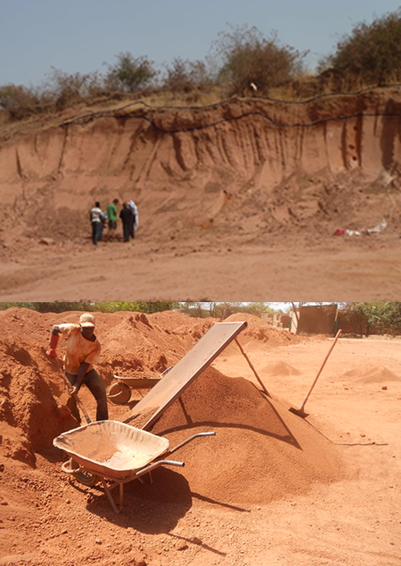
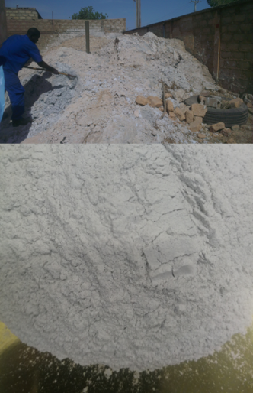
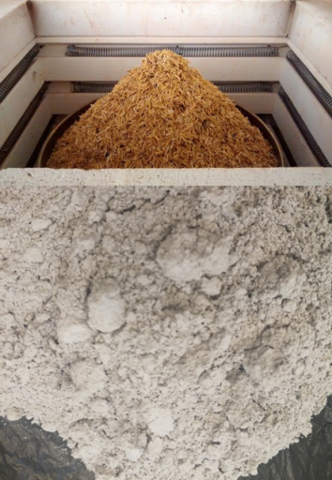
Raw materials were processed and characterized
Earthen material
Pulverized (<5 mm)
Kaolinite (>75 %)
CCR
Ball milled (<125 µm)
Active lime ($\sim$50 %)
RHA
Calcinated : 500°C (2 h)
Ball milled (<80 µm)
Amorphous silica (70 %)
Figure 3. Raw (top) and processed (bottom) materials

Slide 8
Binder (CCR/CCR:RHA) was added to the earthen material on weight percentage basis
CCR | 0 | 5 | 8 | 10 | 15 | 20 | 25
CCR: RHA (ratios) | - | - | - | 10 | 15 | 20 | 25
 |  |  |  | (9:1) | (13.5:1.5) | (18:2) | (22.5:2.5)
 |  |  |  | (8:2) | (12:3) | (16:4) | (20:5)
 |  |  |  | (7:3) | (10.5:4.5) | (14:6) | (17.5:7.5)
 |  |  |  | (6:4) | (9:6) | (12:8) | (15:10)

Slide 9
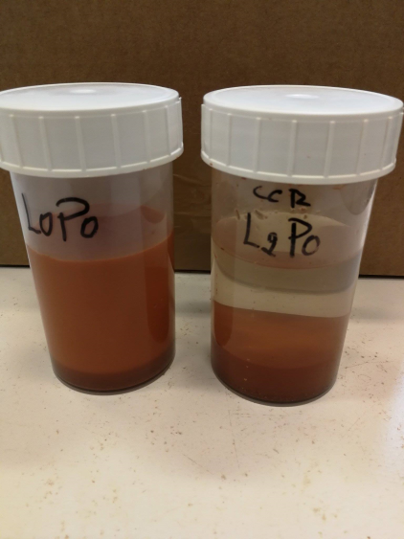
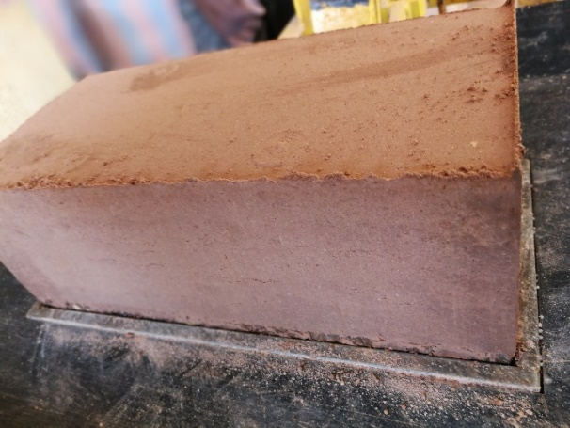
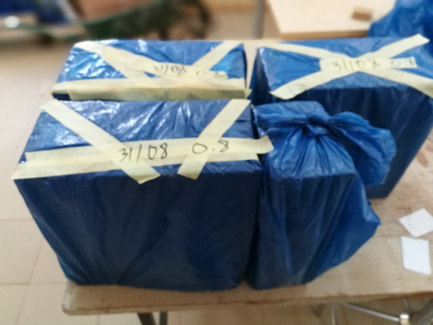
Mix solutions and CEBs were prepared, cured and characterized
Concentration of free calcium [Ca²⁺]
Compressive strength in saturated and dry condition
Mineral change by XRD
1. Curing mix solutions (1-90 days); 40±2°C
2. Prodution and Curing stabilized CEBs (45 days), 40±2 °C

Slide 10
RESULTS & IMPLICATIONS

Slide 11
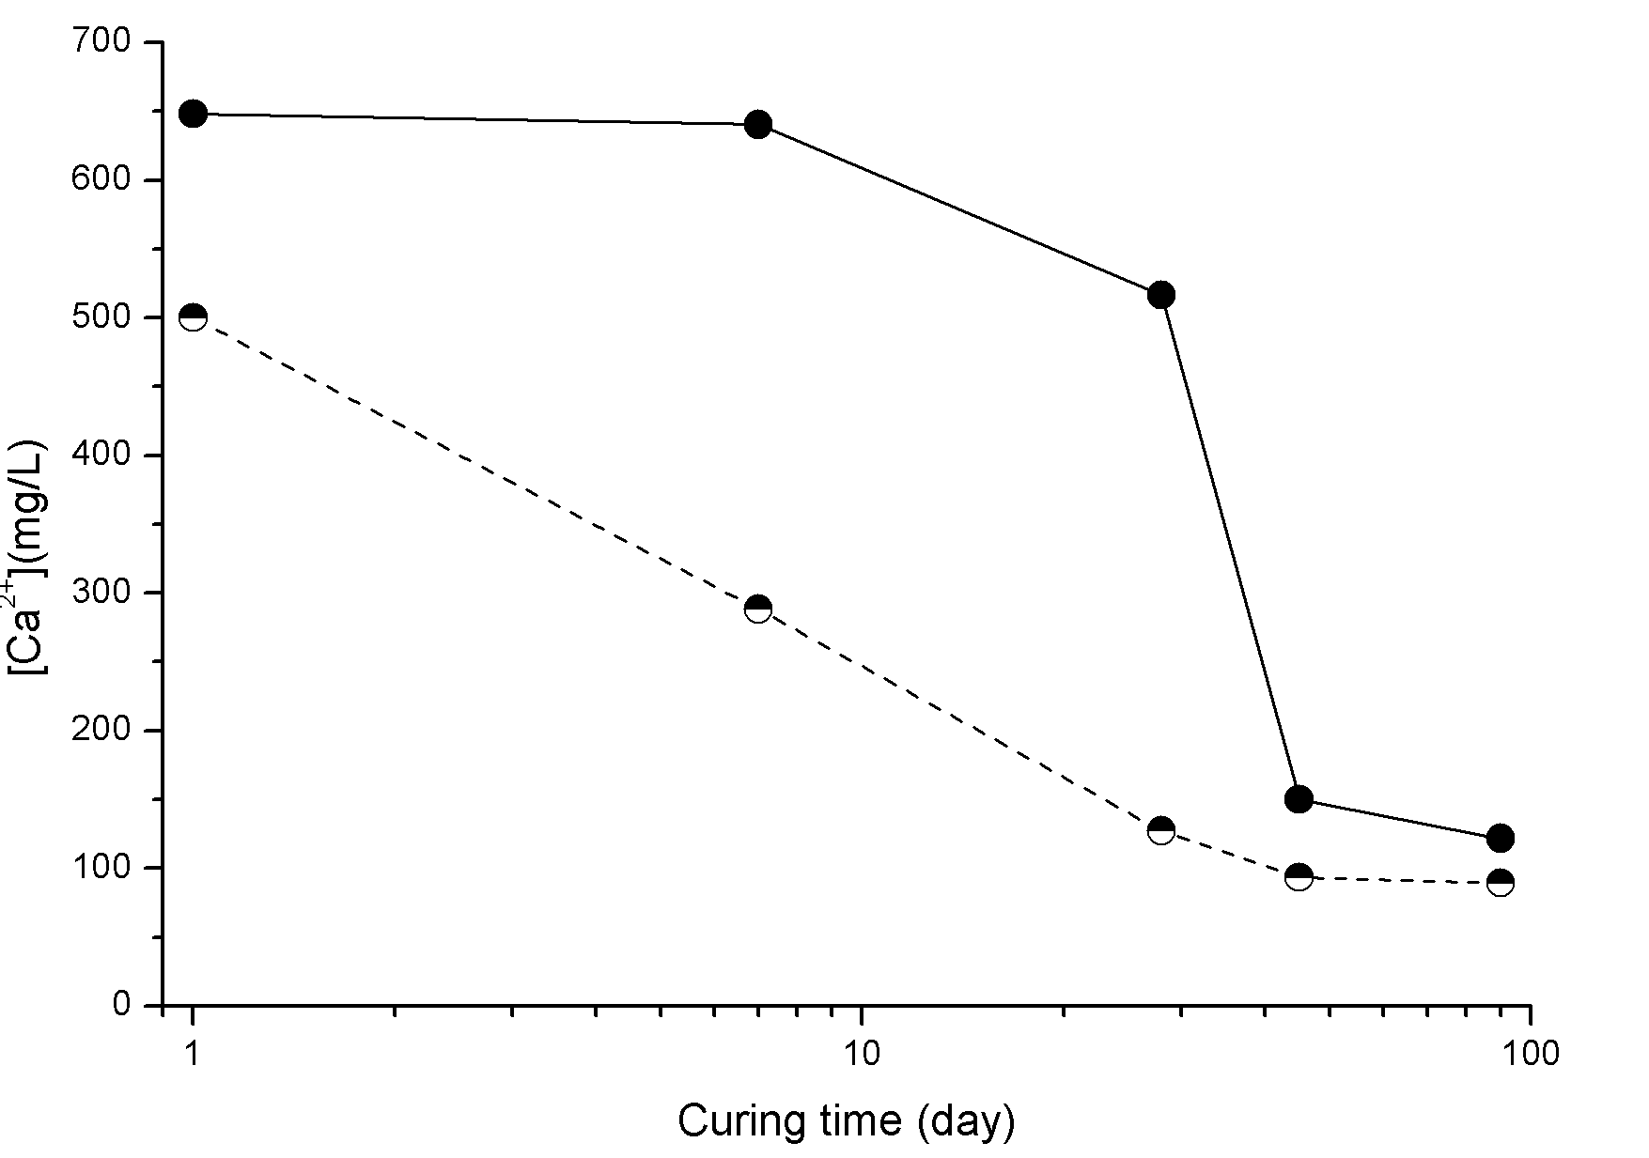
Concentration of unconsumed calcium [Ca²⁺] in mix solutions reached the minimum after 45 days
Earth+20 % CCR
Earth+20 % CCR:RHA(16:4)
28
45
Consumption of free [Ca²⁺] during the pozzolanic reaction

Slide 12
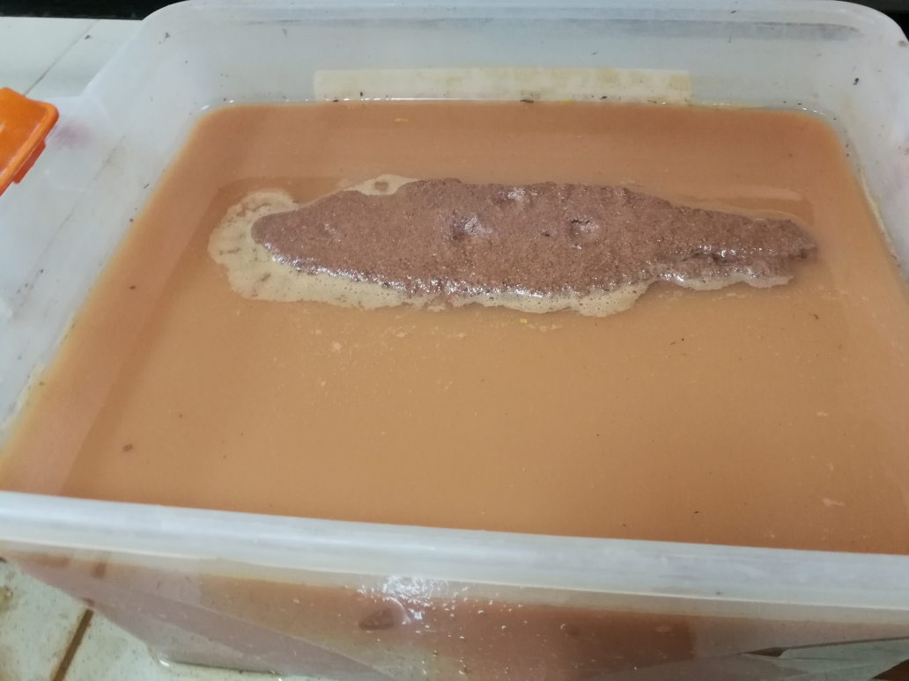
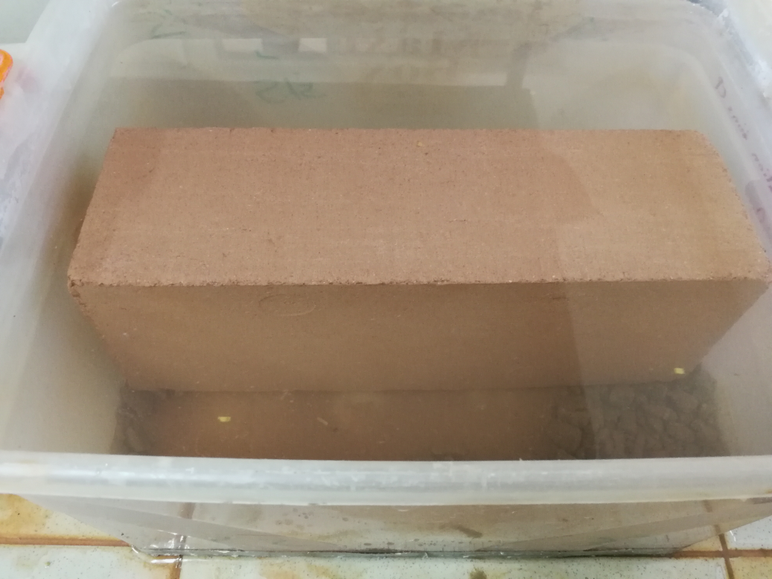
CEBs stabilized with CCR/ CCR:RHA were resistant to the degradation after 2 hours in water
Unstabilized CEBs (0 % CCR)
Stabilized CEBs (5 % CCR)
Pozzolanic reaction improved the cementation in CEBs

Slide 13
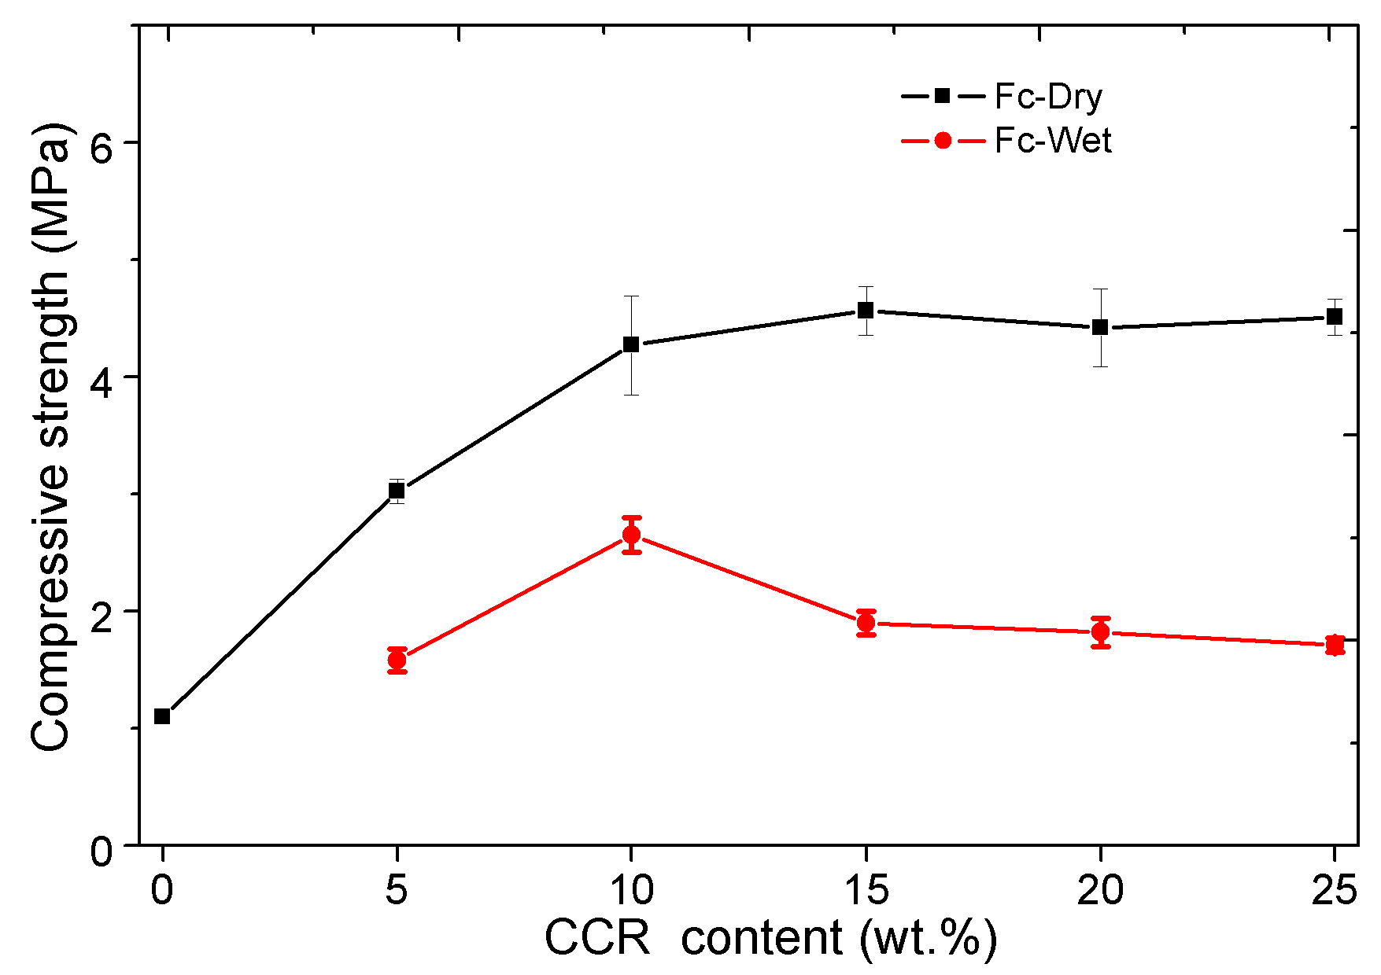
Compressive strength of CEBs was improved and reached the maximum with 10-20 % CCR
Dry
Two-torey housing
Saturated
Compressive strength required for load-bearing wall (4 MPa)

Slide 14
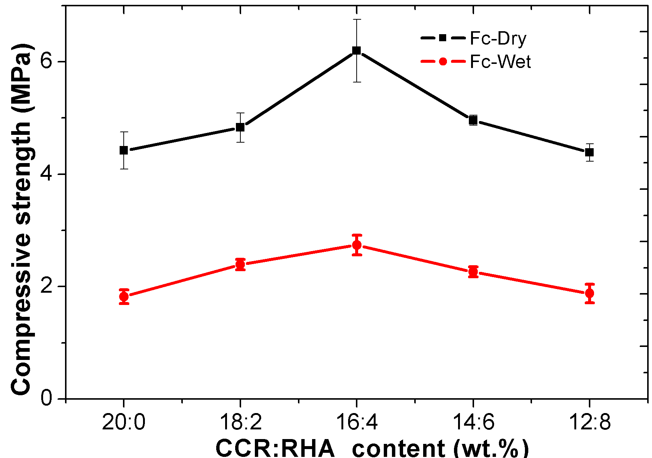
Compressive strength of CEBs was further improved with 20 % CCR:RHA in 16:4 ratio
Three-storey housing
Dry
Two-storey housing
Saturated
RHA accelerated the pozzolanic reaction resulting in occurrence of extra compressive strength (6 MPa)

Slide 15
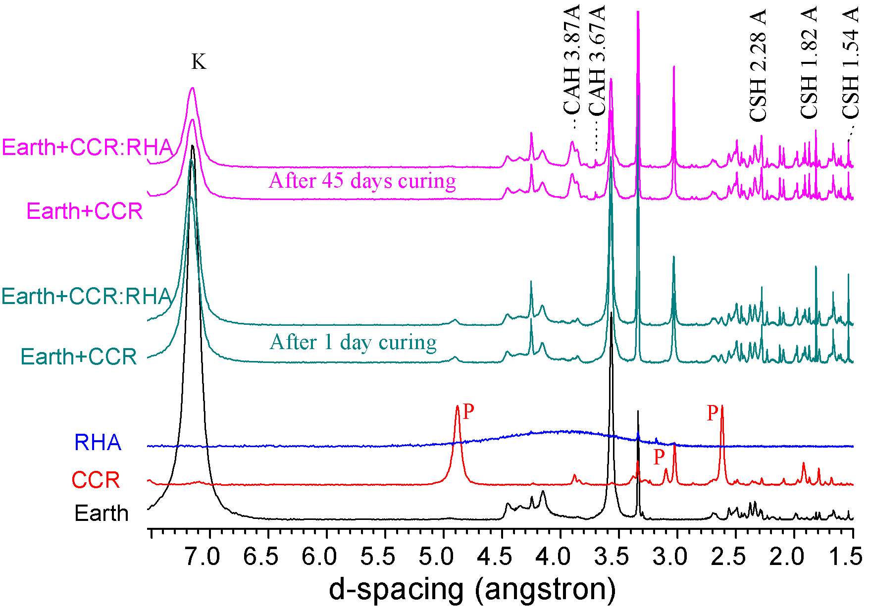
Cementitious products formed from the pozzolanic reaction between aluminosilicates and CCR
CSH: Calcium Silicate Hydrate; CAH: Calcium Aluminate Hydrate K: kaolinite; P: Portlandite (active lime)

Slide 16
CONCLUSIONS & REMARKS

Slide 17
Conclusions and studies in perspective
Hydro-mechanical performances of CEBs were improved by stabilization with by-products :
10-25 % CCR alone reaches 4 MPa required for two-storey housing;
20 % CCR:RHA (16:4) reaches 6 MPa for tree-storey housing;
Investigate the performance of stabilized CEBs at early age;
Investigate the durability of CCR/CCR:RHA stabilized CEBs
Notes:
CCR alone requires at least 45 days for curing and reaching the 4 MPa for two-storey housing construction
CCR:RHA requires 28 days for curing and imparting extra compressive strength for three-storey housing construction behaving more like cement

Slide 18
MERCI POUR VOTRE ATTENTION
PRD 2016-2021: Amélioration de la qualité de l’habitat en terre crue au Burkina Faso
philbert.nshimiyimana@2ie-edu.org
pnshimiyimana@doct.uliege.be
Skype ID: philbert.nshimiyimana

