Slide 1

Development of a new Index for Urban Air Quality as an urban design tool
FALZONE C. – Researcher
ROMAIN AC. – Professor
Sensing of Atmospheres and Monitoring
University of Liege

Slide 2
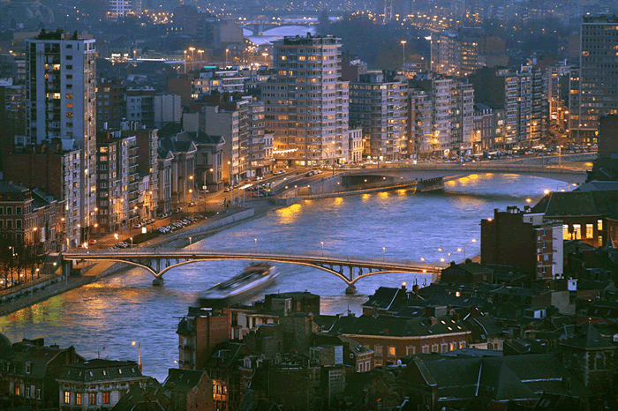
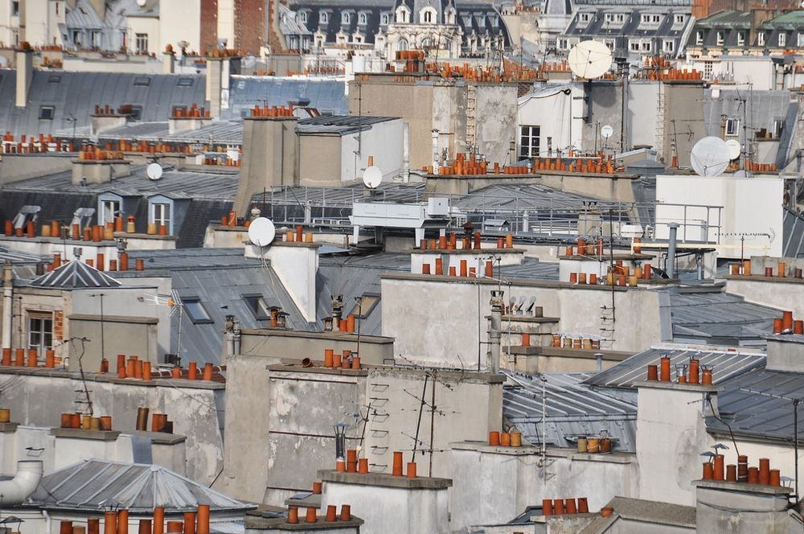

Introduction
World urban population growing every year
  http://donnees.banquemondiale.org/indicator/SP.URB.TOTL.IN.ZS
Higher activity for a given area
  Traffic
  Heating
https://thetravelcrew.files.wordpress.com/2012/06/liege.gif
depositphoto
https://maison-monde.com/petites-cheminees-toits-de-paris/
Notes:
Augmentation de 21.2% en 57 ans soit 0.9% / an
Densification de la population -> augmentation de l’activité sur une plus petite surface -> impact environnement

Slide 3

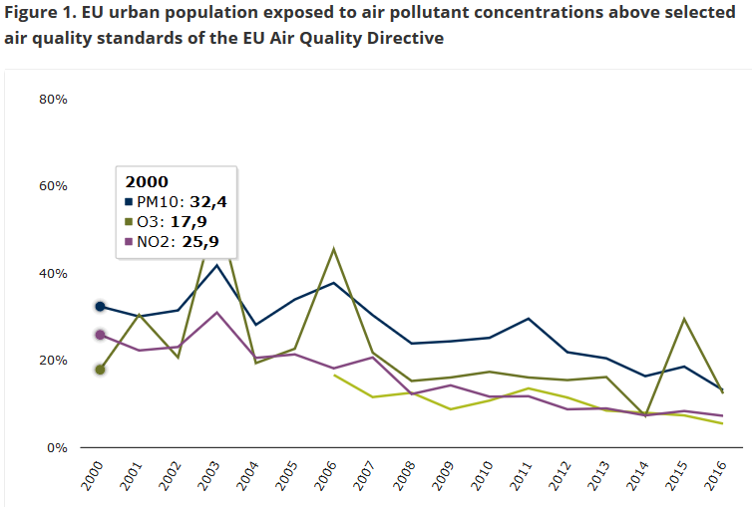
Introduction
Air quality (urban) impacts human health
Effects:
  Irritation of the respiratory tract
  Head aches
  Eyes irritation
  Lung cancer
  …
“In conclusion, for particles and nitrogen dioxide, the proportion of the urban population in the EU exposed to levels above the EU air quality standards and to the WHO guidelines has been decreasing while the trend for ozone is unclear because of the high fluctuations over time. However, because of the widespread exceedance levels in urban areas it is unlikely that the air quality standards for these pollutants will be met by 2020 across the EU, while achieving air quality in line with the WHO guidelines is much further away (except for NO₂ for which the EU standard and the WHO guidelines are the same).
Effective air quality policies require action and cooperation at global, European, national and local levels, which must reach across most economic sectors and engage the public (EEA, 2018a). This has been recognised by the European Commission in its latest Communication ‘Clean Air for all’ (EC, 2018). Holistic solutions must be found that involve technological development, structural changes — including the optimisation of infrastructures and sustainable urban planning — and behavioural changes. These will be necessary to deliver a level of air quality across the EU that is more conducive to the protection of human health (EEA, 2016).”
Notes:
https://www.eea.europa.eu/publications/europes-urban-air-quality
Lignes OMS
NO₂ 200 / 1h ; 40 / 1an
O₃ 160 / 1h (info); 240 / 1h (alerte); 100 / 8h
PM₁₀ 50 / 24h; 20 / 1h
PM_{2.5} 25 / 24h; 10 / 1h

Slide 4
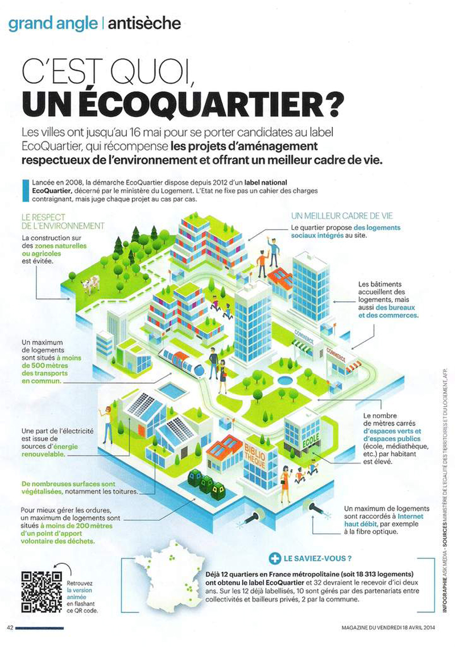
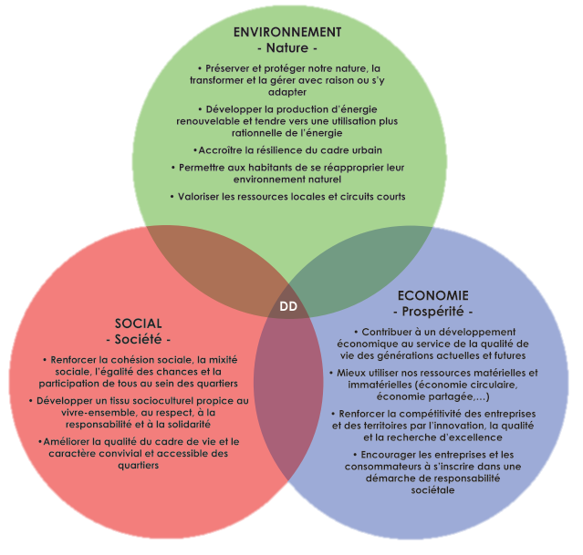
Introduction
Development of eco-neighbourhood
  http://spw.wallonie.be/dgo4/site_colloques/QuartiersNouveaux/assets/documents/referentielQN.pdf
http://carte-education.fr/wp-content/uploads/CM2-Geographie-3.3-3.jpg
Notes:
Développement des zones urbaines en quartiers reposant sur 3 piliers. Cette thèse est s’inscrit dans la partie environnement avec le développement d’un outil d’aide à la décision concernant la qualité de l’air

Slide 5
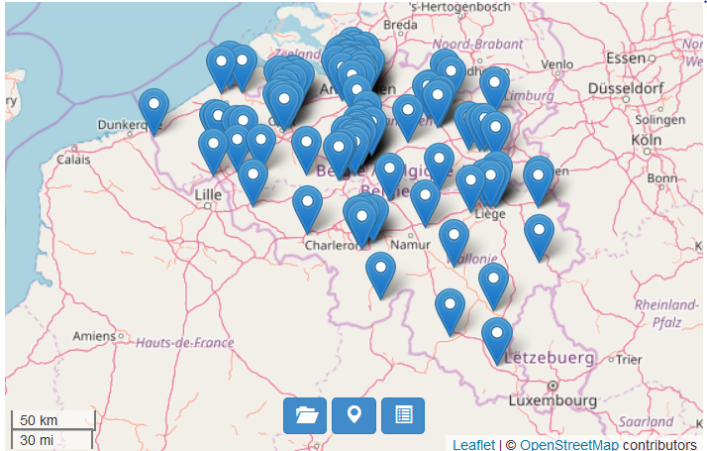
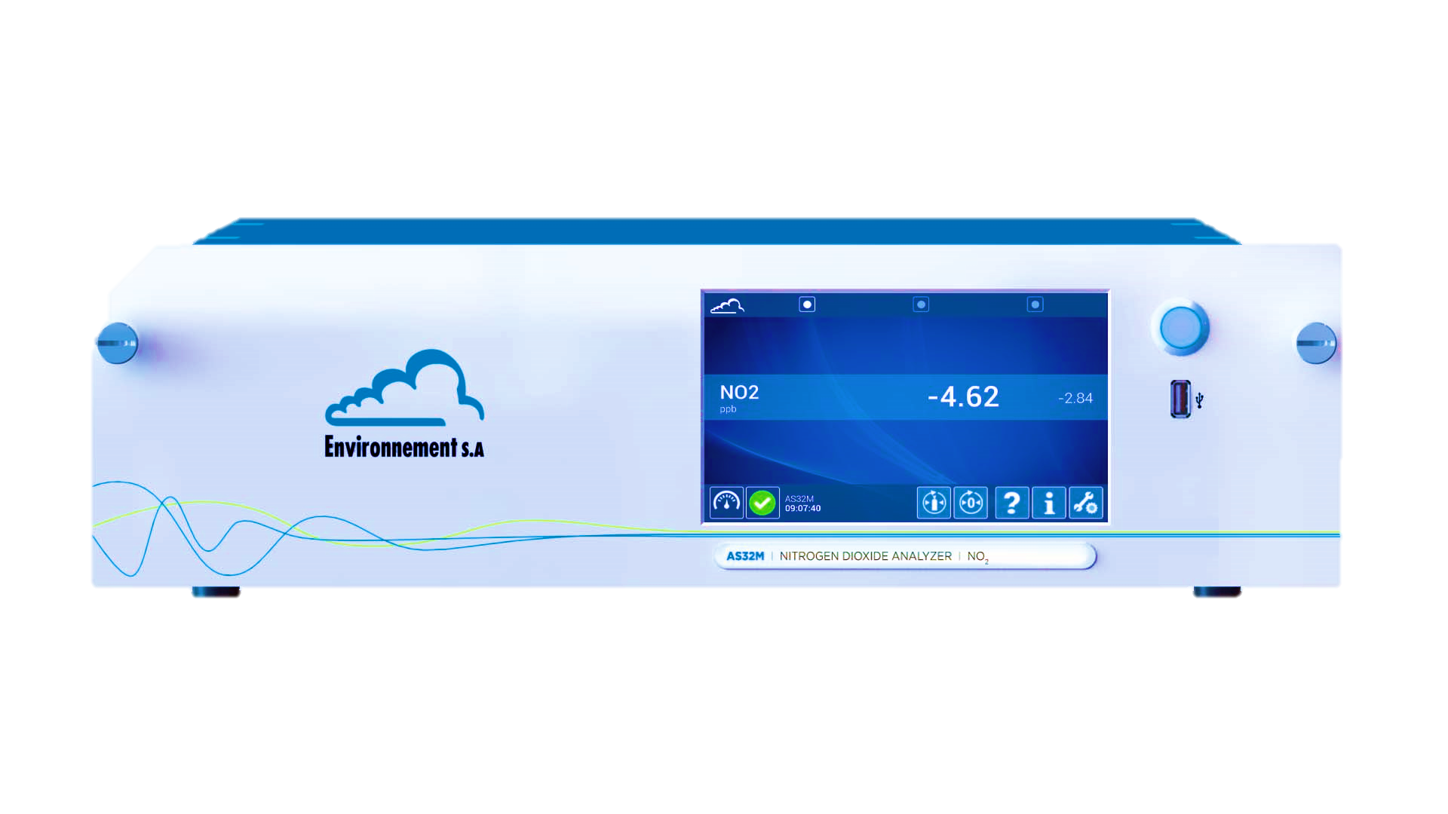
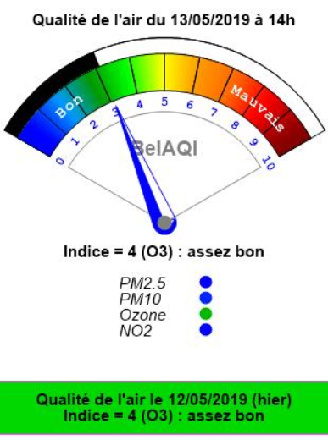
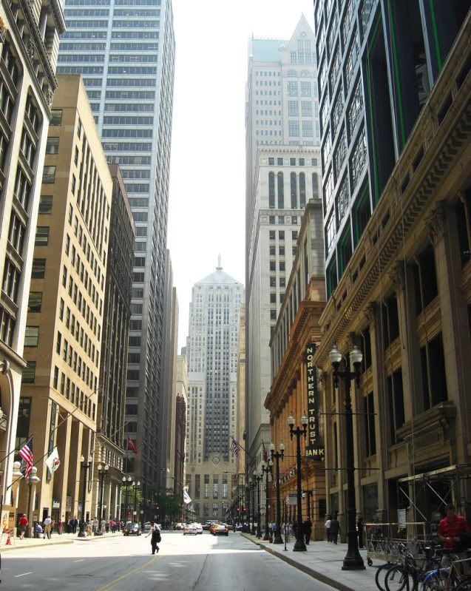
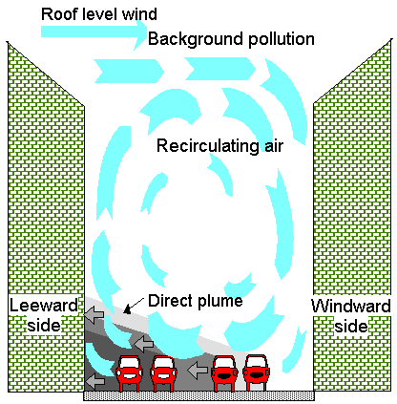
Introduction
  Air quality monitoring
  Telemetric network
    Analysers
  BelAQI (Belgium)
    NO₂; O₃; PM₁₀; PM_{2.5}
  Quid local pollution ?
https://i.pinimg.com/736x/4e/69/0d/4e690dc5653d23bf59b13db42add9094.jpg
http://ibis.geog.ubc.ca/courses/geob370/students/class13/bho/
Notes:
Comment est mesuré la qualité de l’air, information au public, innovation de plateformes multi-capteur à base de capteurs bons marchés. Un réseau de ces plateforme revient cher (plateforme fait maison 1500€ pour 6 polluants, commerce 5000€ pour 3 polluants)

Slide 6
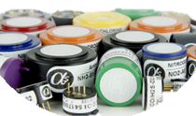
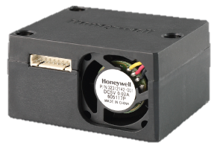
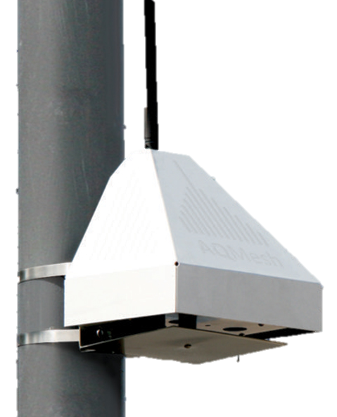

Introduction
  Solutions
  Low-cost sensors
  Electrochemical sensors
    Optical sensors
    …
  Low-cost sensors network
    Multi-sensors platform
M.I. Mead et al. / Atmospheric Environment 70 (2013) p.186-203
Notes:
piD
Comment est mesuré la qualité de l’air, information au public, innovation de plateformes multi-capteur à base de capteurs bons marchés. Un réseau de ces plateforme revient cher (plateforme fait maison 1500€ pour 6 polluants, commerce 5000€ pour 3 polluants)

Slide 7
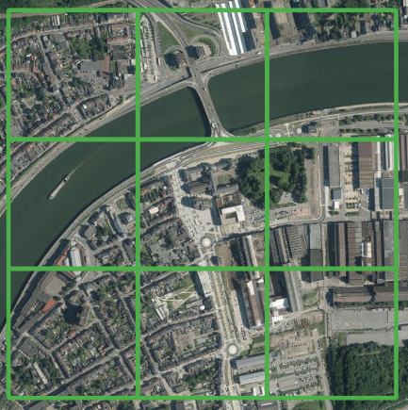
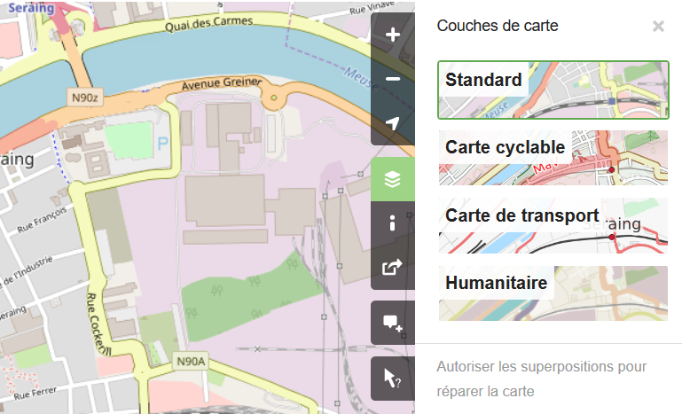
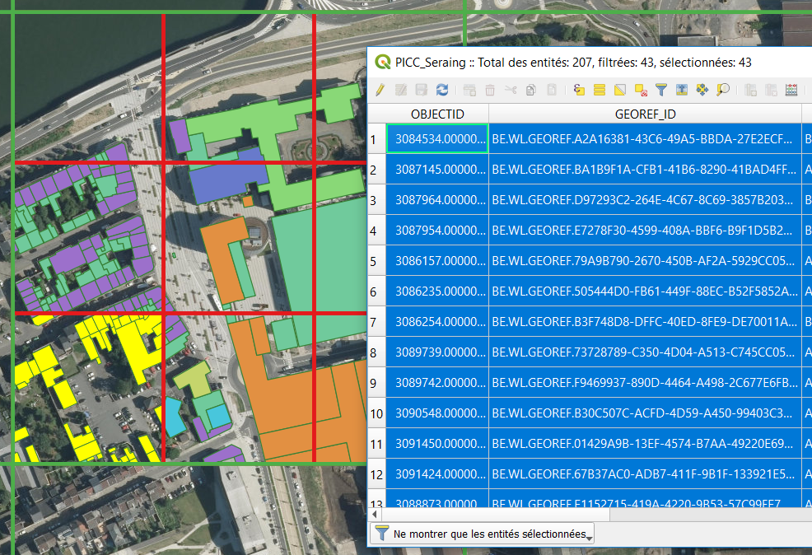

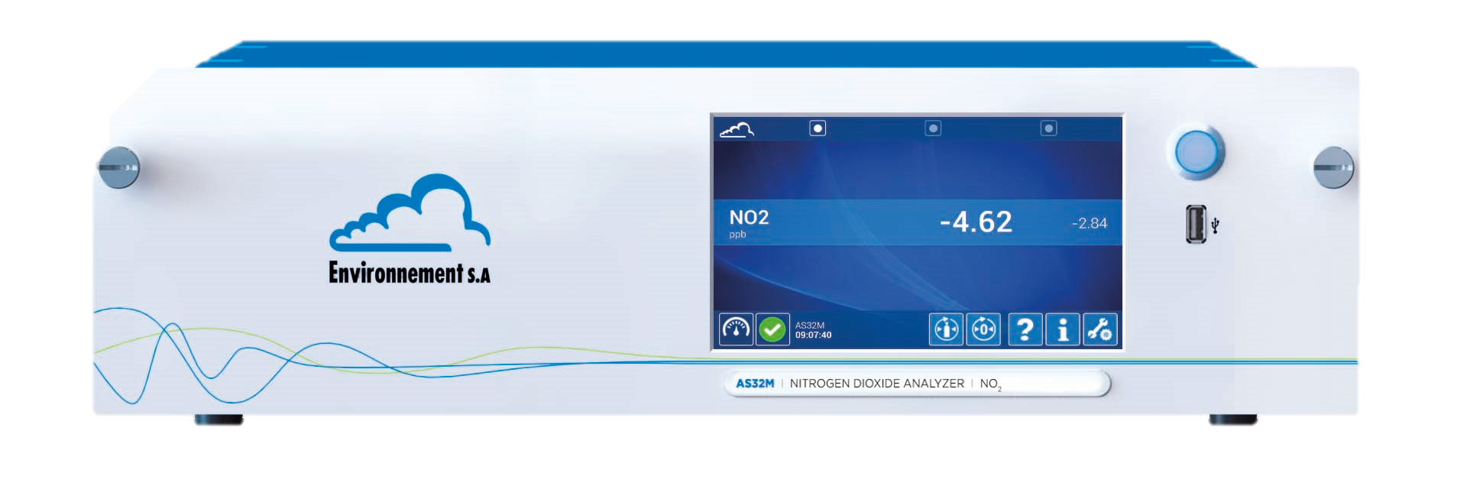
Objective
Development of an air quality state index
Represents a state index
For small area
Built on an open access database
  Internet
  GIS extraction
Drivers
Responses
900 m
Cause
Policies and targets
900 m
Pressures
Impact
Pollutants
Health, ecosystems, materials
State
  e.g.: Open Street Map
Quality
Independent of the pollutant measurement at short term

Slide 8

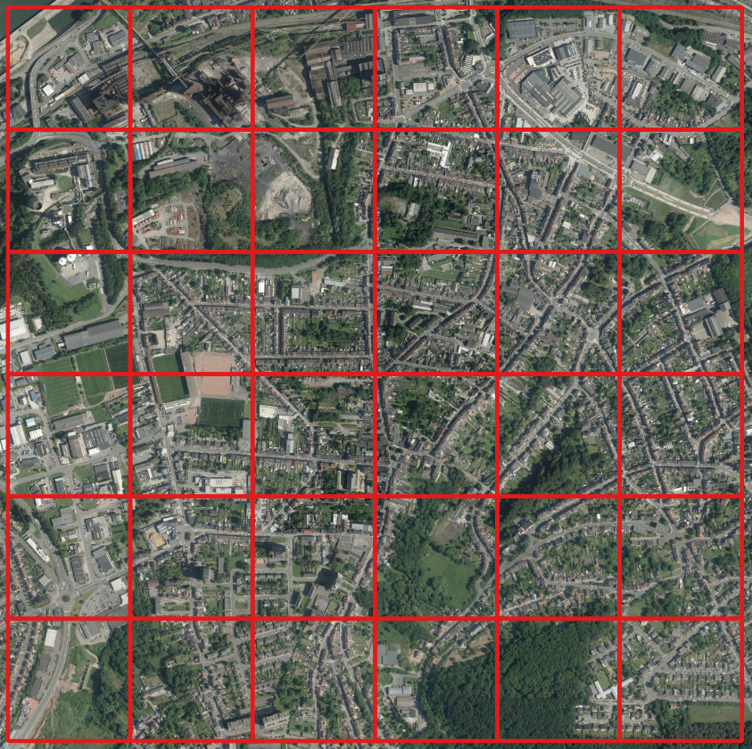
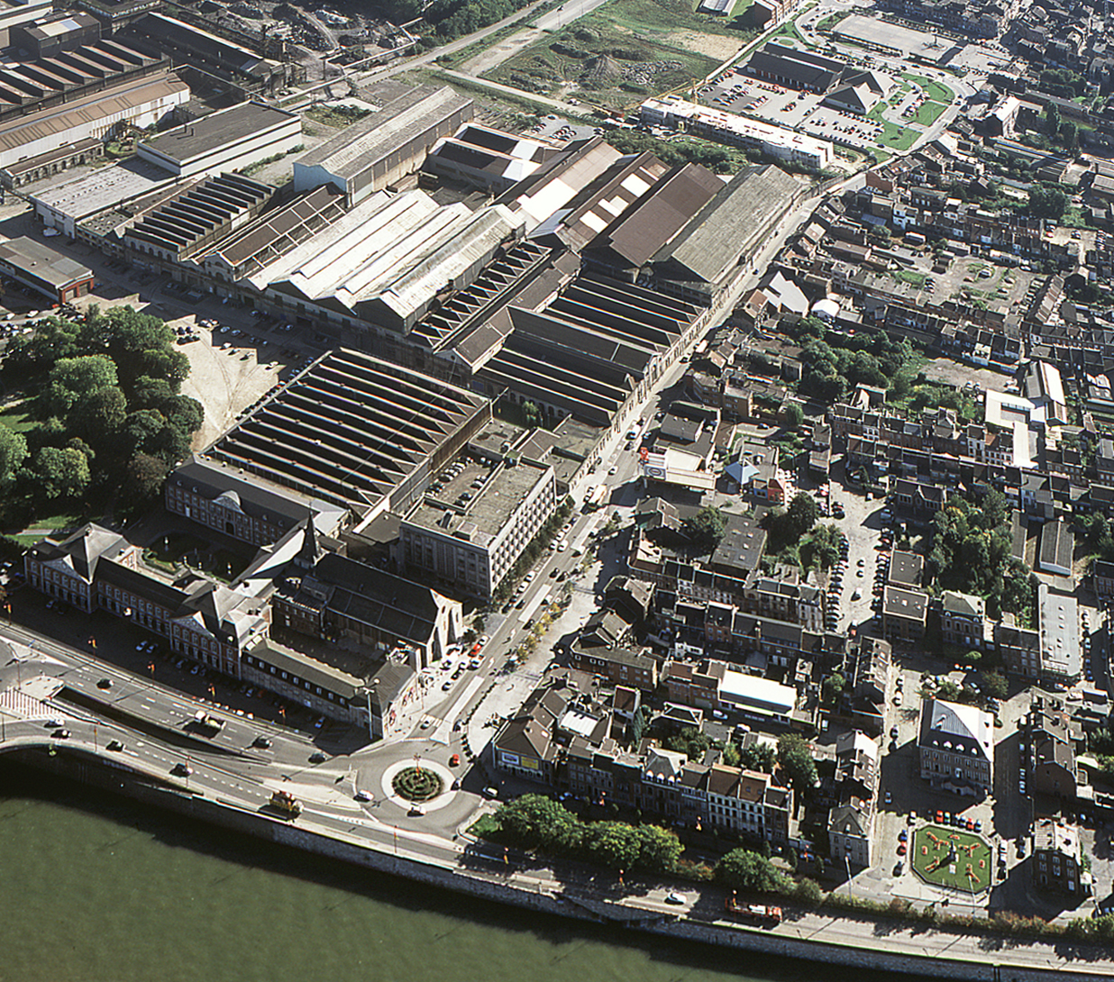
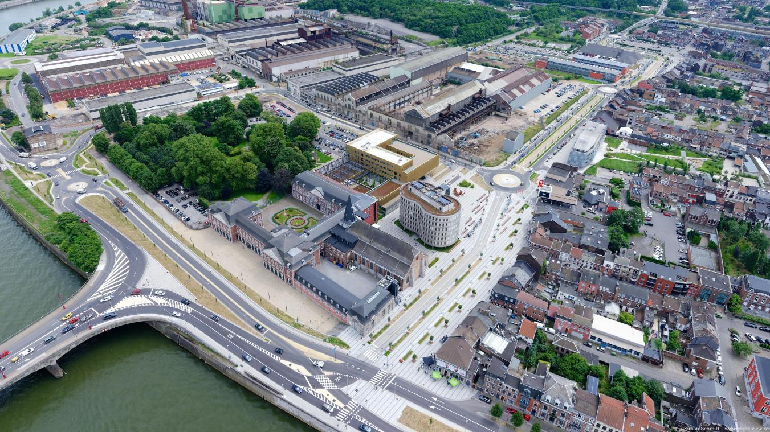


Objective
Applications
  Chose a place for a new urban project
  Comparison of a site over time
Seraing
1800 m
Before
After
1800 m
Notes:
Développer un indicateur faible coût avec mise en évidence de niches.
Finalité choix d’un site ou comparaison temporelle

Slide 9


Material
  Open access database
      WalOnMap (Projet Informatique de Cartographie Continue)
      BelAQI
      Industrial emissions (IED)
      GIS calculation (e.g.: area)
      List of carcinogenic pollutants (IARC)
  Software
    QGIS (v3.6.0)
    Access 2016
    Rstudio (v3.4.1)
    Elyx3D
    Envi-MET (v4.4.2)
Notes:
Equivalent Français :
Plateforme ouverte des données publiques françaises
Indice Atmo

Slide 10

Results - AQOI
  Structure
Each parameter interacts with the wind direction
Parameters composed by variables
Topography
Building
Road
Vegetation
IED + Road
Dispersion
Sources
AQOI
AQOI :
Air Quality Observed Index
Notes:
Indicateur sur une base annuelle

Slide 11
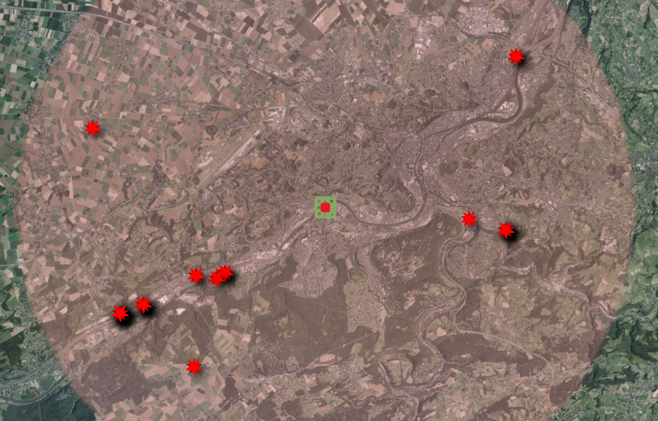
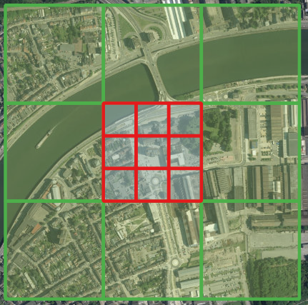

Results - AQOI
  Study area:
Area where industrial sources are taken into account
15 km
External traffic grid
300 m
IC (9 s-IC)

Slide 12
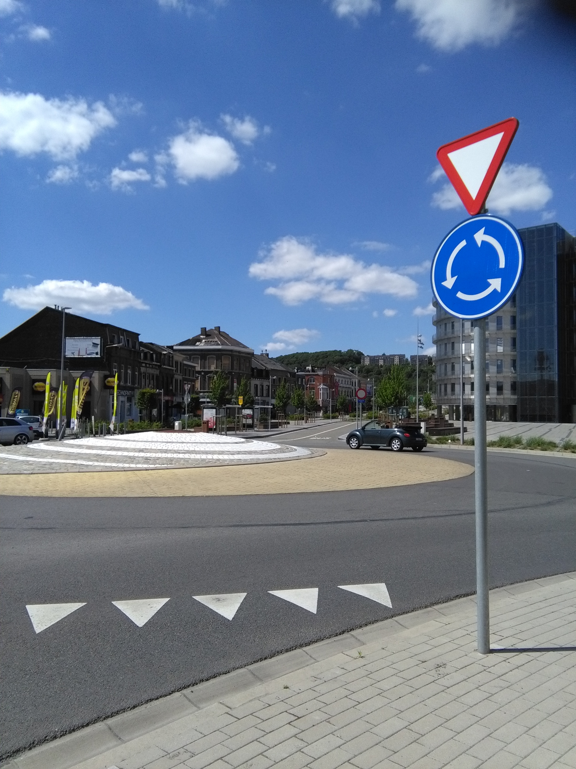
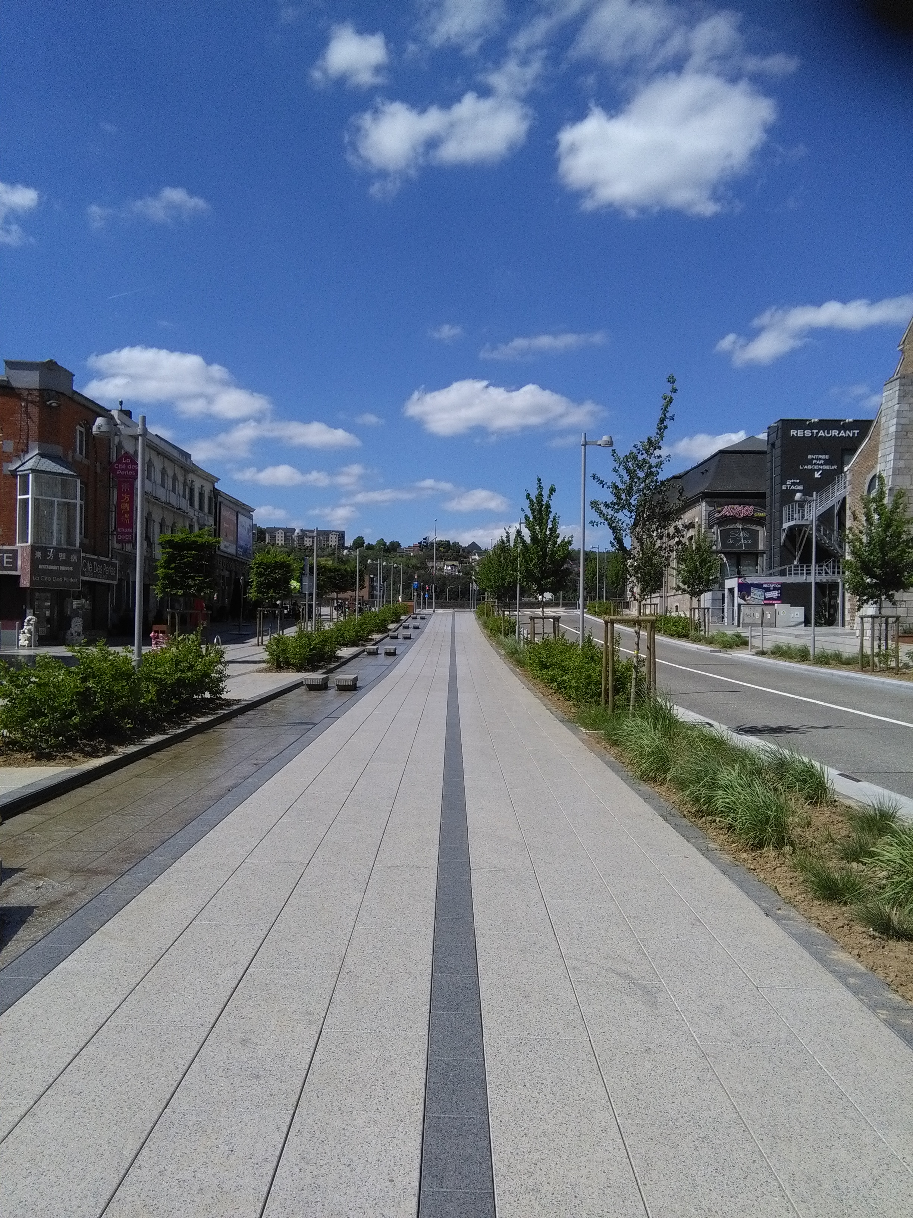
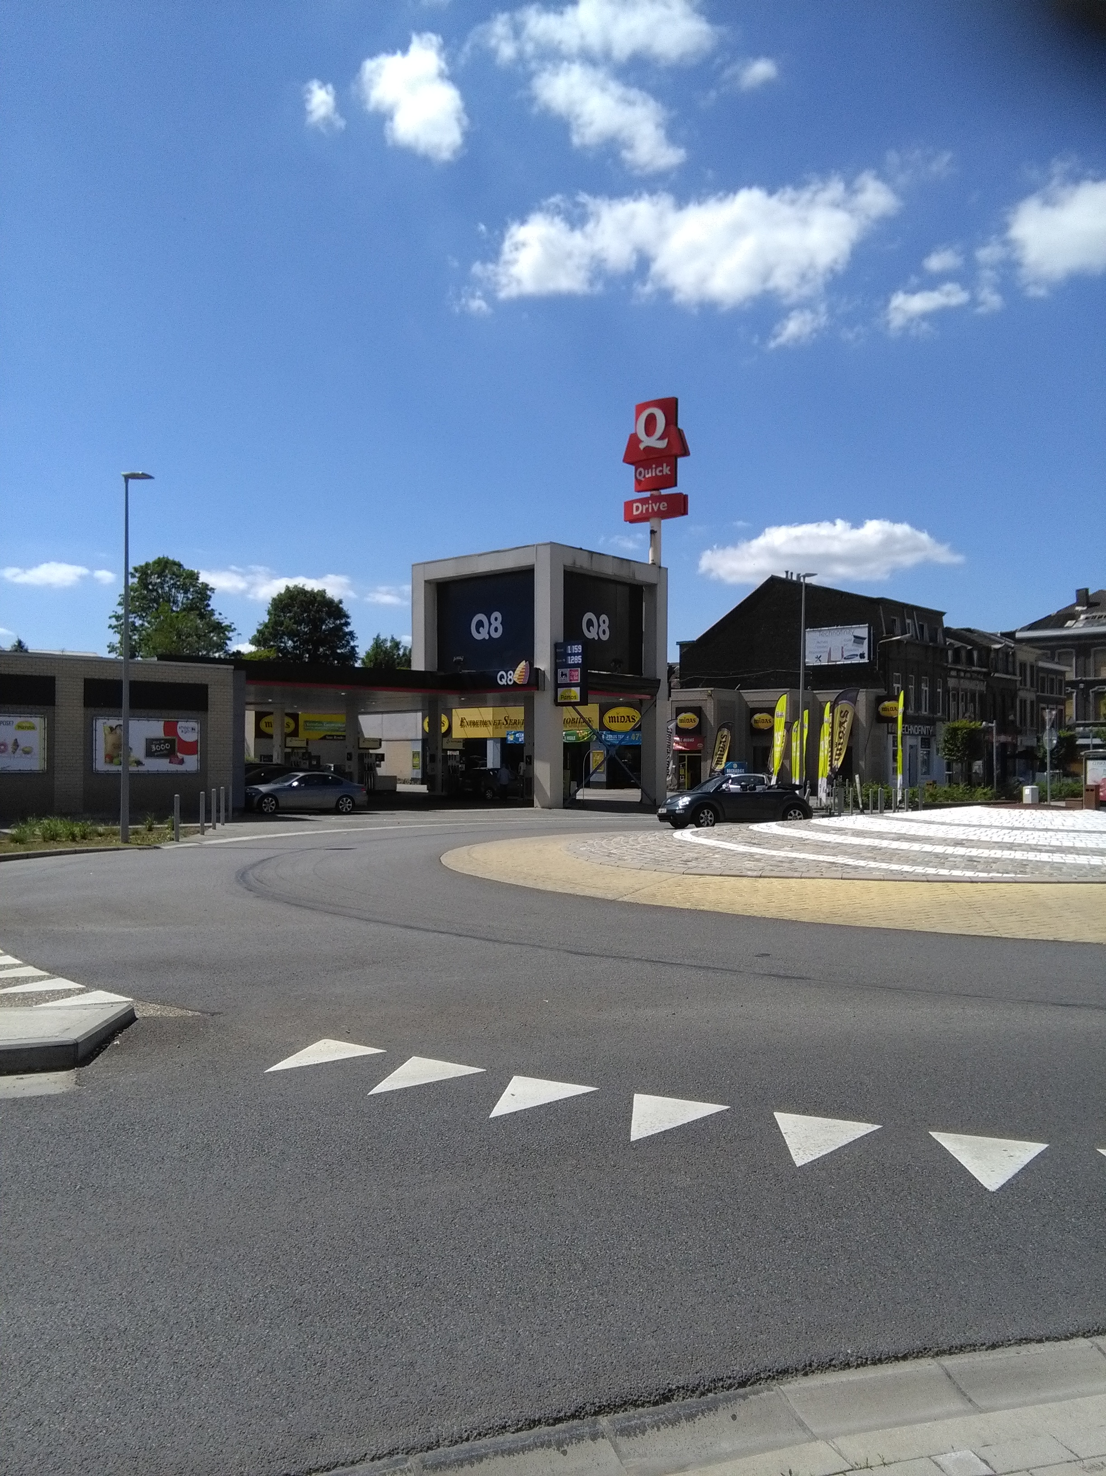
Results - AQOI
  First step:
Inventory of features
  Observed variables (e.g.)
Seraing (Liège, Belgium) – pilot site for EcoCityTools project
Notes:
Identification des variables d’intérêt sur site.
Exemples : végétation, station service, arrêt…

Slide 13
Results - AQOI
  Second step:
GIS extraction
  Referenced variables (e.g.)
« Le PICC reprend selon leurs coordonnées x, y, z, avec une précision inférieure à 25 cm, tous les éléments identifiables du paysage wallon :
Bâtiments et ouvrages d'art ;
Équipements (taques, poteaux, pylônes, etc.);
Réseau ferroviaire ;
Réseau hydrographique ;
Occupation du sol (arbres isolés, lisières, terrains de sport, etc.) ;
Éléments du relief (talus, etc.) ;
Voiries (axes, bords, trottoirs, etc.).
Depuis décembre 2014, le PICC couvre toute la Wallonie. »
http://geoportail.wallonie.be/catalogue/b795de68-726c-4bdf-a62a-a42686aa5b6f.html
Notes:
Type de variables pouvant être extraites

Slide 14
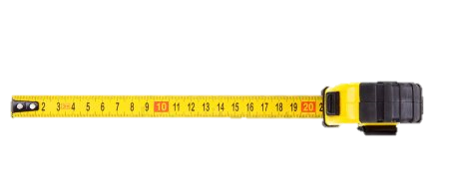



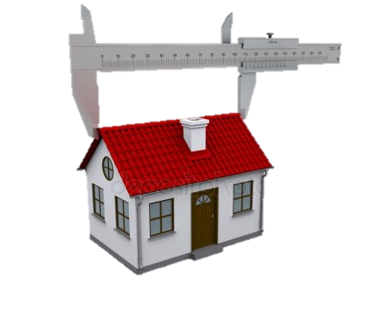
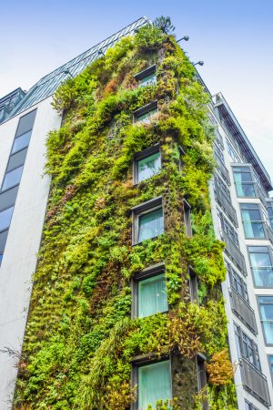
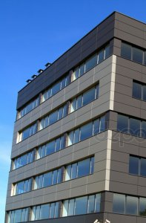

Results - AQOI
  Third step:
Listing of proxy variables
      Metric
      Absence / presence
      Listing
      Listing with classification
Position
North
East
West
South
…
e.g. Dimension
e.g. Green wall
e.g. Position in IC
e.g. Building affectation
Images : Depositphotos

Slide 15
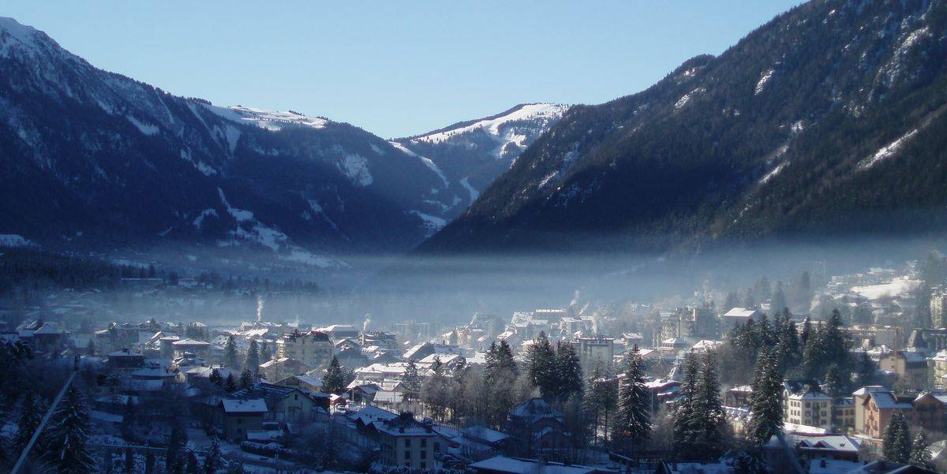
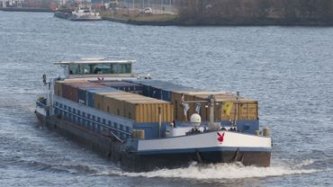
Results – AQOI
Topography Parameter
Variables | Type | Examples
Relief |  | Pollutants concentration is different between top and bottom of a valley
Waterway |  | River traffic
Notes:
Pied du Mont-Blanc vallée de l’Arve
Relief – variable classe (vallée – flanc -…)
Voie navigable – absence/présence
Affectation – variable classe
Position – variable classe (seule inutile, à croiser avec vent)
Hauteur – variable métrique
Chauffage – variable classe (bois, pellet…)
Murs végétaux – absence/présence
Galerie – absence/présence

Slide 16
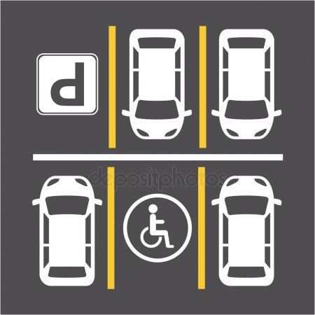
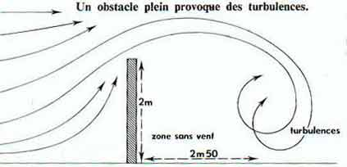
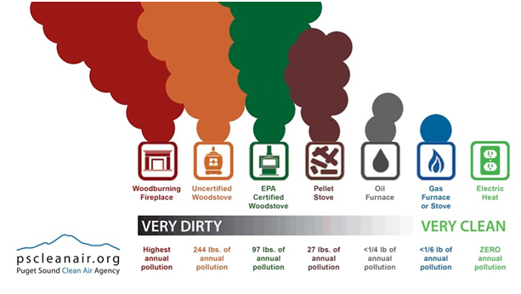
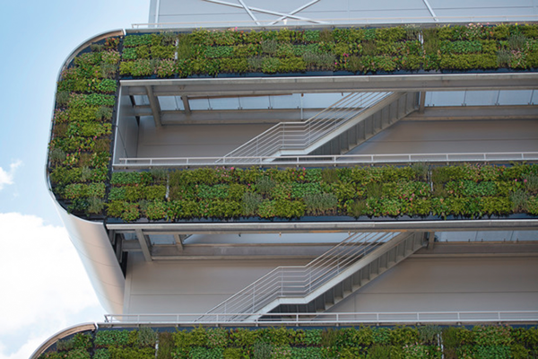
Results – AQOI
Building parameter
Variables | Type | Examples
Affectation |  | More traffic for a hospital than for a house
Position in IC |  | Wind from the North coupled with a building located in the North IC  Pollutants stay out of the IC Wind from the North coupled with a building located in the South IC  Pollutants stay in the IC
Height |  | Screen effect affected
Heating system |  | Wood emits more PM than gas
Green wall |  | Local action
Gallery |  | Pollutants trap
Y-d. Huang and al. / Journal of Hydrodynamics 28 (2016) p.801-810
http://arrosoirs-secateurs.com/Protection-contre-le-vent-dans-un
Notes:
Pied du Mont-Blanc vallée de l’Arve
Relief – variable classe (vallée – flanc -…)
Voie navigable – absence/présence
Affectation – variable classe
Position – variable classe (seule inutile, à croiser avec vent)
Hauteur – variable métrique
Chauffage – variable classe (bois, pellet…)
Murs végétaux – absence/présence
Galerie – absence/présence

Slide 17
Results – AQOI
Road Parameter
Variables | Type | Examples
Width |  | H/W ~= 1 regular canyon
Height |  | H/W ~= 1 regular canyon
Orientation |  | Wind from the North coupled with a street facing North  Pollutants are driven off the street Wind from the North coupled with a street facing East  Pollutants remain on the street
Classes |  | Higher traffic density on a national highway than on a residential street
Stop |  | Stopped vehicles emit pollutants over a longer period of time
S. Vardoulakis et al. / Atmospheric Environment 37 (2003) 155–182
Notes:
Affectation – variable classe (vouée à disparaitre)
Largeur et hauteur – variables métriques
Orientation – variable classe (couplée au vent)
Classe – variable classe
Arrêt – absence/présence

Slide 18
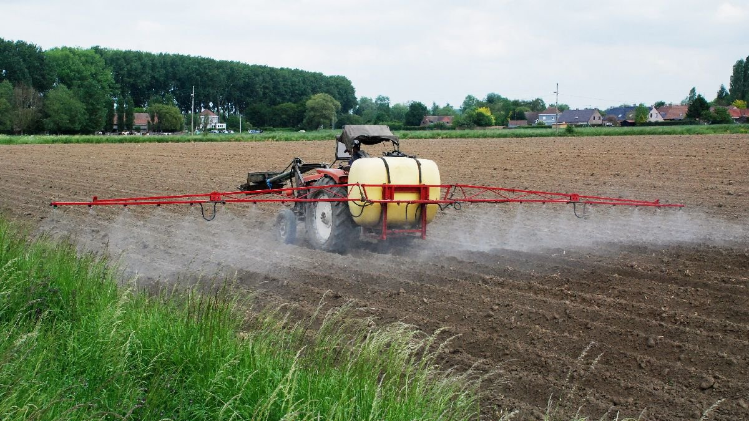
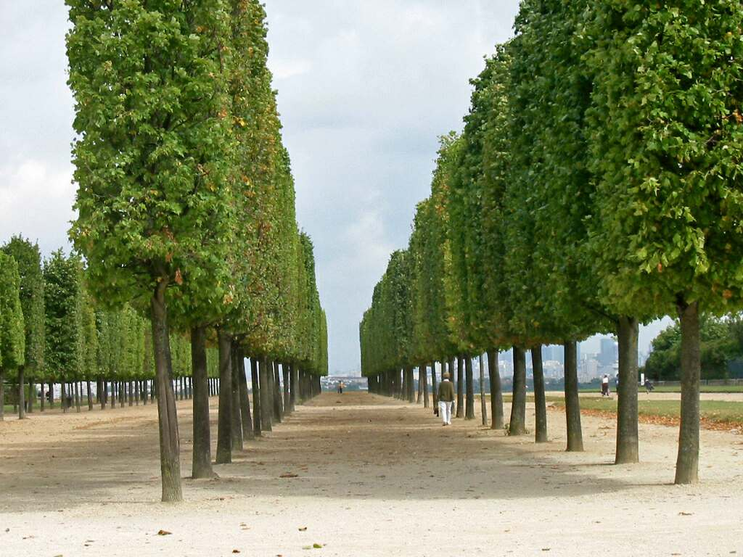
Results – AQOI
Vegetation Parameter
Variables | Type | Examples
Type |  | Local depollution by trees ; Agriculture contribution to pollution
Canopy |  | Large canopy traps pollutants under the tree
Disposition |  | No screen effect for a single tree while for grouped trees yes
Height |  | Screen effect affected
Deciduous leaf |  | The leaves act on the environment
Position in IC |  | Same as building parameter
Orientation |  | Wind from the North coupled West-East linear disposition  Screen effect Wind from the West coupled West-East linear disposition  No Screen effect
Allergenicity |  | Birch is more allergenic than beech
www.airallergy.be
K.V. Abhijith et al. / Atmospheric Environment 162 (2017) 71-86
Notes:
Type – variable classe
Type canopée – variable classe
Disposition – variable classe
Hauteur – variable métrique
Autre – variables classes
Allergénicité – variables classes et métrique

Slide 19
Results – AQOI
External sources Parameter
Variables | Type | Examples
IED - Distance from IC |  | An industry located 15 km away will be less likely to impact the IC than an industry located 500 m away
IED - Pollutants emitted |  | Not all emitted pollutants have the same impact on health; some are carcinogenic (cf. IARC)
IED – Quantity of pollutants |  | The quantity emitted impacts health
Road - Orientation |  | Wind from the North coupled with a street facing North  Pollutants are driven off the street Wind from the North coupled with a street facing East  Pollutants remain on the street
Road - Position around IC |  | Wind from the North coupled with a North facing street located North of IC  Pollutants enter the IC Wind from the North coupled with a North facing street located South of IC  Pollutants don’t go in the IC
Notes:
Gamme valeur AQOI 0 à 5.
Engis 2.6502
Seraing 2.1336
Jemeppe 1.8967
Boncelles 1

Slide 20
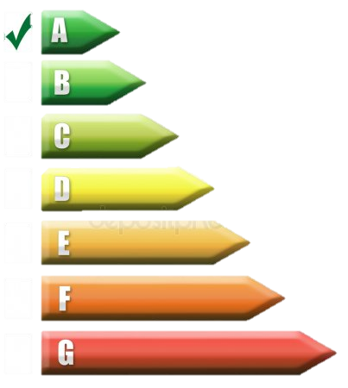
Conclusions and perspectives
  Done
  In progress
  Variables
Identification based on
  Data relevance
  Accessibility # Low-cost
Values determined according to the impact on air pollution
Integration of parameters to calculate AQOI
  Build a classification based on worst and best situation for each parameters
Validation
  By measurement of pollutants integrated over a long period of time
Optimisation based on the validation results
Integration into GIS through heat map
  Parameters
Clustering of variables
  Easy encoding
  Used for urban planning
Values
  Matrix of interaction between several variables
Notes:
Identification : pertinence des données, accessibilité (ex: IED/santé;
Groupement de variables: facilité d’encodage, cible différent champs de la planification urbaine

Slide 21


EcoCityTools Project
Funding: Wallon Region
Thank you for your attention

