Slide 1
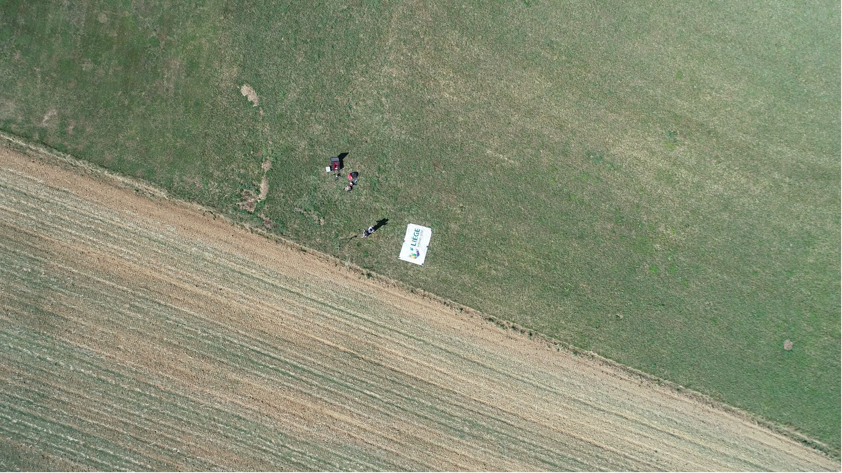
Spatial modelling of weeds and crop growth in century-old charcoal kiln sites with integration of high and very high resolution remote sensing
University of Liege – Arlon Campus Environment
. September 2018
Ramin Heidarian Dehkordi

Slide 2

Outline
Story of the UAVs
PhD research

Slide 3




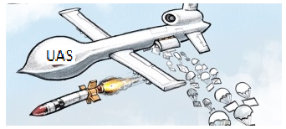

UAV
Drone: Dynamic Remotely Operated Navigation Equipment
UAV: Unmanned Aerial Vehicle
UAS: Unmanned Aerial System

Slide 4
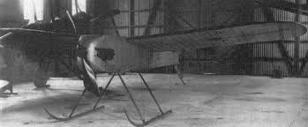
UAV
Definition
    An aircraft without a human pilot onboard
    Remotely controlled by a pilot (or autonomous software) on the ground
Pioneer
    “Aerial Target” in 1916
    Royal Aircraft Factory, in Putnam
    As a flying bomb

Slide 5
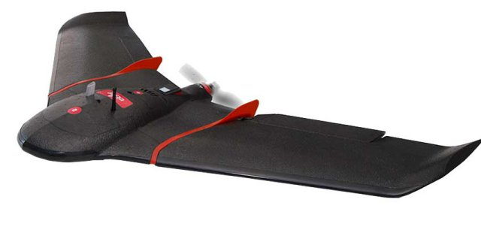
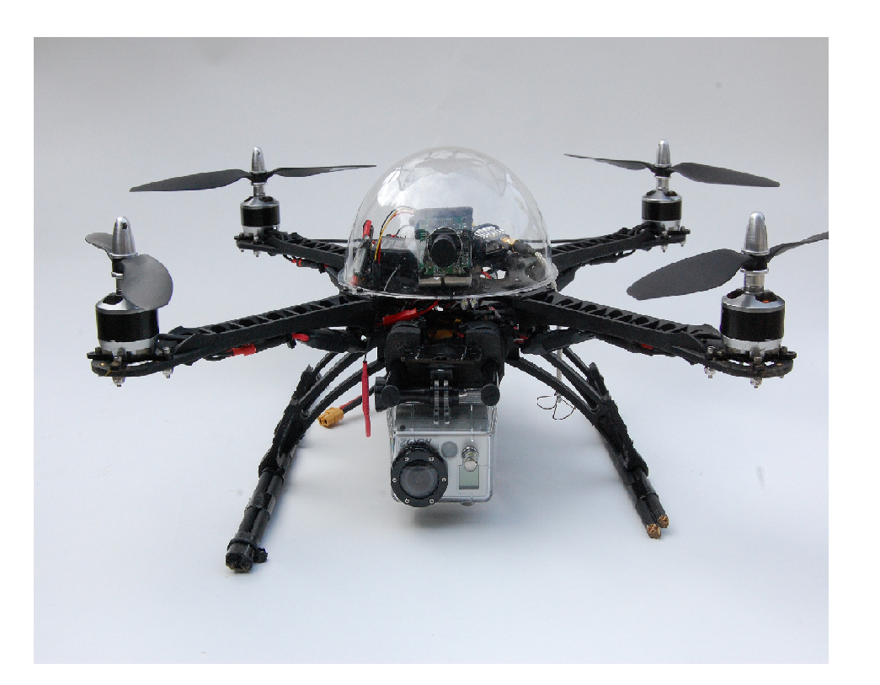
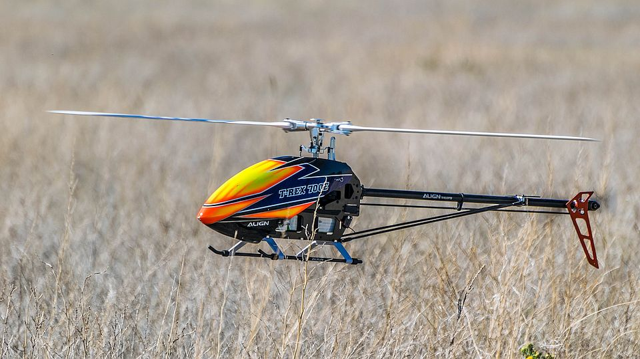
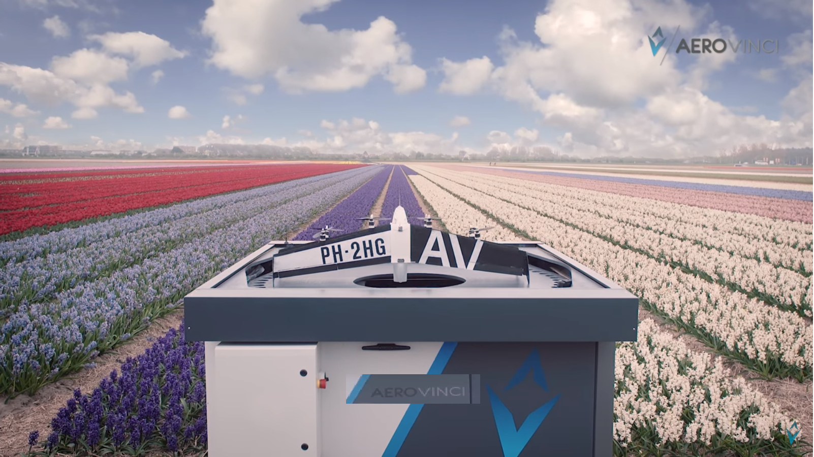
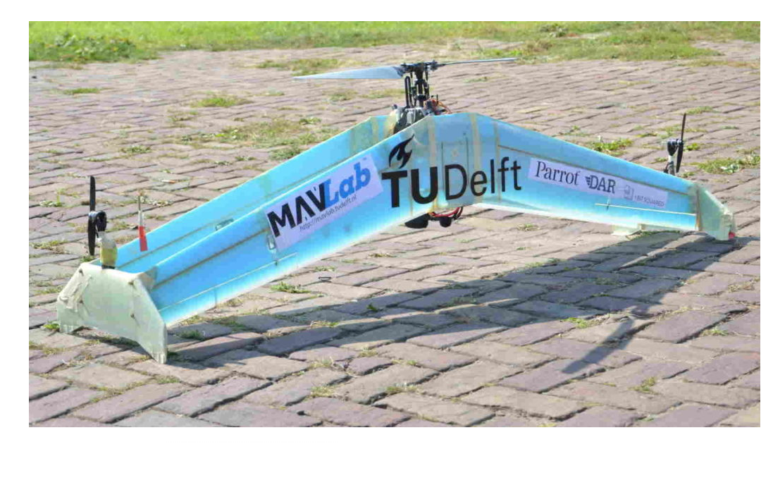
UAV
Types of UAVs
Fixed-wing: uses wings (like an airplane) to provide the lift
      suitable for large-scale areas
Multi-copter: more stable, cost effective
Single-rotor: like helicopters in manned aviation
Hybrids Fixed-wing: vertical takeoff & landing mechanism
fully autonomous
are still under development

Slide 6
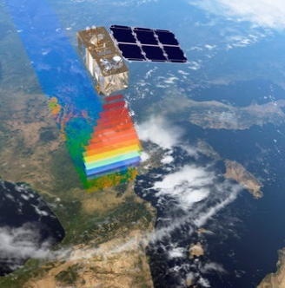
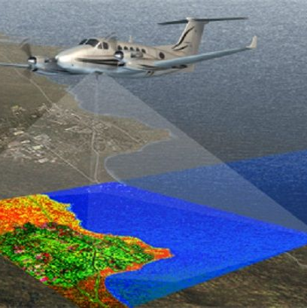
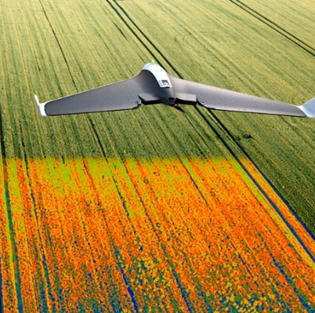
UAV
Hierarchy of Earth observation
Altitude
Footprint
Space-borne imagery
Airborne imagery
Manned
Unmanned
GSD

Slide 7
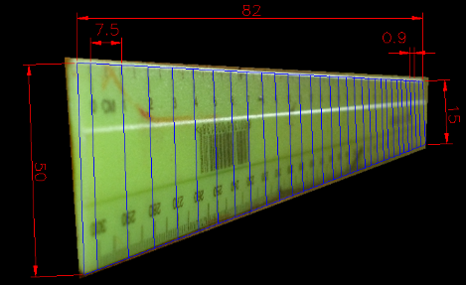
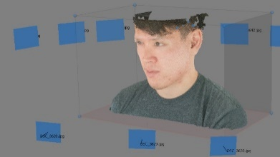
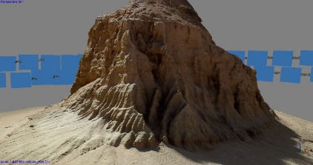
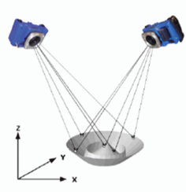
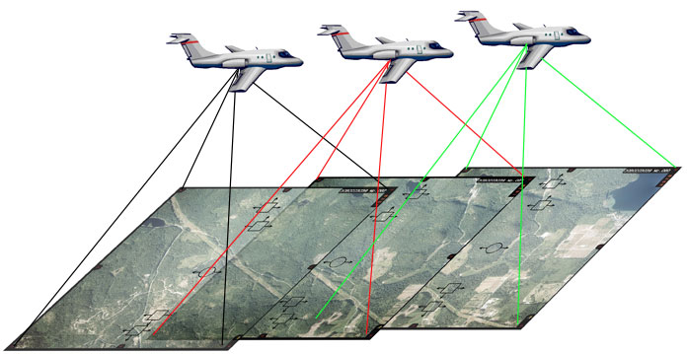
UAV
Airborne remote sensing
Photogrammetry
  science of making measurements from photographs
(size, shape, geographic position)
  Reconstructing the geometry of the photographed surface
Stereo-photogrammetry
  Same features from different angles in different photos
  Paired overlapping photos, distorted in a different way
  3D coordinates reconstruction

Slide 8
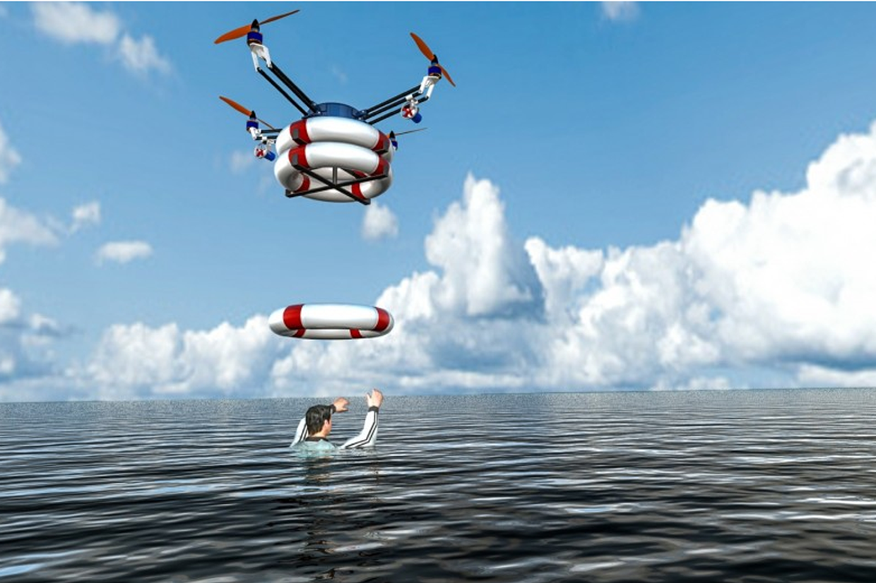
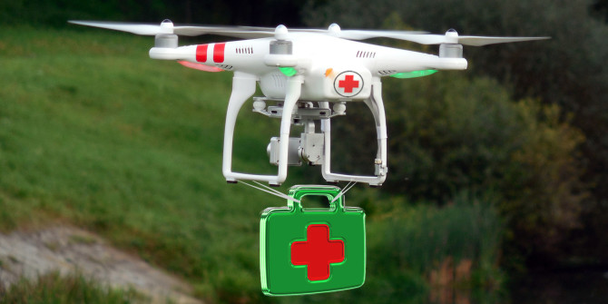
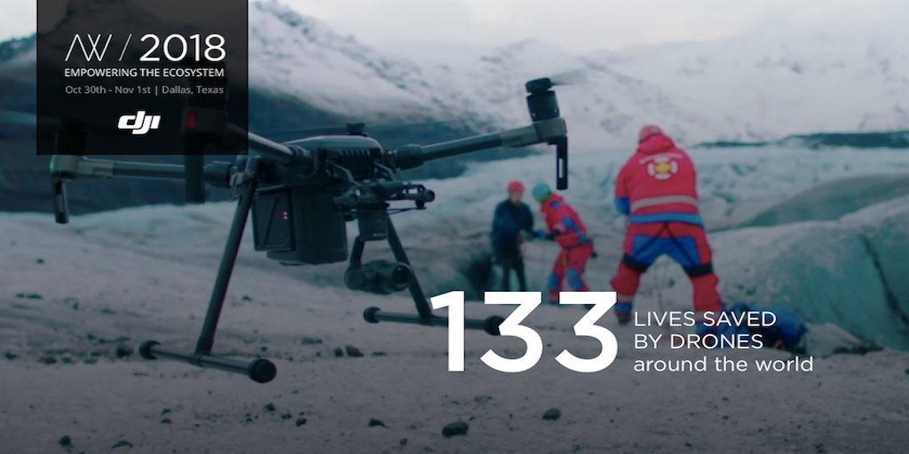
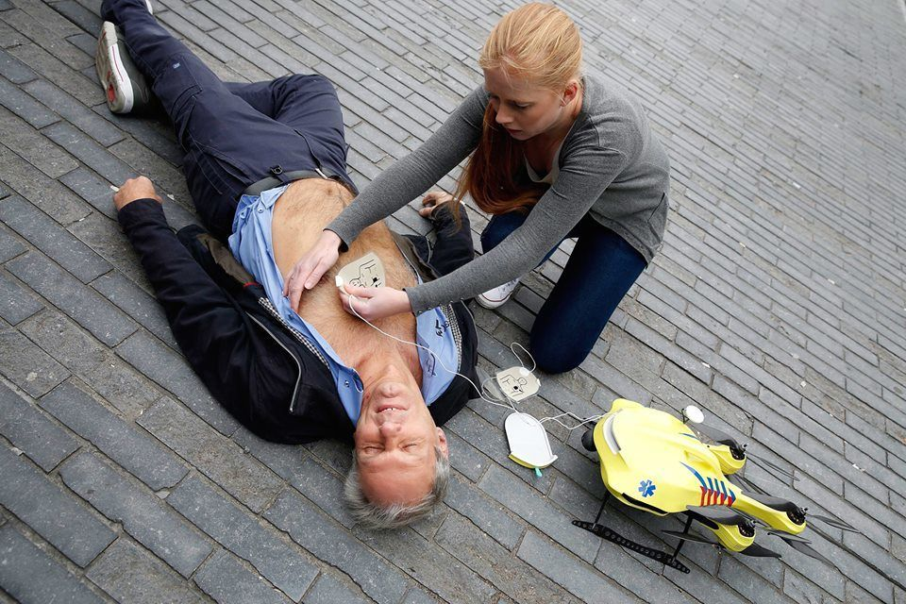
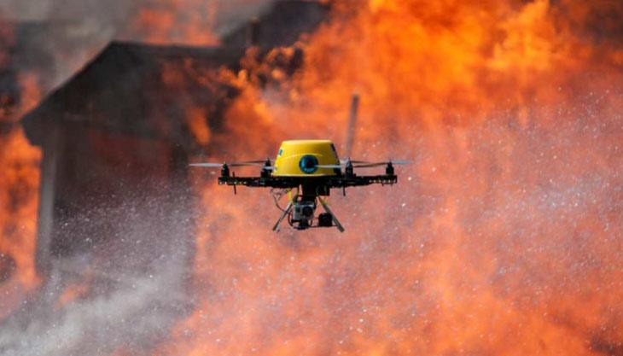
UAV
Applications
  Rescue UAVs

Slide 9
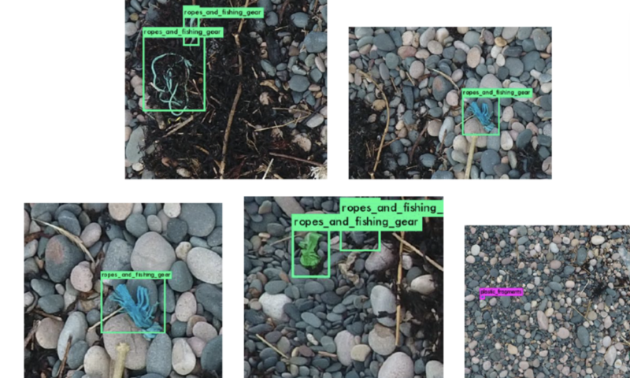
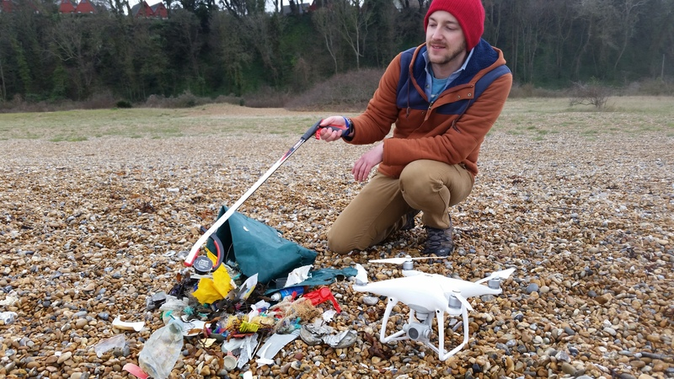
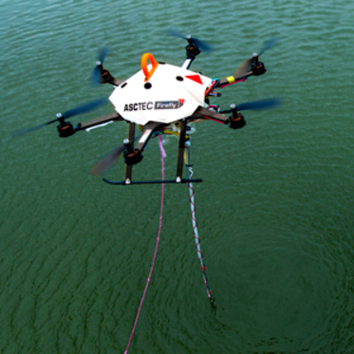
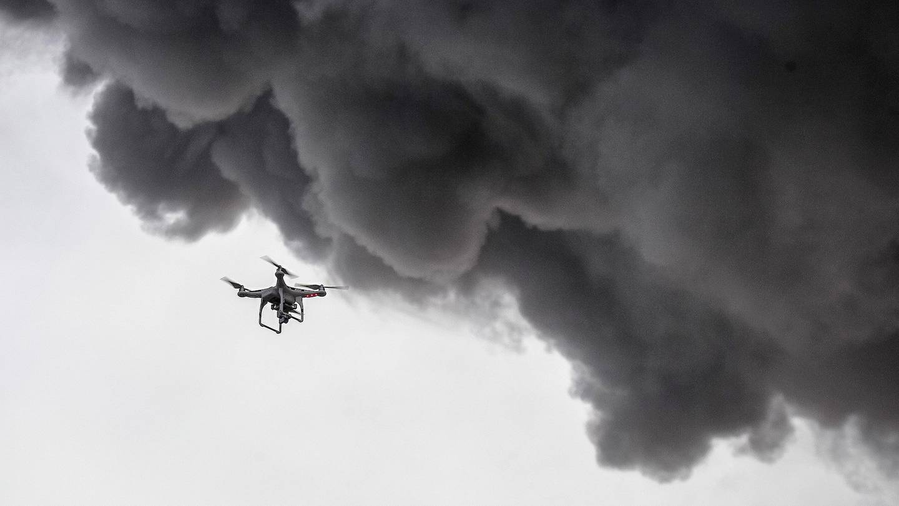
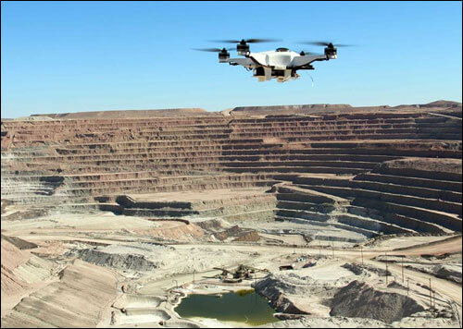
UAV
Applications
  Rescue UAVs
  UAVs for Environmental monitoring

Slide 10
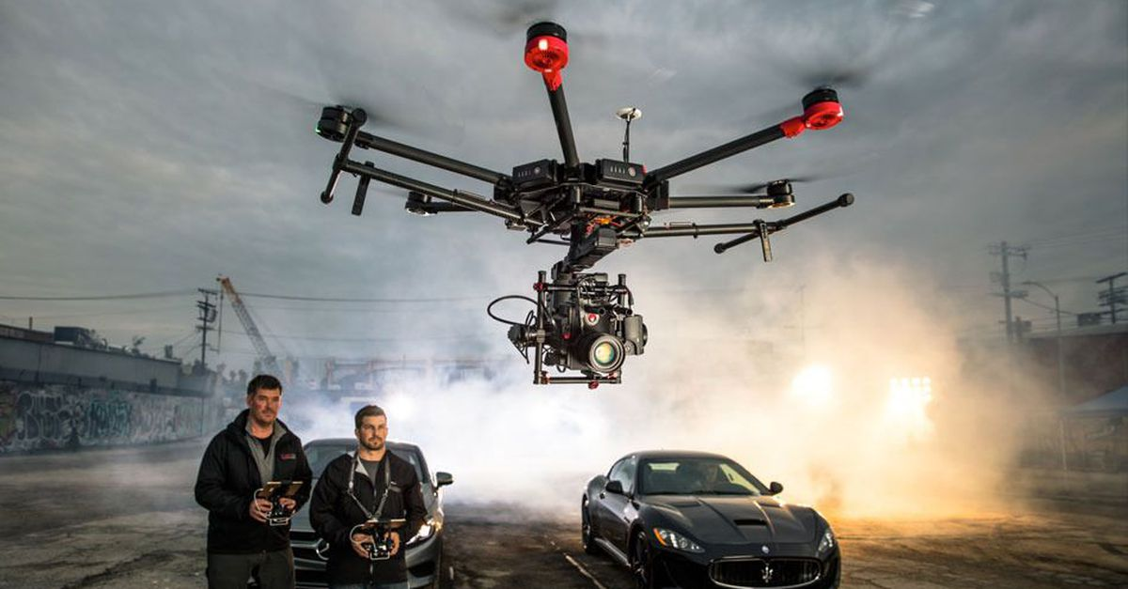
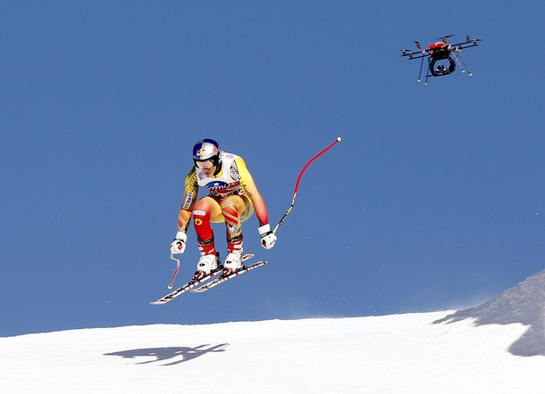
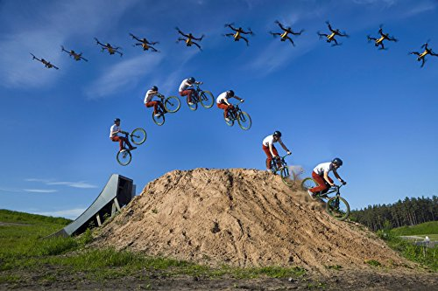
UAV
Applications
  Rescue UAVs
  UAVs for Environmental monitoring
  UAVs for visual effects

Slide 11
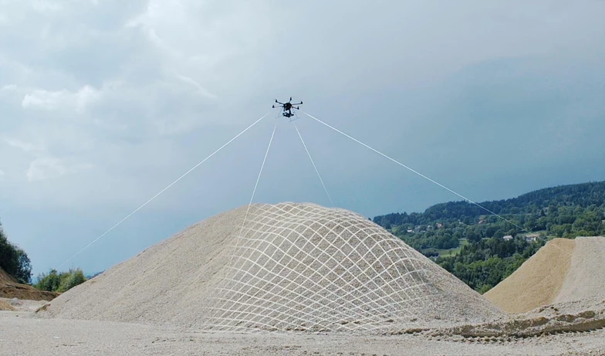
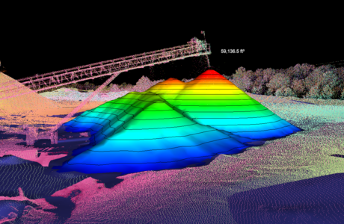
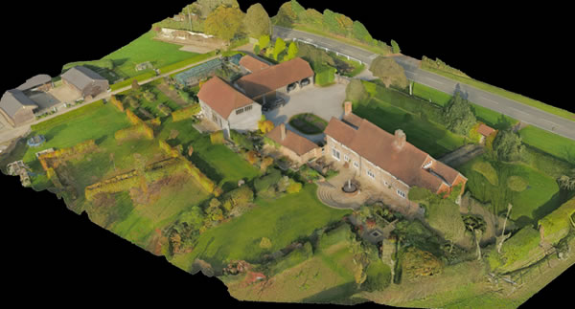
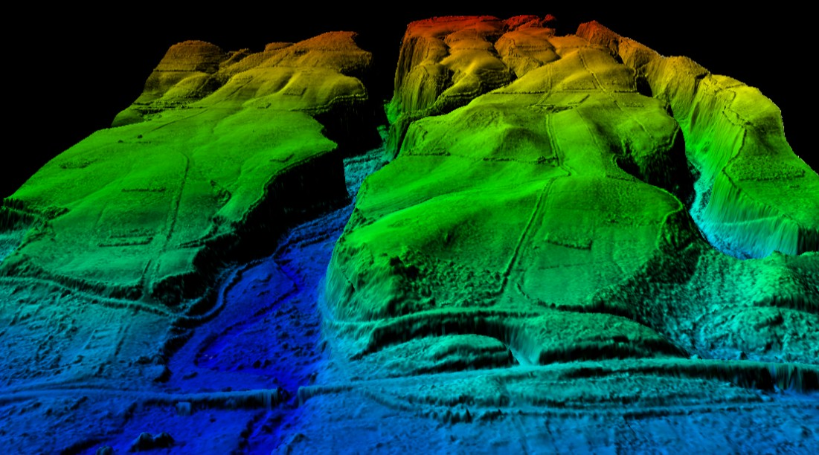
UAV
Applications
  Rescue UAVs
  UAVs for Environmental monitoring
  UAVs for visual effects
  UAVs for surveying

Slide 12
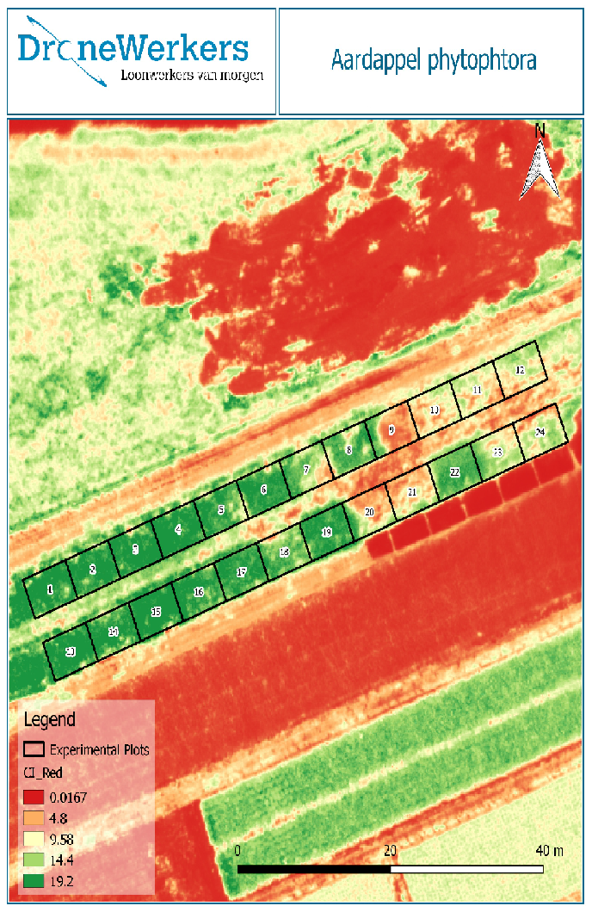
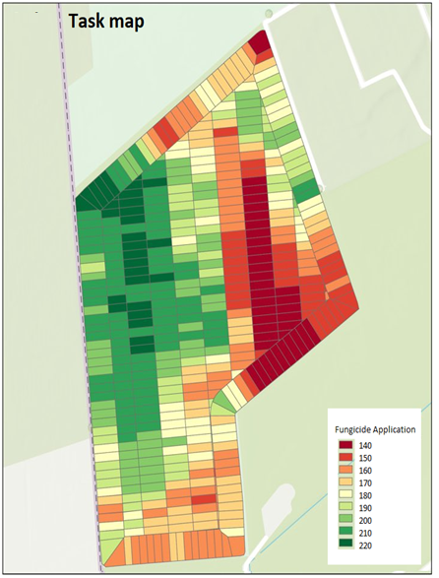
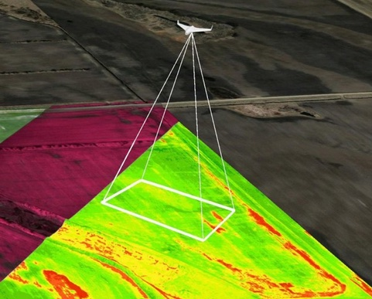
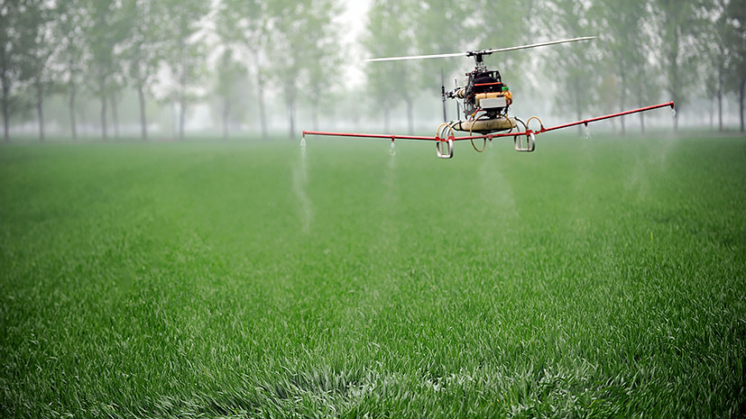
UAV
Applications
  Rescue UAVs
  UAVs for Environmental monitoring
  UAVs for visual effects
  UAVs for surveying
  UAVs for agriculture

Slide 13
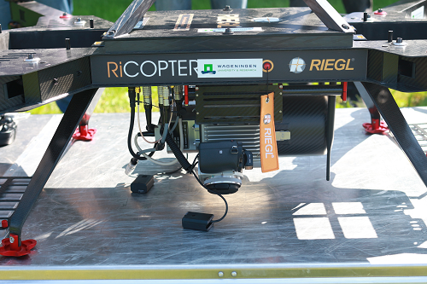
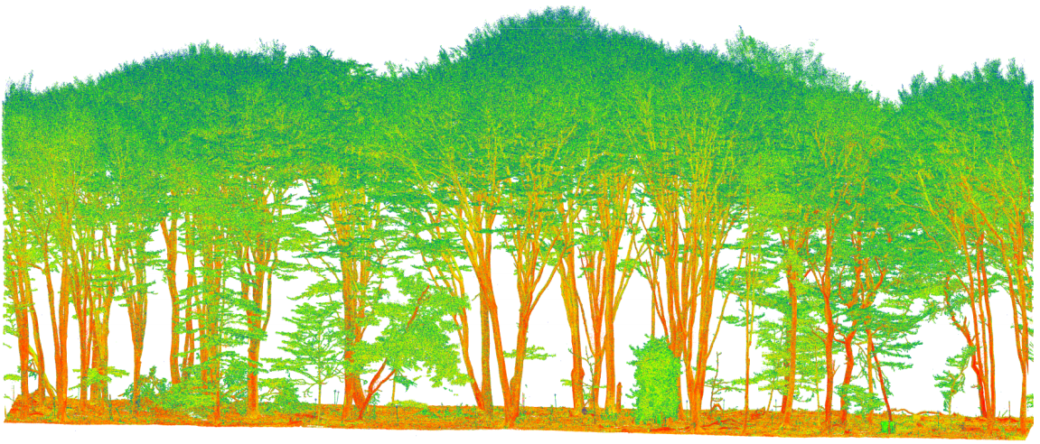
UAV
Applications
  Rescue UAVs
  UAVs for Environmental monitoring
  UAVs for visual effects
  UAVs for surveying
  UAVs for agriculture

Slide 14
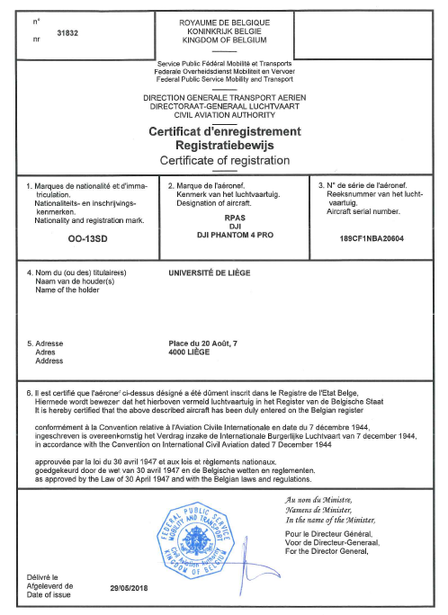
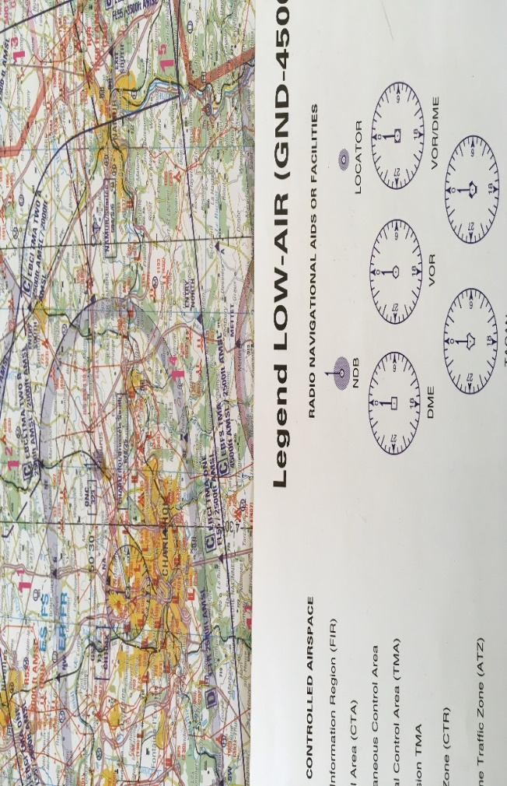
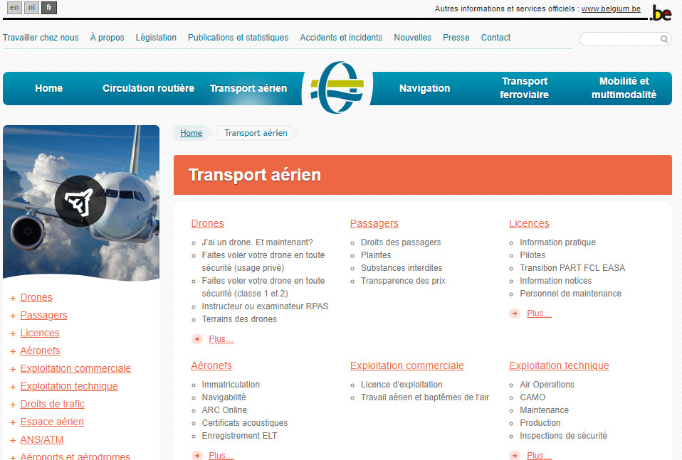
UAV
Administrative
Belgian drone piloting license
    Class 2: drone less than 5kg, 45m max altitude
    Class 1: 90m max altitude
Drone registration at DGTA
Drone & pilot insurance !
Belgian Low air map ---> check the air activities of the zone ---> NOTAM (NOtice To AirMan)

Slide 15
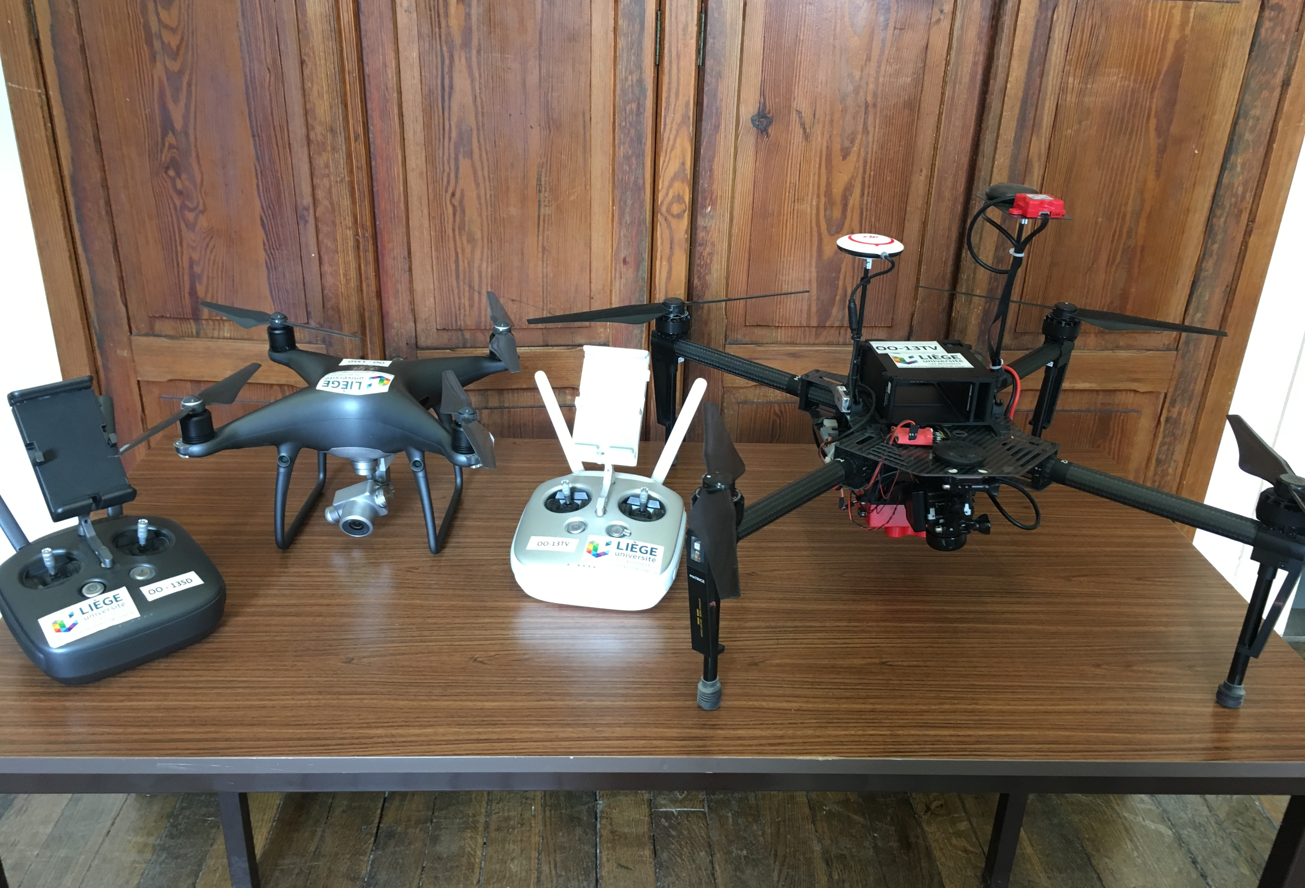
UAV
The value is paired with the mounted sensors!
- DJI Phantom 4 Pro --> RGB - DJI Matrice 100 --> multispectral + thermal
Optical RGB --> overview, (DSM & crop height)
Multispectral sensor --> crop status, vegetation indices, crop growth
Thermal --> crop stress, evapotranspiration

Slide 16
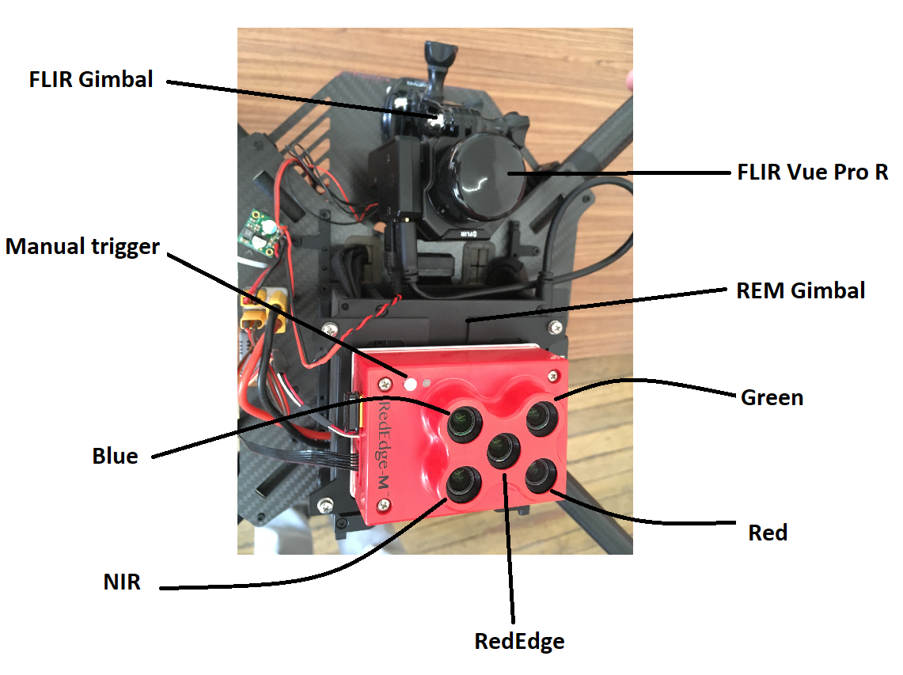
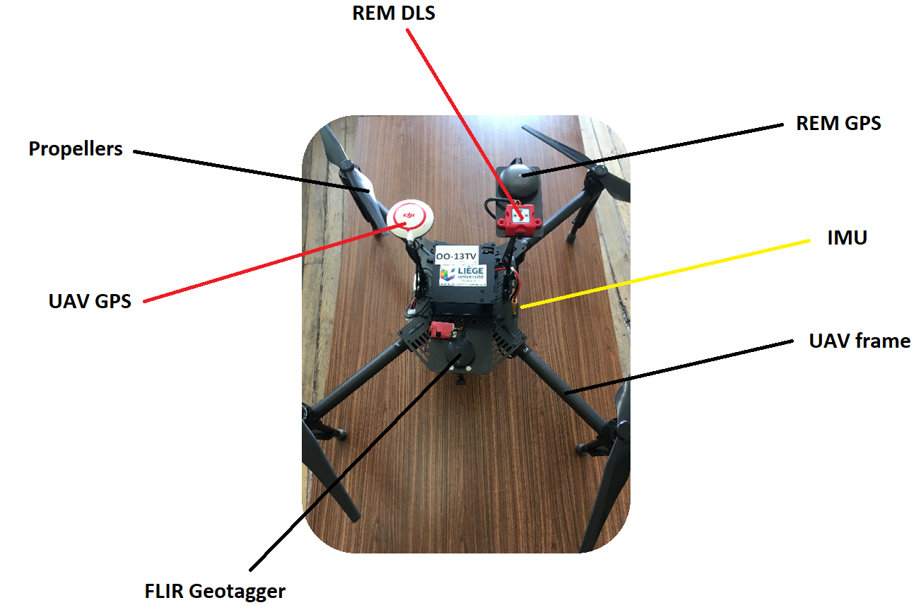
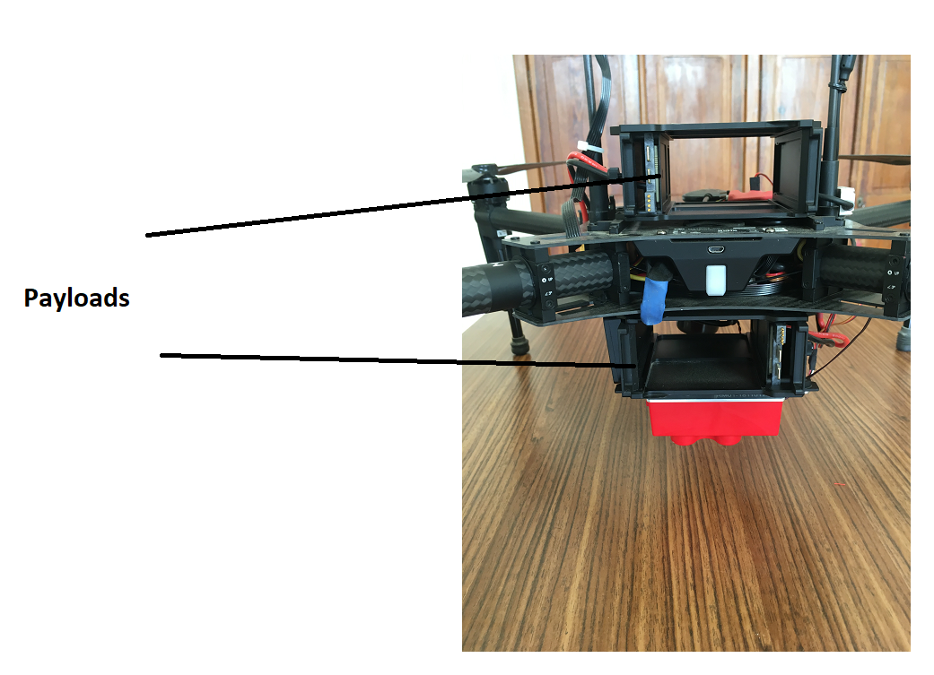
UAV
DJI Matrice 100

Slide 17
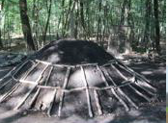
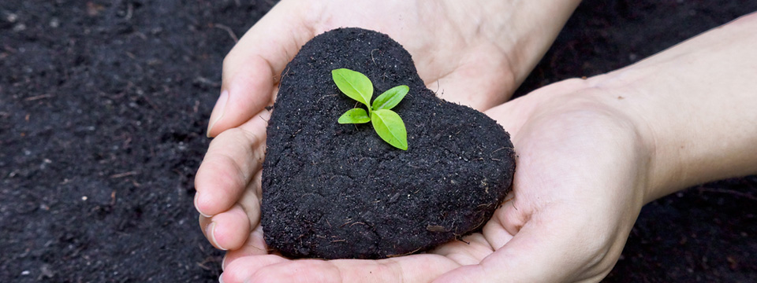
Context & background
Biochar
Thermochemical decomposition of biomass in an oxygen-limited environment (Trupiano et al., 2017)
---> Higher water (Liu et al., 2012 ) and nutrient (Steiner, 2007) contents
---> Improve the soil quality (Paz-Ferreiro et al., 2014)
----> Crop growth and Yield ? (B. Hardy, 2017 ; Liu et al., 2014)

Slide 18
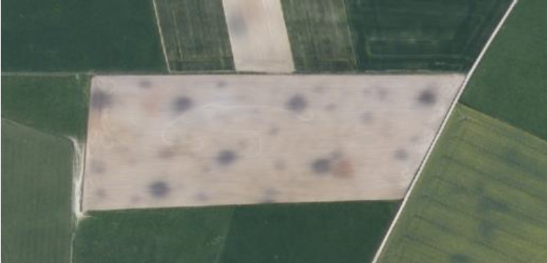
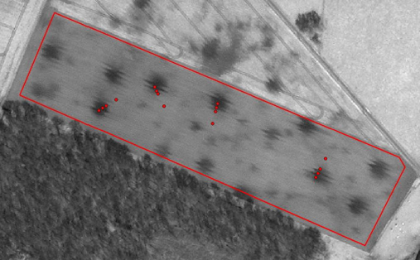


Context & background
High-resolution VIS-NIR Remote sensing is able to detect charcoal patches (B. Hardy, 2017)
Charcoal patches ---> darker soil ---> less reflectance (B. Hardy, 2017)
Charcoal kiln sites ---> higher temperature (B. Hardy, 2017)

Slide 19
Problem definition
Footprint of charcoal kiln sites appears in growth stage (B. Hardy, 2017)
Response of the crop growth and yield to the charcoal ---> remains open (B. Hardy, 2017)
Biochar ---> increased biomass and plant height (Carter et al., 2013)
Biochar ---> no impact on the crop yield (Liu et al., 2014)

Slide 20
Research Objective
Impact of charcoal-enriched soil on crop growth using remotely-sensed data
Crop growth (biomass/yield) over both sort term and long-term monitoring
Modelling crop water stress
Geo-statistical evaluation of the impact of biochar on crop yield/biomass, water contents
Decrease the modelling resolution drone (cm) --> satellite (m)
Added value of using very high-resolution drone images (compared to the conventional techniques)

Slide 21


Methodology - study area

Slide 22

Methodology - study area
Geo-referencing
  Ground Control Point (GCP) tiles

Slide 23

Methodology - study area
Geo-referencing
      Accurate Geo-referencing
      Satellite image registration
      Pixel-by-pixel time-series analysis
      Proper overlaying of different sensors (RGB, MSP, Thermal)

Slide 24

Methodology - study area
Geo-referencing
      Accurate Geo-referencing
      Satellite image registration
      Pixel-by-pixel time-series analysis
      Proper overlaying of different sensors (RGB, MSP, Thermal)

Slide 25

Methodology - study area
Geo-referencing
      Accurate Geo-referencing
      Satellite image registration
      Pixel-by-pixel time-series analysis

Slide 26

Methodology - study area
Geo-referencing
      Accurate Geo-referencing
      Satellite image registration
      Pixel-by-pixel time-series analysis
      Proper overlaying of different sensors (RGB, MSP, Thermal)

Slide 27


Methodology - study area

Slide 28







Methodology - Software

Slide 29

Methodology - Methods
    Spatio-temporal crop monitoring using drone imaging
    Data Analysis

Slide 30


Methodology - Methods
    Spatio-temporal crop monitoring using drone imaging
    Data Analysis --> RGB mission
      Crop height
crop height = Digital Surface Model – Digital Train Model*
*DSM --> train points (or focal min function) --> interpolation (cubic spline than IDW) --> DTM

Slide 31

Methodology - Methods
    Spatio-temporal crop monitoring using drone imaging
    Data Analysis --> RGB mission
      2. Crop diameter

Slide 32

Methodology - Methods
    Spatio-temporal crop monitoring using drone imaging
    Data Analysis --> RGB mission
      3. Crop counting
        Machine learning --> eCognition, Neural network
        Manually within the limited number of plots --> QGIS

Slide 33


Methodology - Methods
    Spatio-temporal crop monitoring using drone imaging
    Data Analysis --> Multispectral mission
      Vegetation indices
      2. Leaf Area Index (LAI)
        Field measurements of LAI
        Drone-based WDVI map
$$5) CCCI=\frac{\left(NIR−RE\right)/(NIR+RE)}{\left(NIR−R\right)/(NIR+R)}$$
Prediction model
LAI map over the entire field

Slide 34


Methodology - Methods
    Spatio-temporal crop monitoring using drone imaging
    Data Analysis --> Multispectral mission
      3. fCover
        Proportion of the vegetation cover
      4. Surface albedo
        Sentinel-2
        Drone
        --> There will be a shift compared to the satellites but the pattern is still realistic!

Slide 35


Methodology - Methods
    Spatio-temporal crop monitoring using drone imaging
    Data Analysis --> Thermal mission
      Crop Water Stress Index
        Extreme pixels --> Similar to Trapezoid method in SEBAL
                But hot pixel should be covered by a bit of vegetation as well!

Slide 36

Methodology - Methods
    Spatio-temporal crop monitoring using drone imaging
    Data Analysis --> Thermal mission
      Crop Water Stress Index

Slide 37
Methodology - Methods
    Spatio-temporal crop monitoring using drone imaging
    Data Analysis --> Thermal mission
      Crop Water Stress Index
      Evapotranspiration
        SEBAL, ETlook

Slide 38

Flight logs …

Slide 39

Results - PoV

Slide 40

Results - Statistics
Paired T-test

Slide 41

Results - Statistics
Global statistics: 2 independent non-normal sample t-test

Slide 42

Results - PoV

Slide 43



Results - PoV

Slide 44

Results – Possible amendment
Classification based on the Charcoal concentration ---> Soil surface Albedo

Slide 45


Results - VI

Slide 46


Results - spectra
5 vegetation samples per plot ---> Vegetation spectra ---> leaf charcoal index

Slide 47


Topographic Wetness Index
Input
Modelling
Output

Slide 48


Topographic Wetness Index modelling
Input
Modelling
Output

Slide 49



Topographic Wetness Index modelling
Input
Modelling
Output

Slide 50

Topographic Wetness Index modelling
Input
Modelling
Output

Slide 51

CWSI modelling

Slide 52


CWSI modelling

Slide 53

TWI vs. CWSI
RGB imagery (topography)
Thermal imagery
TWI CWSI July CWSI August

Slide 54


Field measurements
Charred
Higher yield?
No
Crop stress
Reference
Yes

Slide 55
Field measurements
Charred
Higher yield?
No
Reference
Crop stress
Charred
Higher yield?
Yes
Reference

Slide 56

Field measurements

Slide 57
Questions?
Thanks for your attention ☺

