Slide 1
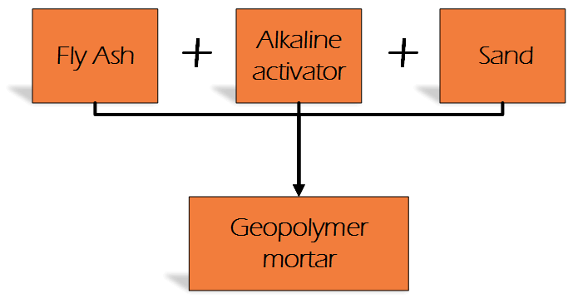
Fly Ash Geopolymer - a new type of alternative, sustainable binder. The influence of calcium compound on geopolymerization process
M.Sc.Eng. Piotr Prochoń
p.prochon@student.uliege.be +48 693 379 433
PARTNERS
General project information
This PhD research was conducted in the framework of collaboration between Warsaw University of Technology and Liège Université through the research project: “Matériaux bio-sourcés et recyclés pour une construction durable”. The research objective is to analyze potential reuse of industrial byproducts and create an alternative bio-source binders with low carbon footprint.
1. Introduction
Ordinary Portland Cement (OPC), within its nearly two centuries of history, become an essential component of the built environment. The production of OPC is widely recognized as one of the major contributors of greenhouse gas emissions by emitting, depending on the source, from 6-8% of all anthropogenic based carbon dioxide into the atmosphere. To mitigate those emissions and the problems associated with them, a new type of alternative sustainable and environmental friendly material so called geopolymer is realized.
2. Materials
4.TGA
In this research the influence of calcium additive on geopolymerization process and
functional relationship between the amount of this additive and mechanical properties of
geopolymer mortars based on Co-combustion of coal and wood Fly Ash (CFA) and Referenced coal combustion Fly Ash (RFA) are examined.
As an additional calcium component a quicklime (CaO) was added. The calcium additive substituted fly ashes by 2%, 5% and 7% of mass. 5M NaOH solution was used as an activator.
Possible advantages of geopolymers
High structural integrity;
High level of resistance to acid and salts attack;
Low permeability;
Good resistance to thaw-freeze cycles.
Enviromental friendly binder;
The first weight loss for all mixes is observed below 200°C. In this region the water evaporation depends on the used raw material and the amount of calcium additive. The highest losses are observed for mixes with CFA. In case of RFA, the substitution of raw material by CaO increases the amount of measured free water. It can be connected with geopolymerization process, during which water is a reaction byproduct.
In the temperature range 410–550°C (decomposition of Ca(OH)₂) higher mass losses are obtained for RFA samples. CFA mortars on the contrary, had higher decreases in CaCO₃ decomposition range (650–900°C). At higher temperatures, distinct weight drops are likely caused by the decomposition of other carbonated phases or connected with the decomposition of the unburned carbon. The total weight loss at 1000°C was the highest for CFA mortars among all mixes.
3. The influence of CaO addition on compressive strength
CONCLUSIONS
1
The geopolymerization process depends on the amount of free calcium compound in precursor of geopolymerization
The best compressive strength results were obtained with a 7% quicklime substitution of coal combustion fly ash
It is possible to obtain M10 class geopolymer masonry mortars with low molar concentration of NaOH
From obtained results of compressive strengths it is possible to observe that the increase of CaO amount in RFA mortars enhanced the mechanical properties (difference after 56 days between RFA mortar with 0% of CaO – RFA_REF and the mortar with 7% of CaO - RFA_CaO_7, more than 73%). In case of CFA samples the addition of more than 5% of CaO had a marginal effect on the mechanical properties (higher compressive strength of CFA mortars with 5% of CaO after 28 days and close to 8% difference in it between CFA_CaO_5 and CFA_CaO_7 after 56 days). It can by connected with high active CaO content in the CFA chemical composition. Further analysis need to be taken.
2
3

