Slide 1
Global Electricity Network
(pre-)Feasibility Study
David Radu
Montefiore Institute, University of Liège, Belgium
March 21, 2019

Slide 2
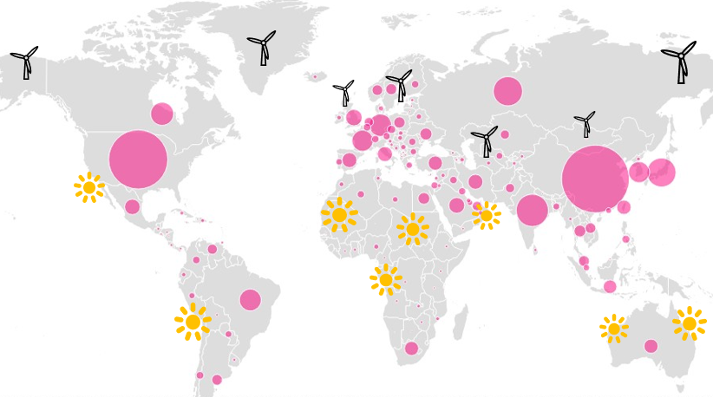
Motivation
(…beyond climate concerns, resource depletion, etc.)
Sparse distribution of VRE sources and their location relative to demand centers
Resource complementarity as solution to high power output intermittency
Potential of integrating demand profiles over a range of longitudes (time zones)
Other operational advantages
Scope
Carrying out a first (pre-)feasibility study targeting macro-regional integration of power systems via large-scale HVDC/HVAC interconnectors
Assessing costs and benefits, potential challenges in line with a set of assumptions

Slide 3
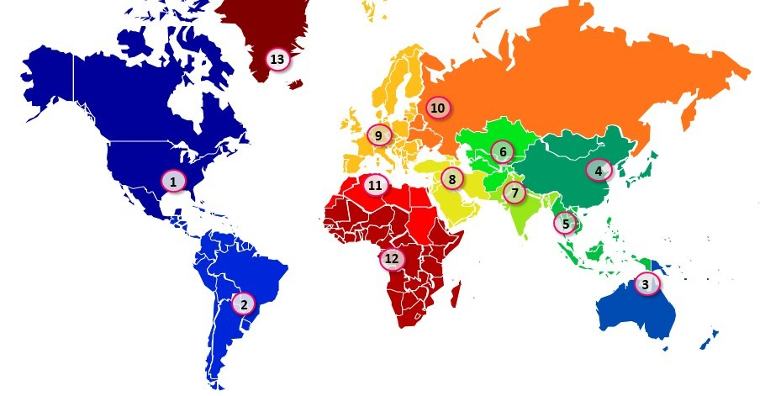
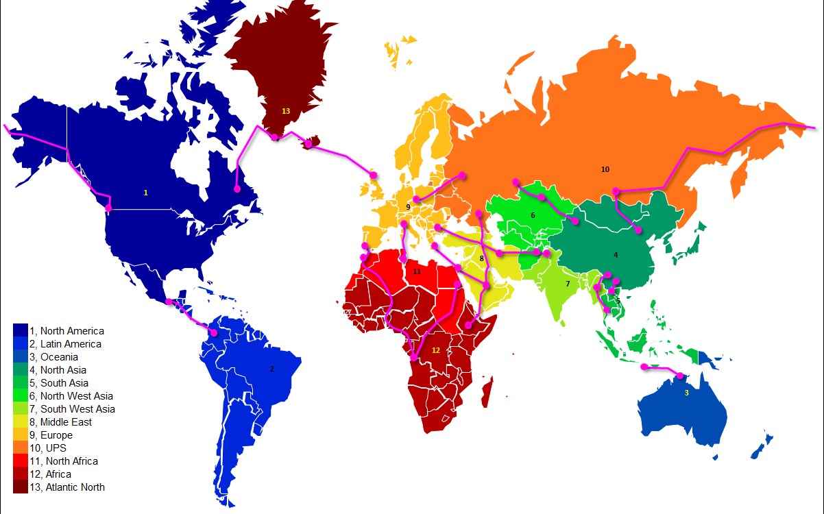
Region and Corridor Mapping
Splitting into 13 macro-regions (nodes) based on geographical boundaries, basic economic indicators and existing political ties
Transmission corridor selection (20 links) done via a-priori assessment of terrain (OHL following “easy access” routes and already existing infrastructure elements) and bathymetry (2000m max for USCs)
Connection points coincide with existing, large-scale transmission assets (sub-stations and lines)

Slide 4
Data collection & Analysis
Conventional generation: WEC data on installed capacity, utilization factors
VRE generation: unconstrained technical potential, potential modelled via reanalysis data
Demand data: WEC data on total volumes, internal data on yearly profiles
Costs: IEA data for generation, European/Asian project data for transmission ($/km*GW)

Slide 5
Data collection & Analysis
Conventional generation: WEC data on installed capacity, utilization factors
VRE generation: unconstrained technical potential, potential modelled via reanalysis data
Demand data: WEC data on total volumes, internal data on yearly profiles
Costs: IEA data for generation, European/Asian project data for transmission ($/km*GW)

Slide 6
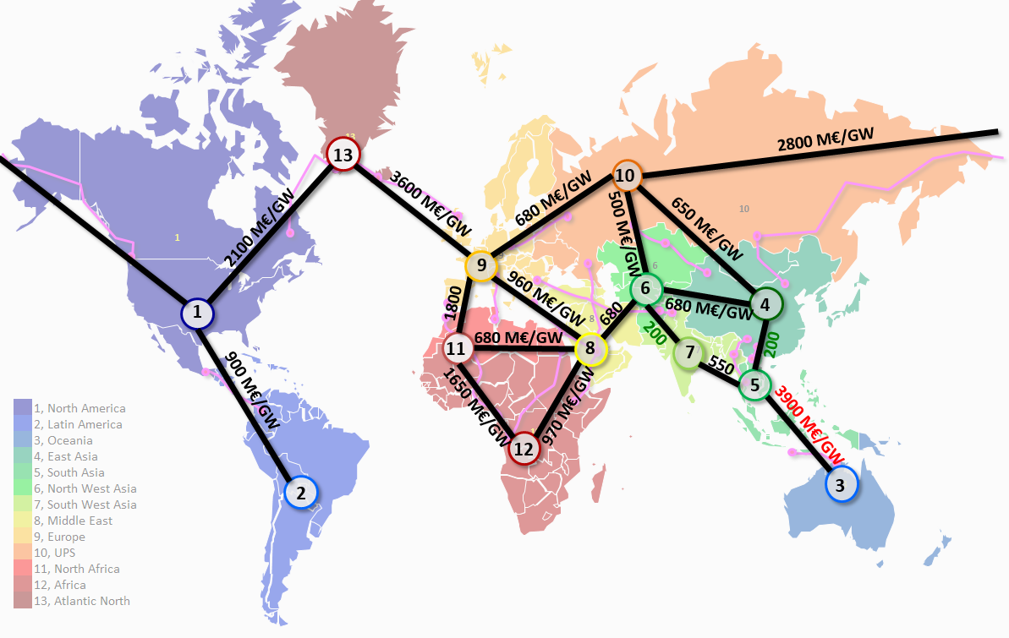
Data collection & Analysis
Conventional generation: WEC data on installed capacity, utilization factors
VRE generation: unconstrained technical potential, potential modelled via reanalysis data
Demand data: WEC data on total volumes, internal data on yearly profiles
Costs: IEA data for generation, European/Asian project data for transmission ($/km*GW)
Cost (M€) | DC OHL (M€/km/GW) | DC USC (M€/km/GW) | AC OHL (M€/km/GW) | AC/DC Converter (M€/GW/SS) | AC/AC B2B (M€/GW/SS)
Max | 0,33 | 1,90 | 0,25 | 158 | 158
Min | 0,18 | 1,27 | 0,13 | 90 | 90

Slide 7
Methodology and Test Cases
ANTARES used as optimization tool
  no limits on sizing variables
  copper plate within regions
  flat costs across regions
  conservative demand profiles
  no actual PSO/PSS investigation
Inputs: load & VRE gen. potential hourly time series, conventional gen. capacities, annualized tech. costs, CO2 cost. BUILD-UP FROM WEC CAPS!
Objective function: minimize system cost to serve given electricity demand
Outputs: VRE/NG installed capacities, interconnector capacities/hourly flows, electricity generation mix, etc.
 | What are we testing?
0 | Base case, all regions are decoupled.
1 | Regions can be interconnected.
2 | Influence of VRE potential in selected regions.
3 | Influence of transmission losses.
4 | Sensitivity on transmission cost.
5 | Addition of daily regulated (low power) storage.
6 | Addition of daily regulated (high power) storage.
7 | Consideration of seasonal storage.
8 | Influence of CO2 price.
9 | Solar PV deployments only.
10 | VRE deployments only.
11 | US-Russia geopolitical impact.
12 | Sensitivity on EUMENA transmission costs.

Slide 8
Results – Case 0 (Isolated regions)
System cost : 54 €/MWh
RES share : 53 %
CO2 emissions: 850 Mt/year
Interconnection cap. : 0 GW
Interconnection cost : 0 B€/year

Slide 9
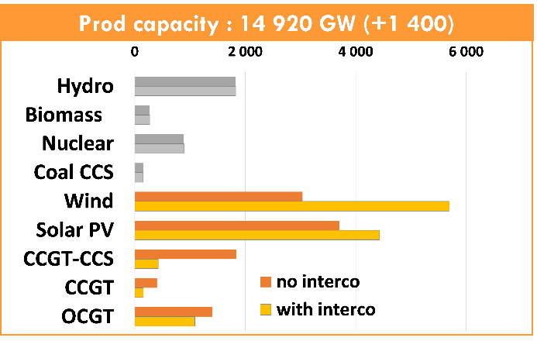
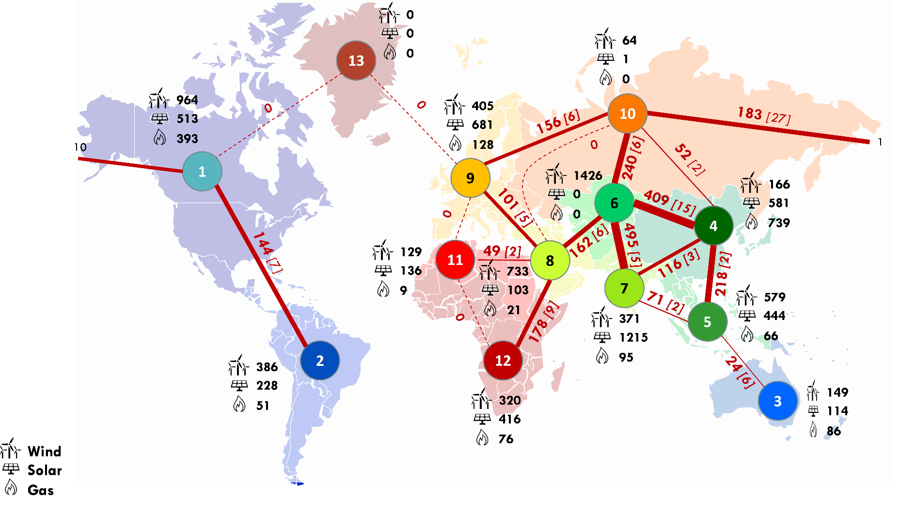
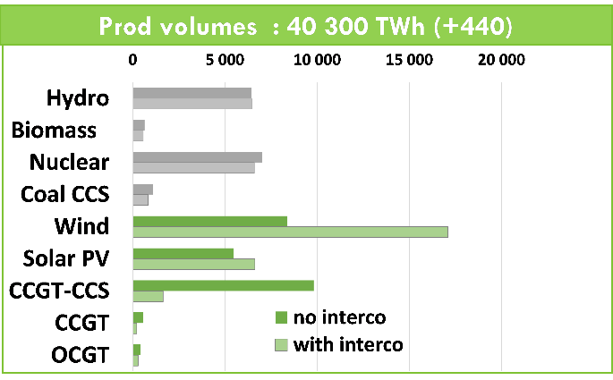
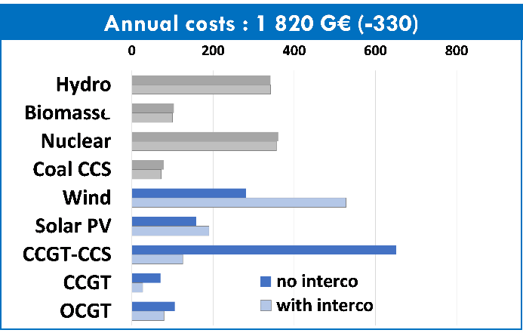
Results – Case 1 (The value of interconnections)
System cost : 48 €/MWh (-6 €/MWh)
RES share : 76% (+23%)
CO2 emissions: 343 Mt/y. (-510 Mt/y.)
Interconnection cap. : 2600 GW
Interconnection cost : 104 B€/year

Slide 10
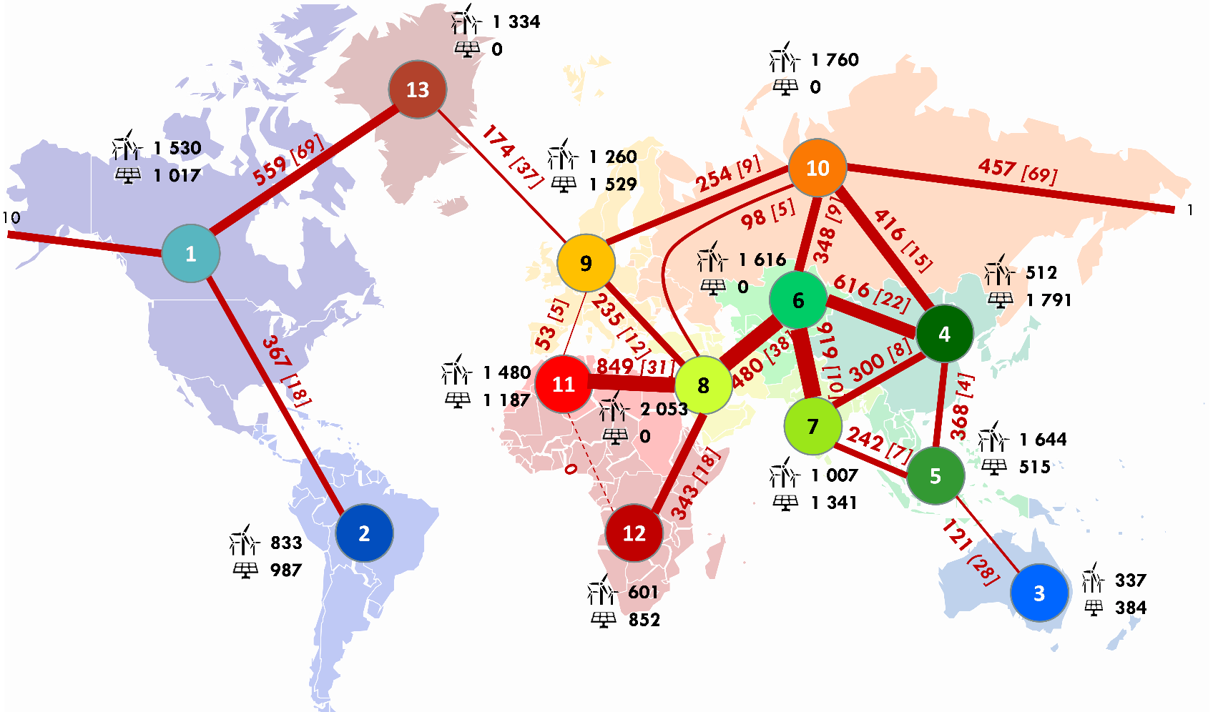
Results – Case 10 (100% VRE system)
For a given demand level & value
of lost load:
Interconnection cap. : 7800 GW
Interconnection cost : 415 B€/year
VRE capacity: 25800 GW
VRE generation: 62000 TWh
VRE curtailment: 22000 TWh
Interconnection-to-VRE: 30%
System cost: 58 €/MWh

Slide 11


Challenges & Follow-up…
C1.35 technical brochure coming out
Follow-up WG (end of 2019) to assess:
  Interconnection vs. storage trade-off
  Sequence of interconnector deployment
  More accurate estimation of VRE potential / demand profiles
  On the ULiège side:
  Scientific material already out
  Ongoing (and exciting) work on renewable resource complementarity
  Development of planning tools focusing on VRE deployment schemes & interconnector vs. storage trade-offs
Critical Time Windows for Renewable
Resource Complementarity Assessment
Complementarity Assessment of South Greenland
Katabatic Flows and West Europe Wind Regimes

