Slide 1
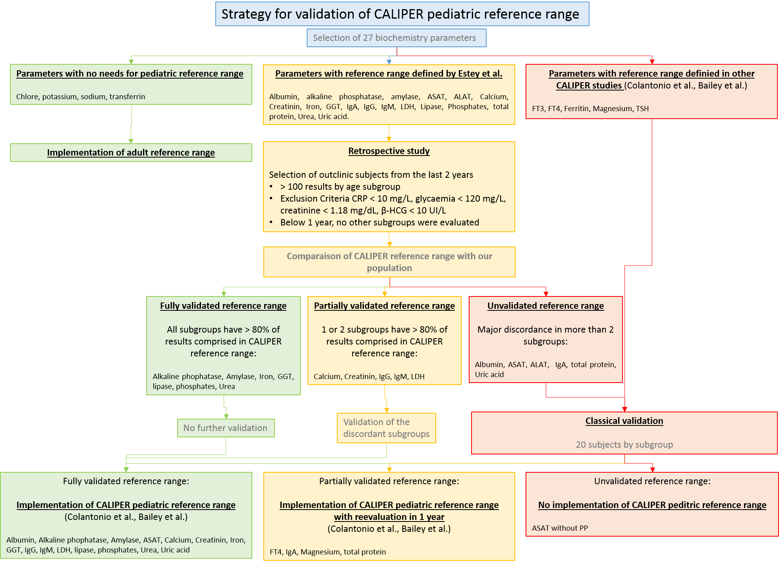
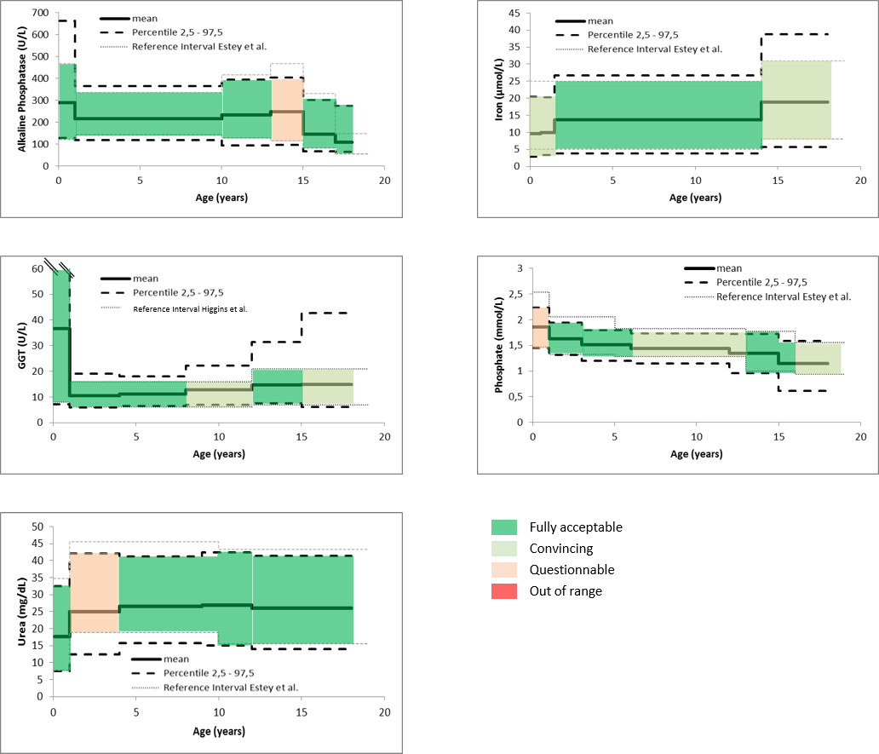
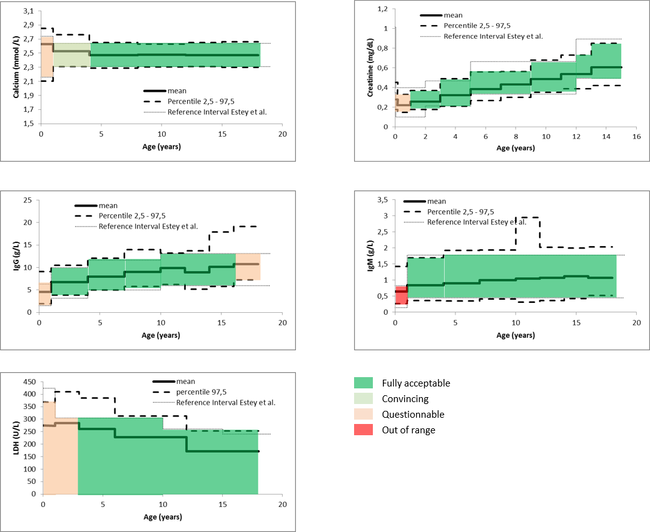
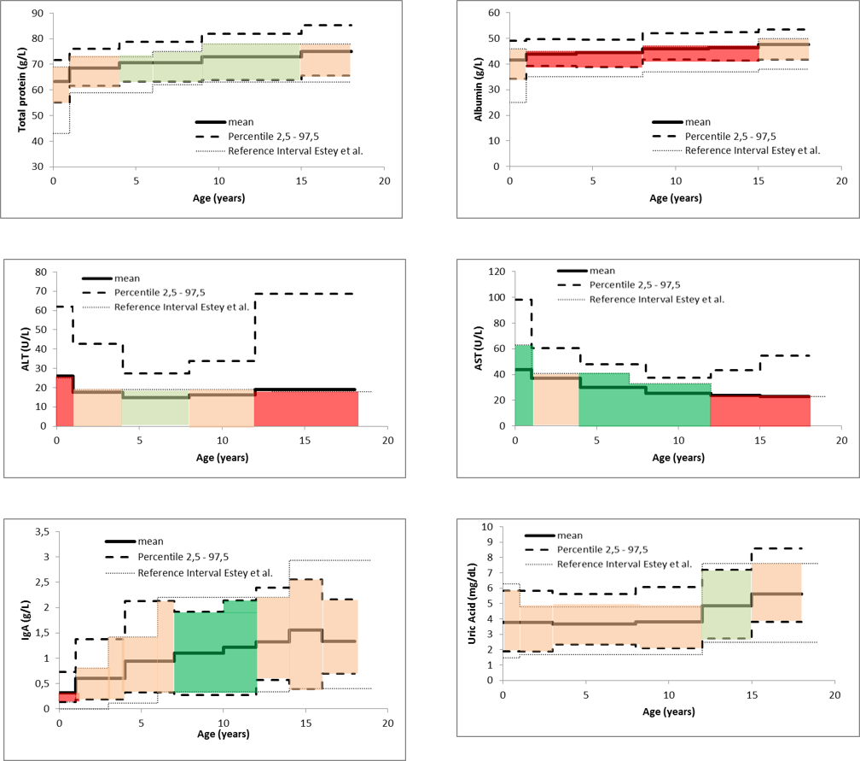
GLOBAL STRATEGY OF IMPLEMENTATION OF CALIPER PEDIATRIC REFERENCE VALUES IN A BELGIAN INSTITUTE
A. Ladang, C. Bertholet, L. Vranken, E. Cavalier
Department of Clinical Chemistry, ULiège and CHU of Liège, Belgium
Introduction:
Strategy:
As part of validation of Alinity° technologies (ABBOTT), we decided to implement the pediatric reference ranges of the Canadian large-scale prospective studies (the CALIPER initiative) in our laboratories. To limit the number of tests, we considered a 2-step validation model. The first step consists in a retrospective data analysis based on our old method. Then, the second step validates classically the parameters who failed the first step. This 2-step validation is based on the fact that, in the CALIPER strategy, results were obtained on Architect° (Abbott°) and mathematically transferred to many other method (such as Cobas°). Therefore, we considered that if results are valid in one method, they should be valid in other ones.
@
Material and Methods:
27 chemistry parameters were considered for our 2-step validation. First, for the retrospective data analysis, we compared results obtained the last 2 years on our old method (Cobas° C6000 results (ROCHE°)) to CALIPER reference ranges. If more than 80% of our population fits in CALIPER intervals, results were considered as acceptable for every method and CALIPER intervals were implemented for our new method without any additional checking. For subgroups where more than 20% of our population was out of CALIPER range, a classical validation was realized on our new automate (Alinity° (ABBOTT°)) with 20 healthy children for each subgroup.
Fig 1. Strategy for validation of CALIPER reference ranges
Results:
@
@
@
Fig 2. CALIPER reference ranges fully validated by retrospective study.
Fig 3. CALIPER reference ranges partially validated by retrospective study: o-1 year subgroup was validated by checking 20 subjects
Fig 4. CALIPER reference ranges unvalidated by retrospective study:
all subgroups were revaluated by 20 subjects in each group
Conclusions:
Our 2-step validation model facilitates validation of pediatric reference range and significantly decreases the number of tests required for validation with a consistent gain of money.

