Slide 1



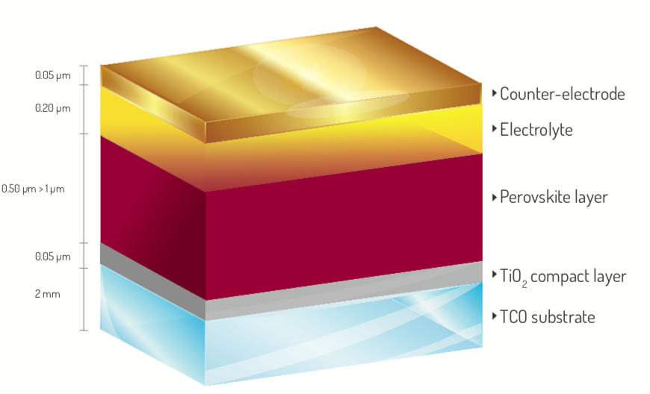
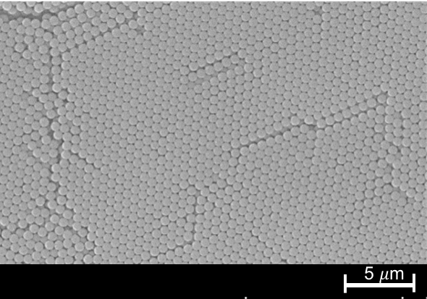
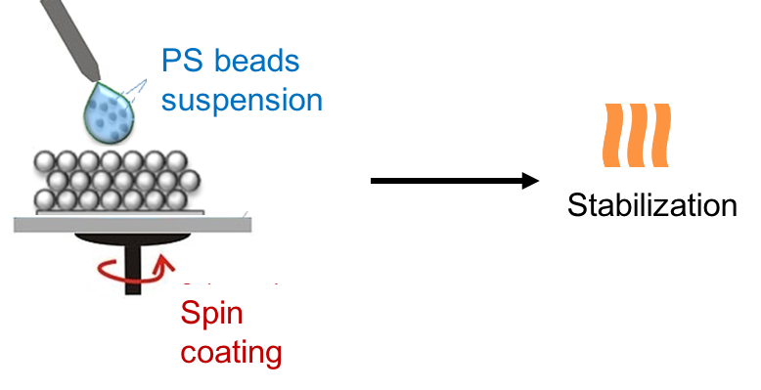
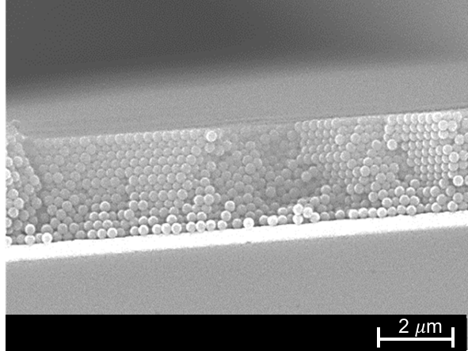
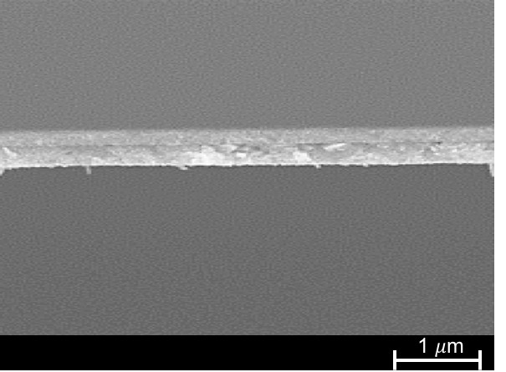
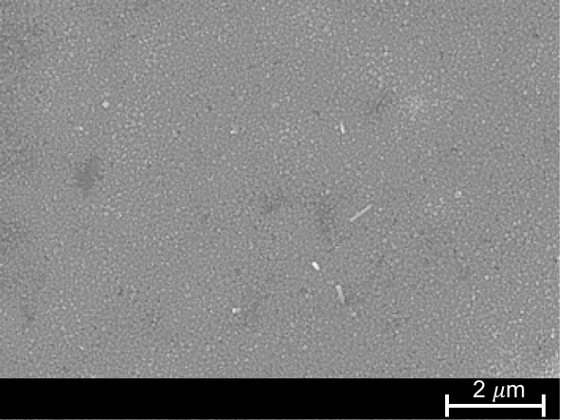
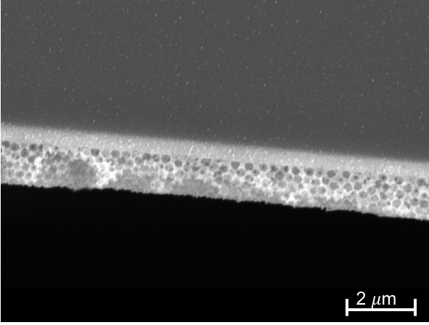
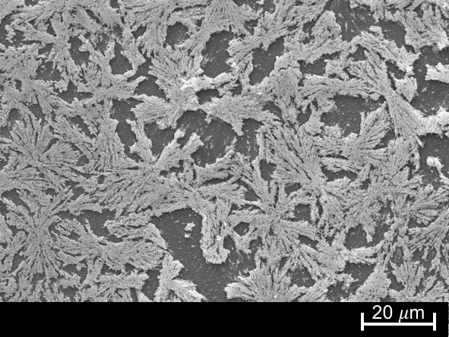
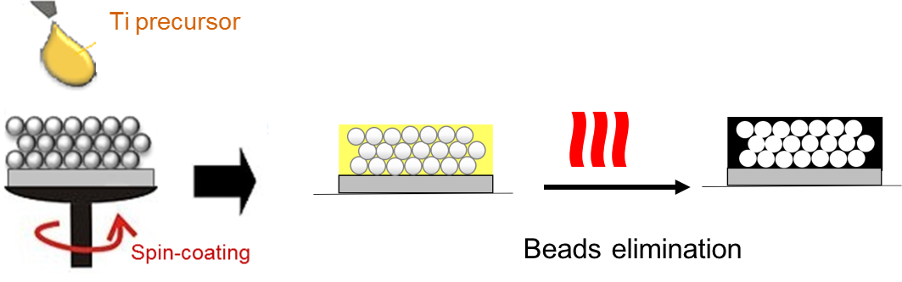
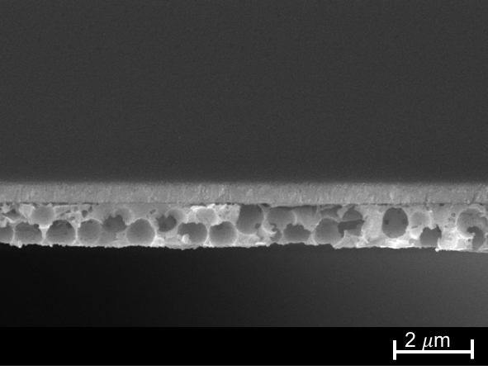
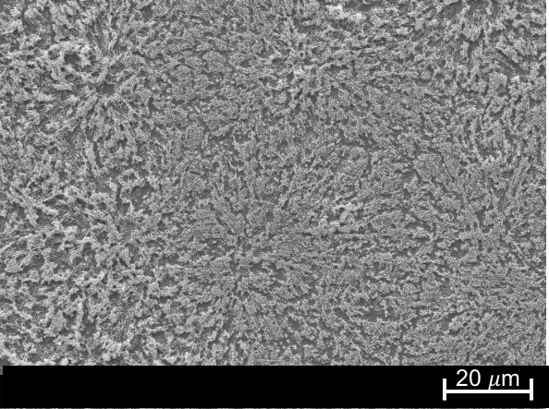
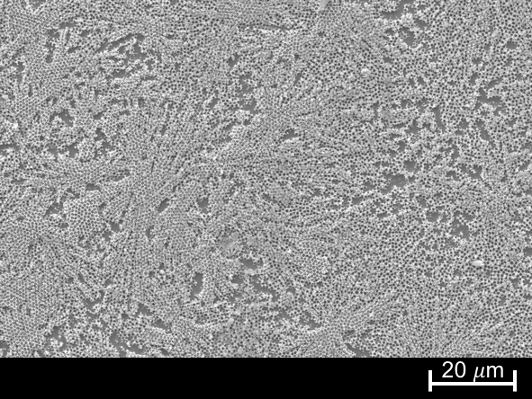
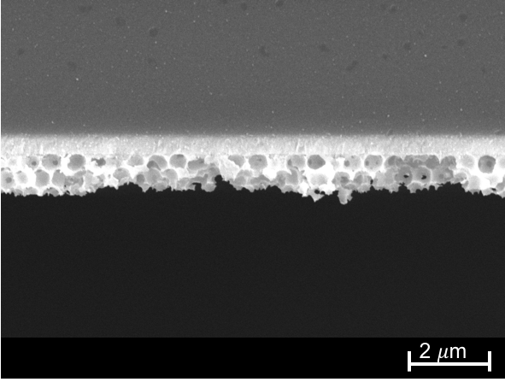
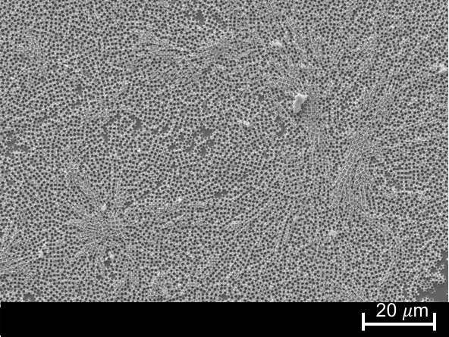
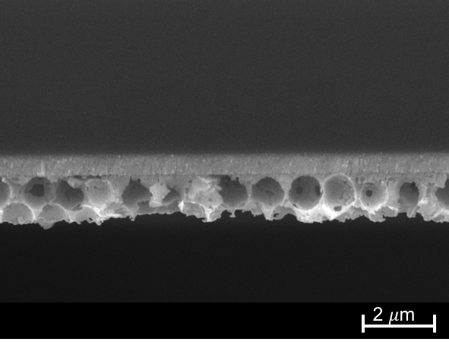
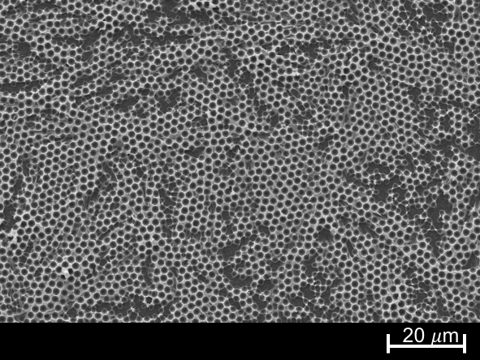
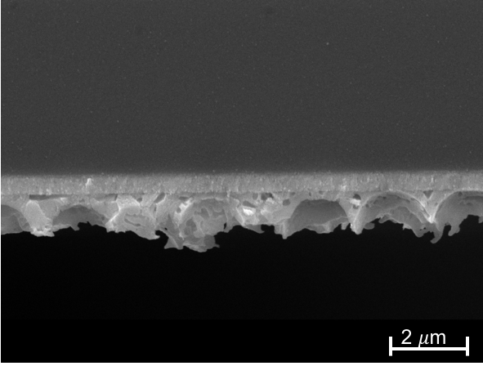
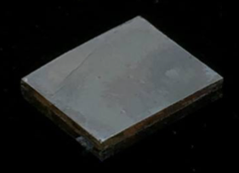
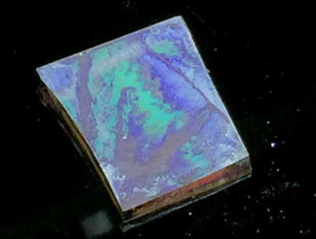



Influence of the microstructure and doping of CH₃NH₃PbI₃ films as photoelectrodes in perovskite-based photovoltaic cells
N. Daem, J. Dewalque, G. Spronck, A. Schrijnemakers, R. Cloots, C. Henrist
Objective
<
CH₃NH₃PbI₃
dense photoanode
Photonic structure
CH₃NH₃PbI₃
inverse-opal photoanode
Optimization of light interaction within the layer
Improvement of PV efficiency through photonic effect
Tuning of cell coloration/transparency
Opal-like structuration: templating
Two-steps deposition: (PS beads layer followed by perovskite precursor infiltration)
1) PS beads as structuring agent
2) Precursor solution infiltration and PS beads elimination
➔ CH₃NH₃PbI₃ perovskite inverse-opal porous layer
Experimental settings:
PS beads suspension: 10 % vol.
in H₂O/i-PrOH 50/50 vol.
PS beads diameter: 300 nm, 540 nm,
810 nm, 1000 nm or 2100 nm
Spin-coating parameters : 1000 RPM 30 s
Stabilisation: 70°C 30min
Dense
PS 300
Perovskite
precursor
PS 540
PS 810
Experimental settings:
CH₃NH₃PbI₃ precursor: PbI₂ + MAI 0.7 M in DMSO
Spin-coating parameters: 2000RPM 30s
Stabilisation: 100°C 1h
Beads elimination: Toluene washing 2 min
PS 1000
PS 2100
Optoelectronics properties
DENSE
$⊘$ PS beads
Dense
PS 810
PS 300
PS 540
PS 810
PS 1000
PS 2000
0.8 %
$η$ (%)
0.1 %
1.9 %
1.1 %
2.3 %
1.0 %
Photovoltaic efficiency improvement with PS bead diameters
Photovoltaic efficiency improvement due to 3D structuration
Coloration of illuminated films on silicon substrates
Conclusion
✓
Coloration and $η$improvement with 3D structuration
Acknowledgements
The research was funded through the ARC grant for Concerted Research Actions, financed by the French Community of Belgium, and supported by the Walloon Region (SOLIDYE_1 Project, Complement FEDER, Grant agreement 1510607).

