Slide 1
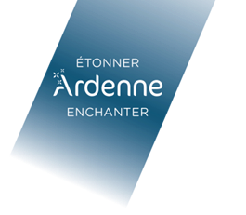
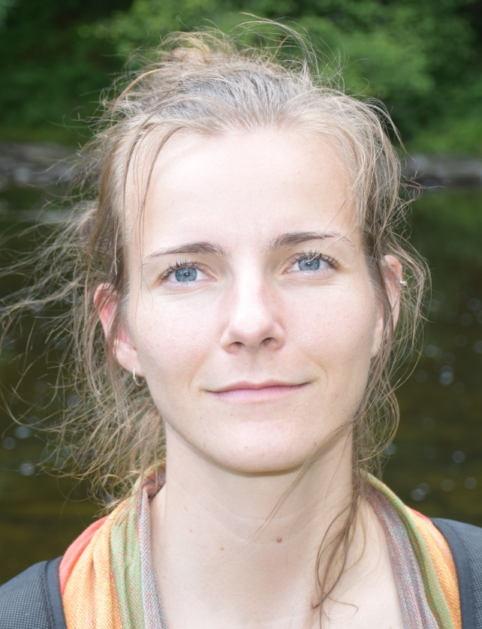
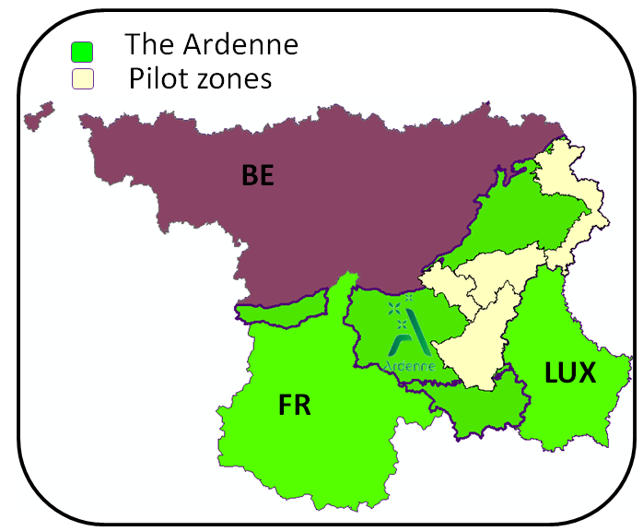
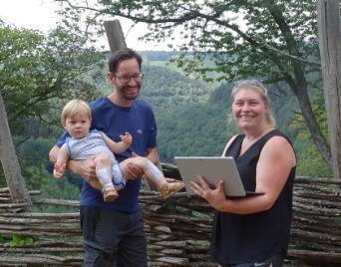
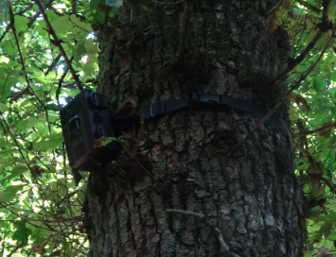
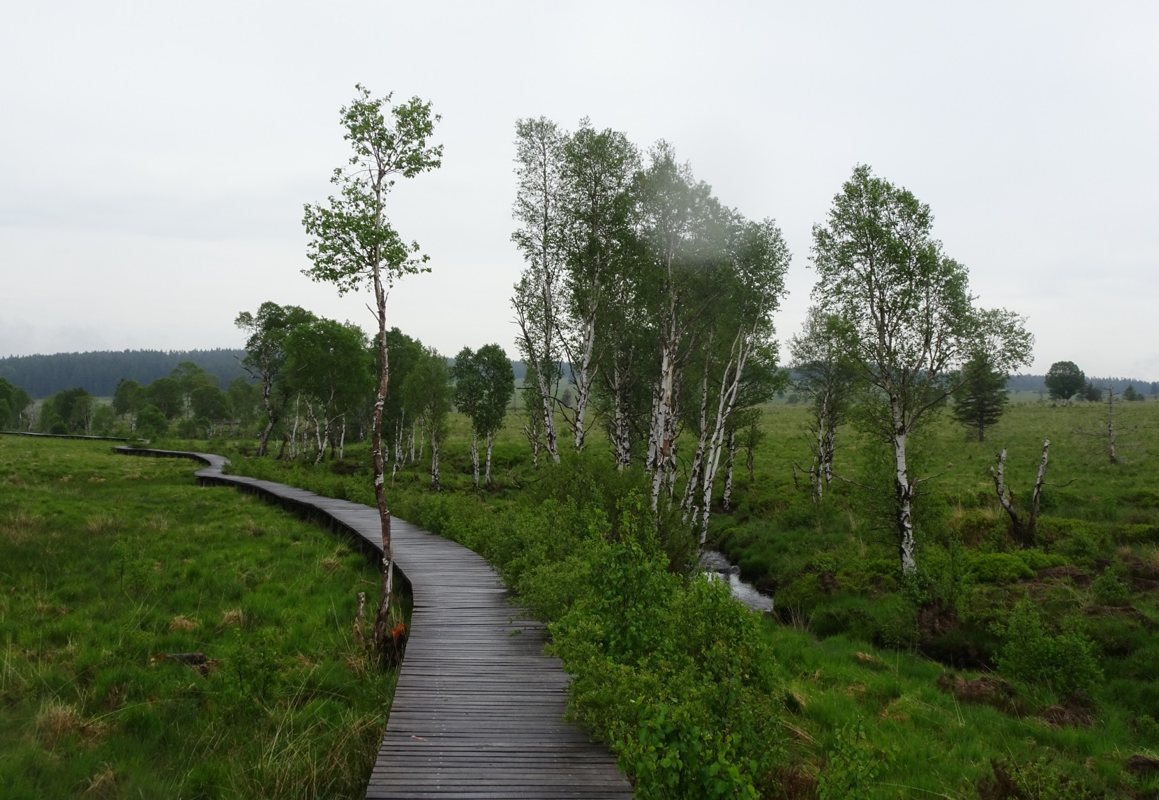
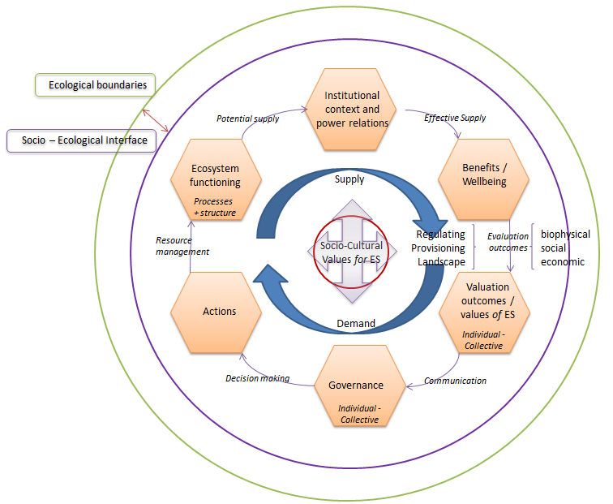
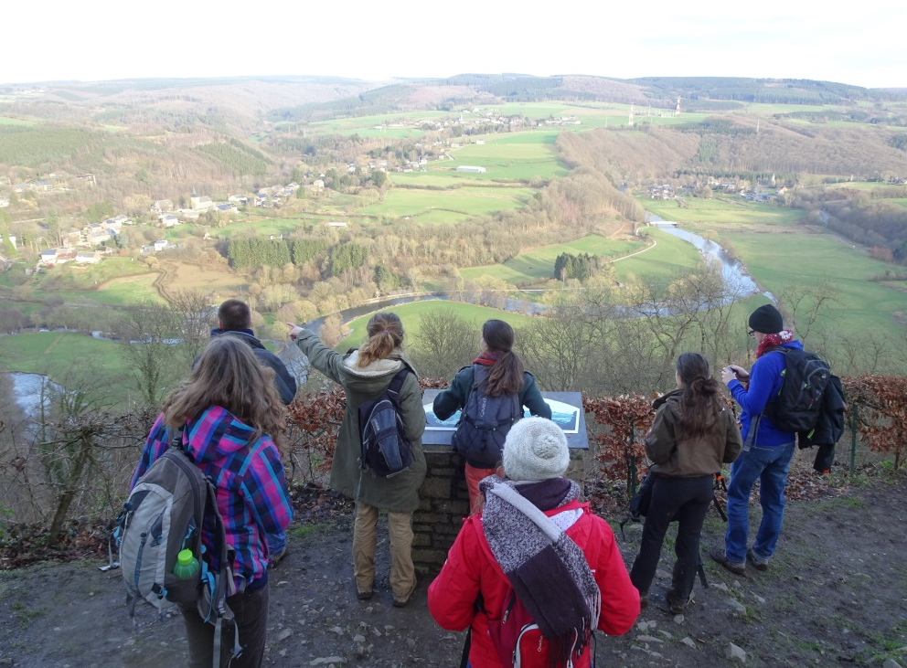
The attractiveness of natural landscapes, valorizing the Ardenne in terms of ecotourism services
Breyne Johanna¹, Maréchal Kevin², Abildtrup Jens³, Dufrêne Marc¹
¹Biodiversity and Landscape Unit, Gembloux Agro-Bio Tech, University of Liège, 5030 Gembloux, B-5030, Belgium
²Rural economy Unit, Gembloux Agro-Bio Tech, University of Liège, 5030 Gembloux, B-5030, Belgium
³Institut national de la recherche agronomique – 54000 Nancy, Fr-54000, France
1. The AGRETA Project
Project objective : To reinforce the cultural and touristic valorization of the patrimony
Action 1,2
Project management and communication
Action 3
Analysis of supply and demand
Action 4,5,6
Supply development
Action 7
Mobilization of tourism operators
Action 8
Marketing of the Ardenne
2. Ecotourism Demand – Flow - Supply
Actor profiling
Actual behavior
Landscape preferences (DCE’s)
Perceptions (appropriate usages)
Monitoring fluxes
Visitor frequencies (Big data analytics, ≠ field monitoring tools, surveys)
Economic evaluations (CV/TCM)
Mapping availabilities
Biophysical characteristics
Infrastructural elements
Relational network
→ Social, ecological and economic valuation outcomes (integrated assessment)
University of Liege – Gembloux Agro-bio Tech – Biodiversity and Landscape Unit Contact johanna.breyne@uliege.be
University of Liege – Gembloux Agro-bio Tech – Biodiversity and Landscape Unit Contact johanna.breyne@uliege.be
3. Broadening the scope
Integrating components
Confronting supply, flow and demand sides
Identifying potential supply (ao landscape modifications)
Underscoring socio-cultural values for (bundles of) ES
Pinpointing interdependencies between actors and services (>> the tourism sector)
Assessing societal constraints and trade-offs
4. Transitional processes
One participative experimental pilot zone (sections 1, 2 and 3 as inputs)
Processes of co-construction, implementation and transition (sections 3 and 4)
Assessment of changes in perceptions, values and societal constraints
Notes:
My research is part of a wider collaboration project, called AGRETA, which focusses on the Ardenne region, situated in southern belgium, northern France and in Luxembourg.
This region concerns a rather green, forested area, prenched in between the very populated areas of flanders and large aglomerations in northern France as well as in eastern germany and because of this kind of green refuge aspect, it is considered very attractive in terms of a touristic potential. While tourism represents indeed a large share of the Walloon revenues, the management of the ardenne forests is currently dominated by hunting and forestry interests. This focus on production and game keeping has its repercussions on the biodiversity status of the region, And at the same time on its touristic attractiveness, however there are very few data available to back up these dependencies and to illustrate the importance of natural areas for the tourism sector. Within this project we are responsible for the analysis of the supply, flow and demand in terms of the attractiveness of natural landscapes. Whilst the general focus lies on the entire territory of the Ardenne, we identified 4 pilot sites for the field operations.
To do this we focus for the demand on the actual behavior of tourism stakeholders trhouogh surveys and field monitoring tools, their preferences for certain landscape characteristics through a choice experiment, and their perceptions concerning appropriate ought usages in and of forests through 3 principal surveys (tourism operators, tourists on site and the larger general public, so also including local inhabitants and otehr stakeholders).
For the flow we estimate visitor frequencies, forwhich we make use of big data analytics as mobile phone positioning data, camera traps and surveys and we also perform certain economic evaluations.
For the supply we plan to map the available and preferred landscapes, as well as available infrastructures and services.
With these elements we aim to combine social, ecological and economic elements to evaluate the actual and potential attractiveness of the natural landscapes in the ardenne area and identify contraining and or beneficial types of landscape management.
A parrallel part of teh research focusses on the perceptions and values that tourists, but also other local stakeholders have concerning the ardenne forests and how these values and the perceptions on certain forest usages align or differ according too the profile of teh actor and according to individual or deliberated assessments.
This information will also serve as an input for an action-research project that will be developped in one of te pilot sites, where through participaptive methods, stakeholders are invited to be part of a porcess of co construction to define a novel way of forest management, whith a focus on biodiversity conservation and how to frame a diffuse ecotourism and a qualitative wood production within.
As to date we just finished our report on the visions and actions ofArdenne tourist operators, who very clearly evocate the importance of nature and wilderness for the future of the region. You are welcome to discuss these first results or other aspects of teh project with me afterwards if you are interested.

