Slide 1

Safe and/or Secure?
Dealing with uncertainties in high-risk industries
Colin Glesner
Belgian Nuclear Research Center (SCK-CEN),
University of Liège
colin.glesner@sckcen.be

Slide 2
Scope of the project
Belgian Nuclear Research Center
Safety and security aspects in projects
Ethnographies
Interviews
Document analysis
Vulnerability approach
Compare literature with case studies

Slide 3
Methodology
Ethnography
Interviews
Document analysis
Informal discussions
Regulatory frameworks
Meeting reports
Safety and security internal documents
Nuclear safety regulator
Internal service for safety and security at work
Project leaders
Employees
Meetings

Slide 4
Overview
Literature analysis
Fieldwork analysis

Slide 5
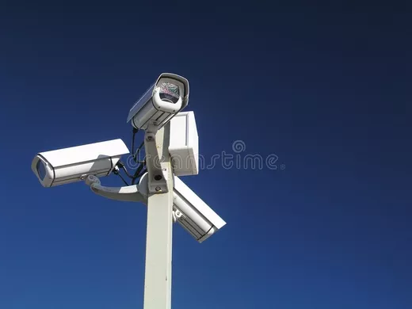
Dominant views on safety & security
Safety
Security
« Two sides of the same coin »
Focus on synergies
Results from literatures on safety & security

Slide 6
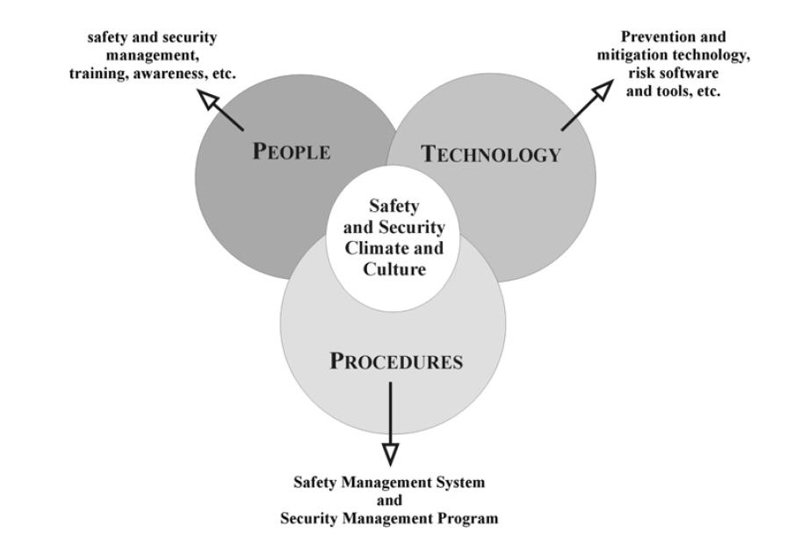
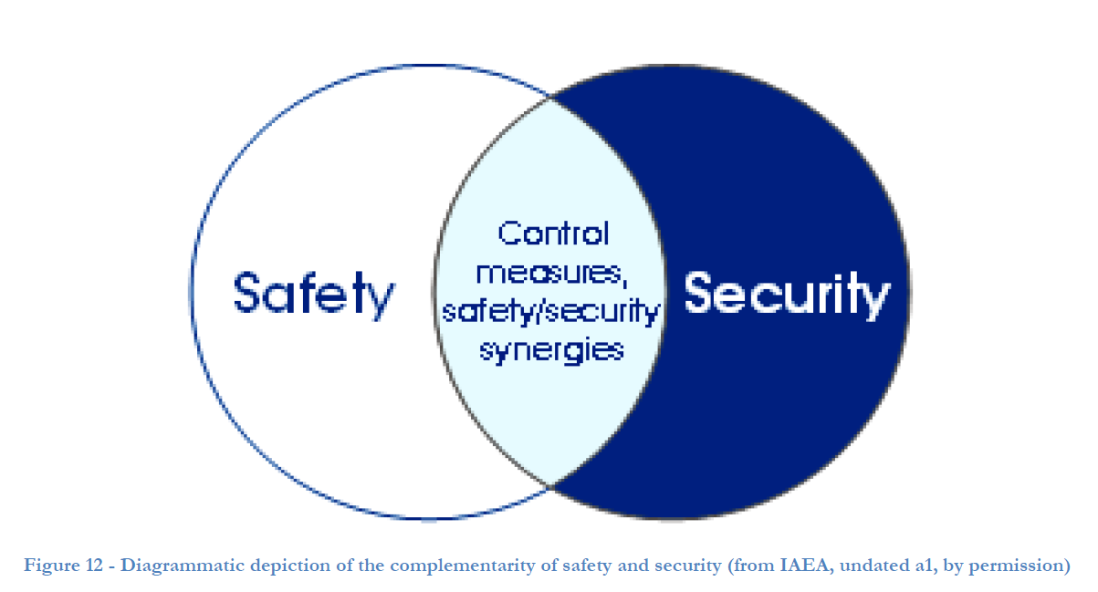
Safety & security models
IAEA (International Atomic Energy Agency) model
P2T Model (Reniers, 2010)
Safety & security management, training, awareness
Synergies
Integration

Slide 7
Tensions
Safety
Security
Confidentiality
Access control
Lockdown
Transparency
Access facilitation
Evacuation facilitation

Slide 8
Discrepancies
Safety culture
Security culture
Confidentiality
Access control
Confinement and screening
Minimization of time transport and visibility
Infrastructure easily screenable
Transparency
Relief effort facilitation
Transport’s visibility and safety requirement
Evacuation
Heavy bunkering
Catch unlawful act authors
Only protect people & environment

Slide 9
About tensions and their governance
“These conflicts can be solved” (IAEA, 2010)
«resolution of potential conflicts» (Kriaa et al., 2015)
Tensions between safety & security
« To avoid conflicting situations» (Reniers, 2011)
“resolve possible conflicts” (Karanikas, 2017)
Notes:
Still in this widespread vision (safety and security could be integrated) tensions have to be overcome, resolved, avoided. They are or seen as bad, or seen as the outcomes of not good integrations between safety and security. Tensions are always seen at least at, sometimes, necessary burdens and at most elements that can be and should by eliminated or avoided through a better integration between safety and security.

Slide 10
Overview
Literature analysis
Fieldwork analysis

Slide 11
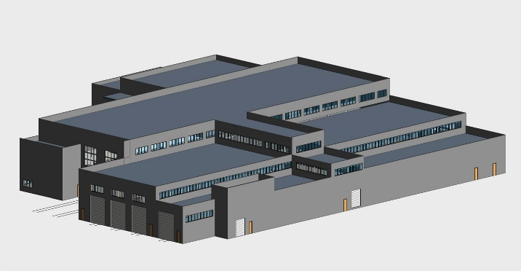
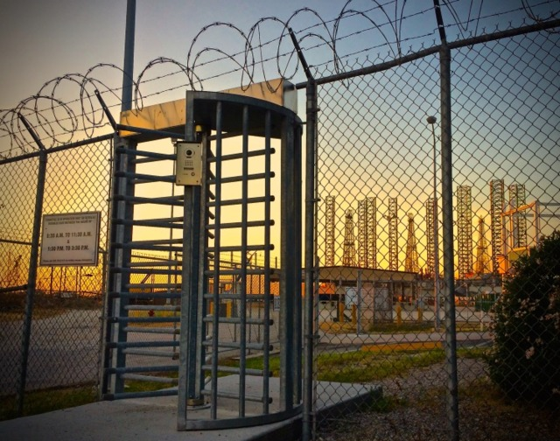
Fieldwork: Safety and security aspects in a Nuclear Research Center
Vulnerability
Focus on the system studied
Context dependent
May be good!!
“necessary condition for [a sociotechnical system] survival”
“opportunity to act, learn and innovate” (Bijker et al., 2014, p. 22).
Notes:
Having the literature in mind, I intend to analyze how emprically safety and security interplay and how they are dealt with. In roder to do so, I carried out a field in a Nuclear Research Center in Belgium

Slide 12
Safety and security aspects of projects’ set-up
Regulator
Security department
Regulator
Safety department
Internal Service for Prevention and Protection at Work
Head of service
Security
Industrial safety
Nuclear safety
Project leader
Set up project

Slide 13
Safety and security aspects of projects’ set-up
Regulator
Security department
Regulator
Safety department
Regulations
Internal Service for Prevention and Protection at Work
Head of service
Security
Industrial safety
Nuclear safety
Advisory documents
Project leader
technologies
procedures
Set up project

Slide 14
A central actor
Internal Service for Prevention and Protection at Work
<10% of employees
Coordination of safety and security
Following specific regulations
3 units
Advising

Slide 15
About tensions

Slide 16
Regulator Security department
Regulator safety department
Head of internal service
Security
Industrial safety
Nuclear safety
Tensions
Project leader
Safety-security actors
Safety & security-project leader
Safety-security tensions
Set up project

Slide 17
About tensions
Tensions between safety and security actors
« they never speak to us! They are not open minded and they have a secrecy culture. This create tensions because I need some information »
Tensions between safety/security actors and project leaders
“Everyone can become project leader. This is why they are often incompentent”
Tensions between safety/security technologies
« It is always when the building or the project has been carried out that we notice safety and security conflicting elements. And clashes between different actors arise from it. »

Slide 18
… And their (non)articulation

Slide 19
Regulator security department
Regulator safety department
Absence of tensions areas/venues
Non recognition of tensions
Unstructured tensions
Head of internal service
Security
Industrial safety
Nuclear safety
Project leader
Hamper resilience
Set up project

Slide 20
… And their silencing
Absence of tensions venues
« Internal service units meet once a year. Otherwise no systematic meetings. We do not know each other. »
Non recognition of tensions
“There is one culture in the internal service and collaboration between units is fluent”
Unstructured tensions
“We ask other units to send their pieces of advice to our unit, we send ours to the others but they do not do the same. We are for the transparency, this is not the case for the others.”
Notes:
Absence of tensions venues and non recognition of tensions create unstructured tensions

Slide 21
Embracing tensions
Some tensions are inherent
Some tensions are positive
Should acknowledge tensions
Should create and valorise venues for tensions
Should have an attitude to look for tensions in a transparent way
Notes:
Unproductive tensions are created through tensions silencing (vicious circle)

Slide 22
Thank you for your attention
Colin Glesner
Belgian Nuclear Research Center (SCK-CEN),
University of Liège
colin.glesner@sckcen.be

Slide 23
Copyright © 2018 - SCK•CEN
PLEASE NOTE!
This presentation contains data, information and formats for dedicated use only and may not be communicated, copied, reproduced, distributed or cited without the explicit written permission of SCK•CEN.
If this explicit written permission has been obtained, please reference the author, followed by ‘by courtesy of SCK•CEN’.
Any infringement to this rule is illegal and entitles to claim damages from the infringer, without prejudice to any other right in case of granting a patent or registration in the field of intellectual property.
SCK•CEN
Studiecentrum voor Kernenergie
Centre d'Etude de l'Energie Nucléaire
Belgian Nuclear Research Centre
Stichting van Openbaar Nut
Fondation d'Utilité Publique
Foundation of Public Utility
Registered Office: Avenue Herrmann-Debrouxlaan 40 – BE-1160 BRUSSELS
Operational Office: Boeretang 200 – BE-2400 MOL

