Slide 1
Sexualization and aggression against women
A focus on sexualized characters in video games
May 2 2019

Slide 2
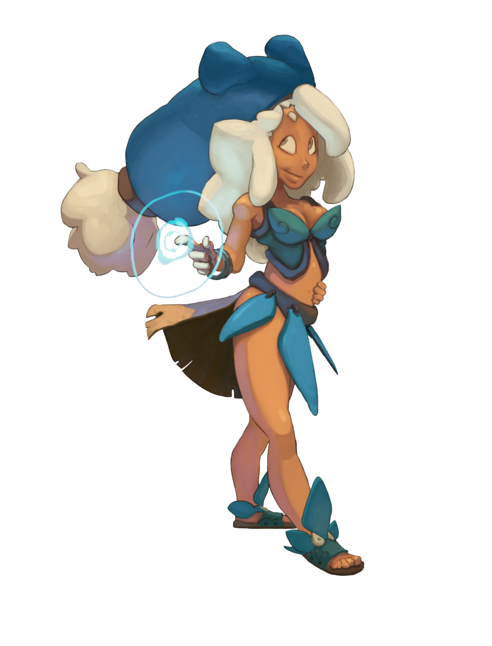
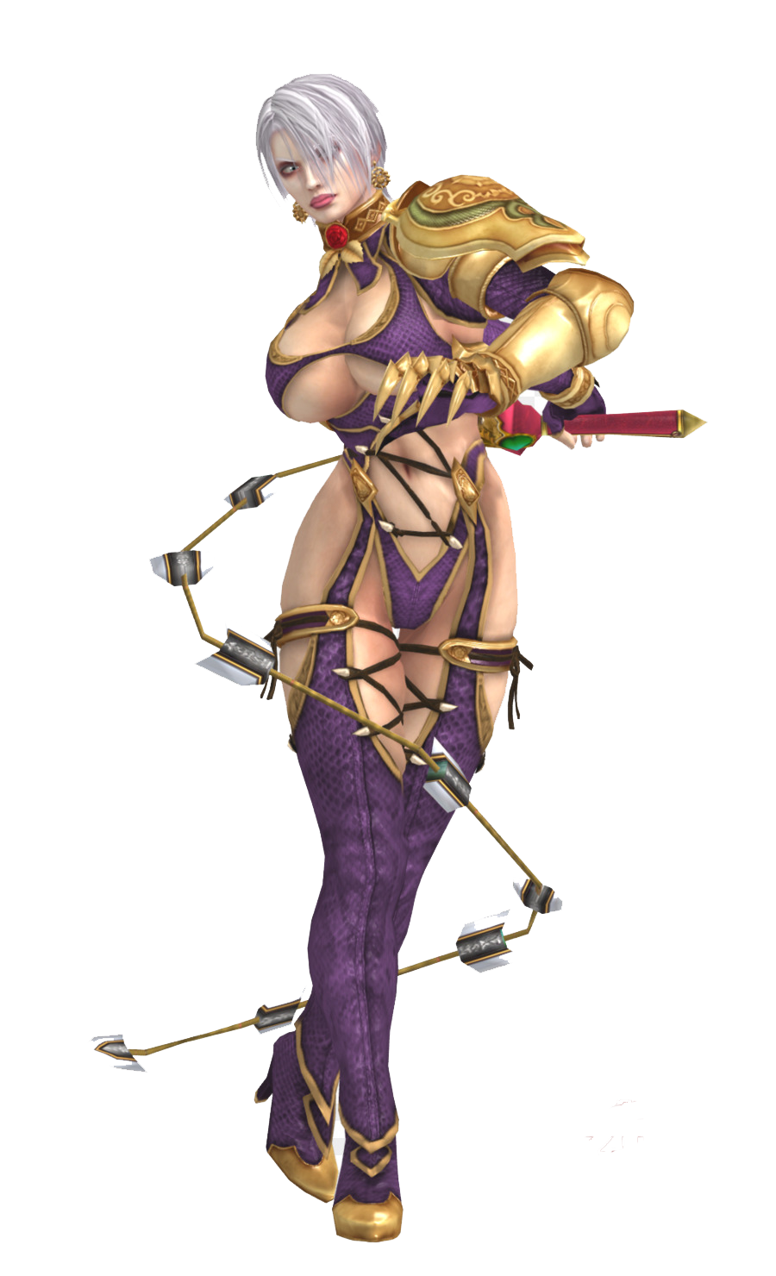
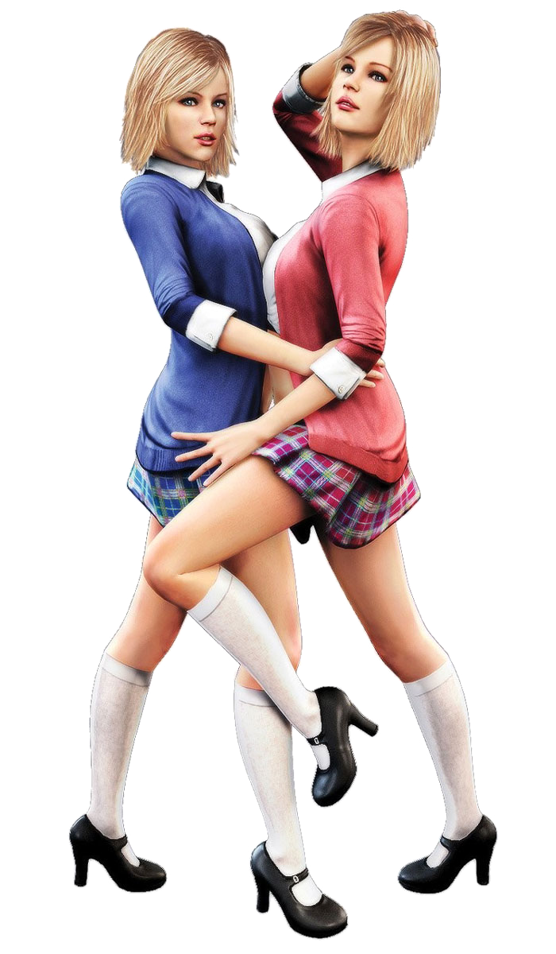
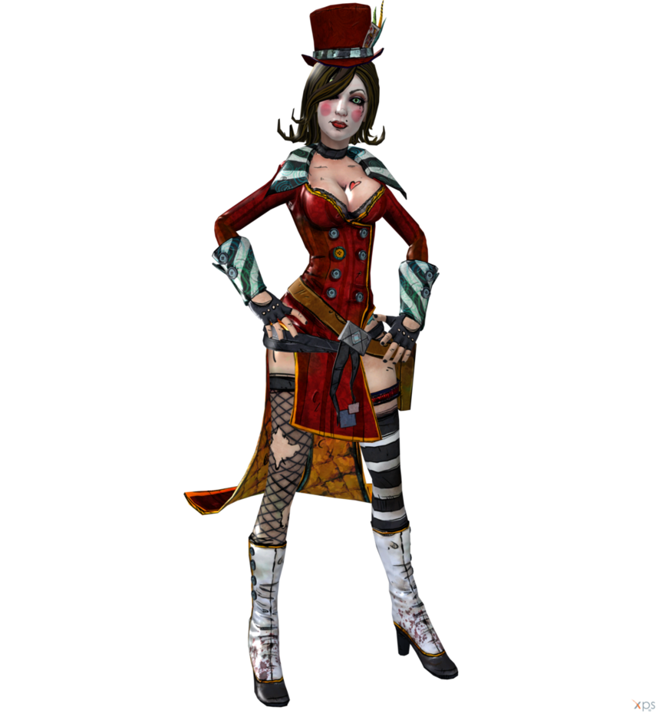
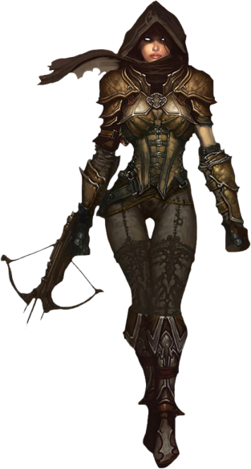
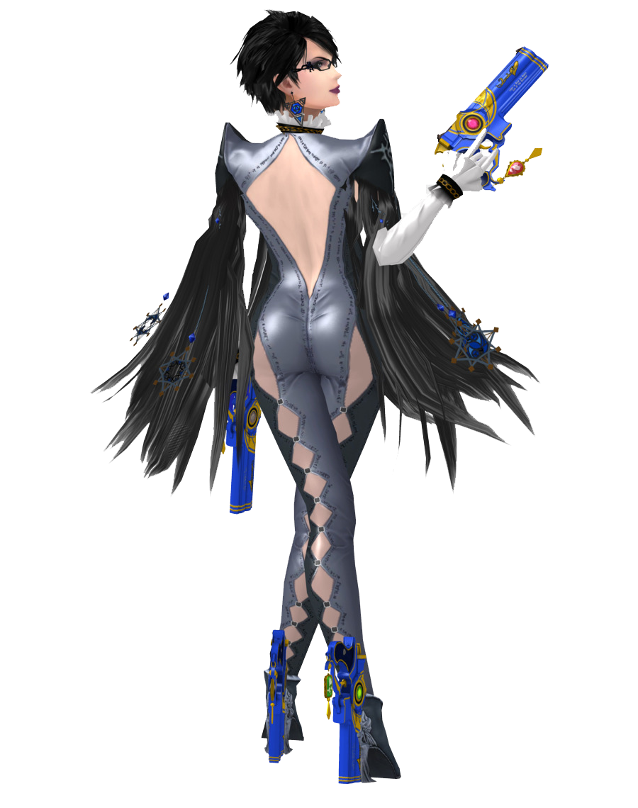
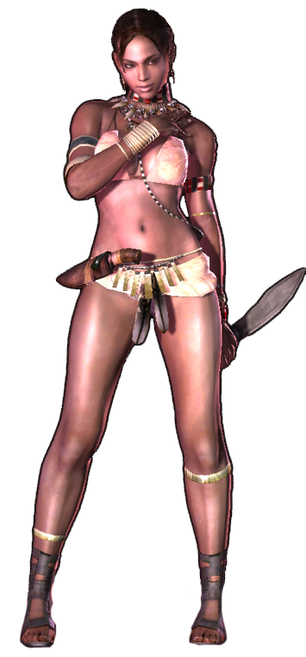
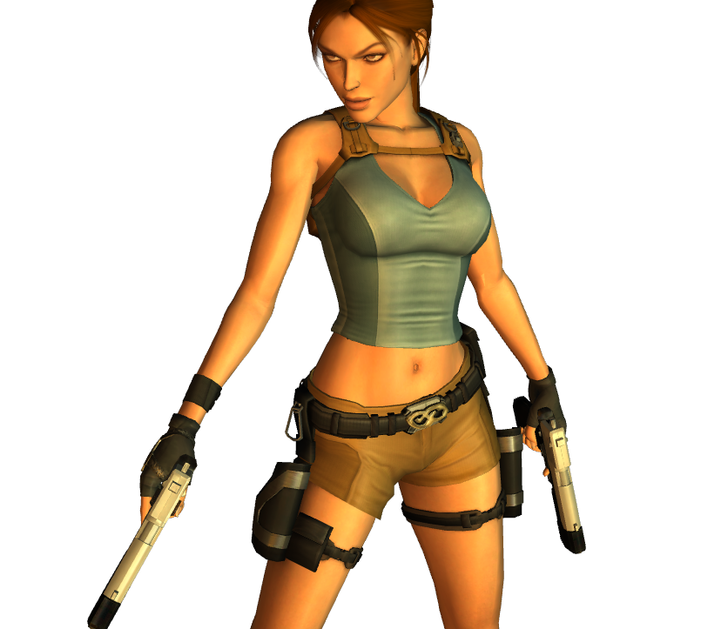
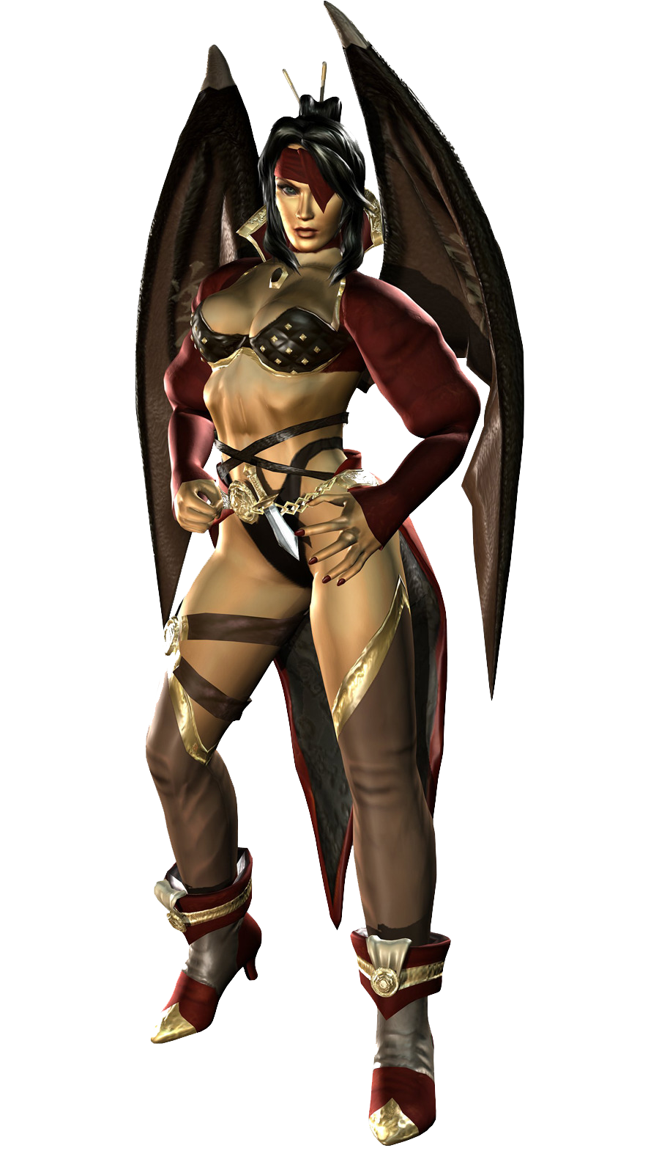
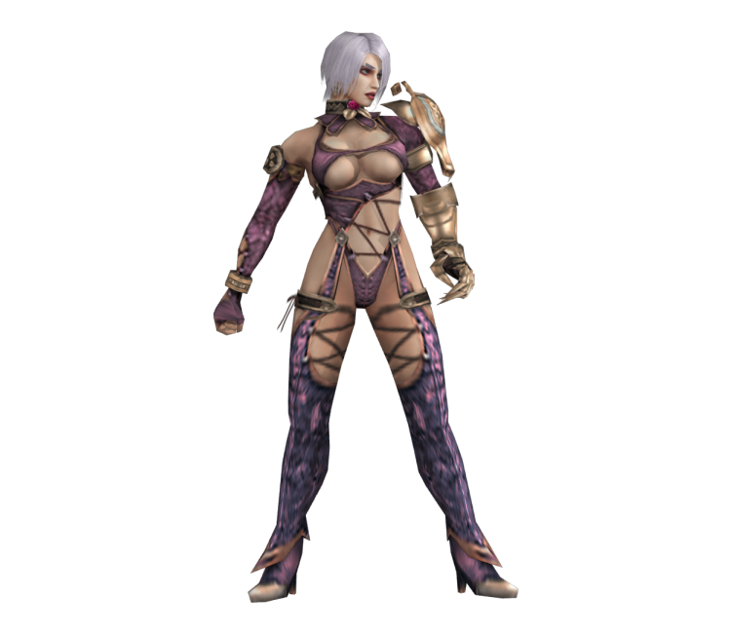
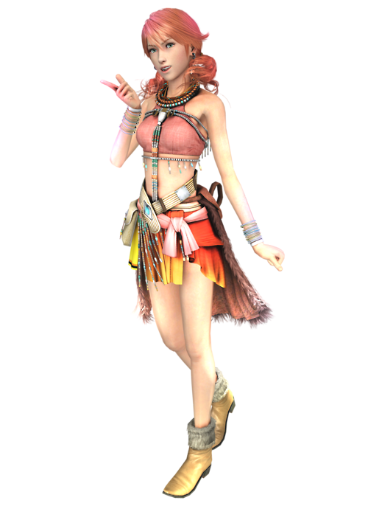
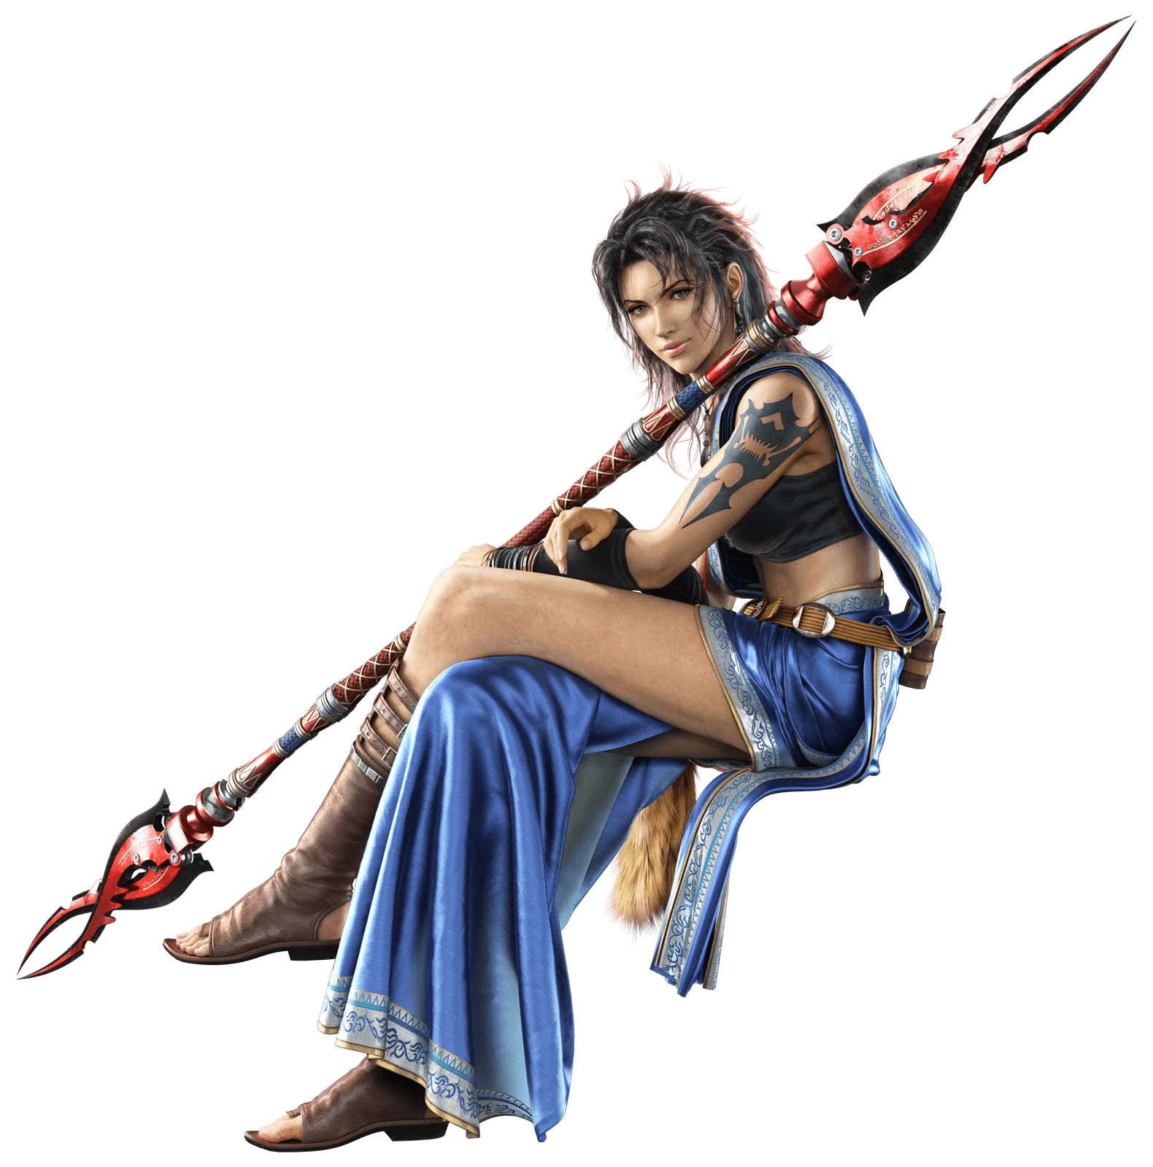
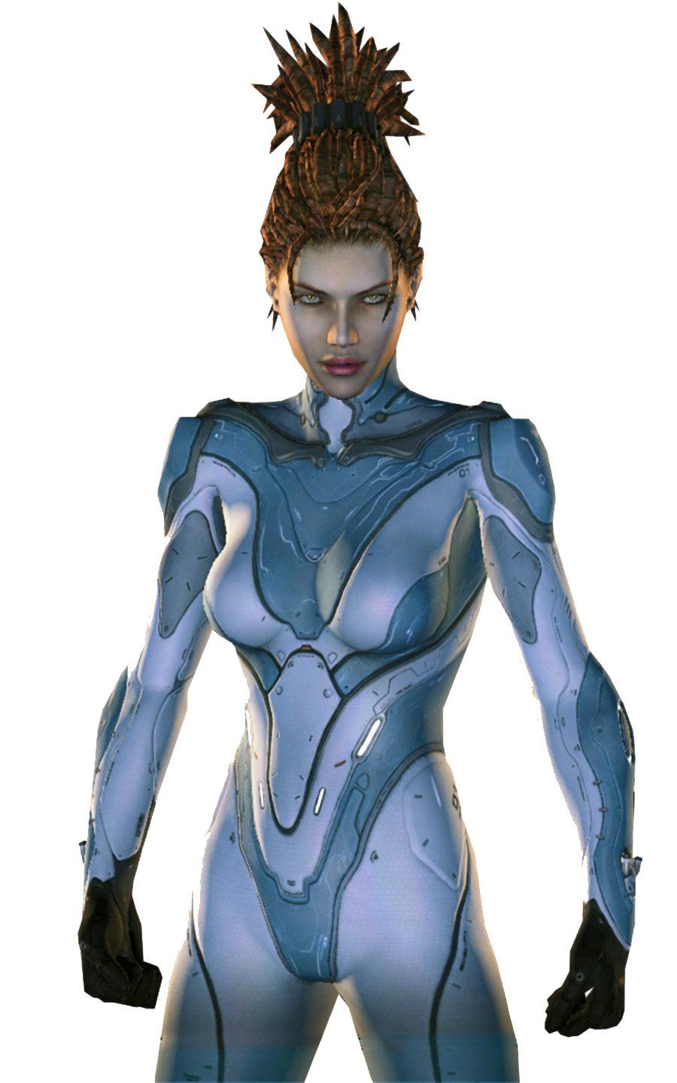
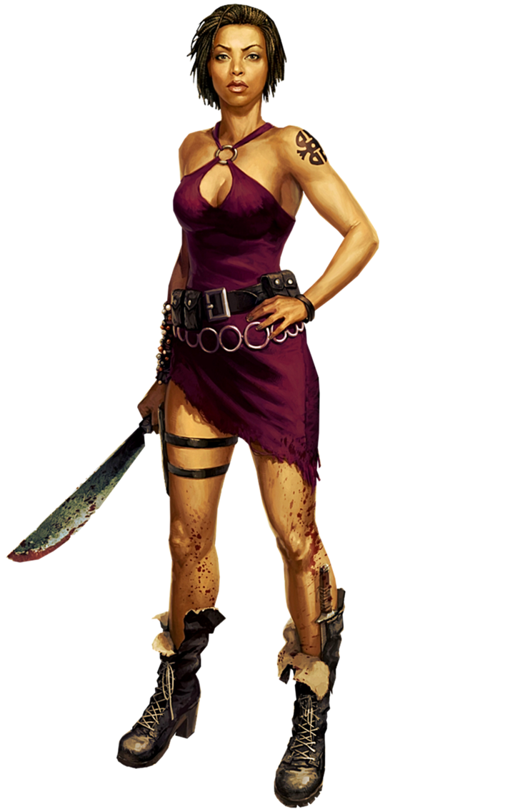
Compared to male characters
Underrepresented
Secondary character
Sexualized

Slide 3
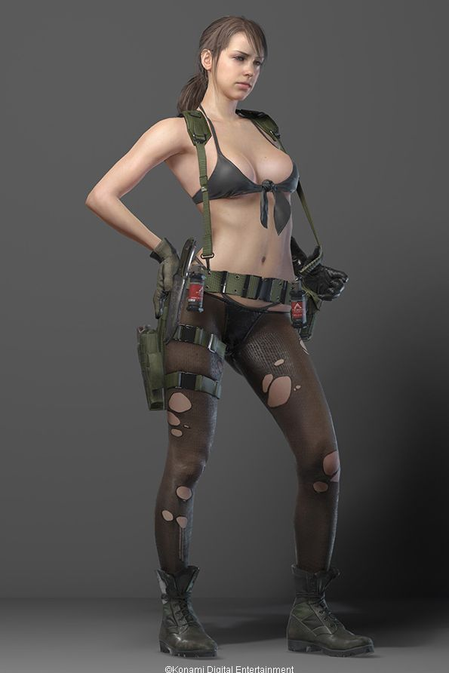

Slide 4
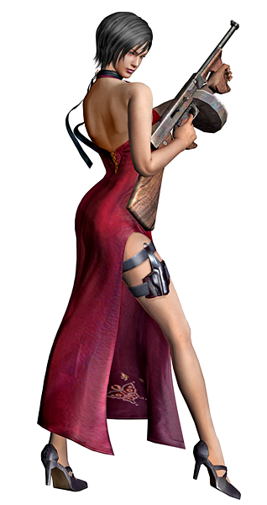

Slide 5
Sexualization
Nudity
Revealing clothing
Suggestive poses

Slide 6
Aggression against women
Public physical sexual harassment
Know a victim
+ Aggression by partner
56%
Non-consensual sex by hierarchic superior
Rape
7%
13%

Slide 7
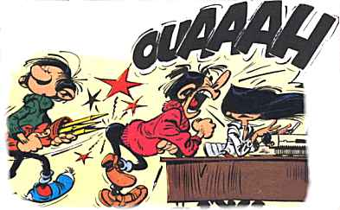
Aggression
External and visible
Involves two people
Intentional
Avoid being hurt

Slide 8
Aggression against women

Slide 9
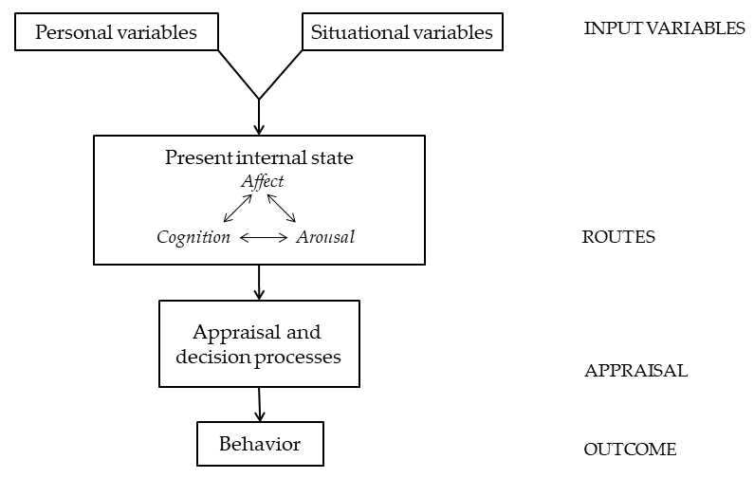
Hard day at school
Competitive, violent, sexualized video game
Lost
Female player
Provocation
Young
Male
Traditional roles
Angered
“What a bitch”
Heart beat
I have to answer
Insult

Slide 10
Can sexualized content from video games cause aggression against women?
Study 1
Behavior
Study 2
Study 3
Affect
Cognition
Study 4
Meta-analysis
Study 5

Slide 11
2
Introduction
Sexualization
Sexual harassment

Slide 12
2
Method
211 College students
18 to 37 years old
Burnay, J., Bushman, B. J., Larøi, F. (2018). Effects of sexualized video games on online sexual harassment. Aggressive Behavior, 45, 214-233. doi: 10.1002/ab.21811

Slide 13
2
Method
211 College students
18 to 37 years old
Burnay, J., Bushman, B. J., Larøi, F. (2018). Effects of sexualized video games on online sexual harassment. Aggressive Behavior, 45, 214-233. doi: 10.1002/ab.21811

Slide 14
2
Method
Sexual Harassment Task
Why do sharks swim in salt water? Because pepper would make them sneeze!
Neutral jokes
Sexist jokes
Why don't women wear watches? There's a clock on the stove.
Burnay, J., Bushman, B. J., Larøi, F. (2018). Effects of sexualized video games on online sexual harassment. Aggressive Behavior, 45, 214-233. doi: 10.1002/ab.21811

Slide 15
2
Method
211 College students
18 to 37 years old
Ambivalent Sexism Inventory
Aggression Questionnaire
Online Disinhibition Scale

Slide 16
2
Results
Source F Df p ηp2
Sexualization 0.56 1 .455 .003
Partner Gender 12.85 1 <.001 .061
Participant Gender 4.37 1 .038 .021
Sexualization*Partner Gender 6.13 1 .014 .030
Sexualization*Participant Gender 0.26 1 .612 .001
Partner Gender*Participant Gender 0.15 1 .694 .001
Sexualization*Partner Gender*Participant Gender 0.17 1 .678 .001
Hostile Sexism 7.02 1 .009 .034
Benevolent Sexism 2.16 1 .144 .011
Trait Aggression 1.84 1 .176 .009
Online Disinhibition 3.81 1 .052 .019
Error 199

Slide 17
2
Results
Partner
Partner
Partner
Participant
Participant

Slide 18
2
Discussion
Sexualization
Sexual harassment
Burnay, J., Bushman, B. J., Larøi, F. (2018). Effects of sexualized video games on online sexual harassment. Aggressive Behavior, 45, 214-233. doi: 10.1002/ab.21811

Slide 19
2
Discussion
Partner
Partner
Participant
Participant
Burnay, J., Bushman, B. J., Larøi, F. (2018). Effects of sexualized video games on online sexual harassment. Aggressive Behavior, 45, 214-233. doi: 10.1002/ab.21811

Slide 20
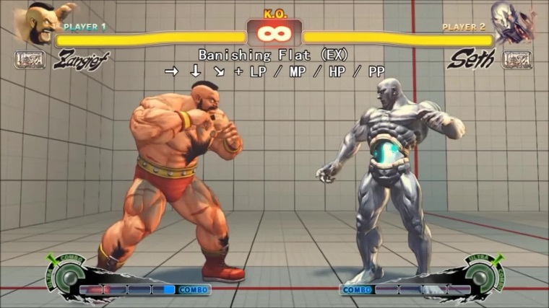
2
Discussion
Limitations
Sexualized males
Intention?
Type of sexual harassment
Present internal state
Sexual harassment
Gender
harassment
Sexual
coercion
Unwanted sexual attention
Burnay, J., Bushman, B. J., Larøi, F. (2018). Effects of sexualized video games on online sexual harassment. Aggressive Behavior, 45, 214-233. doi: 10.1002/ab.21811

Slide 21
3
Introduction
Sexualization
Negative evaluation of women
Burnay, J., Larøi, F. An Examination of the Possible Impact of the Sexualized Content of Video Games and Cognitive Load on Implicit Evaluations of Women.

Slide 22
3
Method
Low cognitive load
High cognitive load
137 College students
18 to 33 years old
Low cognitive load
High cognitive load
Burnay, J., Larøi, F. An Examination of the Possible Impact of the Sexualized Content of Video Games and Cognitive Load on Implicit Evaluations of Women.

Slide 23
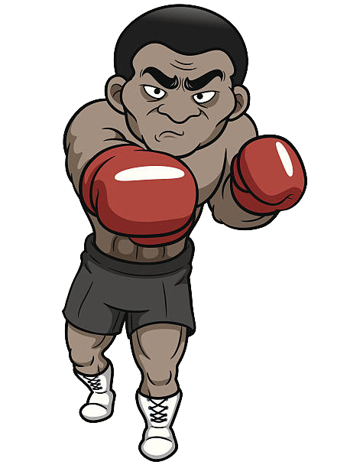
3
Method
Cognitive load
Low
High
Burnay, J., Larøi, F. An Examination of the Possible Impact of the Sexualized Content of Video Games and Cognitive Load on Implicit Evaluations of Women.

Slide 24
3
Method
Sexualization
Negative evaluation of women
Burnay, J., Larøi, F. An Examination of the Possible Impact of the Sexualized Content of Video Games and Cognitive Load on Implicit Evaluations of Women.

Slide 25
3
Method
Affect Misattribution Procedure
Prime
75ms
100ms
Chinese pictograph
100ms
Mask
Ambivalent Sexism Inventory
Aggression Questionnaire
Illinois Rape Myth Acceptance Scale
Burnay, J., Larøi, F. An Examination of the Possible Impact of the Sexualized Content of Video Games and Cognitive Load on Implicit Evaluations of Women.

Slide 26
3
Results
F(1, 127) = 5.09, p = .026, η²p = .039
Burnay, J., Larøi, F. An Examination of the Possible Impact of the Sexualized Content of Video Games and Cognitive Load on Implicit Evaluations of Women.

Slide 27
3
Discussion
Sexualization
Negative evaluation of women
Burnay, J., Larøi, F. An Examination of the Possible Impact of the Sexualized Content of Video Games and Cognitive Load on Implicit Evaluations of Women.

Slide 28
3
Discussion
Limitations
Lack of sensitivity
Muscularity
Burnay, J., Larøi, F. An Examination of the Possible Impact of the Sexualized Content of Video Games and Cognitive Load on Implicit Evaluations of Women.

Slide 29
3
4
Introduction
Sexualization
Rape Myth
Burnay, J., Larøi, F. Impact of Sexualized Video Game and Cognitive Load on Rape Myth Acceptance and Dehumanization of the Perpetrator

Slide 30
3
4
Method
Low cognitive load
High cognitive load
142 College students
18 to 27 years old
Low cognitive load
High cognitive load
Burnay, J., Larøi, F. Impact of Sexualized Video Game and Cognitive Load on Rape Myth Acceptance and Dehumanization of the Perpetrator

Slide 31
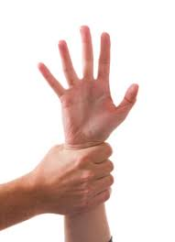
4
Method
Rape date story
Burnay, J., Larøi, F. Impact of Sexualized Video Game and Cognitive Load on Rape Myth Acceptance and Dehumanization of the Perpetrator

Slide 32
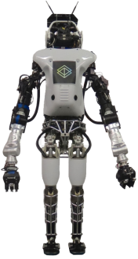
4
Method
Dehumanization
Humanness
Human
Uniqueness
Human
Nature
Burnay, J., Larøi, F. Impact of Sexualized Video Game and Cognitive Load on Rape Myth Acceptance and Dehumanization of the Perpetrator

Slide 33
4
Method
Cognitive load
Dehumanization
Sexualization
Responsibility
Ambivalent Sexism Inventory
Aggression Questionnaire
Illinois Rape Myth Acceptance Scale
Gamer Identification
Burnay, J., Larøi, F. Impact of Sexualized Video Game and Cognitive Load on Rape Myth Acceptance and Dehumanization of the Perpetrator

Slide 34
4
Results
Victim
High Cognitive load
Denial of positive
human uniqueness
Cognitive load
Dehumanization
b=.173
b=.271
Sexualization
Responsibility
Burnay, J., Larøi, F. Impact of Sexualized Video Game and Cognitive Load on Rape Myth Acceptance and Dehumanization of the Perpetrator

Slide 35
3
4
Discussion
Sexualization
Rape Myth
High Cognitive load
Burnay, J., Larøi, F. Impact of Sexualized Video Game and Cognitive Load on Rape Myth Acceptance and Dehumanization of the Perpetrator

Slide 36
4
Discussion
Limitations
Cognitive load
Dehumanization
Sexualization
Responsibility
Dehumanization of a different woman
Burnay, J., Larøi, F. Impact of Sexualized Video Game and Cognitive Load on Rape Myth Acceptance and Dehumanization of the Perpetrator

Slide 37
4
Results
Perpetrator
Positive
human nature
High Cognitive load
b=-.237
Negative
human nature
b=.271
Positive
human uniqueness
b=-.215
Negative
human uniqueness
b=.238
Sexualization
Responsibility
Burnay, J., Larøi, F. Impact of Sexualized Video Game and Cognitive Load on Rape Myth Acceptance and Dehumanization of the Perpetrator

Slide 38
4
Discussion
Limitations
Cognitive load
Dehumanization
Sexualization
Responsibility
Stranger (Bernard, Loughnan, et al., 2015) vs. Acquaintance (Bernard, Legrand, & Klein, 2016)
Empathy
Identification
More quality of contact = more humanness = more support for rehabilitation
(Viki, Fullerton, Raggett, Tait, & Wiltshire, 2012)
Burnay, J., Larøi, F. Impact of Sexualized Video Game and Cognitive Load on Rape Myth Acceptance and Dehumanization of the Perpetrator

Slide 39
5
Introduction
Burnay, J., Kepes, S., Bushman, B. J. Effects of Violent and Nonviolent Sexualized Media on Aggression-Related Thoughts, Feelings, Attitudes, and Behaviors:
A Meta-Analytic Review

Slide 40
5
Method
Aggressive behavior
Aggressive cognition
Aggressive affect
Hostile attitudes
Aggression
Burnay, J., Kepes, S., Bushman, B. J. Effects of Violent and Nonviolent Sexualized Media on Aggression-Related Thoughts, Feelings, Attitudes, and Behaviors:
A Meta-Analytic Review

Slide 41
5
Results
97 studies
55596 participants
Aggressive behavior
k=63; N=19137 / 55.3%
k=11; N=12649 / 61.9%
Aggressive cognition
k=16, N=2354 / 54.5%
Hostile attitude
k=79, N=19196 / 53.7%
.5
.10
.15
.20
Burnay, J., Kepes, S., Bushman, B. J. Effects of Violent and Nonviolent Sexualized Media on Aggression-Related Thoughts, Feelings, Attitudes, and Behaviors:
A Meta-Analytic Review

Slide 42
5
Participant gender | Female = Male
Amount of clothing | Scantily clothed = Nude & genitalia not visible = Nude & genitalia visible
Media format | Video game = Film > Print
Age of participants | =
Population Sampled | College students = Non-college students
Type of design | Experimental = Cross-sectional > Longitudinal (n.s.)
Publication Outlet | Published = Unpublished
Year of Publication | =
Impact a large part of the population

Slide 43
Can sexualized content from video games cause aggression against women?

Slide 44
Summary, conclusions & perspectives
Sexualization
Negative evaluation of women
Rape Myth
Sexual harassment

Slide 45
Summary, conclusions & perspectives

Slide 46
Summary, conclusions & perspectives
Sexual thoughts
Self-efficacy
Self-objectification
Assumption of sexual openness
Woman’s agency
Drive for muscularity

Slide 47
Summary, conclusions & perspectives
Cultivation Theory
Social Cognitive Theory of Gender Development and Differentiation
Expectation State Theory
Objectification Theory
Ambivalent Sexism Theory
+

Slide 48
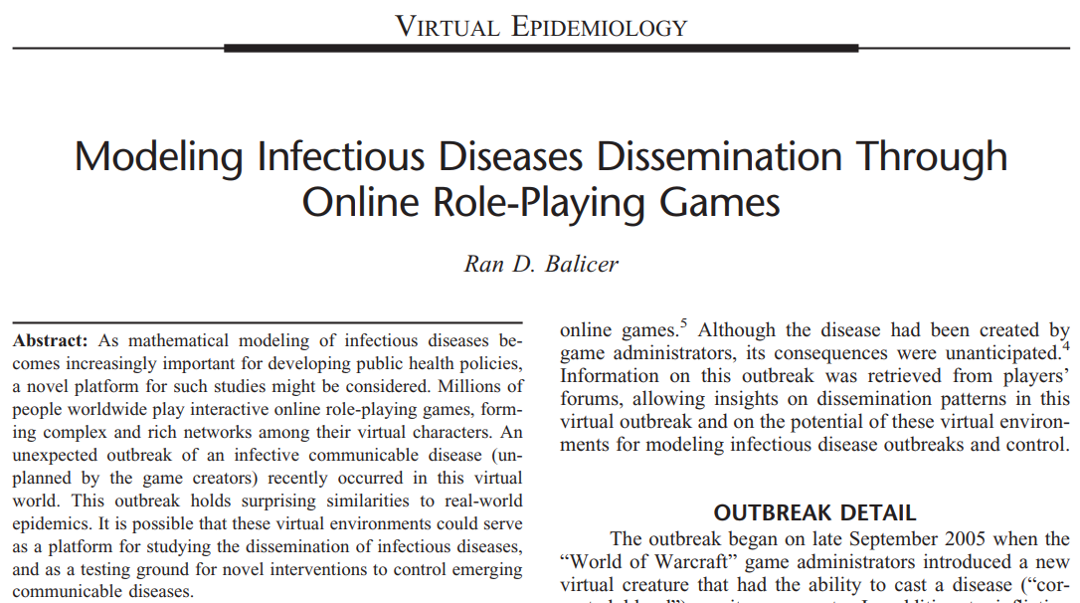
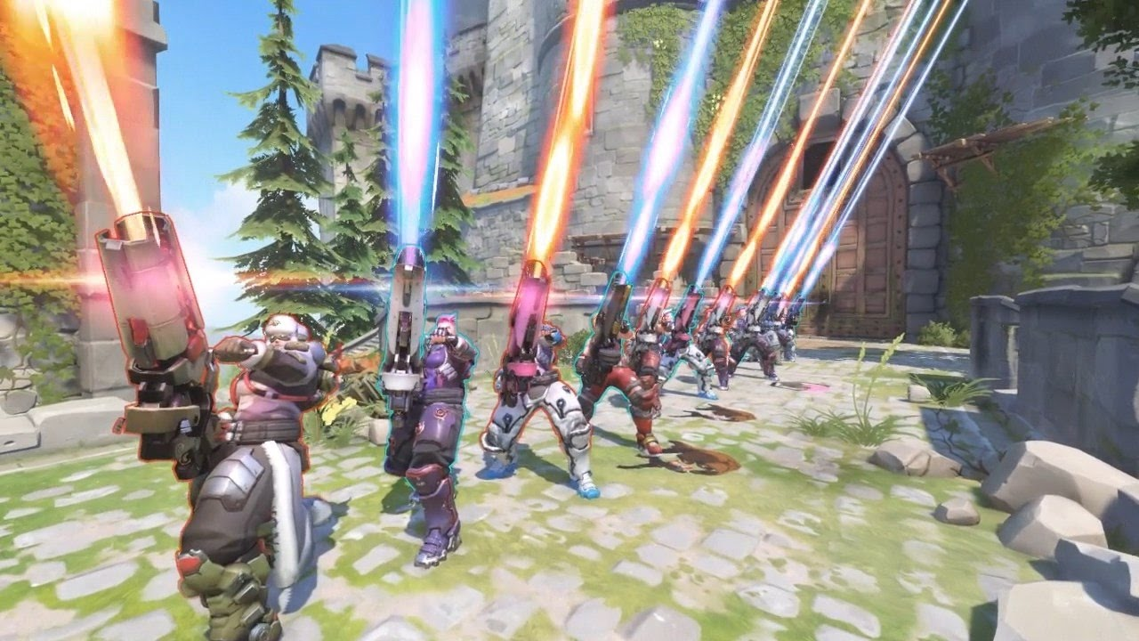
Summary, conclusions & perspectives
General conclusion

Slide 49
