Slide 1
Transforming even-aged coniferous stands to uneven-aged stands: an opportunity to increase tree species diversity?
Journées CAQSIS: 26-28 mars 2019, Aix-en-Provence
Gauthier Ligot¹, Philippe Balandier², Sophie Schmitz³, Hugues Claessens¹
¹ ULiège, Gembloux Agro-Bio Tech, Belgium
² Forest Ecology and Ecophysiology, Irstea, Nogent-sur-Vernisson, France
³ CRA-W, Gembloux, Belgique

Slide 2
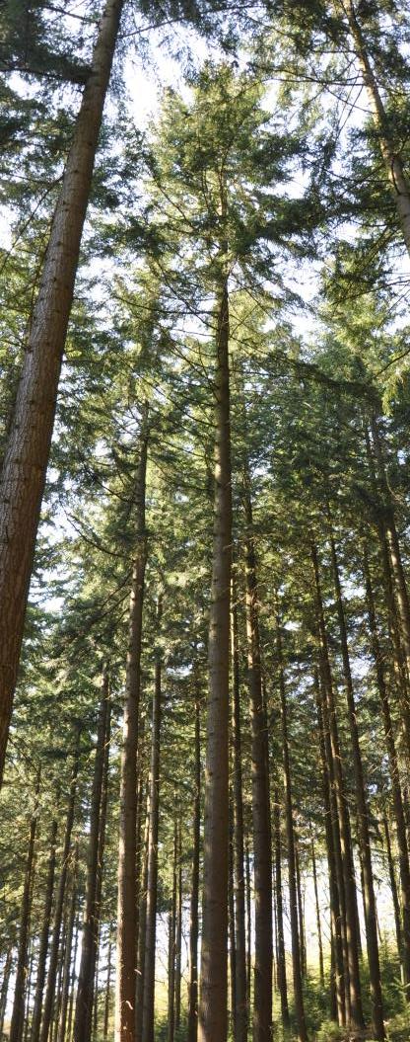
Even-aged to uneven-aged
Coniferous plantations (monoculture), still cover large areas in Europe
50% of forest areas in Belgium
Traditionnally, these stands are managed with clear-cuts and plantations
Silviculture avoiding clear-cutting is more and more encouraged or even imposed by regulation
Pro-Silva silviculture must be applied in state-owned forest in Belgium
Clear-cuts are forbidden in peri-urban forests around Paris, France
…
But very few guides for practionners…
How long does it take to reach an equilibrium state and to harvest the planted trees?
What is the forest productivity during the transformation period?
What will be the composition (and resilience) of future uneven-aged stands?
Notes:
Today, anthropogenous coniferous forests that were planted from the end of the 18th century on, as a consequence of the prior destruction and overutilisation of broad-leaved woodland, still cover large areas in Europe.

Slide 3
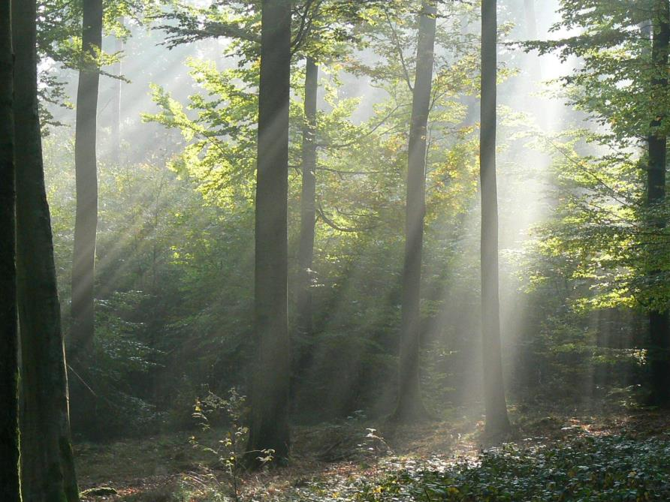
Understory light is assumed to be a key factor of natural regeneration
Assumed to be a limiting factor under continuous cover forestry

Slide 4
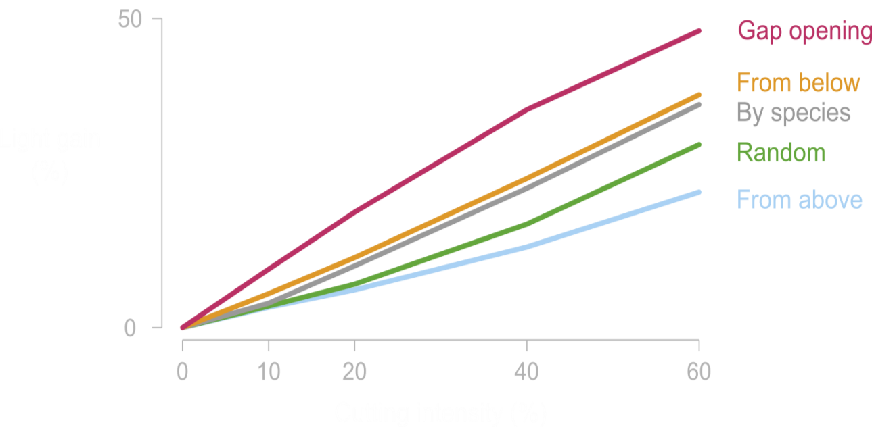
Understory light is assumed to be a key factor of natural regeneration
Assumed to be a limiting factor under continuous cover forestry
Understory light levels can be controlled by partial cuttings
Ligot et al. (2016) Can. J. For. Res. 46 (7)

Slide 5
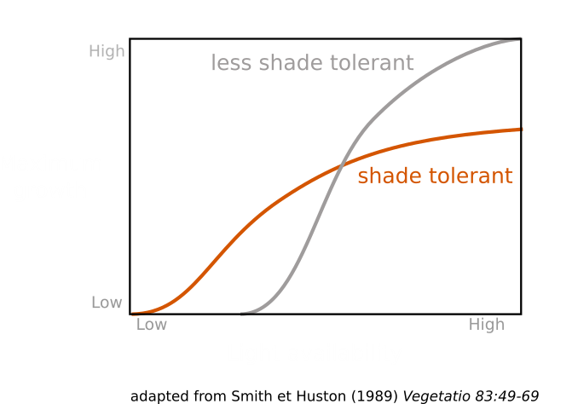
Understory light is assumed to be a key factor of natural regeneration
A limiting factor under continuous cover forestry
Understory light levels can be controlled by partial cuttings
Drive inter-specific competition

Slide 6
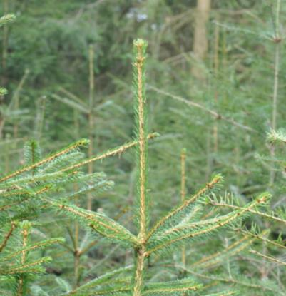
Understory light is assumed to be a key factor of natural regeneration
A limiting factor under continuous cover forestry
Understory light levels can be controlled by partial cuttings
Drive inter-specific competition
The apical dominance ratio has been suggested to be a good indicator of understory light conditions for some species
$$ADR=\frac{terminal shoot length}{Longest lateral shoot length}$$
Terminal
shoot length
Longest lateral
shoot length

Slide 7
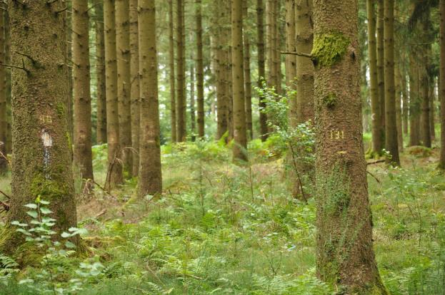
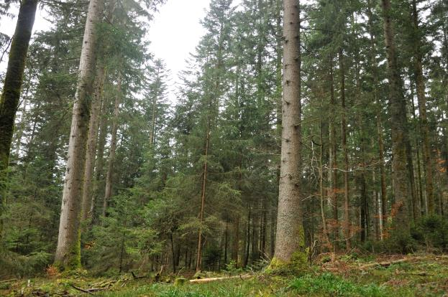
Research questions
Can we expect that tree species diversity will increase in stands managed without clear-cut? What are the light conditions that best promote species diversity? Can we control it?
Is the Apical Dominance Ratio (ADR) a good indicator of understory light for that purpose?
?
Notes:
Ruel 2000
Shade tolerant species present more variation in ADR than less shade tolerant species
For some pine, no correlation with light have been reported
Strong correlation are expected for Douglas fir and spruce
For Silver fir:
< 0.25 = very suppressed seedlings
0.25-0.5 = suppressed seedlings
0.5-1 = moderatly suppressed
1 – 1.2 = healthy seedlings
> 1.2 = very healthy seedlings

Slide 8
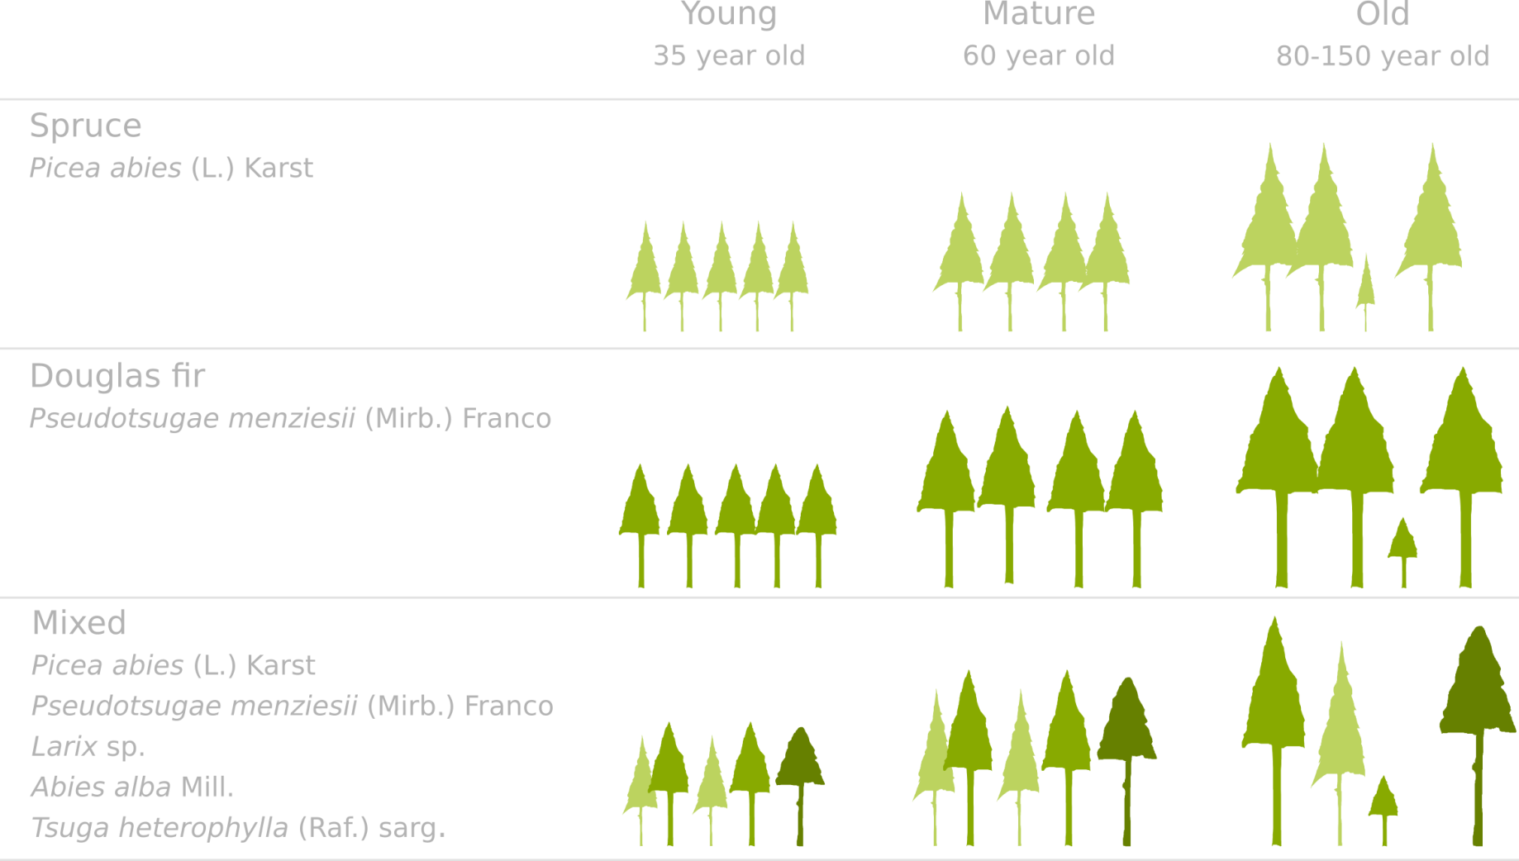
Study area
9 coniferous stands in Belgium at 400-600 m a.s.l

Slide 9
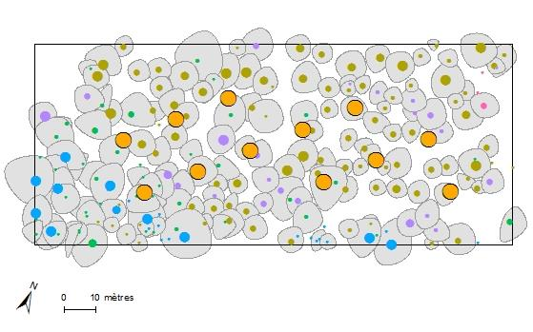
Measures
1 ha plots in each site
12 circular subplots of 3-m radius

Slide 10
Measures
For the 3 tallest saplings of each species, we measured
Sapling height
Terminal shoots
Longest lateral shoots
Defoliation rate
Visual estimate of the percentage of remaining needles on two secondary branches of 3 year old
Terminal shoots
(2016-2018)
height
Lateral shoots
(2016-2018)

Slide 11
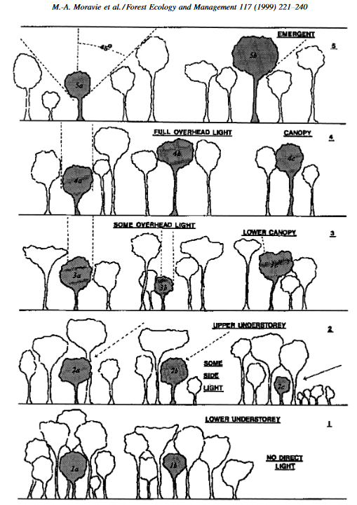
Measures
For the 3 tallest saplings of each species, we measured
Sapling height
Terminal shoots
Longest lateral shoots
Defoliation rate
Visual estimate of the percentage of remaining needles on two secondary branches of 3 year old
Competition index
Dawkins classification

Slide 12
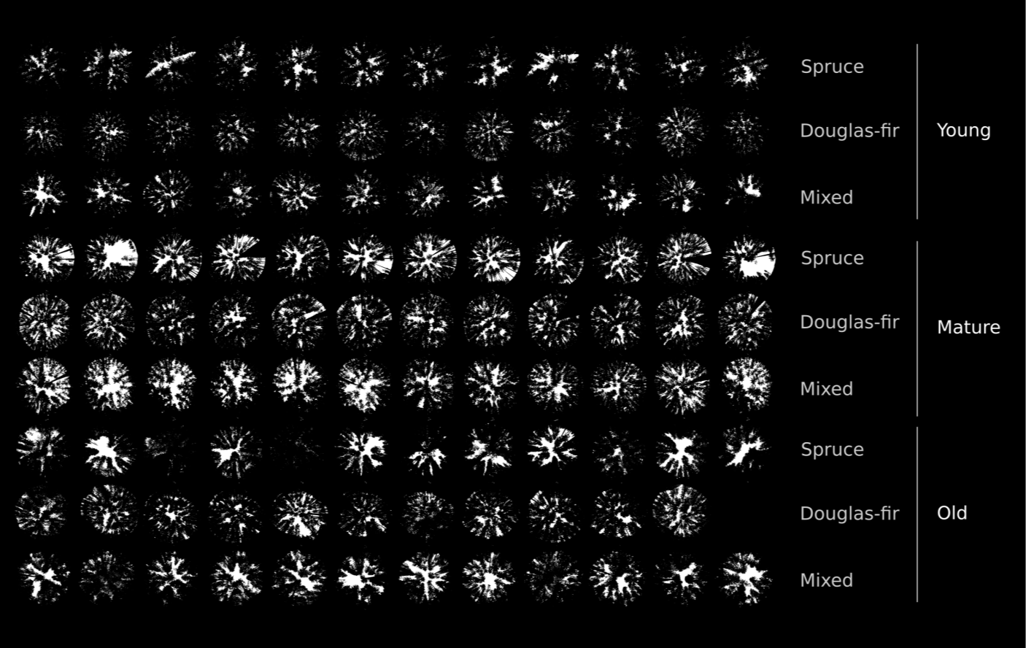
In spring 2018, 107 hemispherical photographs to measure to percentage of above canopy light (PACL), taken above the regeneration of each subplot (with a telescopic pole and an auto-stabilized device)

Slide 13
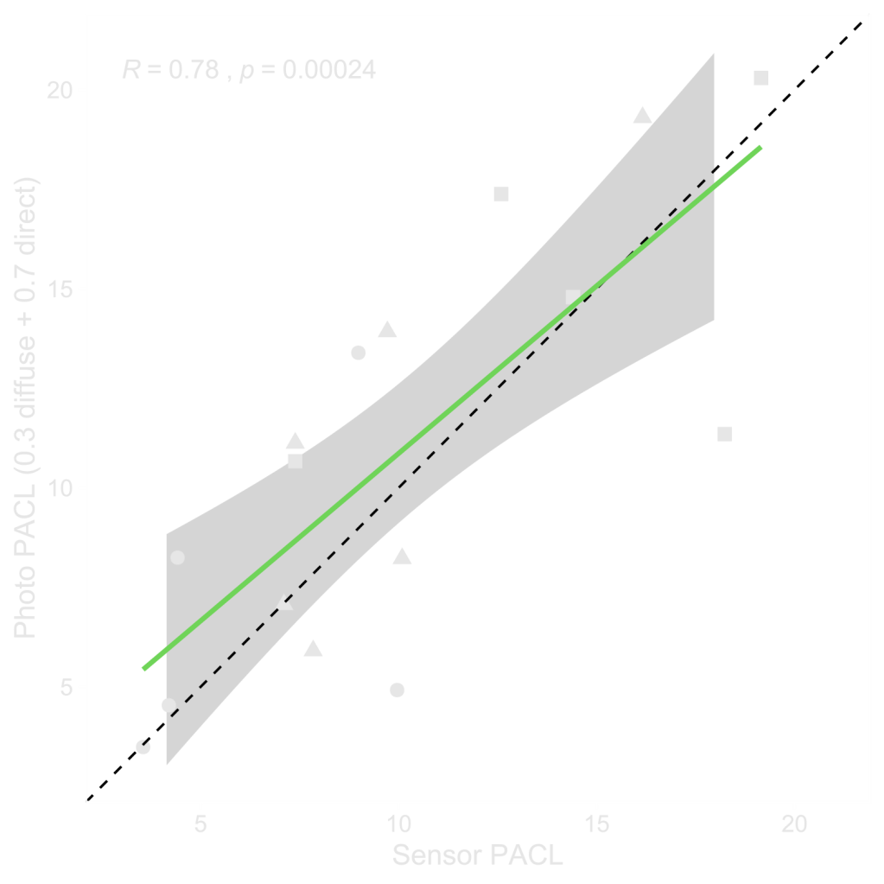
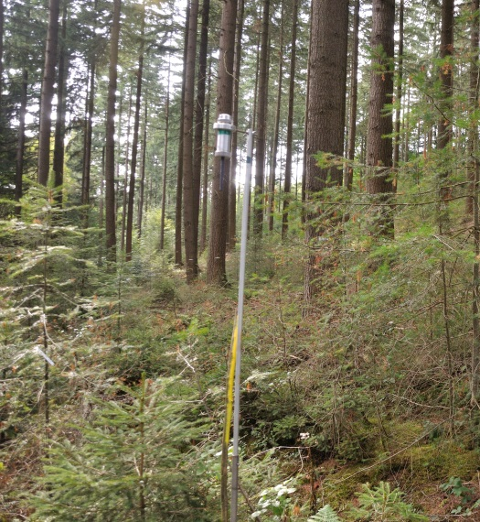
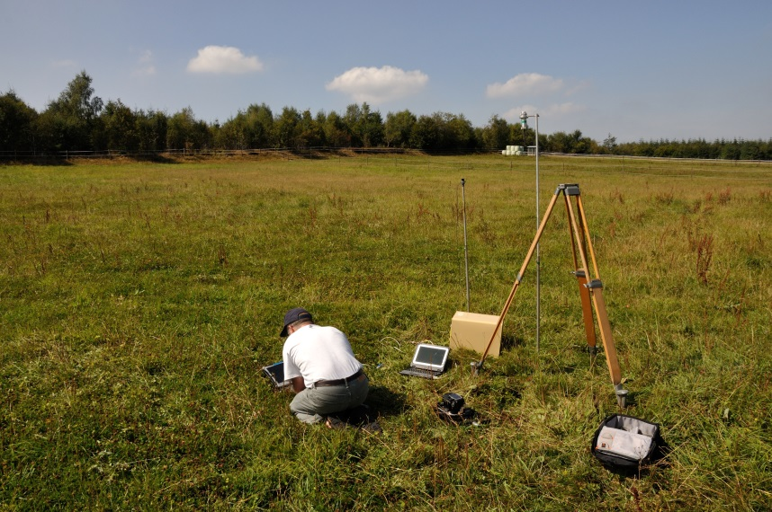
Validation of photo thresholiding measuring understory light with light sensors during two days in three study sites

Slide 14
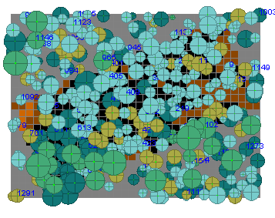
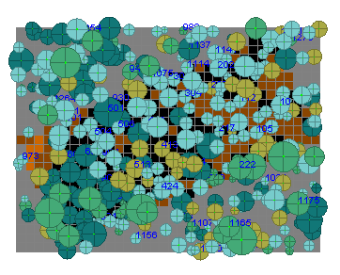
Simulations with SamsaraLightLoader (Capsis4) to estimate the understory light before 2018 to take into account tree mortality and thinnings
Tree inventory of 2016
Tree inventory of 2018

Slide 15
Summary statistics
n = 1354 measures of terminal shoots of 565 saplings
247 spruces
141 douglas firs
56 larches
58 silver firs
54 hemlocks
Height up to 445 cm
PACL varying from 1% to 45%

Slide 16
Modelling terminal shoot lenght
Non-linear mixed model fitted with the restricted maximum of likelihood
with a, b, c the fixed parameters
α a random plot effect : α ~ N(0,σ_{a})
ɛ the random residual error : ɛ ~ N(0, σ_{ɛ})
$terminal shoot length i,j,k,l=$ (a + α_{i}) height^{b}_{i,j,k,l} PACL^{c}_{i,j,k} + ɛ_{i,j,k,l}

Slide 17
Modelling terminal shoot lenght
Terminal shoot logically increased with height and PACL
Western hemlock, a very shade tolerant species, had terminal shoot about three times that of the other species in all observed light conditions (no saplings of height ≥ 200 cm observed)

Slide 18
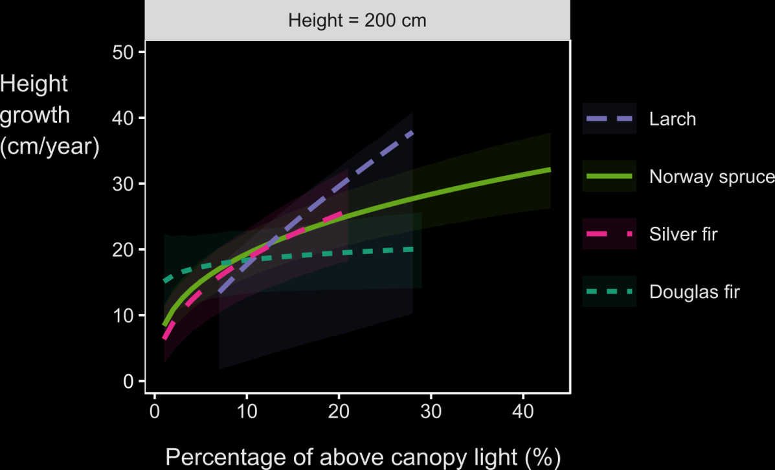
Modeling terminal shoot lenght
Not considering Western Hemlock:
In low light conditions, all species grow at relatively similar height growth rates
In high light conditions, some species can grow faster than others. They are by order of decreasing height increment:
Larch (shade intolerant)
Spruce (shade tolerant)
Silver fir (very shade tolerant)
Douglas fir (less shade tolerant)

Slide 19
What’s wrong with the Douglas fir?
We expected larger height increment and stronger response to light

Slide 20
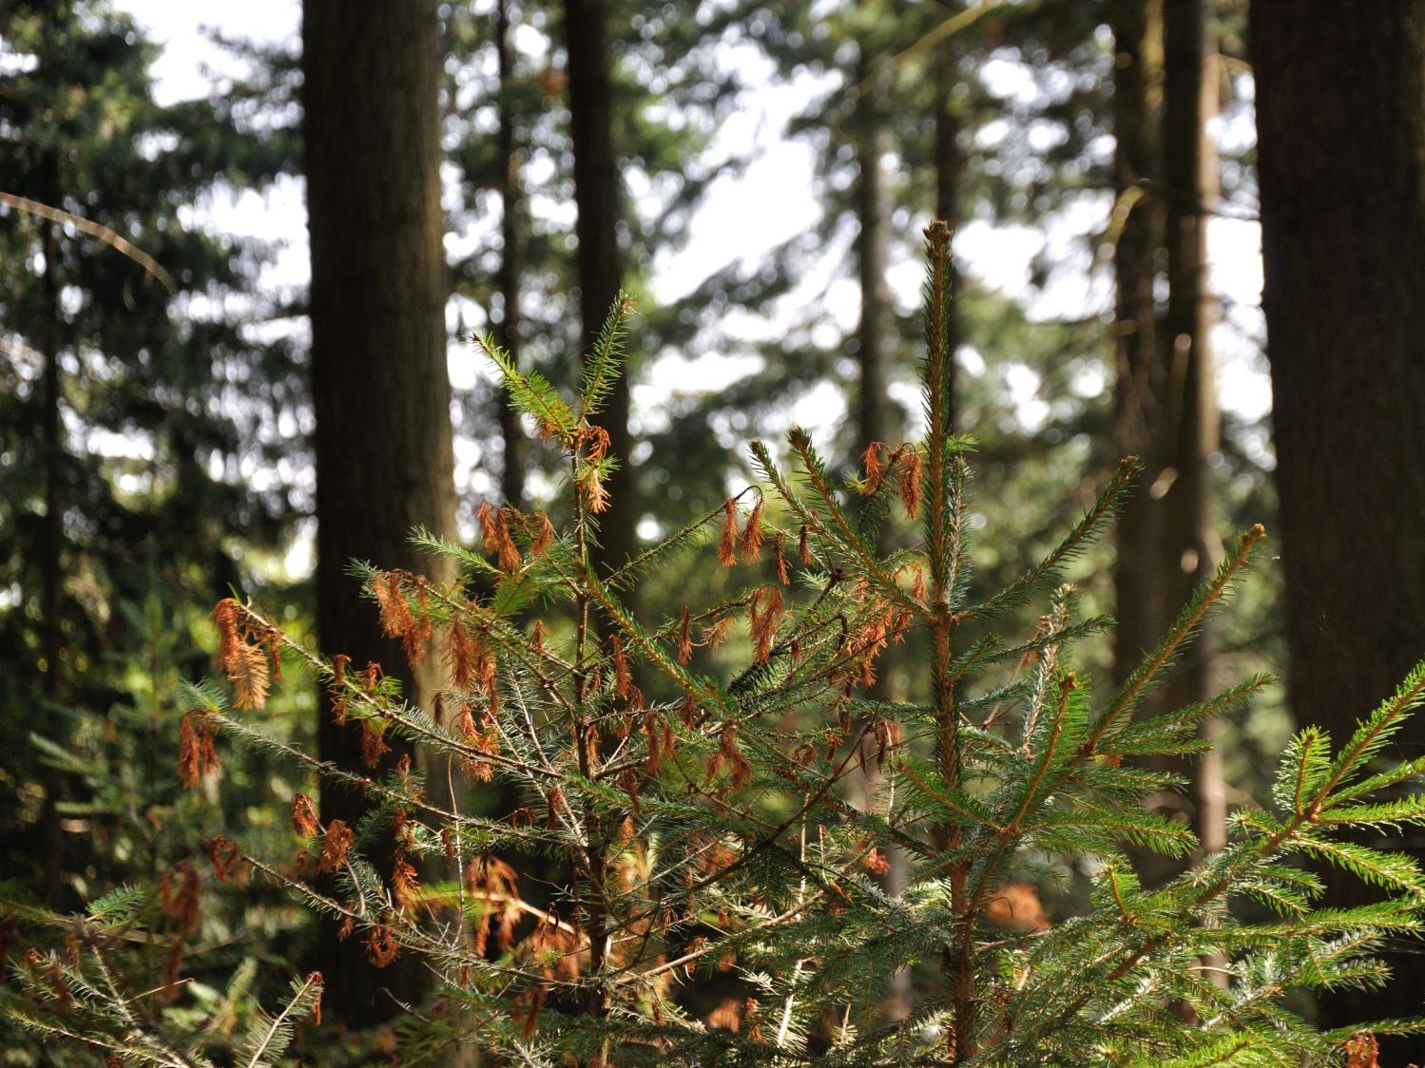
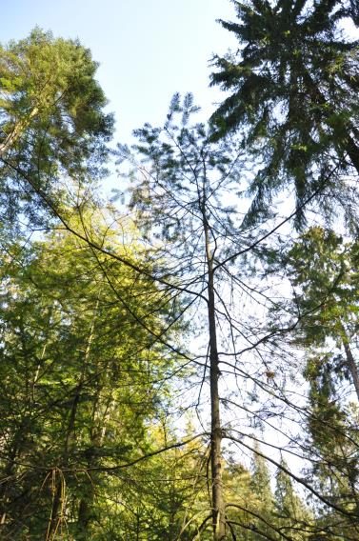
Spruce
Douglas fir
Increased sensitivity to different pest and pathogens in the recent years (abundance of necroses and important defoliation):
Phaeocryptopus gaeumannii (Swiss needle cast )
Identified in 5/5 sites
Sirococcus conigenus
Identified in 4/5 sites
Sydowia sp.
Identified in 2/5 sites
Botrytis sp.
Identified in 1/5 sites
Contarinia pseudotsugae
Identified in 5/5 sites, 20-40% of needles had galls caused by this insect

Slide 21
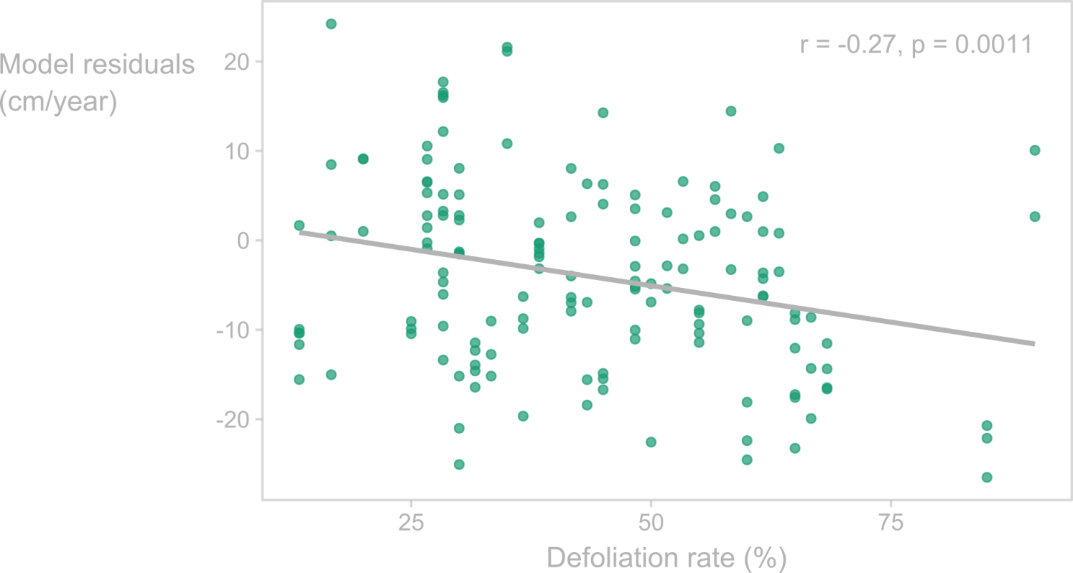
Defoliation rate and douglas fir growth
In average, douglas fir saplings had a defoliation rate of 50% while silver fir and spruce had a defoliation rate of about 20%.
We found a weak but significant correlation between the residuals of the height increment model for douglas fir and the defoliation rate

Slide 22
ADR: a good indicator of understory light?
For all species but Western Hemlock, the relationships between ADR and PACL are significant but weak : R² < 19%
PACL estimate at subplot center may not be accurate enough to estimate the light transmitted to the saplings (sometimes 3m away from the subplot center)
Other factors likely interacts (e.g. pathogens)
Picking one sapling at random and estimating its ADR, will likely not provide accurate measure of understory light (within the studied range of light conditions (1-40%))
Notes:
Picking randomly one saplings, estimating its ADR, will only provide poor estimate of PACL

Slide 23
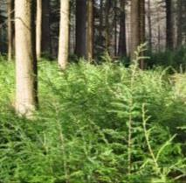
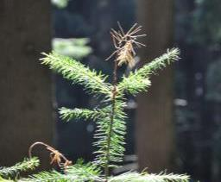
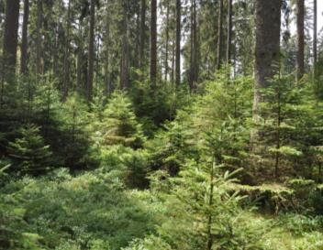
Is the conversion from even-aged to unevenaged an opportunity to increase future stand diversity?
Hemlock regeneration generally outcompeted other tree species. This thread can likely not be avoided by controlling understory light (whithin the range of light conditions observed with continuous cover forestry).
Natural regeneration of Douglas fir in Belgium suffers from different pest and pathogens which likely reduce its competitivity and future abundance.
Maintaining closed canopies can be used to reduce the vigor of the most vigorous species and increases the probability of less vigorous species to be recruited.

Slide 24
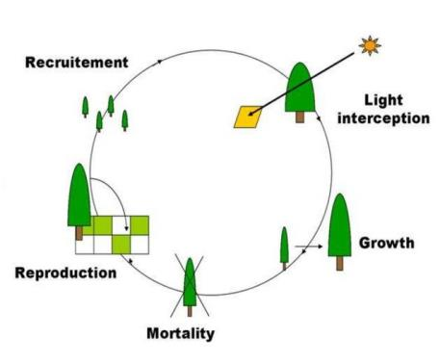
Perspectives
Implement these models in a forest dynamics simulator to simulate the conversion of even-aged to uneven-aged structure and provide silvicultural guides
Continue evaluating regeneration dynamics and in particular sapling and young tree survival
Samsara2 model
Courbaud et al. (2015) Ecol. Model. 314

Slide 25
Thank you !

