Slide 1





Behavioral Markers of Recovery of Consciousness After Severe Brain Injury
13th World Congress on Brain Injury, March 2019
Géraldine Martens^{1,2}, Yelena G. Bodien^{1,3}, Joseph T. Giacino¹
1 Department of Physical Medicine and Rehabilitation, Spaulding Rehabilitation Hospital, Harvard Medical School, Boston, MA
2 Coma Science Group, GIGA-Consciousness & Neurology Department, University and University Hospital of Liege, Liege, Belgium
3 Laboratory for Neuroimaging in Coma and Consciousness, Massachusetts General Hospital, Boston, MA

Slide 2
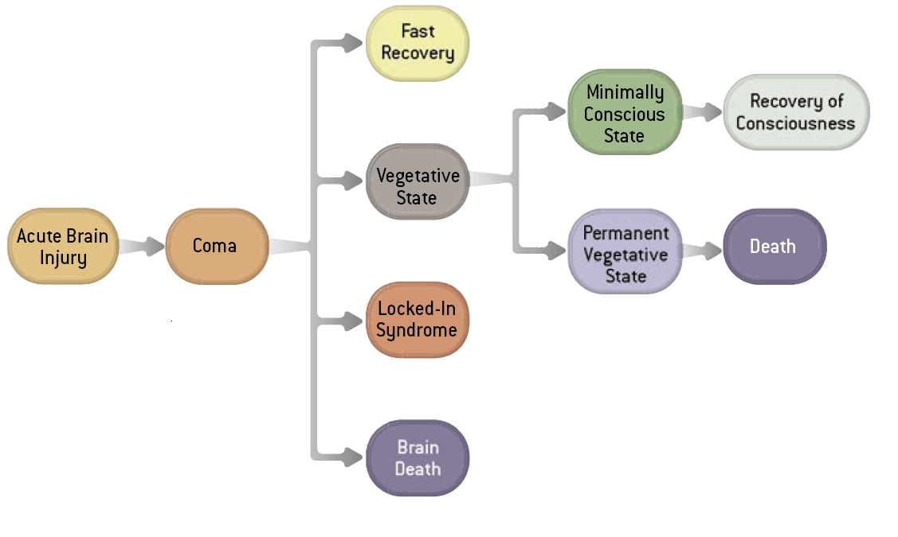

Background
?
Vegetative State/Unresponsive Wakefulness Syndrome
Visual pursuit & Visual Fixation (Bagnato et al. 2016)
Laureys, Scientific American, 2007
Notes:
The rationale for this research takes place in the larger context of the different clinical entities that one can observe in a patient recovering from a coma.
And while we are all familiar with the typical pathways patients can follow following a severe brain injury; less is known about the clinical profile of patients who are evolving from behaviorally unconscious states (UWS) to conscious states (MCS) or emergence of the MCS. The only study kind of focusing on this aspect showed a high frequency of visual behaviors.
And in a hospital or rehab setting, the early identification of behavioral evidence of consciousness is important for prognosis and care decisions. Proper assessment, with particular attention to those behaviors emerging early, could decrease the misdiagnosis rate of disorders of consciousness (DoC) during transition from unconsciousness to consciousness.

Slide 3
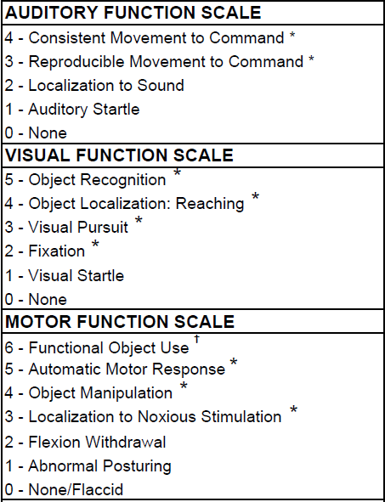
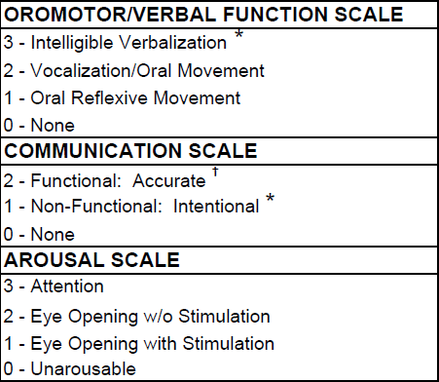
Background
Coma Recovery Scale-Revised (CRS-R)
11 signs of MCS *
2 signs of EMCS †
Giacino, Kalmar and Whyte, 2004
Notes:
And to this end, many of us use the gold standard Coma Recovery Scale-Revised (CRS-R), a standardized behavioral bedside assessment scale consisting of 23 items hierarchically-organized within 6 subscales that assess auditory, visual, motor, verbal, communication and arousal functions, is the only scale recommended for clinical use in patients with DoC by the American Congress of Rehabilitation Medicine with minor reservations. And as you can see, across these different subscales there are 11 specific signs denoting the MCS (such as xx) while 2 additional signs denote EMCS so among these 23 items, 13 are conscious behaviors, according to the CRS-R guidelines

Slide 4
Aims
Primary: determine frequency of conscious CRS-R behaviors emerging first in patients transitioning from VS/UWS to MCS (or EMCS)
Secondary: time to emergence; influence of etiology (TBI vs. nTBI)
VS/UWS
VS/UWS
MCS
MCS
VS/UWS
Which behavior(s)?
CRS-R assessments (2-3/week)
Notes:
The aim of the study I’m going to present is therefore to determine which conscious behaviors are observed when a patient is transitioning from and UWS to a MCS for the 1st time. For instance, when a patient is assessed with the CRS-R several times a week, as it is the case at SRH and other TBIMS centers, what is the frequency of signs of consciousness on the first assessment showing MCS , even if the patients return to UWS at some point because of fluctuation. As secondary outcomes, we were interested in knowing how long it took to get to MCS and if there was any significant influence of the etiology (traumatic or non-traumatic)

Slide 5

Methods
Retrospective observational database study on metrics collected by clinicians in an inpatient rehabilitation setting with a specialized DOC program (SRH).
Inclusion Criteria
  ≥16 y/o
  Diagnosed coma or VS/UWS on admission
  Transitioned to MCS or EMCS during inpatient rehab on 2 consecutive CRS-R obtained within the same week
Notes:
We conducted a retrospective analysis of a Redcap database housing many observational metrics collected by the clinicians working within a specialized DOC program. This database contains a lot of demographical and clinical information of course as well as assessment scales such as the DRS, the CAP, the FIM but we only focused on the CRS-R. To extract the data, we applied the following inclusion criteria xxx

Slide 6
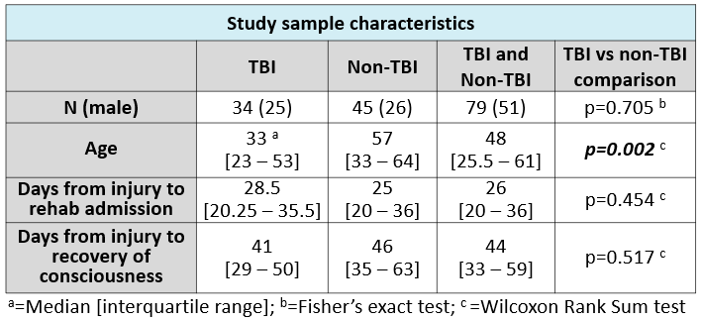
Results: Study Sample
79/324 patients eligible admitted between June 2012 and August 2017
Notes:
So, in the end, 79 patients met our inclusion criteria and their demographic and clinical characteristics are shown here. The only significant difference between TBI and non-TBI subpopulations was regarding age (TBI patients were younger). As part of our secondary outcomes, it took 44 days for our sample to recover behavioural evidence of consciousness and this duration did not differ between TBI and non-TBI, interestingly.

Slide 7
Results: Primary Aim
57 patients showed only 1 sign of consciousness (72%)
N=79
Notes:
Regarding our primary outcome, you can observe here the distribution of CRS-R conscious behaviors at transition in our study sample of 79 subjects. So, as a reminder, these are all the behaviors observed on the single first assessment denoting consciousness. A majority of the subjects showed one behaviour, while some did present 2 – 3 – 4 (sometimes even 5). In these conscious behaviors observed a transition, visual pursuit is by far most frequently observed, followed by reproducible movement to command and automatic movement, while all other behaviors are present in 15% of the cases or less.
Interestingly, a few patients (2) recovered functional object use, a sign of EMCS, while they were diagnosed as vegetative on the assessment just before that one. So this means it appeared they transitioned from UWS to eMCS.

Slide 8
Results: TBI vs. nTBI
* p <0.05
Notes:
Influence of etiology was our secondary outcome so we plotted the frequency of observed behaviors separately and investigated using Fisher (?) tests if there was a significant difference between TBI and non TBI in terms of presence vs absence of each behaviour. The only significant difference was for automatic movement, that was more present for TBI patients. which are these overlearned sequences of movement that are not reflexive such as scratching or social gestures such as waving.
Some other differences are obvious, like the fact that non-TBI patients show more often visual behaviors (pursuit and fixation) even though these differences were not significant.

Slide 9
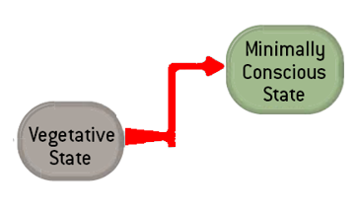
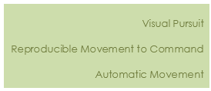
Summary
Top 3 – Visual Pursuit, Reproducible Movement to Command & Automatic Movement: consistent with (few) previous findings
~44 days to transition from unconsciousness to consciousness (TBI & nTBI)
At transition, TBI patients show significantly more Automatic Movement
Limitations: low sample size, single-site study (selection bias), retrospective analysis
Notes:
So, to summarize our findings, the transition from unconscious to conscious states is characterized by visual pursuit, reproducible response to command and automatic movement in a vast majority of cases. It took about 6 weeks after injury to recover behavioural evidence of consciousness, for both TBI and non-TBI populations and at transition, TBI patients show significantly more Automatic Movement,
I have to disclaim this study is limited by the low sample size and the fact that it was a retrospective single-site study

Slide 10
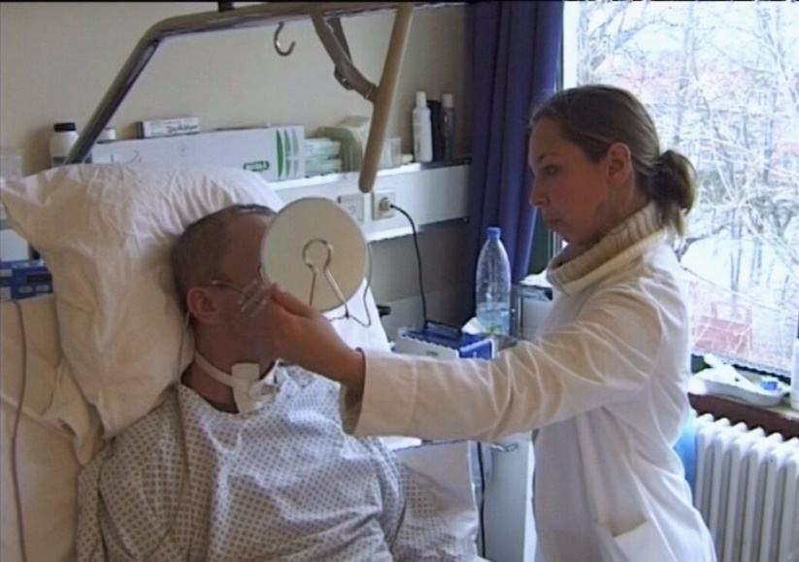
Conclusion
Clinicians: behavioral assessment methods should be sensitive to the detection of behaviors that signal the transition to consciousness
Researchers: future studies should investigate the association between time to emergence of specific conscious behaviors and long-term functional outcome.
Notes:
And to conclude, the take home message for clinicians would be to ensure assessment methods are sensitive enough to the detection of these behaviors signalling consciousness recovery, especially the top 3 ones. For researchers, it would be interesting to look at the association between the emergence of specific behaviors within the CRS-R, the time to recover them and the long-term functional outcome.

Slide 11
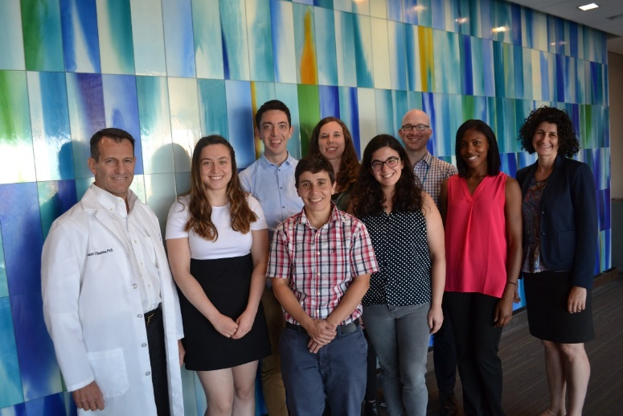
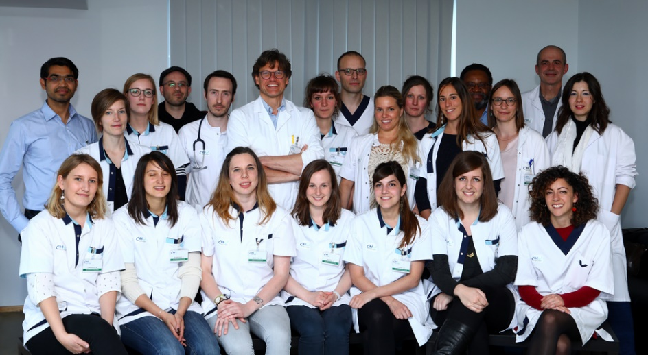







Thank you !
geraldine.martens@ulg.ac.be
gmartens@partners.org

Slide 12
Disclosure
Presenter has no relevant financial or non-financial interest to disclose.
This continuing education activity is managed and accredited by AffinityCE in cooperation with the International Brain Injury Association. AffinityCE, IBIA, and all accrediting organizations do not support or endorse any product or service mentioned in this activity. Disclosure will be made when a product is discussed for an unapproved use.
AffinityCE staff, IBIA staff, planners, and reviewers have no relevant financial or non-financial interests to disclose.
Commercial support was not received for this activity.

Slide 13
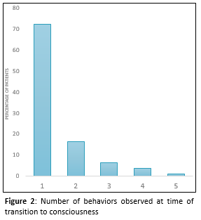
Supplementary
72% of patients presented with a single behavioral feature of MCS or EMCS at time of transition

Slide 14
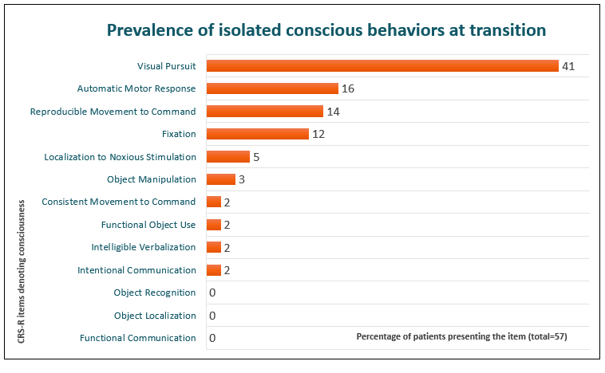
Supplementary
These patients (72%) mainly presented visual pursuit

Slide 15
Supplementary
Table II: CRS-R assessments per subject
Days of CRS-R monitoring | 60.5 [41.5 – 97.5] ª
Days between consecutive assessments | 4 [3 – 5]
Number of assessments between admission and discharge | 16 [11 – 24.75]
Number of assessments between admission and transition to consciousness | 4 [2 – 7.5]

Slide 16
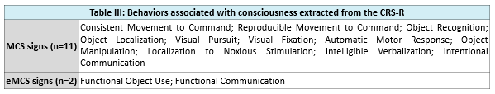
Supplementary

