Slide 1

UNIVERSITE FELIX HOUPHOUËT
BOIGNY D’ABIDJAN COCODY
Variability of essential oil composition and biological activities of Lantana rhodesiensis Moldenke (Verbenaceae)
from Côte d’Ivoire
Fatimata NEA^{ab*},
Evelyne A. Tanoh^{ab}, Tierry Kenne^{b}, Matthew Saive^{b}, Manon Genva^{b}, Felix Z. Tonziboª, Marie-Laure Fauconnier^{b}
4 February 2019

Slide 2
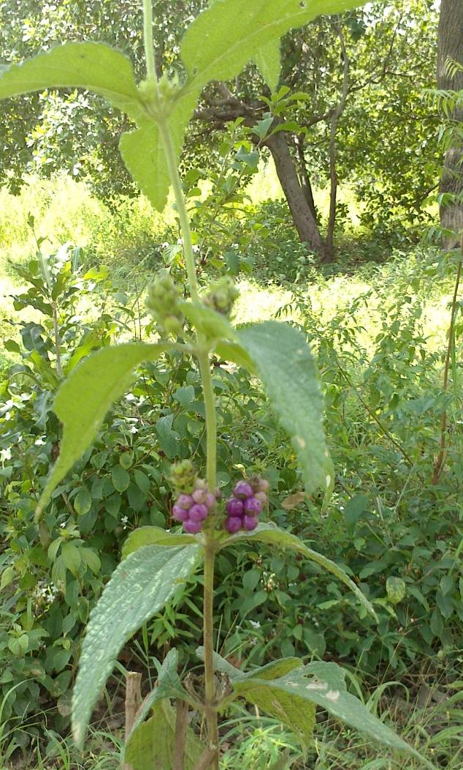
INTRODUCTION (1/1)
Lantana rhodesiensis Moldenke:
  Herb or small shrub
  Multi-stemmed ¹
  Leaves: opposite
  Flowers: mauve to purple
  Fruits: blue to purple berries ¹
Traditional medicine, infusion or decoction plant: Diabetes¹, rheumatism², arterial hypertension³.
Infusions of Leaves, stems fever
Côte d’Ivoire:
Fruits eaten, feed
Objective: Variation of chemical composition, in vitro antioxidant and anti-inflammatory activities.
1. Piero, N. M. et al. 2015
2. Ruffo CK, et al. 2002
3. Jean Bangou, M. et al. 2011

Slide 3
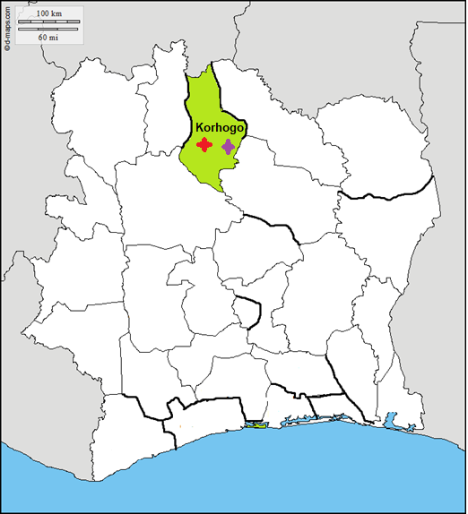
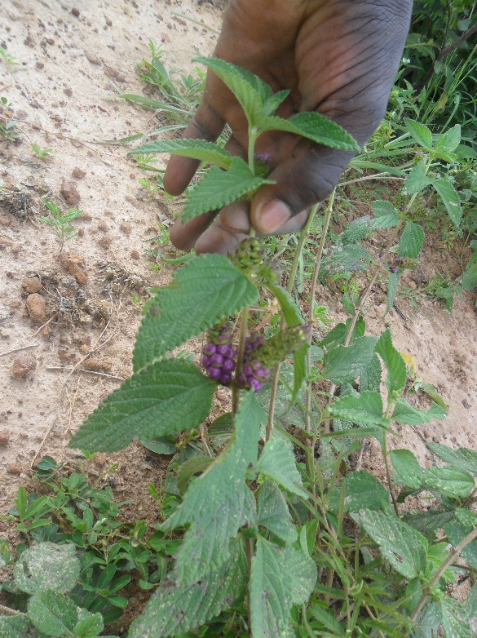
ESSENTIAL OIL PRODUCTION (1/2)
Côte d’Ivoire
Plant harvesting
NORTHERN Region
Month:
June → September 2017
Localities:
Kapelé
CENTRE Region
WESTERN Region
EASTERN Region
3 km
Nyanbélégé
SOUTHERN Region
Accessibility and abundance of the plant in local area

Slide 4
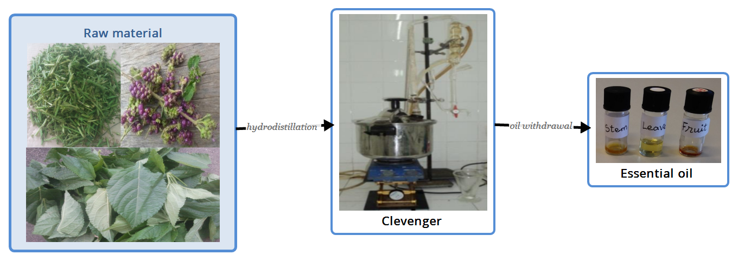
ESSENTIAL OIL PRODUCTION (2/2)
stems
fruits
leaves
yield (w/w calculated on fresh weight basis)

Slide 5
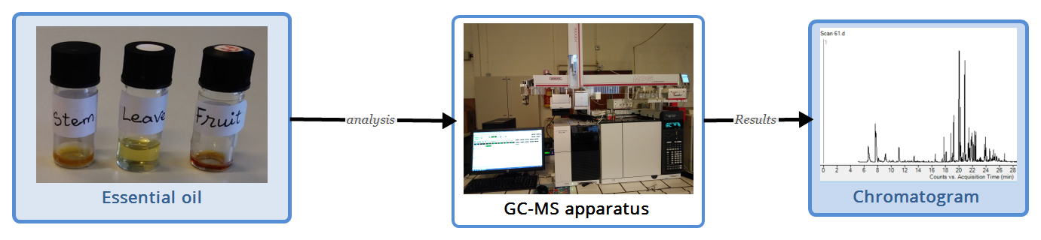
METHODS & RESULTS (1/6)
1. CHEMICAL COMPOSITION
0,01 mg essential oil; 1 ml hexane
GC-MS system 7890B coupled MSD 5977B detector, HP-5MS capillary column, helium gas
MassHunter Workstation Software

Slide 6
METHODS & RESULTS (2/6)
Yields essential oils
GC-MS analysis
Leaves: 0,46 %
Nyanbelégé
Leaves | 35 | 33
Stems | 37 | 35
Fruits | 29 | 34
Kapelé
Stems: 0,17 %
Fruits: 0,13 %

Slide 7
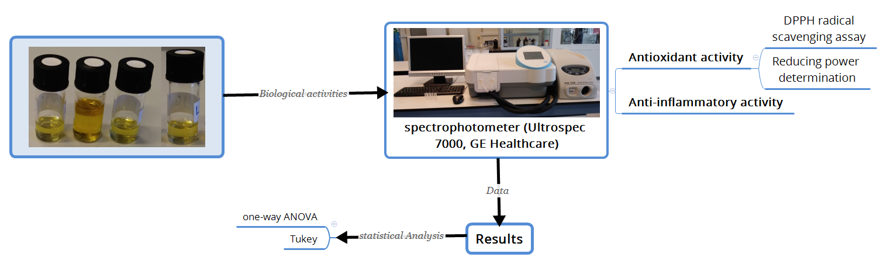
METHODS & RESULTS (3/6)
2. BIOLOGICAL ACTIVITIES
Leaves essential oils
June Kapelé
July Kapelé
June Nyanbelégé
September Nyanbelégé

Slide 8
METHODS & RESULTS (4/6)
ANTIOXIDANT:
Leaves essential oils, Trolox, Thymol and Limonene
DPPH
The lower the IC50 value, the greater the antioxidant activity of a compound.
Trolox: positive control
Thymol is reported as an antioxidant compound of essential oils
July Kapelé, September Nyanbelégé essential oils: high antioxidant activity
IC₅₀ of thymol is low, evidence that this compound exhibits antioxidant activity.
A significant difference between thymol and Trolox
June essential oils: high value of IC50, low activity
Limonene have highest value of IC50, low antioxidant activity
Figure 4: IC₅₀ values (µg/mL)
a, b, c, d, e, f: represent the non-significant aspect of the Tukey statistical test. Histograms that do not share any letters are significantly different

Slide 9
METHODS & RESULTS (5/6)
ANTIOXIDANT:
Leaves essential oils, Trolox, Thymol and Limonene
REDUCING POWER
Higher the absorbance greater the reducing power.
Essential oil of June from two localities have lower absorbance than those of essential oil from july and September, which are abundant in thymol.
Absorbance of Thymol are not significantly from that of Trolox
Limonene has very low absorbance
Figure 5. Reducing power of essential oil of Lantana rhodesiensis, trolox, thymol and limonene of various concentrations.
a, b, c, d, e: represent the non-significant aspect of the Tukey statistical test. Histograms that do not share any letters are significantly different.

Slide 10
METHODS & RESULTS (6/6)
ANTI-INFLAMMATORY ACTIVITY (Denaturation of bovine albumin)
Diclofenac: positive control
Comparison of the IC₅₀ values shows that the effect of Diclofenac is close to that of June essential oils. This is confirmed by statistical analysis.
Essential oil of September from Nyanbelégé have highest value of IC50, then the anti-inflammatory activity is low
Figure 7. IC₅₀ values (µg/mL)
a, b, c, d, e: represent the non-significant aspect of the Tukey statistical test. Histograms that do not share any letters are significantly different.

Slide 11
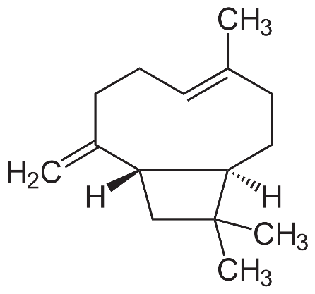
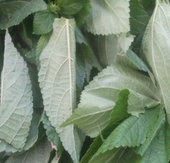
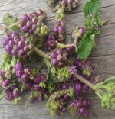
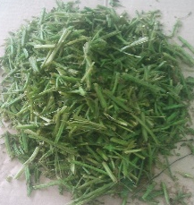
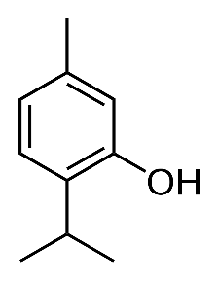
CONCLUSION
ESSENTIAL OILS COMPOSITION
Lantana rhodesiensis
β-caryophyllene
Côte d’Ivoire
Kapelé
Nyanbelégé
Potent compound
Periods
June| July| August| September
thymol
Sesquiterpenes
Major compound
BIOLOGICAL ACTIVITIES OF ESSENTIAL OILS
Antioxidant
Anti-inflammatory
July Kapelé
June Kapelé
High activity
High activity
September Nyanbelégé
June Nyanbelégé
Thymol
June Kapelé
July Kapelé
Low activity
Low activity
June Nyanbelégé
September Nyanbelégé

Slide 12
ACKNOWLEDGEMENT
UNIVERSITE FELIX HOUPHOUËT
BOIGNY D’ABIDJAN COCODY
ªLaboratory of Biological Organic Chemistry, UFR-SSMT, University Félix Houphouët-Boigny,
BPV 34 Abidjan, Côte d’Ivoire
^{b}Laboratory of Natural Molecules Chemistry, University of Liège, Gembloux Agro-Bio Tech, 2, Passage des Déportés, B-5030 Gembloux, Belgium
E-mail : neafatima@gmail.com

