Slide 1
Qualities of a Good Researcher
Shady Attia PhD, USGBC Faculty and LEED Accredited Professional
Head of Sustainable Buildings Design Lab (SBD)
shady.attia@ulg.ac.be

Slide 2
Academic Modules

Slide 3
Content
This presentation is for early carrier researchers.
Publish or Perish
Researcher Quality
Types of Publications
H-Index
Research Quality
Recommendations
Qualities of a Good Researcher

Slide 4
Publish or Perish
Rule of the Game
Sustain your Career
Indicator of your Qualifications
Number of Citations indicates your impact
Advances Research
Motivates Scholars

Slide 5
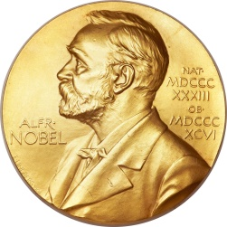
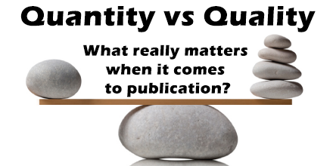
Researcher Quality
Number of published papers in journals with an impact factor (Journals can be measured by their impact factor (IF), which is the average number of citations to articles published in a particular journal)

Slide 6
Publish in peer reviewed journals !
Types of Publications
peer reviewed journal
national journal
international conference proceedings
national conference proceedings
internal communication (seminar)

Slide 7
Your ultimate goal should be:
Types of Publications
Publish a number of journal papers in highly ranked journals that bring you credit as a scientist with a healthy number of citations.
Promote those journal papers through international conference papers, extend your scientific network, get feedback for your ideas from peers and get exposed to the international scientific community.

Slide 8
Researcher Quality
What count is your solid work
Publishing is important and all that matters is the content
Journals have an important role in selecting/curating the most relevant/important/impactful papers.
What´s the value of a paper with severe errors ?
What´s the value of a paper with fabricated data ?

Slide 9
Researcher Quality
The research counts, then the journal
With quantity comes quality (Publishing in Journals is Hard)
Large quantity of publications does not mean a higher status.

Slide 10
H-Index
Bibliometric Indicator for researchers
Impact + Citation + Productivity
Scopus H-Index
Google H-Index
The h-index is an author-level metric that attempts to measure both the productivity and citation impact of the publications of a scientist or scholar. The index is based on the set of the scientist's most cited papers and the number of citations that they have received in other publications.

Slide 11
Scopus H-Index

Slide 12
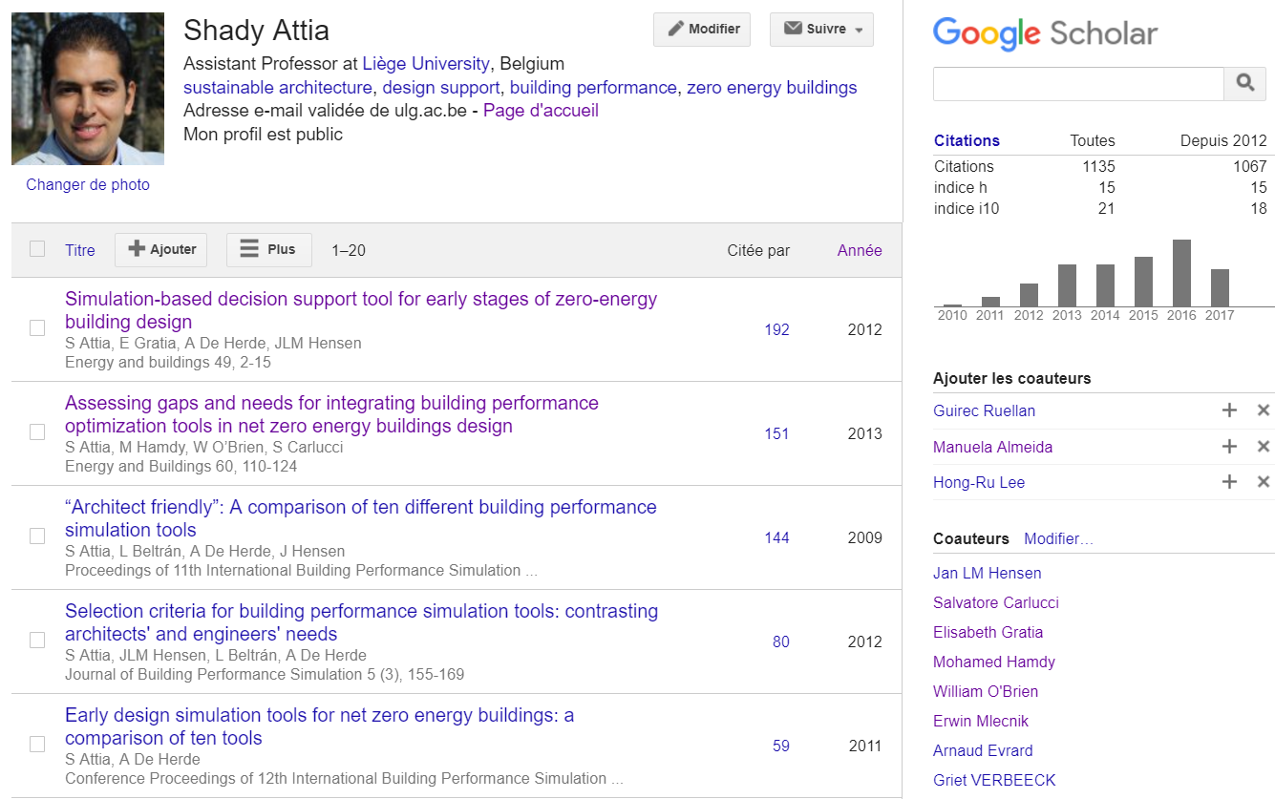
Google H-Index

Slide 13
Strategical Planning
H-Index is important but…
Solid work is more important
Develop an area of science, where you make progressive, discovery and you earn a reputation for Solid Work !

Slide 14
Research Quality
What count is really the DATA
If you do good, solid work consistently, you’ll be recognized.
H-Index is not the only way to judge researchers.
Institutions have to judge the quality of a person based on the quality of the research.

Slide 15
Researcher Quality
What count is your solid work
You shouldn’t be relying on journals and two or three reviewers to judge that.
Do research with passion.
Be persistent and deliberate.
Seek the highest quality

Slide 16
What is good for you?
Don’t waste time with the highest impact factor journals in your early carrier
Don’t waste several times repeated attempts to get published in the same journal.
Publish as high as is practical.
Seek funding and write grants proposals.

Slide 17
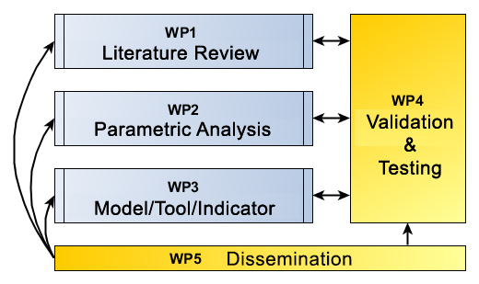
Recommendation
Use journal publications as a vehicle to advance your research
Plan your research activities into work packages and consequently

Slide 18
Recommendation
Build your Digital ID and profile (see Video)
Make sure your journal publications are included in the indexing services of Scopus and Google Scholar
Researchers Digital ID

Slide 19
Academic Modules

Slide 20
Qualities of a Good Researcher
Shady Attia PhD, USGBC Faculty and LEED Accredited Professional
Head of Sustainable Buildings Design Lab (SBD)
shady.attia@ulg.ac.be

