Slide 1
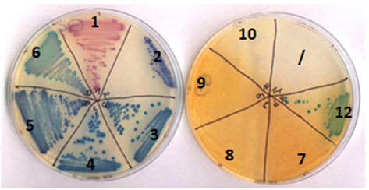
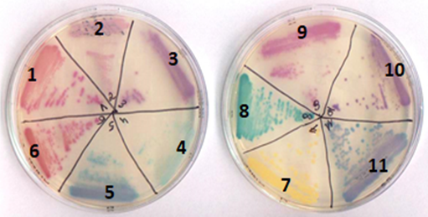
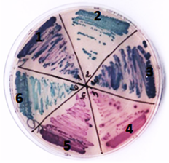
CHROMagar™ Mastitis medium: assessment of the new formulation and comparison with the previous one.
DIDESSE E.¹, DUPREZ JN.², MAINIL J.², THIRY D.²
¹. HEPL André Vésale, Bachelor's degree "Medical Laboratory Technologist" ². Department of Infectious and Parasitic Diseases, Bacteriology, FARAH, ULiège
Introduction :
CHROMagar™ Company has developed several chromogenic culture media specific either for bacteria or for pathologies. In 2016, this firm has developed two media for the research of the main bacterial pathogens in the context of bovine mastitis: the CHROMagar™ Mastitis media for Gram positive or Gram negative bacteria. A previous study highlighted several problems with these formulations: low selectivity of Gram negative medium, difficulty of differentiation of some genera, growth of common contaminants (Bacillus sp. and Aerocccus sp.) also detected an another mastitis pathogen (Corynebacterium bovis). This study aims to assess a new formulation composed of 3 media: Gram negative, Staphylococcus and Streptococcus and to compare them with the previous formula. Sensitivity and specificity were calculated.
Material and method : In order to test this new formula, 35 control strains and 113 strains of clinical milk samples (pathogens and contaminants), identified biochimically and confirmed by MALDI TOF, were inoculated on the agar plates to evaluate the selectivity of the media and to note the color of the colonies which will make it possible to calculate the sensitivity and the specificity of each agar medium.
Results: (Sp= Specificity, Se = Sensitivity)
Streptococcus media
1 agalactiae 2 dysgalactiae 3 uberis 4&5 Enterococcus 6 Aerococcus
 | n= | Expected colour in selective media | Gram - media |  |  |  |  | Staphylococcus media |  |  |  |  | Streptococcus media
 |  |  | Good color | Bad color | No grow | Sp | Se | Good color | Bad color | No grow | Sp | Se | Good color | Bad color | No grow | Sp | Se
S.aureus | 33 | pale pink to dark pink | 0 | 0 | 33 | / | / | 31 | 1 | 1 | 92.70% | 93.90% | 0 | 5 | 28 | / | /
Staphylococcus sp. | 33 | all colour except pink | 0 | 0 | 33 | / | / | 22 | 9 | 2 | 99.10% | 66.60% | 0 | 2 | 31 | / | /
Lactic Streptococcus | 23 | pale blue to purple | 0 | 0 | 23 | / | / | 0 | 0 | 23 | / | / | 23 | 0 | 0 | 94.70% | 100%
Enterococcus sp. | 11 | dark pink | 0 | 0 | 11 | / | / | 0 | 0 | 11 | / | / | 11 | 0 | 0 | 100% | 100%
Aerococcus sp. | 7 | Not renseigned | 0 | 0 | 7 | / | / | 0 | 7 | 0 | / | / | 7 | 0 | 0 | / | /
E.coli | 7 | pale pink to dark pink | 7 | 0 | 0 | 100% | 100% | 0 | 0 | 7 | / | / | 0 | 0 | 7 | / | /
Coliform | 18 | blue to purple | 16 | 2 | 0 | 100% | 88.90% | 0 | 0 | 18 | / | / | 0 | 0 | 18 | / | /
Proteus & Providencia sp. | 4 | Colorless or blue with orange halo | 4 | 0 | 0 | 100% | 100% | 0 | 0 | 4 | / | / | 0 | 0 | 4 | / | /
P. aeruginosa | 3 | colorless with yellow hallo | 2 | 1 | 0 | 100% | 66.70% | 0 | 0 | 3 | / | / | 0 | 0 | 3 | / | /
C. bovis | 3 | not renseigned | 0 | 0 | 3 | / | / | 0 | 0 | 3 | / | / | 0 | 0 | 3 | / | /
Truyperella sp. | 2 | not renseigned | 0 | 0 | 2 | / | / | 0 | 0 | 2 | / | / | 0 | 0 | 2 | / | /
Bacillus sp. | 4 | not renseigned | 0 | 0 | 4 | / | / | 0 | 0 | 4 | / | / | 0 | 0 | 4 | / | /
Gram – media
1 E.coli 2 Citrobacter 3 Enterobacter 4 Pantoea 5 & 6 Serratia 7 & 8 Proteus 9 & 12 Providencia 10 Pseudomonas
 | Old formula |  | New formula
 | Sp | Se | Sp | Se
S.aureus | 82.70% | 100.00% | 92.70% | 93;90%
Staphylococcus sp. | 73,70% | 36,40% | 99.10% | 66.60%
Lactic Streptococcus | 84,40% | 100% | 94.70% | 100%
Enterococcus sp. | 85,60% | 100% | 100% | 100%
E.coli | 95% | 100% | 100% | 100%
Coliform | 100% | 100,00% | 100% | 88.90%
Proteus | 100% | 100% | 100% | 100%
Pseudomonas | 100% | 66,70% | 100% | 66.70%
Previous Gram + media Previous Gram - media
Staphylococcus media
1 aureus 2 epidermidis 3&9 hyicus 4 saprophyticus 5 xylosus 6 haemolyticus 7 chromogenes 8 cohnii 10 pseudintermedius 11 sciuri
1 S. aureus
2 S xylosus
3 S.saprophyticus
4 S.epidermidis
5 S.chromogenes
6 S.succinus
7 C.bovis
8 S.dysgalactiae
9 S.agalactiae
10 S.uberis
11 Aerococcus sp
12 E.faecalis
13 E. faecium
E.coli
K.pneumoniae
E.cloacae
Pantoea sp.
P.vulgaris
P.aeruginos
Discussion :
The new formulas allows an increase in the specificity of the medium for all pathogens. Indeed, the better selectivity of Gram negative medium prevents the growth of Enterococcus sp. And the separation of Gram positive medium into two media (Staphylococcus and Streptococcus) allows a better differentiation of there two genera.
Aerococcus sp. grows on Staphylococcus medium. In the same way none strains of Staphylococcus grow on the Streptococcus medium. However, the morphology and the color of the colonies make it possible to distinguish them quite easily from the target bacterial species.
The new formula Staphylococcus, certainly more selective, shows false negatives. For the species Staphylococcus aureus, the sensitivity slightly lowered but is still acceptable. For the other staphylococci, these false negatives are largely compensated by the selectivity of the medium compared to other Gram positive and the sensitivity has therefore increased.
The contaminants of the genus Bacillus are completely inhibited. Unfortunately, Corynebacterium bovis is also inhibited
Acknowledgments: We want to thank the firm Chromagar for taking into account our remarks during the first study and for supporting this second study.

