Slide 1
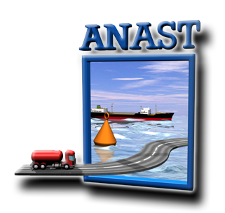
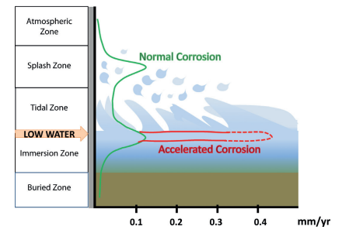
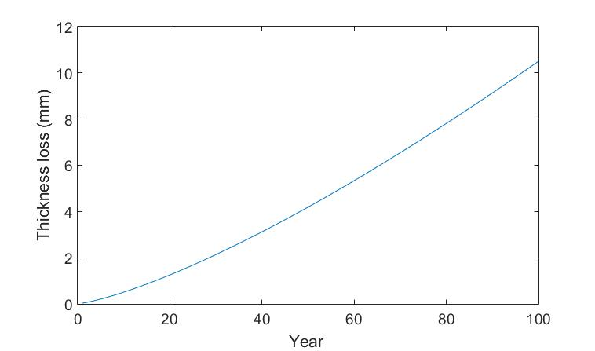
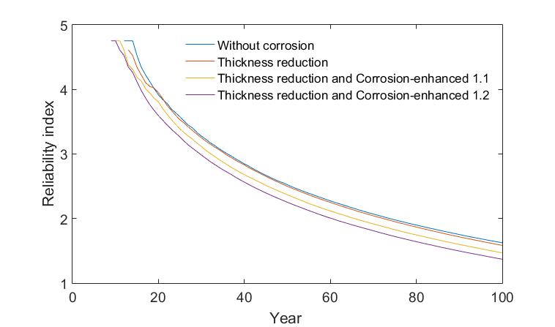
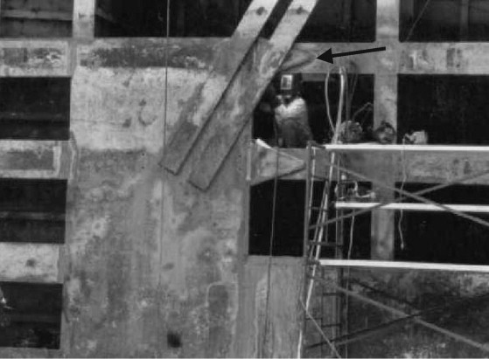
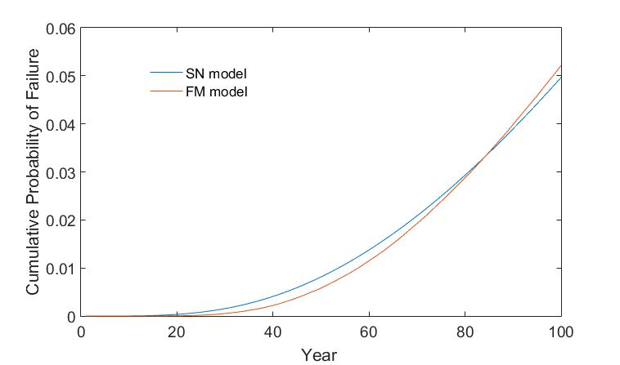
Reliability assessment of aging miter gates in the presence of corrosion and fatigue
Thuong Van DANG, Quang Anh MAI, Pablo G. MORATO, Philippe RIGO
dangvanthuong@doct.uliege.be +32 488 613309
PARTNERS
ABSTRACT
Aging Hydraulic steel structures, especially lock gates suffer from structural deterioration with fatigue and corrosion, resulting in a reduction of their resistance. A prolonged exposure to these hazards results in a reduction of structural resistance which can lead to failure. This research presents an approach to compute the reliability of aging miter gates in the presence of corrosion and fatigue. First order reliability index method is used to calculate reliability of the structure. An example of an aging miter gate is used for demonstration.
1. INTRODUCTION
Corrosion and fatigue cracking are two factors that significantly influence the integrity and life cycle costs hydraulic steel structures. Therefore, it is essential to mitigate the adverse consequences associated with structural failure under corrosion and fatigue. Furthermore, there are significant uncertainties associated with corrosion and fatigue models. In general, corrosion of a miter gate is affected by many factors such as corrosion protection, temperature, humidity, constant wet/dry cycling, immersion in fresh or saline water. Fatigue crack propagation is also affected by many parameters such as initial crack size, history of local nominal stress range, geometry factor. This study aims to provide an approach for calculating the reliability of hydraulic steel structures to give strategies and solutions mitigate risk under corrosion and fatigue. An example of an assessment of the reliability for vulnerable members about fatigue and corrosion as well, e.g., welded joint is used in illustration.
2. CORROSION MODEL
4. THE RESULTS
The reliability assessment is performed considering the effects of corrosion and fatigue. In the presence of a fatigue crack, a corrosion-enhanced fatigue crack-growth model is given by:
$a\left(t\right)=[a_{0}^{1−\frac{m}{2}}+\left(1−\frac{m}{2}\right)$ ${C{C_{corr}∆σ}^{m}Y}^{m}π^{m/2}nt]^{2/(2−m)}$ (6)
where $C_{corr}$ is the corrosion-enhanced fatigue crack growth parameter.
The limit state function follows then Eq.(7)
g = $a_{c} −a_{rt}−a(t)$ (7)
Where $a_{c}$ is thickness, $a_{rt}$ is thickness loss
Corrosion reduces the section modulus of the structure by thinning the thickness of primary structure members. It reduces the ability of the structure to resist the loading during the operation. Several models of general corrosion growth have been suggested. The most commonly used model, as follows Eq. (1).
$a_{rt}(t)= C_{1}(t − t_{0})^{C_{2}}$ (1)
Where $a_{rt}(t)$ is the thickness reduction, $t_{0}$ is the life of coating (years), t is the age of the structure (years), $C_{1}$ represents annual corrosion rate and although $C_{2}$ take values ranging from 1/3 to 1.
Fig. 1. Typical corrosion rate
Fig. 4. Thickness loss without protection
3. FATIGUE MODEL
Two main approaches for assessing fatigue strength are S-N model and Fracture mechanic model. S-N method based on S-N curves and Miner’s rule:
$g=Δ−n \frac{B_{S}^{m}{∆σ}^{m}}{C}$ (2)
where $Δ$ is the damage criteria, $Δ$σ is stress-range Bs is uncertainty load factor, n is number of cycle per year, C and m are material parameters, respectively.
Fracture mechanics model is used for crack propagation. The most widely used model is the Paris-Erdogan law:
$\frac{da}{dN}$ $= C(Y∆σ\sqrt{πa})^{m}$ (3)
where da/dN is the rate of crack growth, C and m are material parameters, Y is geometry function.
Subsequently, the crack size at time t (m≠2) is:
$a\left(t\right)=[a_{0}^{1−\frac{m}{2}}+\left(1−\frac{m}{2}\right)C{∆σ}^{m}Y^{m}π^{m/2}nt]^{2/(2−m)}$ (4)
$a\left(t\right)=$ $a_{0}\exp\left(CY^{2}{∆σ}^{2}πnt\right) m=2$ (5)
where $a_{0}$ is the initial crack size
FM model is then calibrated to give failure probabilities as obtained form S-N model.
Fig. 5. Reliability assessment
CONCLUSIONS
Fig. 2. Fatigue failure on Miter gate
A practical method for reliability assessment of an aging miter gate subjected to structural degradations has been presented.
The model for corrosion growth, fatigue crack and corrosion enhanced fatigue crack propagation that weaken the capacity of a miter gate has been developed.
Based on these results, a strategy for inspection, evaluation and repair of hydraulic steel structures can be applied to mitigate risk under fatigue and corrosion.
Fig. 3. Calibrated result

