Slide 1
Figure S1: Rictor knockdown in the DMS does not alter saccharin intake or locomotor activity
A
SCR
shRictor
B
78
78
24
ns
52
ns
Saccharin intake (g/kg/4h)
52
16
26
26
Water intake
(ml/kg/4h)
8
0
1
2
3
4
5
6
0
s1-6
0
s1-6
C
Sessions
SCR
shRictor
18
18
ns
12
12
Beam breaks (X100)
6
6
0
10
20
30
0
0-30min
Time (min)

Slide 2
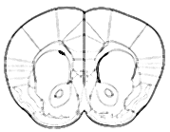
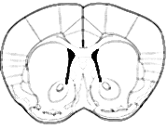
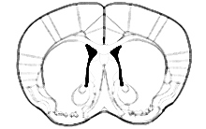
Figure S2: mTORC2 activation in the DMS does not influence saccharin intake
A
Bregma:
1.34mm
1.10mm
0.86mm
B
Vehicle
A-443654
C
35
ns
10
28
8
ns
21
6
Saccharin intake
(ml/kg/1h)
Water intake
(ml/kg/1h)
14
4
7
2
0
0

