Slide 1
AI & Competition Law
Algorithmic Price Discrimination
Algorithmic Tacit Collusion
Ashwin Ittoo
Notes:
Topics chosen to address apd and a
Joint research topics with colleagues from the LCII,

Slide 2
AI & Learning
Dominant form of AI
Machine/Deep Learning
(Deep) Reinforcement Learning
Learning from experience/past data

Slide 3
Machine Learning
Learning from past data
Illustration:
Learning to predict Willingness To Pay/WTP
{Higher , Lower} price for given product
Predicted Variable
(Supervised Learning)
Predictors
Notes:
Algos learn from data collected in the past
For e.g. We could rely on data as shwon on the slide to learn how to predict WTP from a number of variables, such as

Slide 4
Supervised Learning (cont)
Sex
Several models for learning & representing knowledge
Decision Tree Example: simplest, intutive
Given new consumer
Apply model (follow branches)
Predict WTP for given product
male
female
Age
> 45
<= 45
…
High WTP
Low WTP
Moderate WTP

Slide 5
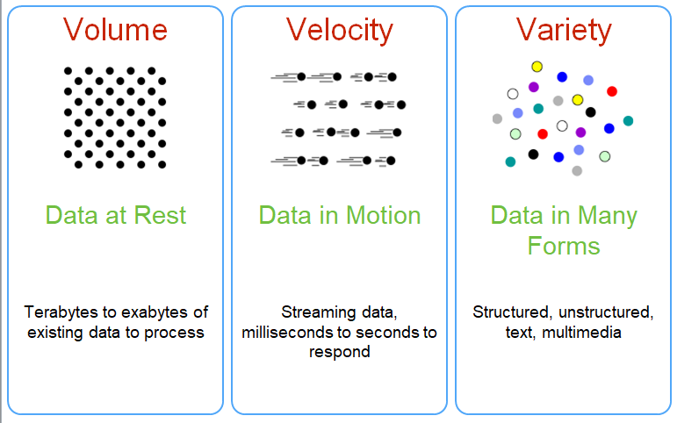
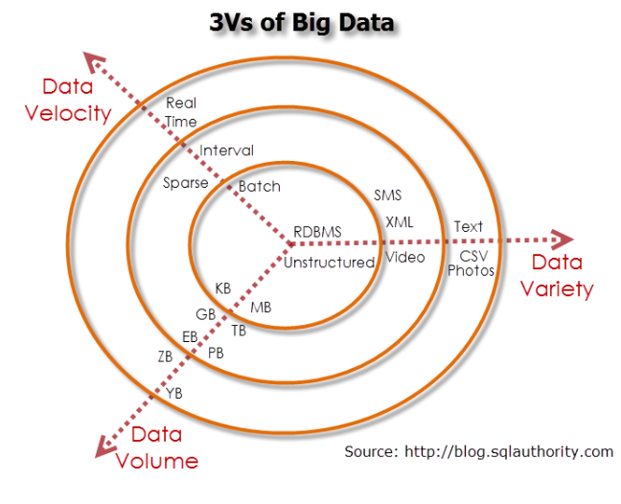
Big Data: 3Vs
AI cannot be decoupled from data
Data central for learning
Big Data
3 (or 4) Vs

Slide 6
Price Discrimination

Slide 7
Price Discrimination
Charging different (classes of) customers
Difference prices
Goods (services) whose costs are the same
Single price
Different customers for whom supply costs differ
Old age” phenomenon
Loyalty discounts
volume or multi-buy discounts
status based discounts (students, old-age pensioners, unemployed)

Slide 8
Price Discrimination
“Old age” phenomenon
Familiar manifestations
Loyalty discounts
Volume or multi-buy discounts
Status based discounts (students, old-age pensioners, unemployed)

Slide 9
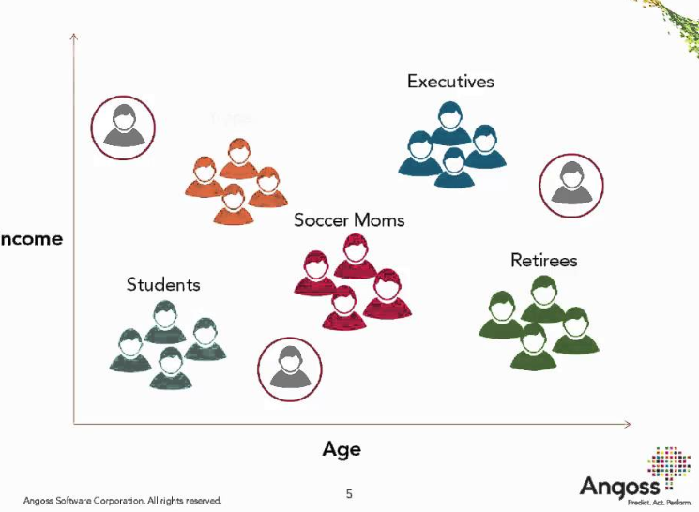
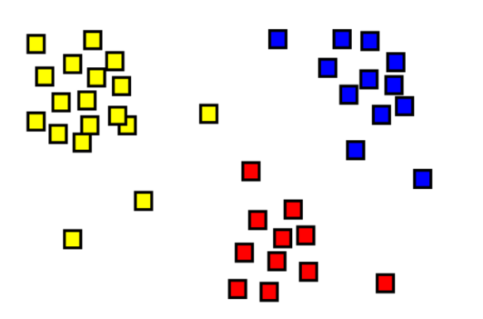
AI & Price Discrimination
AI for 3rd degree PD
Commonplace in marketing
Clustering algorithms
Segment consumers
“Similar” consumers → same groups
Similarity
Traditional demographic variables
Age, Sex, Location, Salary, …

Slide 10
AI & PD (cont)
Advent of digital platforms
Consumers revealing behavioral information breadcrumbs
Likes (preferences)
Dislikes
Sentiments, opinions
Purchase patterns
“AI” (machine/deep learning)
Reconstruct of digital profile from breadcrumbs
Infer WTP
Notes:
Consumers disclosing breadcrumbs of behavioral information revealing
With the current sota in machine learning: possible to reconstruct a fairly accurate digital profile of the consumer from these information

Slide 11
It is until 2015 that the prospect of SPT practices started to worry legislators, prompting a report by the Counsel of Economic Advisors (CEA) devoted entirely to differential pricing with big data (CEA, 2015). Recognizing how “...big data and electronic commerce have reduced the costs of targeting and first-degree price discrimination” (CEA, 2015, page 12), the report mostly drew dire conclusions about the potential harm to customers:
“[Differential pricing] transfers value from consumers to shareholders, which generally leads to an increase in inequality and can therefore be inefficient from a utilitarian standpoint” (CEA, 2015, page 6)
A similar concern for customer harm has been echoed in the recent mainstream business media, in the cases of Amazon, Stapes among others
Subsequently, there has been growing pressure for regulators to curb or restrict pricing based on individial’s data.

Slide 12
AI & PD (cont)
Does AI enable Perfect 1st degree PD?
Data as main impediment
Perfect 1st degree PD requires perfect consumer information
Not revealed
Consumers acting strategically
In (imperfectly) competitive markets, PD conditioned on
Search costs (some consumers have no other options than a given vendor)
Switching costs (brand preferences)
Information hard to obtain or unknown to firms

Slide 13
AI & PD (cont)
AI + (available imperfect) information
More granular PD than 3rd degree
Tends towards, approximates 1st degree PD
Dubé & Misra (2018)
Classical machine learning, econometrics algorithms
Scalable “price targeting” application
80% expected profit gains from targeted pricing
Notes:
However, AI coupled with available data/information does allow for finer grained seg of consumers and more granular PD, which tends towards and approx PD
For E.G. , in the study of Mishra, they made use of std ML and econetrics methods to implement a scalable price targeting algorithm
Showd that profits etc.

Slide 14
AI & PD (cont)
Is PD always profitable?
Yes if sole owner of consumer data
Marginal benefits if all firms have access to same data (from brokers)
Is PD fair, beneficial to consumers?
Loss in customer surplus but
Redistributive aspect
Includes “weaker” customers, excluded in uniform pricing

Slide 15
Algorithmic Tacit Collusion

Slide 16
Algorithmic Tacit Collusion
AI algorithms increase market transparency
Transparency
Easier to coordinate price
Detect deviations
AI increases occurrences of algorithmic tacit collusion?
Notes:
claims rest on the hypothesis that AI algorithms will increase market transperancy , and favour collusion
Indeed, transparent market make it easier for algorithmic agents from competitng firms to coordinate their prices and to detect deviation
Recent research , at the confluence of AI & Game theory, in MARL has indeed shown that agents can learn how to autonously cordinate their behavior and actions to reach a state wit h a higher reward than if they acted individually
However, besides coordinate, a cornerstone of collusion is the establishment of a credible device
In our research, we have found out that it is extremely difficult if not possible for agents to establish a credible punishment device with current sota
So, given the current sota, we believe that a collusive strategy involving a coordination and punishsment component is hard or impossible to implement
If prices are known: then esier for competiting firms to coordinate their prices and to detect deviation

Slide 17
Algorithmic Tacit Collusion (cont)
More sophisticated algorithms than PD
Reinforcement/Deep Reinforcement Learning
Different data requirements
Actions and corresponding rewards of competitors
Research in MARL (AI & Game Theory)
Agents learn to coordinate
Maximize a “collective” reward
Higher than if acted individually
Notes:
Recent research , at the confluence of AI & Game theory, in MARL has indeed shown that agents can learn how to autonously cordinate their behavior and actions to reach a state wit h a higher reward than if they acted individually
However, besides coordinate, a cornerstone of collusion is the establishment of a credible device
In our research, we have found out that it is extremely difficult if not possible for agents to establish a credible punishment device with current sota
So, given the current sota, we believe that a collusive strategy involving a coordination and punishsment component is hard or impossible to implement
If prices are known: then esier for competiting firms to coordinate their prices and to detect deviation

Slide 18
Algorithmic Tacit Collusion (cont)
Coordination only 1 component of collusion
Credible punishment device as cornerstone of collusion
Can agents learn how to establish credible punishment mechanisms?
Loss from punishments >> Profits when deviating
If one agent deviates,
How long will detection take?
Will agents collude again? (No plausible in human cartels)
Notes:
Recent research , at the confluence of AI & Game theory, in MARL has indeed shown that agents can learn how to autonously cordinate their behavior and actions to reach a state wit h a higher reward than if they acted individually
However, besides coordinate, a cornerstone of collusion is the establishment of a credible device
In our research, we have found out that it is extremely difficult if not possible for agents to establish a credible punishment device with current sota
So, given the current sota, we believe that a collusive strategy involving a coordination and punishsment component is hard or impossible to implement
If prices are known: then esier for competiting firms to coordinate their prices and to detect deviation

Slide 19
Algorithmic Tacit Collusion (cont)
Will AI increase occurences of algorithmic tacit collusion?
AI facilitates coordination,
Establishment of credible punishment device: open question
Current Work with A.Gautier andN.Petit

