Slide 1

Law & Economics of Big Data & AI
Algorithmic Price Discrimination & Tacit Collusion
Axel Gautier
Ashwin Ittoo
Nicolas Petit
3/12/2018
Notes:
Topics chosen to address apd and a
Joint research topics with colleagues from the LCII,
1

Slide 2
Agenda
Introduction
Price Discrimination
Economic
Foundations
Legal
Aspects
Discussion
Data & AI
3. Collusion
4. Discussion

Slide 3
Introduction
Dominant forms of AI
  Machine/Deep Learning
  (Deep) Reinforcement Learning
Firms using AI for pricing algorithms
  Learn how to price optimally
  Learning from past data (example on next slide)
Giving rise to new concerns, new questions

Slide 4
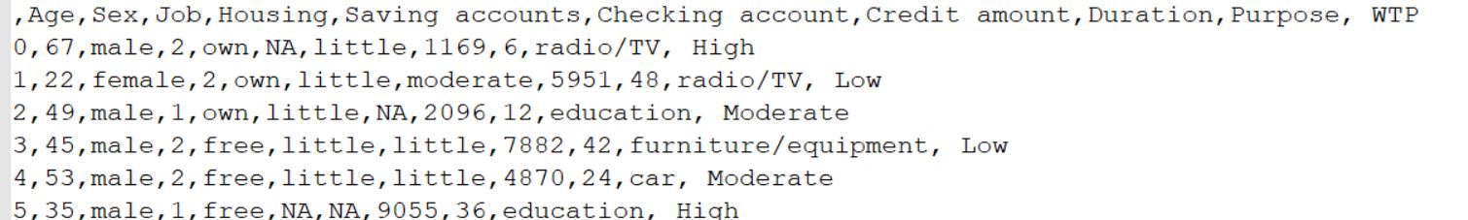
1. Introduction (cont)
Illustration: Machine Learning
Learning from past data
  Learning to predict Willingness To Pay (WTP)
Predictors
Predicted Variable
(Supervised Learning)
Notes:
Algos learn from data collected in the past
For e.g. We could rely on data as shwon on the slide to learn how to predict WTP from a number of variables, such as
4

Slide 5
1. Introduction (cont)
Research Focus: AI (&Big Data) on
  Price Discrimination
  Tacit Collusion
Specifically: Does AI
  Extends the possibility to price discriminate leading to more personalized prices (Belleflamme et al., 2018)?
  Facilitates collusion by algorithms (Ezrachi and Stucke, 2016)?
Notes:
“More” personalized prices
5

Slide 6
Overview: Methodology & Results
Methodology
  Grounded in Economic, AI & Legal Scientific Literature
  Compare Price Discrimination (PD) and Tacit Collusion (TC)
Main result: PD & TC diametrically opposed
  Data requirements
  AI methods
  Strategies (more complex for TC)
  Context (one-shot v. repeated games)

Slide 7
2. Price Discrimination (PD)
/
Personalized Pricing (PC)

Slide 8
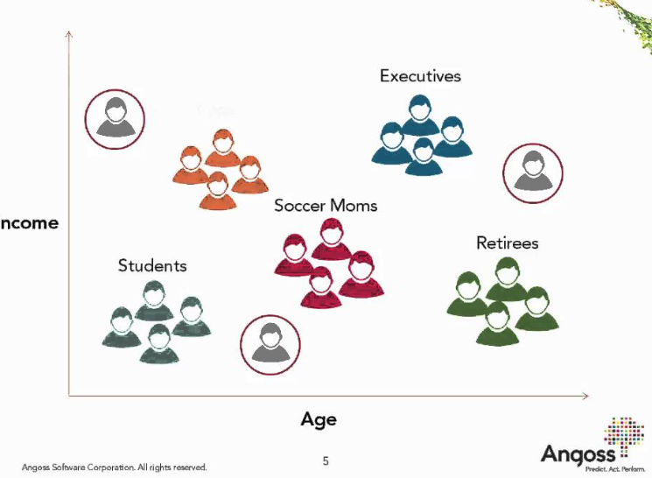
2.1 Economic Foundations
Third-degree price discrimination
  Customers segmented in different groups
  Different prices offered to each group
Group Pricing
  Clustering algorithms
  Similar customers → same groups/segments
  Similarity based on observable characteristics, e.g.demographics
  Age, Sex, Location, Salary, …
Notes:
More groups, but smaller
In the extreme case: each group is 1 customer
3rd degree pushed to the limit
No need to personalized degree
8

Slide 9
2.1 Economic Foundations (cont)
Group pricing in monopoly → increased profits
  Output expansion (as compared to uniform pricing)
  Surplus extraction
  => efficient
Finer grained segmentation → increased profits
  Large number of (small) clusters
  Extreme case: 1 customer = 1 cluster
  From 3rd to 1st Degree PD

Slide 10

2.2 Data & AI
Several real-life PD cases reported
Local grocery store or pharmacy
  Tailored pricing
  Not overt: labelled as personalized deals or coupons [Elliot [2013], Gross [2012]]. See Shiller 2014
Staples
  Pricing based on
    Location, Distance from competitors’ stores
  Discounts if competitors within 20 miles of Staples store
  See WSJ Article
Notes:
Several cases of pd documented /reported in practice
Local grocery or pharmacy offr tailor prices, which is a form of PD. However, it is not overt and is labeled as …

Slide 11


2.2 Data & AI (cont)
TravelVelocity
  Pricing based on
    Browser (IE, FireFox, IE)
    Platform (OSX, iOS, Android, Windows)
    Account log-in
Amazon
  Clearing cache, deleting cookies
  Drop in DVD price: $26.24 to $22.74
  Customers refunded
Notes:
Other documented PD cases in practice, well-known case of amazon.

Slide 12
2.2 Data & AI (cont)
Most real-life examples
  Instances of 3rd degree PD, albeit more graunular
  E.g. distance (customer, Staples) > 20 miles → 1 segment
  But…
Does AI (&Big Data) lead to more personalized prices?

Slide 13
2.2 Data & AI (cont)
Advent of digital platforms
Consumers revealing
  Personal & demographic
    Age, sex, location, education, device, …
  Behavioral information breadcrumbs
    Likes (preferences), sentiments, opinions, purchase patterns
Information breadcrumbs
  Enable reconstruction of digital personae
  Fairly accurate profile of consumers
  “Guess” WTP of consumers

Slide 14
2.2 Data & AI (cont)
Past research
  Empirical evidence Machine Learning/Econometrics Methods
  Applied to customer data
  More granular 3rd degree PD
  Tends towards 1st degree PD
See for e.g.
    Shiller, 2014
    Ban & Keskin, 2017
    Dubé & Misra, 2018
    (Summary in following slide)
Supported by documented real-life PD cases
Notes:
Past research has also provided empirical evidence that AI/Econ metrics lead to more granular 3rd degree PD, tends towards 1st degree

Slide 15
Data & AI (cont)
 | Data Demographic + Behavioral | ML/Econ. Methods | Main Results (w.r.t. PD)
Shiller (2014) | (Netflix) Race, age, income, population density, web browsing behavior, | Ordered-choice Model Averaging (OMA), | Profits increase by 12.2% more than 2nd degree PD profits
Ban & Keskin (2017) | Gender, income bracket, age, height, and weight | Least square, Lasso Regressions | Devised near-optimal pricing policy (min. regret)
Dubé & Misra (201) | (Ziprecruiter) Job state, company category, job category, benefits | Lasso, Weighted likelihood Bayesian bootstrap | Profit increase: > 10% Customer surplus declines: > 1%..but 70% of customers pay less

Slide 16
2.3 Discussion
Big Data, AI
  More sophisticated pricing algorithms
  Finer-grained segments
Facilitate Price Discrimination
But
No clear consensus if PD is an economic equilibrium in a competitive environment
Notes:
No doubt algo can help but doubtful on econ equlibrium. For econ equi → need absence of competition on retail and data markets
16

Slide 17
2.3 Discussion (cont)
Dual impact of PD in competitive environment
  Output expansion (⬆Profits)
  Intensified competition (⬇ Profits)
General consensus from the literature:
  Too much retail competition is incompatible with price discrimination
  Similar datasets, algorithms leads to collapse of price discrimination (Liu & Serfes, 2004; Belleflamme et al. 2018)
Important to consider retail & data market when analyzing the impact of AI on PD
For economic equilibrium: need absence of competition on retail and data markets

Slide 18
2.4 Law & Policy Aspects
In EU law, Article 102 c) does not capture PD targeted to consumers (end users), but Article 102 a) captures « unfair » pricing => possible legal basis to use when all surplus is extracted
Threshold level of dominance : Only applies to 3rd of 1st degree PD by monopoly, not in competitive markets
Article 102 b) could be used : output limitation => when PD is successfully deployed, there are no longer gains from trade for buyers => markets collapse in the long term
Also for these laws are possibly applicable for price discrimination:
  Consumer protection, gdpr
  Data protection
  Anti discrimination
  And competition law, could be interesting as it follows a case by case approach

Slide 19
3. Tacit Collusion

Slide 20
3.1 Economic Foundation
Collusion without formal agreement
  Oligopoly markets
  May emerge as repeated game equilibrium
Based on “grim-trigger” strategy
  Play the collusive outcome at date t, if the other player(s) has played the collusive outcome at all date t’<t
  Play the non-collusive (or competitive) outcome otherwise
  Constitutes (under conditions) subgame perfect Nash equilibrium (SPNE)
Non-unique SPNE (Folk theorems)
  Non-collusive outcome is a SPNE of the game
  Possible to sustain collusion for different collusive prices
  Possible to sustain equilibria with limited punishment periods, e.g.
    “if a player deviates from the collusive outcome, play the non collusive outcome for T periods and then return to the collusive one”. If T is large enough, it can sustain a SPNE

Slide 21
3.1 Economic Foundation (cont)
3 conditions for collusive outcome
  Meeting of the minds (coordination) on a collusive price (or output level)
  Monitoring device
  Credible punishment
    Cornerstone of collusive strategies
    Losses incurred from punishment at least cancel benefits of cheating
    Optimal response of competitors after deviation

Slide 22
3.2 Data & AI
Intuitively
  AI Algorithms facilitate price monitoring
  Increase market transparency
Does AI increase occurrences of (algorithmic) tacit collusion?

Slide 23
3.2 Data & AI (cont)
(Tacit) Collusion
  Formalized as Reinforcement Learning (RL) problem
  RL: class of AI paradigm
RL Agent
  Explores its environment
  Learns best (optimal) sequence of actions to reach goal
  Actions yield rewards (positive scalar or zero)

Slide 24
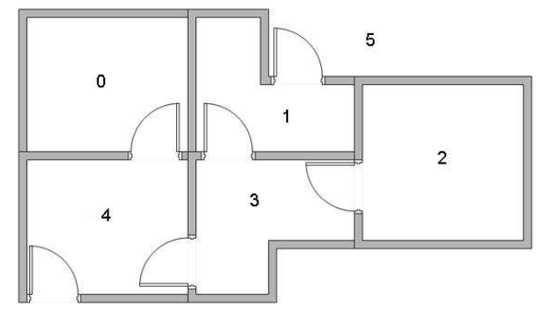
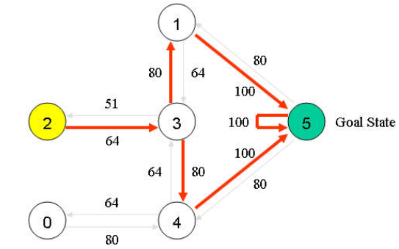
3.2 Data & AI (cont)
RL Illustration
  Agent’s Goal:
    Find “optimal solution” to reach state 5 (exit the building)
    “Optimal solution”: action sequence that yields highest rewards
    Actions: up, down, right, left
    Agent learns about different solutions via exploration

Slide 25
3.2 Data & AI (cont)
Q-Learning
  Classical algorithm for RL
  Variants: Nash Q-Learning, Independent Q-learning
Empirical evidence on collusion between Q-Learning agents
  Klein (2018)
  Calvano et al. (2018)
  Harrington (2017)
But current research
  Simplistic duopoly environments, not accurate reflection of real-life (oligopoly, with n competing agents, n >2)
  Non-stationary environment with n > 2 agents; Q-learning fails
  Punishment mechanism overlooked, except in Calvano et al.
Notes:
Current research has provided empirical evidence and shown that Q-learning agents can learn how to collude and punish
25

Slide 26
3.3 Discussion
General conclusion
  Multiplicity (and complexity) of equilibria is a concern (in coordinating and punishment)
  Overcome in restricted, laboratory environments
Given current state of the art in AI and the issue of multiple, complex equilibria :
Doubtful if algorithmic tacit collusion can occur in real-life
Notes:
Algo tacit collusion involves multiple, complex equilibria, which can be overcome in lab settings
And with regards to tacit collusion, our conclusion is that..

Slide 27
3.3 Law & Policy Aspects
It is communication that is illegal in collusion. So, if algorithmic agents do not communicate —> no collusion...nothing different to human collusion
But tacit collusion can be indirectly remedied in merger proceedings
  4 to 3 merger leading to increased risks of tacit collusion
Collusion has always existed . Do we need new laws for algorithmic collusion? (no different from human collusion)
  Perhaps if tacit collusion occurs at scale
  Idea would to legally fight collusive outcome (parallel pricing) instead of incriminating collusive process (communication)
  Pure economic approach (Kaplow)

Slide 28
Conclusion
AI & Big Data undoubtedly facilitate Price Discrimination (PD)
But is PD an equilibrium in a competitive environment?
Important to consider retail & data markets when analyzing the impact of AI on PD
  For equilibrium: limited competition on retail & data markets
AI & Big Data increase market transparency
But can algorithmic agents can collude in real-world? Still an open-research question
Issues of multiple equilibria, complexity of equilibria
State of the art AI not “sophisticated” enough to capture mechanisms of collusive strategies, especially punishments

Slide 29
Conclusion (Cont’d)
TC and PD/PP do not work well together
When PD/PP is possible, oligopolists’ algorithms can cheat on each customer (C) → anarchy (see diagram on next slide)
Unless TC on each price point on the demand curve, TC is not a stable equilibrium
TC occurs on usual range of output , but PD/PP occurs on the marginal range of output unserved under TC
Note : TC is less efficient than PD/PP. Policy should focus on TC ?
Note 2 : TC is less frequent than PD/PP. Policy should focus on PD ?
Notes:
à l'équilibre, le prix de collusion est > au coût marginal, et tout l'output n'est pas produit sur le marché. Le range of output situé entre le prix de collusion et le cout marginal représente les quantités non servies au client. On pourrait imaginer que les cartellistes se fassent concurrence via du PD sur cette frange marginale du marché. Cela s'apparente à de la semi collusion.
Deux, TC is less efficient que PD (1st degree) car dans TC, il y a un deadweight loss, et pas dans 1st degree PD.

Slide 30
Conclusion (Cont’d)
TC and 3rd Degree PD are compatible
TC and 1st Degree PD are not compatible

Slide 31
Conclusion (cont)
 | PD | TC
Game | Static or dynamic | Dynamic
Data needed | Customers’ characteristics | Pricing of competitors, sales volume
AI | ML to cluster consumers and infer WTP Design targeted discount | RL Algo. agent explores environments, learns optimal action sequence to max. profits
Pricing | Personalized price, random prices, personalized discounts | Linear/flat pricing

Slide 32
QUESTIONS

