Slide 1

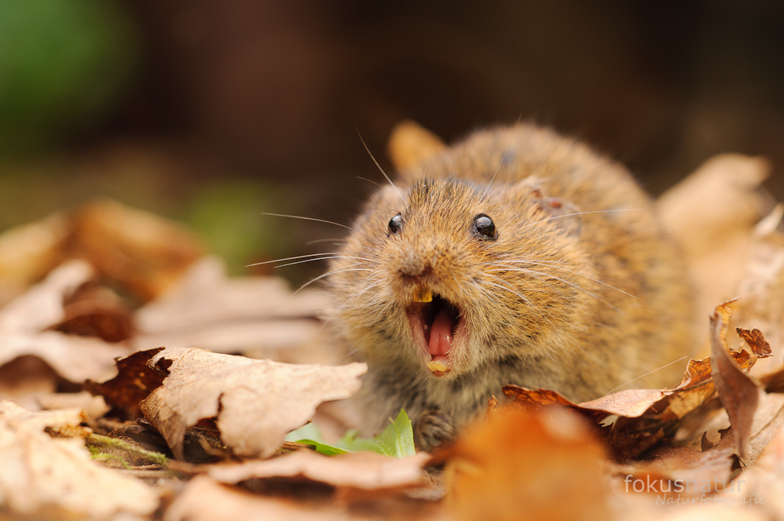

How can genetic tools contribute to the study and management of wild fauna?
An overview of genetic tools to study biodiversity
Lise-Marie Pigneur, François Gillet, Adrien André & Johan Michaux
Conservation Genetics Lab, Institute of Botany (Bat. 22), University of Liège Belgium
www.gecolab.weebly.com

Slide 2
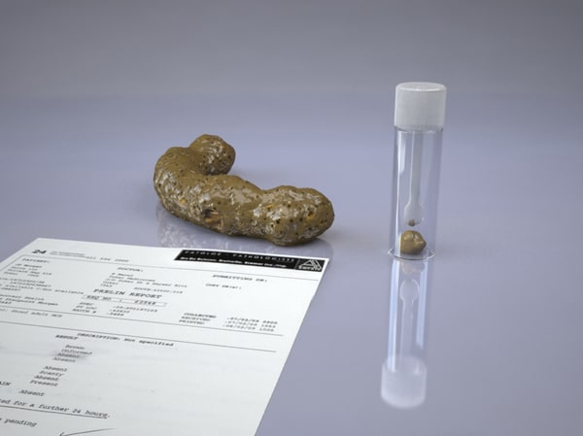
From DNA to species conservation
3 main approaches
1) Mt or nuclear DNA sequencing
2) Microsatellite / SNP markers
3) Next Generation Sequencing for metabarcoding
« Fresh » tissue samples or environmental DNA
(faeces, hair, water)
species identification, population size estimate,
individual monitoring, diet study or bacterial pathogen
identification.

Slide 3
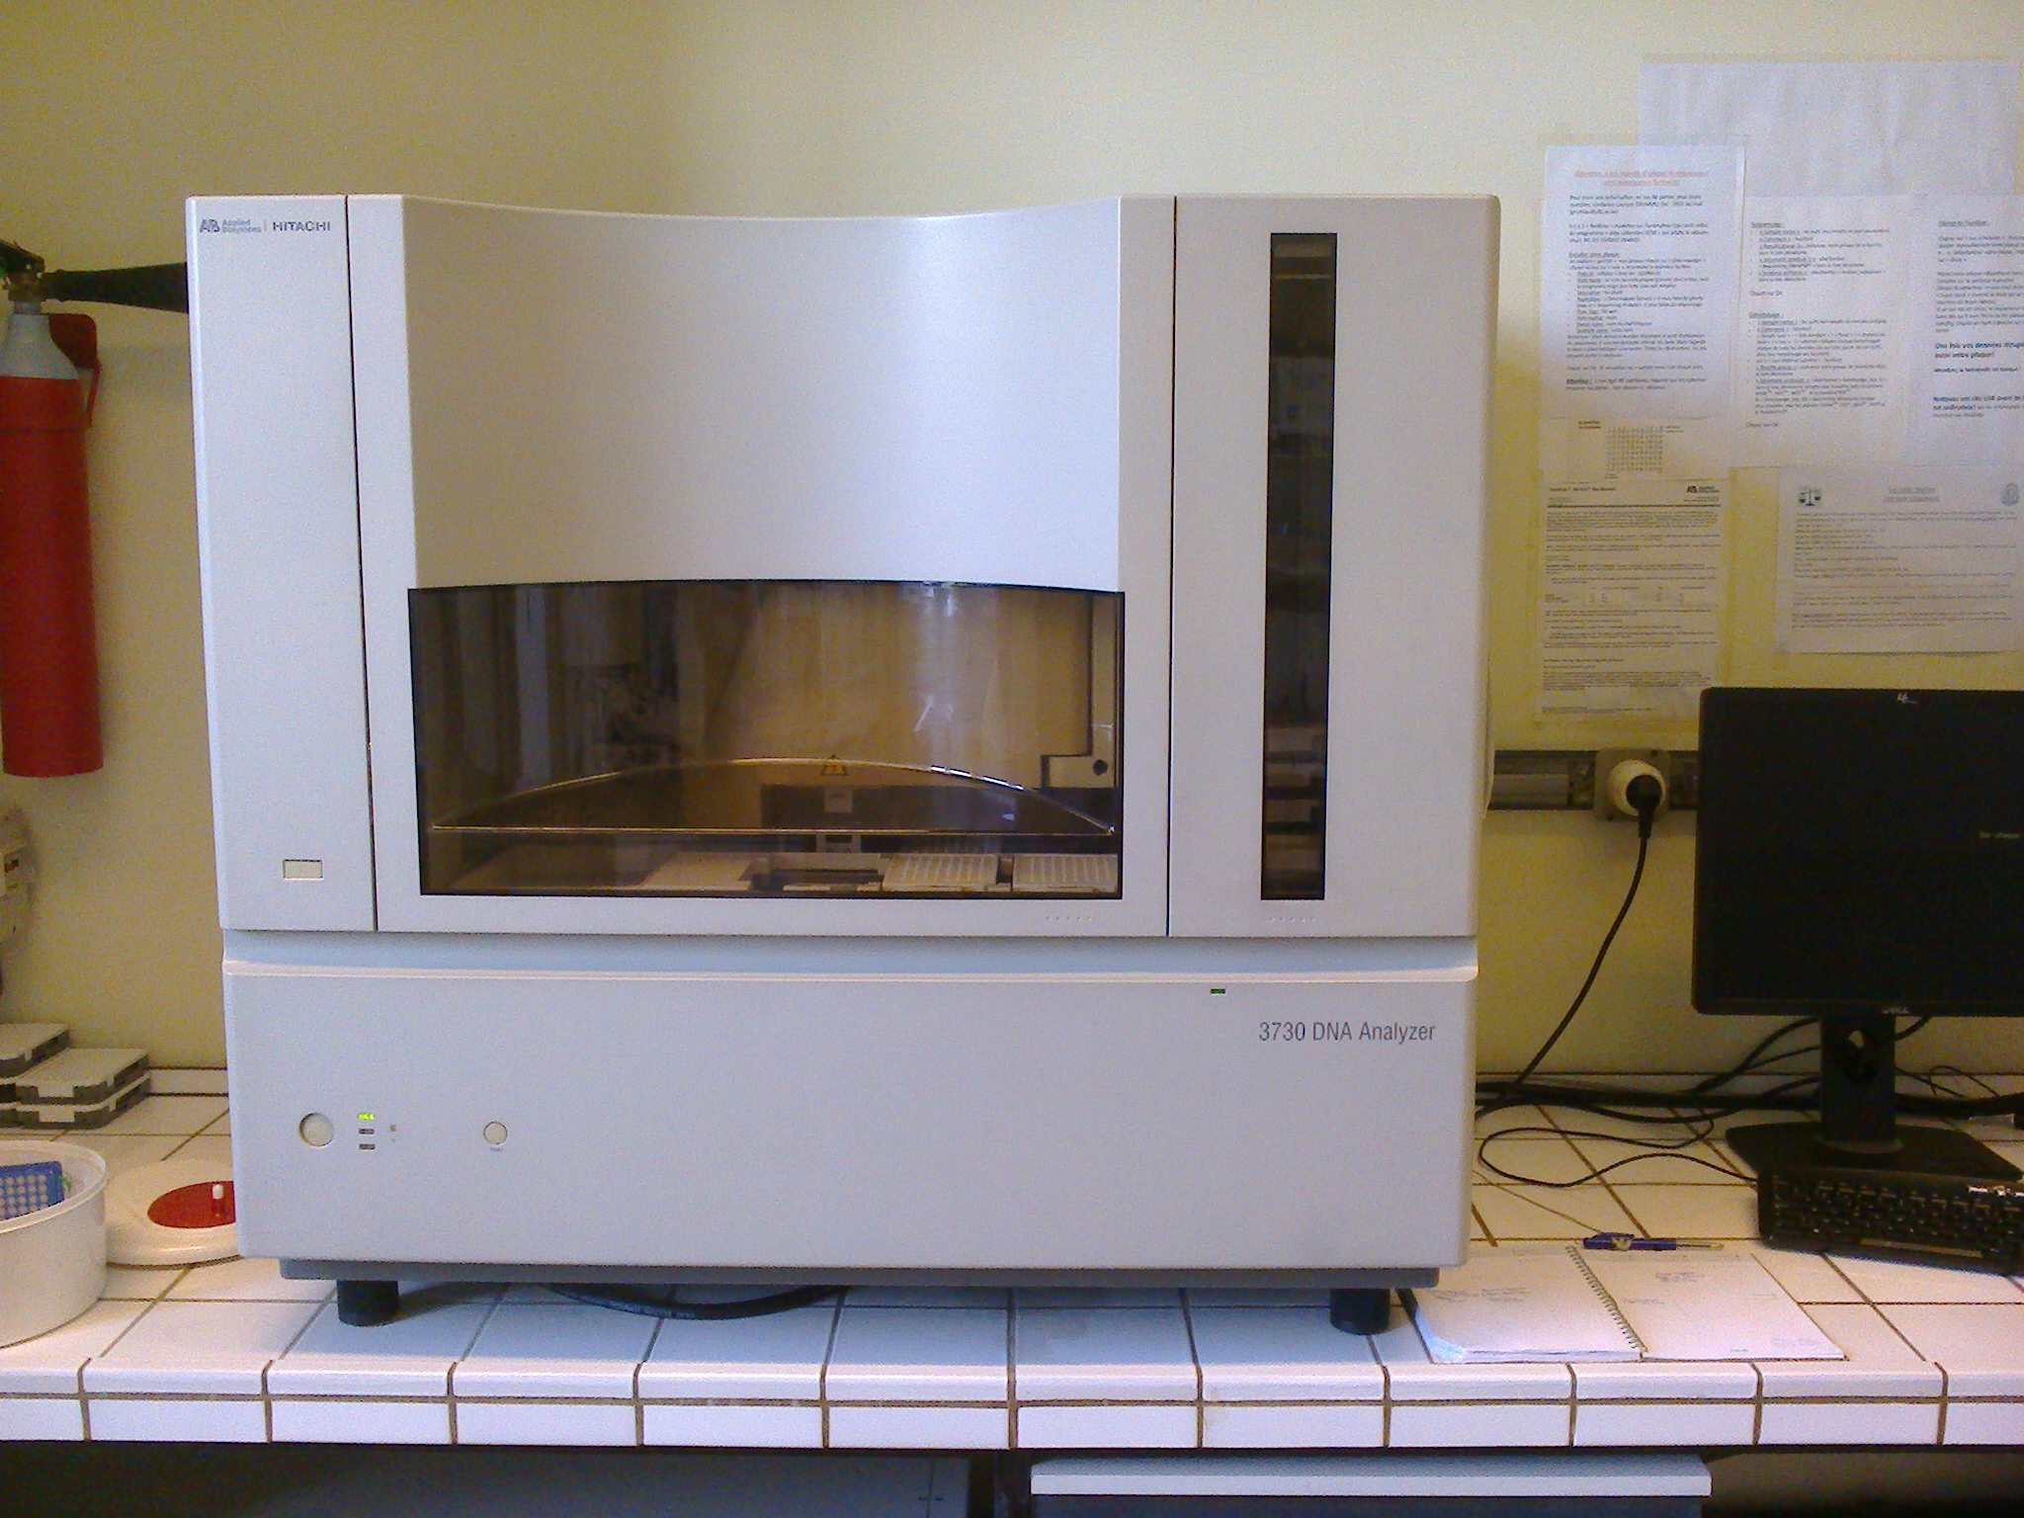
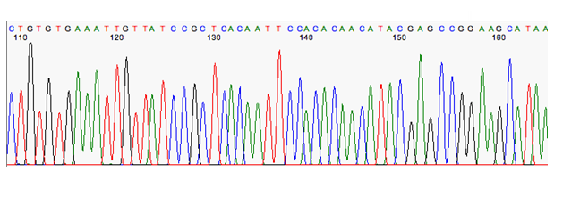
1) Mt or nuclear DNA sequencing
Sanger sequencing of genes
Precisely provides the nucleotide sequence
Notes:
Most of the time : from hair or tissues

Slide 4
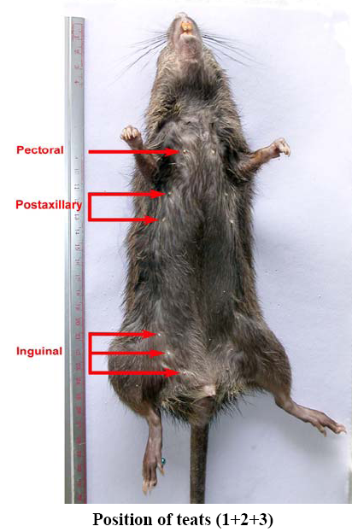
Applications of mt or nuclear DNA sequencing
Many misidentifications related to the subjectivity of morpho-logical markers
e.g. complexity of mammal species, particularly in South East Asia (>160 rat species!!)

Slide 5
Molecular phylogeny
Applications of mt or nuclear DNA sequencing
Large set of genetic markers (mitochondrial and nuclear markers)
Help to resolve taxonomic uncertainties
Allow to identify or discover cryptic and unknown species

Slide 6
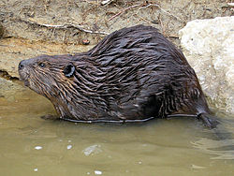
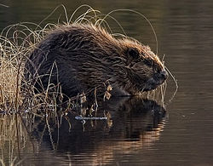
Applications of mt or nuclear DNA sequencing
Identification of beaver species in Wallonia
Castor fiber ? Castor canadensis
Protected VS Invasive species
non invasive sampling (hair)
Species identification using mt DNA sequence
(subspecies identification for C. fiber)
Notes:
comparison of sequences based on alignment and public + private database we developed / microsat have been used to study genetic structure and relatedness between c. canadensis samples in the Greater region

Slide 7
Phylogeography
Based on genetic markers with high evolutionary mutation rates (mitochondrial and nuclear markers).
Help to evidence intraspecific variability.
Allows to understand the impact of past historical events (climate changes, insular isolations etc) on the genetic intraspecific structure of vertebrates.

Slide 8
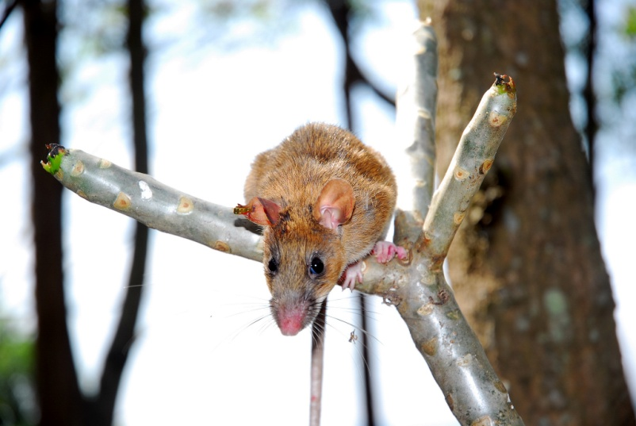
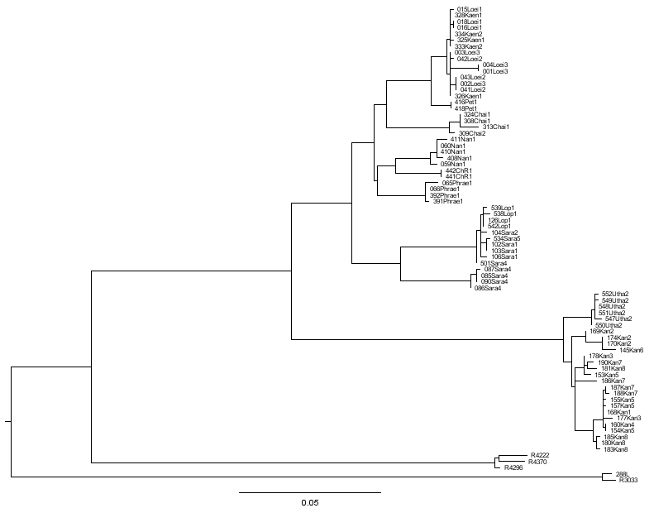
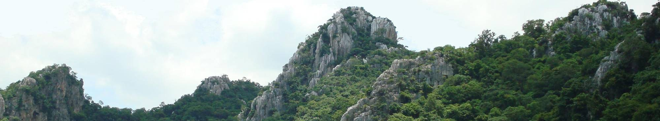
At the intraspecific level, the case of Leopoldamys neilli
Geographical structure
Evidence of 4 main groups subdivided in 10 geographically
well-structured lineages.
Latinne et al. , 2011. Conservation Genetics
ML phylogenetic tree
4 combined genes (cytb/COI/bfib/G6PD)
(ML bootstrap/BIPP)
NORTH-EAST
Loei
Khon Kaen
956/0.99
988/1.0
701/0.93
997/1.0
Petchabun
1000/1.0
Chaiyaphum
515/0.44
NORTH
996/1.0
Nan
836/
0.97
Chiang Rai
398/
-
1000/1.0
850/1.0
1000/1.0
Phrae
CENTRE
1000/1.0
Centre 1
999/1.0
979/1.0
1000/1.0
Centre 2
998/1.0
Uthai Thani
1000/1.0
WEST
1000/1.0
658/0.84
Kanchanaburi
10 lineages

Slide 9
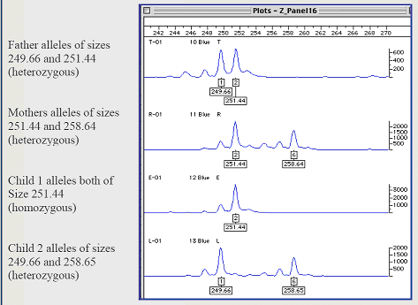
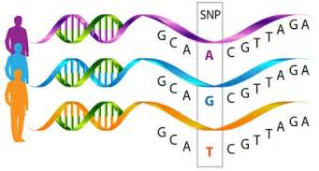
2) Microsatellite or SNPs genotyping
Amplification of highly polymorphic short regions
differences at the individual level
« genetic ID card »
Can work with non invasive samples.
Important for elusive or endangered species !

Slide 10
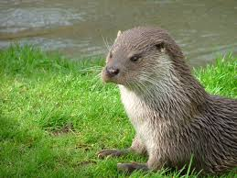
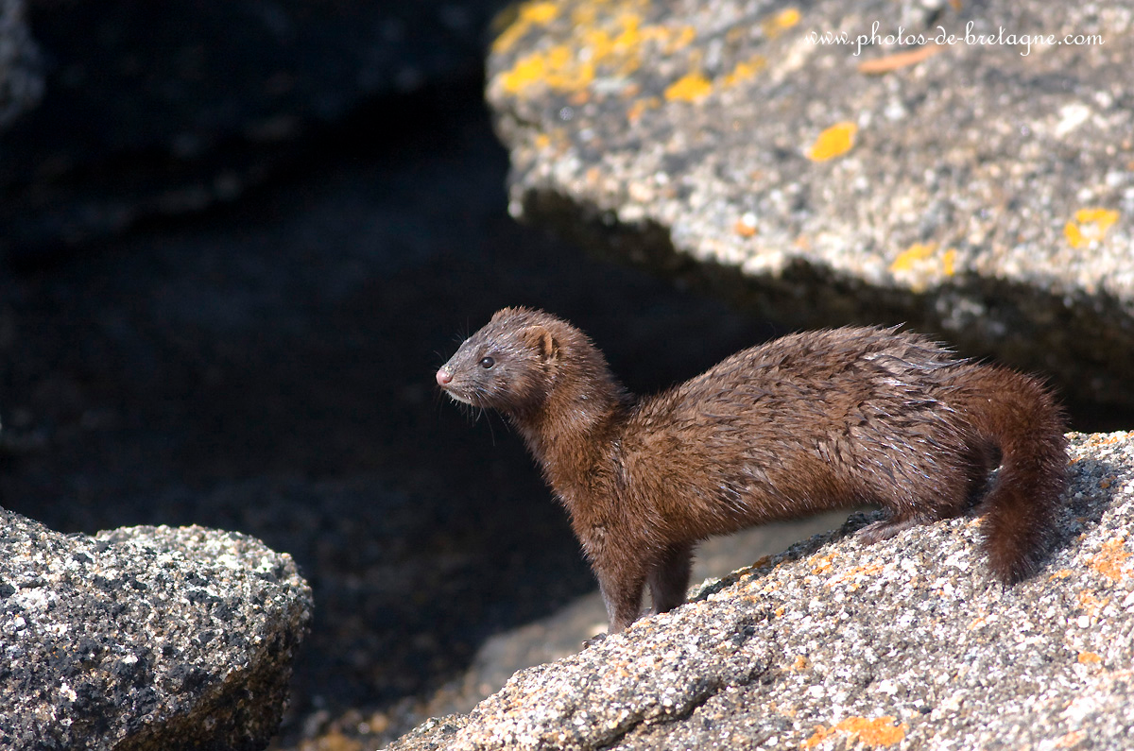
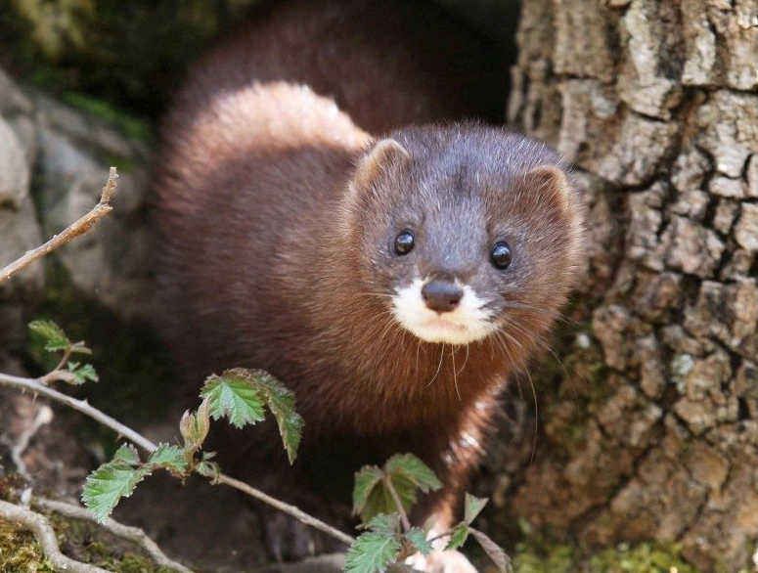
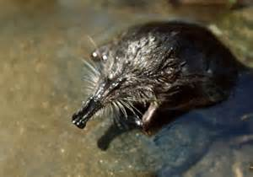
Genetic structure and population dynamics of wild mammals
Applications of microsatellites/SNPs genotyping
Eurasian otter (Lutra lutra)
American mink (Neovison vison)
European mink (Mustela lutreola)
Pyrenean desman (Galemys pyrenaicus)
DNA from hair, tissue or feces
genetic structure, size population estimates, inbreeding level,
gene flows, …
Notes:
Nbr of individuals, genetic structure linked with geography, inbreeding , gene flows + detection of hybrids

Slide 11
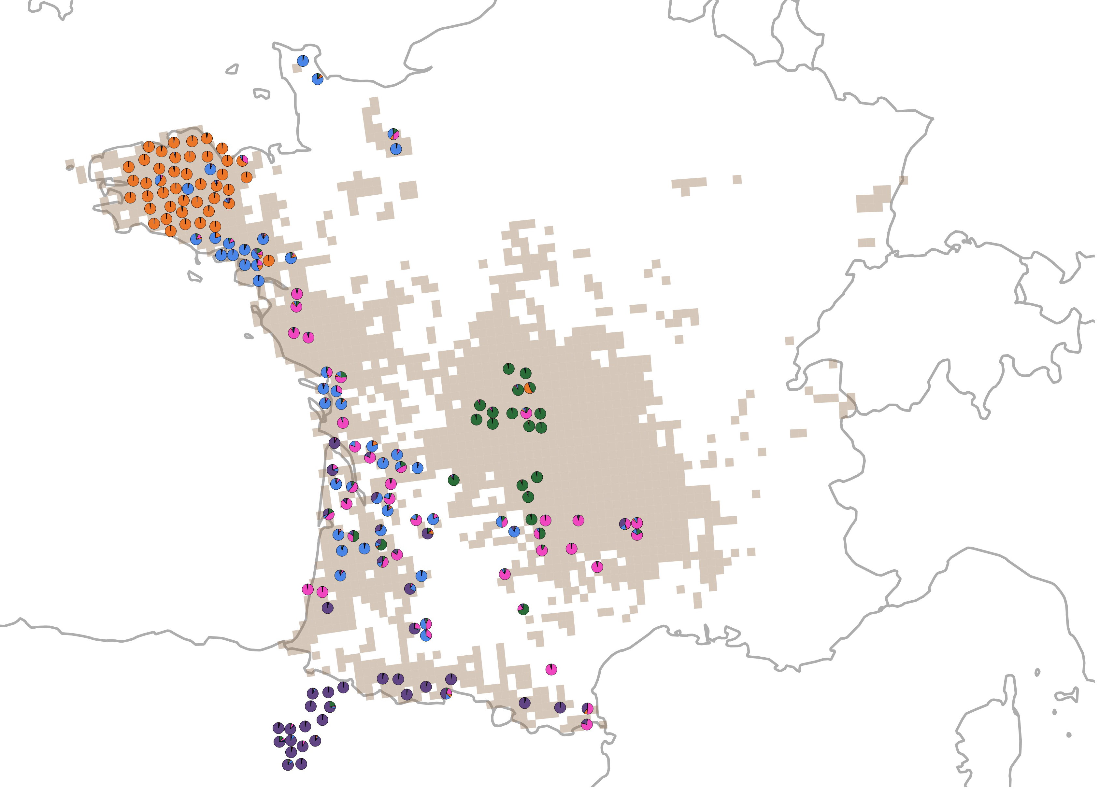
Eurasian otter in France
Applications of microsatellites/SNPs genotyping
5 genetic lineages (? linked to historical refuge)
admixture between lineages
long distance dispersal

Slide 12
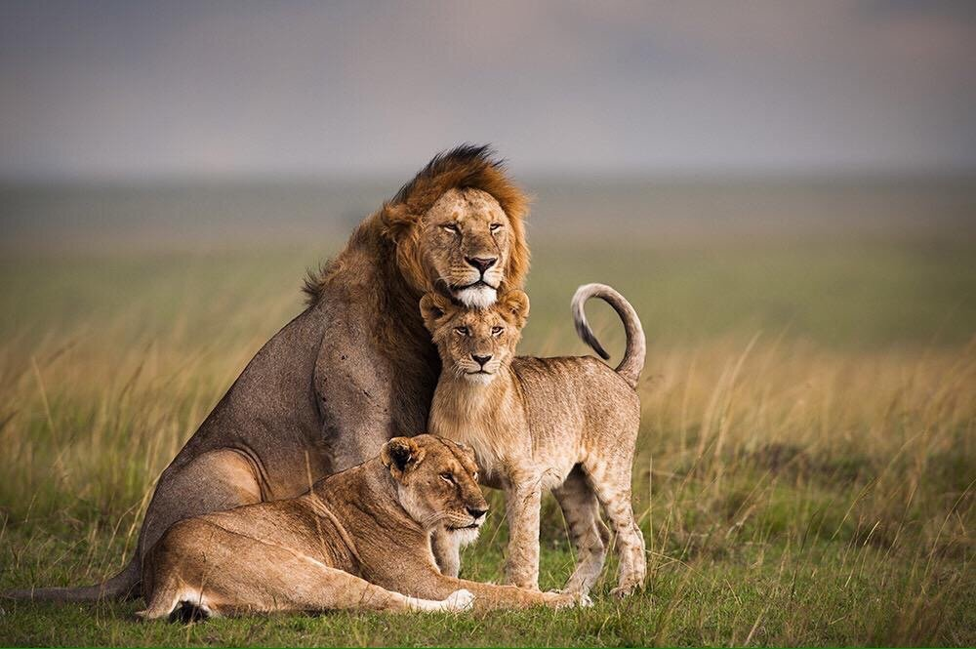
The case of the African lion in Tanzania
Applications of microsatellites/SNPs genotyping

Slide 13
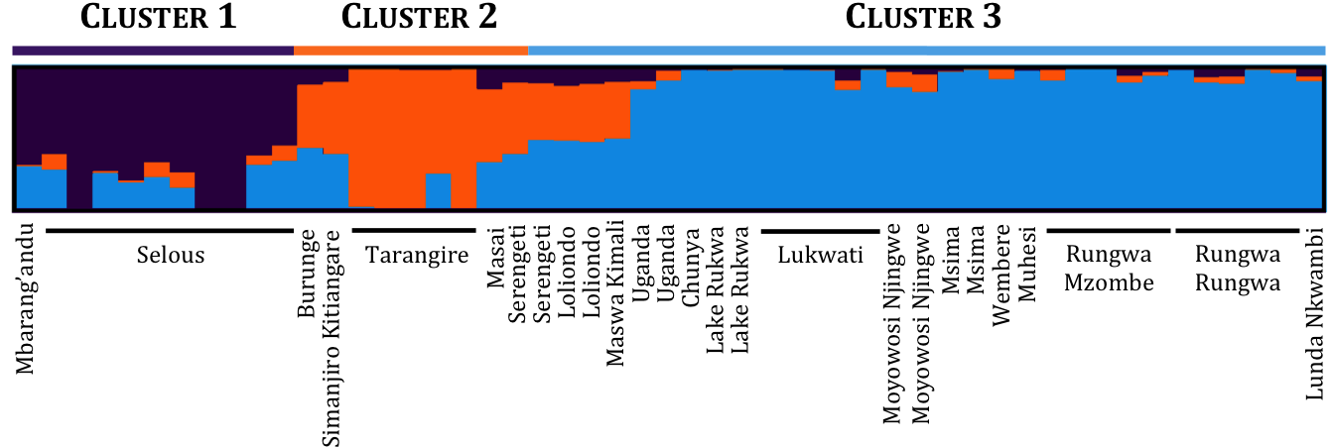
Clustering analyses based on hypervariable genetic markers (SNP's)
Applications of microsatellites/SNPs genotyping

Slide 14
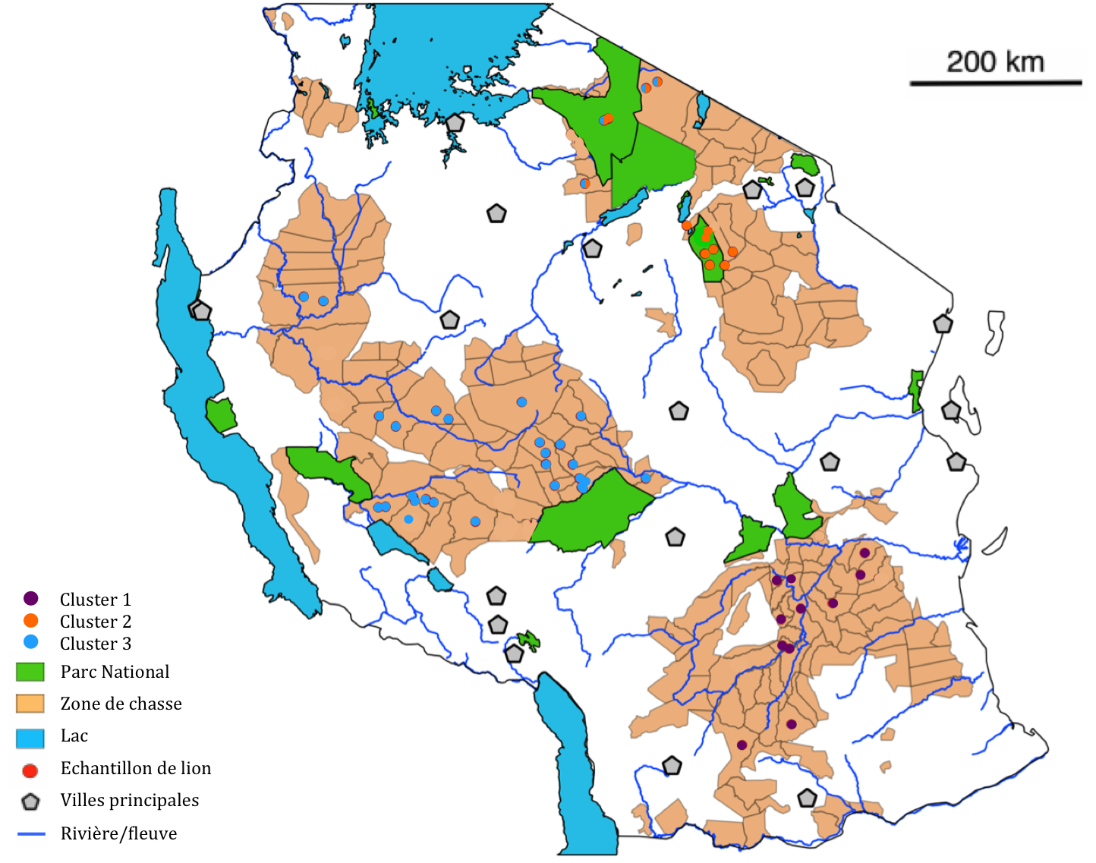
Applications of microsatellites/SNPs genotyping

Slide 15

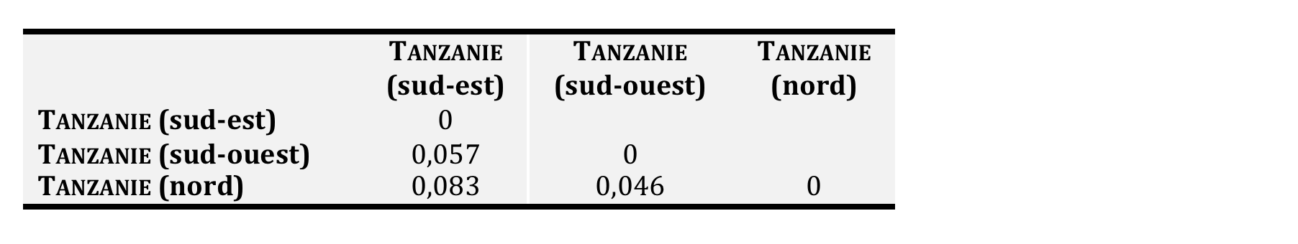
Gene flow and estimation of isolation among populations.
Recent gene flow among population. Recent isolation.
Inbreeding depression risk
Inbreeding depression index : F_{IS} = 0,078 : cluster 1 (South-East)
F_{IS} = 0,210 : cluster 2 (North)
F_{IS} = 0,124 : cluster 3 (South-west)
High values of inbreeding index, suggesting high depression risks.
Help to propose the best management measures for the lion populations (translocations, corridors among protecte areas…)
Notes:
➔ Au niveau de la Tanzanie, la différenciation de la population en 3 clusters permet de porter notre réflexion sur 2 stratégies de conservation opposées, à savoir : doit-on gérer ces trois populations en tant qu’unités de gestion indépendantes ou bien doit-on mélanger ces 3 populations entre elles afin d’augmenter leur diversité génétique et leur donner une meilleure chance de survie à long terme ?

Slide 16
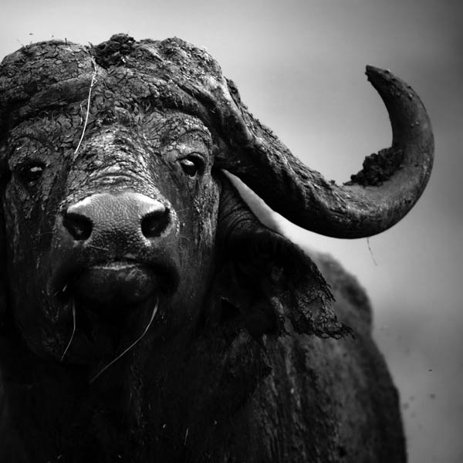
Applications of microsatellites/SNPs genotyping
Study of the genetic structure of the African buffalo populations (Syncerus caffer): impact of its high mobility and of the fragmentation of its habitat on its distribution and its interactions with humans
Nathalie Smitz’s PhD thesis
supervised by Dr Johan Michaux

Slide 17
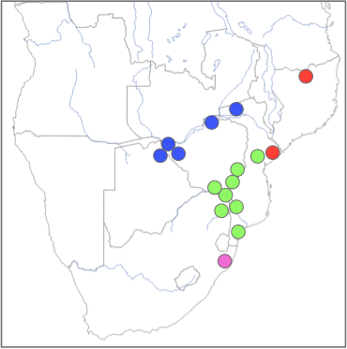
Populations Structure
4 Clusters (Structure, Geneland)

Slide 18
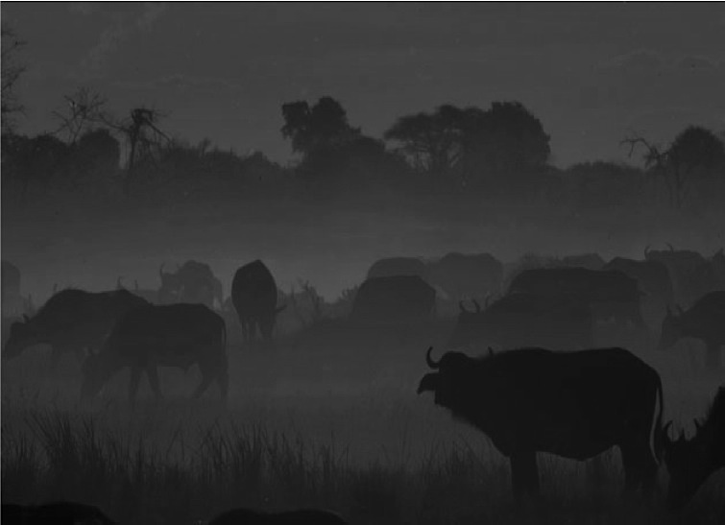
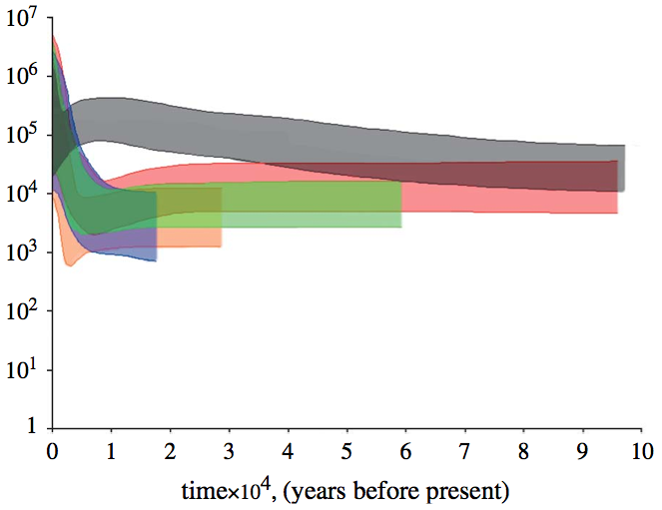
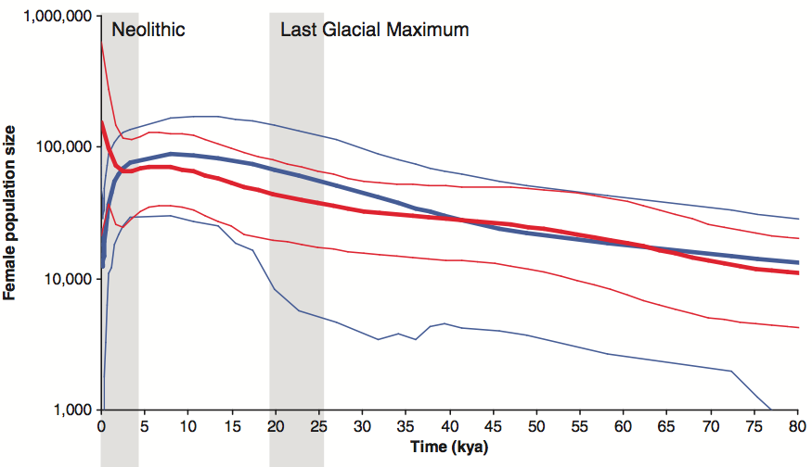
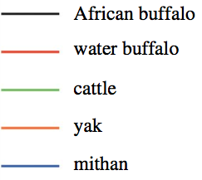
Demographic history
Finlay et al. 2007
Heller et al. 2012
African buffalo
Human
Effective population size (Ne)
Inversely correlated to the human and domesticated bovine (cattle, mithan, water buffalo, yak) explosive population growth of the Neolithic

Slide 19
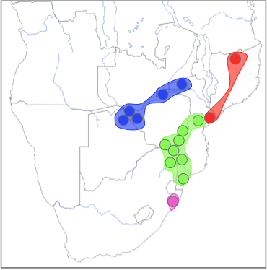
Isolation degrees among the clusters
F_{ST} Matrix (Arlequin)
 | Pop 1 | Pop 2 | Pop 3 | Pop 4
Pop 1 | 0
Pop 2 | 0.024 | 0
Pop 3 | 0.022 | 0.039 | 0
Pop 4 | 0.006 | 0.035 | 0.037 | 0
Pop 2
Pop 3
Pop 4
Pop 1
Notes:
Weaker gene flow, lower mtDNA diversities → 75 individuals reported in 1929

Slide 20
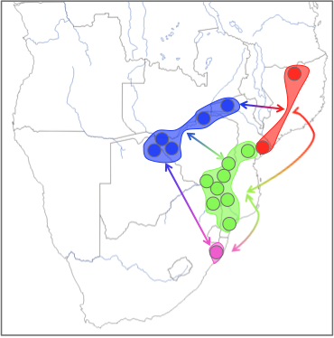
Number of migrants per generation
And important number of immigrants per generation (Migrate program)
Highest migration rate from POP4 toward the other one
M_{Pop 4}
2,345
M_{Pop 1}
M_{Pop 4}
7,125
M_{Pop 2}
M_{Pop 4}
6,290
M_{Pop 3}
Pop 2
M_{Pop 3}
0,984
M_{Pop 1}
Pop 3
M_{Pop 3}
2,387
M_{Pop 2}
M_{Pop 3}
3,047
M_{Pop 4}
M_{Pop 2}
2,900
M_{Pop 3}
Pop 4
M_{Pop 2}
2,296
M_{Pop 4}
M_{Pop 1}
1,111
M_{Pop 2}
Pop 1
M_{Pop 1}
1,174
M_{Pop 3}
M_{Pop 1}
1,277
M_{Pop 4}

Slide 21
Inbreeding depression
 | N_{indv} | H_{O} | H_{E} | F_{IS}
Pop 1 | 28 | 0.554 | 0.586 | 0.048
Pop 2 | 58 | 0.651 | 0.673 | 0.010
Pop 3 | 60 | 0.620 | 0.639 | 0.025
Pop 4 | 115 | 0.618 | 0.651 | 0.048
Pop 2
Pop 3
Pop 4
Pop 1

Slide 22
Conclusion
Current population sizes did not have recently reached critical low level
BUT without migration between confined protected area, the African buffalo should not be able to maintain historical levels of genetic diversity in the future
Encourage translocation programs and/or establishment of corridor between reserves…
Notes:
SNP also for fish farm project => selection and mixing of genetic strains

Slide 23
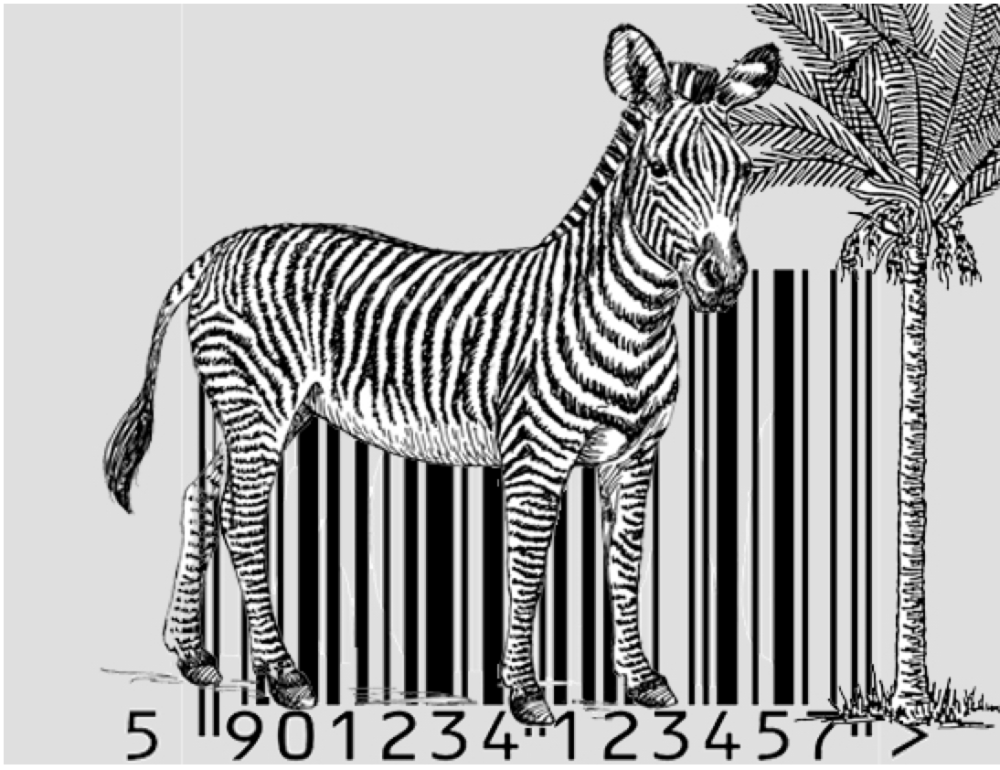
3) NGS metabarcoding
Amplification of a very short genetic sequence from a standard part of the genome.
DNA barcoding
Most common markers :
- Animals : small region of the mitochondrial cytochrome c oxidase 1 gene (“CO1”).
- Plants : fragment of the TrnL or ITS2 regions.

Slide 24
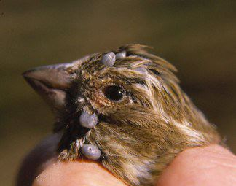
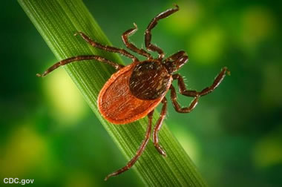
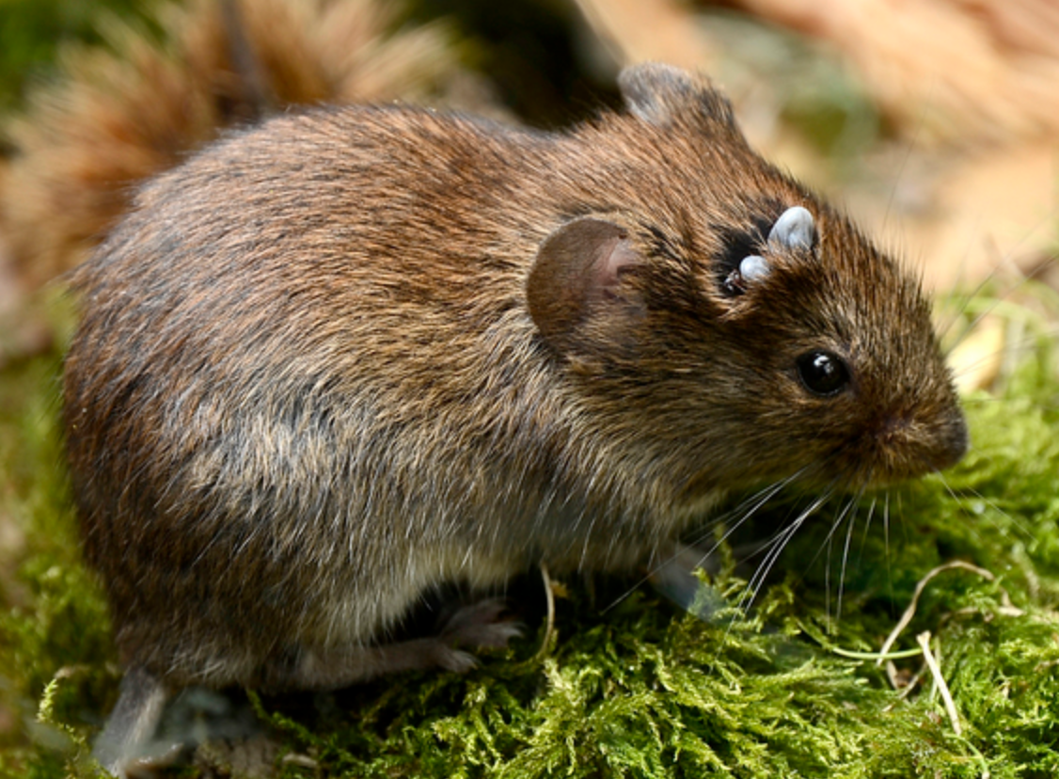
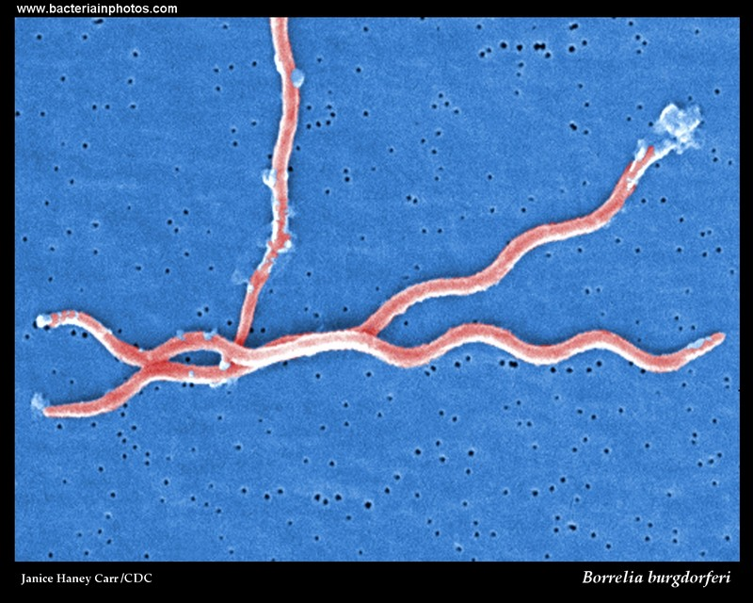
Applications of DNA metabarcoding
Identification of tick species,
vectors of several pathogens
Borrelia (Lyme disease)

Slide 25
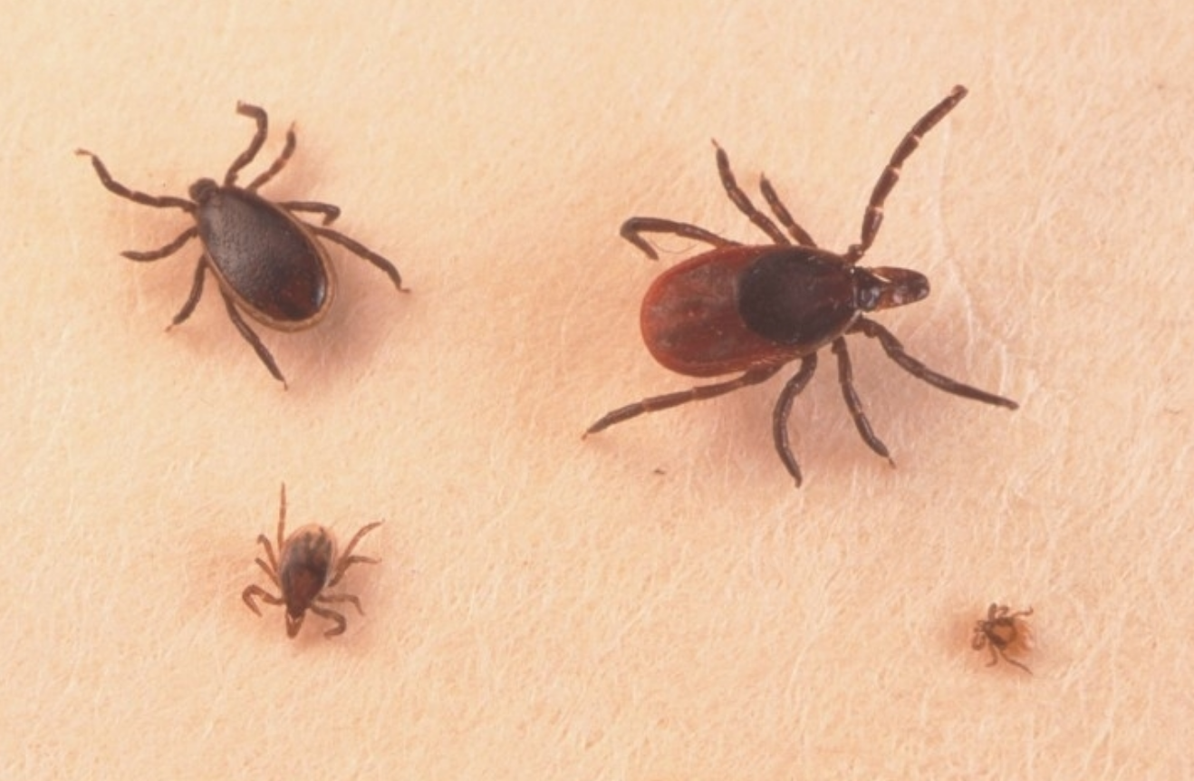
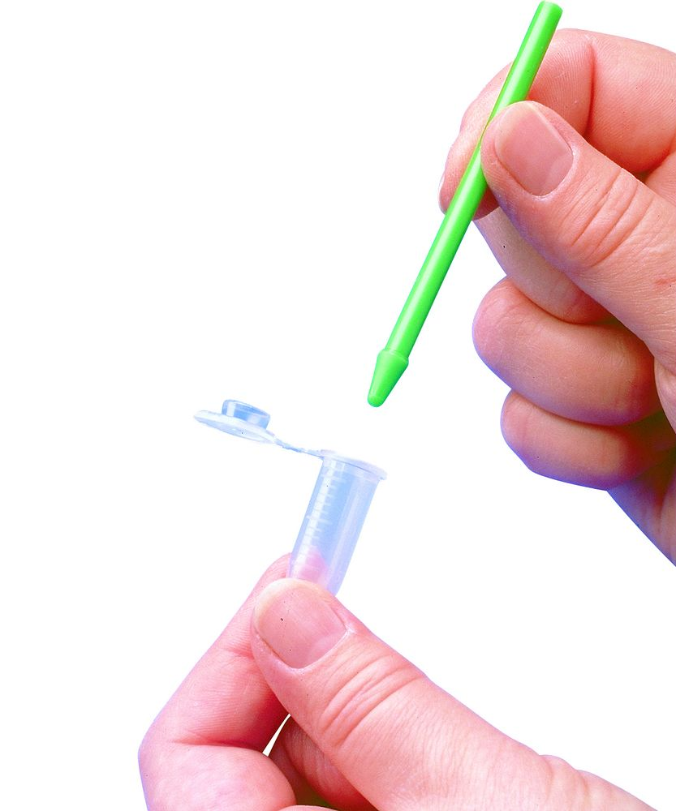

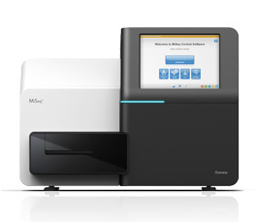
Vector species
DNA Extraction
DNA sequencing (Next Generation Sequencing)

Slide 26
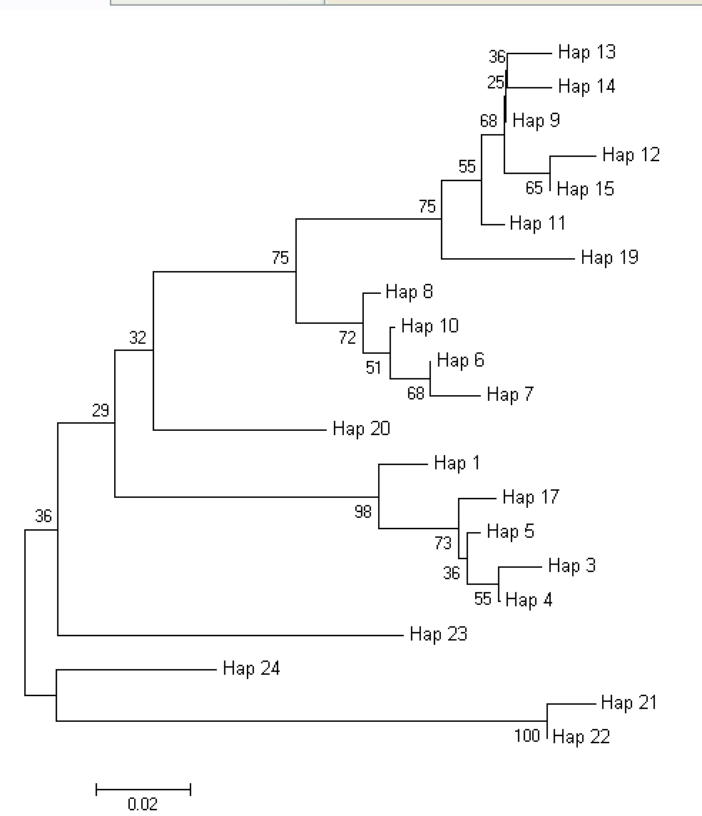
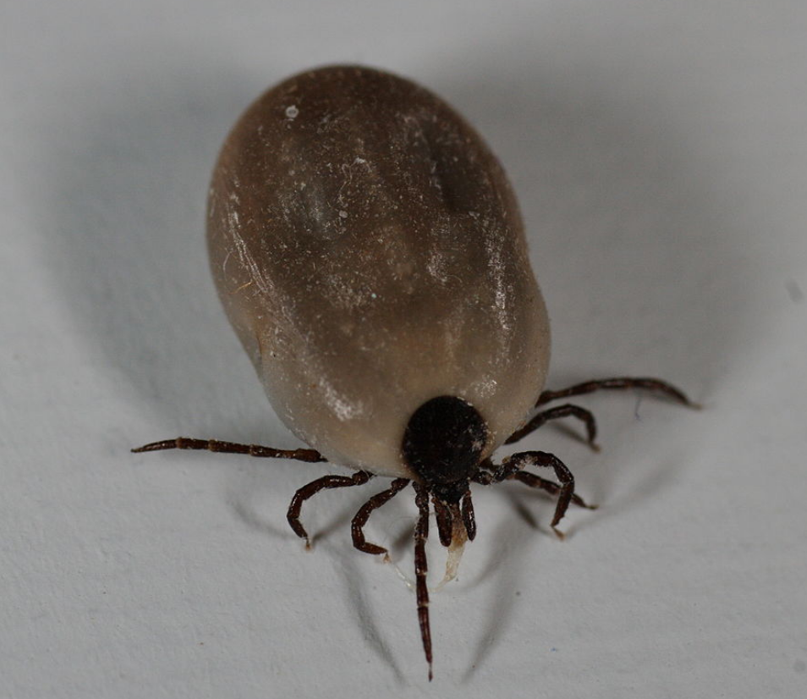
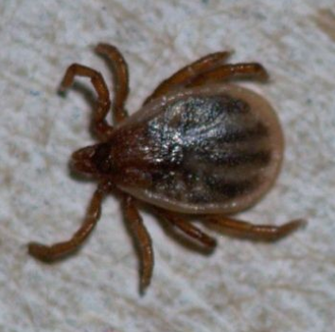
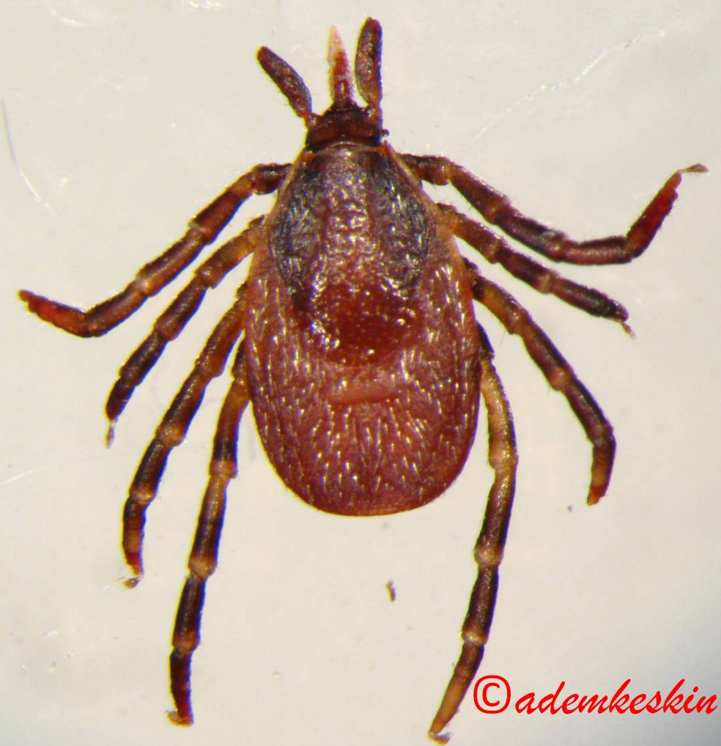
Applications of DNA metabarcoding
I. ricinus 1
I. ricinus 2
I. frontalis
I. arboricola

Slide 27
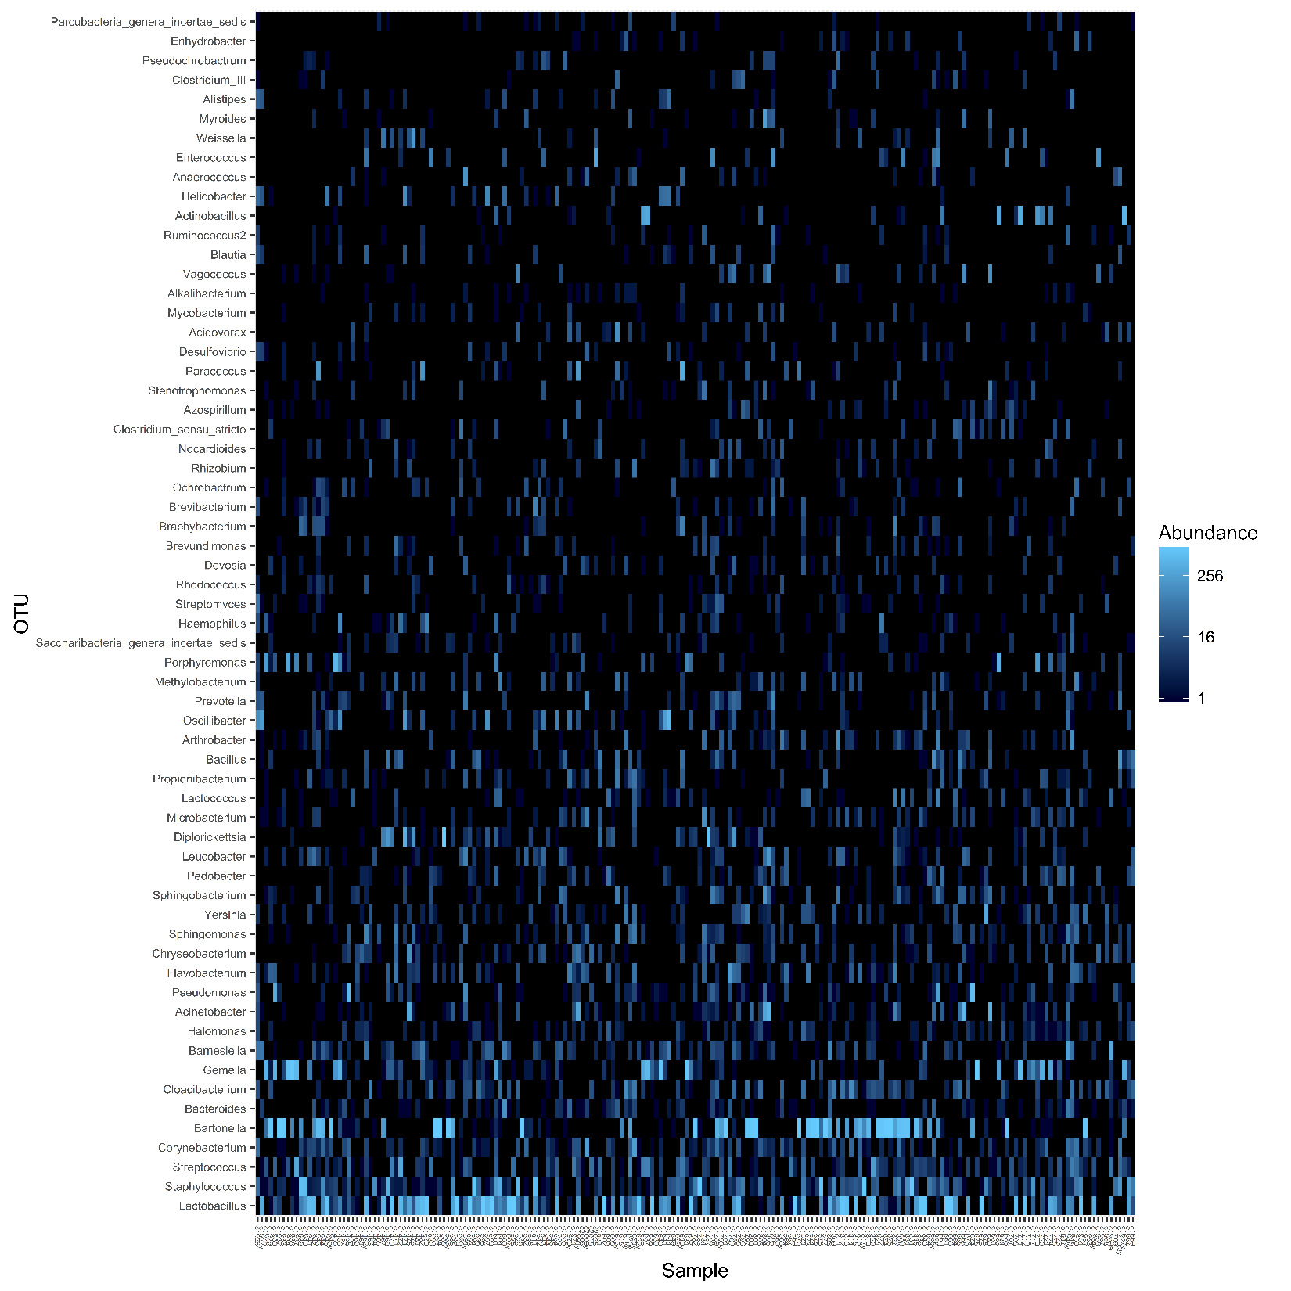
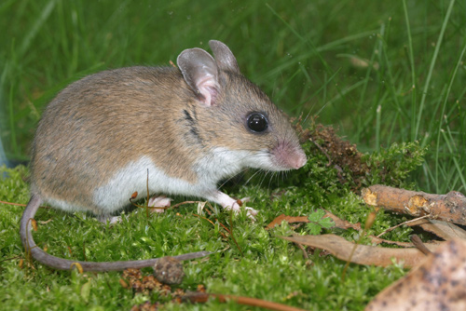
Applications of DNA metabarcoding

Slide 28
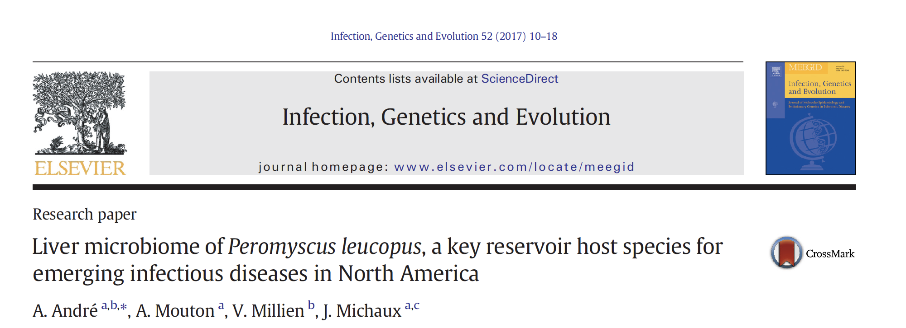
Applications of DNA metabarcoding
Studies on bacteriomes
- Screening of a large panel of bacteria (commensal or pathogens);
- Identification of putative co-infections (e.g. Borrelia and Bartonella);
- Better sensitivity to detect bacteria during first stages of infection (e.g. NGS methods 4 x more sensitive than "classical" PCR or serological methods).

Slide 29
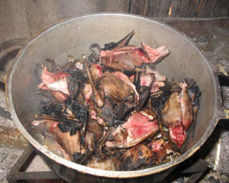

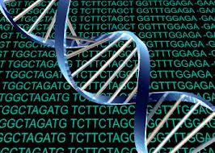

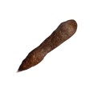

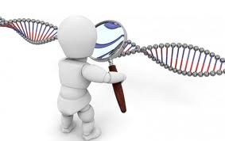
Applications of DNA metabarcoding
Identification of bushmeat samples
DNA isolation
Amplification of genetic markers with tags
Next Generation Sequencing
(Illumina technology)
Identification of the species.
Identification of the diet (if use of faeces).
Comparison of the obtained sequences with databases (GenBank, Bold…)

Slide 30
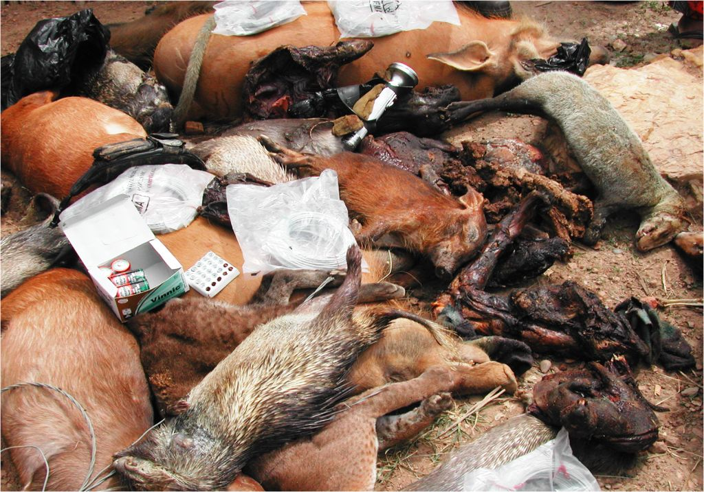
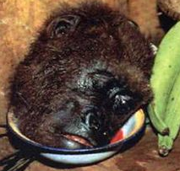



NGS for bushmeat projects in Africa
Importance for conservation and/or trade of threatened species, but also for health issues (e.g. rise of Ebola virus)
? ? ?
Notes:
Identification of species, but could also use other markers to study phylogeography and origin of samples

Slide 31








Applications of DNA metabarcoding
Diet studies
from faeces samples
Vegetal or animal diet
Notes:
Also for Desma, small carnivores

Slide 32







Applications of DNA metabarcoding
NGS for small mammals inventories
DNA from mix of hair samples
Notes:
Important for elusive species detection such as dormouse or small carnivores

Slide 33



Applications of DNA metabarcoding
NGS for amphibians inventories
De Somer P
Pilliod D
eDNA from water samples
Several DNA sequences from the species living in the lakes or ponds
Hellebaut P

Slide 34
Conclusion
Genetic tools help to answer various questions :
resolve taxonomic uncertainties (inter and intraspecific levels);
study the genetic structure and diversity of threatened species;
identify vector species and their pathogens;
identify species from non invasive or « degraded » samples;
study the diet of species;
perform species inventories (from hair, feces or water samples).

Slide 35





Thank you for your attention
Many thanks to all contributors, sample collectors
and colleagues

