Slide 1










Effect of habitat fragmentation on the genetic structure
of southern African populations of African buffalo
(Syncerus caffer)
Nathalie Smitz- PhD student

Slide 2

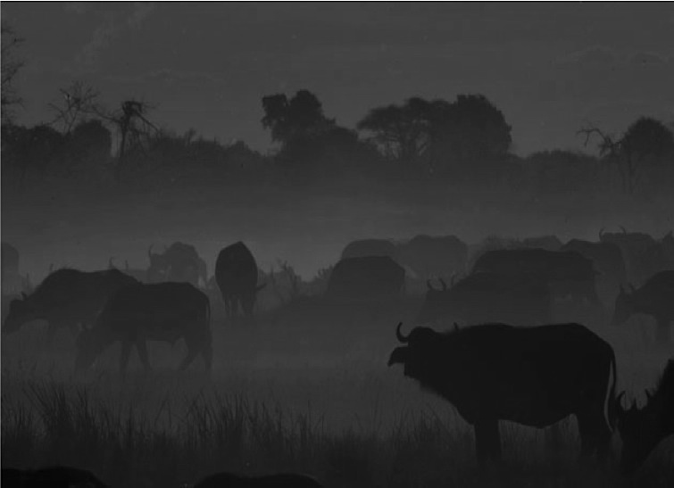
Introduction
One of the most predominant mammals in terms of biomass in the savannas
BUT faced severe reduction in size and geographical distribution since the 19th century :
→ poaching
→ habitat degradation
→ disease
Around 70% of the savanna buffalo are confined within a network of protected areas, loosely connected to one another.
GENETIC HEALTH & DEMOGRAPHIC HISTORY
Notes:
One of the most predominant mammals in terms of biomass in the savannas of Southern Africa.
Restriction of gene flow expected to lead to an erosion of genetic diversity
We aimed to assess the “genetic health” of the African buffalo populations in southern Africa and their demographic history.

Slide 3
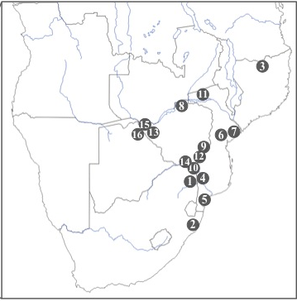
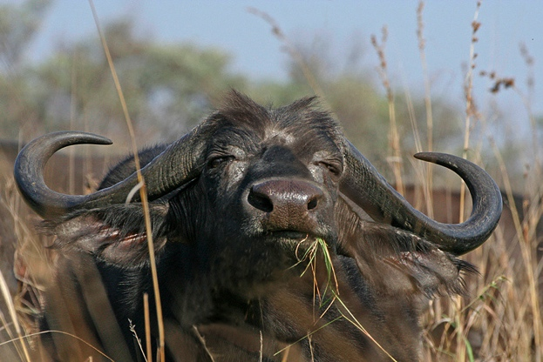
Samples locality
N= 261
14 microsatellites
S. c. caffer
1. Kruger, 2. Umfolozzi, 3. Niassa, 4. Limpopo, 5. Manguana, 6. Gorongosa, 7. Marromeu, 8. Zambezi Valley, 9. Malilangwe, 10. Crooks Corner, 11. Nyakasanga, 12. Gonarezhou, 13. Hwange, 14. Sengwe, 15. Victoria Falls, 16. Chobe

Slide 4
Population Structure
4 Clusters (Structure, Geneland)
Notes:
Population significantly differentiated
Results from clustering analysis suggest that the southern African population is globally partitioned into Four clusters.

Slide 5
Population Structure
F_{ST} Matrix (Arlequin)
 | Pop 1 | Pop 2 | Pop 3 | Pop 4
Pop 1 | 0
Pop 2 | 0.124 | 0
Pop 3 | 0.122 | 0.039 | 0
Pop 4 | 0.106 | 0.035 | 0.037 | 0
GENERAL LOW POPULATION DIFFERENTIATION

Slide 6
Population Structure
(Im)Migration Rate (Migrate)
M_{Pop 4}
0,030%
M_{Pop 1}
M_{Pop 4}
0,030%
M_{Pop 2}
M_{Pop 4}
0,030%
M_{Pop 3}
M_{Pop 3}
0,013%
M_{Pop 1}
M_{Pop 3}
0,010%
M_{Pop 2}
M_{Pop 3}
0,009%
M_{Pop 4}
M_{Pop 2}
0,012%
M_{Pop 3}
M_{Pop 2}
0,007%
M_{Pop 4}
M_{Pop 1}
0,005%
M_{Pop 2}
M_{Pop 1}
0,005%
M_{Pop 3}
M_{Pop 1}
0,004%
M_{Pop 4}

Slide 7
Population Structure
(Im)Migration Rate (Migrate)
M_{Pop 4}
0,030%
M_{Pop 1}
M_{Pop 4}
0,030%
M_{Pop 2}
M_{Pop 4}
0,030%
M_{Pop 3}
M_{Pop 3}
0,013%
M_{Pop 1}
M_{Pop 3}
0,010%
M_{Pop 2}
M_{Pop 3}
0,009%
M_{Pop 4}
M_{Pop 2}
0,012%
M_{Pop 3}
M_{Pop 2}
0,007%
M_{Pop 4}
M_{Pop 1}
0,005%
M_{Pop 2}
M_{Pop 1}
0,005%
M_{Pop 3}
M_{Pop 1}
0,004%
M_{Pop 4}
Notes:
Ex : 0,03 % of population 1 came from population 4 every generation

Slide 8
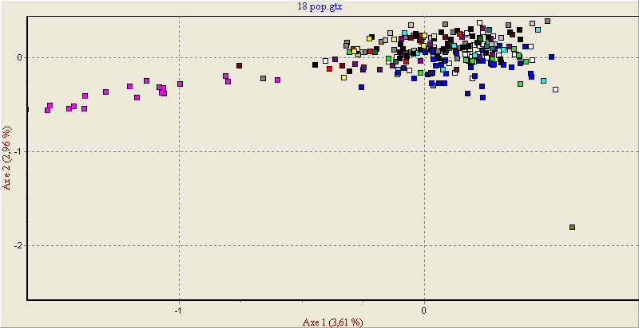
Population Structure
F_{ST} Matrix (Arlequin)
 | Pop 1 | Pop 2 | Pop 3 | Pop 4
Pop 1 | 0
Pop 2 | 0.124 | 0
Pop 3 | 0.122 | 0.039 | 0
Pop 4 | 0.106 | 0.035 | 0.037 | 0
ACP
Genetic Drift
FOUNDER EVENT
Notes:
Weaker gene flow, lower mtDNA diversities → 75 individuals reported in 1929

Slide 9
Population Structure
 | N_{indv} | H_{O} | H_{E} | F_{IS}
Pop 1 | 28 | 0.554 | 0.586 | 0.048
Pop 2 | 58 | 0.651 | 0.673 | 0.010
Pop 3 | 60 | 0.620 | 0.639 | 0.025
Pop 4 | 115 | 0.618 | 0.651 | 0.048
NO LOSS IN HETEROZYGOSITY –
NO INBREEDING
Notes:
Inbreeding coeficient → HWE
Bcp migration pas de differentiation nette entre pop

Slide 10
Impact of Recent Fragmentation
Indices of genetic diversity (F_{IS}, H_{O}, H_{E}) do not indicate signs
of population bottleneck
+ Important gene flow (M and F_{ST}) !!!
Historical population should have been large to overcome the loss of genetic diversity associated to observed population reduction
BUT time elapsed since population and range reduction remains short compared to the interval between successive generations (~6 years) : FUTURE IMPACT
PHRASE PAS CLAIRE À CHANGER
Notes:
Plus ou moins 100 ans

Slide 11
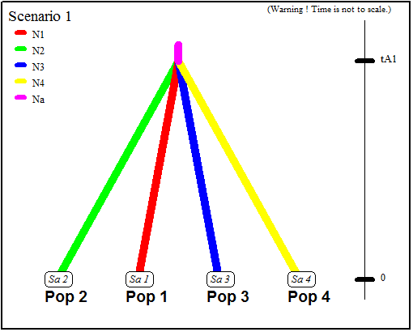
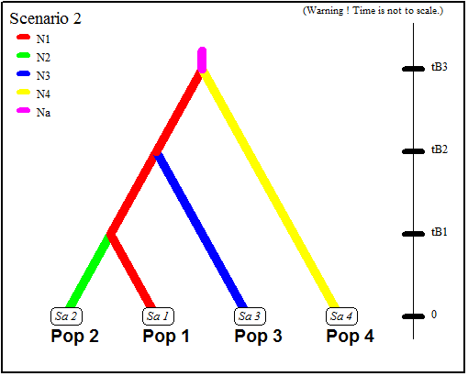
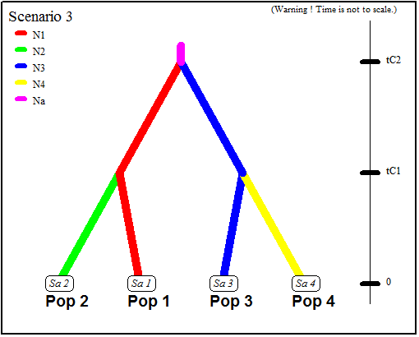
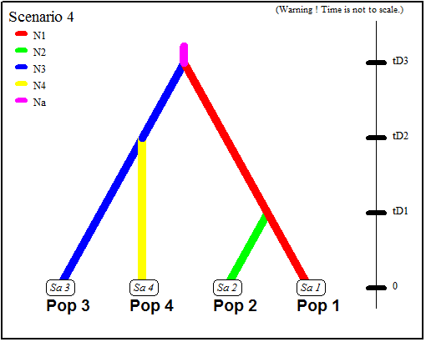
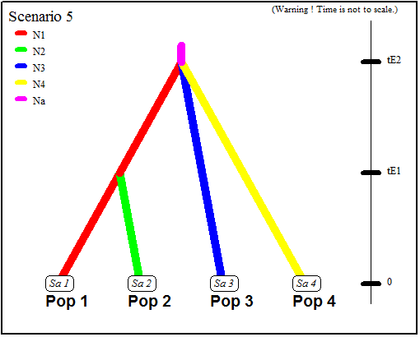
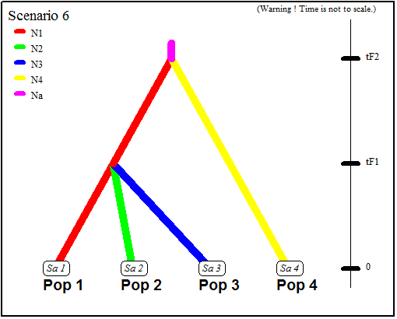
Demographic History

Slide 12
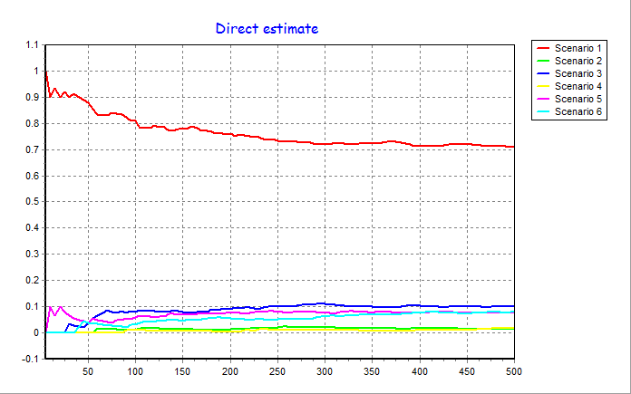
Demographic History
1 100 YBP
Ancestral population size estimated at 1300 indiv
Attention, ceci doit être pris avec beaucoupde précaution, tout comme les dates de séparation.
Vaudrait peut être mieux donner une estimation générale plutôt qu’une date particulière.
Intéressant de discuter ici, la séparation simultanée des pop!
Il y a dû y avoir un évenement particulier qui a conduit à cela et là, tu peux proposer des hypothèses. C’est ça qui est intéressant, je pense
EXPANSION

Slide 13
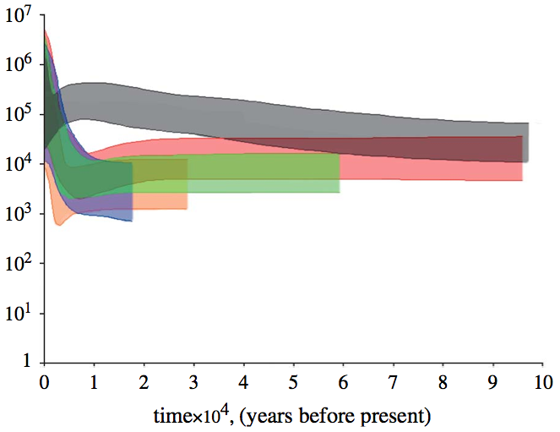
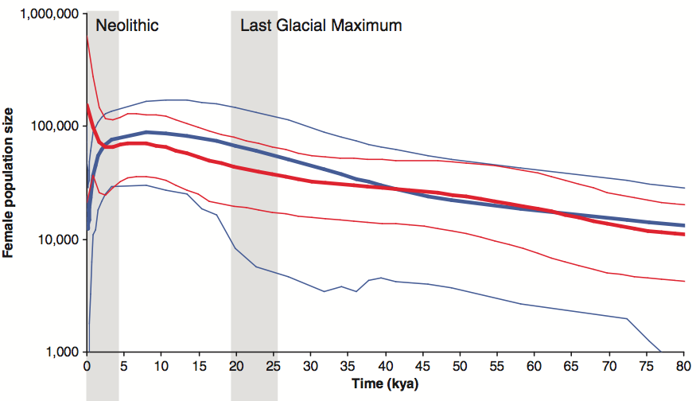
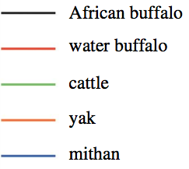
Demographic History
Finlay et al. 2007
Heller et al. 2012
African buffalo
Human
Effective population size (Ne)
Followed by a very population decline … (Recent bottleneck in Pop 2 & 4)
Attention ar le papier de heller montre une réduction de pop qui aurait commencé bien avant 1100 bp. Il y a tout de même une petit incohérence et c’est pourquoi, il faut rester très générale
1. Climate Change – Holocene aridification
2. Explosive Human Growth
Hypothesis :

Slide 14
Demographic History
Effective population size (Migrate/DIYabc):
Ne Pop 1
1000-2000 breeding indiv
Ne Pop 2
6000-8000 breeding indiv
Ne Pop 3
6000-8000 breeding indiv
Ne Pop 4
7000-8000 breeding indiv
Notes:
BUT Most real populations have an Ne much smaller than their census size due to factors like non-breeding individuals, overlapping generations, and unequal reproductive success between genders.

Slide 15
Conclusion
Current population sizes do not have recently reached critical low level
BUT without migration between confined protected area, the African buffalo will not be able to maintain historical levels of genetic diversity in the future
Notes:
Many protected area with less than 3000 individuals

Slide 16
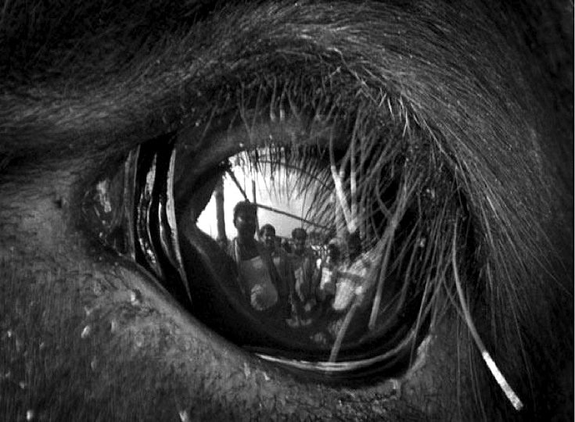
Thank you for your Attention

Slide 17
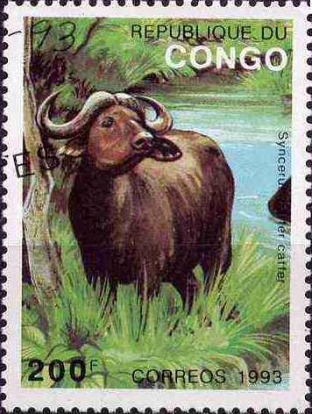
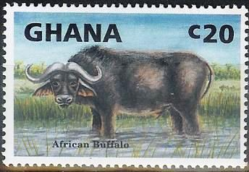

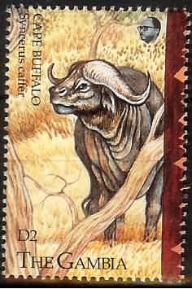


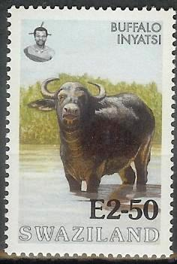
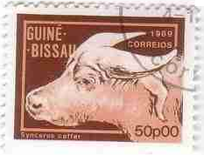
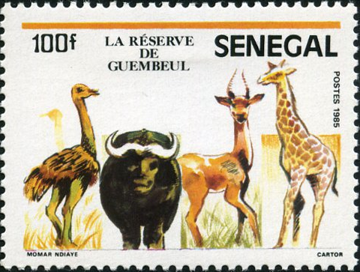
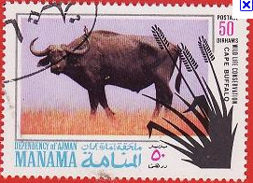

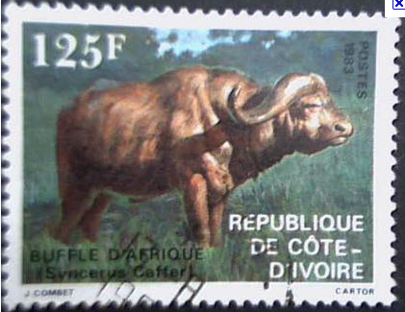
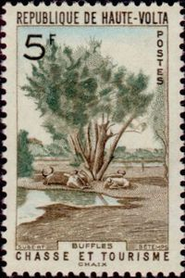
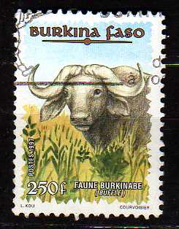
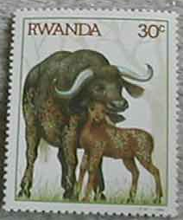
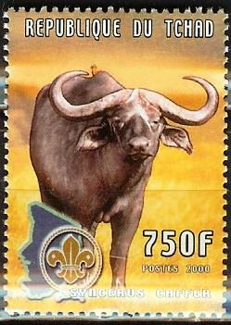
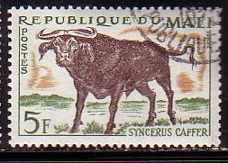
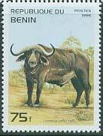

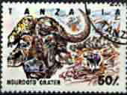
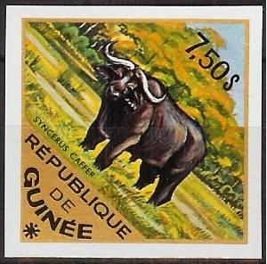
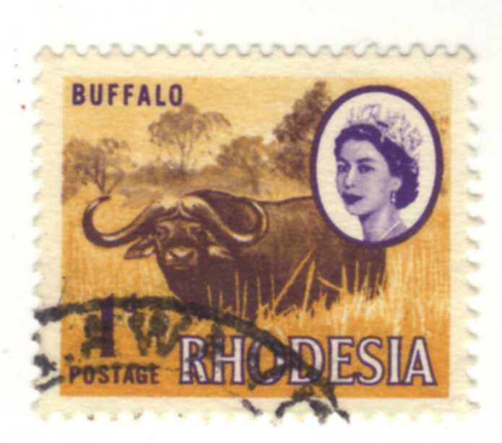



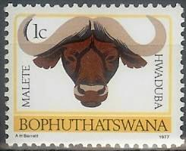
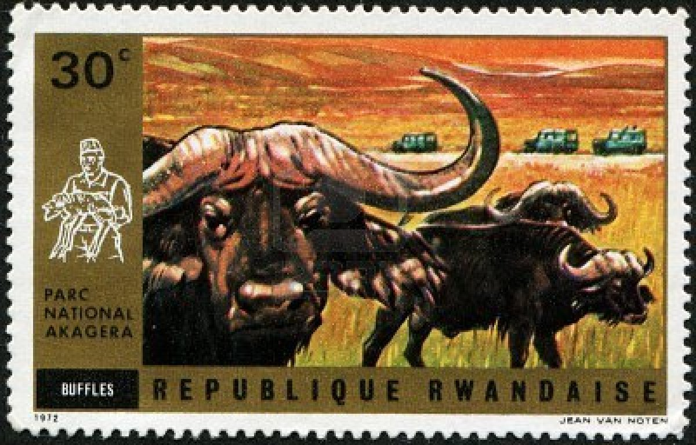

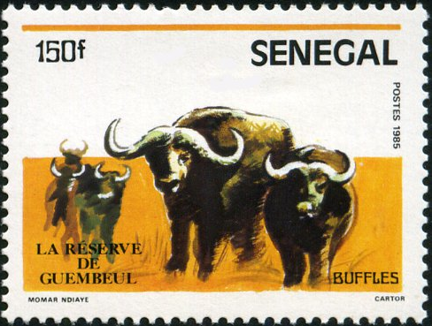
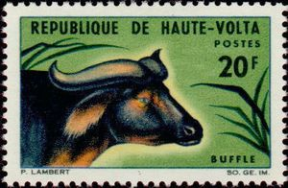
Notes:
Merci de votre attention.

Slide 18
Example:
 | Head | Surface
Niassa | 6,214 | 42,296 km²
Limpopo | 200 | 10,000 km²
Hwange and adjacent area | 24,506 | 24,570 km²
Chobe and adjacent area | 39,579 | 73,478 km²
Kruger | 40,922 | 19,485 km²
(East, 1998), including 670,000 Cape buffaloes
Winterbach (1998a) gave an estimate of buffalo population in southern Africa (excluding Mozambique) at 111,900±10,000 individuals.
Notes:
Merci de votre attention.

