Slide 1


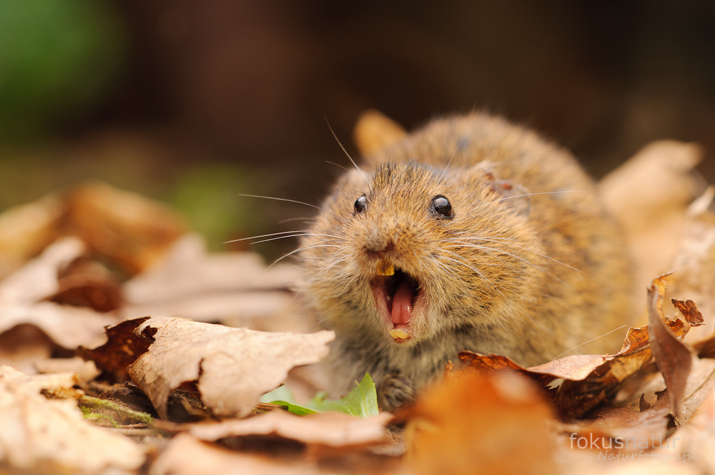

An overview of genetic tools to study biodiversity and health, from the hosts to the vectors and their pathogens
Johan Michaux
CIRAD ASTRE, Campus de Baillarguet, F-34093 Montpellier Cedex 5, France.
Conservation Genetics Laboratory, Institute of Botany (Bat. 22), University of Liège Belgium

Slide 2
Genetics help taxonomic studies and help to identify new and relict species

Slide 3
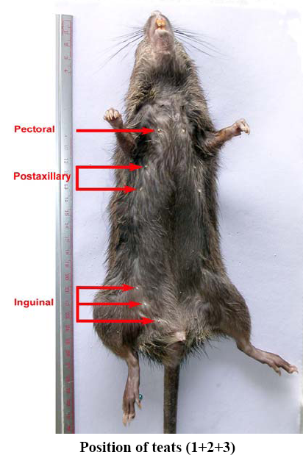
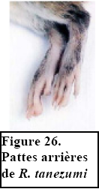
Morphological characters for species identifications
Skin
Body (back,ventre)
Tail
legs
Weight
Size
Head+body
Tail
legs
Ears
skulls
Teeth (color, lenght)

Slide 4
Many misidentifications related to the subjectivity of morpho-logical markers.
Complexity of mammal species, particularly in South East Asia (e.g. more than 160 rat species!!)

Slide 5
Molecular phylogeny
Based on a large set of genetic markers (mitochondrial and nuclear markers).
Help to resolve taxonomic uncertainties.
Allow to discover cryptic and unknown species.

Slide 6
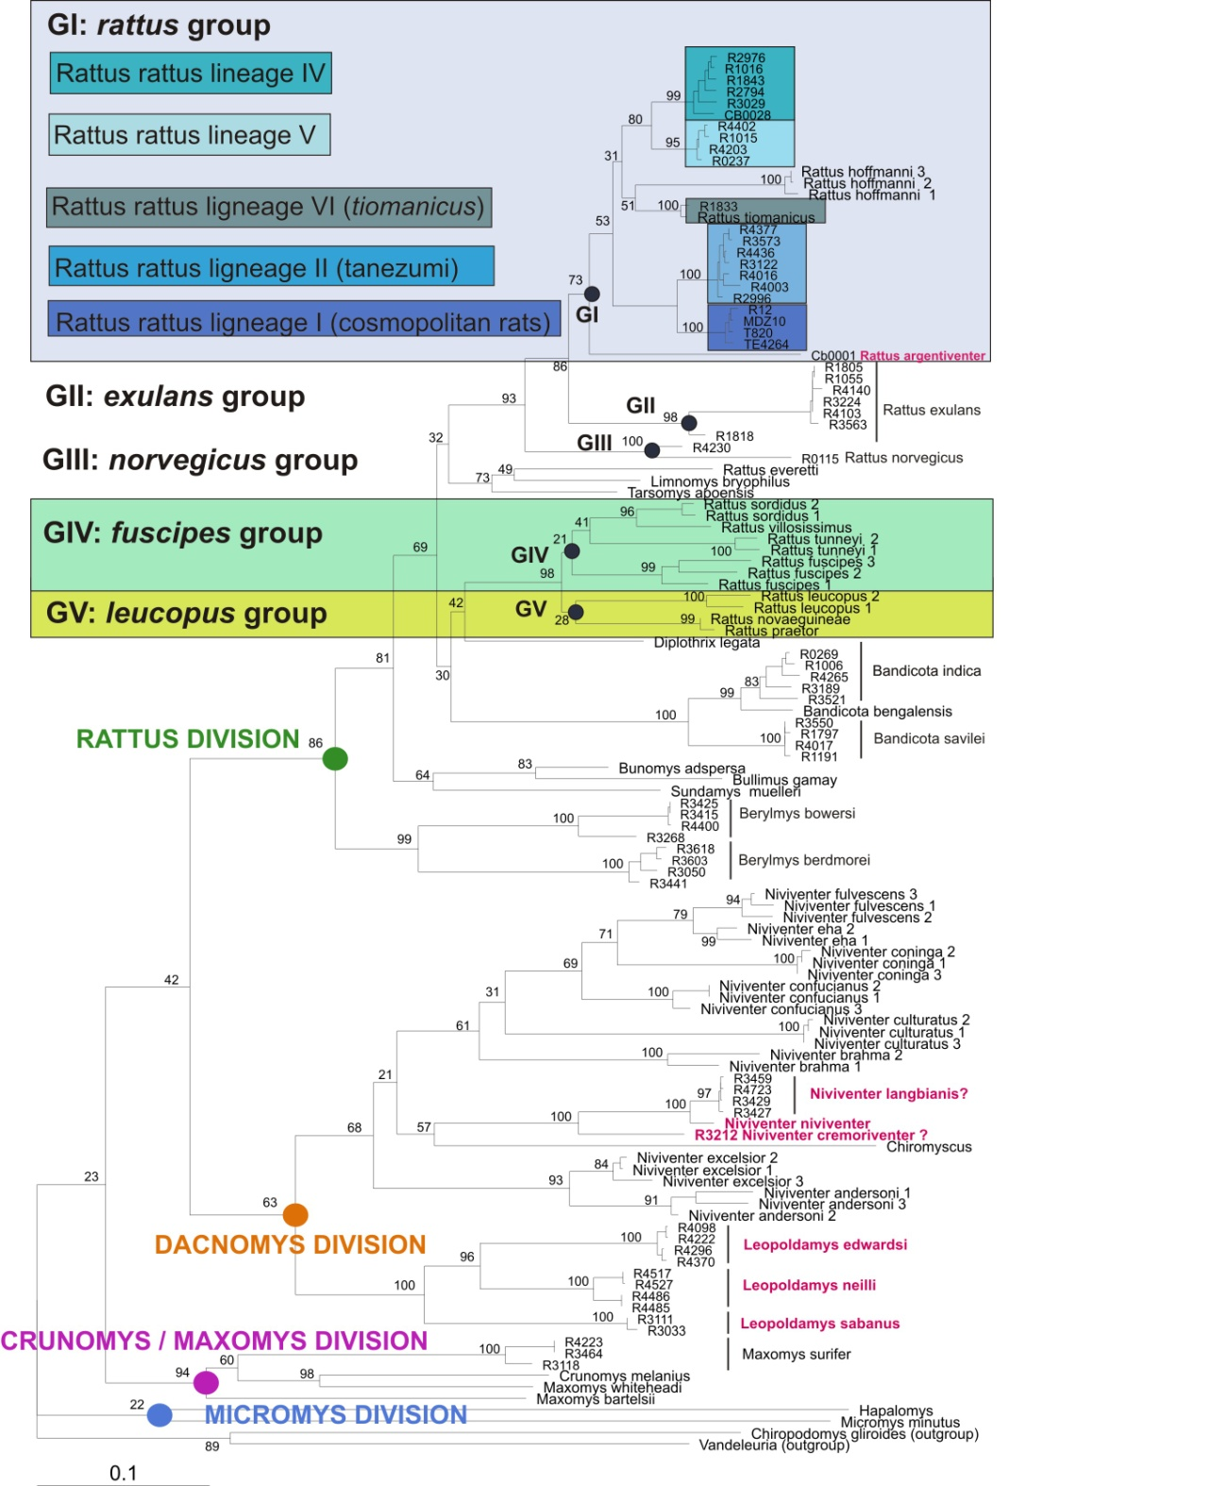
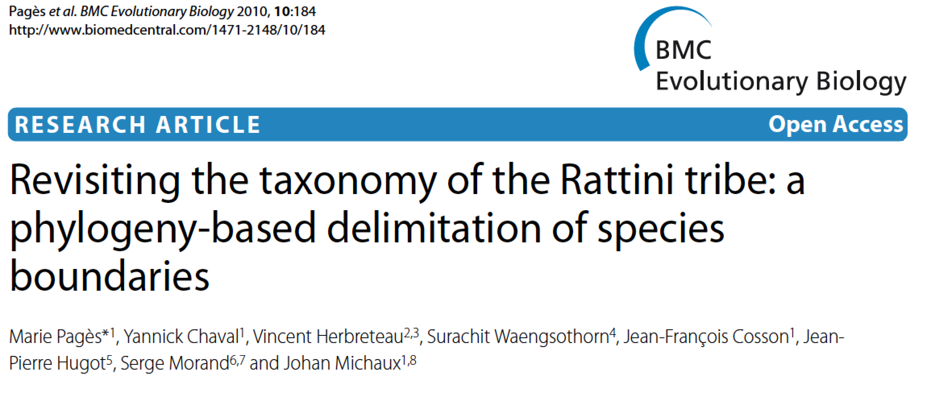
Molecular phylogeny of the Rattini Rodents in the Indochinese region.
A situation much more
complex than generally
Accepted for Rattus…

Slide 7
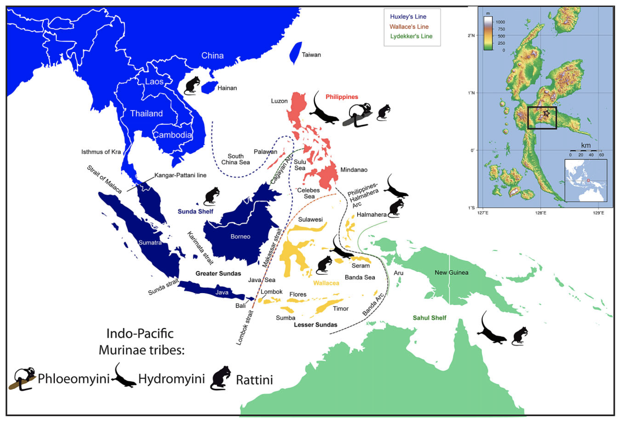
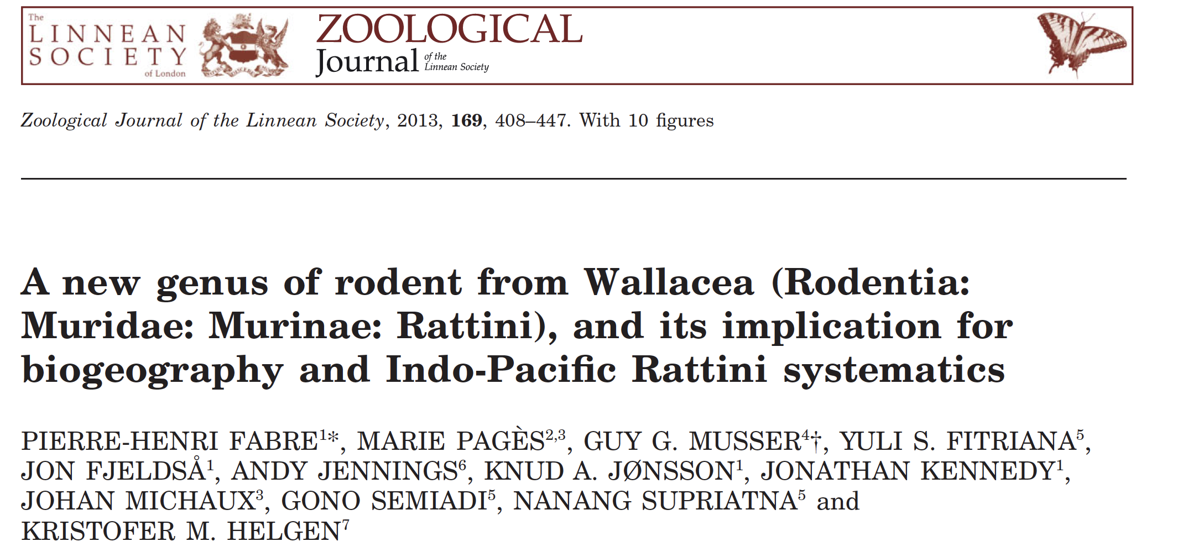
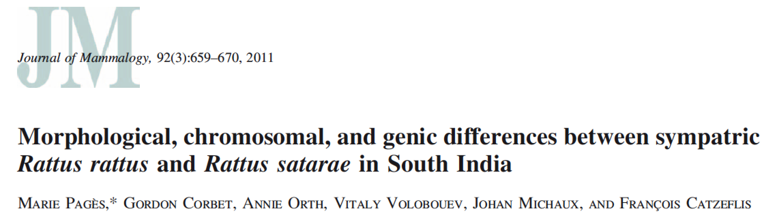
Discovery of a new mammal genus in Indonesia : Halmaheramys bokimekot

Slide 8
Genetics to better understand the evolutionary history of species and how they survived to past climate changes

Slide 9
Phylogeography
Based on genetic markers with high evolutionary mutation rates (mitochondrial and nuclear markers).
Help to evidence intraspecific variability.
Allows to understand the impact of past historical events (climate changes, insular isolations etc) on the genetic intraspecific structure of vertebrates.

Slide 10
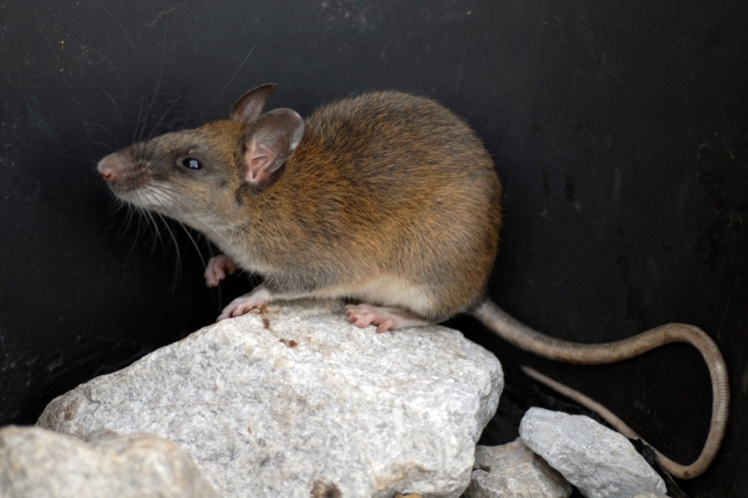
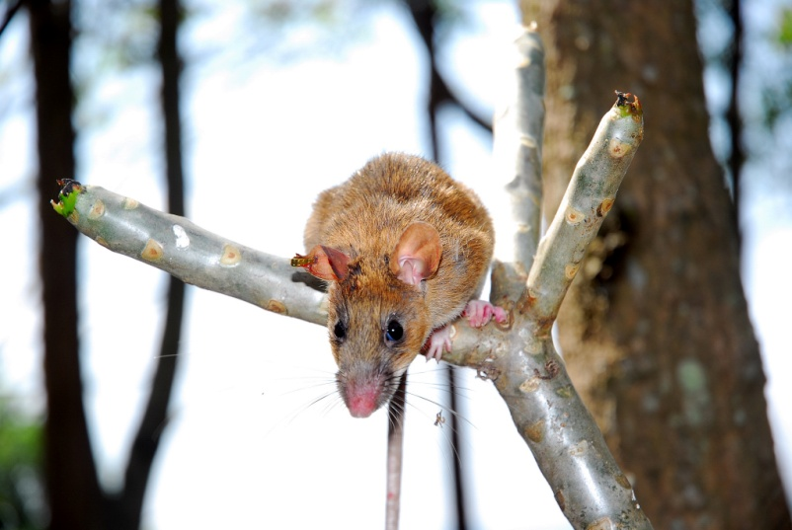
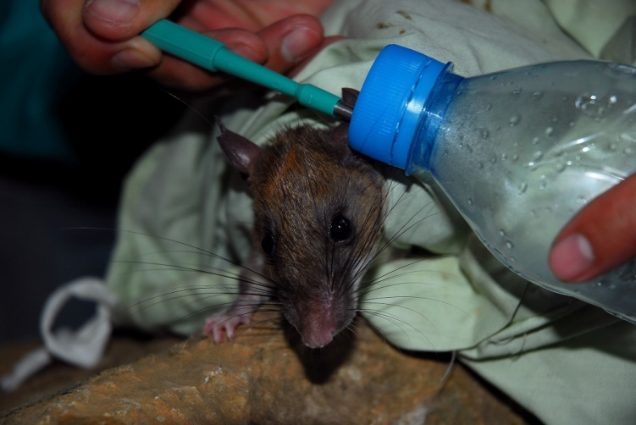
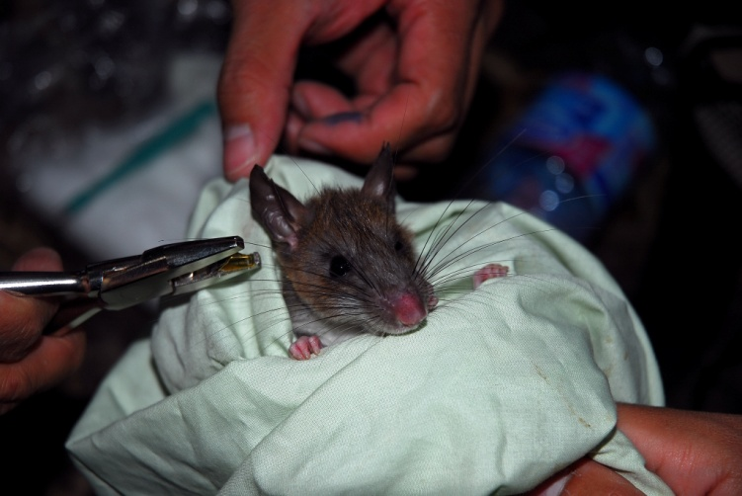
At the intraspecific level, the case of Leopoldamys neilli
PhD thesis of Ms Alice Latinne, University of Liège
J. Michaux
Endemic threatened species
J. Michaux
J. Michaux

Slide 11
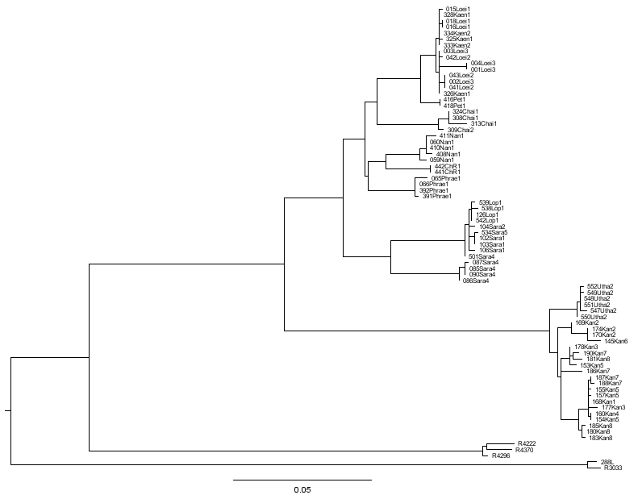
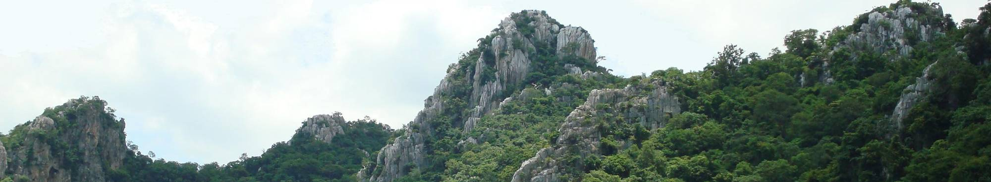
1.Geographical structure of the genetic diversity of L. neilli
Evidence of 4 main groups subdivided in 10 geographically well-structured lineages.
Latinne et al. , 2011. Conservation Genetics, In Press
ML phylogenetic tree
4 combined genes (cytb/COI/bfib/G6PD)
(ML bootstrap/BIPP)
NORTH-EAST
Loei
Khon Kaen
956/0.99
988/1.0
701/0.93
997/1.0
Petchabun
1000/1.0
Chaiyaphum
515/0.44
NORTH
996/1.0
Nan
836/
0.97
Chiang Rai
398/
-
1000/1.0
850/1.0
1000/1.0
Phrae
CENTRE
1000/1.0
Centre 1
999/1.0
979/1.0
1000/1.0
Centre 2
998/1.0
Uthai Thani
1000/1.0
WEST
1000/1.0
658/0.84
Kanchanaburi
10 lineages

Slide 12
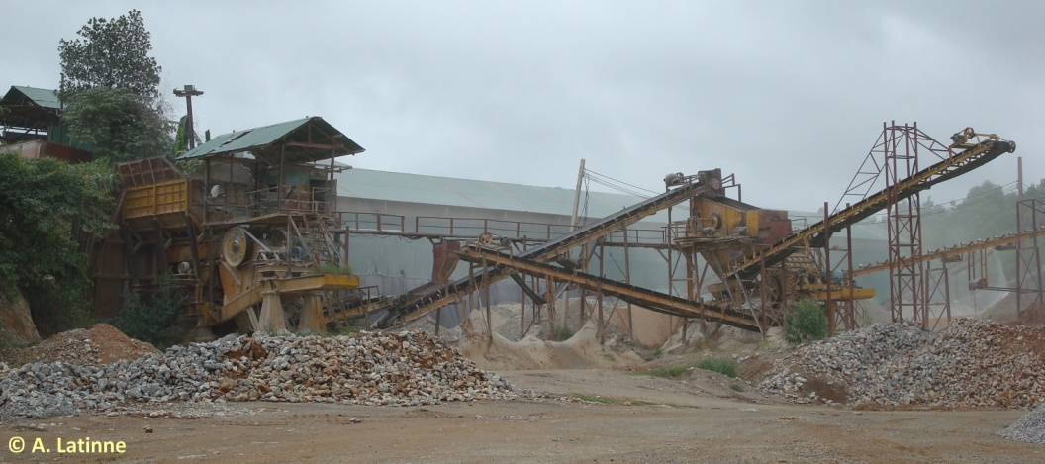
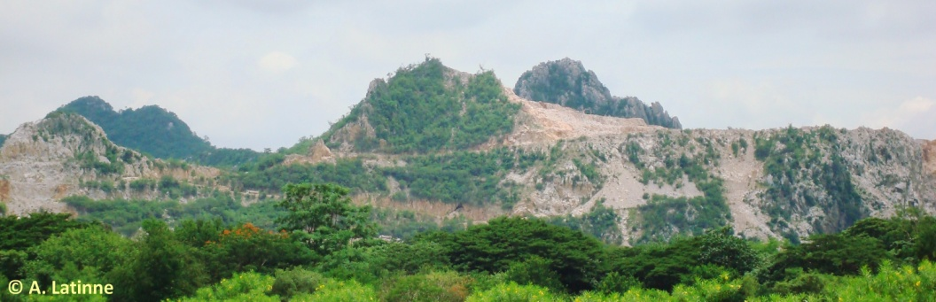
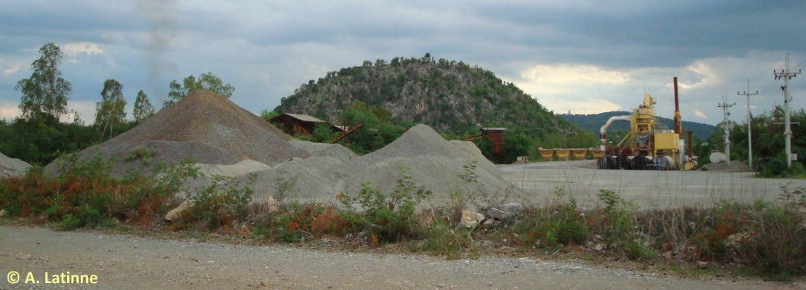
Arks of Biodiversity
Highly threatened :
Hunting
Pollution
Destructions of habitats by quarry
…

Slide 13
Genetics to study threatened species and better understand their chances of long term survival

Slide 14
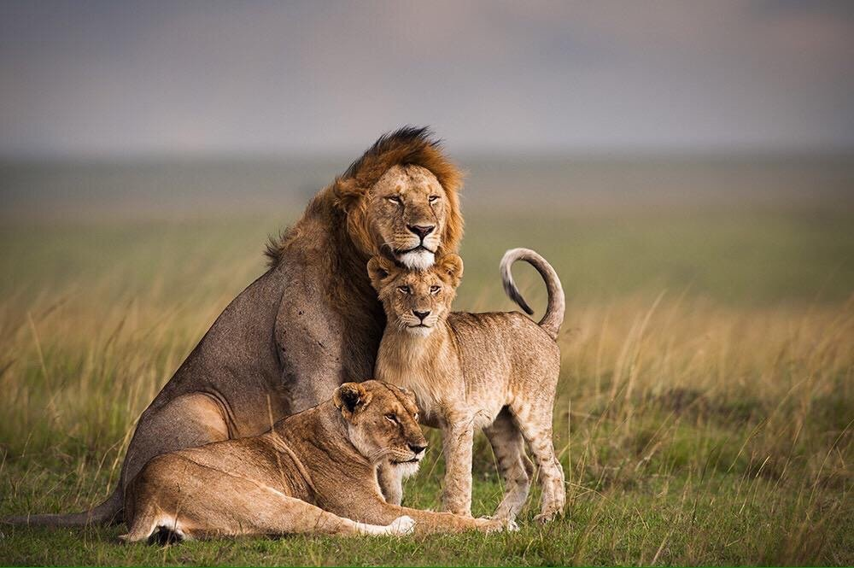
The case of the African lion in Tanzania

Slide 15
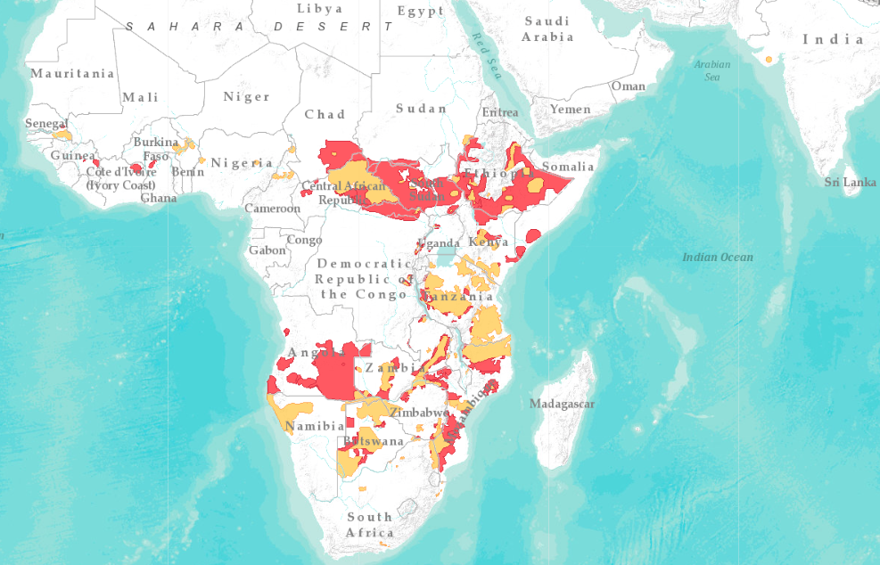
Reduction of its distribution throughout African

Slide 16
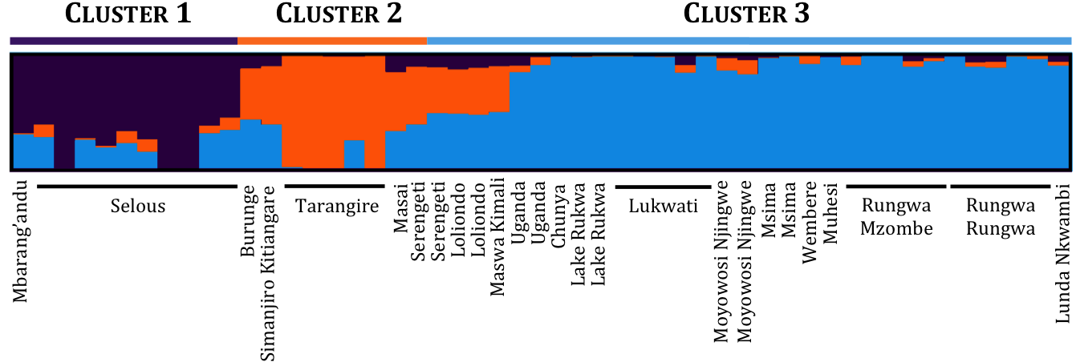
Clustering analyses based on hypervariable genetic markers (SNP's)

Slide 17
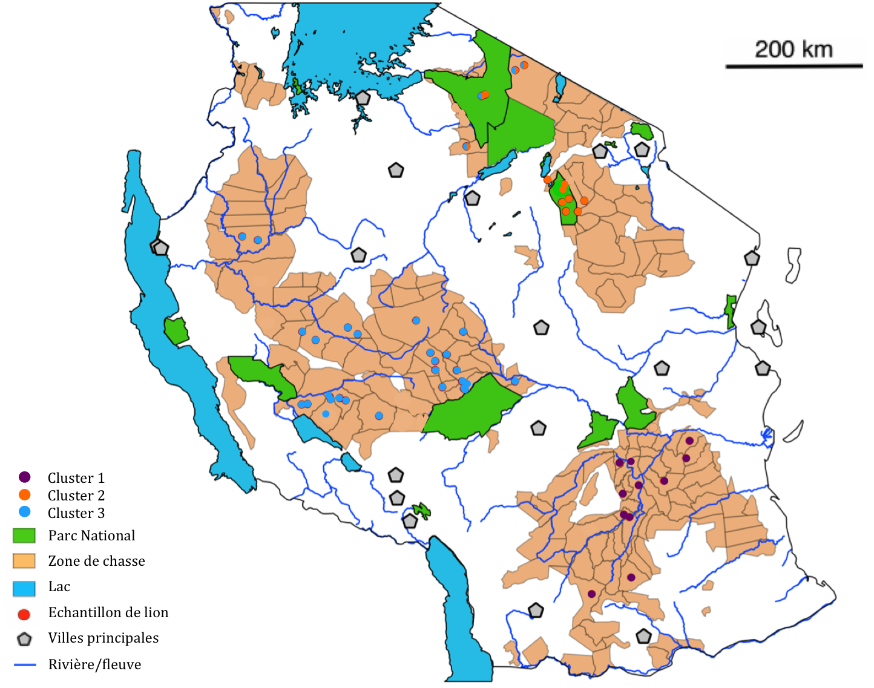

Slide 18
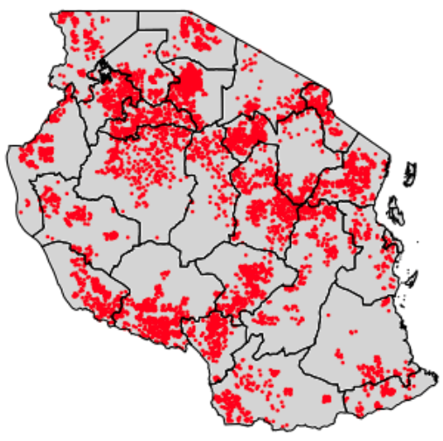
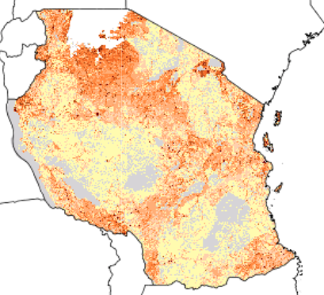
Impact of agriculture and human urbanization on the genetic structure of the lions
Densités par km²
< 2
03 – 10
11 – 20
21 – 50
51 – 100
101 – 200
201 – 500
501 – 1000
> 1000
≈ 500 hectares de culture de maïs
Distribution of corn fields
Distribution of Human densities

Slide 19

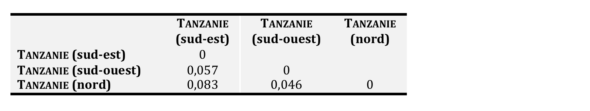
Gene flow and estimation of isolation among populations.
Recent gene flow among population. Recent isolation.
Inbreeding depression risk
Iinbreeding depression index : F_{IS} = 0,078 : cluster 1 (South-East)
F_{IS} = 0,210 : cluster 2 (North)
F_{IS} = 0,124 : cluster 3 (South-west)
High values of inbreeding index, suggesting high depression risks.
Help to propose the best management measures for the lion populations (translocations, corridors among protecte areas…)
Notes:
➔ Au niveau de la Tanzanie, la différenciation de la population en 3 clusters permet de porter notre réflexion sur 2 stratégies de conservation opposées, à savoir : doit-on gérer ces trois populations en tant qu’unités de gestion indépendantes ou bien doit-on mélanger ces 3 populations entre elles afin d’augmenter leur diversité génétique et leur donner une meilleure chance de survie à long terme ?

Slide 20
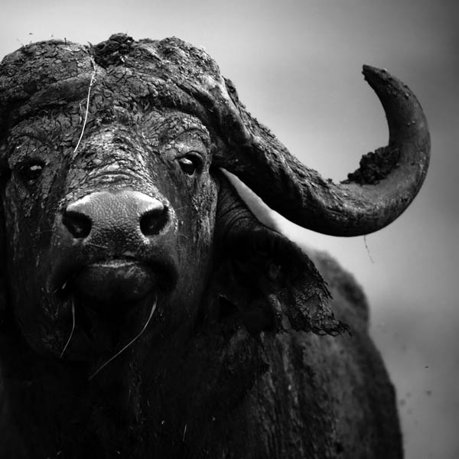








Study of the genetic structure of the African buffalo populations (Syncerus caffer): impact of its high mobility and of the fragmentation of its habitat on its distribution and its interactions with humans
Nathalie Smitz- PhD student
Supervised by Dr Johan Michaux

Slide 21
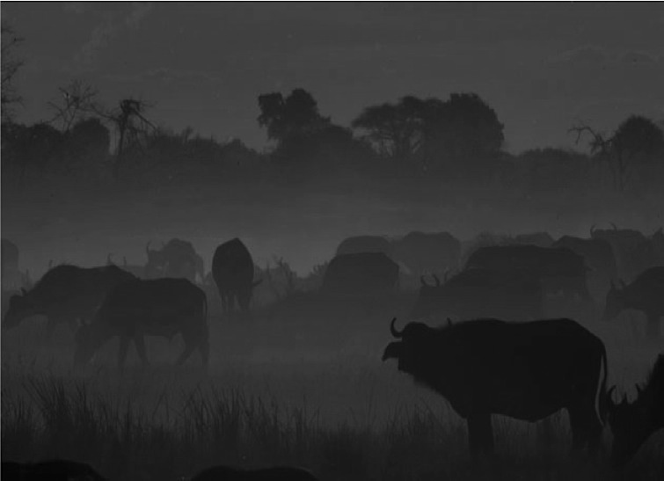
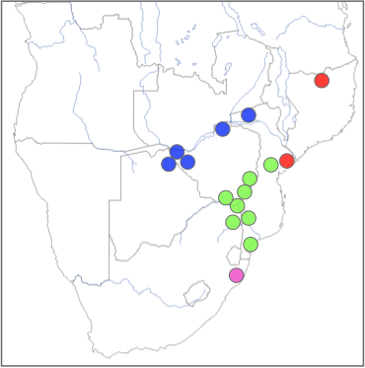
Populations Structure
4 Clusters (Structure, Geneland)

Slide 22
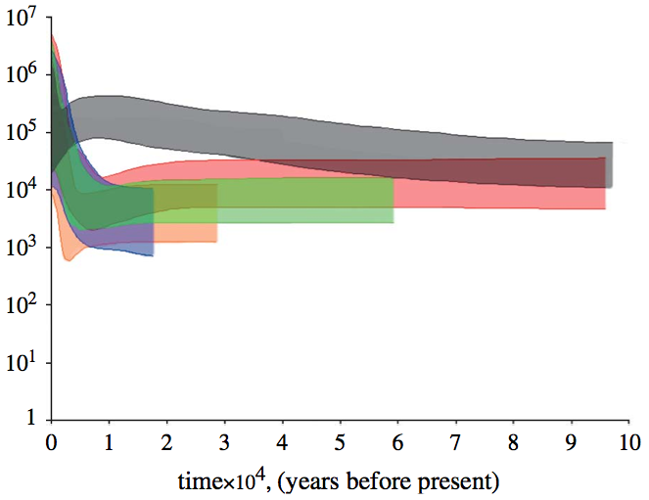
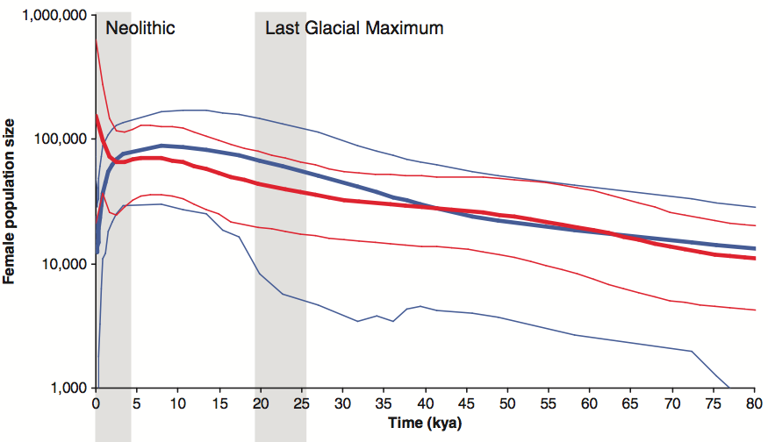
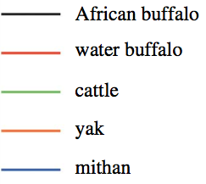
Demographic history
Finlay et al. 2007
Heller et al. 2012
African buffalo
Human
Effective population size (Ne)
Inversely correlated to the human and domesticated bovine (cattle, mithan, water buffalo, yak) explosive population growth of the Neolithic

Slide 23
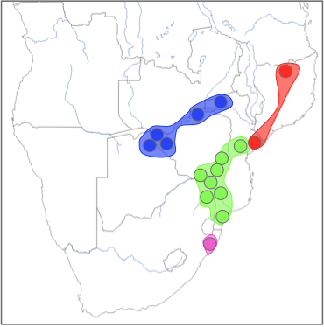
Isolation degrees among the clusters
F_{ST} Matrix (Arlequin)
 | Pop 1 | Pop 2 | Pop 3 | Pop 4
Pop 1 | 0
Pop 2 | 0.024 | 0
Pop 3 | 0.022 | 0.039 | 0
Pop 4 | 0.006 | 0.035 | 0.037 | 0
Pop 2
Pop 3
Pop 4
Pop 1
Notes:
Weaker gene flow, lower mtDNA diversities → 75 individuals reported in 1929

Slide 24
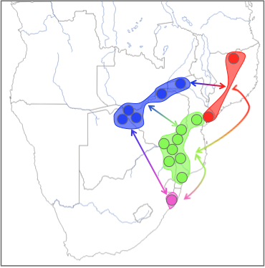
Number of migrants per generation
And important number of immigrants per generation (Migrate program)
Highest migration rate from POP4 toward the other one
M_{Pop 4}
2,345
M_{Pop 1}
M_{Pop 4}
7,125
M_{Pop 2}
M_{Pop 4}
6,290
M_{Pop 3}
Pop 2
M_{Pop 3}
0,984
M_{Pop 1}
Pop 3
M_{Pop 3}
2,387
M_{Pop 2}
M_{Pop 3}
3,047
M_{Pop 4}
M_{Pop 2}
2,900
M_{Pop 3}
Pop 4
M_{Pop 2}
2,296
M_{Pop 4}
M_{Pop 1}
1,111
M_{Pop 2}
Pop 1
M_{Pop 1}
1,174
M_{Pop 3}
M_{Pop 1}
1,277
M_{Pop 4}

Slide 25
Inbreeding depression
 | N_{indv} | H_{O} | H_{E} | F_{IS}
Pop 1 | 28 | 0.554 | 0.586 | 0.048
Pop 2 | 58 | 0.651 | 0.673 | 0.010
Pop 3 | 60 | 0.620 | 0.639 | 0.025
Pop 4 | 115 | 0.618 | 0.651 | 0.048
Pop 2
Pop 3
Pop 4
Pop 1

Slide 26
Conclusion
Current population sizes did not have recently reach critical low level
BUT without migration between confined protected area, the African buffalo should not be able to maintain historical levels of genetic diversity in the future
Encourage translocation programs and/or establishment of corridor between reserves…

Slide 27
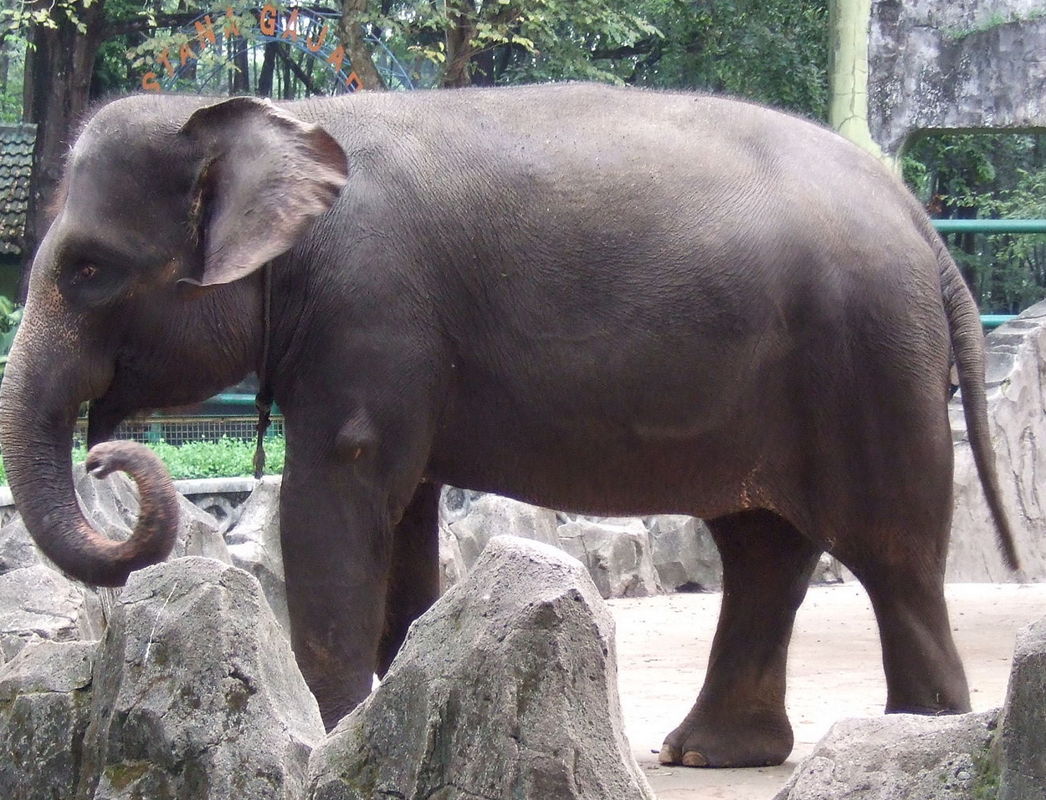
The case of the Sumatran Elephant (Elephas maximus sumatranus)

Slide 28
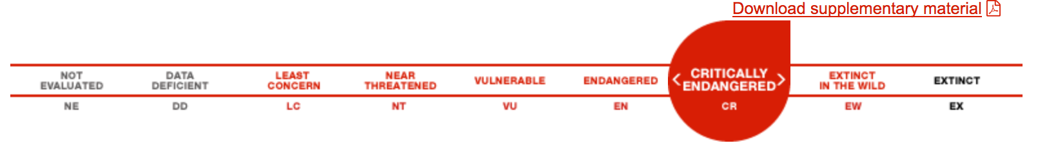
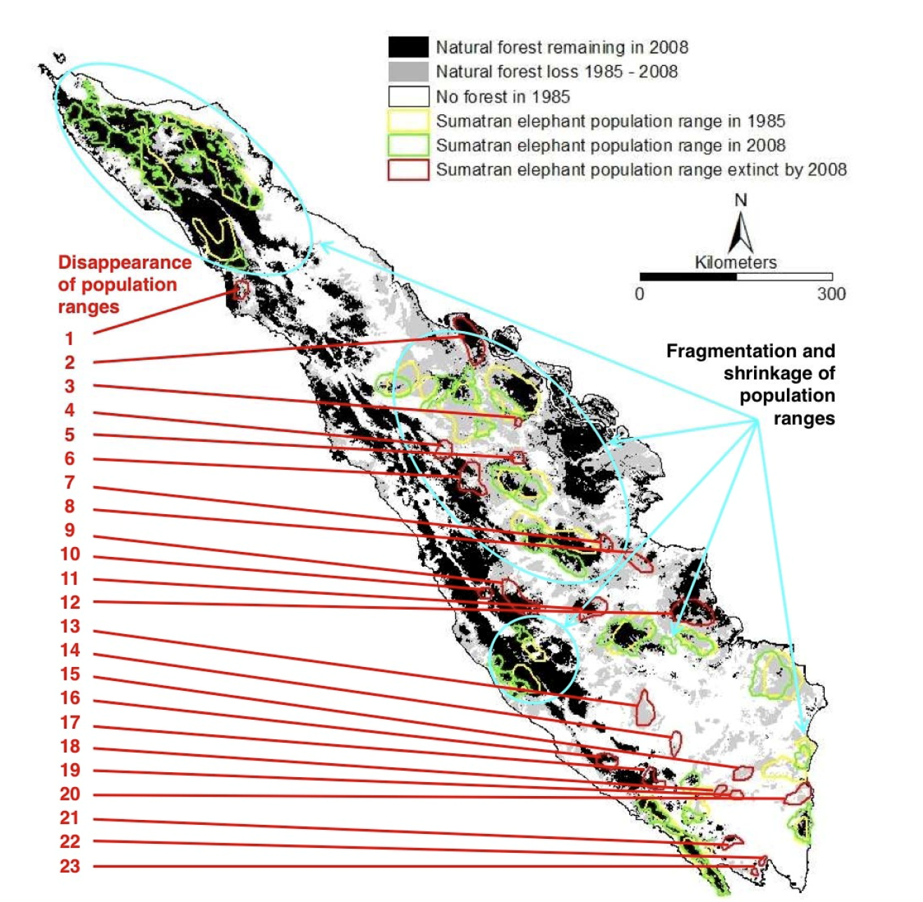
- Over 69% of potential Sumatran Elephant habitat has been lost within just one generation .
- Much of the remaining forest cover is in blocks smaller than 250 km², which are too small to contain viable elephant populations and which are isolated to each other.

Slide 29
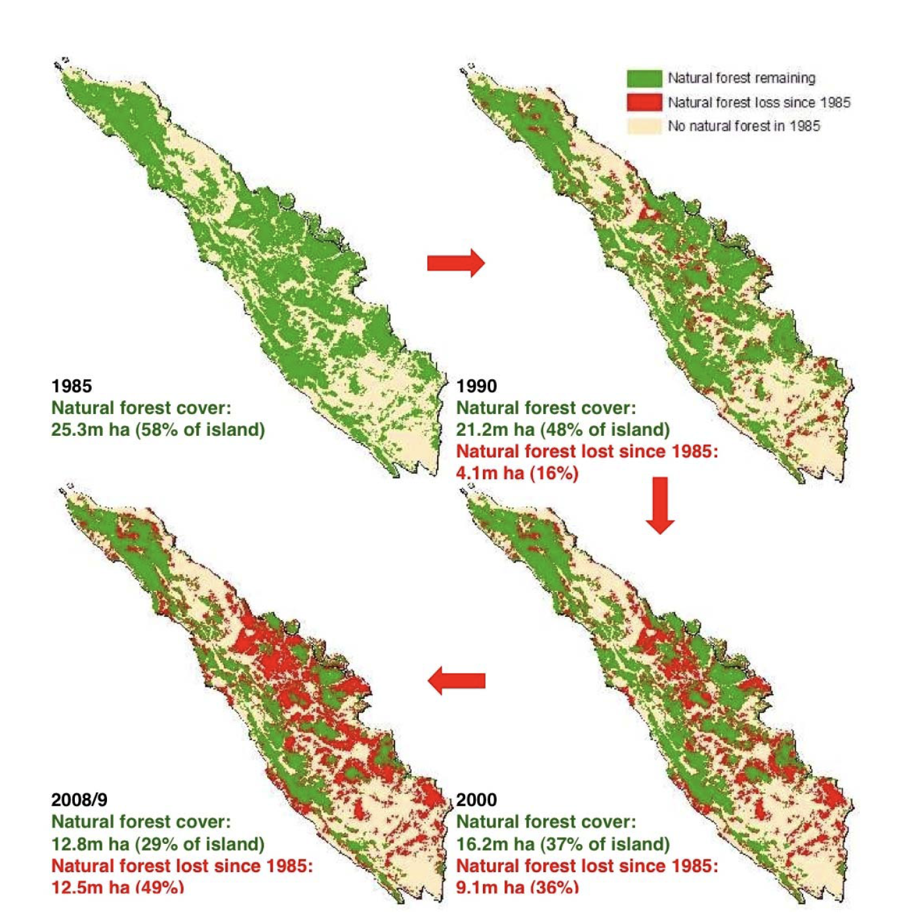
Habitat fragmentation
- Decreasing of population sizes but weak information about it. Need to improve the estimation of remaining elephants in Sumatra (using non invasive approaches, study of dungs)
- Habitat fragmentation probably lead to a strong decrease of gene flow among populations.
- High risk of inbreeding depression for the isolated populations.
- Complementary informations to the study of conflicts between elephants and humans (sociological studies).
importance to estimate more precisely such factors in order to propose the best management measures for the species (translocations, ecological corridors among protected areas, management of human conflicts, ...).

Slide 30
Genetics to better identify vector species

Slide 31
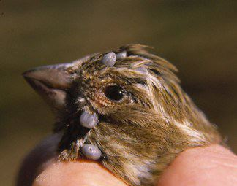
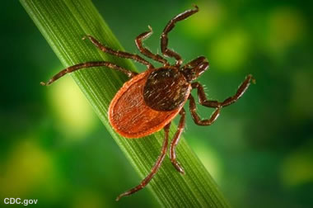
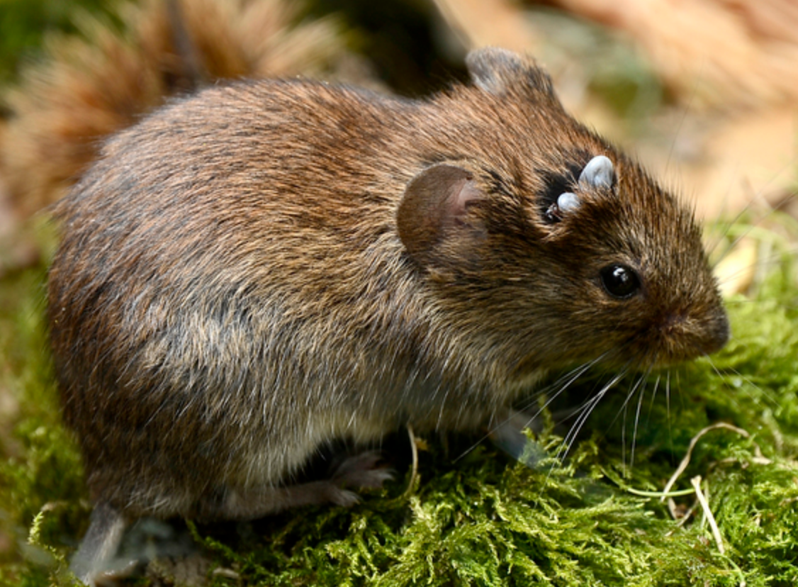
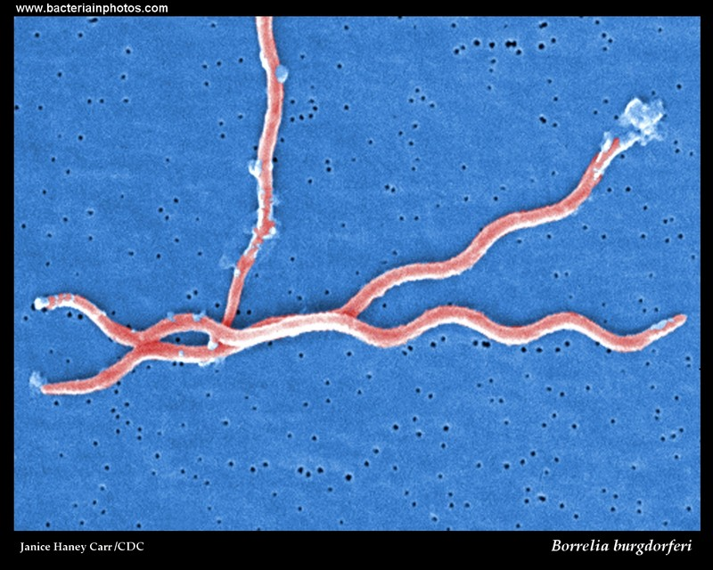
Identification of tick species,
vectors of different pathogens
Borrelia (Lyme disease)

Slide 32
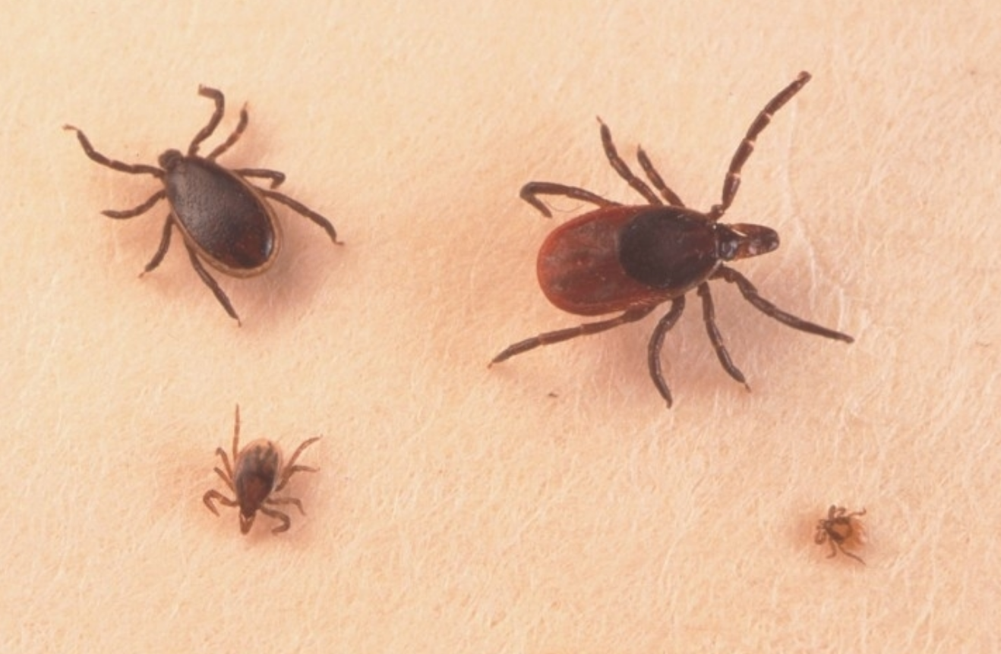
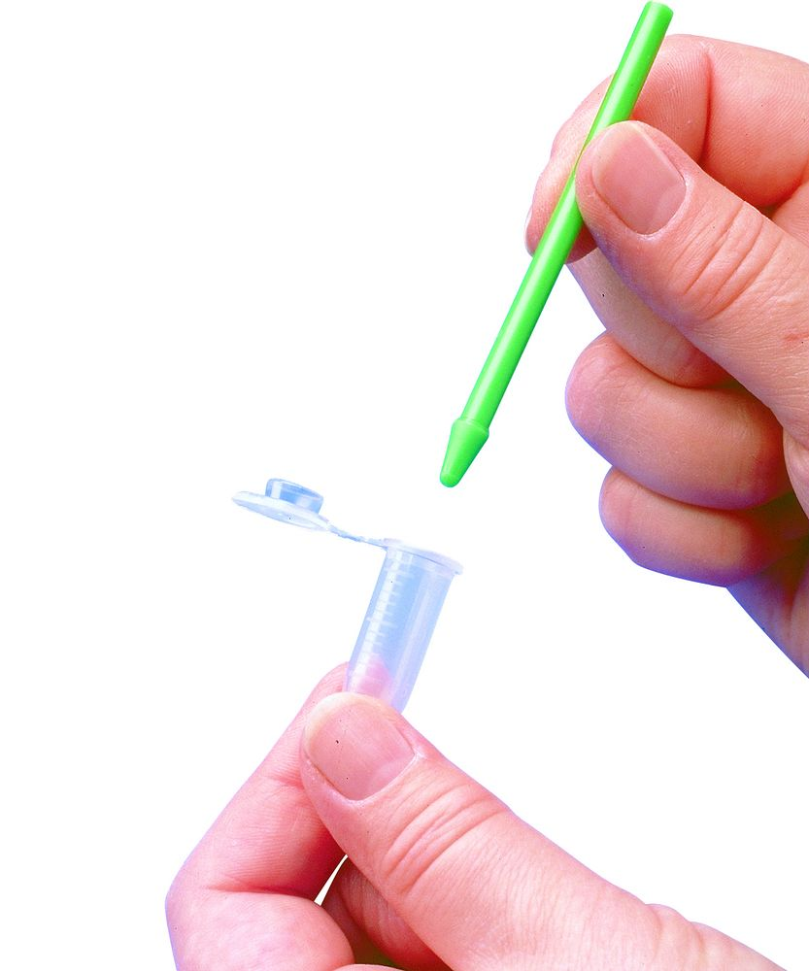

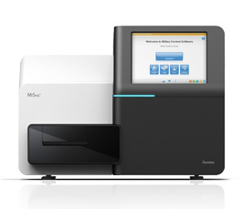
Vector species
DNA Extraction
DNA sequencing (Next Generation sequencing)

Slide 33
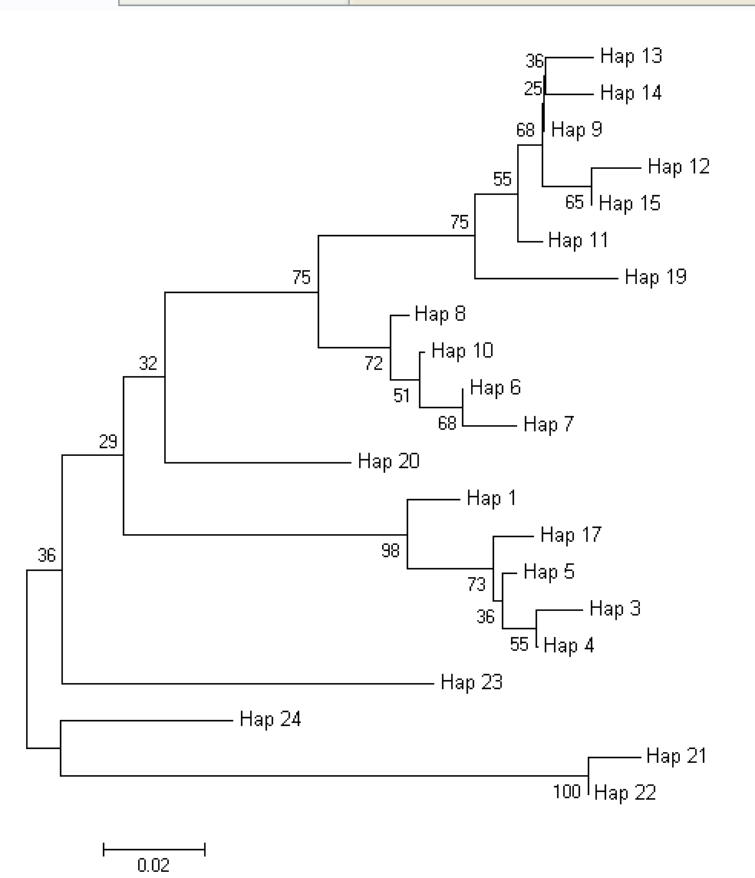
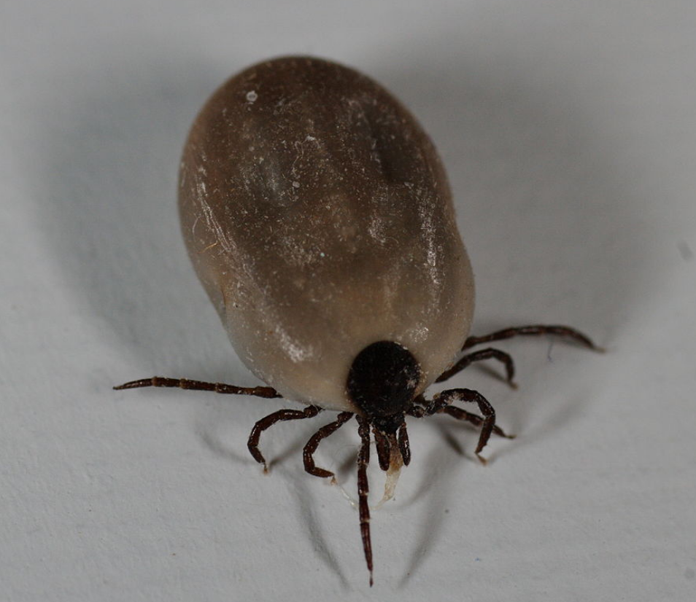
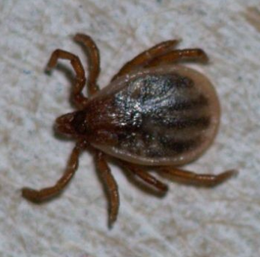
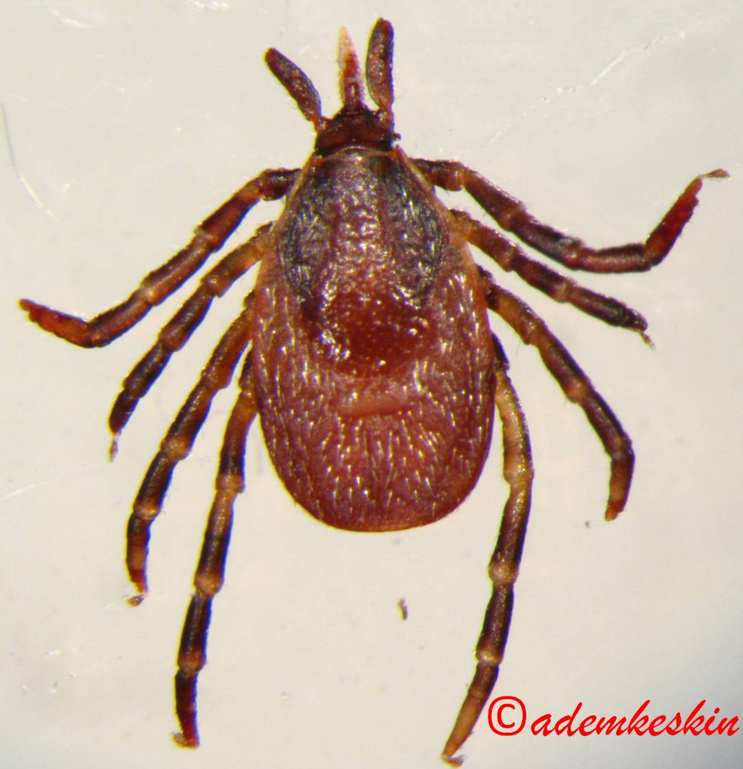
I. ricinus 1
I. ricinus 2
I. frontalis
I. arboricola

Slide 34
Genetics to better identify pathogens on reservoir and vector species

Slide 35
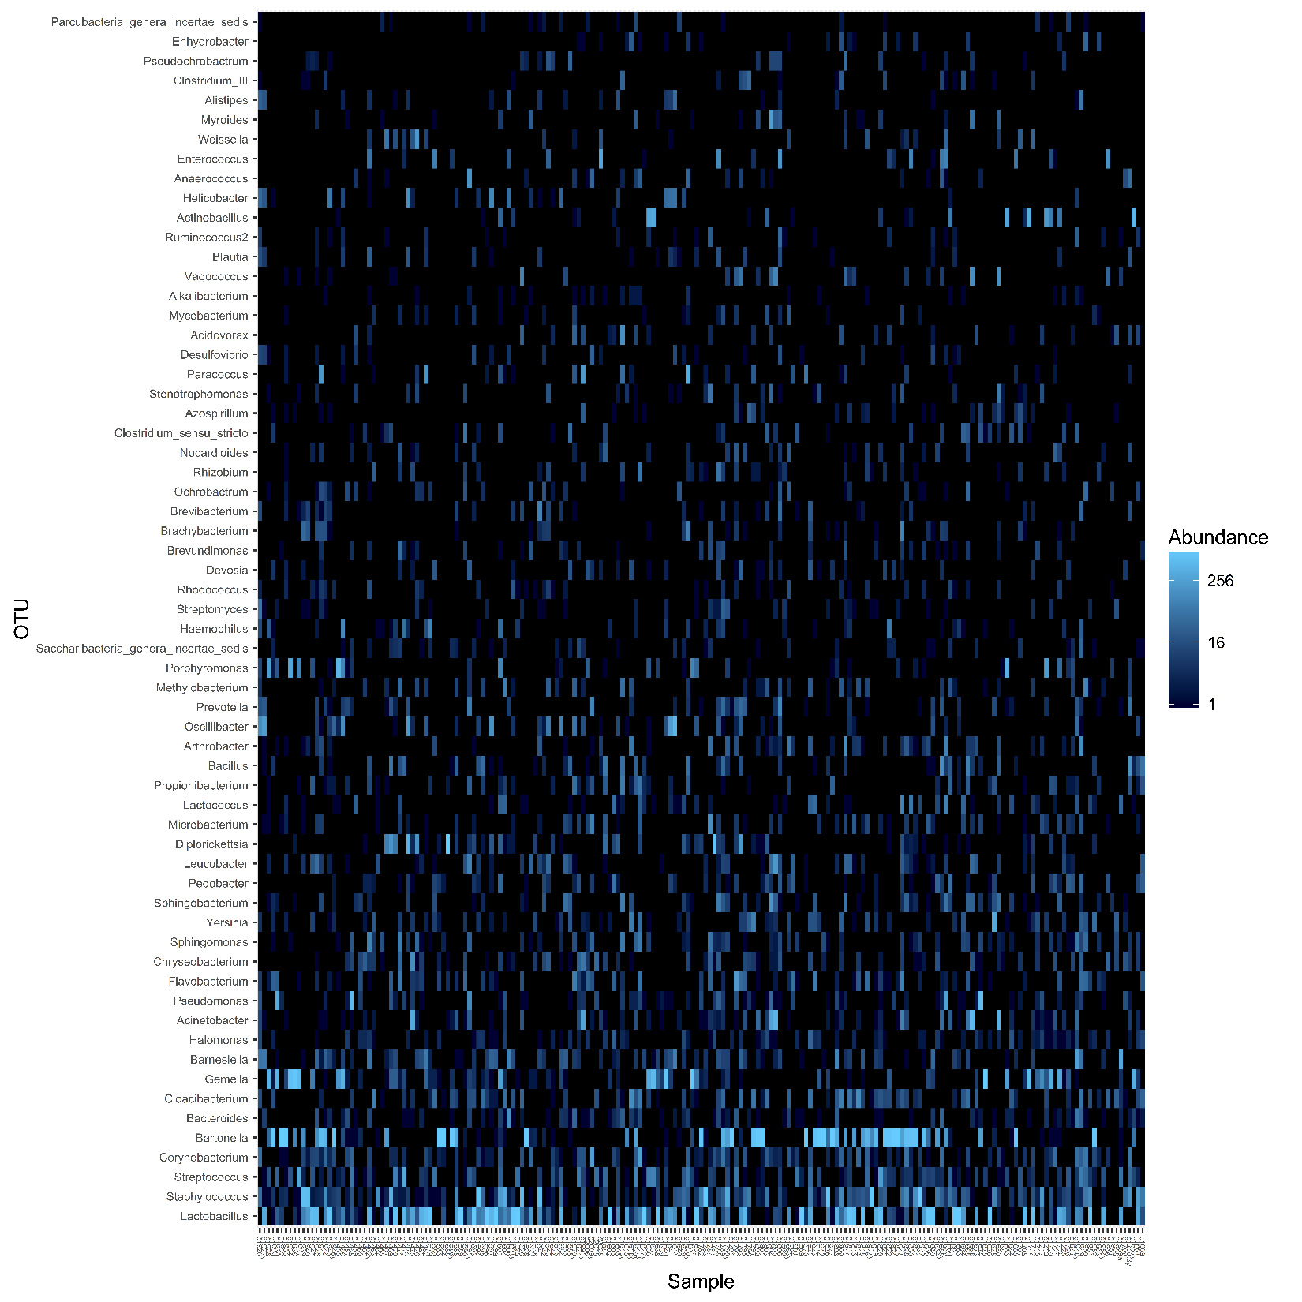
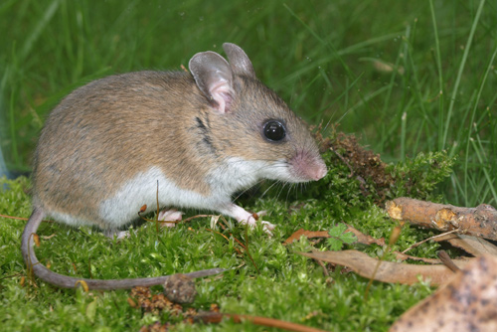
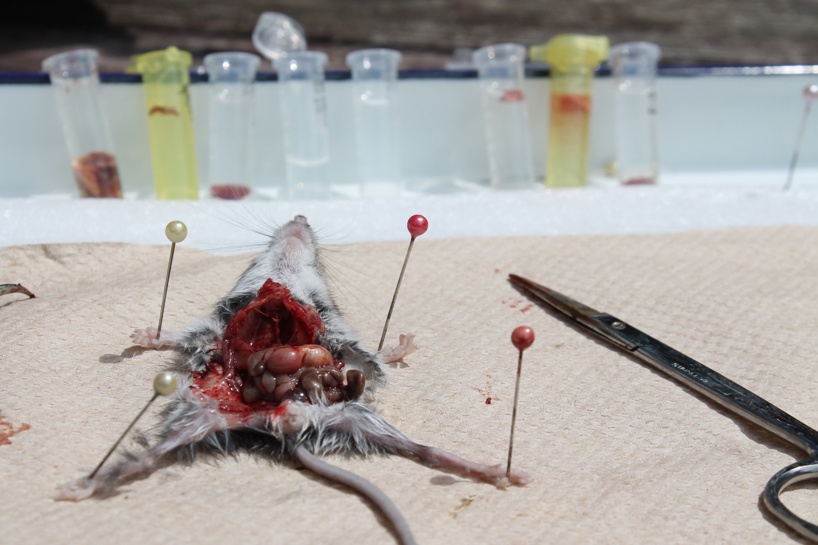

Slide 36

Studies on bacteriomes
- Allow to screen a large panel of bacterias (commensal or pathogens);
- Allow to identify putative co-infections (e.g. Borrelia and Bartonella);
- Better sensitivity to detect presence of bateries during first stages of infection (e.g. NGS methods 4 times more sensitive than "classical" PCR or serological methods.

Slide 37



Development of barcoding approaches
This method identifies species using a very short genetic sequence from a standard part of the genome.
Most common markers :
- Animals : small region of the mitochondrial cytochrome c oxidase 1 gene (“CO1”).
- Plants : Fragment of the TrnL or ITS2 regions.

Slide 38







Next generation sequencing methods based on the sequencing of a fragment of the mitochondrial cytochrome oxydase 1 (COI) gene : METAGENOMIC
DNA extraction
Amplification of genetic markers » with tags
Next Generation Sequencing
(illumina technology)
Identification of the species.
Identification of the diet (if use of faeces).
Comparison of the obtained sequences with databases (GenBank, Bold…)

Slide 39





The use of next generation sequencing for bush meat projects in Africa
Importance for conservation aspects and trade of threatened species, but also for health problems.
? ? ?

Slide 40








The use of next generation sequencing for diet studies on primates

Slide 41







The use of next generation sequencing to perform mammal inventories

Slide 42

Conclusion
Genetic tools help to answer to many different questions :
Resolve taxonomic incertainties (inter and intraspecific levels);
study the biology and the genetic diversity of threatened species;
better identify vector species;
better identify pathogens on reservoir and vector species;
better understand the busmeat trades (barcoding approaches);
study the diets of species;
perform small mammal inventories.

Slide 43
Aknowledgements
Cirad;
Serge Morand;
Michel Degarine;
My Belgian team (Adrien André, Sophie Vanoutryve, Lise Marie Pigneur, Nathalie Smitz, Marie Pagès, Alice Latinne..),
Astre research team (Gilles Balança; Laurence Vial, Frédéric stachurski, Daniel Cornelis, Alexandre Caron, Mathieu Bourgarel, François Roger..);
University of Liège (Genomic platform);
Belgian Funds for Scientific Research

