Slide 1
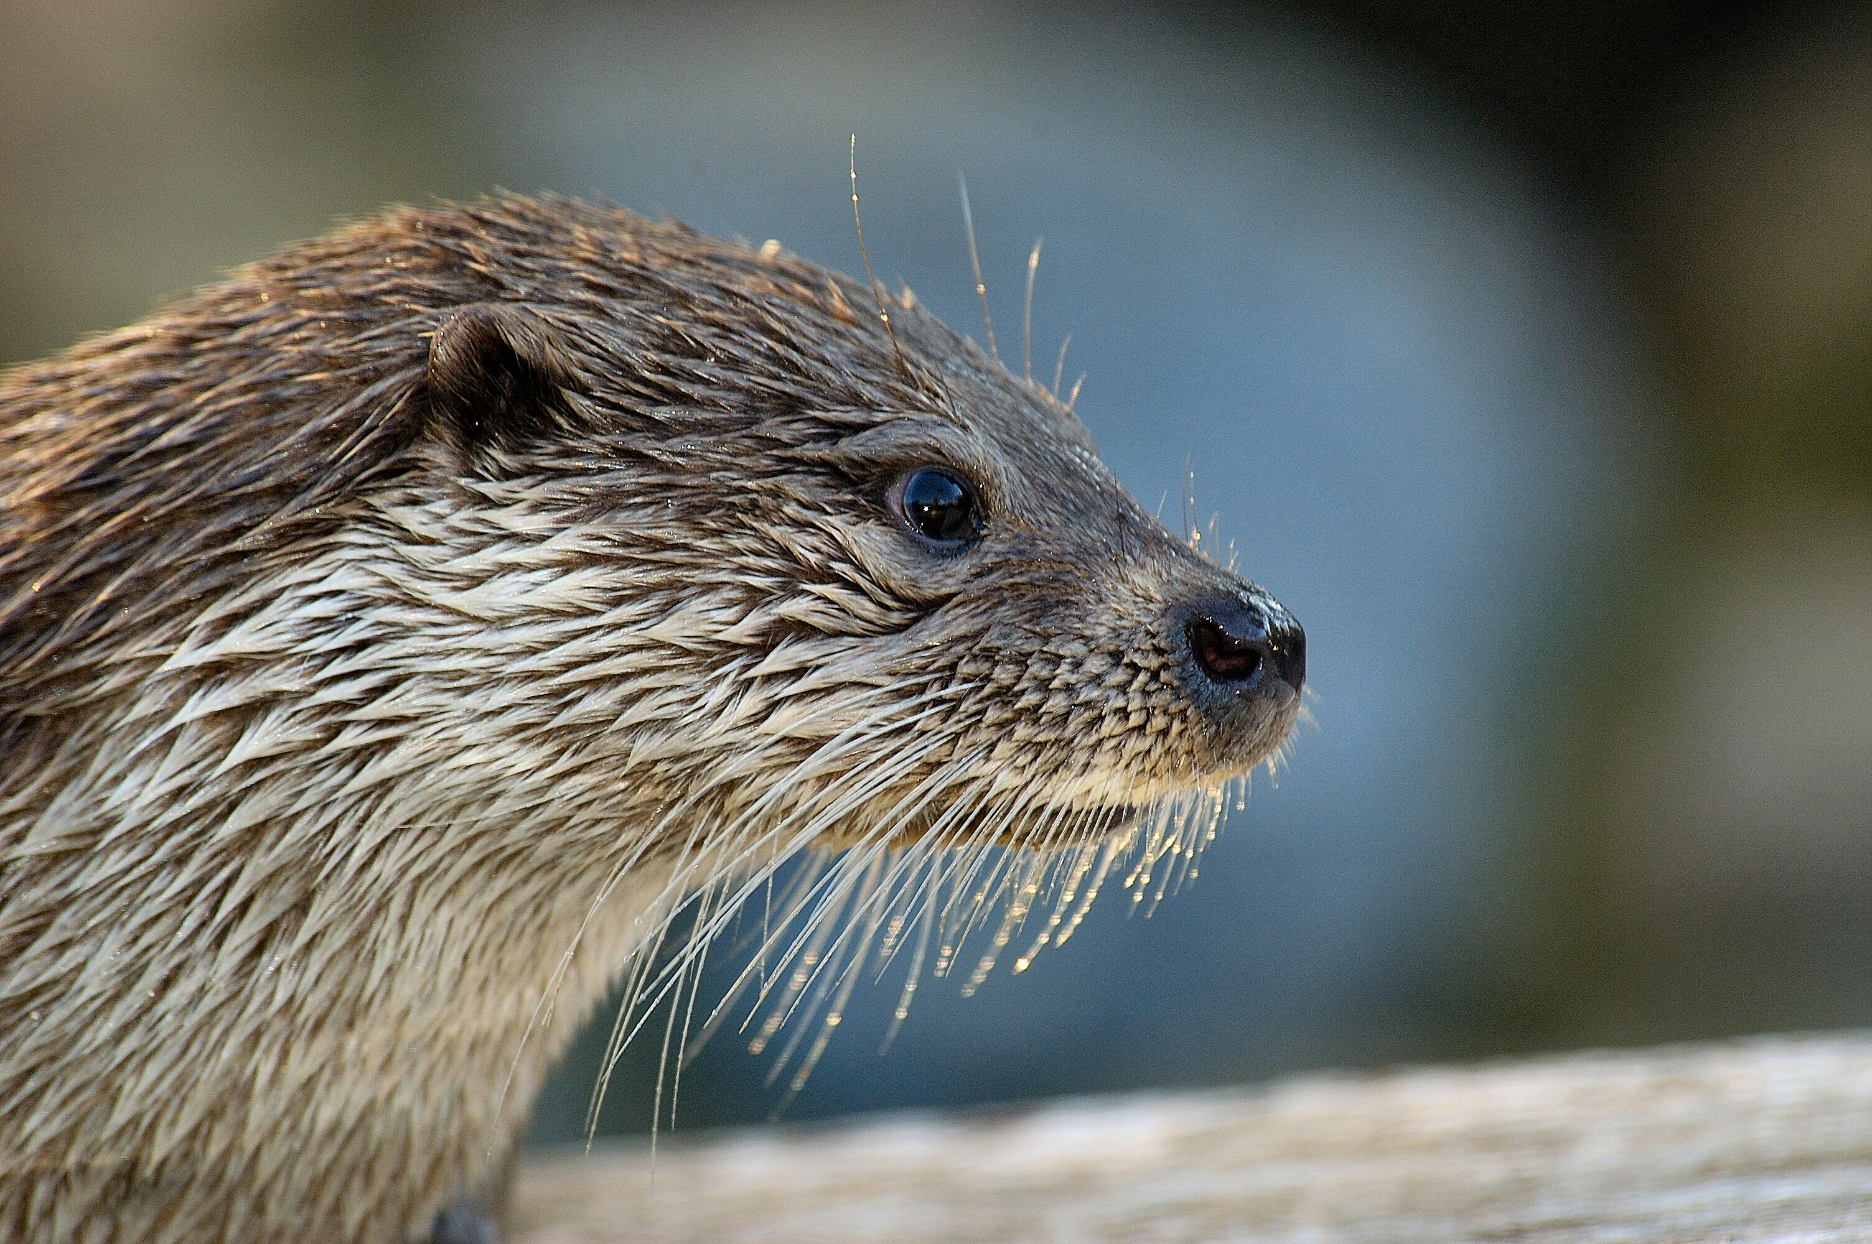
The revolution of new genetic tools for the study of the ecology of rare or elusive species, using non-invasive approaches
Johan Michaux
Conservation Genetics Lab, Institute of Botany (Bat. 22), University of Liège Belgium
www.gecolab.weebly.com

Slide 2
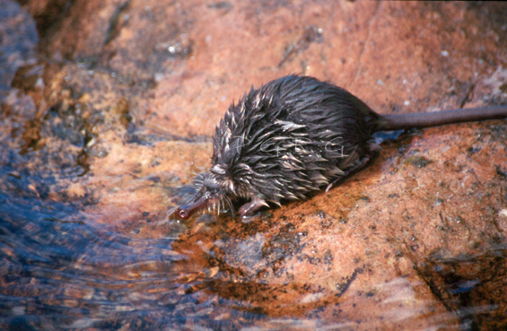
The case of the Pyrenean Desman (Galemys pyrenaicus)

Slide 3
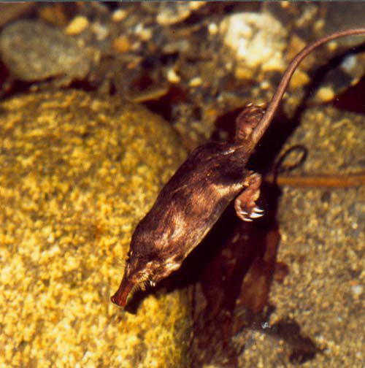
The Pyrenean Desman (Galemys pyrenaicus)
Semi aquatic species
Very difficult to observe
Insectivorous diet
Order : Eulipotyphles
Family : Talpidae

Slide 4
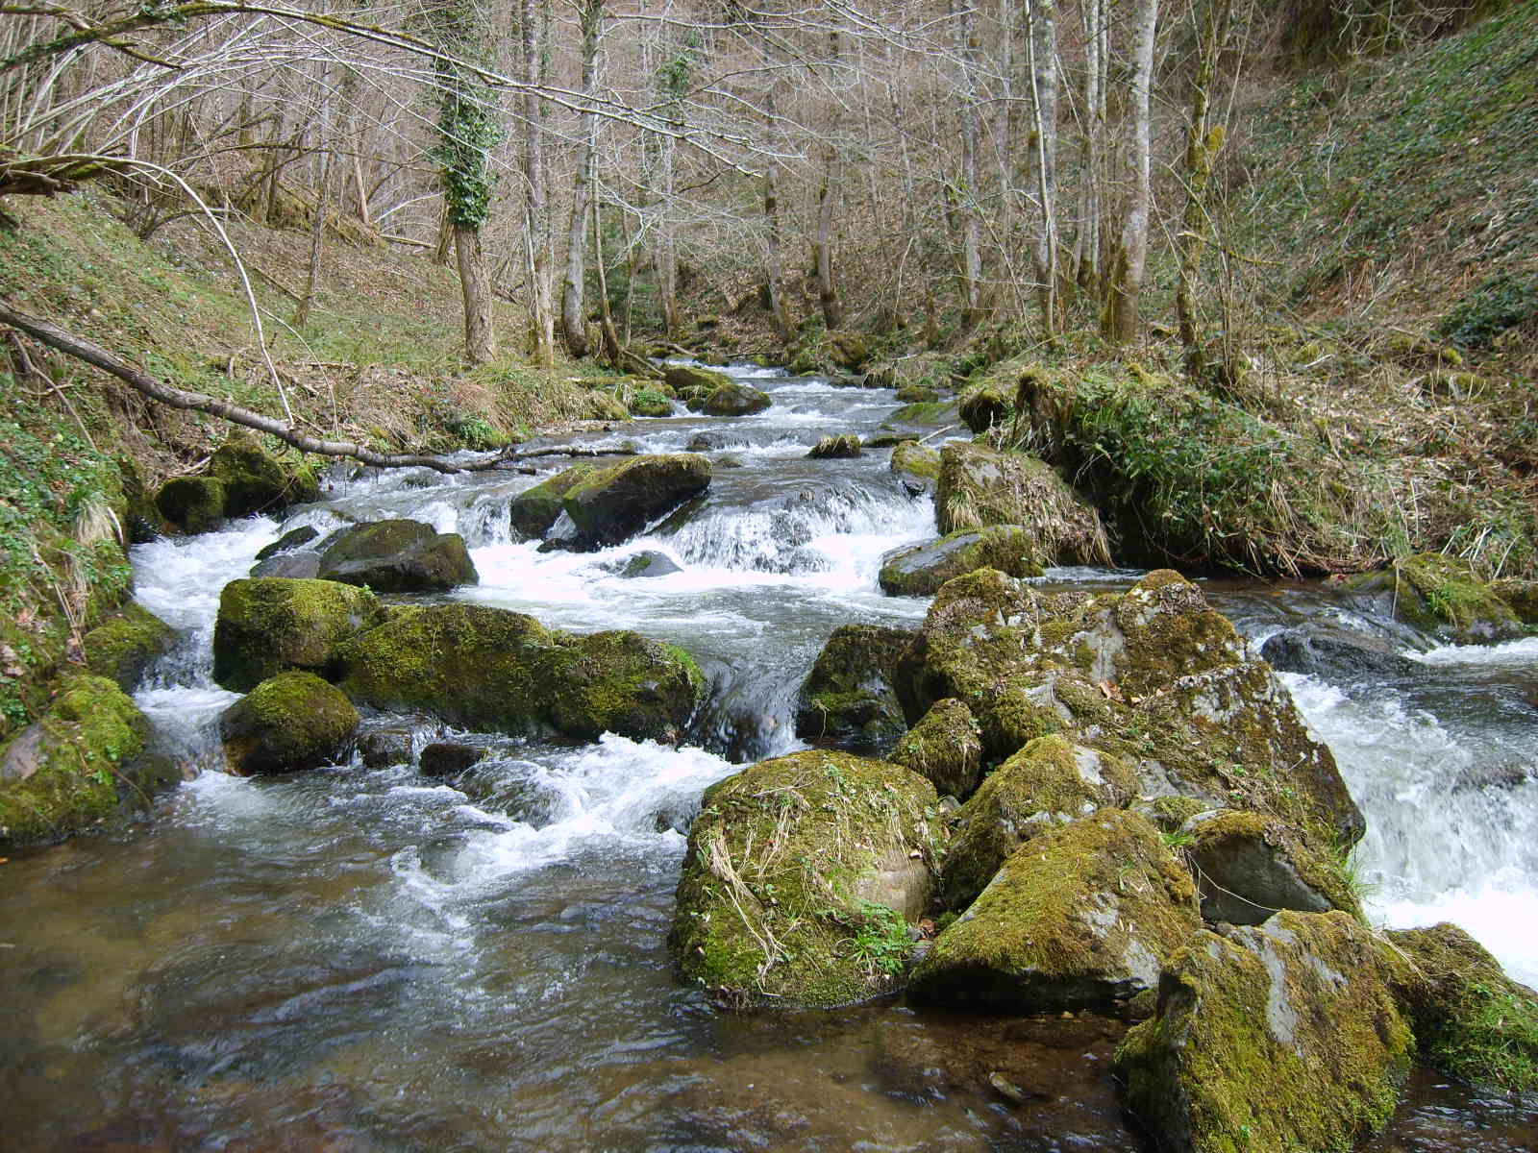
Live in mountain rivers
Endemic to the pyrenees and North Spain.
Its exact distribution area is not yet really known!
Source: IUCN

Slide 5
Conservation Status: « vulnerable » (IUCN)
Very weak information concerning its :
Eco-ethology;
genetic diversity;
distribution area;

Slide 6
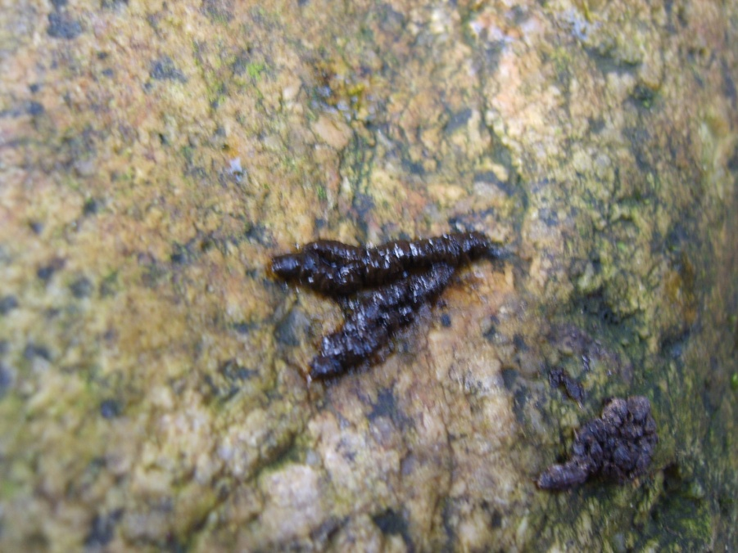
Analyses mainly based on the analyses of faeces collected on the Pyrenean rivers
Question : how to obtain new data from this elusive species, almost impossible to observe in the wild?

Slide 7
Identification of the presence of a threatened species

Slide 8
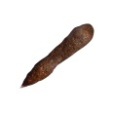
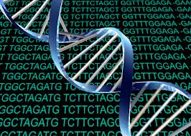
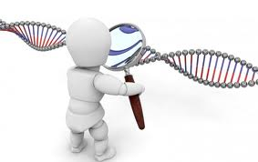
Next generation sequencing methods based on the sequencing of a fragment of the cytochrome oxydase 1 (COI) gene
DNA extraction
Amplification of the CO1 gene with tags
Next Generation Sequencing
Identification of the species who did the faeces
Identification of the diet of this species
Comparison of the obtained sequences with those available in public (BOLD, Genbank) or private databases

Slide 9
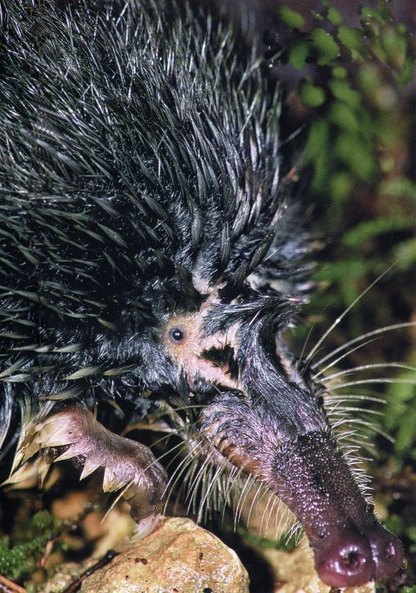
Genetic validation of the Desman presence in the French Pyrenees
Amplification of a small fragment of a mitochondrial markers (COI)
Next Generation sequencing methods
Distribution of the desman based
on Species distribution modeling
Methods.
(Gillet et al. 2015, Mammalian Biology)
(Charbonnel et al. 2015,
Biological Conservation)

Slide 10
Study of the genetic structure of threatened and elusive species (phylogeography, population genetics)

Slide 11
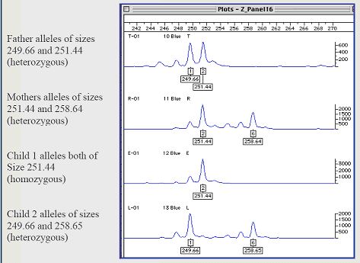
Microsatellite or SNPs genotyping
Amplification of highly polymorphic short regions
Differences at the individual level
« genetic ID card »
Can work with non invasive samples.
Important for elusive or endangered species !

Slide 12
Genetic structure of the Pyrenean Desman
355 analysed faeces (PID = 0,002). Evidence of 108 individual.
Discovery of three main genetic populations : East, West and Centre.
(Gillet et al. 2017, J. of Mammalogy))

Slide 13
F-statistics
- Low gene flow among populations (FST: 0,2 à 0,34).
- High values of the Inbreeding index (Fis) : High risks of inbreeding depression!
Management propositions
- improve connectivity among watersheds. Not easy… many rivers are now not suitable for the Desman…

Slide 14
ABC analyses

Slide 15
Causes of the fragmentation
Recent fragmentation of the habitats
Little ice age

Slide 16
Individual identification, in order to identify the mobility of animals and the existence of barriers for gene flow

Slide 17
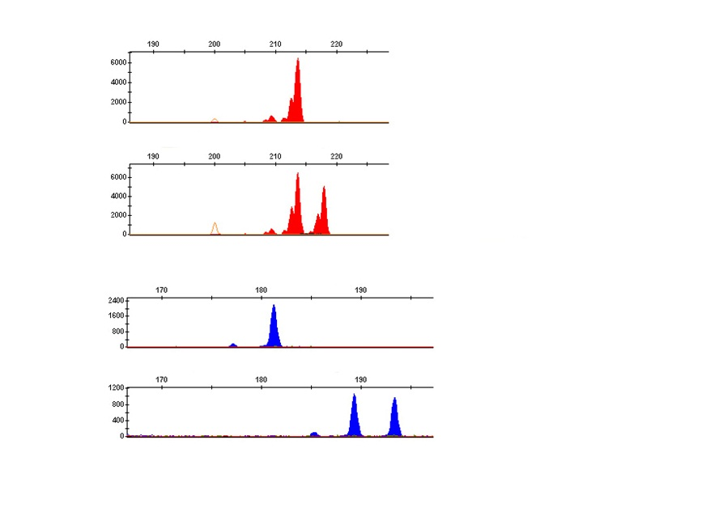
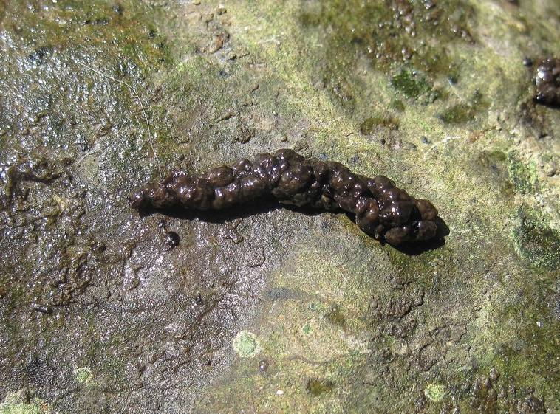
Individual identification
Part of the "Aude river" (+/- 3km)
Important modifications of the stream by different dams (hydro electricity activities)
Impact on Desman populations?
→ Individual genotyping using faeces

Slide 18
Individual identification
→ 23 different individuals identified in the studied river portion.
 | GpyrGS 23 | GpyrGS 32 | GpyrGS 33 | GpyrGS 22 | GpyrGS 34 | GpyrGS 20
DE214a | 207 | 197-201 | 230-234 | 212-216 | 201 | 227
DE215a | 207 | 197 | 230-234 | 216 | 197-201 | 223-227
DE216a | 207-211 | 197 | 234 | 216 | 201 | 223-227
DE217a | 207 | 201 | 234 | 216 | 197-201 | 223-227
DE218a | 203-207 | 197-201 | 234 | 216 | 197-201 | 227
DE219a | 207 | 197-201 | 230-234 | 216-220 | 197-201 | 227
DE437 | 207 | 197 | 234 | 216 | 201 | 223-227

Slide 19
Study of the impact of human barriers for the mobility of the Pyrenean desman

Slide 20
Results
4,8 KM in one month!
(Gillet et al. 2016,
Bel. J. Zoology

Slide 21
16,82 km KM
in 10 months
17,8 km KM
in 12 months
(Gillet et al. 2016,
Bel. J. Zoology

Slide 22
The use of genetics to study the diet of elusive and rare species (using Next Generation Sequencing methods)

Slide 23
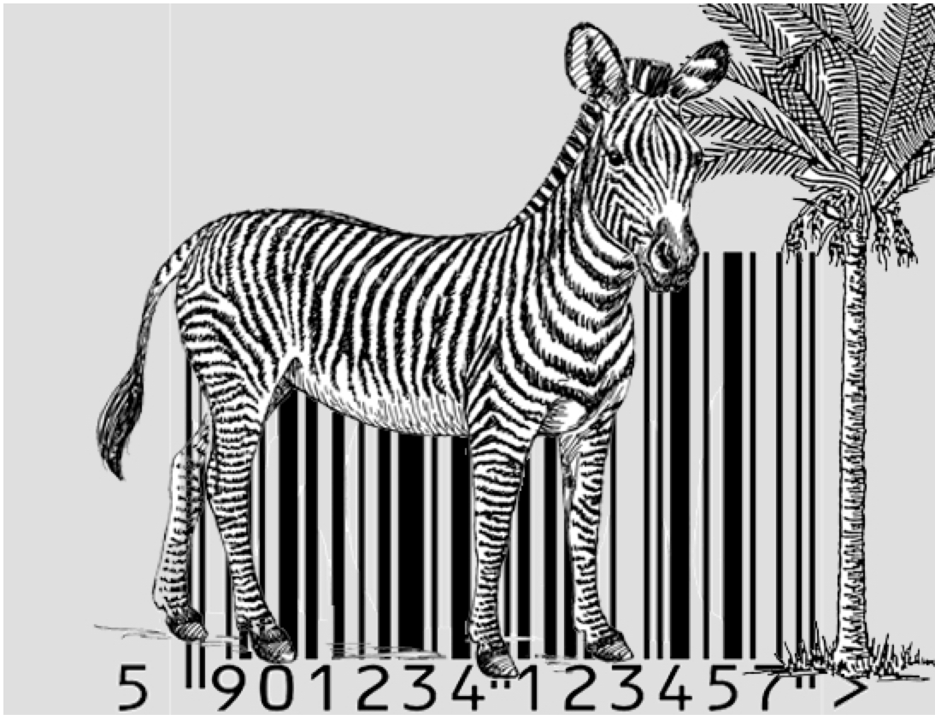
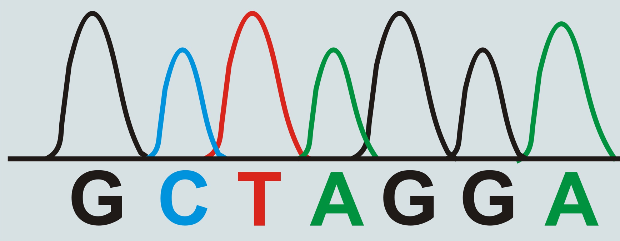
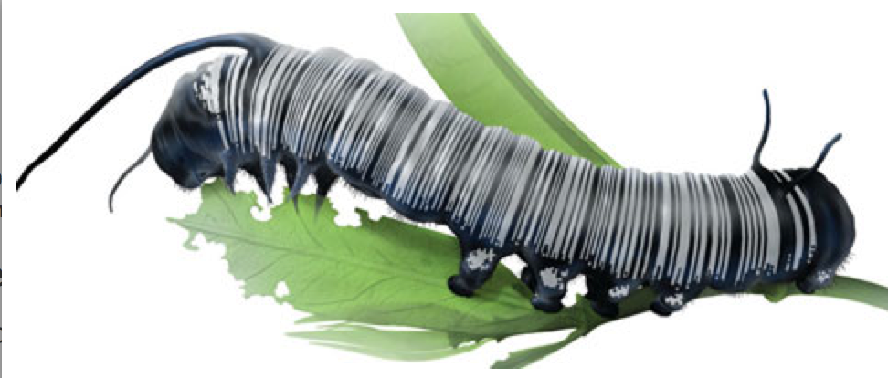
Development of meta barcoding approaches
This method identifies species using a very short genetic sequence from a standard part of the genome.
Most common markers :
- Animals : small region of the mitochondrial cytochrome c oxidase 1 gene (“CO1”).
- Plants : Fragment of the TrnL or ITS2 regions.

Slide 24
Diet of Galemys pyrenaicus
- Identification of 110 genera and 120 prey species;
- Opportunistic diet.
- low amount of Fish preys (0.5%).

Slide 25
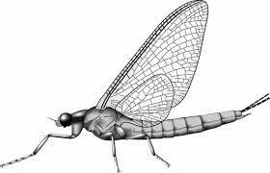
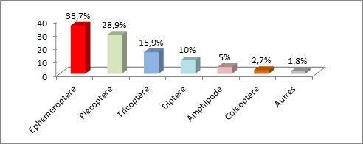
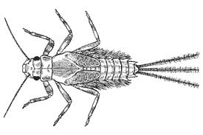
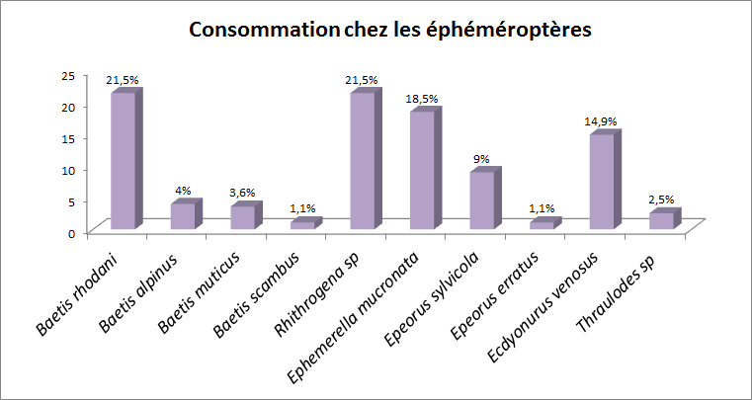
Ephemeropters
(Biffi et al. 2017, J. of Mammalogy)

Slide 26
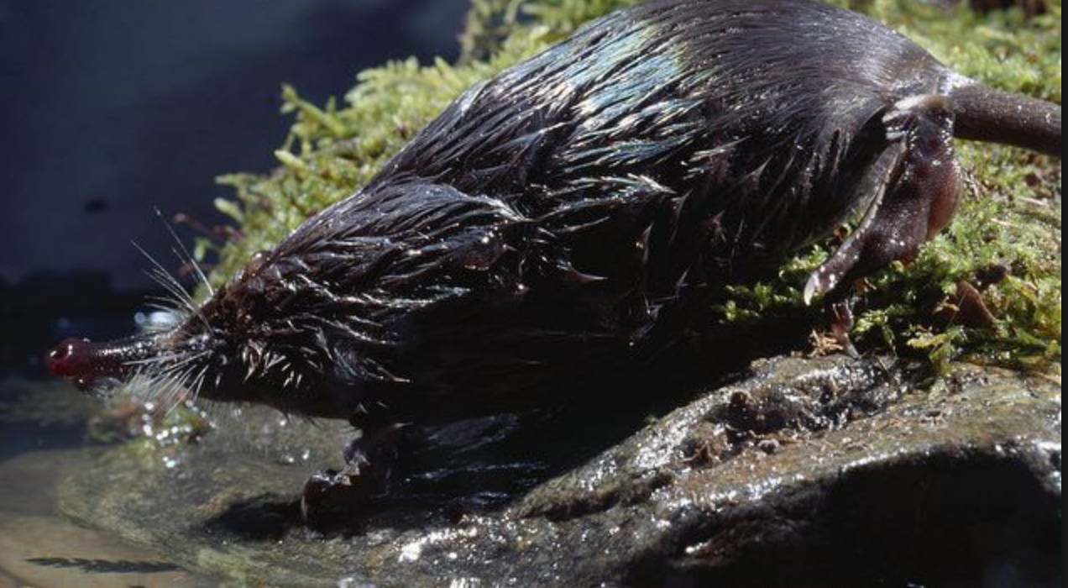
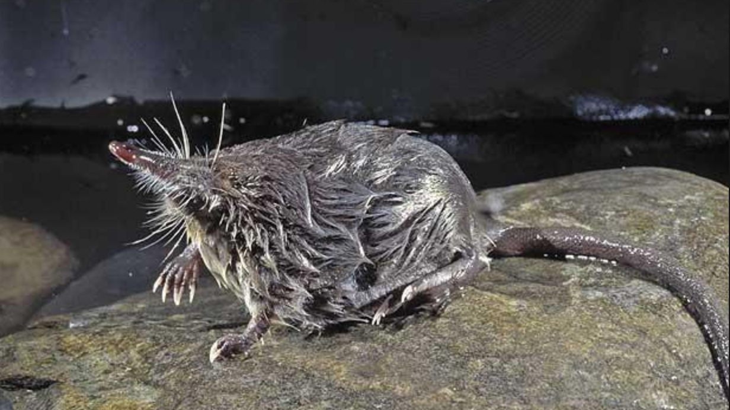
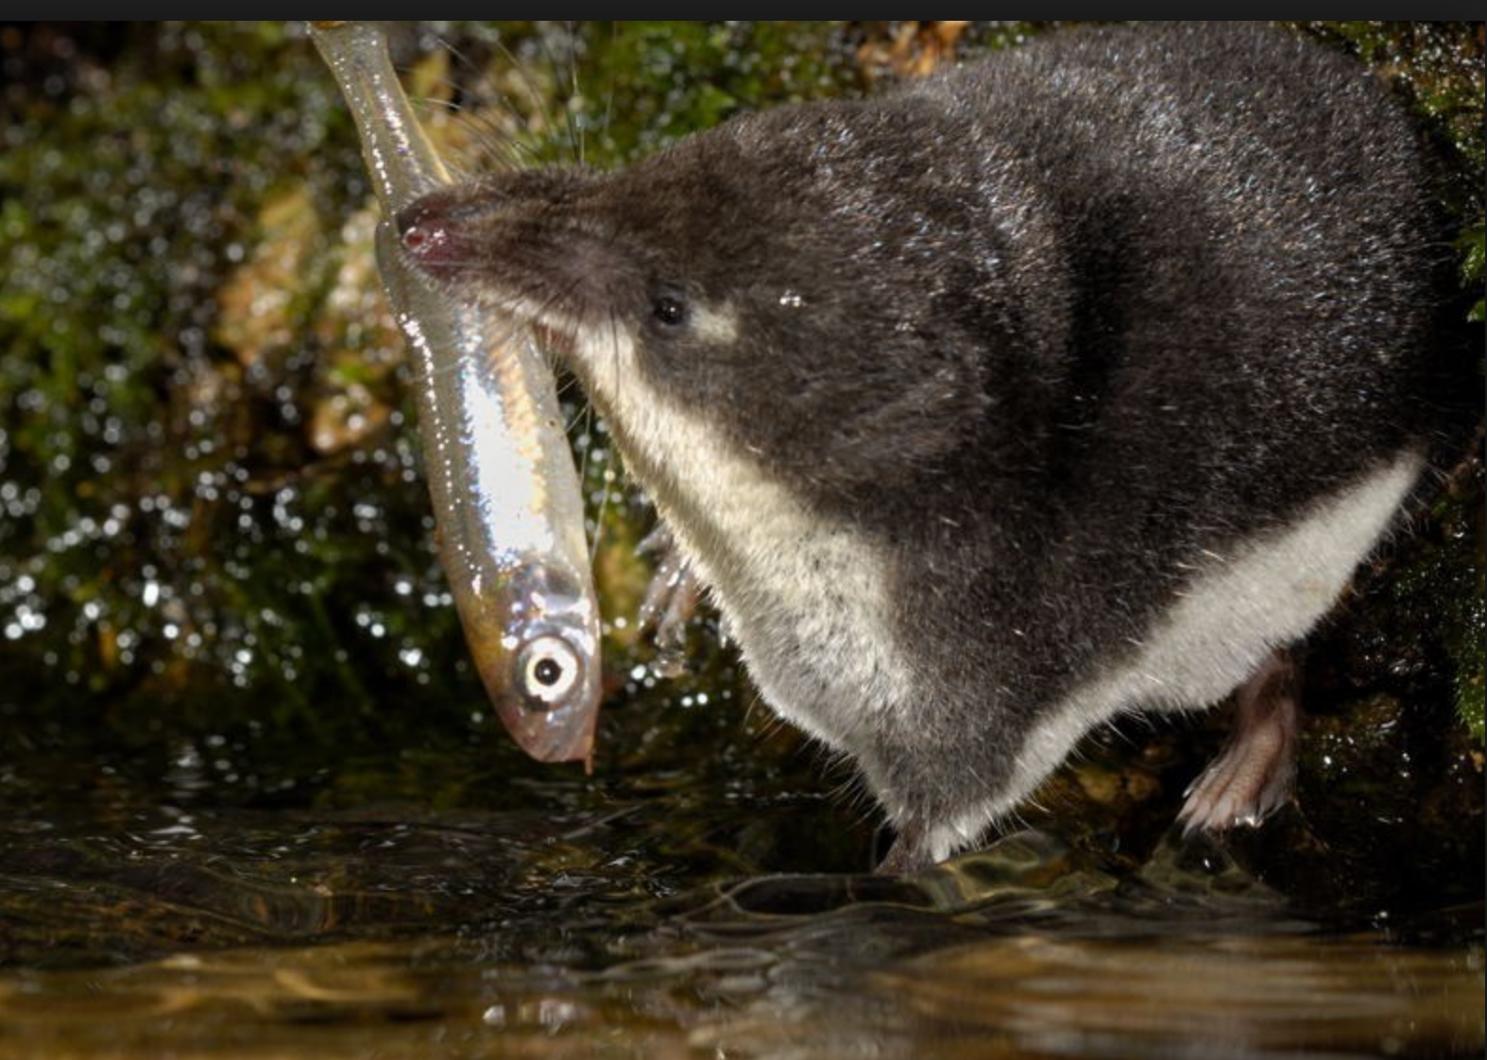
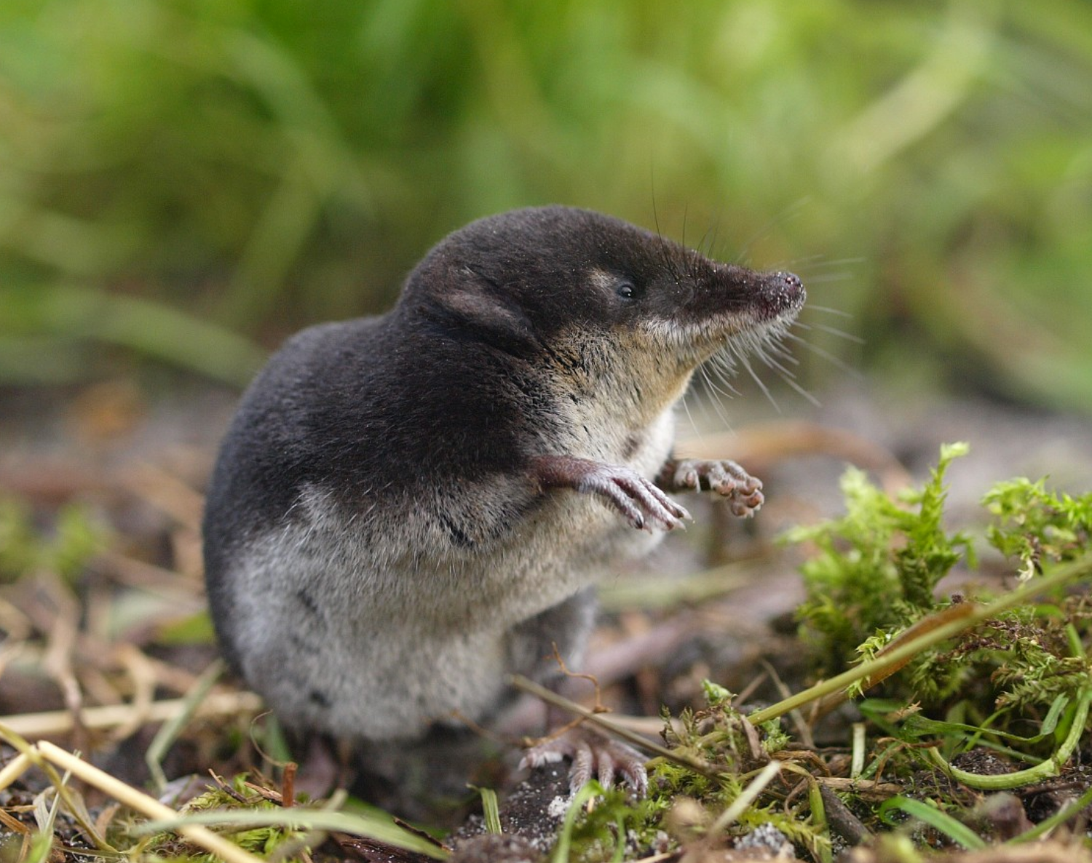
Diet between two semi aquatic mammals : Galemys pyrenaicus and Neomys fodiens

Slide 27
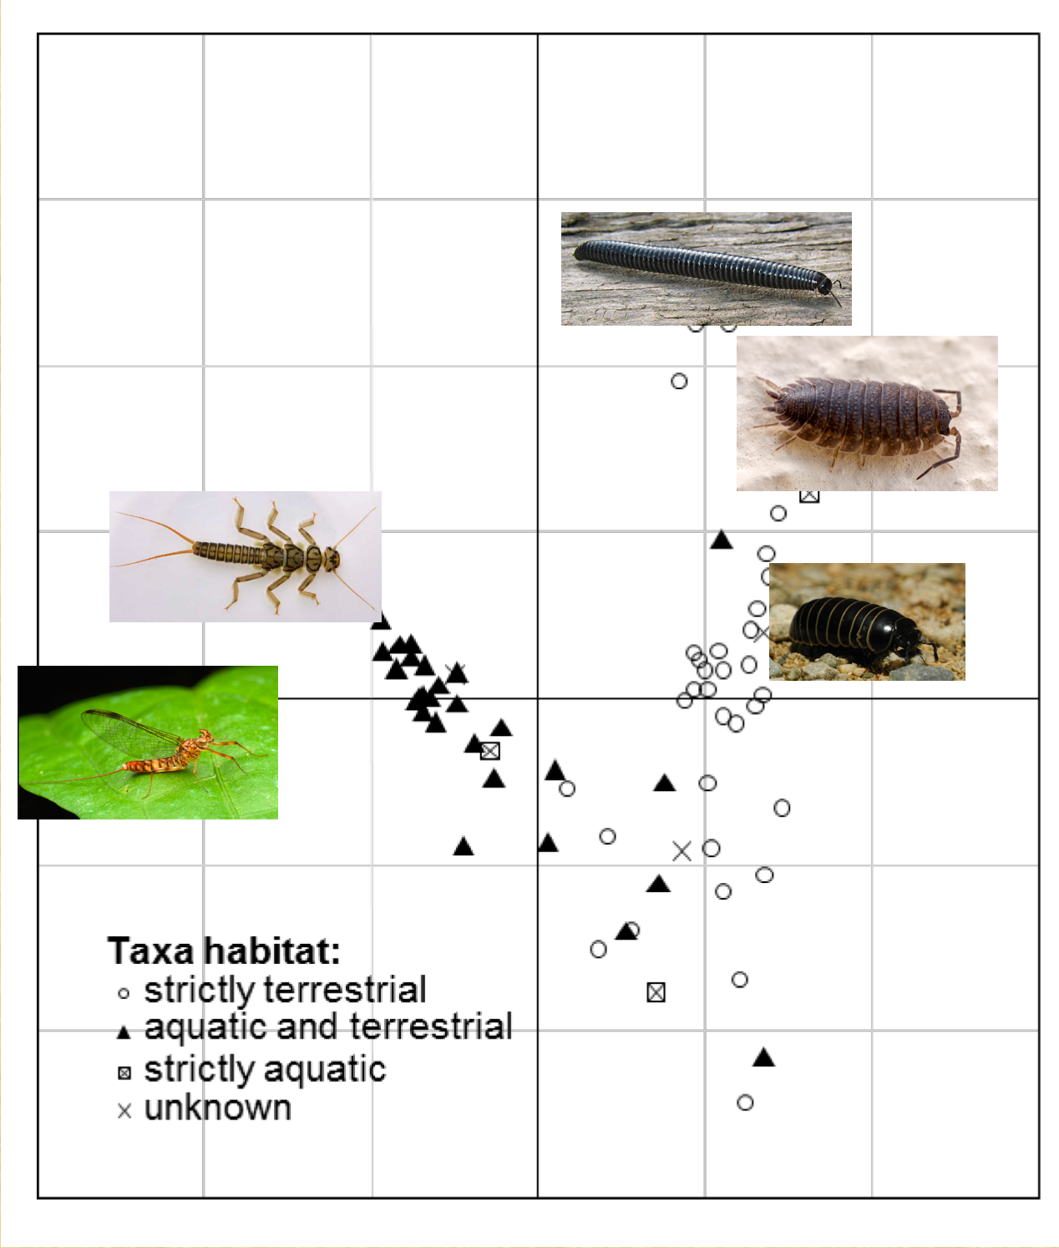
Large diversity of prey species living in different habitats
Notes:
woodlouse

Slide 28
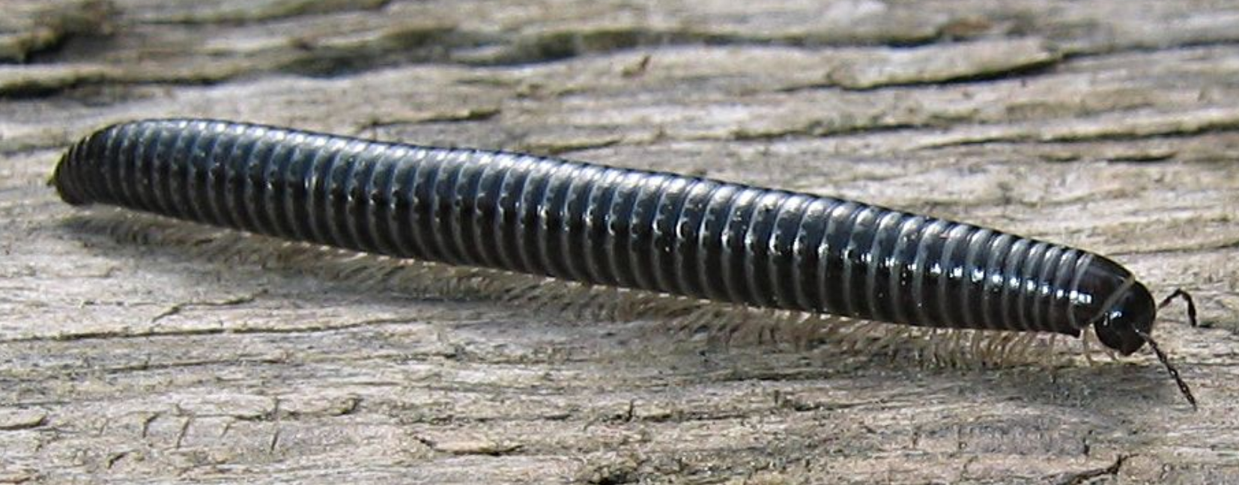
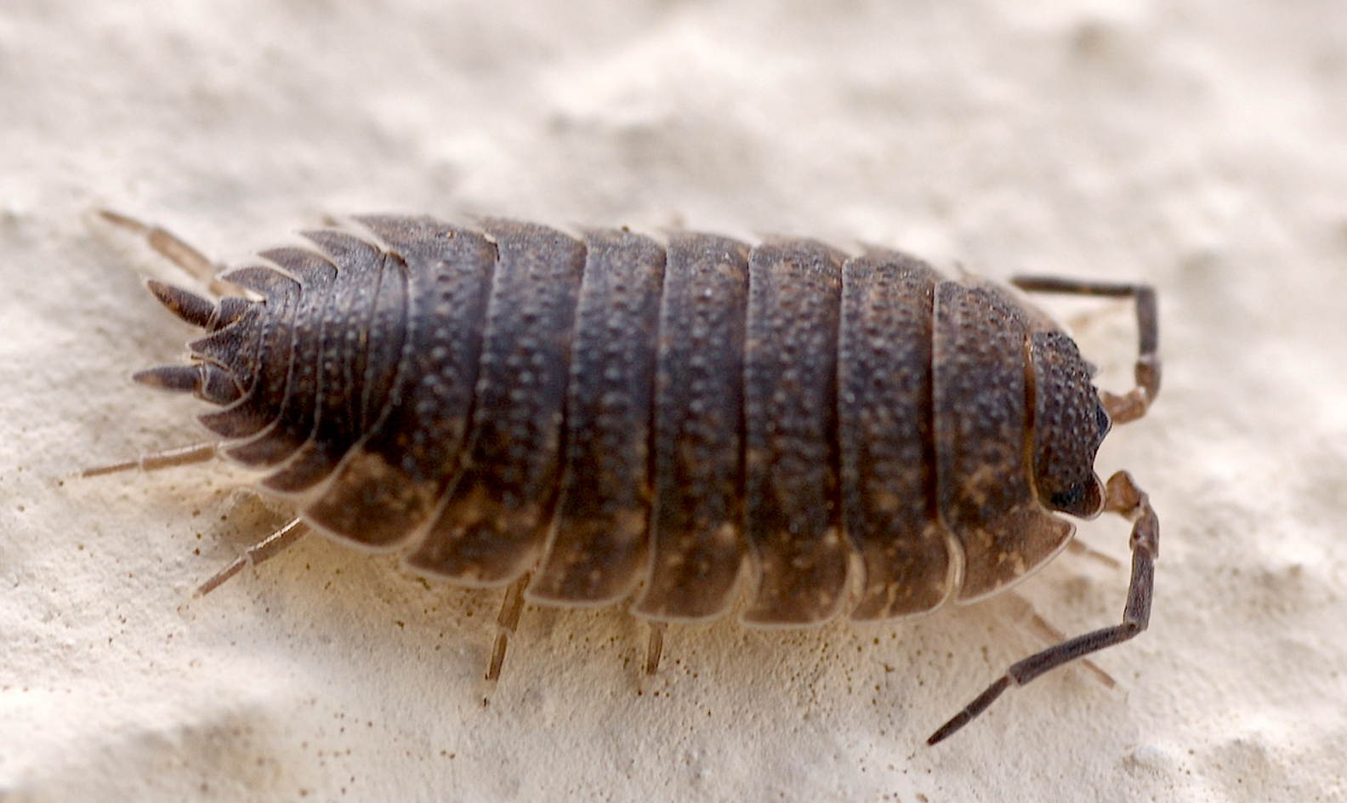
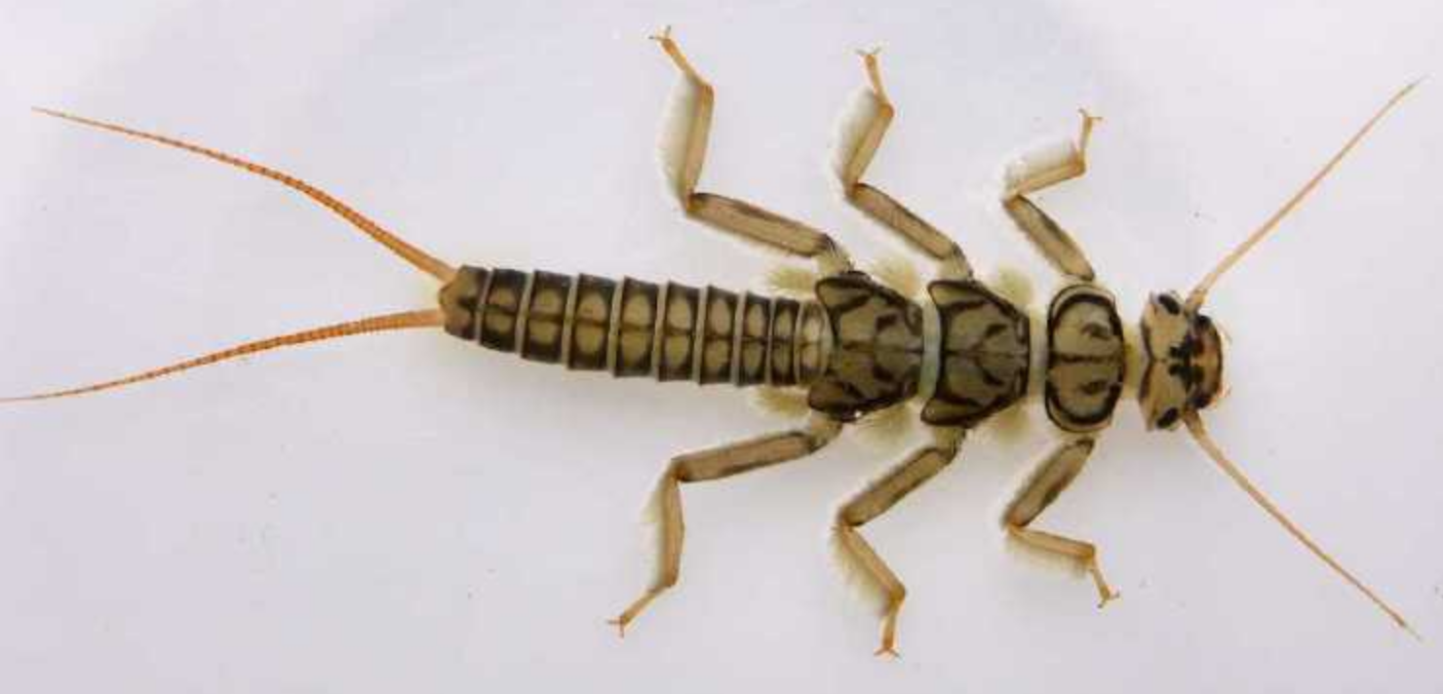
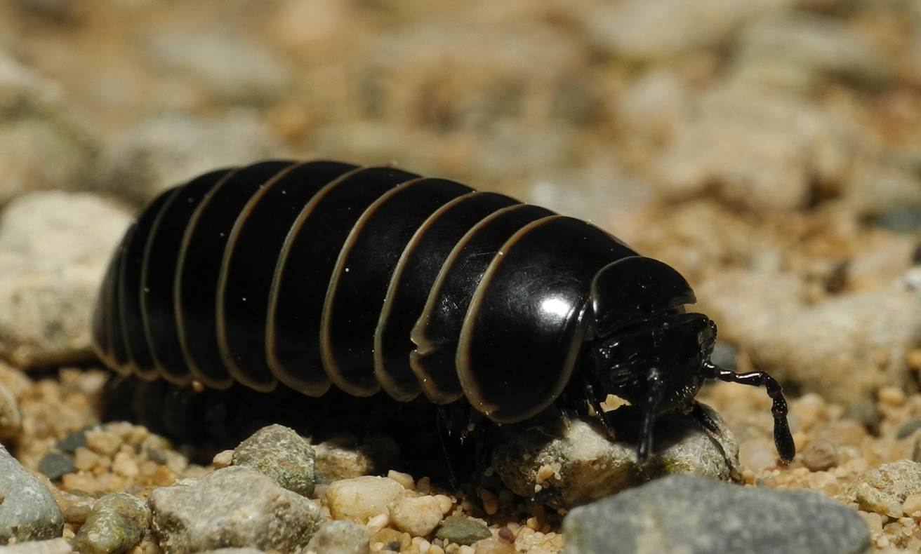
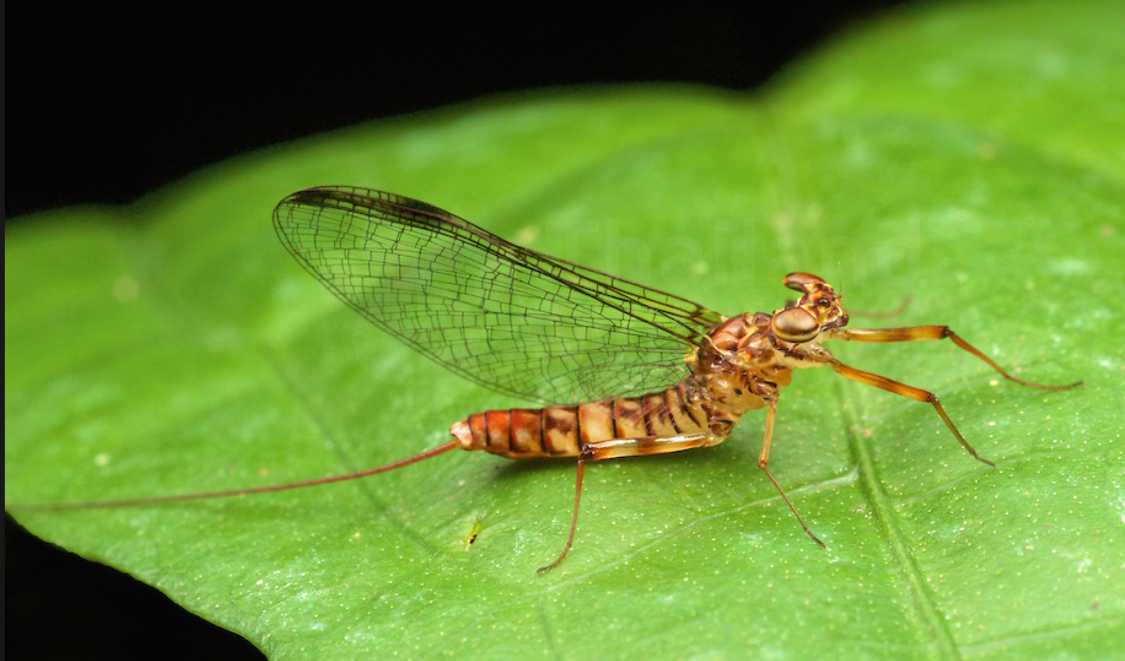
Niche segregation
(Biffi et al. 2017, Mammalian Biology)

Slide 29
Conclusions of the Desman study
The genetic tools helped to evidence :
Heterogeneous distribution of the species throughout the French Pyrenees.
Distribution probably linked to the ecological needs of the species (rivers with high streams and not polluted);
Strong genetic structure (3 lineages).
Weak gene flow among them and high inbreeding risks.
Isolation probably linked to past climate changes and recent human activities.
High mobility along the river where they live. Can cross barriers (dams).
Is not in competition with other aquatic insectivore species (Neomys).
Management measures :
improve gene flow among different regions (translocations?).
Improve water quality where the species is evidenced.
Avoid human disturbances in these rivers (canonying, cattle, big dams..)

Slide 30
Identification of invasive species

Slide 31
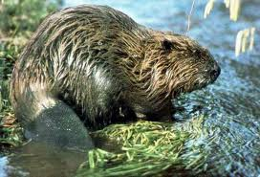
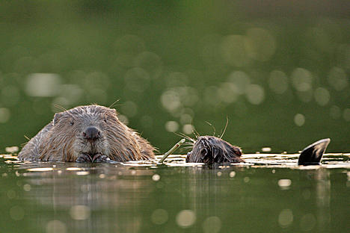
Study of the invasion of the Canadian beaver (Castor canadensis) in Belgium, Luxembourg and Western Germany.
Castor canadensis
J. Herr
Castor fiber

Slide 32
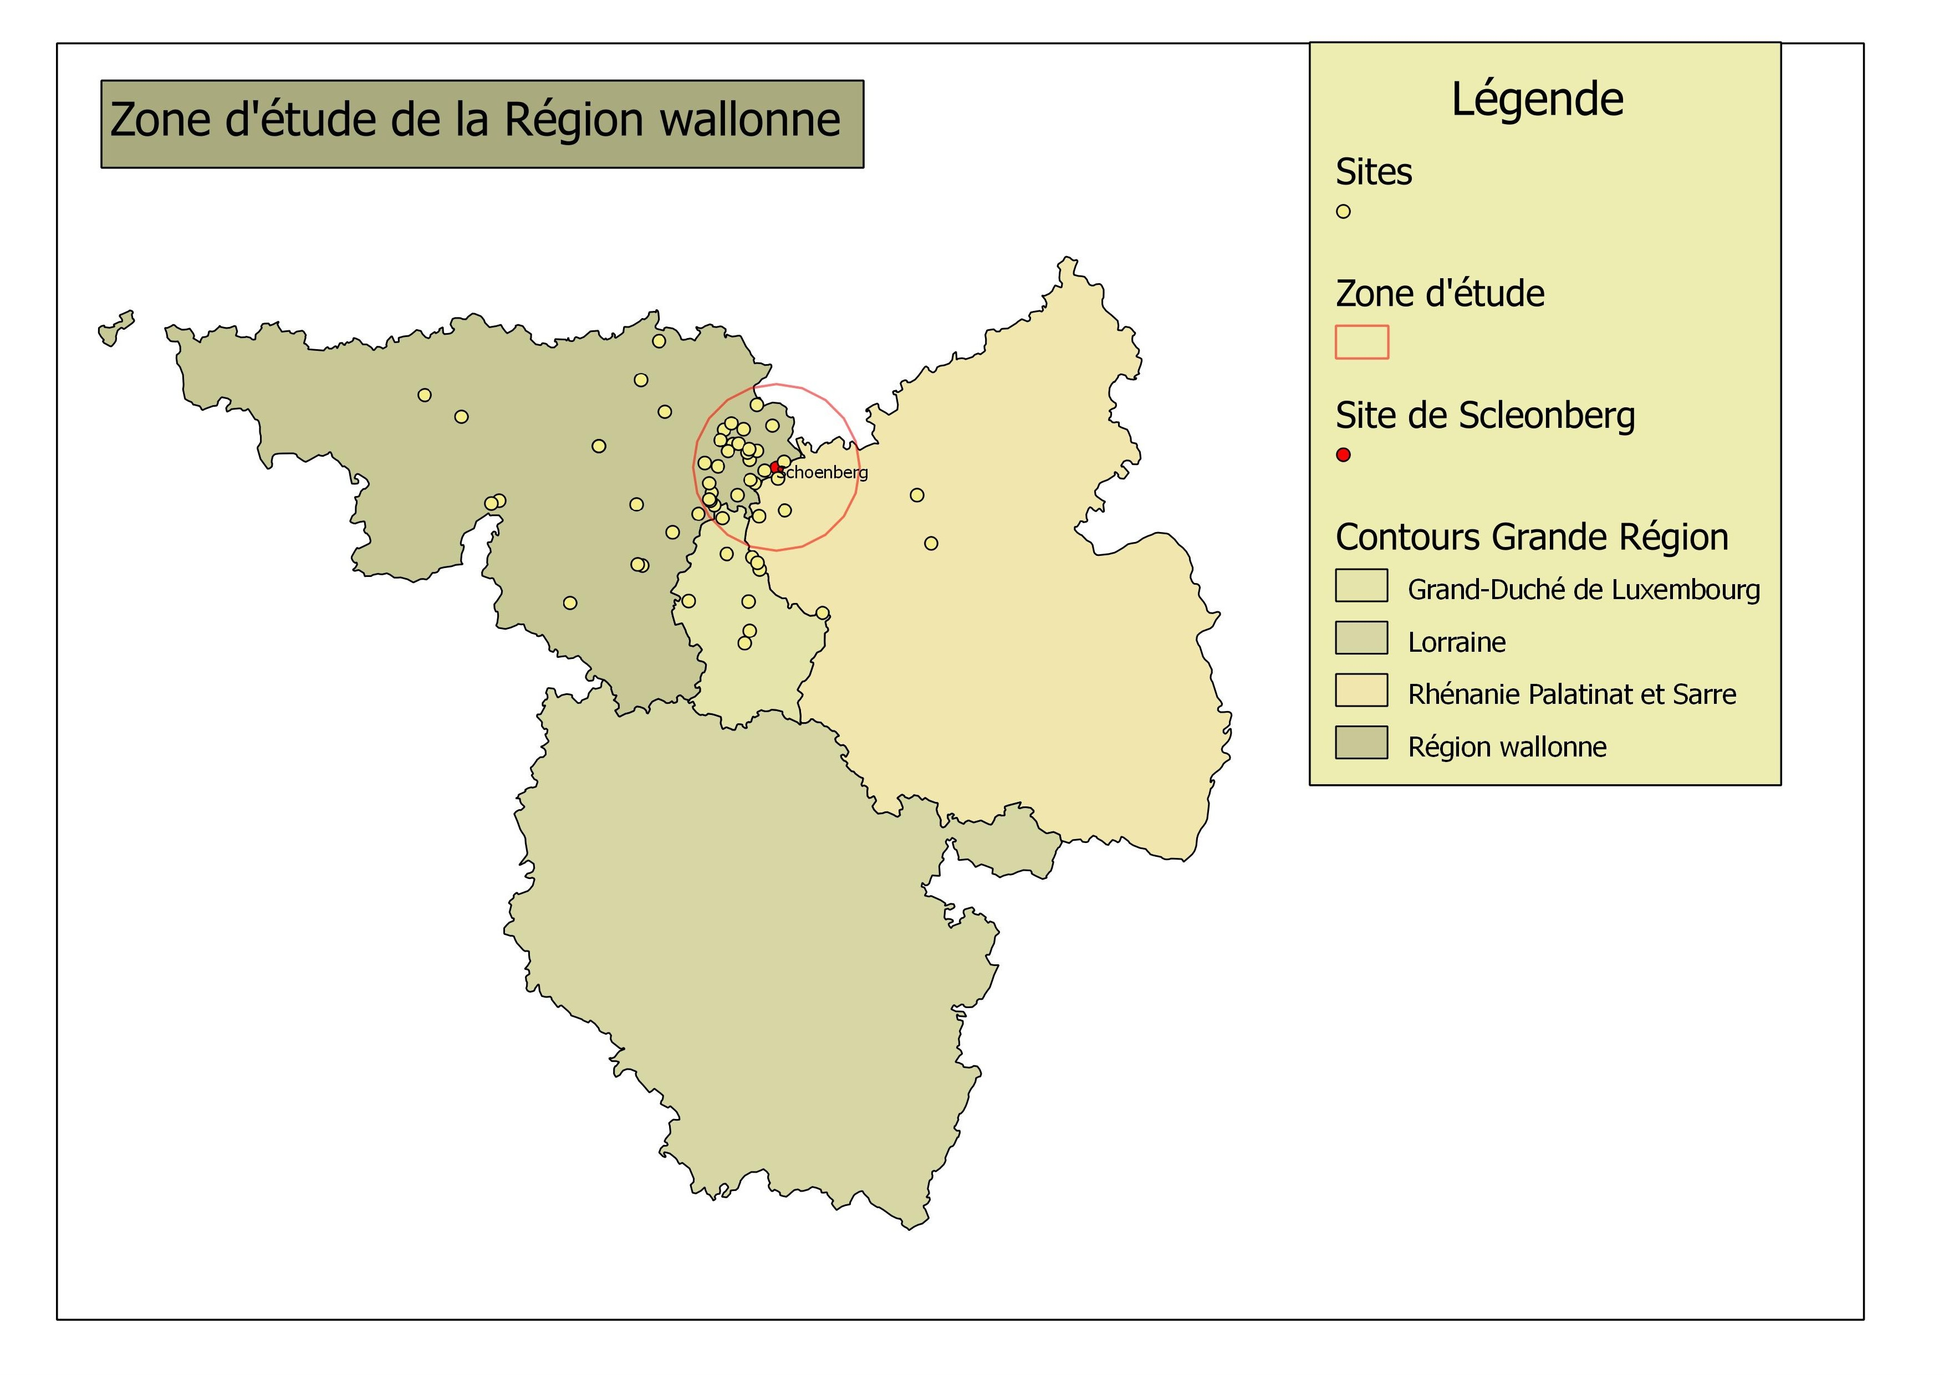

Slide 33
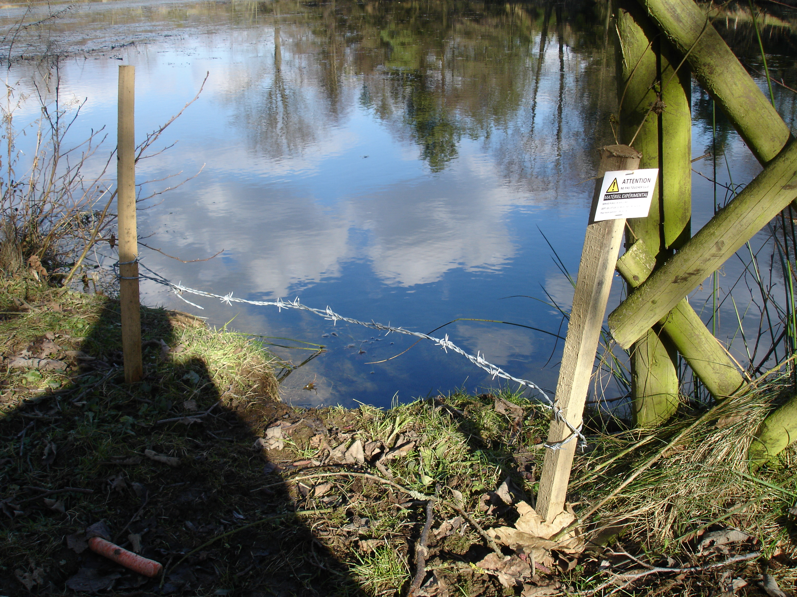
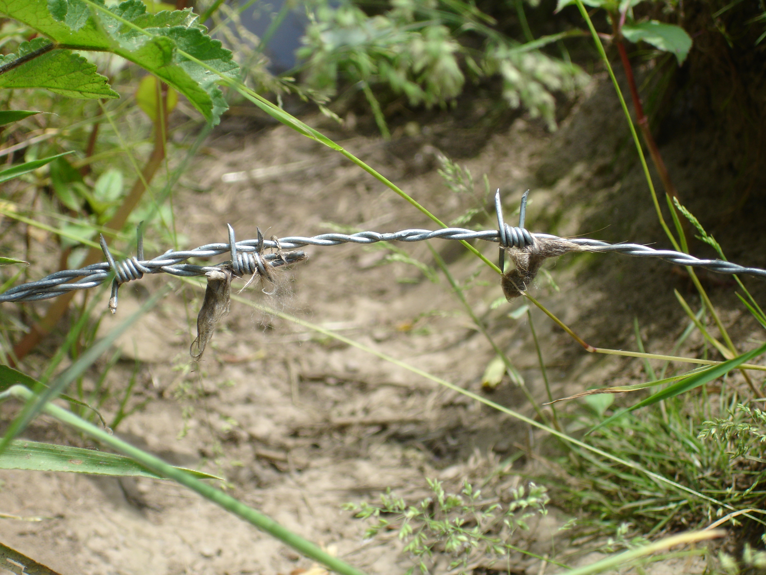
Hair traps
Barbed wire
Beaver hairs
25cm
M. Eugène
Bait
M. Eugène
Notes:
.
33

Slide 34
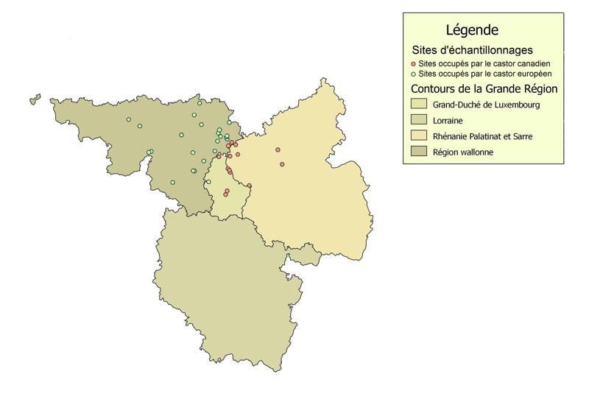

Slide 35
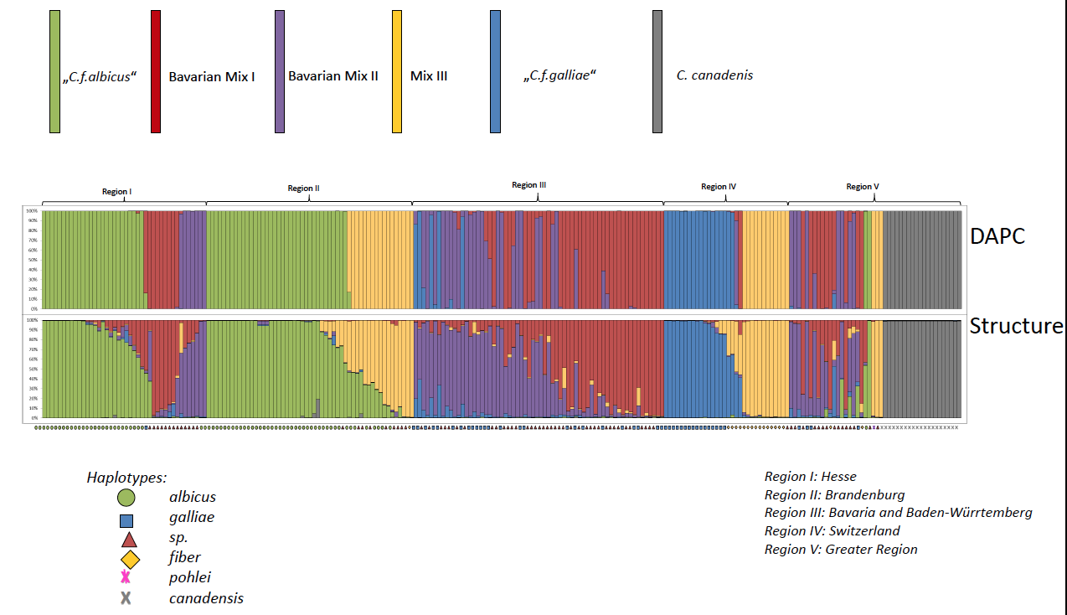
Discovery of a mix of different European beaver subspecies
throughout Western Europe!!
Belgium-
Luxembourg
Germany
Germany
Germany
Switzerland
(Frosh et al. 2015, Plos One

Slide 36
Study of hybridization processes

Slide 37
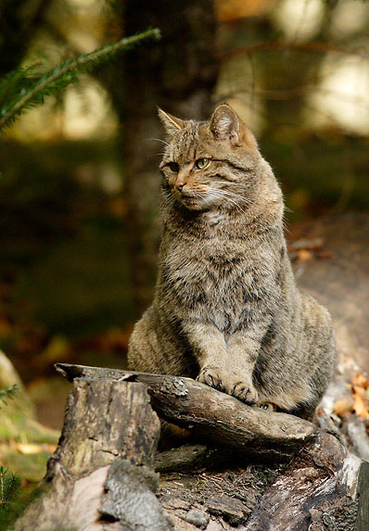
Study of the hybridization process between the European wildcat (Felis sylvestris sylvestris) and the domestic cat (Felis sylvestris catus) In Luxembourg.

Slide 38
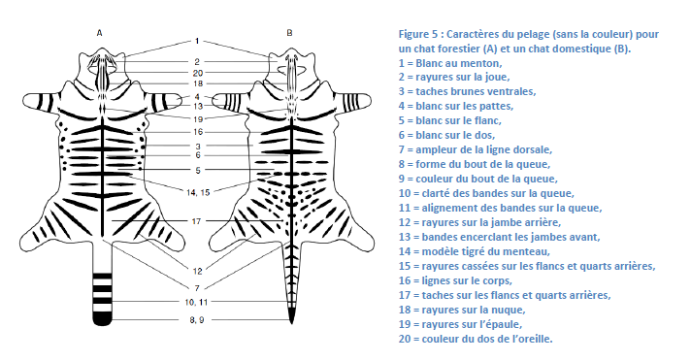

Slide 39
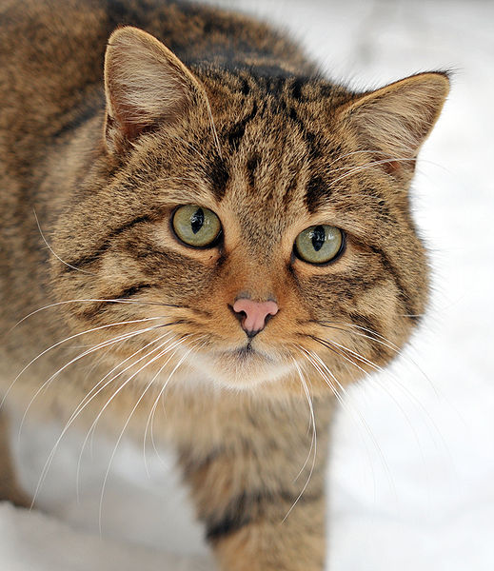
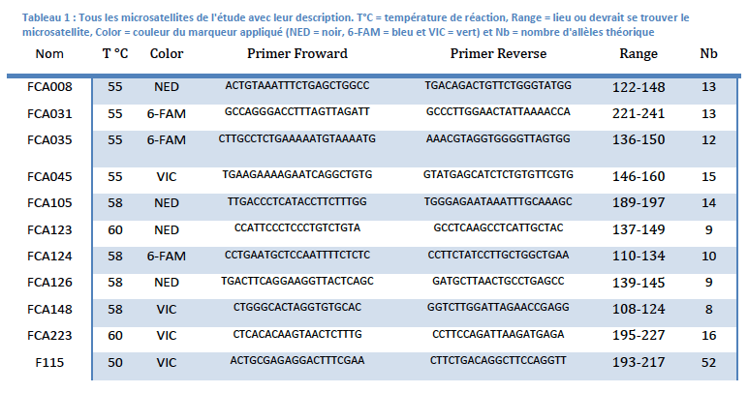
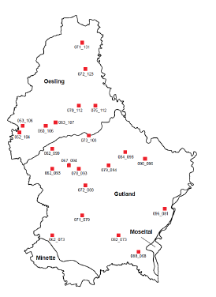
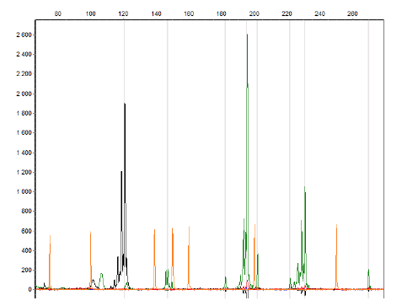
Microsatellite markers

Slide 40
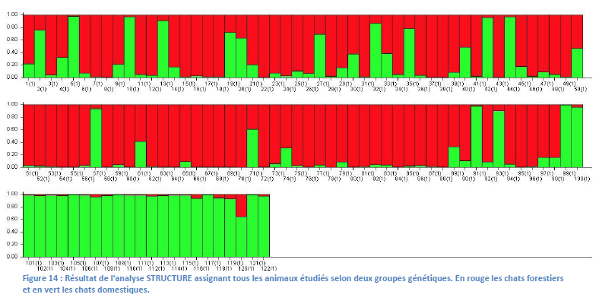
Results of the clustering analyses (structure software)
Evidence of more than 20% of hybrids in the studied populations!

Slide 41
Hybrid detection (using the NewHybrid software)
Allows the detection of hybrid F1, F2, backcross I and II per population
Evidence of F1, backrosses and past hybridization processes.

Slide 42
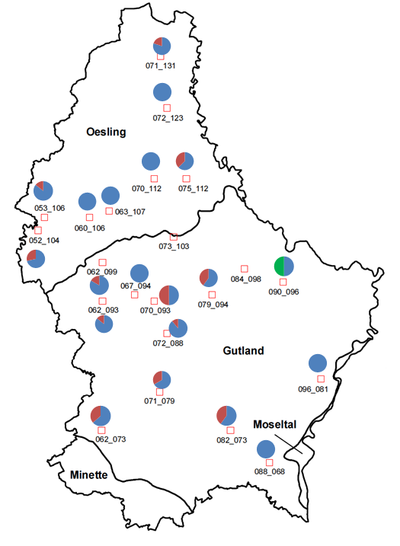
Hybrids (in red), more frequent in the South of the country.
These regions correspond to the most abundant human populations with a high level of forest fragmentation.

Slide 43
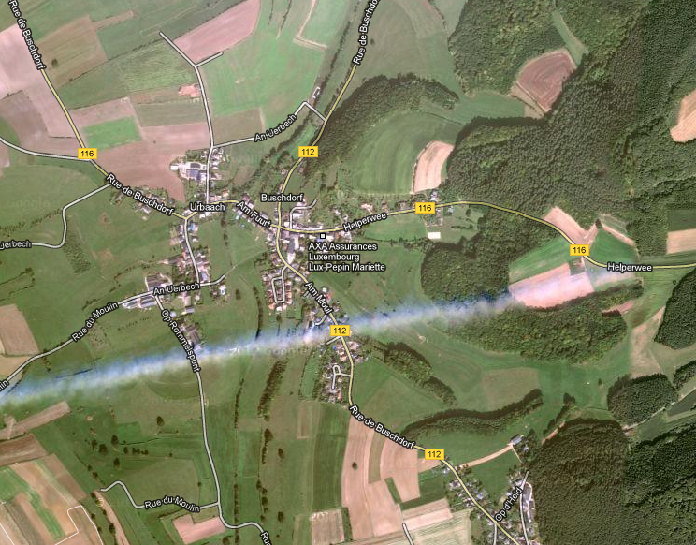
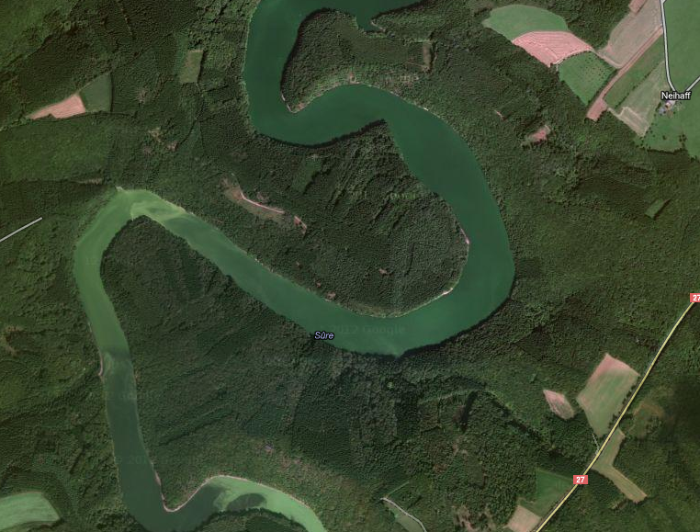
These results suggest a strong link between the level of urbanization and the level of hybridization between the domestic and wild cats.

Slide 44
Conclusion
Genetic tools help to answer to many different questions in the field of conservation biology:
Identification of the presence of a threatened species.
Study the biology and the genetic diversity of threatened species.
Study the impact of human infrastructures and habitat fragmentation on the long term survival of a species.
Study hybridization processes;
Study of colonisation processes of invasive species;
Study the diets of species.

Slide 45
Aknowledgements
All my collaborators working with me on threatened species (M. Nemoz, F. Blanc, P. Fournier, C. Fournier, D. Marc, P. de Groot, C. Essonn, L. Schley, J. Herr, X. Mestdagh, B. Manet, P. Helsen, M. Biffi, A. Charbonnel, C. Nowak, C. Frosch… )
My Belgian team (F. Gillet, Adrien André, Sophie Vanoutryve, Lise Marie Pigneur, Nathalie Smitz, Marie Pagès, Alice Latinne..),
University of Liège (Genomic platform);
Belgian Funds for Scientific Research.

Slide 46
Impact of Human activities on the population structure of threatened species

Slide 47
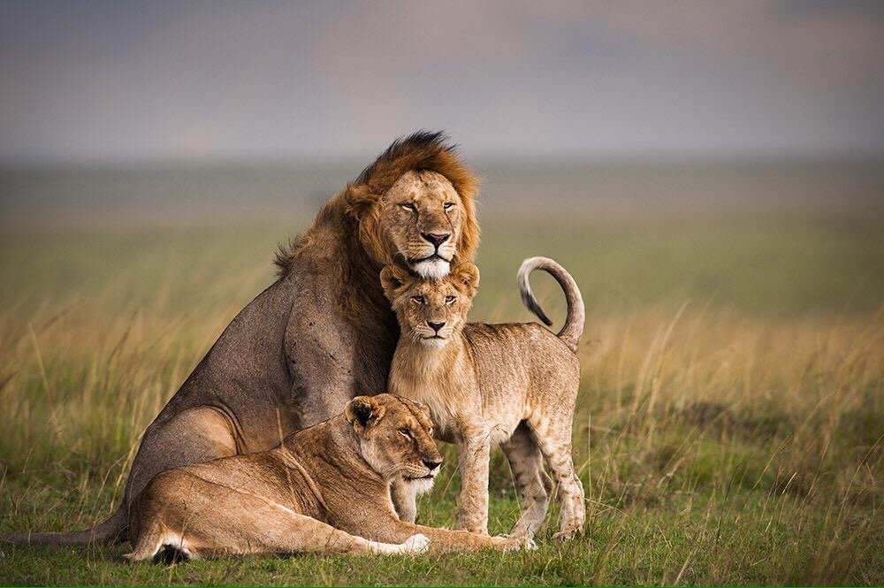
The case of the African lion in Tanzania

Slide 48
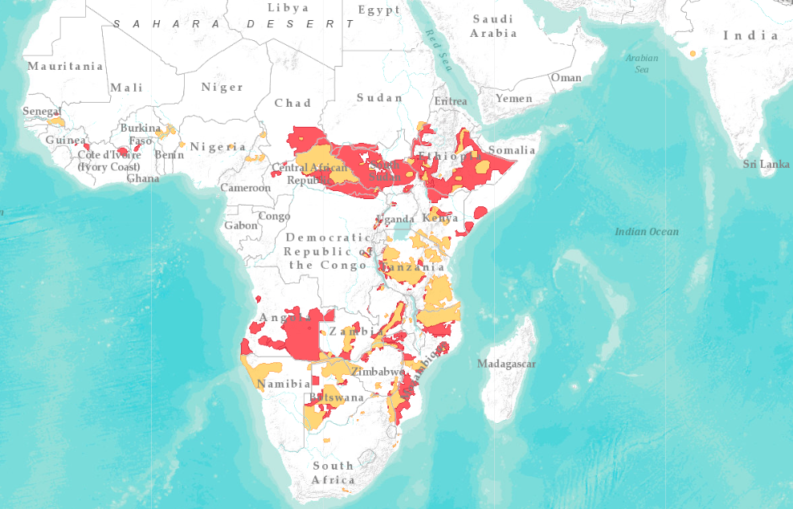
Reduction of its distribution throughout African

Slide 49
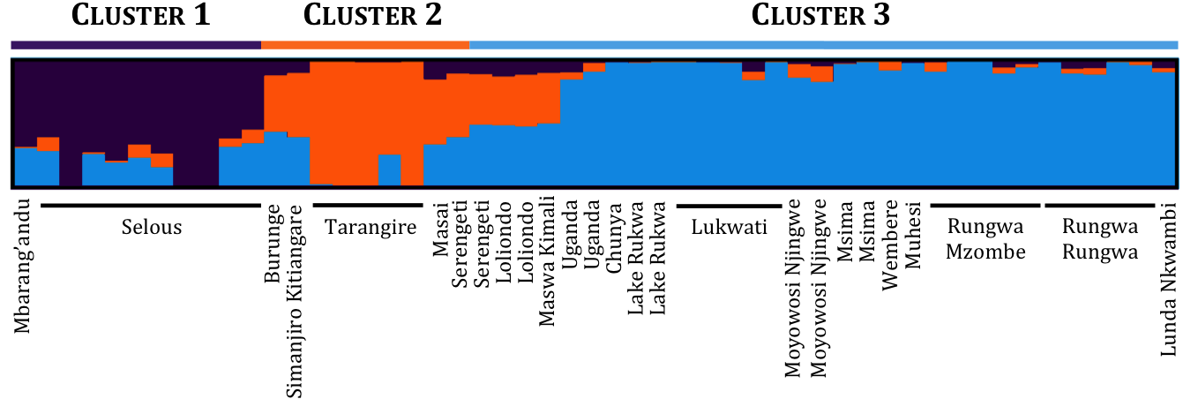
Clustering analyses based on hypervariable genetic markers (SNP's)

Slide 50
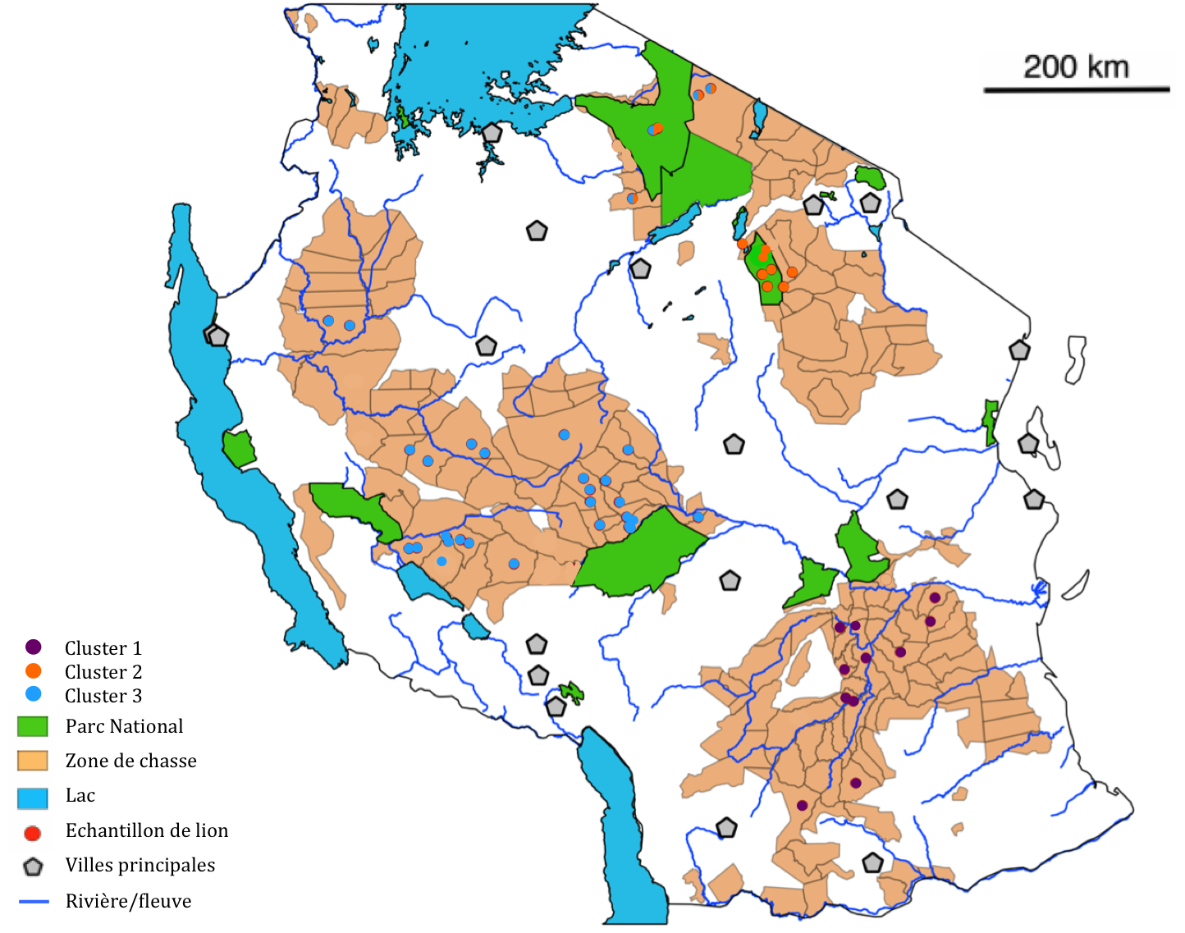

Slide 51
Impact of agriculture and human urbanization on the genetic structure of the lions
Densités par km²
< 2
03 – 10
11 – 20
21 – 50
51 – 100
101 – 200
201 – 500
501 – 1000
> 1000
≈ 500 hectares de culture de maïs
Distribution of corn fields
Distribution of Human densities

