Slide 1
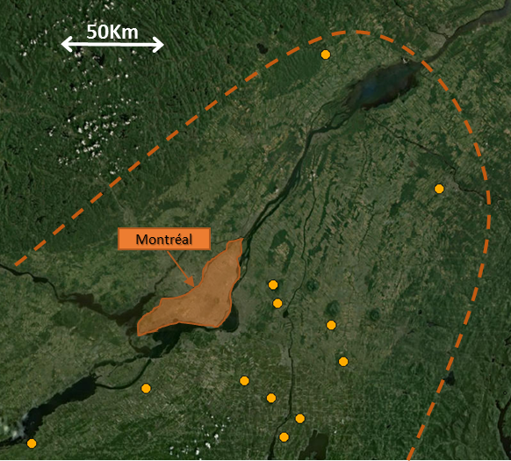
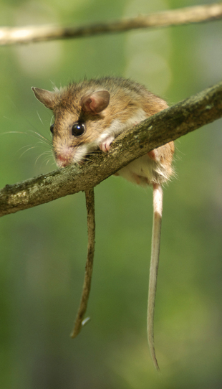
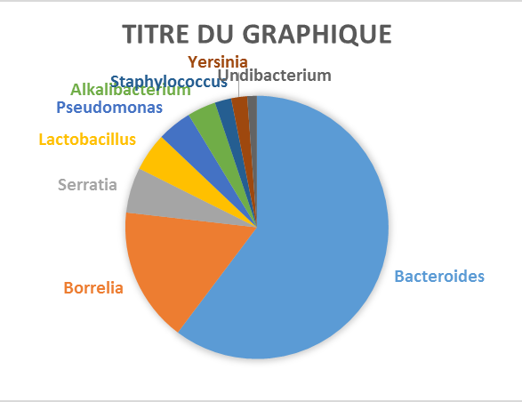
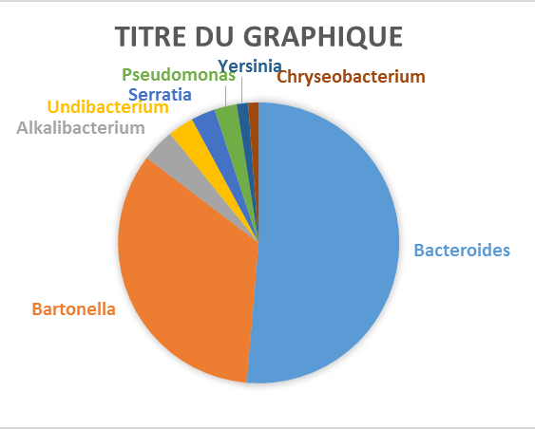
Study of the microbiome from the lyme disease principal reservoir in southern Quebec (Peromyscus leucopus)
A. André^{1,2} ; A. Mouton¹ ; V. Millien² ; J. Michaux¹
1: Université de Liège, institut botanique ; Belgique 2: Redpath Museum, McGill University; Montréal ; Canada
Peromyscus leucopus is the principal reservoir for Lyme disease (Borreliosis) in North America.
The species is expanding its northern range toward southern Quebec causing the emergence of the illness in the region.
Monitoring its health has become a prime necessity in order to determine its ability to colonize new territories
Studying its microbiome in particular can help estimating the pathogen pressure acting on the different populations. Mettre des points ces plus joli
Objectives
Introduction
Detection of Borreliosis and other infections in mice using NGS methods.
Bring out any geographic structure in the pathogenic bacterial presence
Material and methods
Sampling: 360 mice were captured in southern Quebec between summers 2011 and 2014.
Bacterial screening was performed by sequencing the V5-V6 regions from the bacterial 16S rRNA from mouse livers, lungs and spleens, using a Miseq sequencing system (Illumina).
Fig. 1 : Sampling site map
Fig. 2 : Peromyscus leucopus
Preliminary results
The microbiome of 213 mice have succefully been determined.
The Liver screening could not confirm the presence of borrelia in the 6 mice known to be positive. However lung screening could detect the borrelia in 2 out of 3 infected mice, info bizarre ici : tu parles de 6 animaux infectés, puis tu dis que tu en as trouvé 2 sur les 3. où sont les 3 autres?
Pathogen bacteria like Bartonella or Ehrlichia have been detected in several mice
A tout hasard, si vraiment l’info est vrai, tu as aussi détecté la bactérie de la peste : Yersinia!!!! Et ça , ça vaut aussi son pesant d’or….
Il manque une petite discussion sur ces résultats ou bien écrire résults and discussion plus haut
Perspectives
To Test two opposed theories (central-marginal and enemy release hypothesis) concerning the expansion of the species distribution range in southern Quebec.
➔ The present data will be associated with other investigated parameters such as:
The Genetic diversity related to the immune system (MHC genes)
Gastrointestinal helminth presence;
Long term stress level;
Body condition index;
Spleen and testis sizes;
Fig. 3a & 3b : Example og the most represented bacterial genus for two samples
Funding:

