Slide 1
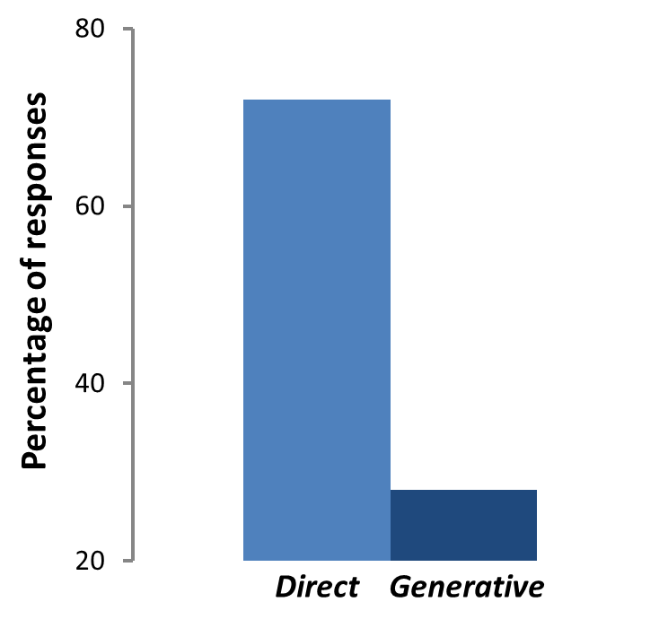
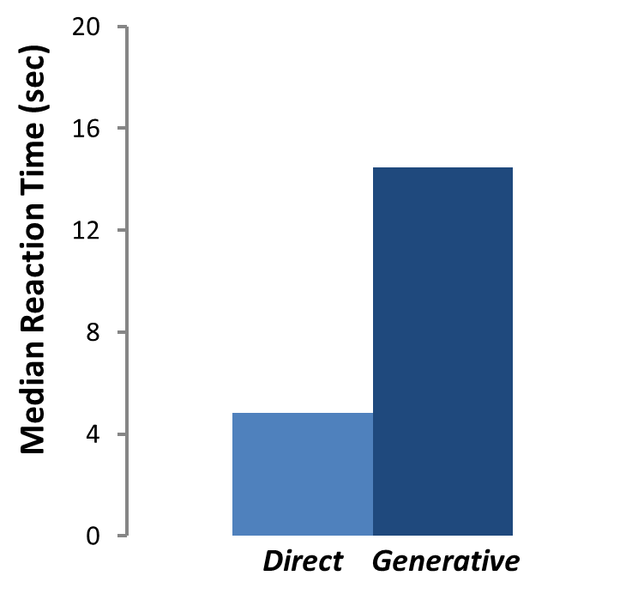
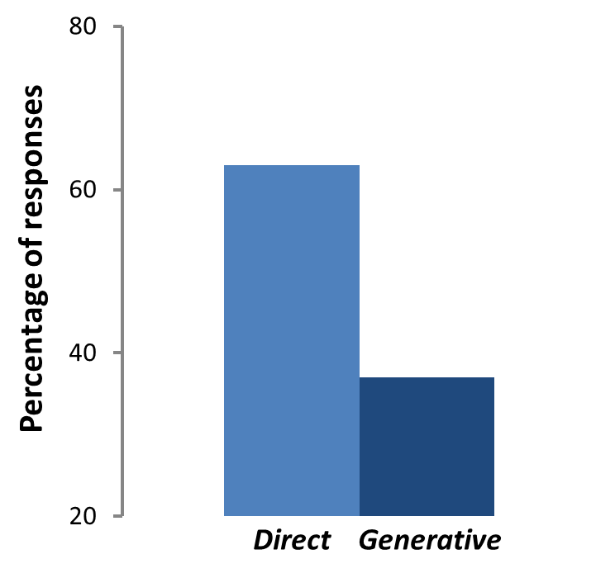
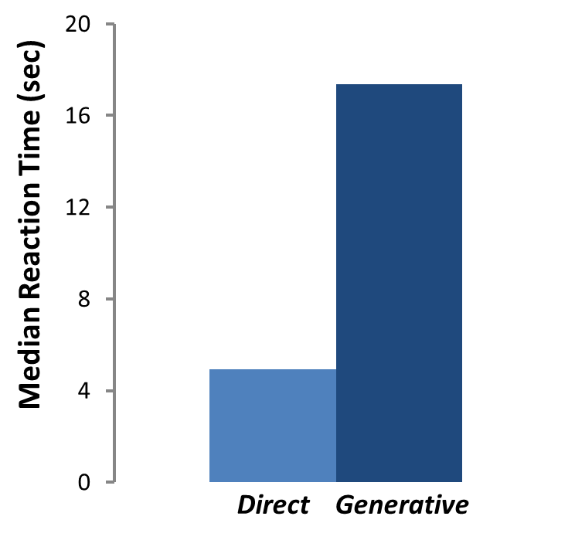
Direct and Generative Construction of Future thoughts:
The Role of Event Characteristics and Executive Processes
Olivier Jeunehommeª & Arnaud D’Argembeau ^{a, b}
ª Department of Psychology – Cognition & Behavior, University of Liège, Belgium
^{b} Fund for Scientific Research FNRS, Belgium
Introduction and aims
Recent research suggests that episodic future thoughts can be formed through the same dual mechanisms, direct and generative, as autobiographical memories (Anderson, Dewhurst, & Nash, 2012; D’Argembeau & Mathy, 2011). However, the prevalence and determinants of the direct production of future event representations remain largely unexplored.
Aims
In two experiment, we address this issue by collecting self-reports of production modes, event characteristics, response times (RTs), for the production of future events in the word cueing paradigm.
Study 1 compares the occurrence and reaction times of both direct and generative modes, explores the possible determinants of the direct mode, and examines the role of recasting on the use of this mode of production.
Study 2 seeks to replicate the finding of Study 1 and assesses the role of executive control (verbal fluency) on both direct and generative modes.
Study 1
Study 2
Participants
Participants
20 students at the University of Liège (10 females).
Mean age = 21 years; SD = 2.8
40 students at the University of Liège (21 females).
Mean age = 23 years; SD = 3.3
Method
Method
The word cueing paradigm
Step 1: Participants imagine 15 specific future events in response to cue words.
Step 2: Judging whether the events came to their mind directly or generatively.
Step3: Evaluation of event characteristics as well as the recasting hypothesis (see below).
The task was identical as in Study 1, except that the word cueing paradigm
was followed by the completion verbal fluency tasks (phonemic and semantic) assessing the controlled access to information in long-term memory.
Results
72
*
14,4
Results
*
63
17.3
28
4.8
27
4.9
The majority of future events come directly to mind
RTs are significantly faster for direct than generative responses
t(36) = -8.24, p <.001, d = 1.37
The majority of future events come directly to mind
RTs are significantly faster for direct than generative responses
t(19) = 8.19, p < .001, d = 1.83
The prevalence and RTs of both direct and generative modes are comparable to Study 1 and our results also replicate the relation of having previously thought about the events
(p < 0.01), the frequency of these thoughts (p < 0.01) and the personal importance of future events on the use of the direct mode (p < 0.01).
Having previously thought about the events predict the use of the direct mode
coefficient= 1.34, SE =0.29, Z = 4.62, p<.001
The odds of direct responses increased with the frequency of previous thoughts about the events…
coefficient = 0.41, SE = 0.15, Z =2.73, p = .006
…and with the personal importance of the events
coefficient = 0.27, SE = 0.08, Z = 3.23, p = .001
No effect of recasting
Correlation between generative mode RTs and semantic fluency
r = - 0.36, p = 0.03
Our results show that the greater the ability to access semantic information in memory, the faster a future event is produced in the generative mode.
Discussion
Collectively, these findings provide novel evidence that the direct production of episodic future thoughts is frequent in the word cueing paradigm.
The fact that most future events that were directly produced had already been thought of on a previous occasion, and that the frequency of previous thoughts as well as the personal importance of the events predicted the occurrence of direct access, suggests that the direct production of episodic future thoughts often involves the activation of personally significant memories of the future (Ingvar, 1985).
The generative production of episodic future thoughts seem to rely, at least in part, on the ability to access semantic information in memory.
Contact:
O,Jeunehomme@ulg.ac,be
References:
Anderson, R. J., Dewhurst, S.A., & Nash R.A. (2012). Shared Cognitive Processes Underlying Past and Future Thinking: The Impact of Imagery and Concurrent Task Demands on Event Specificity. Journal of Experimental Psychology: Learning, Memory, and Cognition, 38(2), 356–365.
D’Argembeau, A.,& Mathy, A. (2011). Tracking the construction of episodic future thoughts. Journal of Experimental Psychology: General, 140, 258-271.
Ingvar, D. H. (1985). "Memory of the future": An essay on the temporal organization of conscious awareness. Human Neurobiology, 4, 127-136.

