Slide 1




Imagining engagement:
A hands-on experiment
Radiation Protection Week – Rovinj
1-5 October 2018
Michiel Van Oudheusden, Bieke Abelshausen, Catrinel Turcanu (SCK•CEN)
Christiane Pölzl-Viol (BfS)
This project has received funding from the Euratom research and training programme 2014-2018 under grant agreement No 662287.

Slide 2

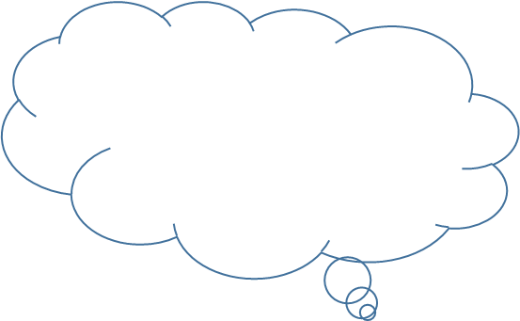


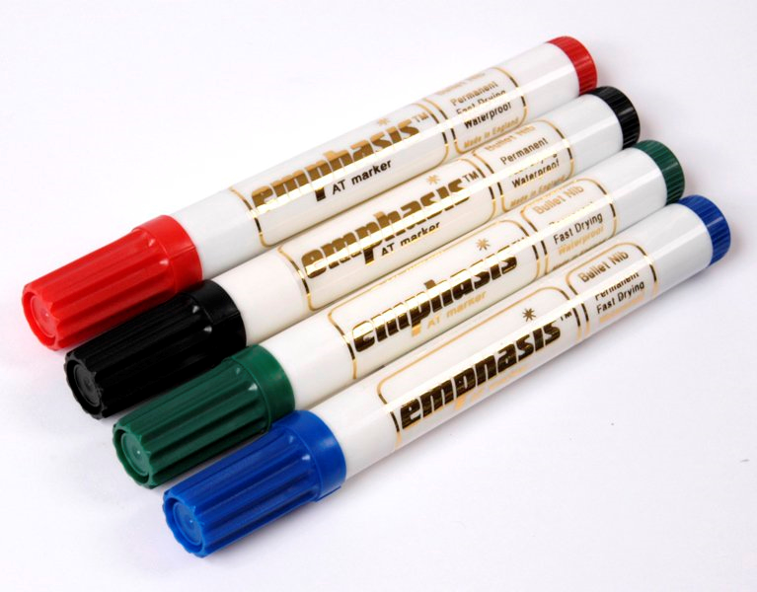

Past
Present
Future
expectations
experiment
experiences

Slide 3
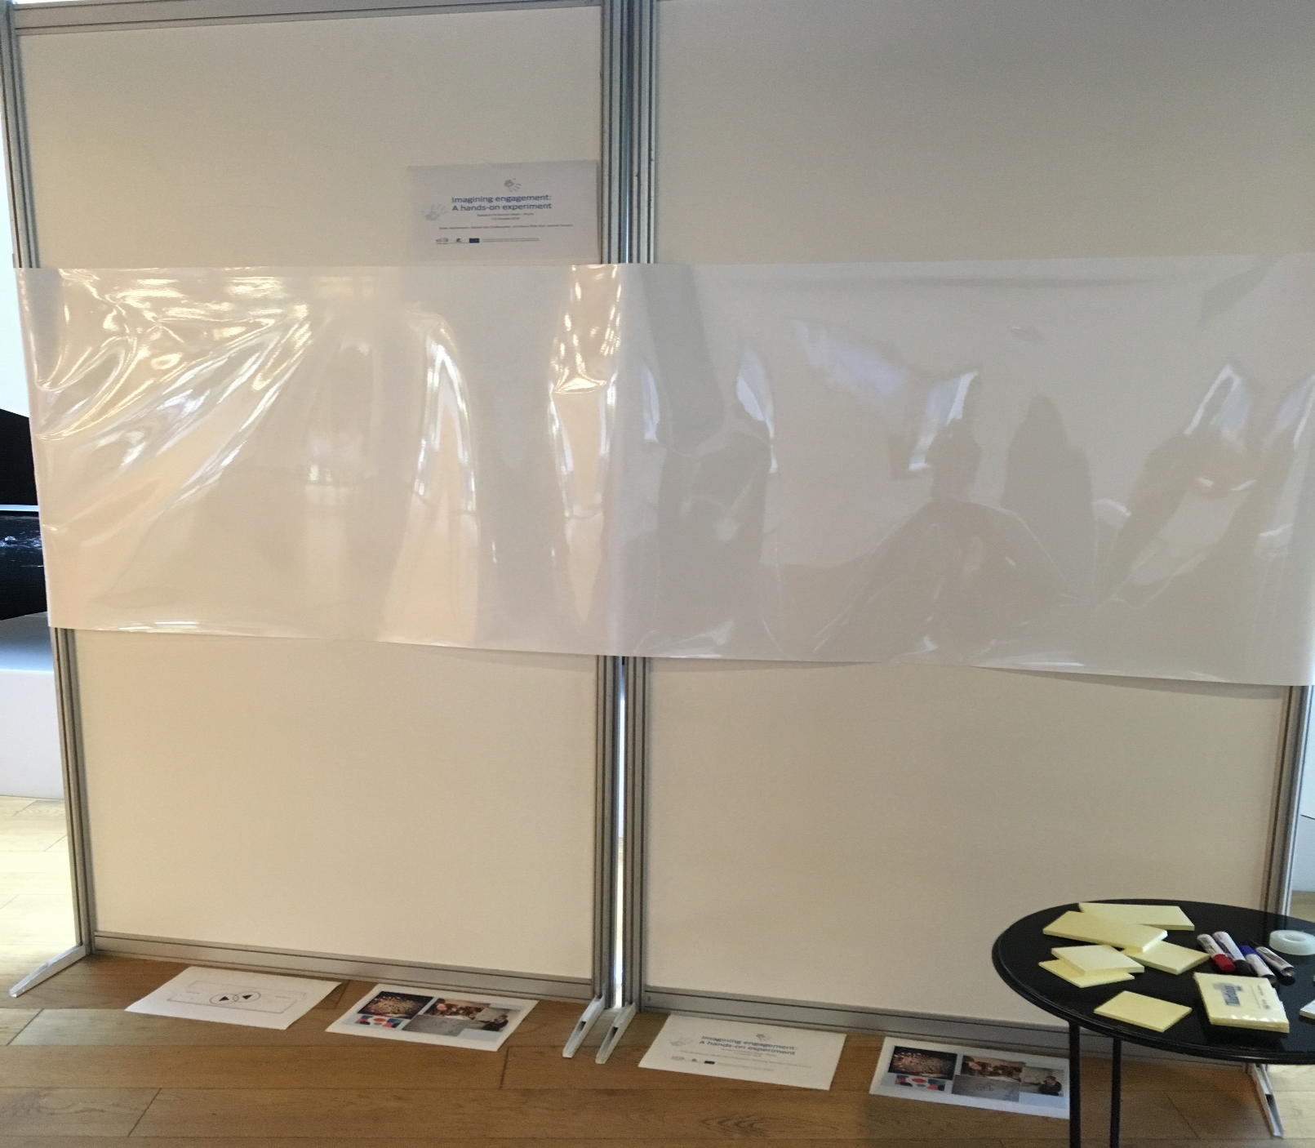

Slide 4
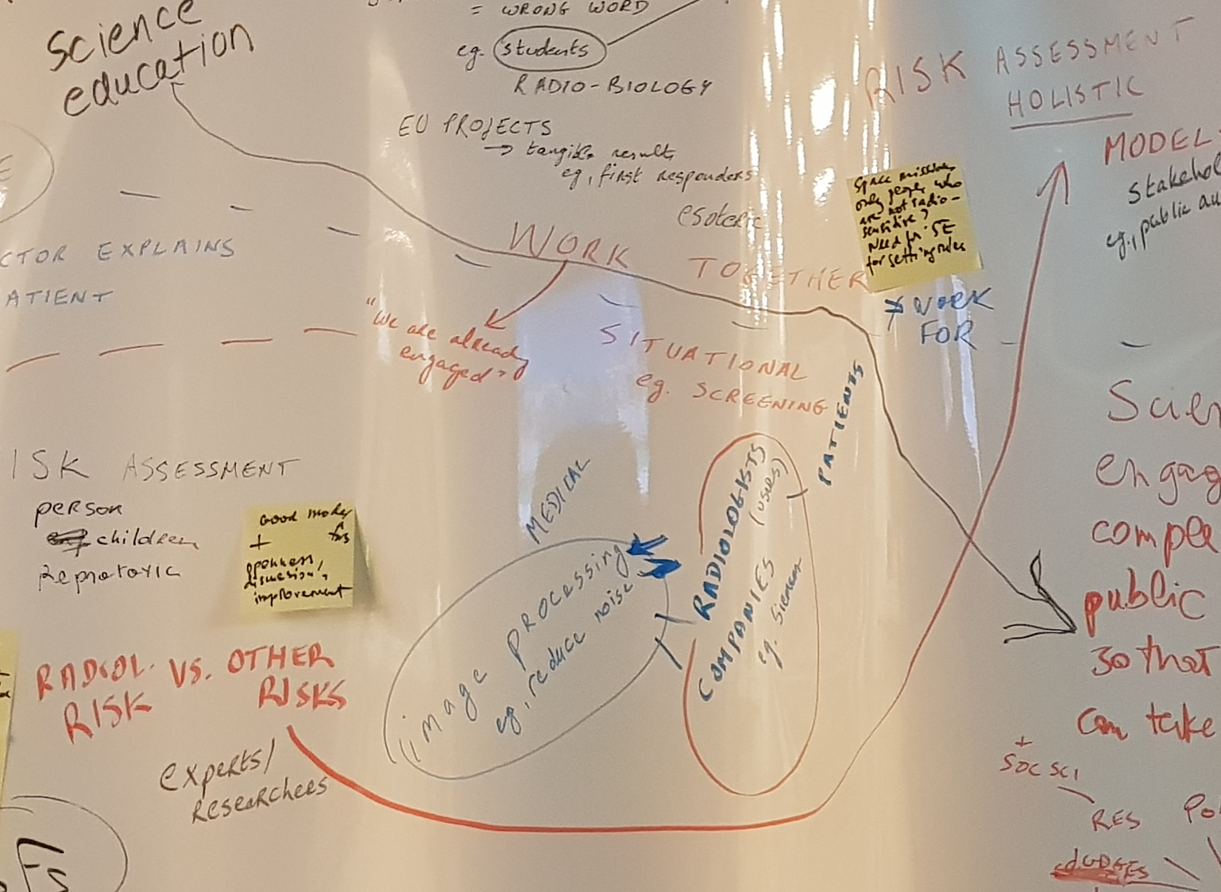
Most participants start from experiences (left) and then move to expectations (right).
Most situate problems/issues on the left and seek to develop solutions to these problems on the right. For instance:
  Risk assessment is changing (and needs to change): used to center on radiological risks; present move to “holistic” approaches that include more stakeholders, such as public authorities.

Slide 5
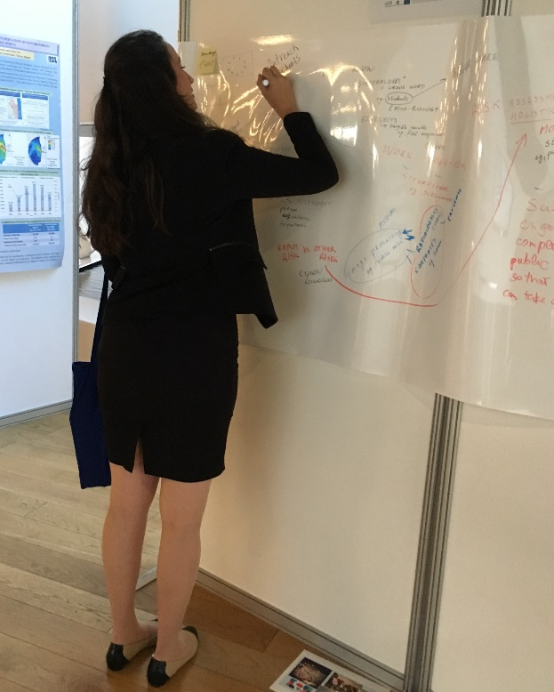
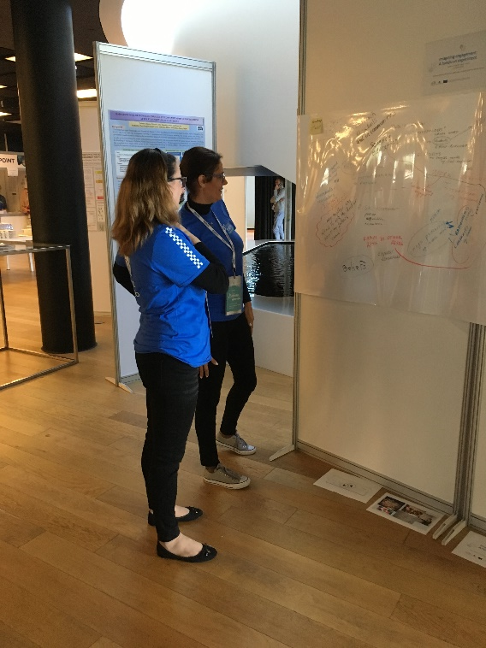
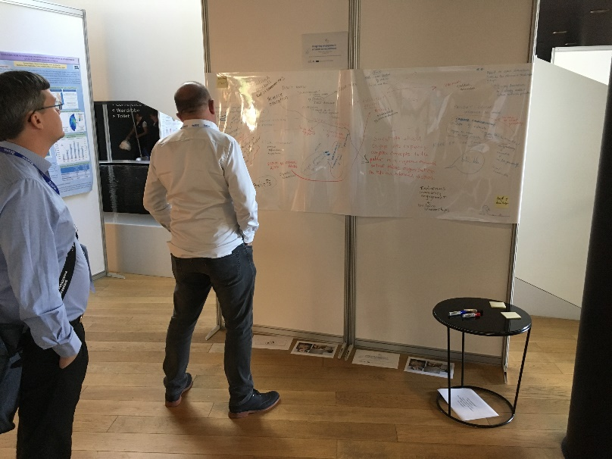
From direct participation to peripheral participation

Slide 6
From depiction to elaboration
As the tableau develops, more and more participants respond to statements/ideas that are already there. Consider the following example:
P1: Medicine: shift from one-way (left) to two-way communication (right), from expert-centered to patient-centered communication. How? Have doctor and patient “work together” to achieve this shift.
  Response P2: “Patients are already engaged. They talk back.”
  Response P3: ((That depends.)) “My mother was afraid to ask the doctor about my father’s cancer.”

Slide 7
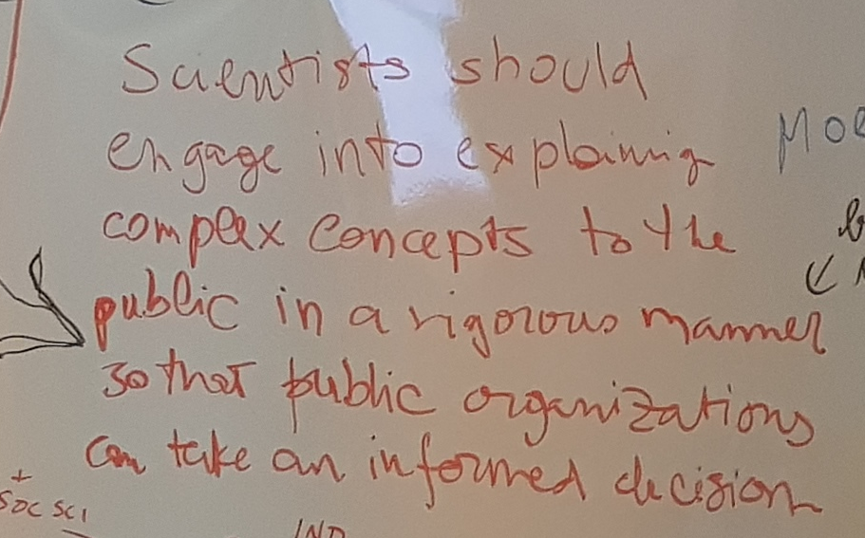
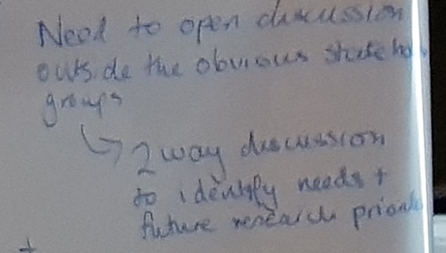
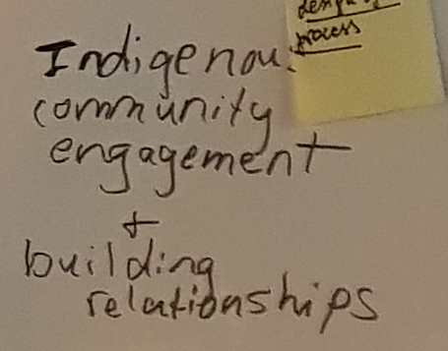
From elaboration to theoritization: e.g. recurring repertoires
1. public ignorance / knowledge deficit
“Scientists should engage into explaining complex concepts to the public in a rigorous manner so that public organizations can take an informed decision.”
2. two-way communication / lay expertise / experiential knowledge:
“Need to open discussion outside the obvious stakeholder groups → 2 way discussion to identify needs + future research priorities.” Also: “Need to expand group that is involved, beyond governments and regulators.”
“Indigenous community engagement + building relationships.” ((Indigenous communities have experiential knowledge and experiences which scientists lack.))

Slide 8
Strong emphasis on teaching, educating, informing the public about science and technology.
→ One participant (speaking from his experiences with RWM and NORM) argues that “educating” is not the appropriate word: “No one likes to hear this.” It’s better to inform all the stakeholders, involve them throughout the process, from the very start, and work with activists, such as NGOs. Publics tend to trust NGOs more than waste organizations, regulators, etc. This way, we make clear that we have nothing to hide.

Slide 9
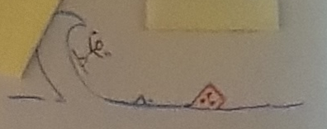
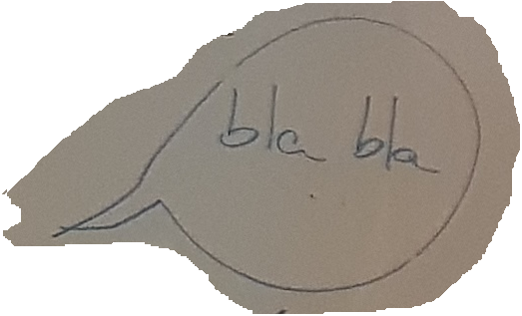
Feedback on the experiment itself
Some very enthusiastic responses to this experiment:
Some prefer not to participate in the experiment:
“I’m just a scientist. I don’t do stakeholder engagement.”
“I need to think about it.”
“I enjoy watching how the poster develops.”
“I love your project.”
“Where can I find more information? How can I follow this up?”
“C’est vraiment chouette.”
Also skepticism about stakeholder engagement
“bla bla,” “More of the same”
“Stakeholder engagement is just a buzz word. What’s the point?”
Notes:
Feedback on the experiment itself = part of the experiment / engagement. Gives us a sense of how stakeholders make sense of engagement, theorizing the reasons for the ways in which they have represented features on the map through drawing and TALKING.

Slide 10
From depiction to elaboration to theoritization
This exercise is a first step towards gaining a better sense of the expectations, views, and experiences of the radiation protection community – particularly RP researchers – with respect to ‘engagement.’
Whereas researchers are usually taken to be stakeholders (by default), their attitudes and views towards engagement may or may not resonate with those of other stakeholders, and with what others expect from them; particularly as the institutional context of engagement shifts from deficit (one-way communication) to dialogue (two-way or x-way engagement).

Slide 11
This experiment suggests that among participants there is:
a shared recognition of the importance of stakeholder engagement (in radiation protection)
a joint acknowledgment that no stakeholder can be willfully excluded
a shared unease or uncertainty about how to organize engagement
  When to initiate it
  Whom to involve at which stage
  What to expect from it
  …
which aligns with an institutional shift from deficit to dialogue.
We welcome your feedback on these propositions.
Thanks to all for participating!

Slide 12
