Slide 1




The importance of spatio-temporal photobiont patterns of association for comprehensive phylogenetic revisions and macroevolutionary studies of lichens: a worldwide case study of the genus Peltigera.
N. Magain, F. Lutzoni, E. Sérusiaux, C. Truong,
C. Pardo, D. Niu, T. Goward, M. Zhurbenko,
B. Goffinet, O. Vitikainen, J. Miadlikowska
Helsinki 2016

Slide 2
The Peltigera project
Generate a world-wide global multilocus phylogeny for the genus Peltigera.
2. Conduct detailed systematic revisionary studies on three species complexes of the genus Peltigera:
The Peltigera aphthosa-leucophlebia (i.e., sections Chloropeltigera and Peltidea).
The Peltigera canina (i.e., section Peltigera).
The Peltigera neopolydactyla-dolichorhiza complexes.

Slide 3
Outline of the talk
A. Explore the sections of the genus
Species diversity
Biogeographic patterns
Specificity with symbiotic partners
B. Phylogeny of the whole genus
1. Temporal context
2. Diversification

Slide 4
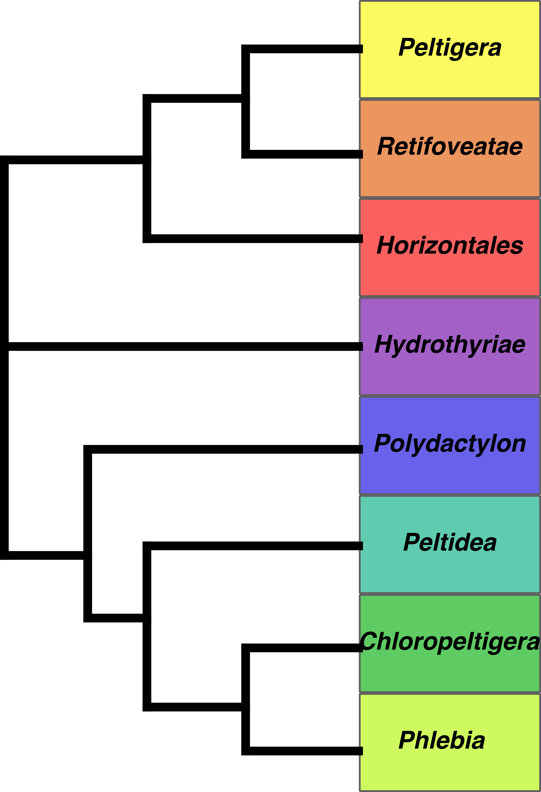
Miadlikowska & Lutzoni 2000:
8 sections
Notes:
+ reference to 2014

Slide 5

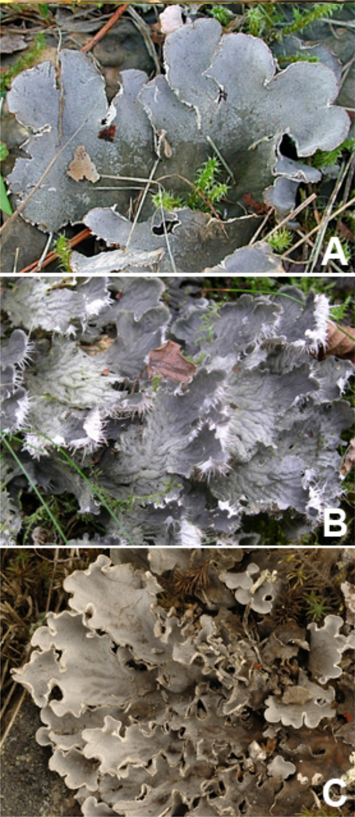
- ~30 species described
- bipartite with Nostoc
often tomentose
no TLC compounds
sorediate/phyllidiate/
isidiate frequent
Notes:
canina, membranacea, rufescens

Slide 6

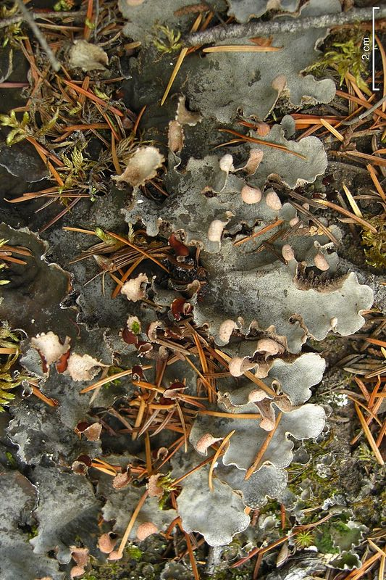
- 1 species: Peltigera retifoveata
- bipartite
- TLC compounds

Slide 7

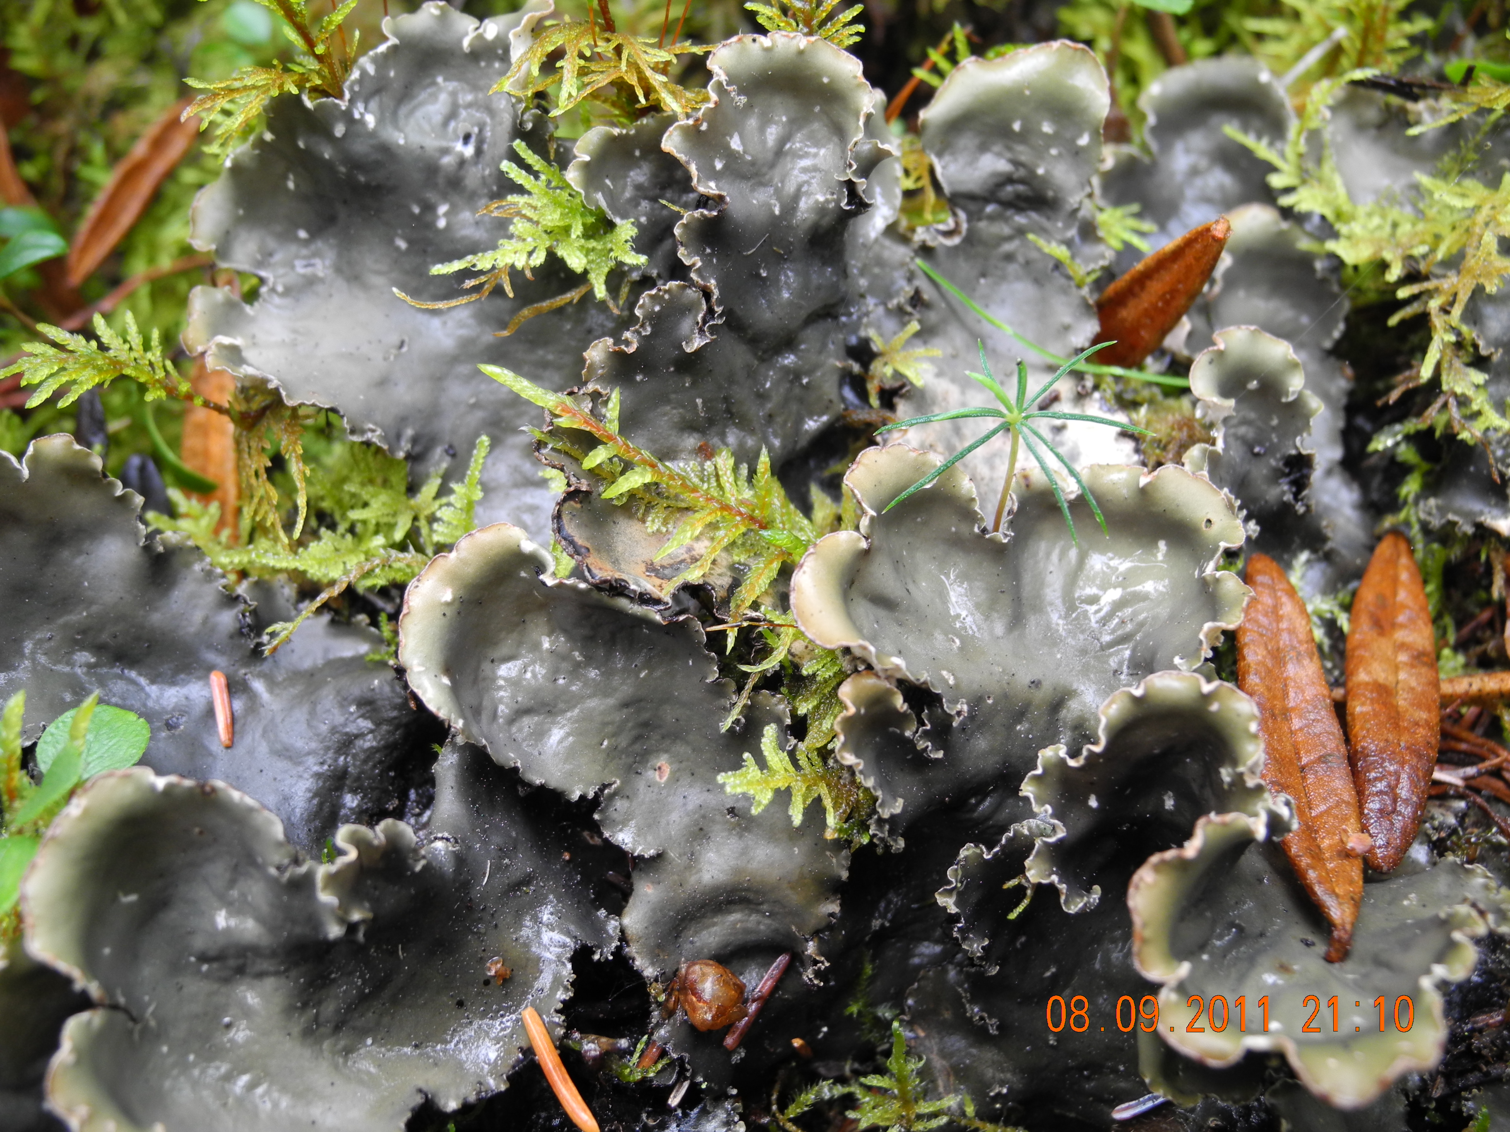
- ~10 species described
- bipartite with Nostoc
- can be sorediate or phyllidiate

Slide 8

- (2) 3 species
- bipartite with Nostoc
aquatic species
position unresolved

Slide 9

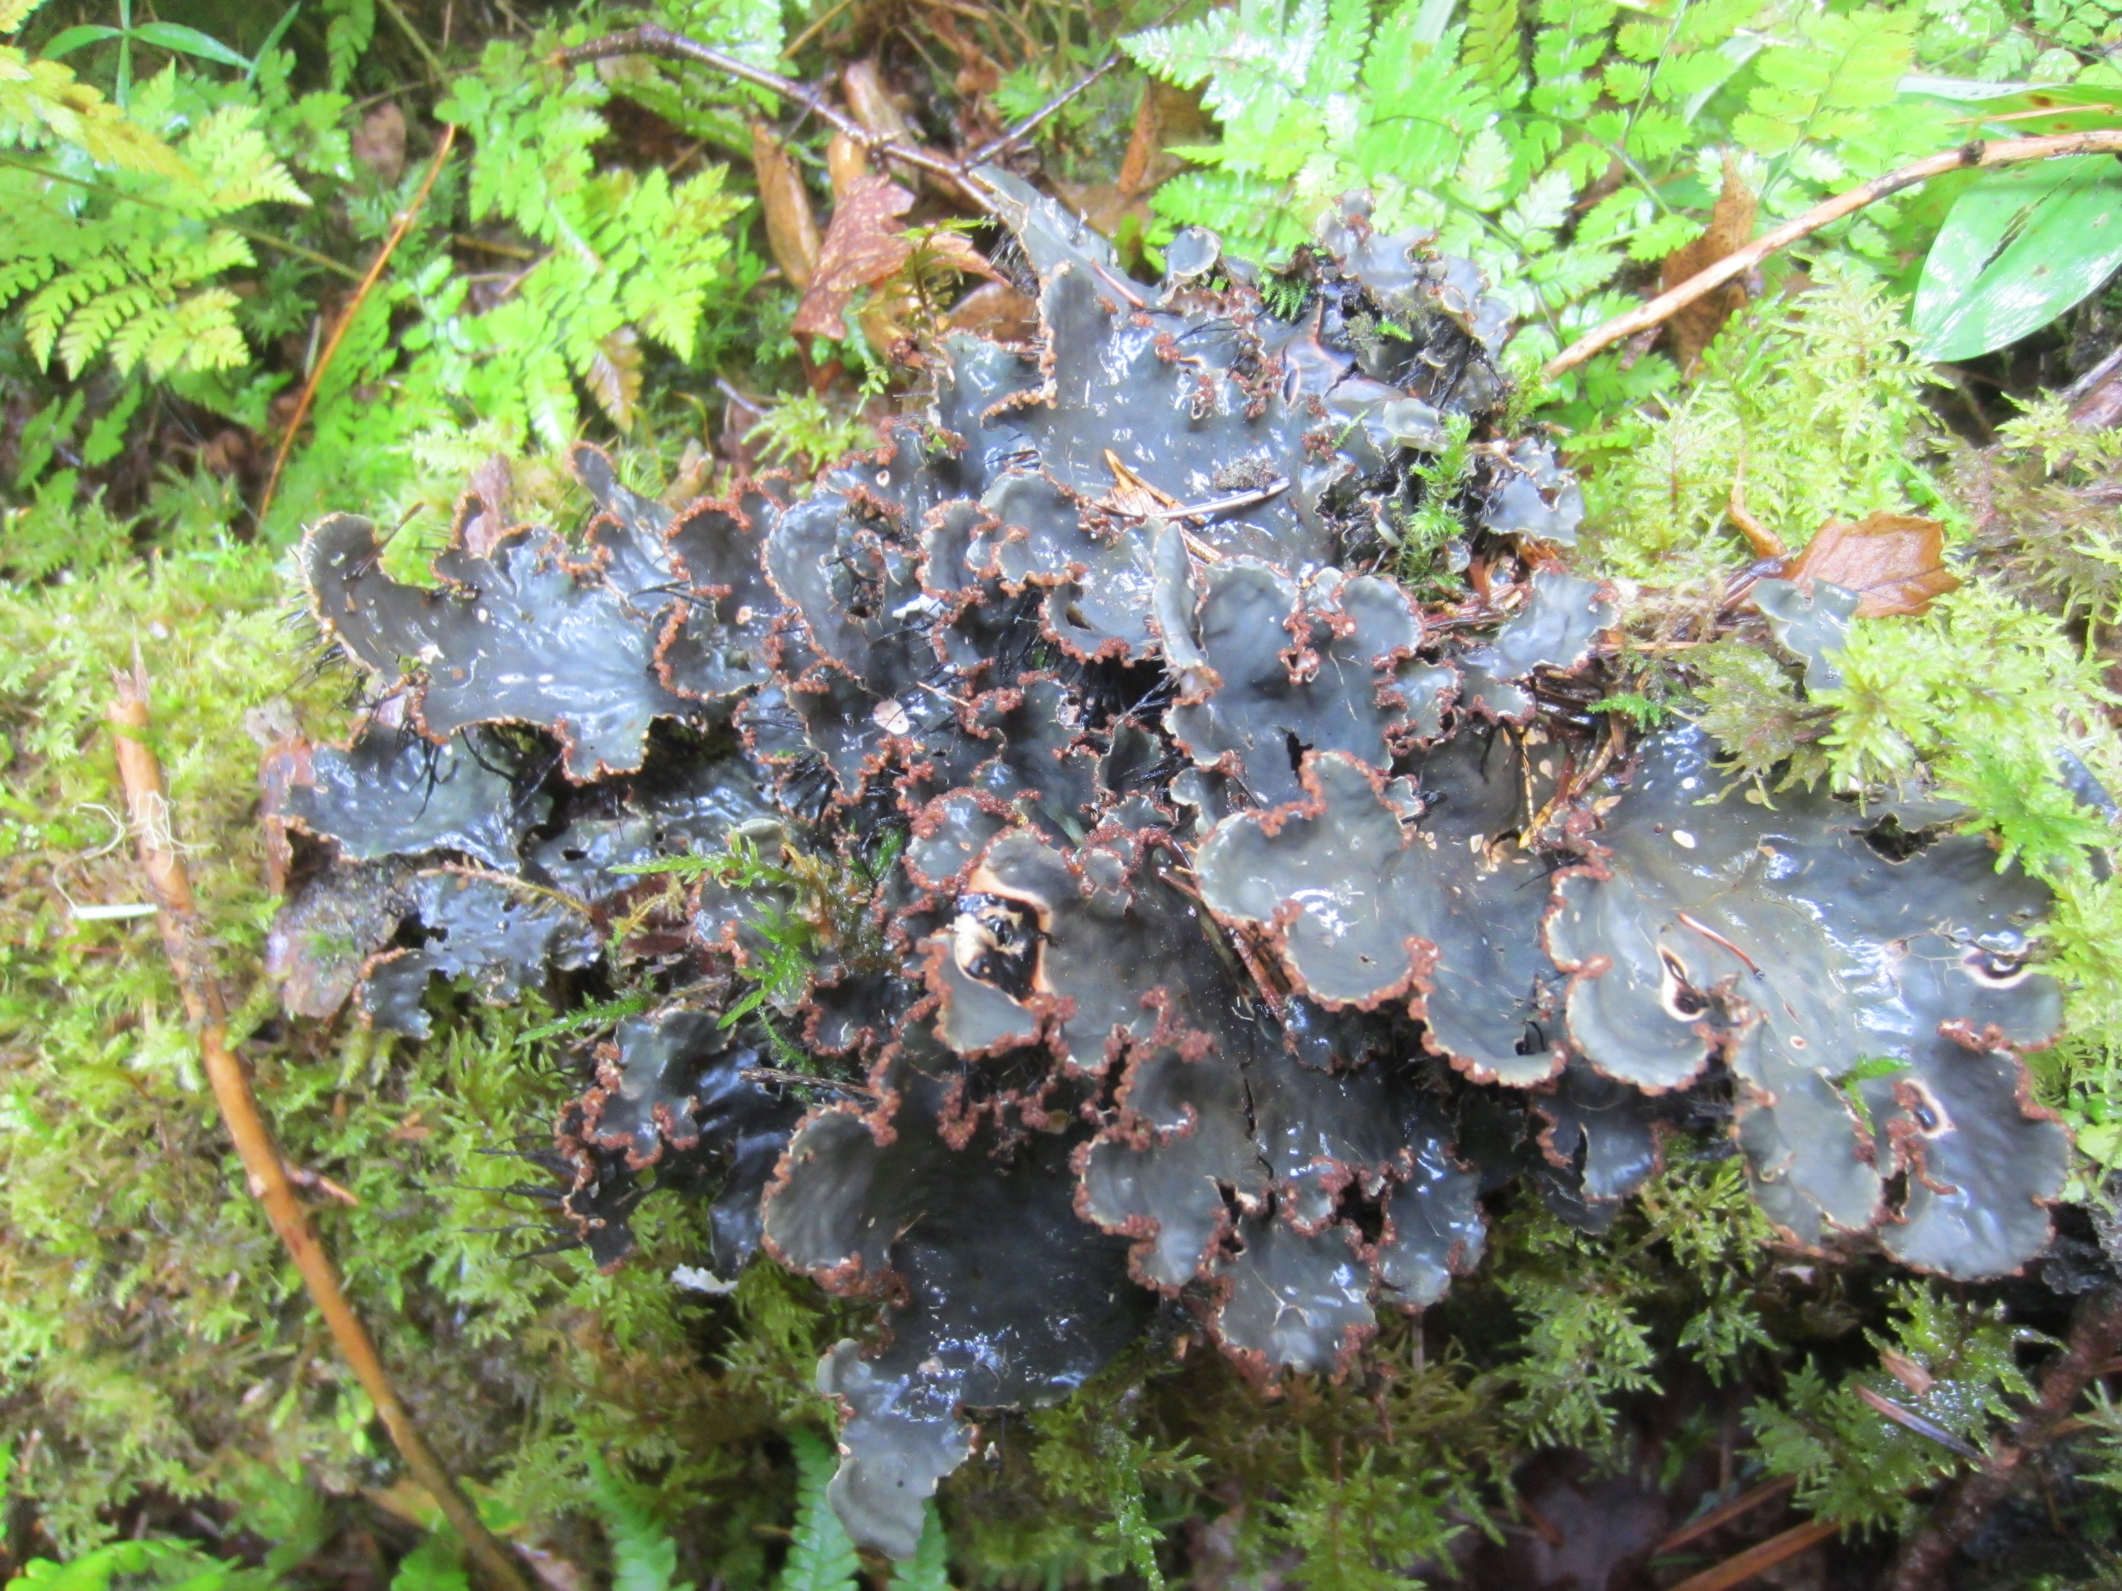
- ~15 species described
- bipartite with Nostoc
glabrous or scabrid (no tomentum)
vegetative structure very rare

Slide 10

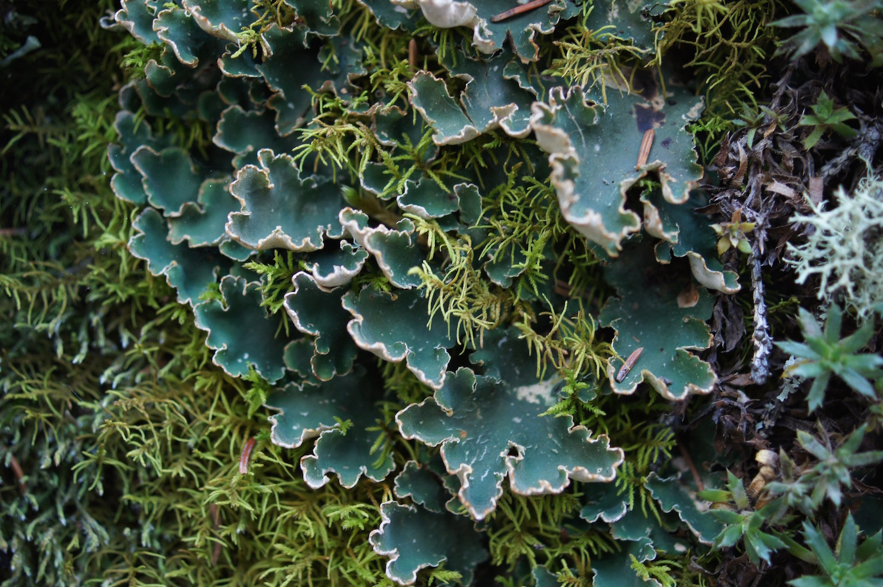
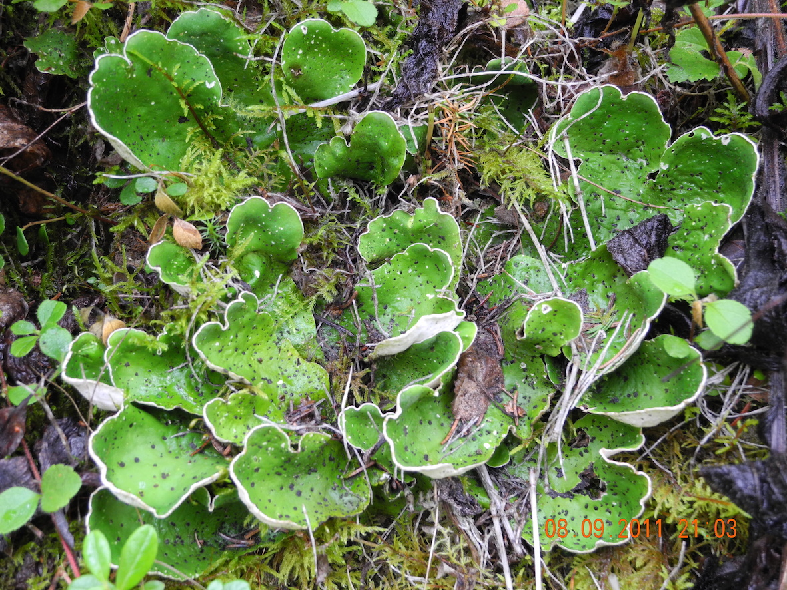
5 species described
Both bipartite and tripartite!

Slide 11

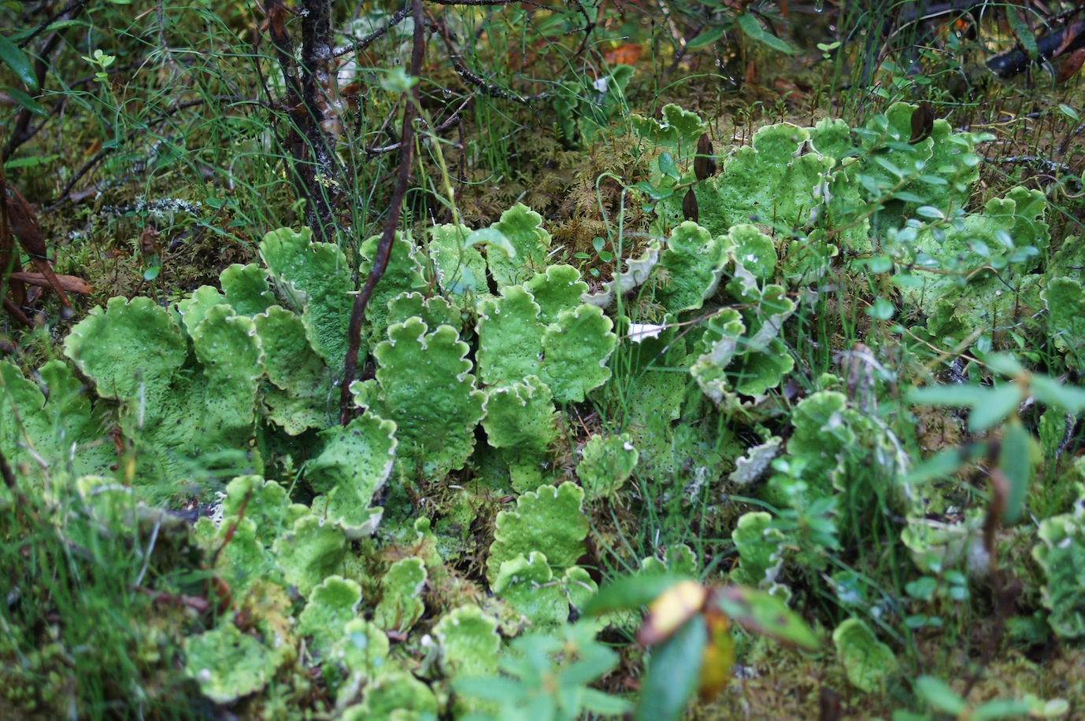
- 3 species
tripartite

Slide 12

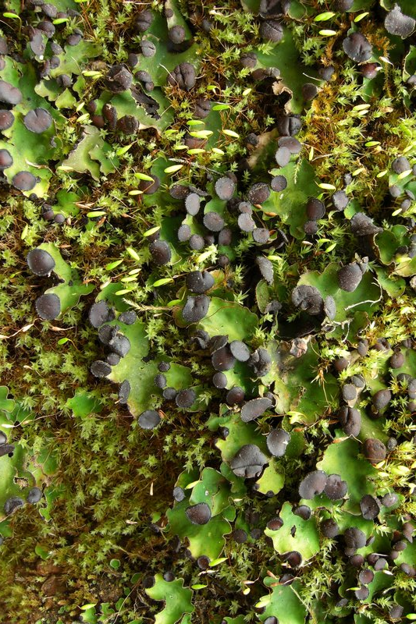
- 1 species: Peltigera venosa
tripartite
Picture:
J. Hollinger,
Ways of
enlichenment

Slide 13

No. sp.
73

Slide 14
Taxonomic revision of Peltigera
Thousands of specimens examined
ITS amplified for over 2000 specimens (~900 unique haplotypes)
Sequenced 8 loci of the mycobiont
- Multilocus data for ~ 500 specimens
(2 ribosomal: ITS and LSU, 3 protein-coding genes: RPB1, ß-tubulin, EFT2.1 (AFTOL2), 3 new markers: COR1b, COR3, COR16)

Slide 15
Taxonomic revision of Peltigera
Sequenced 8 loci of the mycobiont
(2 ribosomal: ITS and LSU, 3 protein-coding genes: RPB1, ß-tubulin, EFT2.1 (AFTOL2), 3 new markers: COR1b, COR3, COR16)
POSTER: Conserved genomic collinearity within and among Pezizomycotina classes to develop broadly applicable and fast evolving markers to resolve species complexes: a case study using the lichen-forming genus Peltigera. (number 126, 2nd floor)

Slide 16
Taxonomic revision of Peltigera
Sequenced 8 loci of the mycobiont
Reconstructed the phylogeny of the genus and sections (RaxML, MrBayes, BEAST)
Used species discovery (Structurama, bGMYC, bPTP) and species validation methods (spedeSTEM, bPP)

Slide 17
Taxonomic revision of Peltigera
Sequenced 8 loci of the mycobiont
Reconstructed the phylogeny of the genus and sections
Used species discovery and validation methods
Look at morphology, geographical and photobiont data
Propose a consensus on the species delimitations in the genus

Slide 18
Taxonomic revision of Peltigera
Sequenced 8 loci of the mycobiont
Reconstructed the phylogeny of the genus and sections
Used species discovery and validation methods
Look at morphology, geographical and photobiont data
Propose a consensus on the species delimitations in the genus
Describe the new species

Slide 19

Phylogeny of the section
Notes:
reference to the upcoming paper
4 min now

Slide 20
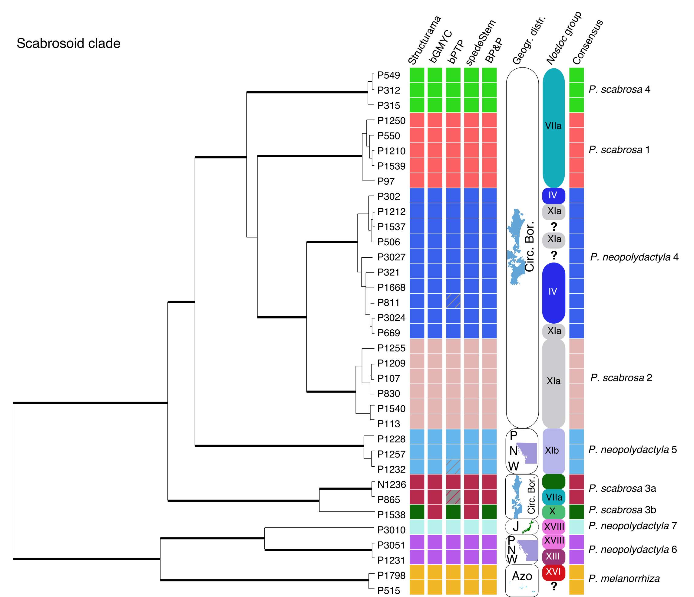
Species delimitation

Slide 21
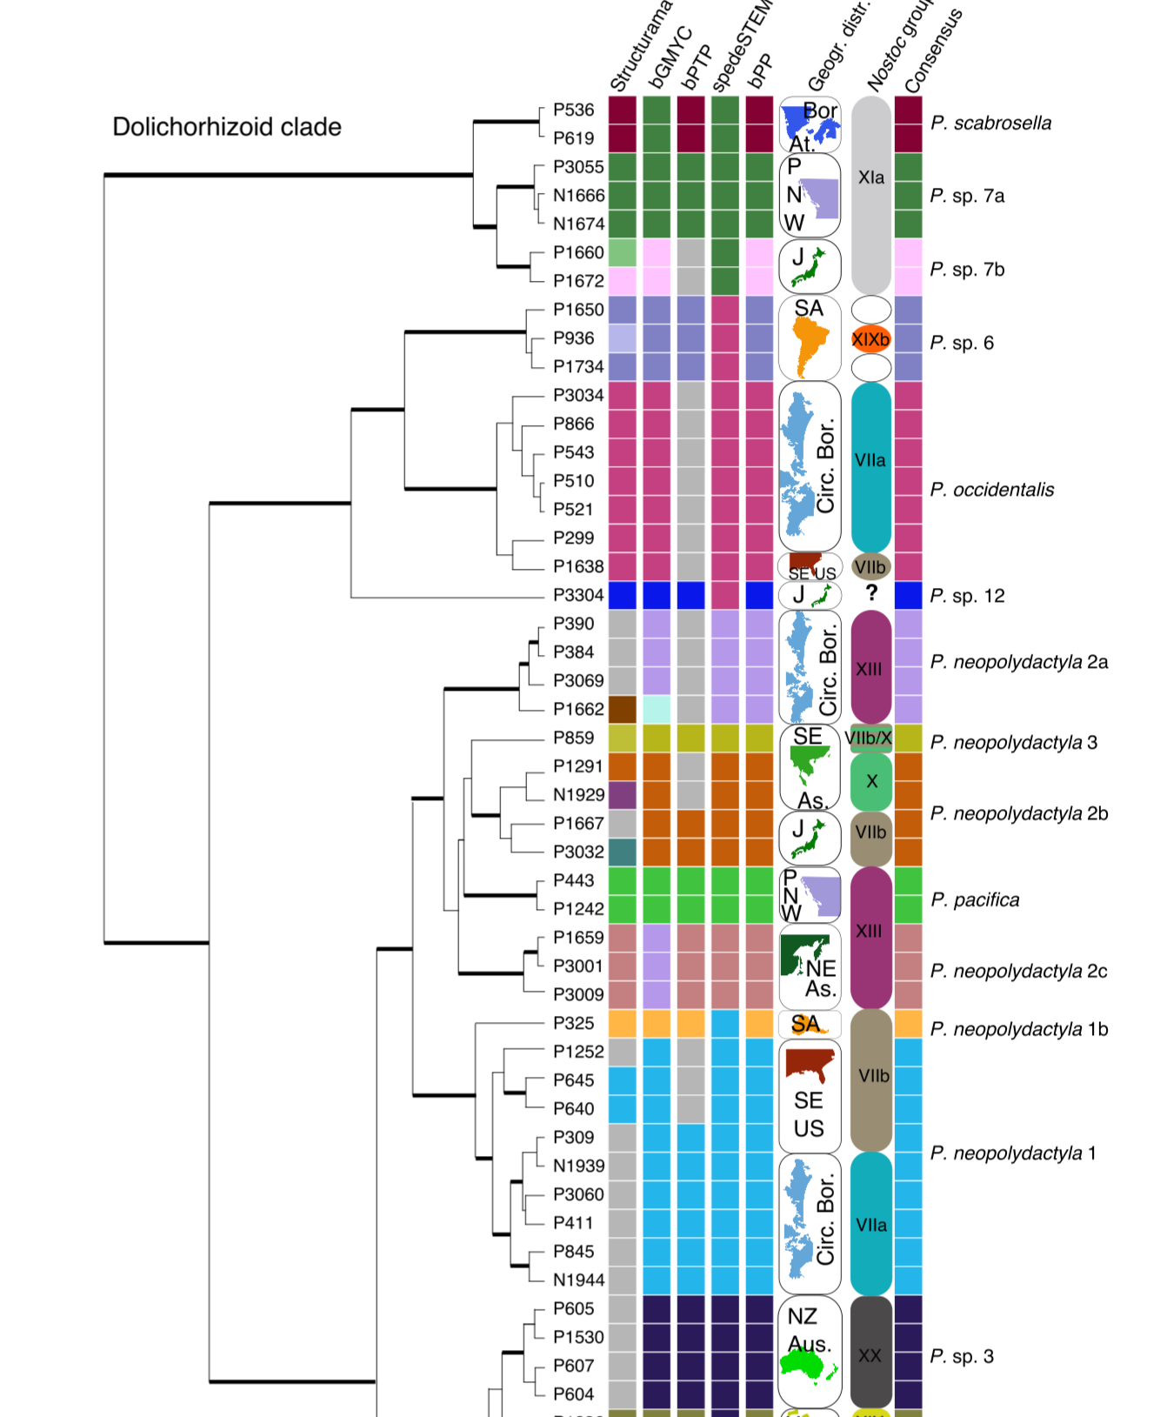
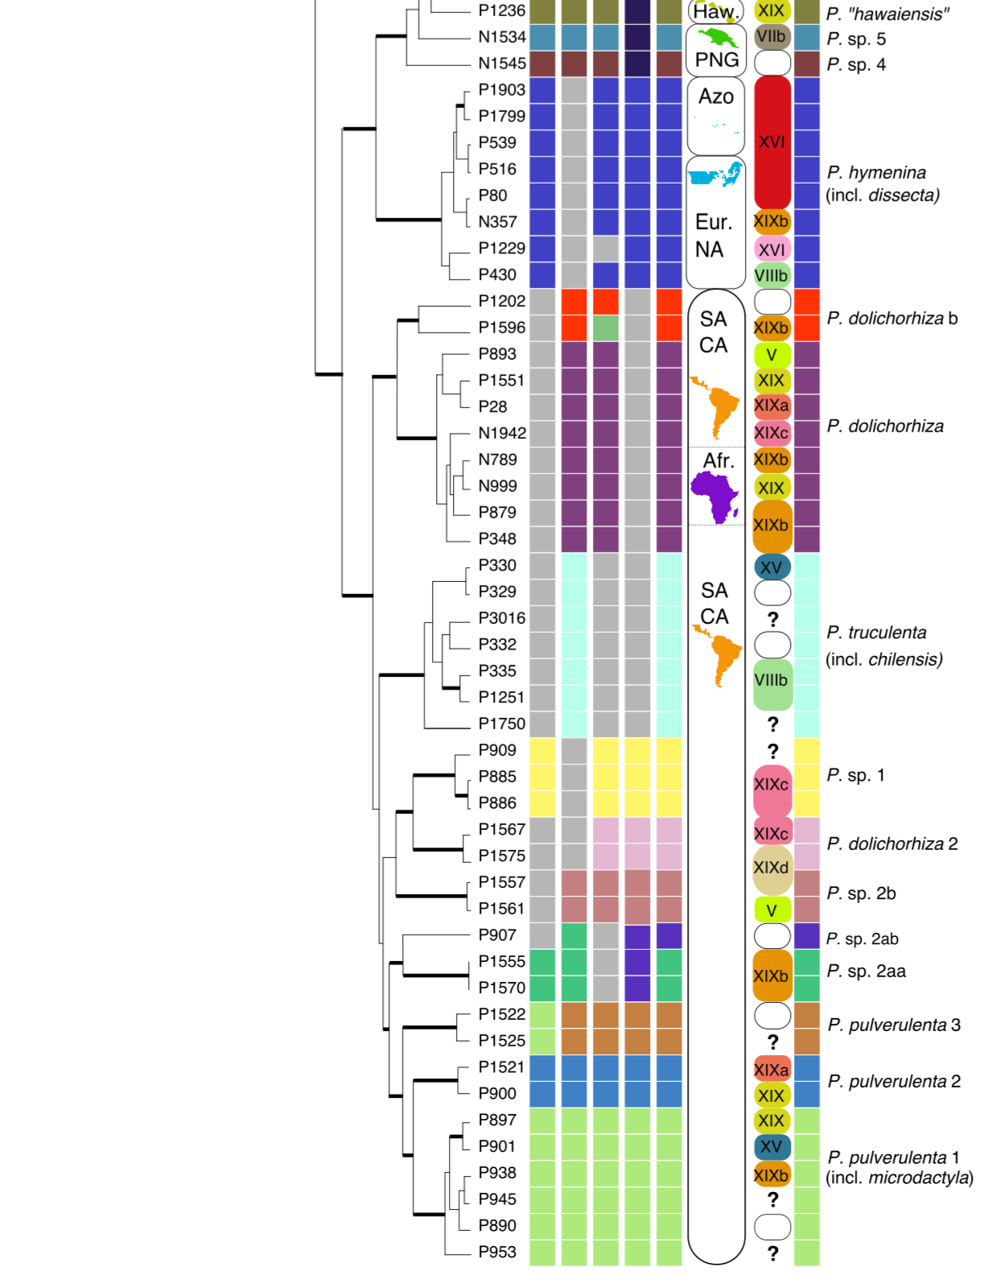
Species delimitation

Slide 22
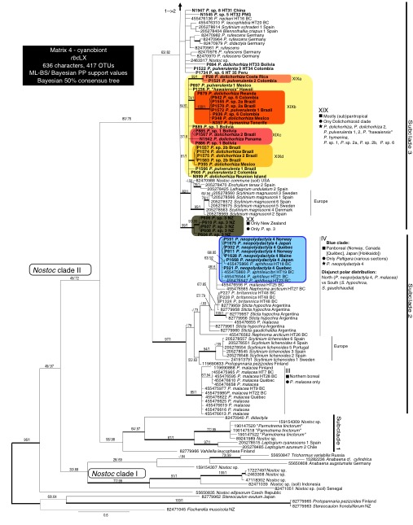
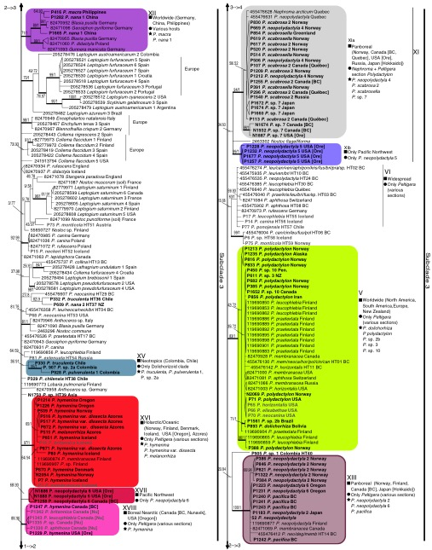
Nostoc phylogeny (rbcLX)
25 phylogroups
(monophyly +
support)

Slide 23
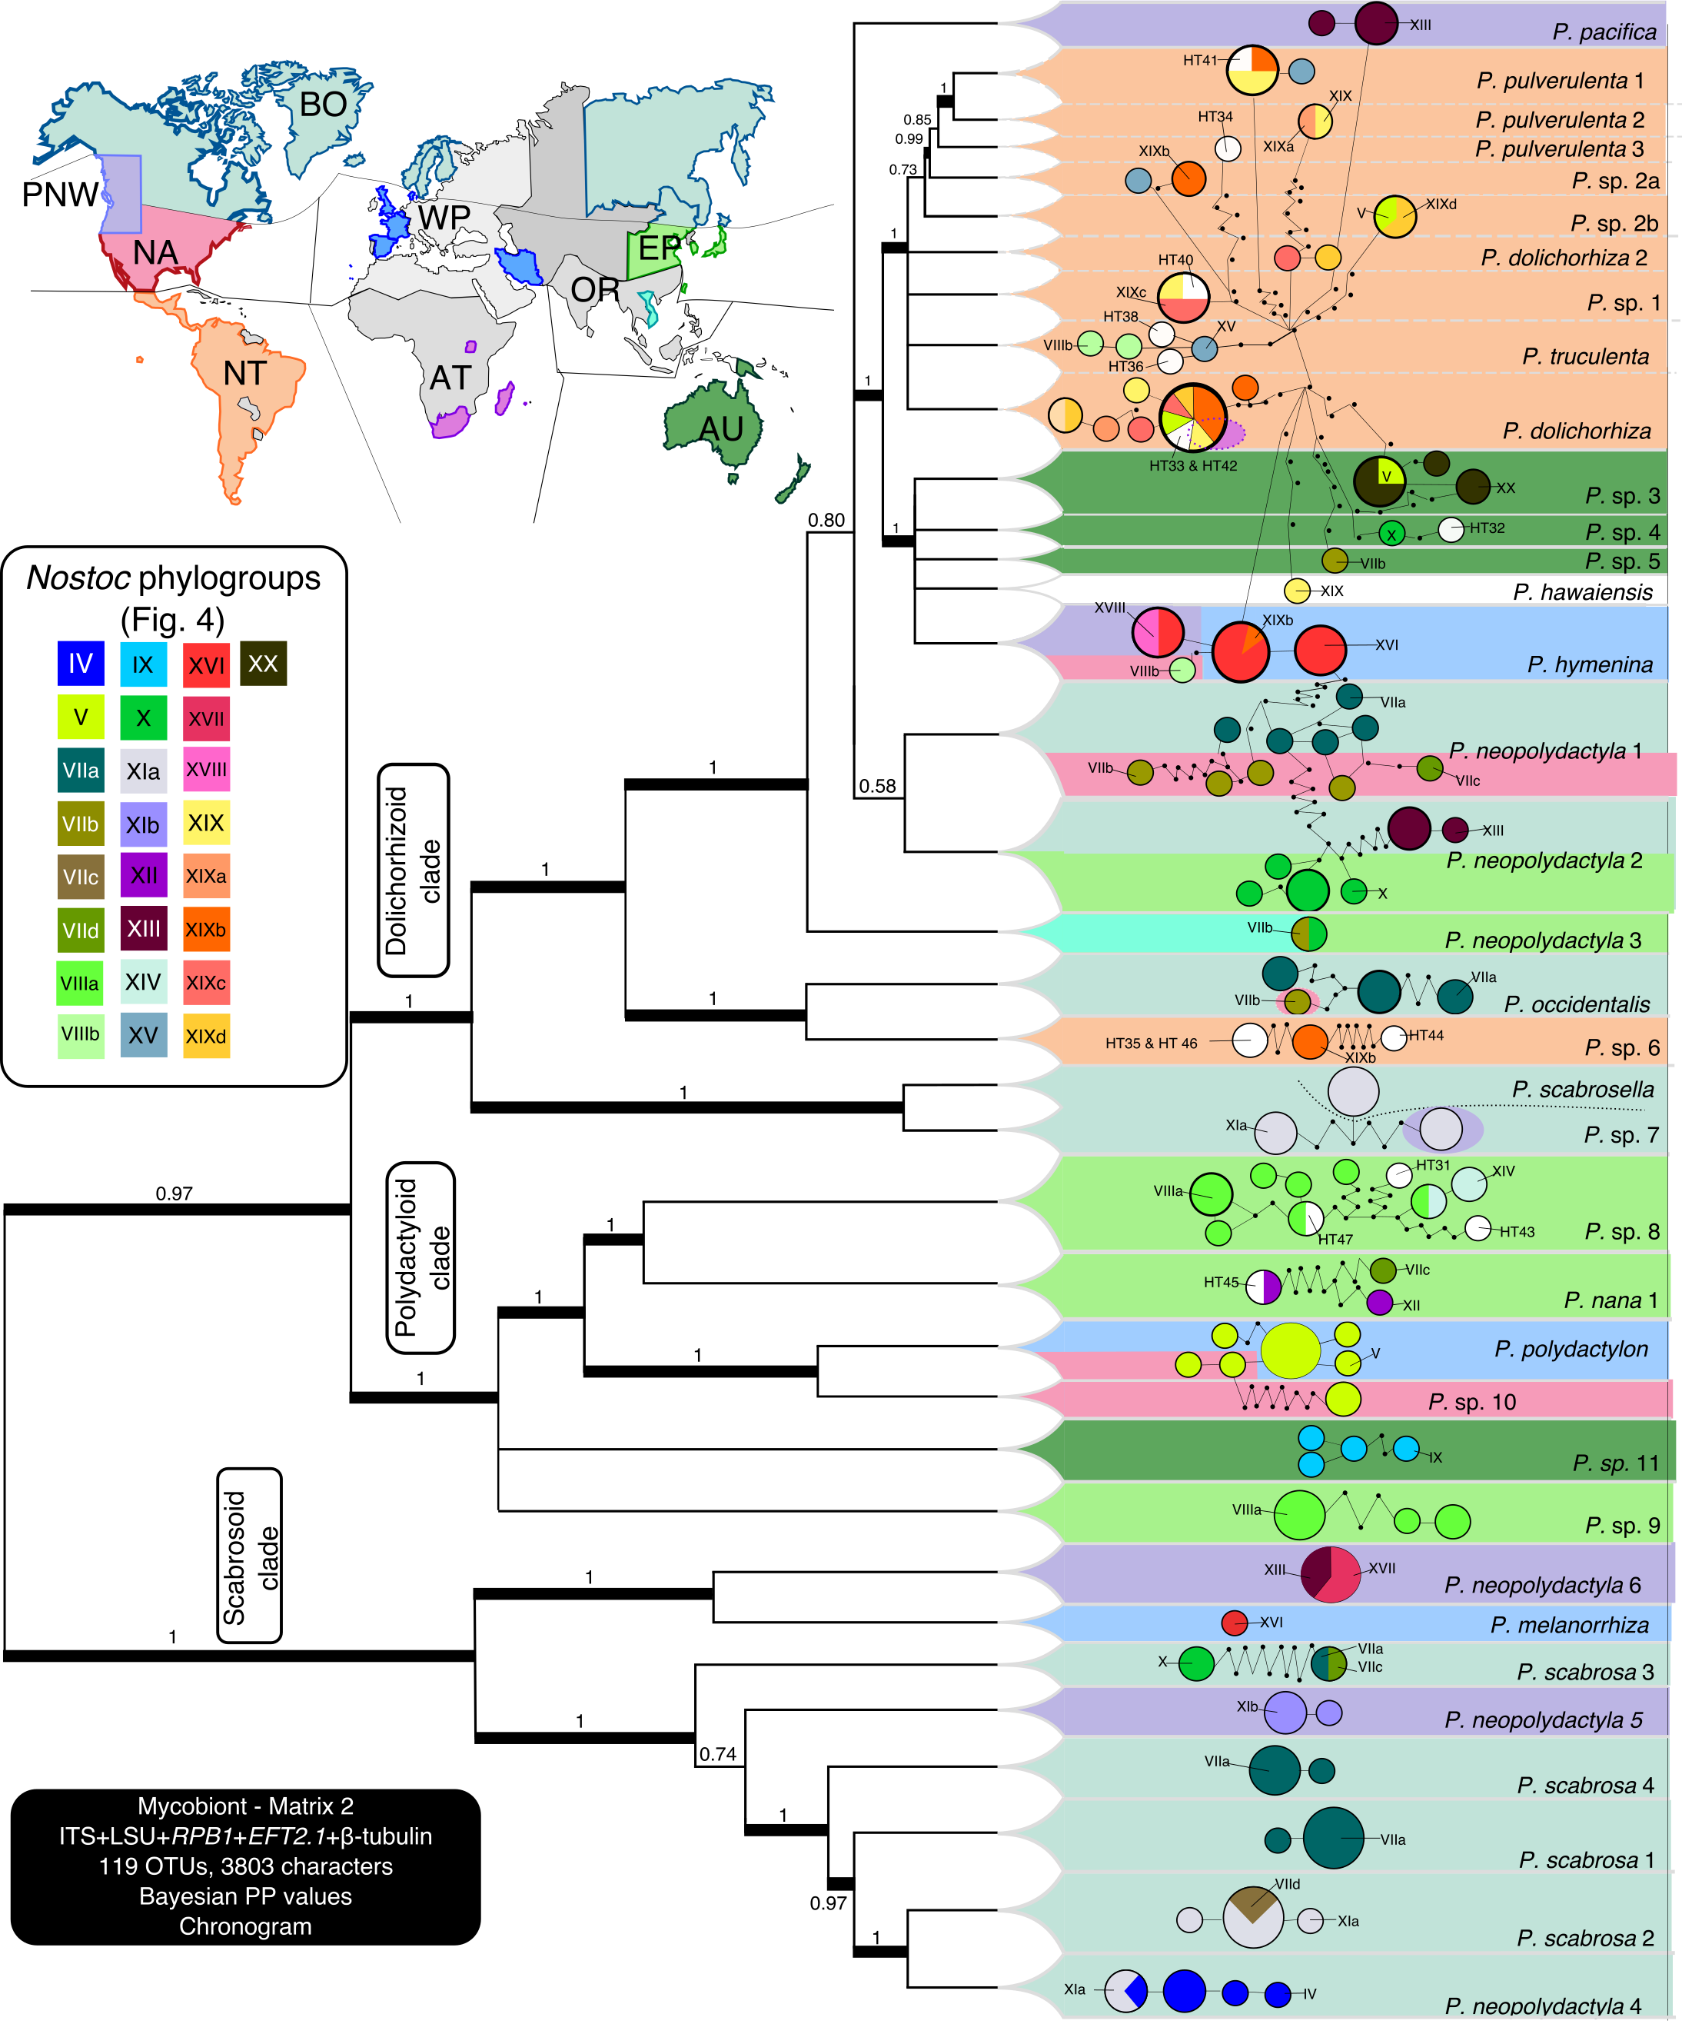
Many specialists
Some local
specialists
Some generalists
Time pattern

Slide 24
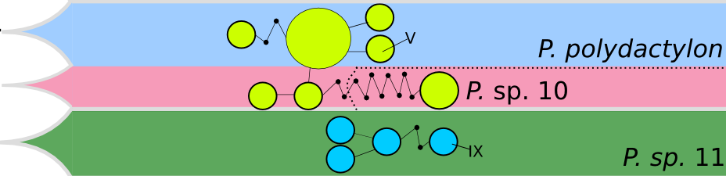
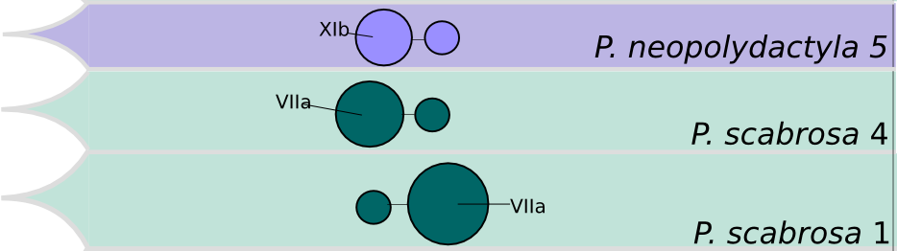

Slide 25
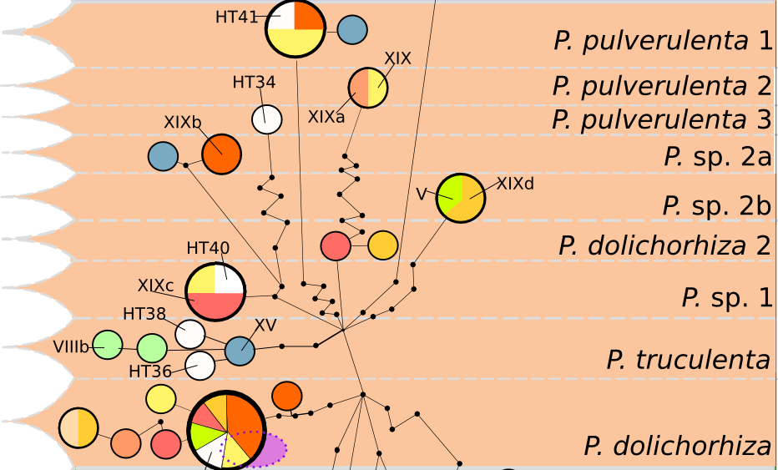

Slide 26
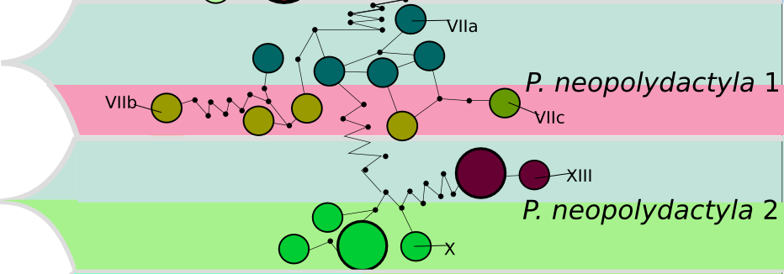

Slide 27
Many specialists
Some local
specialists
Some generalists
Time pattern
Notes:
say n species and n phylogroups

Slide 28
Geographical data

Slide 29
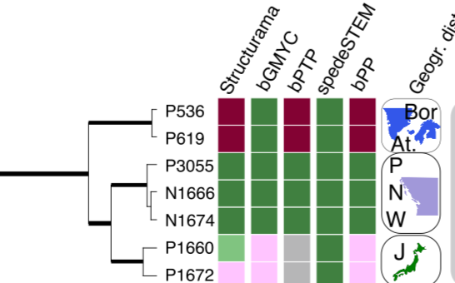
Geographical data

Slide 30
Photobiont data

Slide 31
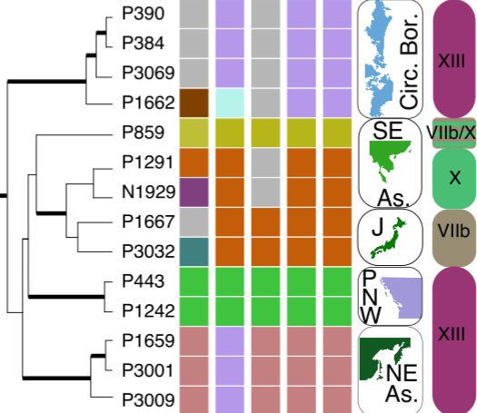
Photobiont data

Slide 32
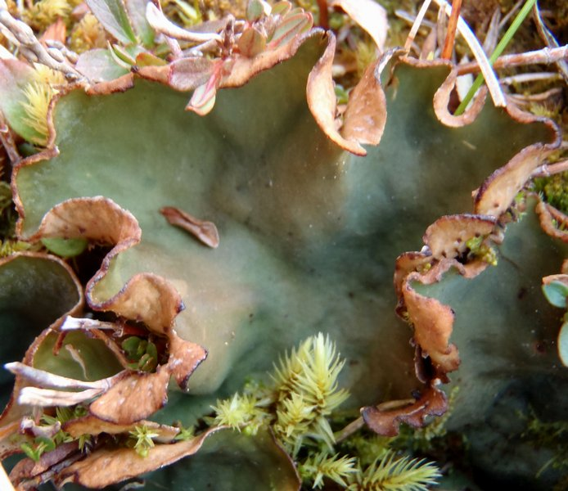
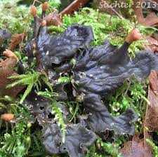
Some Nostoc have distinct colors
With phylogroup VIIa
Most Peltigera

Slide 33
Consensus on species
50 species!
Notes:
n species before too

Slide 34
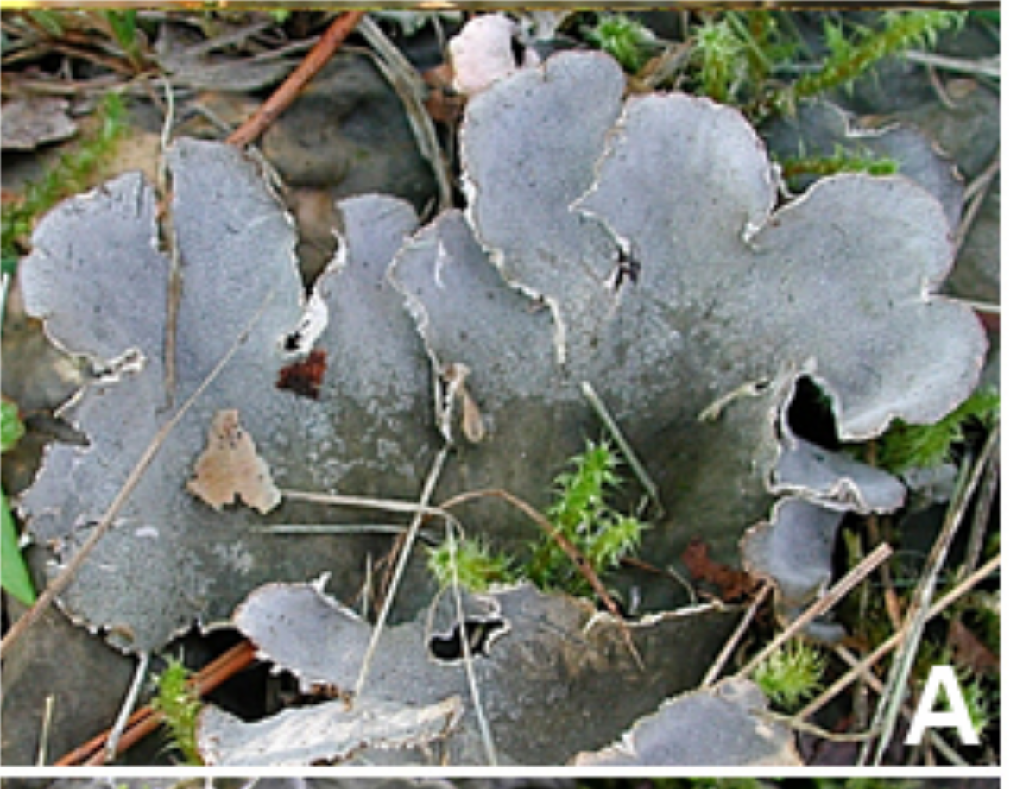
Phylogeny
Camille Truong
produced most
of the data
Potentially 80 species
(30 species described)

Slide 35
Phylogeny
In general,
-less Nostoc specificity
(most species are
generalist)
-less clear biogeographic
patterns
Camille Truong
produced most
of the data
Potentially 80 species
(30 species described)

Slide 36
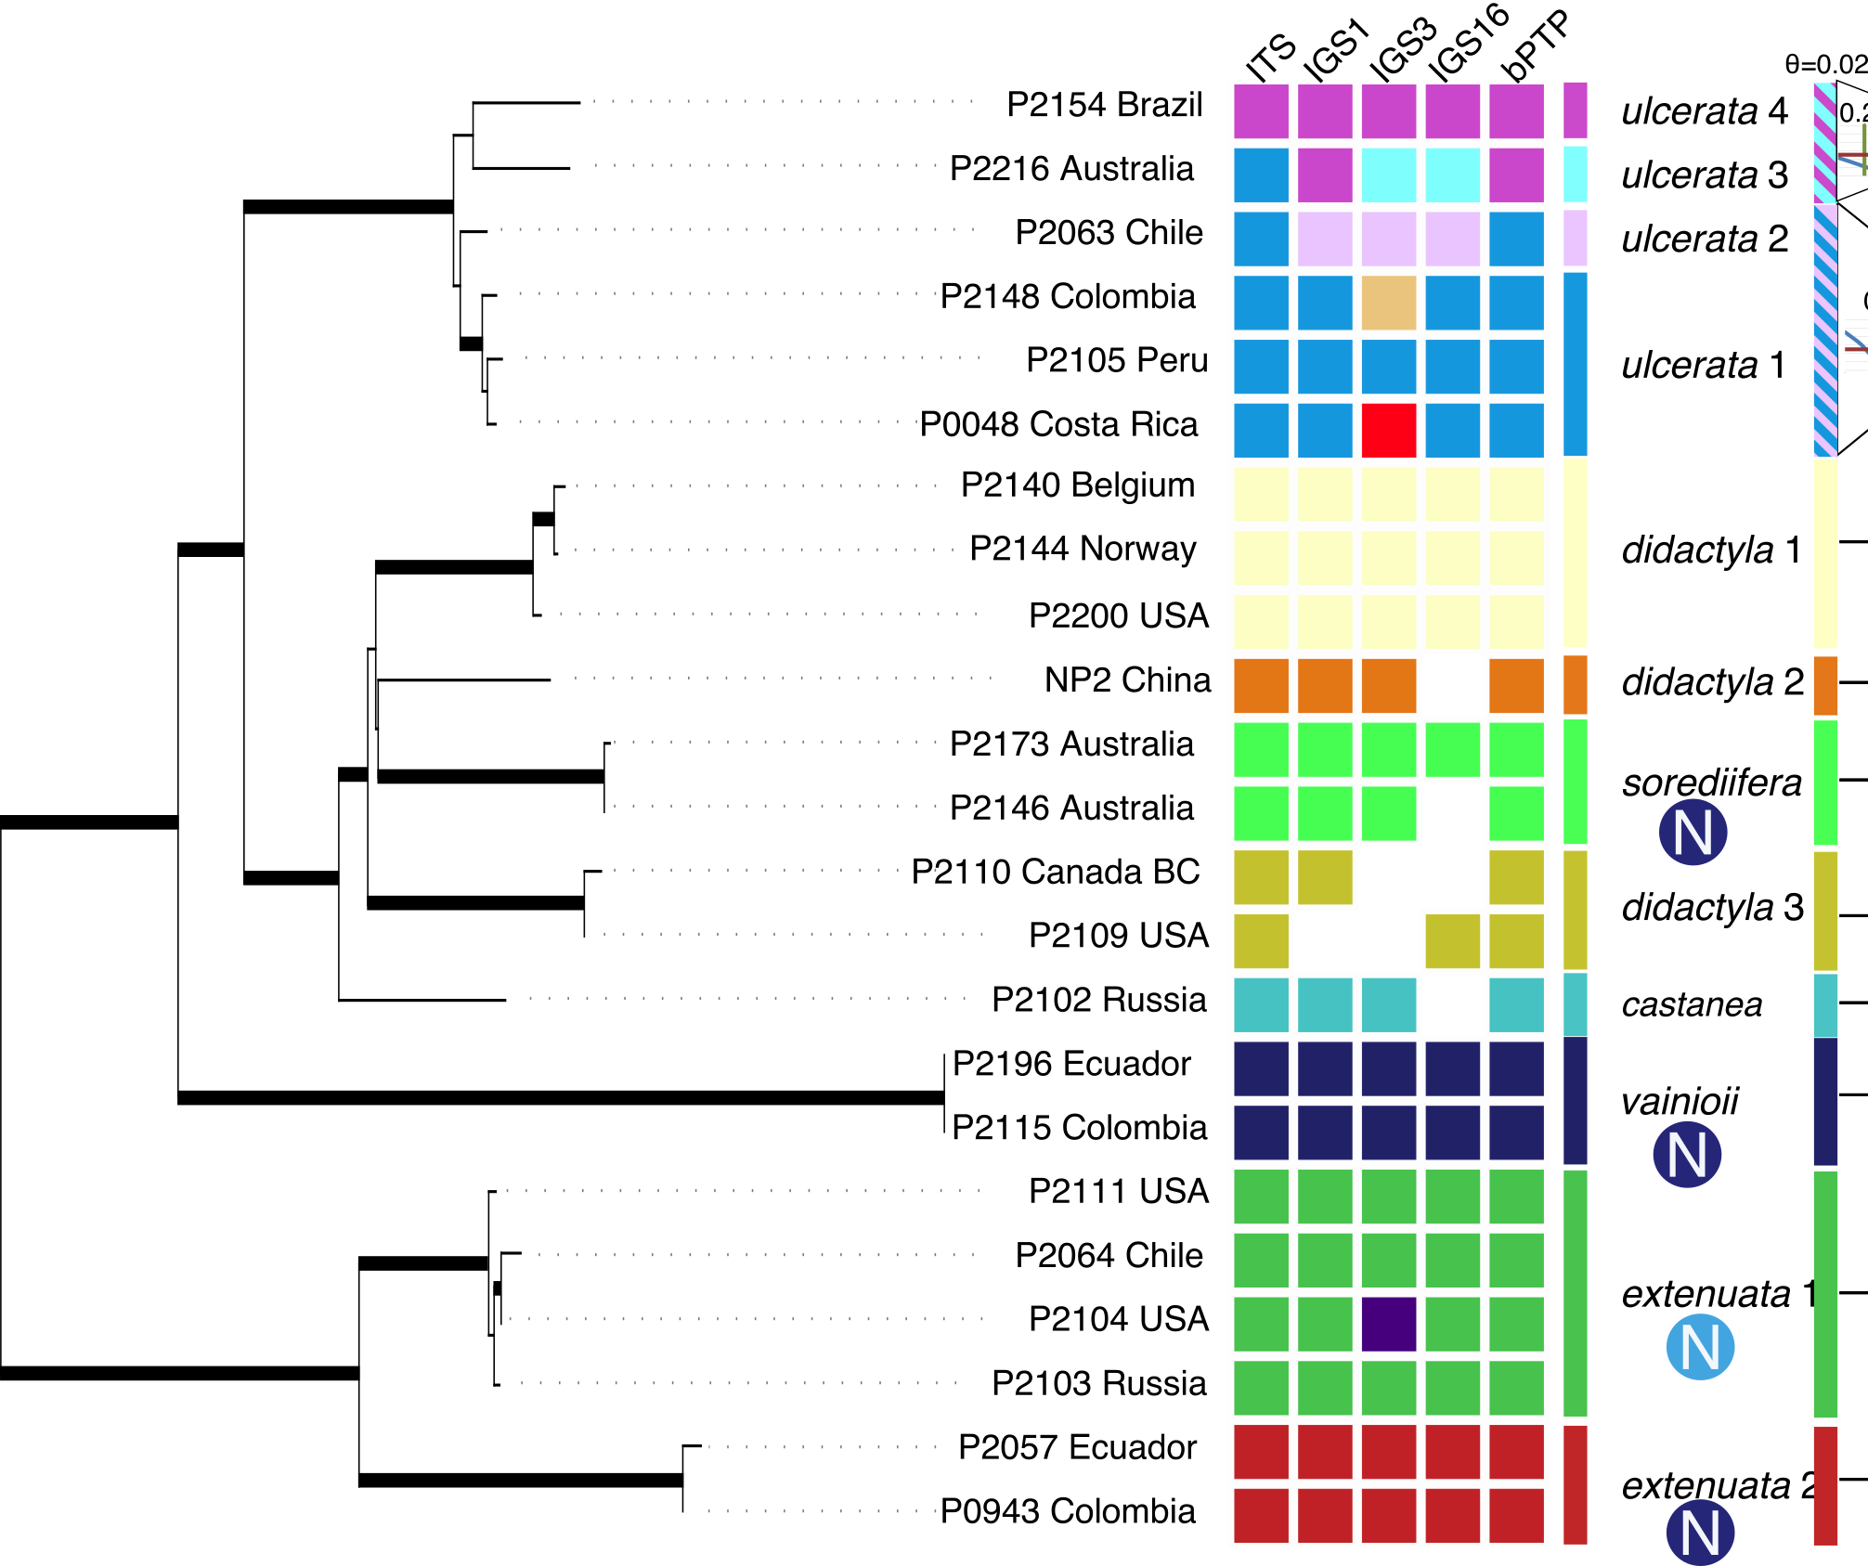
Sorediate species
Notes:
say sorediate clades

Slide 37
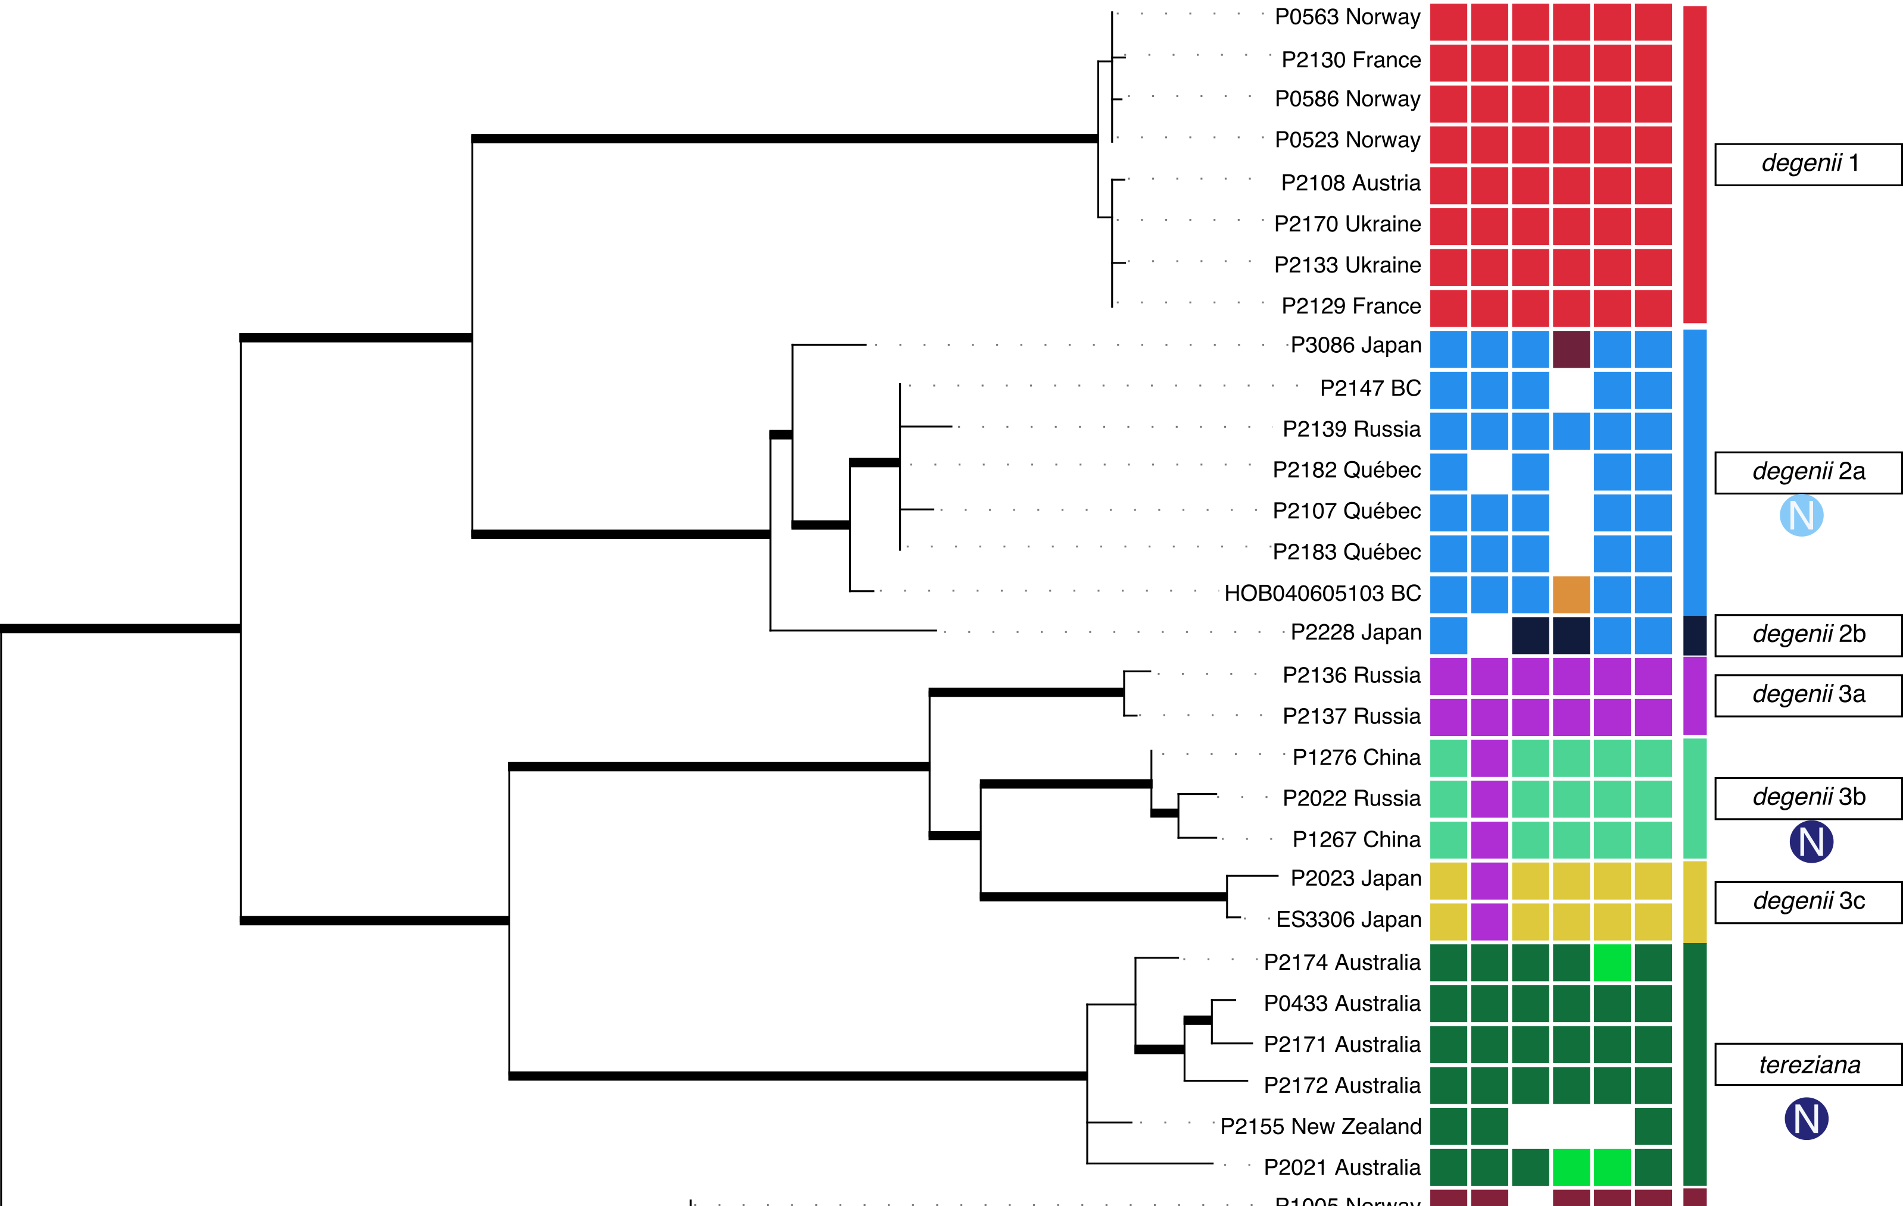
degenii group
OI

Slide 38
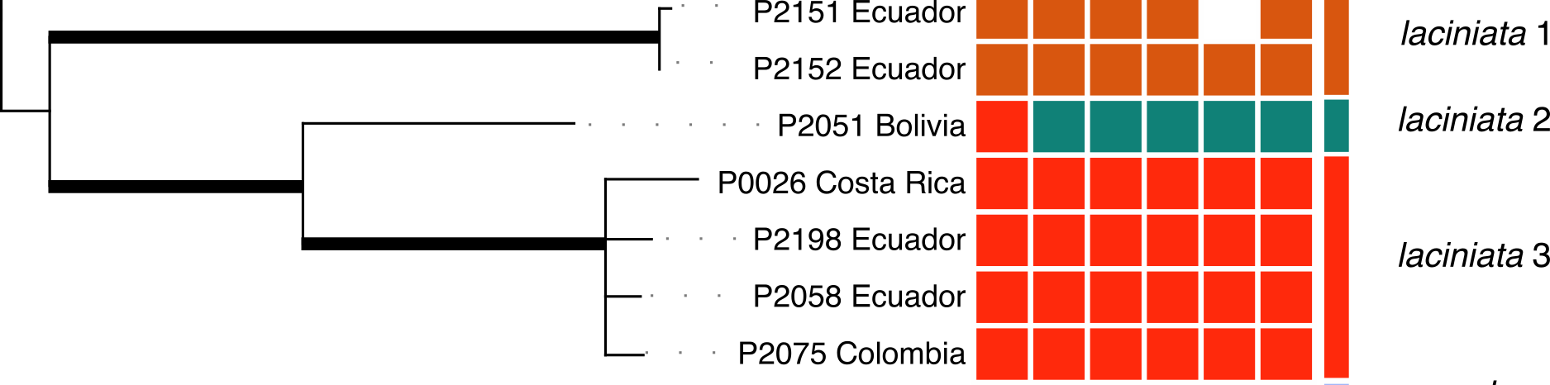
Species delimitation
OI
Methods suggest up to 80 species in section Peltigera !!!
Many cases with no morphological, photobiont or biogeographic
data to support the lineages delimited

Slide 39
Miadlikowska et al. (2014). Phylogenetic placement,
species delimitation, and cyanobiont identity of
endangered aquatic Peltigera species
(lichen-forming Ascomycota, Lecanoromycetes).
American Journal of Botany, 101(7), 1141-1156.
3 species
Geographic pattern
Very high Nostoc specificity
(section + species)
3 species
Nostoc

Slide 40
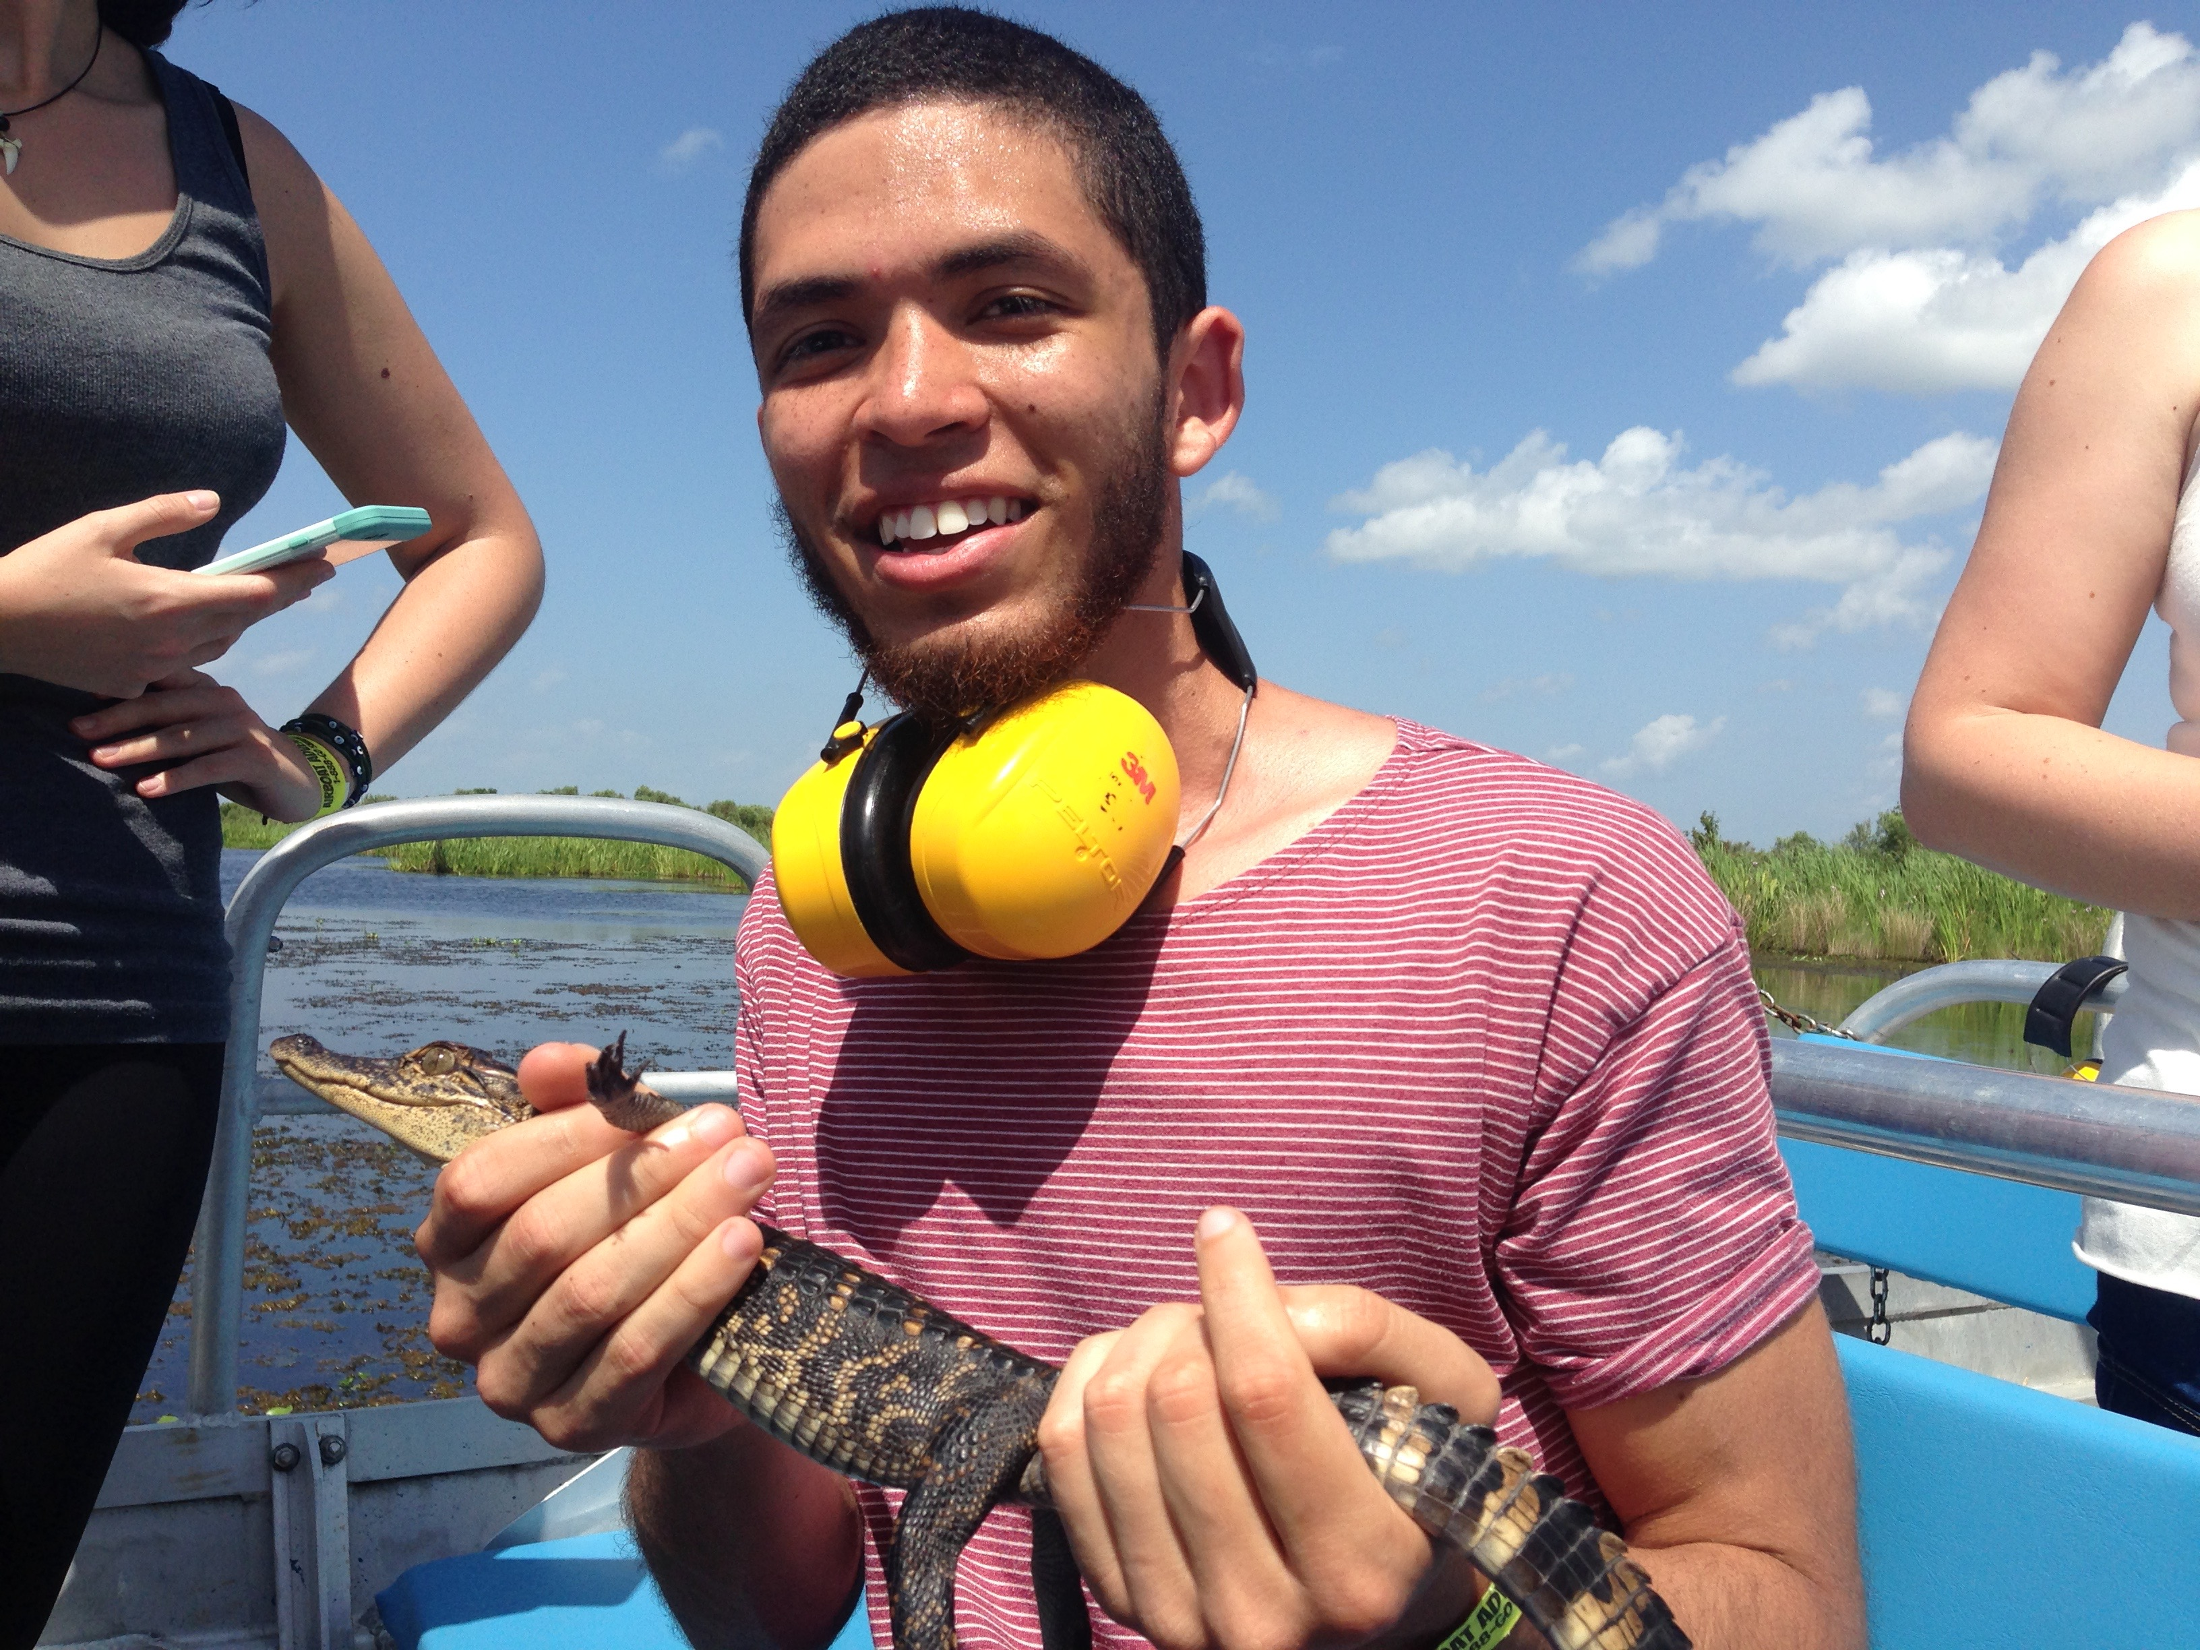
Talk by Carlos Pardo: “Disentangling cryptic diversity and symbiotic patterns using
multilocus data within the tripartite thalli of the cyanolichen genus Peltigera section
Chloropeltigera (Peltigerales, Ascomycota) and its photosynthetic partners.”
(Peltigerales session)
Very interesting,
study of the three
partners!
7 species (3 described)
Low specificity with Nostoc

Slide 41
Species delimitation

Slide 42
Species delimitation
Methods suggest
~13 species in the group
(5 species described)
P. malacea and
P. aphthosa split in
several species

Slide 43
Species delimitation
Methods suggest
~13 species in the group
P. malacea and
P. aphthosa split in
several species
But few morphological,
geographical or
photobiont data
to support these splits!
Several distinct chemotypes
but no match with phylogeny

Slide 44
Nostoc specificity
Very high
Nostoc specificity in
bipartite (P. malacea s.l.)
lineages
Lower specificity in
tripartite (P. aphthosa,
P. britannica lineages)

Slide 45
Nostoc specificity
Very high
Nostoc specificity in
bipartite (P. malacea s.l.)
lineages
Lower specificity in
tripartite (P. aphthosa,
P. britannica lineages)
Low specificity
(tripartite thalli)
Notes:
think about how to introduce Carlos

Slide 46

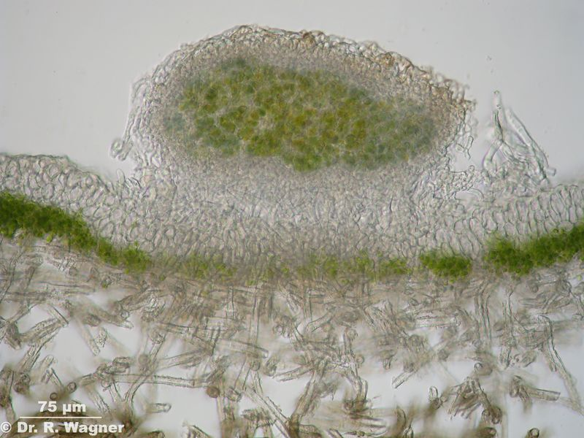
Nostoc in tripartite Peltigera (cephalodia) : low
specificity
Lower requirements on the identity of the Nostoc in cephalodia when Nostoc is not the primary photobiont?
Notes:
talk about Carlos before

Slide 47
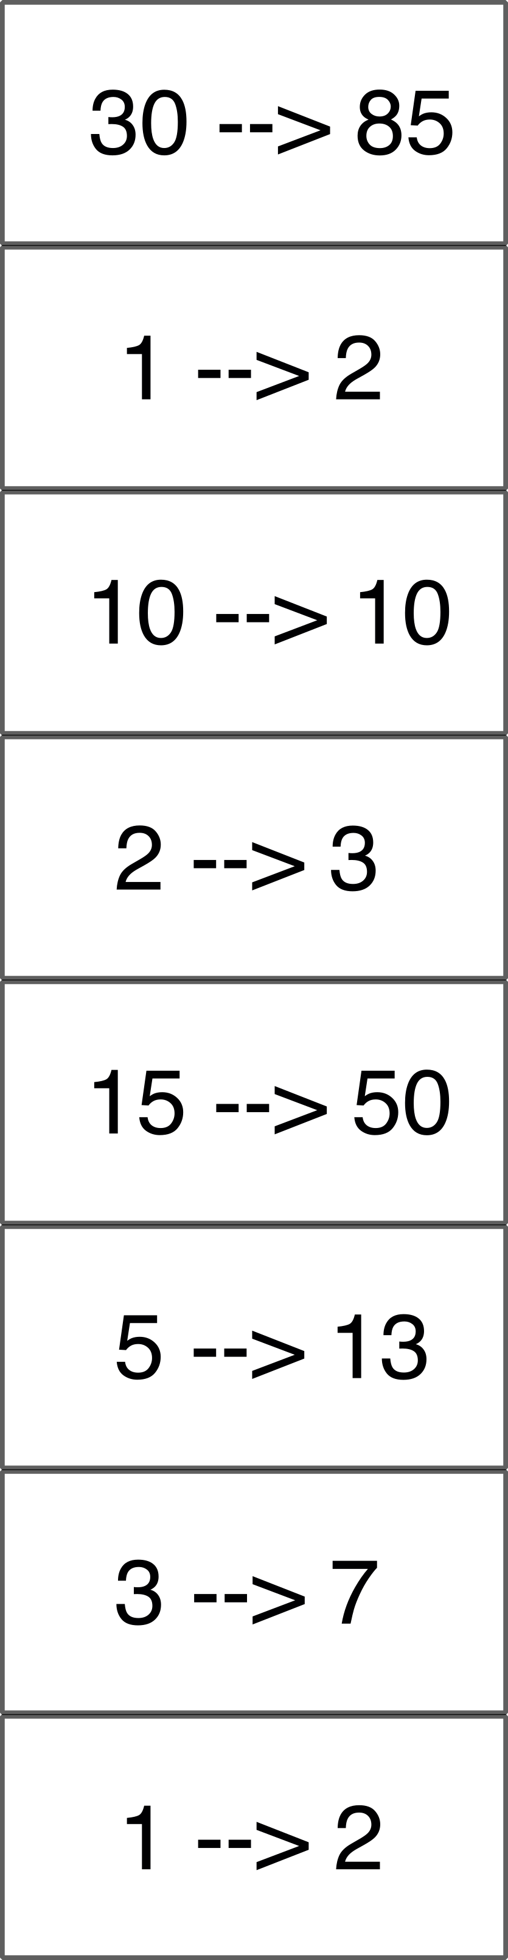
No. sp.
73→172
Notes:
16 before this

Slide 48
No. sp.
Many new species from
poorly sampled regions of the
world
But many “well-understood”
species are also split in several
lineages
73→172

Slide 49
Do we trust our results?
Notes:
I think it’s clear that there are MANY undiscovered species in lichen)-forming fungi, because lichenologists have had a tendency to group together morphologically similar specimens, even from very different places, and of course a lot of these are indeed different species. And in lichens, unlike animals or even pollinated plants, there not such a need of morphological differences, plus what we see as humans is very limited. But at the same time it’s very tempting to use these very fancy modern methods, and then just split and describe every lineage split by the method. But maybe in a few years, new methods will arrive etc

Slide 50
Do we trust our results?
2-3 times more species than described
(seems to be the case in many groups of lichens studied)
in many cases, no morphological, geographical, chemical…
characters to support lineages => difficult (impossible?) to identify species in the field
species with high morphological plasticity (e.g., P. hymenina-P. dissecta) vs. morphologically similar distinct species (e.g., P. pulverulenta 1-4, P. scabrosa 1-4)
Notes:
I think it’s clear that there are MANY undiscovered species in lichen)-forming fungi, because lichenologists have had a tendency to group together morphologically similar specimens, even from very different places, and of course a lot of these are indeed different species. And in lichens, unlike animals or even pollinated plants, there not such a need of morphological differences, plus what we see as humans is very limited. But at the same time it’s very tempting to use these very fancy modern methods, and then just split and describe every lineage split by the method. But maybe in a few years, new methods will arrive etc

Slide 51
example: P. neopolydactyla

Slide 52
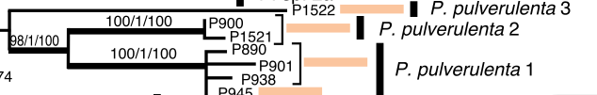
example: P. pulverulenta

Slide 53
What is a species?
Every biologist has a different idea of what a species is and how they should be delimited
Dozens of species concepts
Dozens of species delimitation methods
Every method relies on one species concept
Every method tests species based on one single model, testing one criterion
A model contains many simplifications

Slide 54
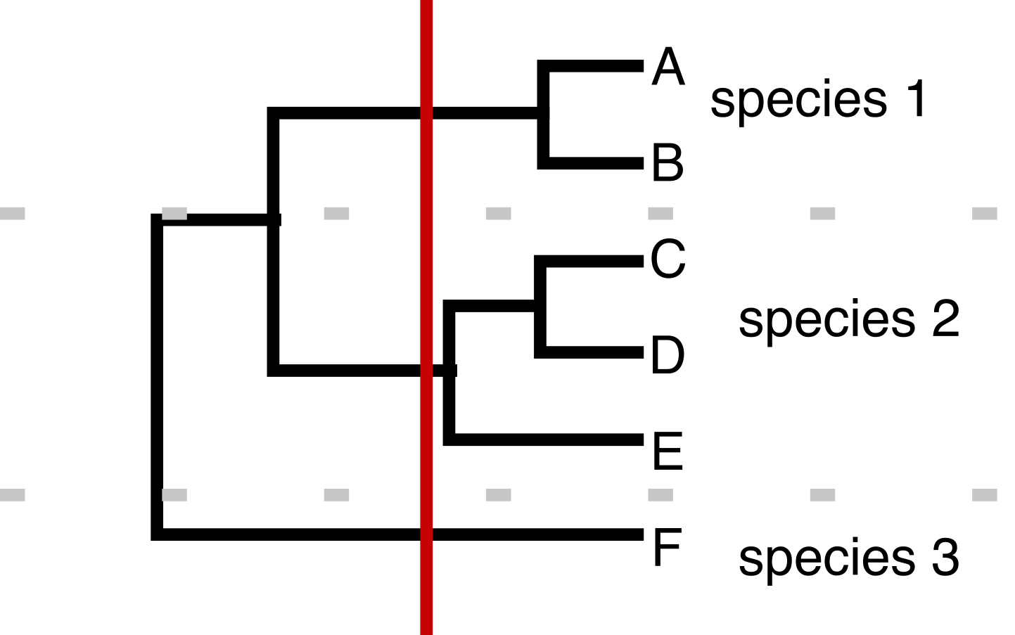
What is a species?
Most methods assume that all species and speciation processes follow the same patterns
Different patterns of species and speciation processes
No reason to assume similar patterns in different groups (and even inside a group)

Slide 55
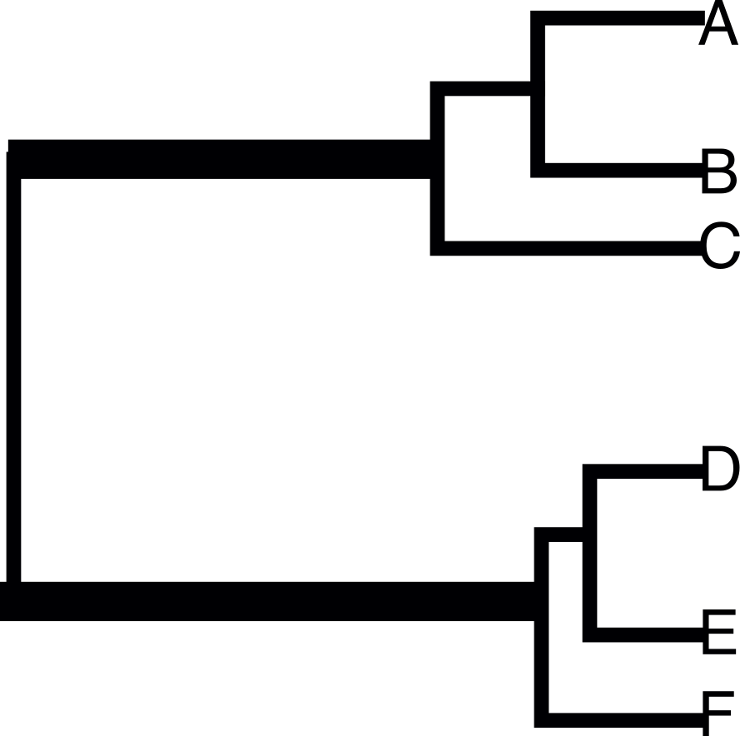
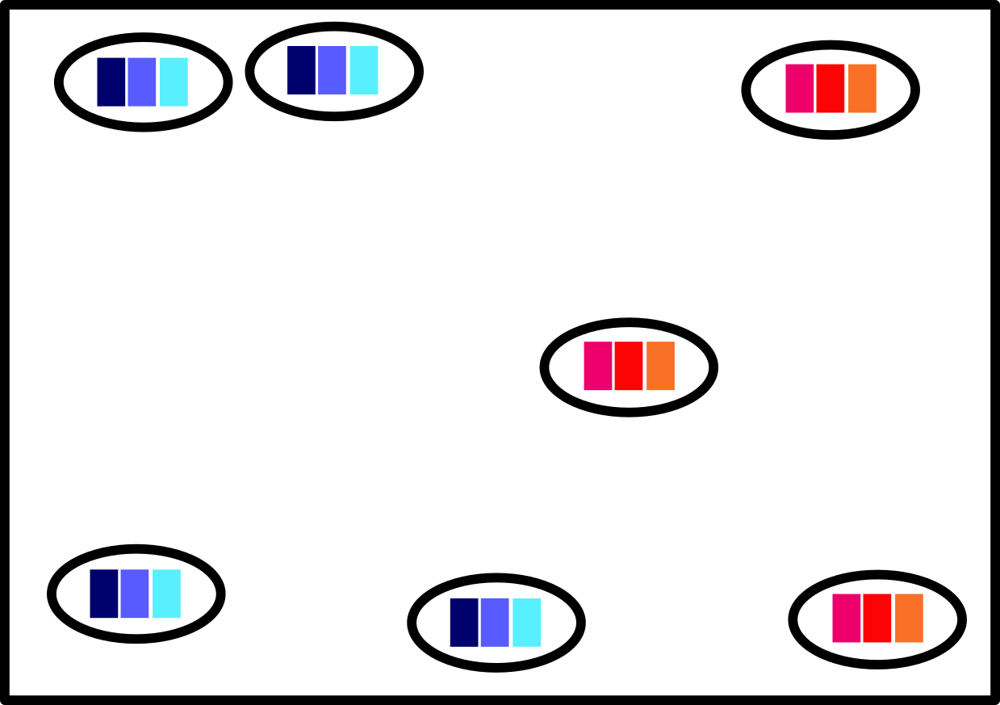
Possible problems with methods
Sampling

Slide 56
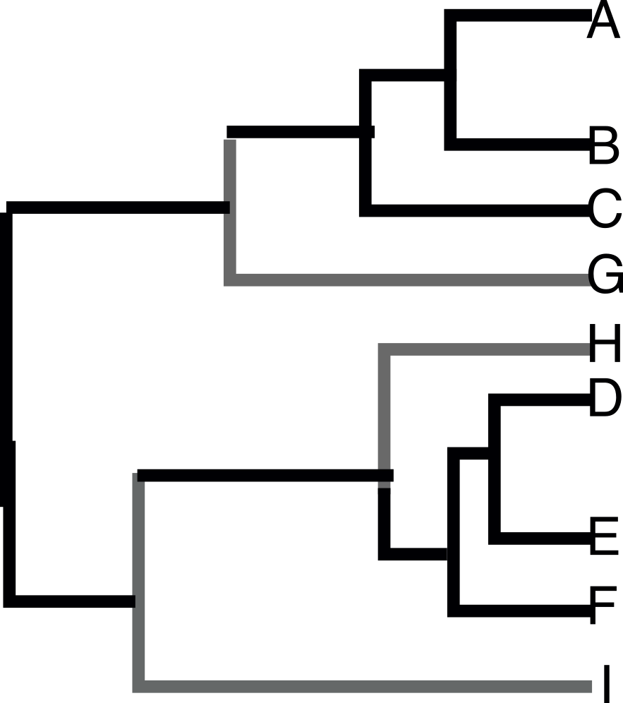
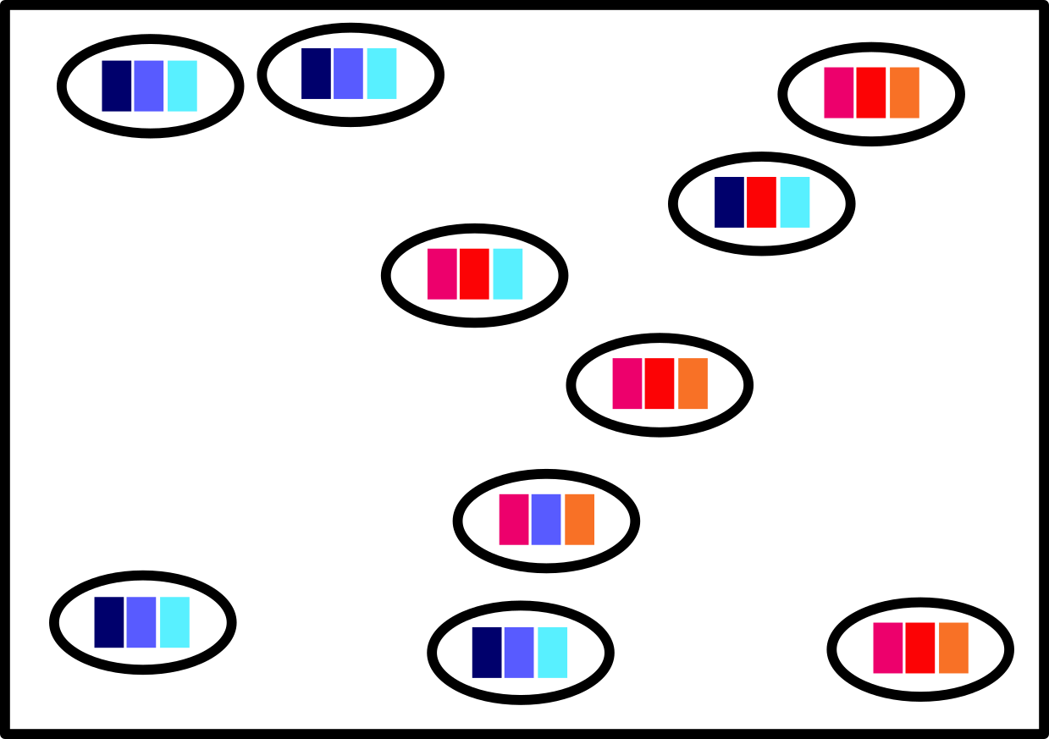
Possible problems with methods
Sampling
Notes:
add polydactylon figures

Slide 57
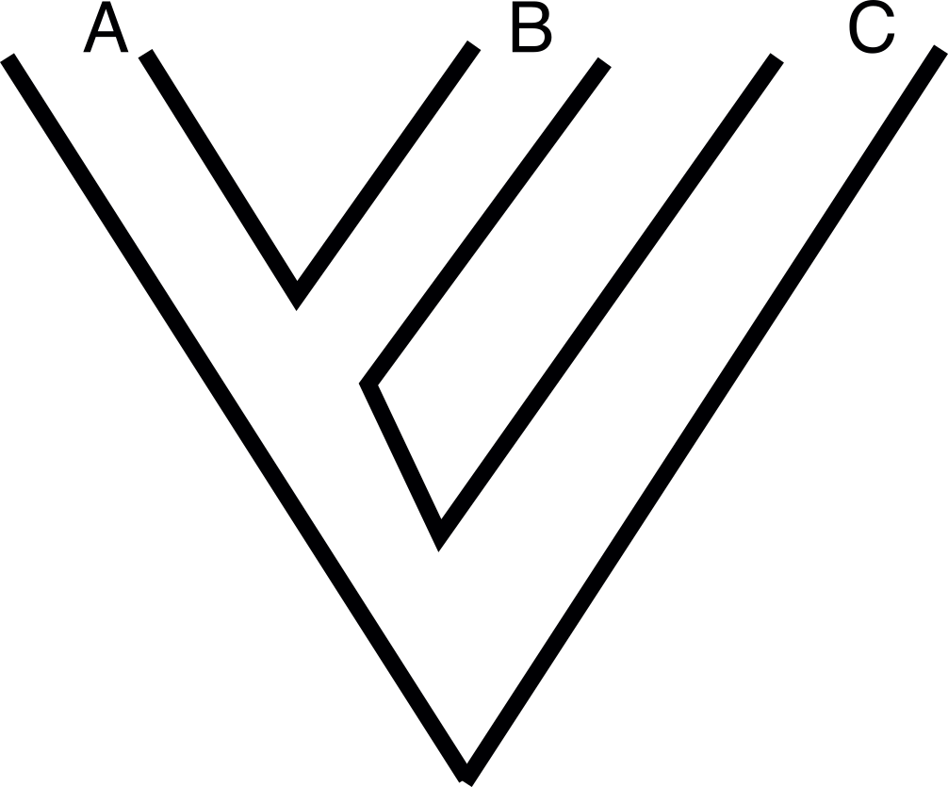
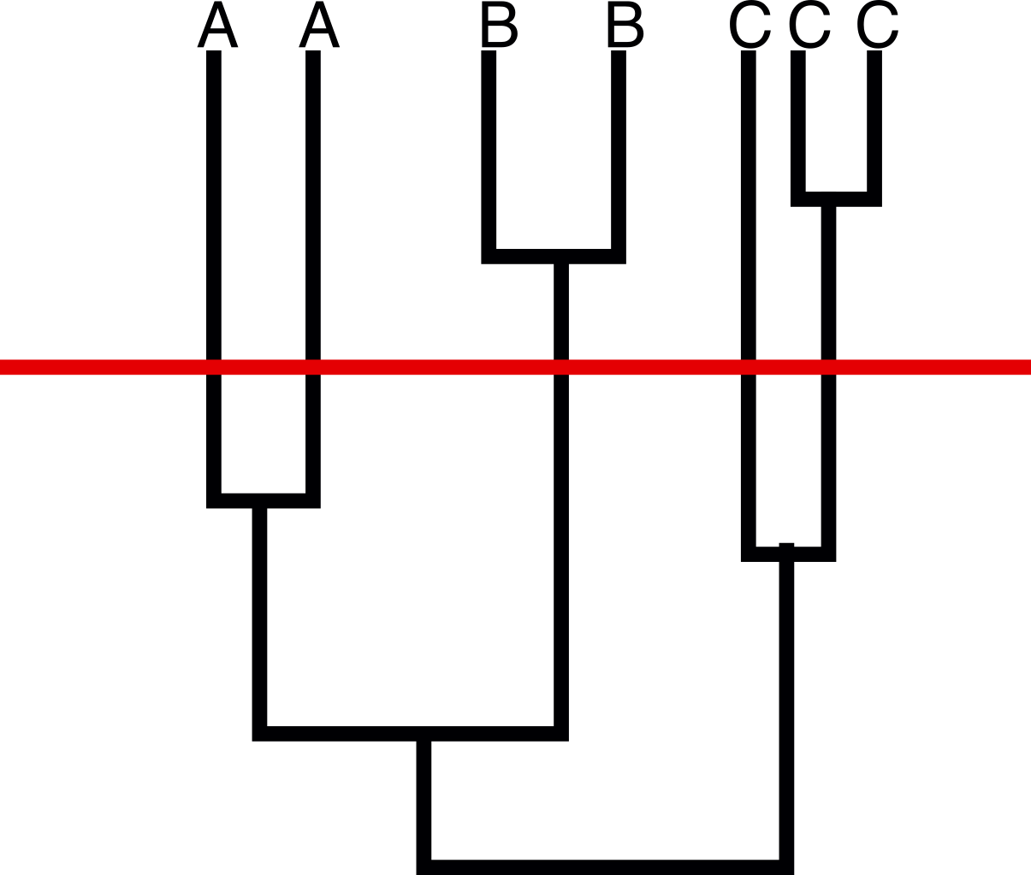
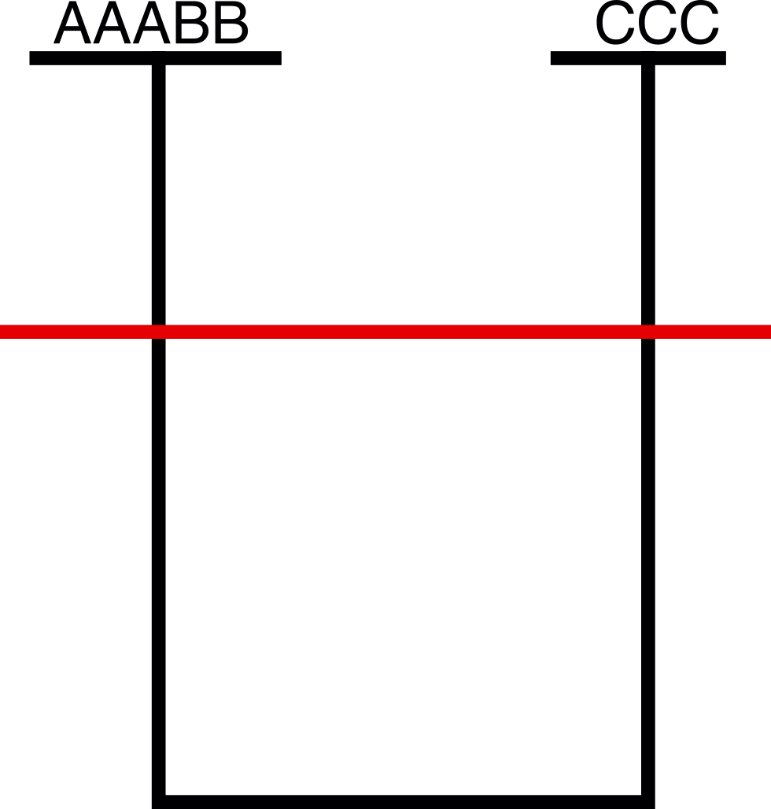
Possible problems with methods
Variation of the loci
High variation
Low variation

Slide 58
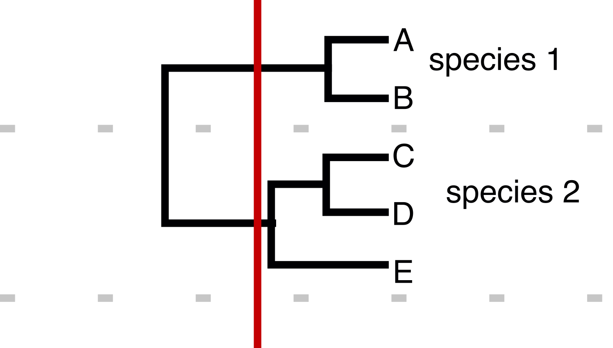
Possible problems with methods
Taxonomic scale

Slide 59
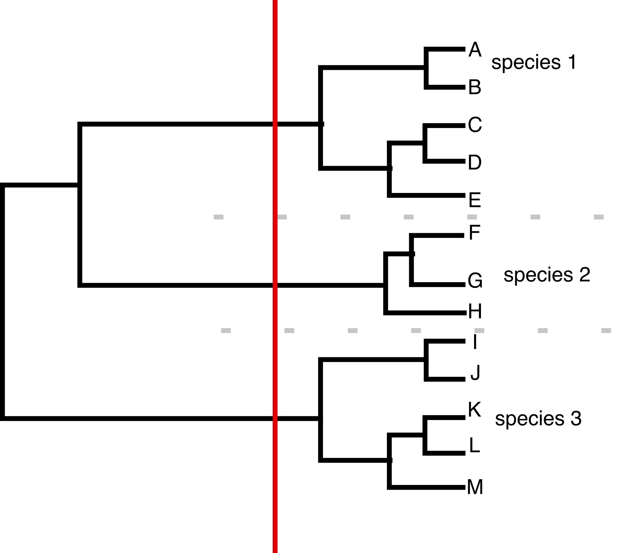
Possible problems with methods
Taxonomic scale

Slide 60
Additional problems
Gene trees =/= species trees
Errors in gene trees estimation, errors in estimation of the models/parameters
Influence of the priors
Some parameters to specify

Slide 61

No. sp.
102-181

Slide 62

No. sp.
Nostoc
102-181

Slide 63

No. sp.
Nostoc
Geogr.
102-181

Slide 64

No. sp.
Nostoc
Geogr.
Morpho.
102-181

Slide 65

No. sp.
Nostoc
Geogr.
Morpho.
Chem..
102-181

Slide 66

No. sp.
Nostoc
Geogr.
Morpho.
Chem..
???
102-181

Slide 67
Datation of the genus
Dataset from:
5 loci: nuSSU, nuLSU, EF1, RPB1, RPB2

Slide 68
Datation of the genus
Dataset from:
5 loci: nuSSU, nuLSU, EF1, RPB1, RPB2
added 6 Peltigera and 2 Solorina to the dataset
BEAST analyses

Slide 72
Dates similar to Gaya et al. 2014, Prieto & Wedin 2013…

Slide 73
Ascomycota
Basidiomycota

Slide 74
Ascomycota
split: 450-600 Mya
Basidiomycota

Slide 75
Lecanoromycetes
250-350 Mya

Slide 76
Peltigerineae
120-160 Mya

Slide 77
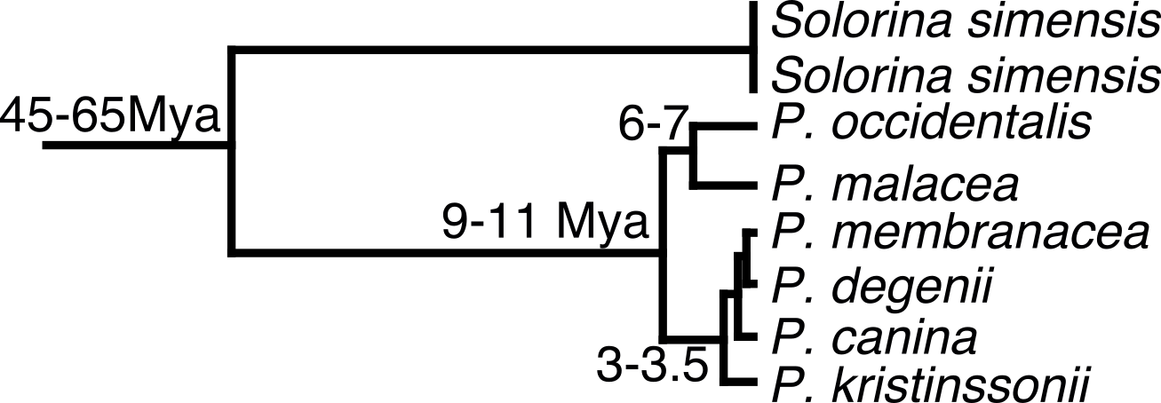

Slide 78
95% interval: 6-14Mya

Slide 79
95% interval: 6-14Mya
Miocene

Slide 80
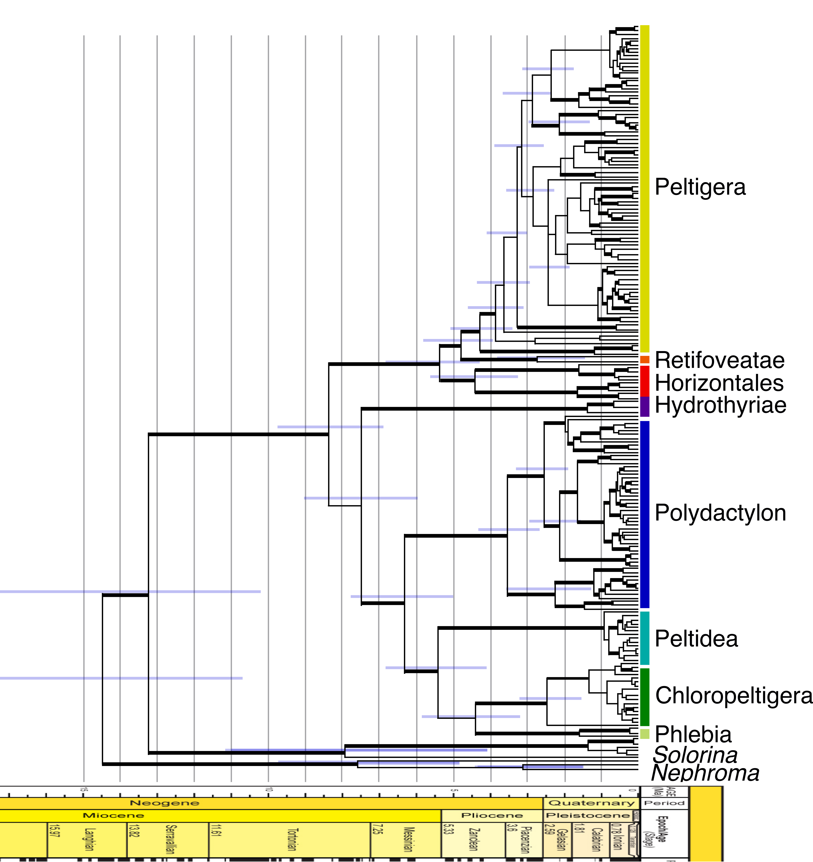
10 loci:
slow: nuLSU, mtSSU,
intermediate: RPB1, RPB2,EFT2.1
fast: ITS, ß-tubulin, COR1b, COR3, COR16
BEAST analyses with priors from
the previous analysis

Slide 81
10 loci:
slow: nuLSU, mtSSU,
intermediate: RPB1, RPB2,EFT2.1
fast: ITS, ß-tubulin, COR1b, COR3, COR16
BEAST analyses with priors from
the previous analysis

Slide 82
10 loci:
slow: nuLSU, mtSSU,
intermediate: RPB1, RPB2,EFT2.1
fast: ITS, ß-tubulin, COR1b, COR3, COR16
BEAST analyses with priors from
the previous analysis

Slide 83
10 loci:
slow: nuLSU, mtSSU,
intermediate: RPB1, RPB2,EFT2.1
fast: ITS, ß-tubulin, COR1b, COR3, COR16
BEAST analyses with priors from
the previous analysis

Slide 84
10 loci:
slow: nuLSU, mtSSU,
intermediate: RPB1, RPB2,EFT2.1
fast: ITS, ß-tubulin, COR1b, COR3, COR16
BEAST analyses with priors from
the previous analysis

Slide 85
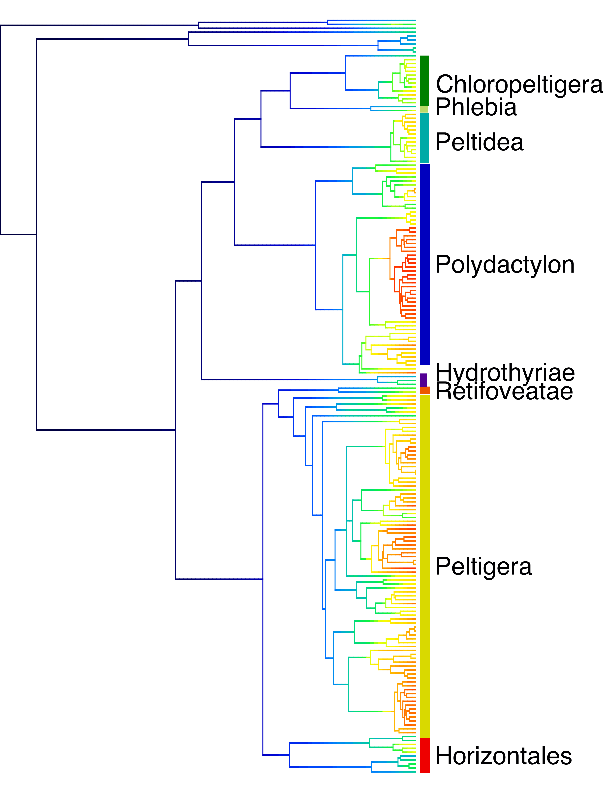
Diversification:
BAMM analysis

Slide 86
Diversification:
BAMM analysis
Diversification
in the recent past
Diversification higher in
Polydactylon and Peltigera

Slide 87
Diversification:
BAMM analysis
Diversification
in the recent past
Diversification higher in
Polydactylon and Peltigera
Link between diversification rates and
specificity of the symbiosis?

Slide 88
Tripartite sections monophyletic!
Single acquisition of the green alga!
Single loss of the green alga!
pp=0.996

Slide 89
Future directions: Nostoc

Slide 90
Future directions: Nostoc
Phylogeny of Nostoc: new markers, new methods to resolve
its evolutionary history

Slide 91
Future directions: Nostoc
Phylogeny of Nostoc: new markers, new methods to resolve
its evolutionary history
Are the lichenized Nostoc also free living? : environmental
sampling at various scales

Slide 92
Future directions: Nostoc
Phylogeny of Nostoc: new markers, new methods to resolve
its evolutionary history
Are the lichenized Nostoc also free living? : environmental
sampling at various scales
How do Peltigera and Nostoc associate? Look at metagenomic
data (genes involved, more on specificity), transcriptomic…

Slide 93
Future directions: Peltigera
More sampling especially in poorly sampled zones
(Asia, Indonesia, Philippines, Africa…)
More markers (genomic data, cf new COR markers) to better understand the remaining questions
Taxonomic work to describe the new species

Slide 94
Future directions: symbiosis
Network analyses (cf. Pierre-Luc Chagnon’s talk) to better understand the symbiosis
Metagenomic, metatranscriptomic data, identify genes involved in the symbiosis
New phylogenetic methods to study the evolution of the symbiosis
Understanding the processes themselves

Slide 95

Acknowledgments
-All collaborators and herbaria that sent us material, collaborators
who helped us during field trips
-Advisors: Emmanuël Sérusiaux, Jolanta Miadlikowska, François Lutzoni,
Bernard Goffinet
-Orvo Vitikainen, Trevor Goward, Camille Truong
-Students: Carlos Pardo, Jade Lu, Antoine Simon
-You for listening!

