Slide 1
Balances as guides towards a sustainable future
Andreas Pfennig Institute of Chemical Engineering and Environmental Technology TU Graz http://www.sustainicum.at/ http://www.vision3000.eu http://ceet.tugraz.at
Copyright: Creative-Commons-Licence by-nc-sa, where not with others

Slide 2
agenda
1 motivation
2 balances
3 where are we today?
4 where do we go?
4.1 fossil energy carriers, world population, standard of living
4.2 atmosphere, carbon dioxide, climate
4.3 land area, bio-energy, nutrition
4.4 options for sustainable energy supply
5 what does this mean for us?
6 conclusions

Slide 3
My personal start:
Aachener Nachrichten, Mittwoch, 6. September, 2006:
Farmer of Today will be Oil Sheikh of Tomorrow
In future electricity and heat are produced on farmland. All that can be produced
from crude oil plants can supply as well. Only politics has to rethink.
series: leaving the greenhouse
by
Franz Alt

Slide 4
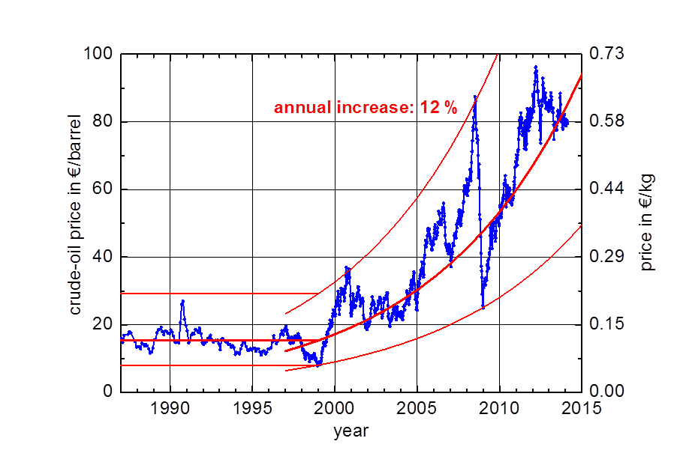
development of crude-oil price

Slide 5
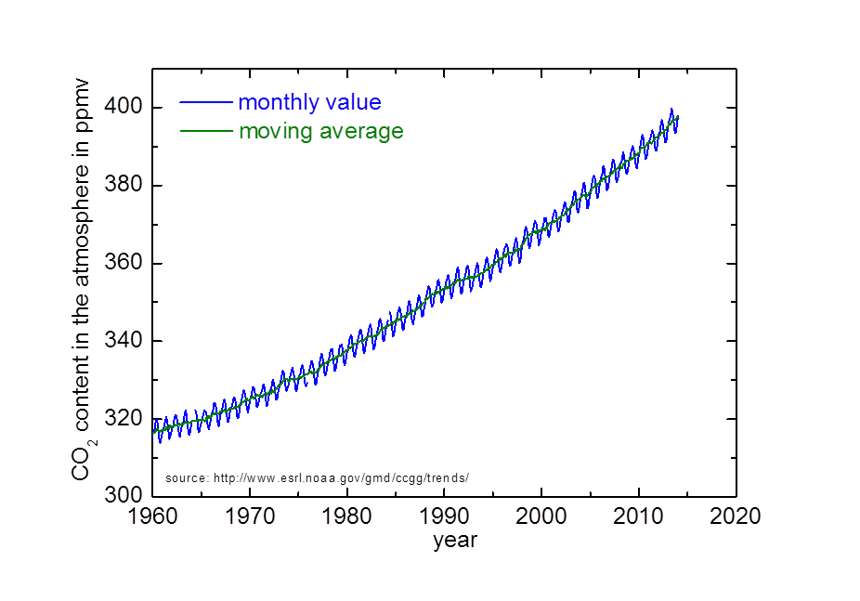
CO₂ content at Mauna Loa, Hawaii

Slide 6
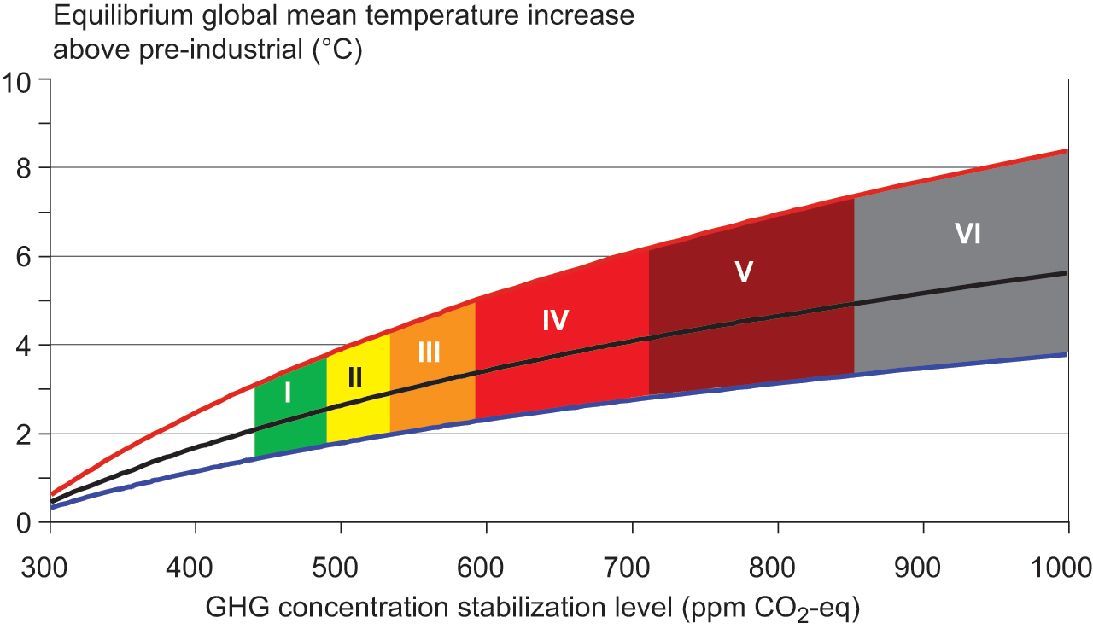
temperature and CO₂ according to IPCC
http://www.ipcc.ch/graphics/ar4-wg3/jpg/spm8.jpg
with kind permission: Based on Climate Change 2007: Mitigation of Climate Change. Working Group III Contribution to the Fourth Assessment Report of the Intergovernmental Panel on Climate Change, Figure SPM.8. Cambridge University Press.

Slide 7
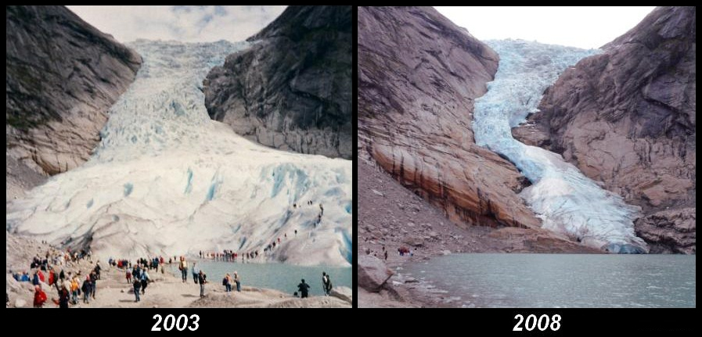
retreat: Briksdal glacier, Norway
http://commons.wikimedia.org/w/index.php?title=File:Briksdalsbreen_Norway_2003_&_2008.JPG

Slide 8
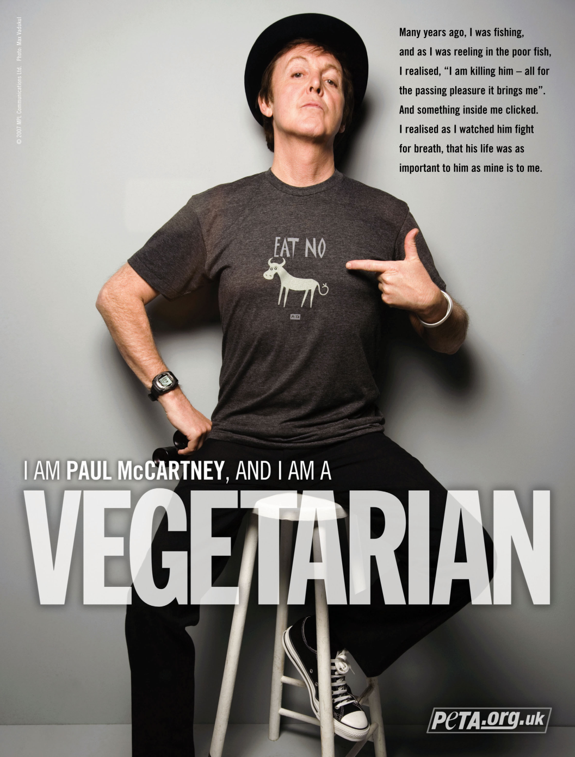
living style
with kind permission:
PETA Deutschland e.V. People for the Ethical Treatment of Animals

Slide 9
historical
1798 T. R. Malthus, An Essay on the Principle of Population
1931 H. Hotelling, The economics of exhaustible resource
1952 W. S. Paley, Resources for freedom; a report to the president
1961 J. W. Forrester, Industrial dynamics
1963 H. Barnett, C. Morse, Scarcity and Growth
1972 D. L. Meadows, Club of Rome, The Limits to Growth
1973 J. W. Forrester, World Dynamics
1980 G. O. Barney, The Global 2000 Report to the President
1987 G. H. Brundtland, Our Common Future
1989 D. Dörner, Die Logik des Mißlingens
1993 D. L. Meadows et al., Beyond the Limits
2004 D. L. Meadows et al., Limits to Growth: The 30-Year Update

Slide 10
engineering perspective
quantitative statements
complete picture
reliable intuition
here also:
freely available information

Slide 11
agenda
1 motivation
2 balances
3 where are we today?
4 where do we go?
4.1 fossil energy carriers, world population, standard of living
4.2 atmosphere, carbon dioxide, climate
4.3 land area, bio-energy, nutrition
4.4 options for sustainable energy supply
5 what does this mean for us?
6 conclusions

Slide 12
Balances as guides towards a sustainable future
Andreas Pfennig Institute of Chemical Engineering and Environmental Technology TU Graz http://www.sustainicum.at/ http://www.vision3000.eu http://ceet.tugraz.at
Copyright: Creative-Commons-Licence by-nc-sa, where not with others

Slide 13
agenda
1 motivation
2 balances
3 where are we today?
4 where do we go?
4.1 fossil energy carriers, world population, standard of living
4.2 atmosphere, carbon dioxide, climate
4.3 land area, bio-energy, nutrition
4.4 options for sustainable energy supply
5 what does this mean for us?
6 conclusions

Slide 14
balance
change inside the balance volume =
+ what is entering
- what is leaving
+ what is produced
- what disappears
source:
www.microsoft.com
www.heinzelmen.de/preise/

Slide 15

balance
change inside the balance volume =
+ what is entering
- what is leaving
+ what is produced
- what disappears
source:
www.microsoft.com
www.heinzelmen.de/preise/

Slide 16
balance
change inside the balance volume =
+ what is entering
- what is leaving
+ what is produced
- what disappears
define balance volume
source:
www.microsoft.com
www.heinzelmen.de/preise/

Slide 17
balance
change inside the balance volume =
+ what is entering
- what is leaving
+ what is produced
- what disappears
source:
www.microsoft.com
www.heinzelmen.de/preise/

Slide 18


balance
change inside the balance volume =
+ what is entering
- what is leaving
+ what is produced
- what disappears
source:
www.microsoft.com
www.heinzelmen.de/preise/

Slide 19
balance
change inside the balance volume =
+ what is entering
- what is leaving
+ what is produced
- what disappears
source:
www.microsoft.com
www.heinzelmen.de/preise/

Slide 20
setting up and solving a balance
define the balance volume, completely enclosed by a balance boundary
quantify what is entering and leaving across the balance boundary, each can be more than one contribution
quantify what is produced and disappears inside the balance volume
quantify the change within the balance volume
solve the balance for the variable of interest, i.e. one variable is usually unknown

Slide 21

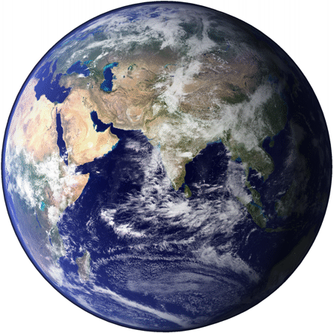
example: solar radiation on earth
photographs sun: NASA, series of images from SOHO - GPN-2002-000120 earth: the blue marble, www.visibleearth.nasa.gov

Slide 22
example: solar radiation on earth
sun
photographs sun: NASA, series of images from SOHO - GPN-2002-000120 earth: the blue marble, www.visibleearth.nasa.gov

Slide 23
example: solar radiation on earth
balance volume, radius R_{sun} = ca. 700 000 km
sun
change inside the balance volume =
+ what is entering
- what is leaving
+ what is produced
- what disappears
photographs sun: NASA, series of images from SOHO - GPN-2002-000120 earth: the blue marble, www.visibleearth.nasa.gov

Slide 24
what is leaving: black-body radiation
Stefan-Boltzmann law for ideally radiating body
Stefan-Boltzmann constant
sun:
P – power, A – area of rading surface, T – absolute temperature

Slide 25
example: solar radiation on earth
sun
earth
ca. 150 million km
photographs sun: NASA, series of images from SOHO - GPN-2002-000120 earth: the blue marble, www.visibleearth.nasa.gov

Slide 26
example: solar radiation on earth
sun
earth
ca. 150 million km
photographs sun: NASA, series of images from SOHO - GPN-2002-000120 earth: the blue marble, www.visibleearth.nasa.gov

Slide 27
example: solar radiation on earth
sun
earth
ca. 150 million km
photographs sun: NASA, series of images from SOHO - GPN-2002-000120 earth: the blue marble, www.visibleearth.nasa.gov

Slide 28
example: solar radiation on earth
sun
1 m²
ca. 150 million km
photographs sun: NASA, series of images from SOHO - GPN-2002-000120 earth: the blue marble, www.visibleearth.nasa.gov

Slide 29
radiation on 1 m² of earth
sun:
area receiving radiation at R = 150 million km:
power of radiation per square meter = solar constant:

Slide 30
example: solar radiation on earth
sun
1 m²
photographs sun: NASA, series of images from SOHO - GPN-2002-000120 earth: the blue marble, www.visibleearth.nasa.gov

Slide 31
example: solar radiation on earth
R_{earth} = 6370 km
sun
photographs sun: NASA, series of images from SOHO - GPN-2002-000120 earth: the blue marble, www.visibleearth.nasa.gov

Slide 32
power of radiation on entire earth
earth:
area receiving radiation:
on entire earth:

Slide 33
example: solar radiation on earth
R_{earth} = 6370 km
sun
photographs sun: NASA, series of images from SOHO - GPN-2002-000120 earth: the blue marble, www.visibleearth.nasa.gov

Slide 34
example: solar radiation on earth
sun
earth
photographs sun: NASA, series of images from SOHO - GPN-2002-000120 earth: the blue marble, www.visibleearth.nasa.gov

Slide 35
power of radiation on earth
earth:
surface of earth:
average on entire earth:

Slide 36
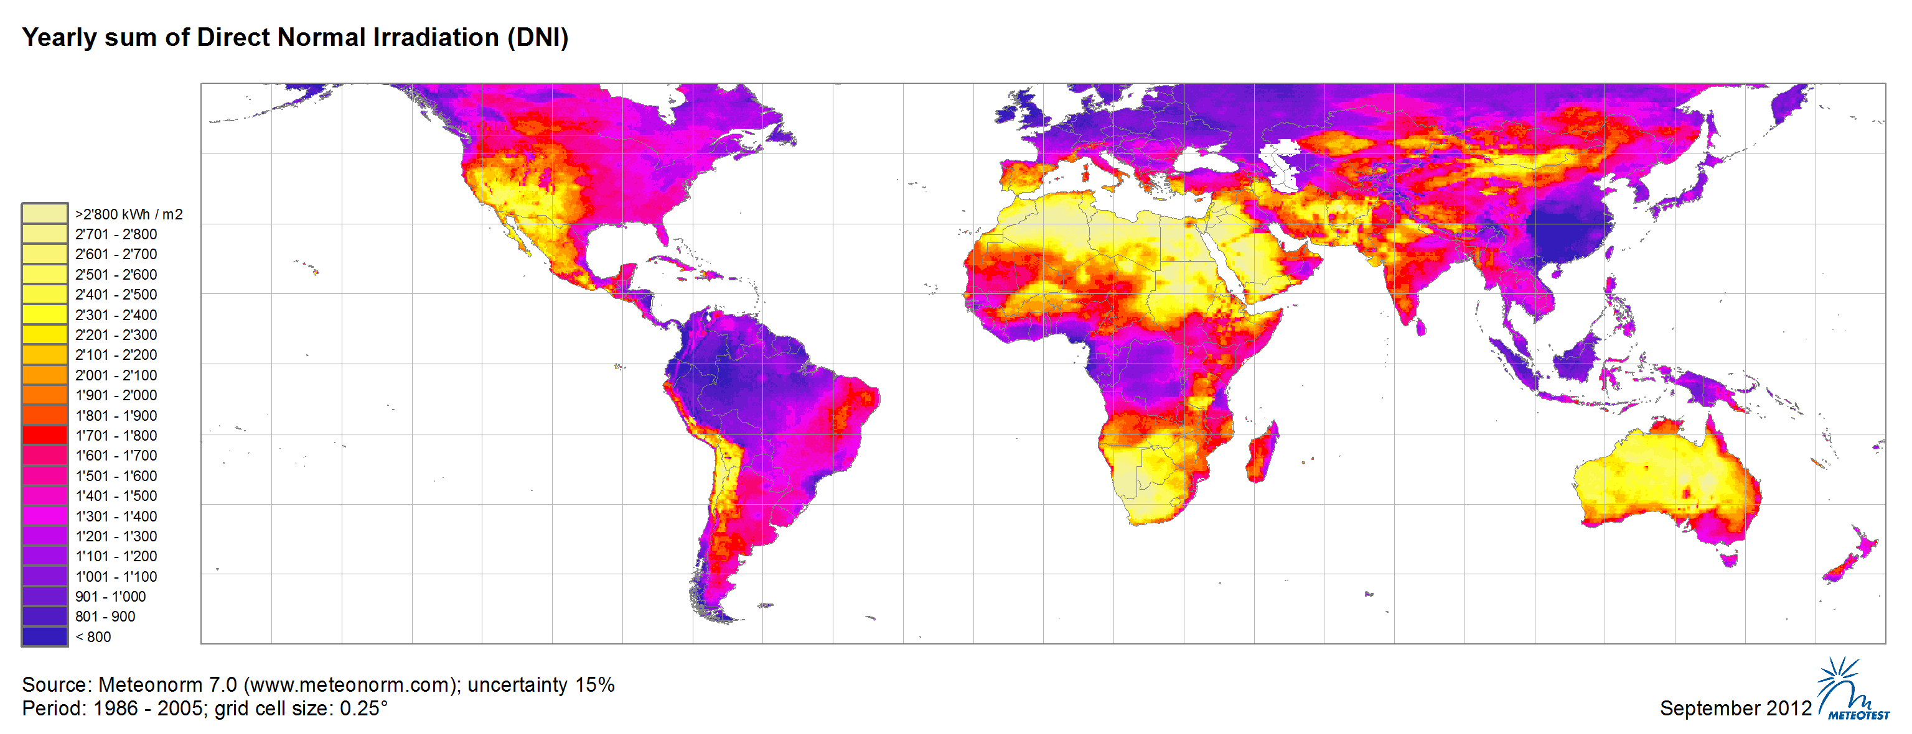
vertical solar power
© METEOTEST; based on www.meteonorm.com

Slide 37
example: solar radiation on earth
sun
earth
photographs sun: NASA, series of images from SOHO - GPN-2002-000120 earth: the blue marble, www.visibleearth.nasa.gov

Slide 38
energy from the sun
photographs sun: NASA, series of images from SOHO - GPN-2002-000120 earth: the blue marble, www.visibleearth.nasa.gov

Slide 39
energy from the sun
balance volume
photographs sun: NASA, series of images from SOHO - GPN-2002-000120 earth: the blue marble, www.visibleearth.nasa.gov

Slide 40
energy from the sun
balance volume
photographs sun: NASA, series of images from SOHO - GPN-2002-000120 earth: the blue marble, www.visibleearth.nasa.gov

Slide 41
energy from the sun
balance volume
photographs sun: NASA, series of images from SOHO - GPN-2002-000120 earth: the blue marble, www.visibleearth.nasa.gov

Slide 42
radiation balance on earth
= 0, steady state
negligible

Slide 43
energy from the sun
balance volume
reflection at the atmosphere
photographs sun: NASA, series of images from SOHO - GPN-2002-000120 earth: the blue marble, www.visibleearth.nasa.gov

Slide 44
radiation balance on earth
degree of reflection
measured: 288 K or +15 °C because of natural and
anthropogenic greenhaouse effect

Slide 45
effect of greenhouse gases
reflection at the atmosphere
atmosphere
longwave radiation
greenhouse gases
shortwave radiation
earth surface

Slide 46
result
temperature of earth results from energy balance
balances are exact and fundamentally valid
all influences need to be considered

Slide 47
agenda
1 motivation
2 balances
3 where are we today?
4 where do we go?
4.1 fossil energy carriers, world population, standard of living
4.2 atmosphere, carbon dioxide, climate
4.3 land area, bio-energy, nutrition
4.4 options for sustainable energy supply
5 what does this mean for us?
6 conclusions

Slide 48
Balances as guides towards a sustainable future
Andreas Pfennig Institute of Chemical Engineering and Environmental Technology TU Graz http://www.sustainicum.at/ http://www.vision3000.eu http://ceet.tugraz.at
Copyright: Creative-Commons-Licence by-nc-sa, where not with others

Slide 49
agenda
1 motivation
2 balances
3 where are we today?
4 where do we go?
4.1 fossil energy carriers, world population, standard of living
4.2 atmosphere, carbon dioxide, climate
4.3 land area, bio-energy, nutrition
4.4 options for sustainable energy supply
5 what does this mean for us?
6 conclusions

Slide 50
definitions
reserves: geologically and technically proven amounts of crude oil, coal, natural gas, etc., which can be extracted economically with technologies available today
resources: amount of a raw material, the technical and economical extraction of which is still uncertain, which can nevertheless be expected based on geological indicators.
B. Hillemeier (Ed.) 2006: Die Zukunft der Energieversorgung in Deutschland. acatech SYMPOSIUM, 21. NOVEMBER 2006

Slide 51
energy
reserves consumption
Gt Gt/a
crude oil 225 4.1
natural gas 154 2.4
coal 860 7.7
CO₂ 34.0
primary energy carriers 143 PWh/a
electricity 22 PWh/a
a = year
G = 1 000 000 000
P = 1 000 000 000 000 000

Slide 52
population
population
million
world 6 970
Austria 8.4
Germany 82
USA 313
EU-27 502
Russia 142
America 943
Africa 1 070
China 1 379
India 1 241

Slide 53
energy
reserves consumption
t/capita kg/(capita a) kg/(capita d)
crude oil 32 582 1.6
natural gas 22 342 0.9
coal 122 1 104 3.0
sum 177 2 028 5.6
CO₂ 4 880 13.4
primary energy 20 480 kWh/(capita a) 56 kWh/(capita d)
electricity 3 160 kWh/(capita a) 9 kWh/(capita d)
a = year
d = day

Slide 54
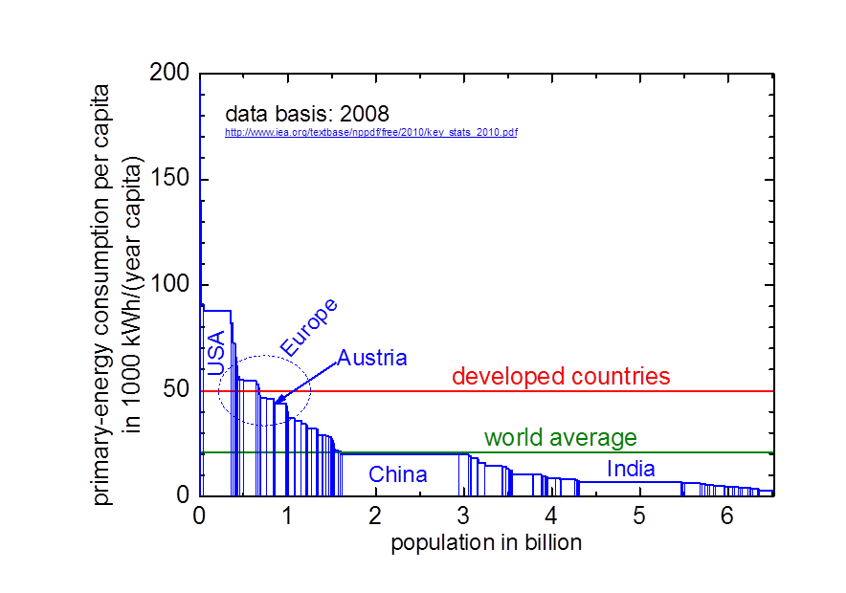
prinmary-energy consumption

Slide 55
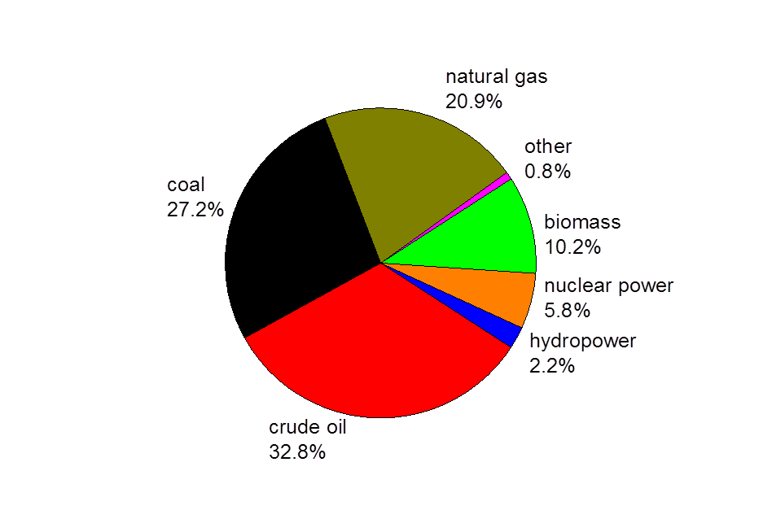
distribution of global consumption 2009
International Energy Agency, 2011 Key World Energy Statistics

Slide 56
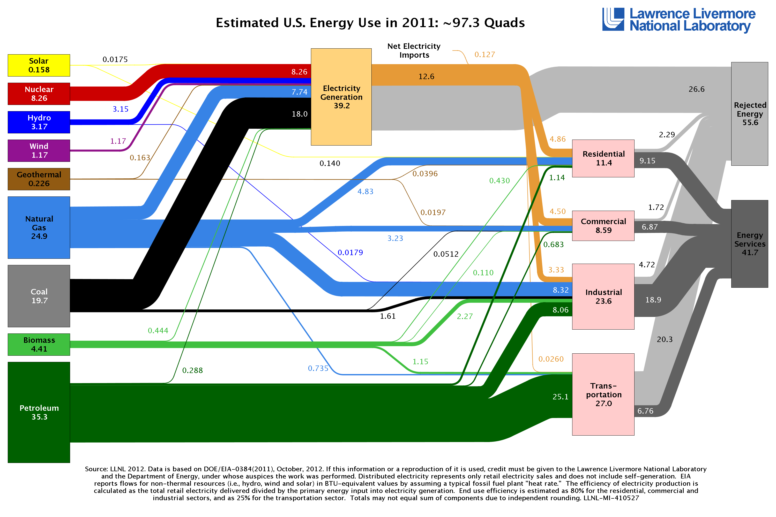
US energy flow chart 2011
source: http://commons.wikimedia.org/wiki/File:LLNLUSEnergy2011.png

Slide 57
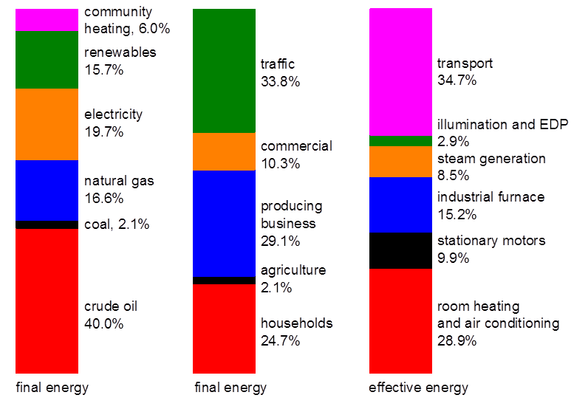
energy profiles for Austria 2009
Energie-Control Austria, Statistikbroschüre 2011

Slide 58
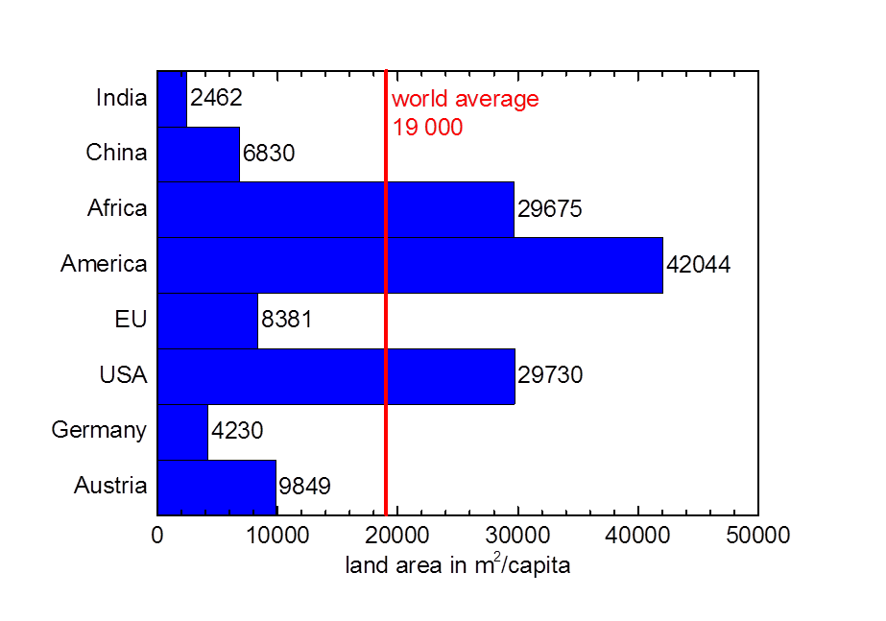
land area per capita
http://faostat.fao.org/

Slide 59
earth surface
m²/capita
sea 51 700
total land area 18 600
agricultural land area 7 000
arable land & permanent crops 2 200
pastures & permanent meadows 4 800
forests 5 800

Slide 60
agriculture
kg/(capita day)
plant-based food 2.26
animal-based food 0.52
other utilization of plants 0.14
paper and cardboard 0.16
wood and wood products 0.61
sum 3.55

Slide 61
nutrition
produced: supplied at consumer:
kcal/(capita d) kcal/(capita d)
corn 1 018 plant-based products 2 330
wheat 792 animal-based products 501
rice 691
soy beans 308 sum 2 831
sugar cane 192
barley 153
rape 103
potatoes 92 cassava 84
vegetables etc. 824
sum 4 257

Slide 62
plant-based food in Germany
energy density
kcal/(m² a)
tomatoes 3 050
corn 2 740
potatoes 2 560
wheat 2 261
carrots 1 450
apples 1 430
cabbage 990
cauliflower & broccoli 450
cucumber 292
salad 230
asparagus 50

Slide 63
nutrition
plant-based:
produced 4257 kcal/(capita day)
at consumer 2330 kcal/(capita day)
animal-based:
at consumer 501 kcal/(capita day)
land area:
arable land & permanent crops 2200 m²/capita
pastures & permanent meadows 4800 m²/capita

Slide 64
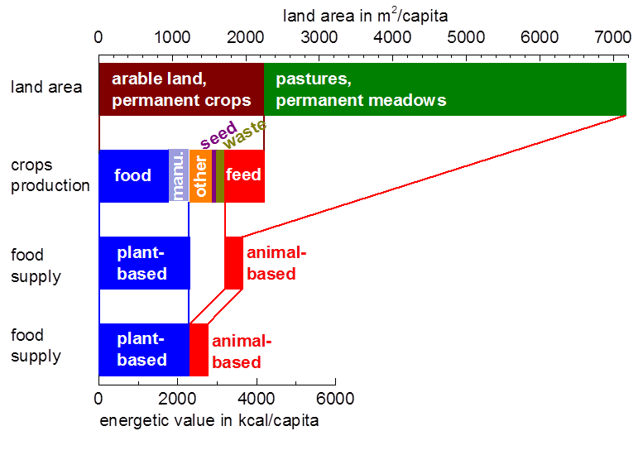
land-area utilization

Slide 65
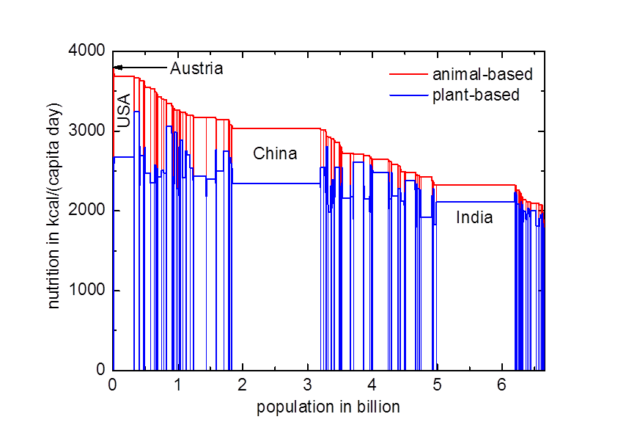
distribution of nutrition by country
2009
http://faostat.fao.org/

Slide 66
summing up 1
quantitative values
per-capita values
fossil = 1.5 * renewables
animal-based food - very excessive use of resources

Slide 67
agenda
1 motivation
2 balances
3 where are we today?
4 where do we go?
4.1 fossil energy carriers, world population, standard of living
4.2 atmosphere, carbon dioxide, climate
4.3 land area, bio-energy, nutrition
4.4 options for sustainable energy supply
5 what does this mean for us?
6 conclusions

Slide 68
Balances as guides towards a sustainable future
Andreas Pfennig Institute of Chemical Engineering and Environmental Technology TU Graz http://www.sustainicum.at/ http://www.vision3000.eu http://ceet.tugraz.at
Copyright: Creative-Commons-Licence by-nc-sa, where not with others

Slide 69
agenda
1 motivation
2 balances
3 where are we today?
4 where do we go?
4.1 fossil energy carriers, world population, standard of living
4.2 atmosphere, carbon dioxide, climate
4.3 land area, bio-energy, nutrition
4.4 options for sustainable energy supply
5 what does this mean for us?
6 conclusions

Slide 70
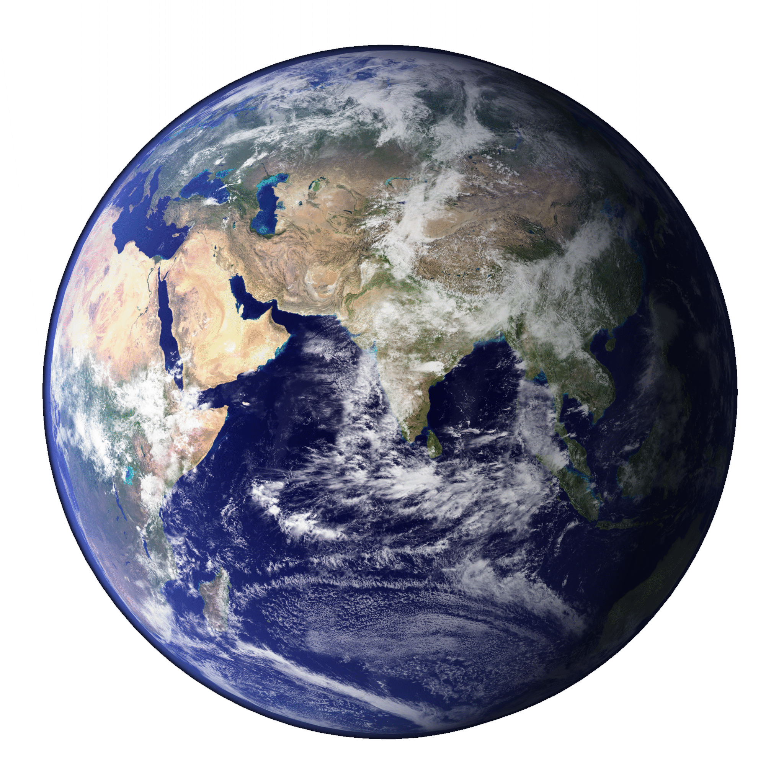
global balances
biosphere
atmosphere
mining, burning
lithosphere: fossil energy
carriers
change in reserve = -- mining
earth: the blue marble, www.visibleearth.nasa.gov

Slide 71
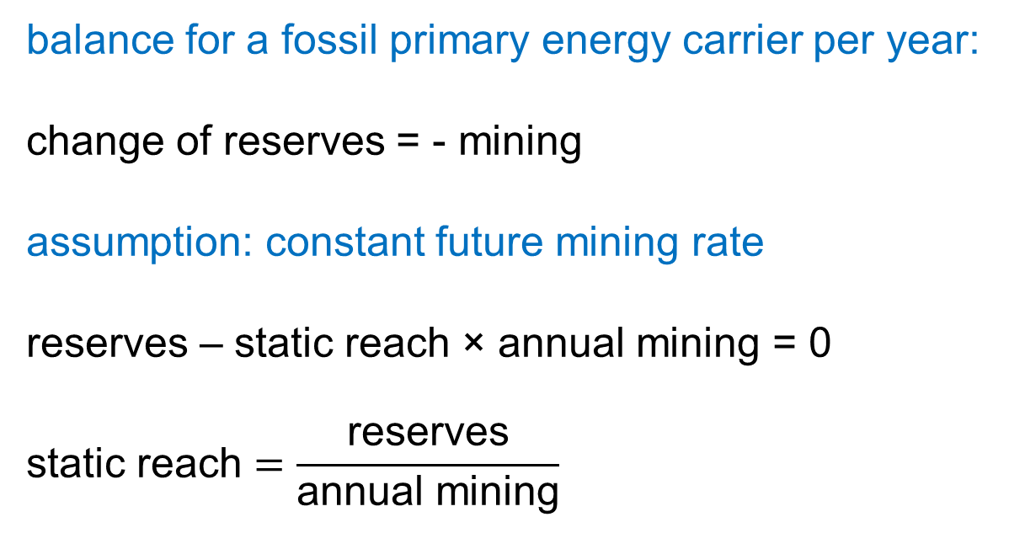
static reach
balance for a fossil primary energy carrier per year:
change of reserves = - mining
assumption: constant future mining rate
reserves – static reach × annual mining = 0
$$\text{static} \text{reach}=\frac{\text{reserves}}{\text{annual} \text{mining}}$$

Slide 72
static reach
static reach
crude oil 55 years
natural gas 65 years
coal 112 years

Slide 73
model inaccuracies
parameter uncertainties
model uncertainties
uncertainty
ignorance
risk

Slide 74
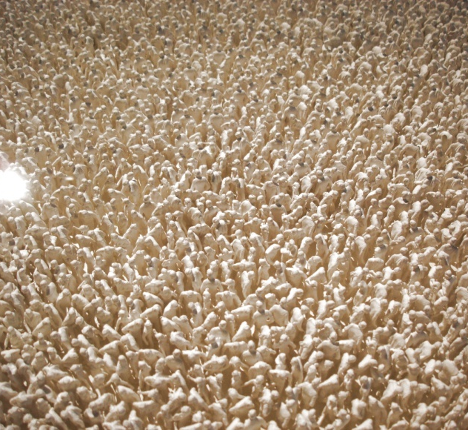
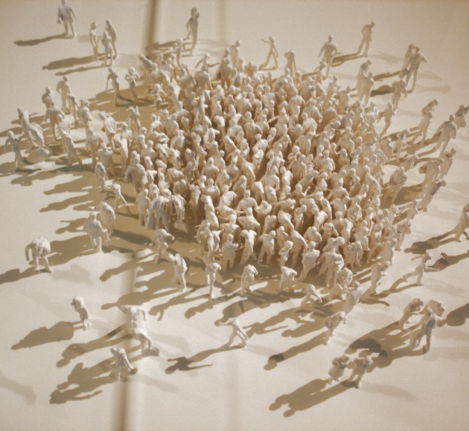
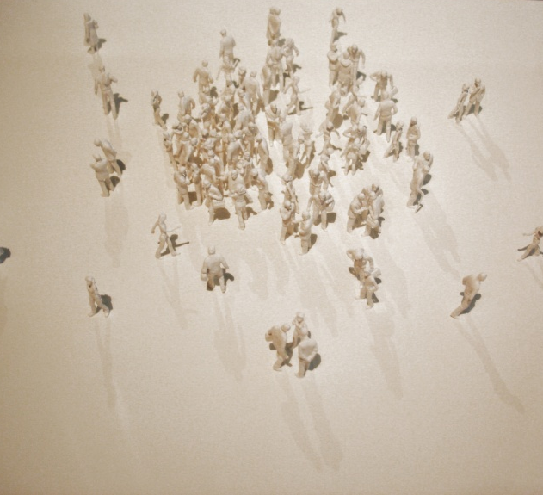
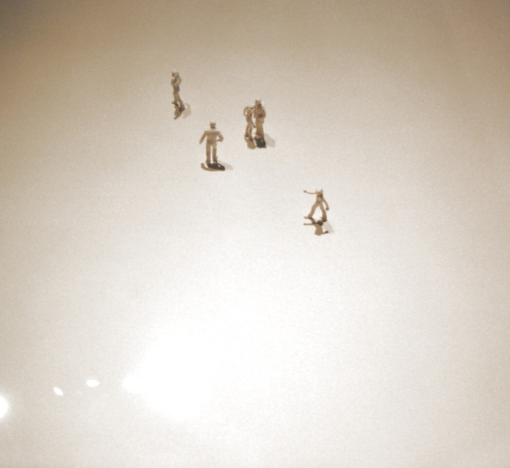
development of world population
2006
1850
0
-10 000
photos: A. Pfennig from the
Neanderthal Museum, Mettmann

Slide 75
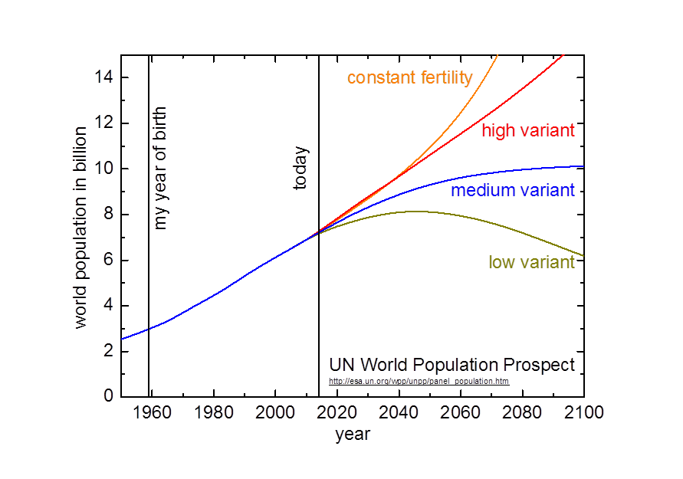
world population

Slide 76
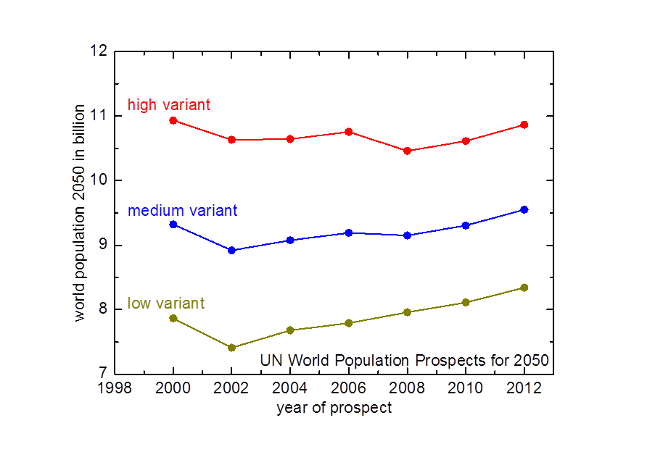
development of prediction for 2050

Slide 77
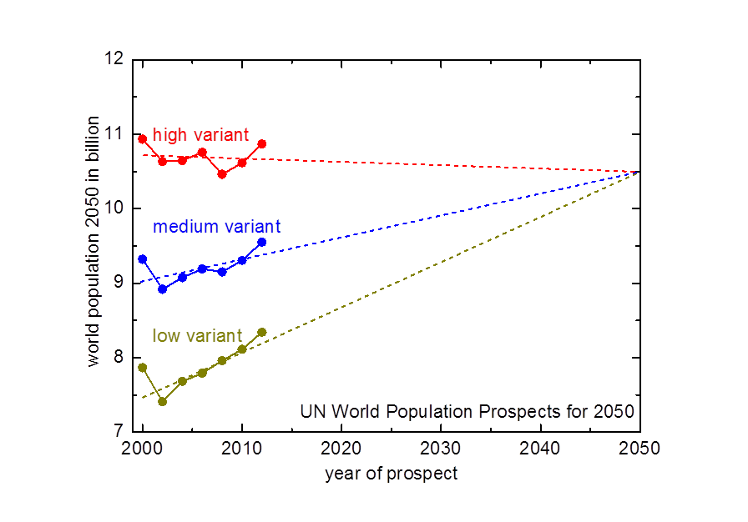
development of prediction for 2050

Slide 78
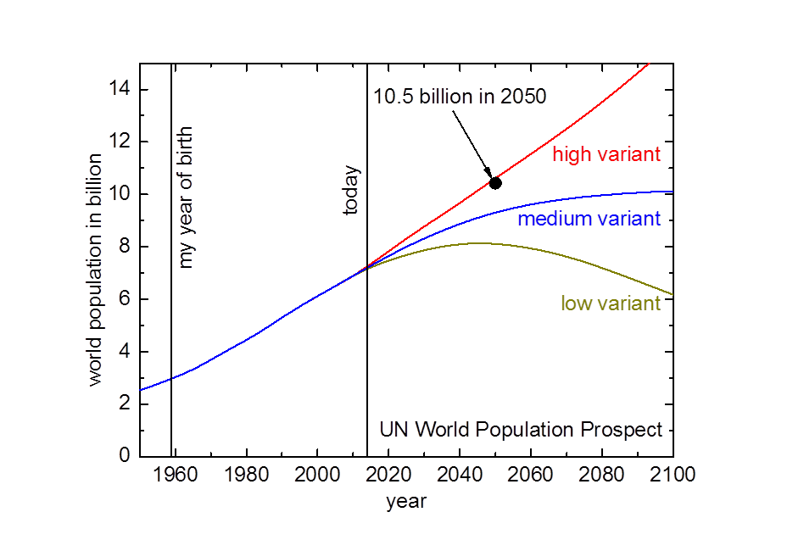
world population prospect

Slide 79
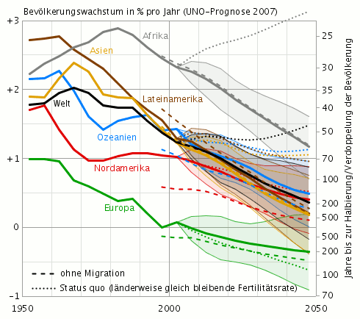
Basis der UN-Prognose
http://commons.wikimedia.org/wiki/File:UNO-Bevölkerungswachstumsanalyse und -prognose (1950–2050).png

Slide 80
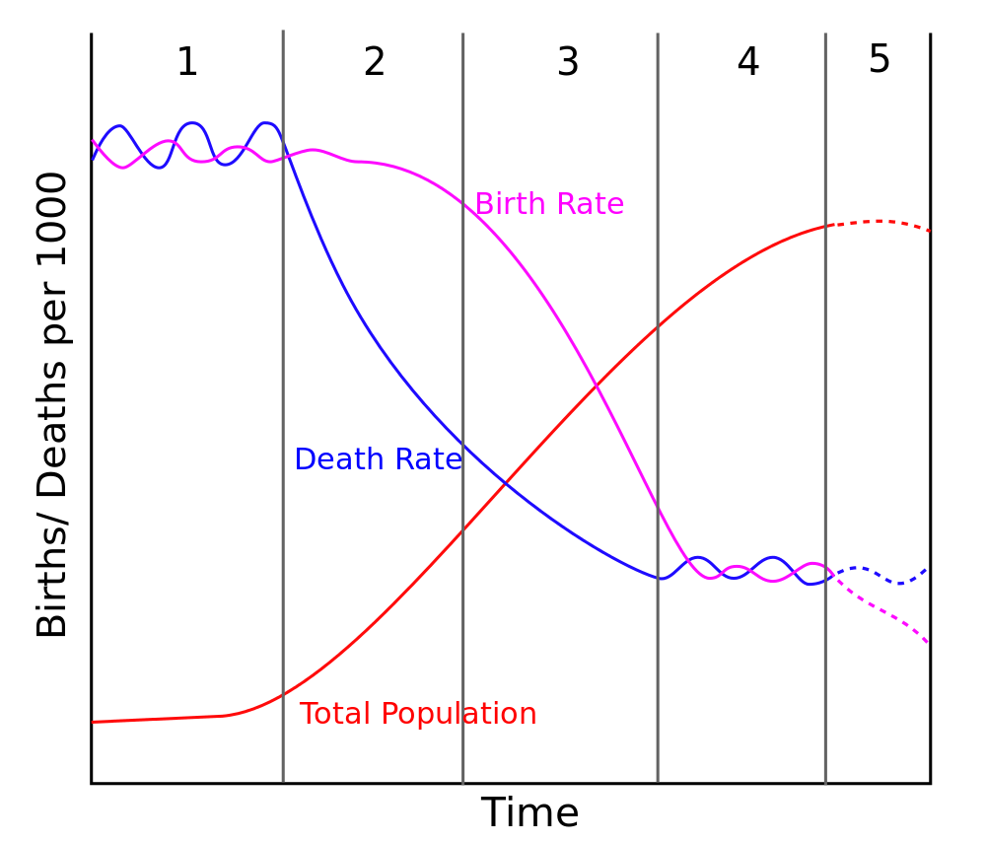
demographic transition model
source: http://en.wikipedia.org/wiki/File:Stage5.svg

Slide 81
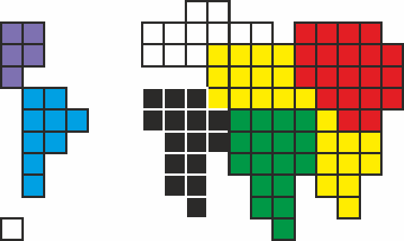
distribution of world population
Europe
China
America
Africa
Asia
= 1%
India

Slide 82
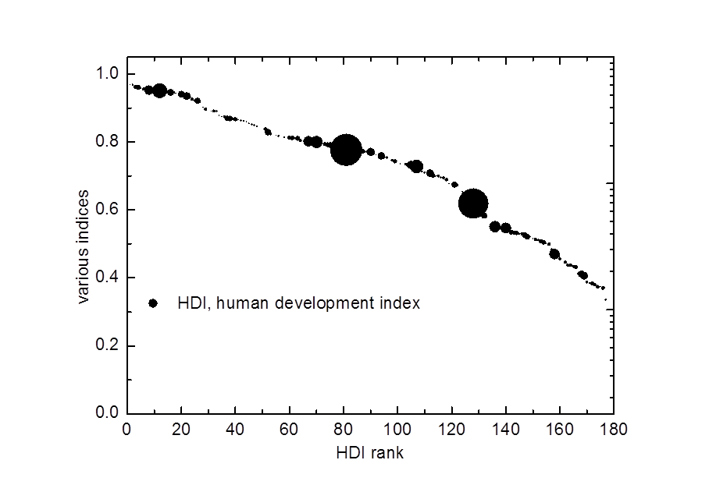
Human Development Index
http://hdr.undp.org/en/reports/global/hdr2007-8/

Slide 83
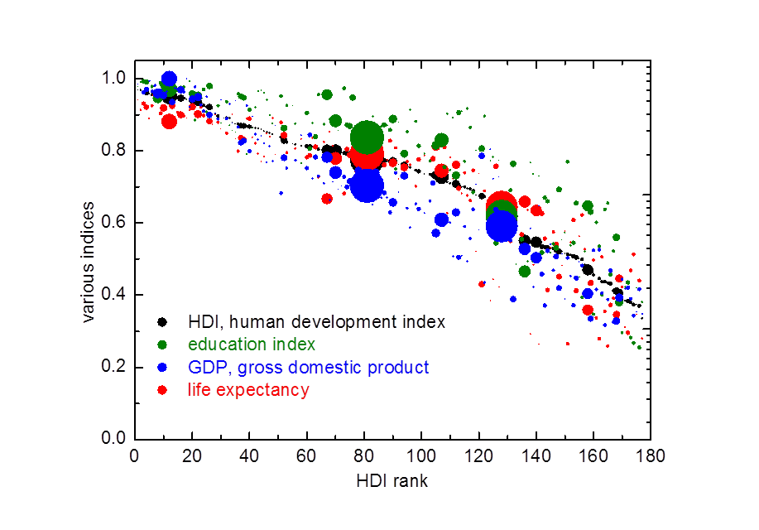
Human Development Index
http://hdr.undp.org/en/reports/global/hdr2007-8/

Slide 84
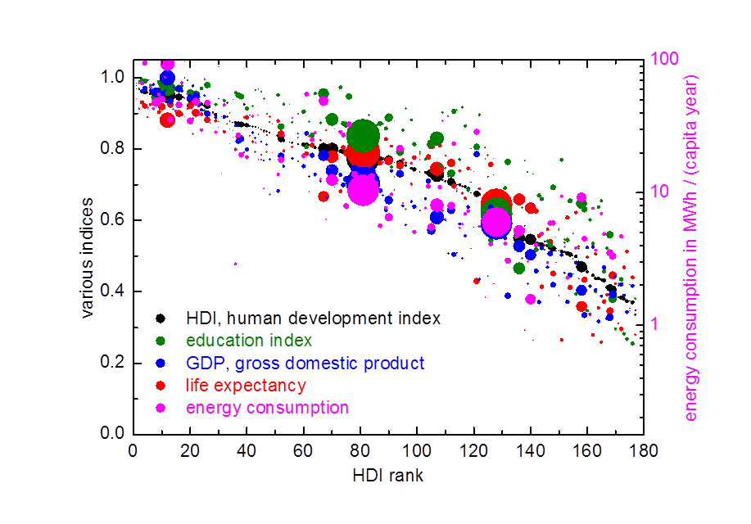
Human Development Index
http://hdr.undp.org/en/reports/global/hdr2007-8/

Slide 85
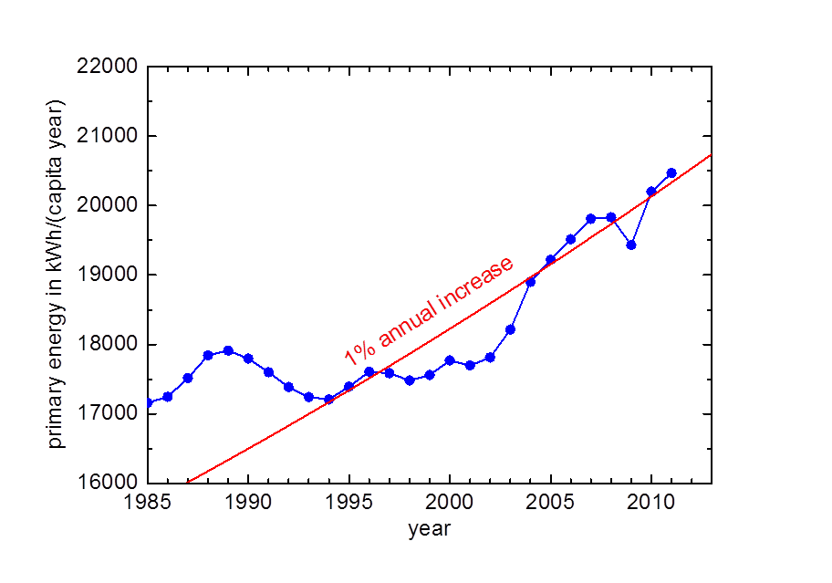
consumption primary energy carriers
http://www.bp.com/statisticalreview
http://faostat.fao.org/

Slide 86
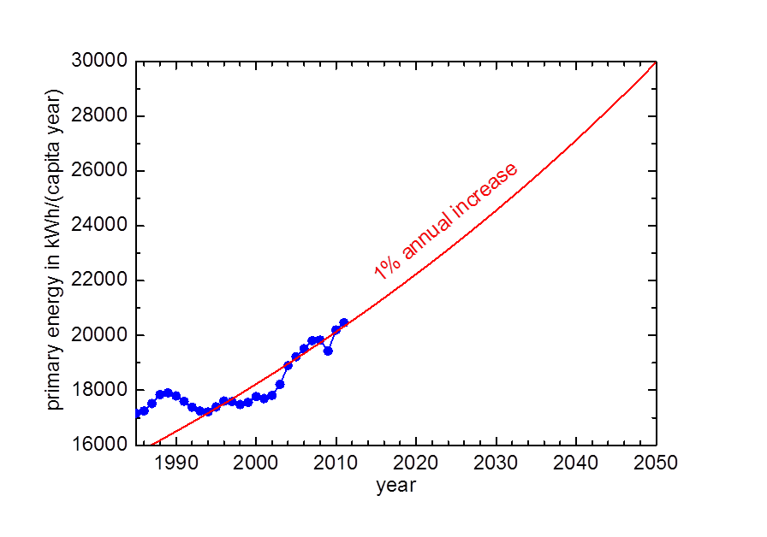
consumption primary energy carriers
http://www.bp.com/statisticalreview
http://faostat.fao.org/

Slide 87
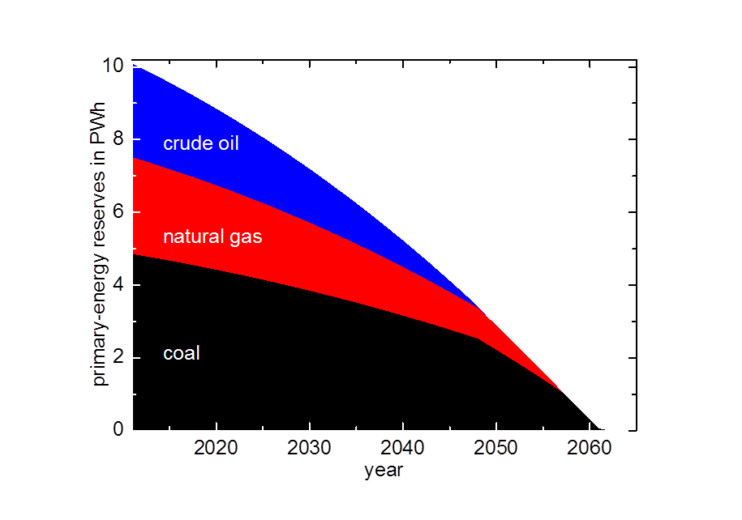
reserves of fossil primary-energy carriers

Slide 88
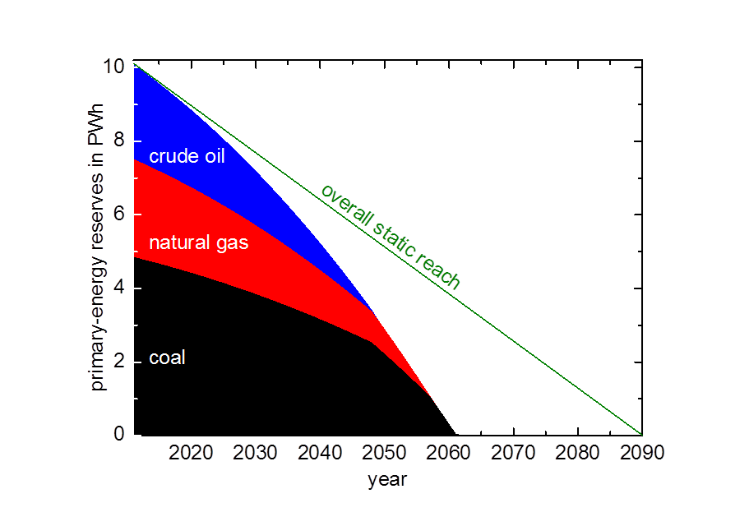
reserves of fossil primary-energy carriers

Slide 89
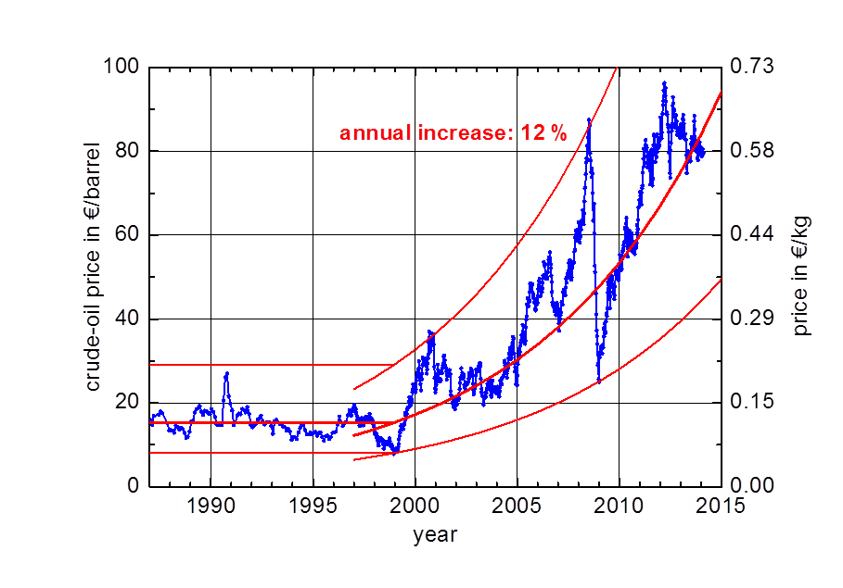
development of crude-oil price

Slide 90
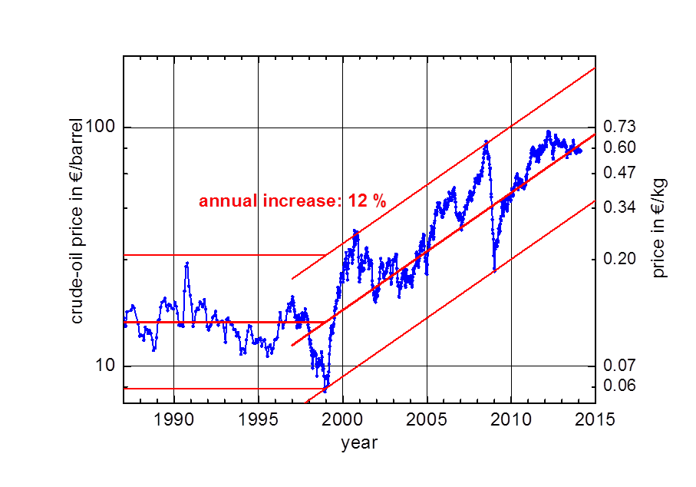
development of crude-oil price

Slide 91
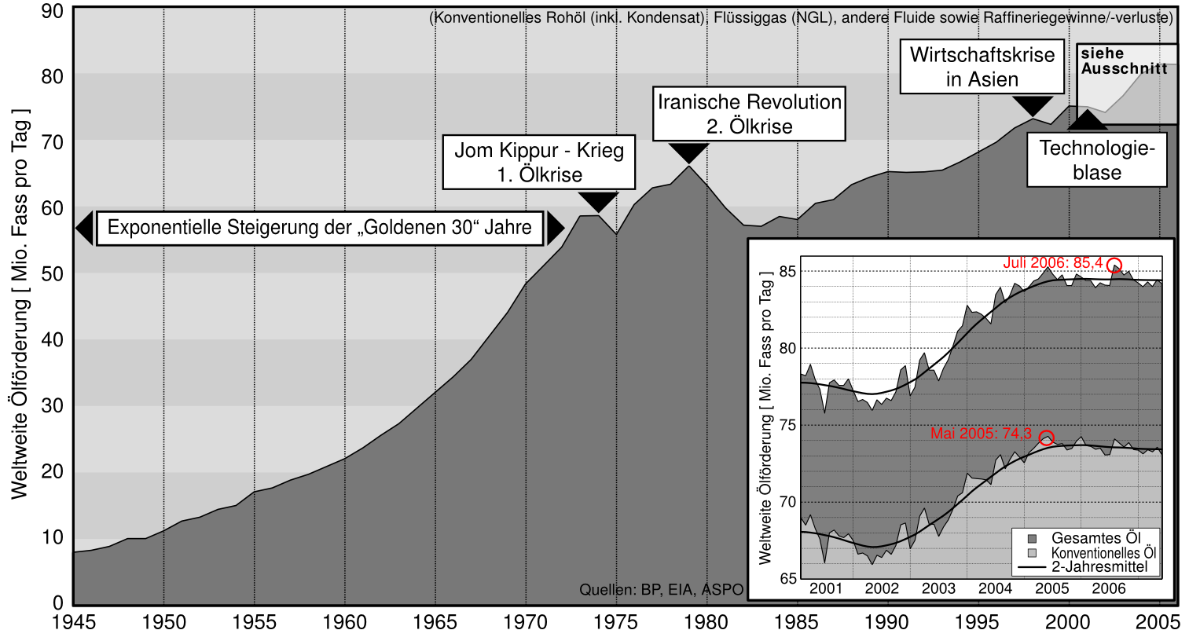
Erdölfördermaximum, Peak Oil
http://upload.wikimedia.org/wikipedia/de/5/58/Weltweite-Erdölproduktion-Grafik.png

Slide 92
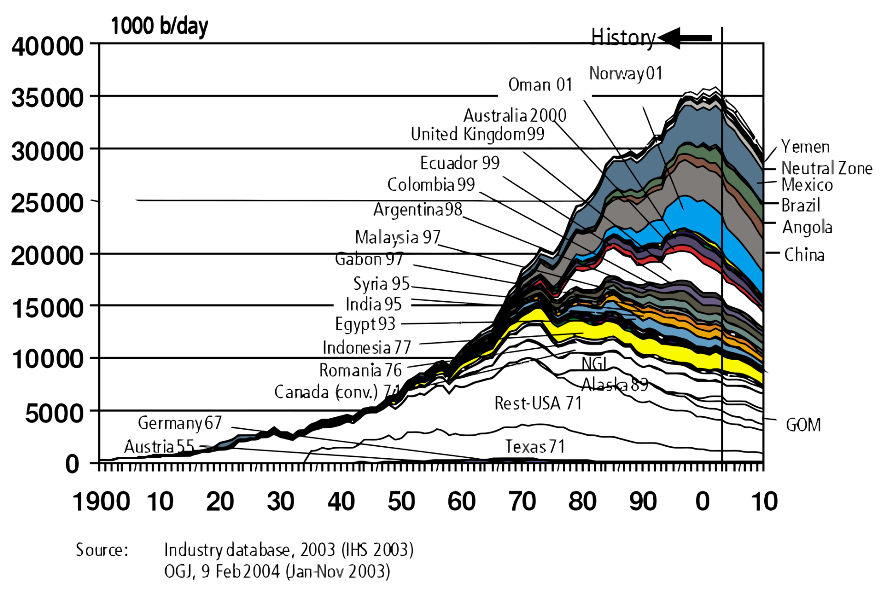
maximum crude-oil production, peak oil
1900 1920 1940 1960 1980 2000
http://en.wikipedia.org/wiki/File:Hubbert_world_2004.svg

Slide 93
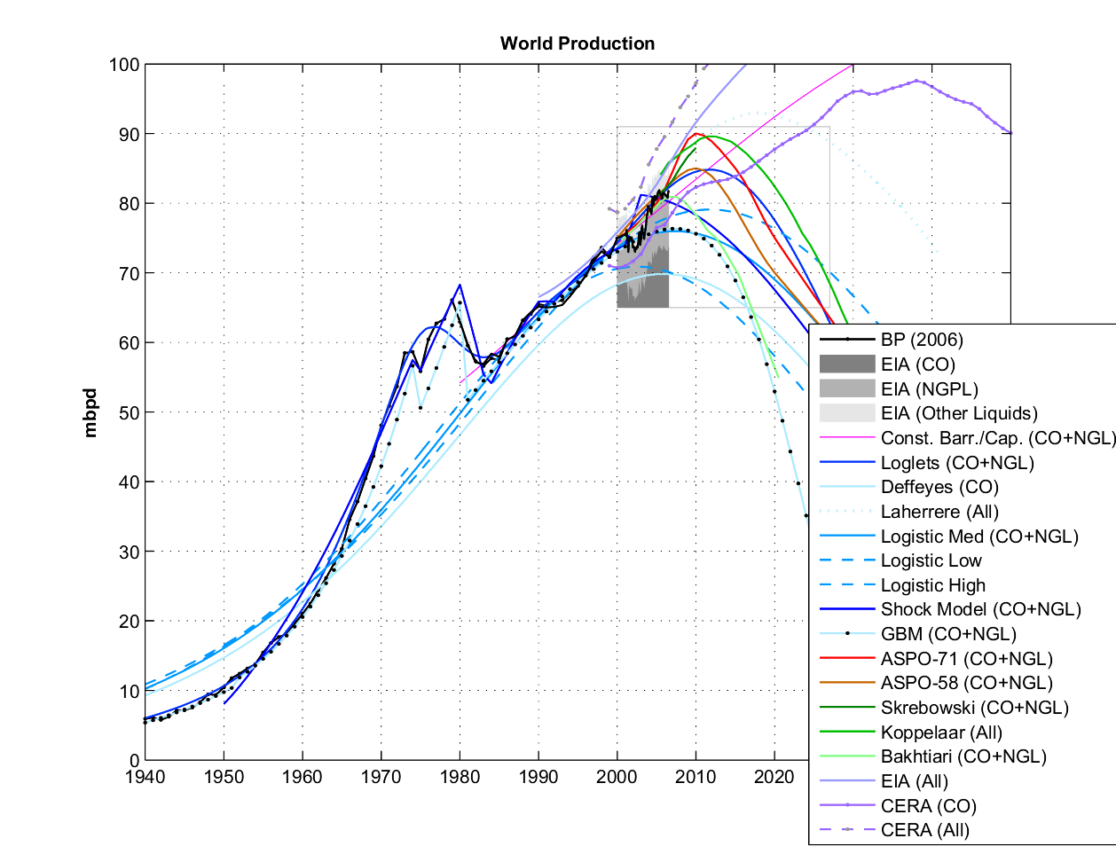
prediction of crude-oil production
Made by Khebab of The Oil Drum, http://en.wikipedia.org/wiki/File:PU200611_Fig1.png

Slide 94
maximum of oil mining, Peak Oil
Handelsblatt
03.12.2005 The supply will be scarcer from now on. Peak Oil has been passed.
Frankfurter Allgemeine
25.01.2006 Peak Oil – oil production has reached its maximum

Slide 95
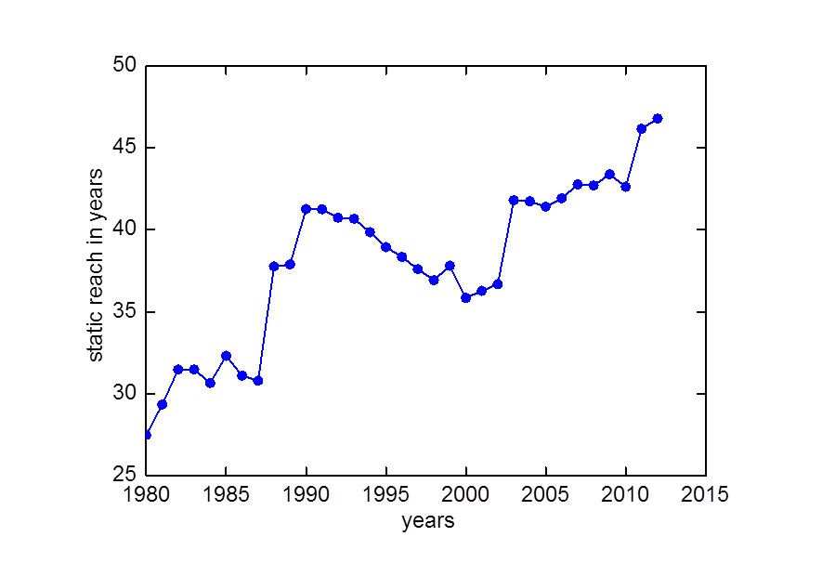
development of static reach of crude oil

Slide 96
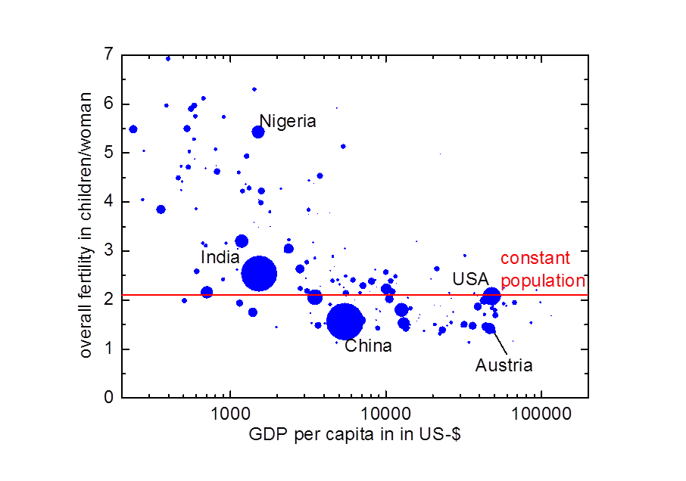
fertility and gross domestic product
2011, 2012
http://data.un.org/

Slide 97
summing up 2
amount of primary energy carriers isn‘t critical
but: energy price!
developing countries will face difficulties - and that is a global problem

Slide 98
agenda
1 motivation
2 balances
3 where are we today?
4 where do we go?
4.1 fossil energy carriers, world population, standard of living
4.2 atmosphere, carbon dioxide, climate
4.3 land area, bio-energy, nutrition
4.4 options for sustainable energy supply
5 what does this mean for us?
6 conclusions

Slide 99
Balances as guides towards a sustainable future
Andreas Pfennig Institute of Chemical Engineering and Environmental Technology TU Graz http://www.sustainicum.at/ http://www.vision3000.eu http://ceet.tugraz.at
Copyright: Creative-Commons-Licence by-nc-sa, where not with others

Slide 100
agenda
1 motivation
2 balances
3 where are we today?
4 where do we go?
4.1 fossil energy carriers, world population, standard of living
4.2 atmosphere, carbon dioxide, climate
4.3 land area, bio-energy, nutrition
4.4 options for sustainable energy supply
5 what does this mean for us?
6 conclusions

Slide 101
global balances
biosphere
atmosphere
mining, burning
lithosphere: fossil energy
carriers
change in atmosphere = α burning
earth: the blue marble, www.visibleearth.nasa.gov

Slide 102
contribution to CO₂ emissions
after: Stern-Report: http://www.hm-treasury.gov.uk/d/Executive_Summary.pdf

Slide 103
carbon cycle
source: U.S. Department of Energy Genomic Science program, http://genomicscience.energy.gov
α > 0.44

Slide 104
CO₂ content at Mauna Loa, Hawaii

Slide 105
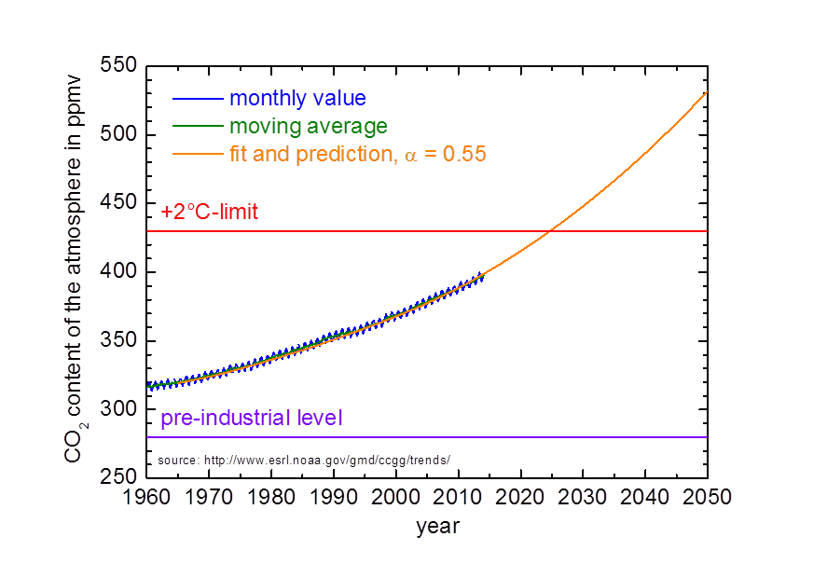
CO₂ content of the atmosphere
530 ppmv

Slide 106
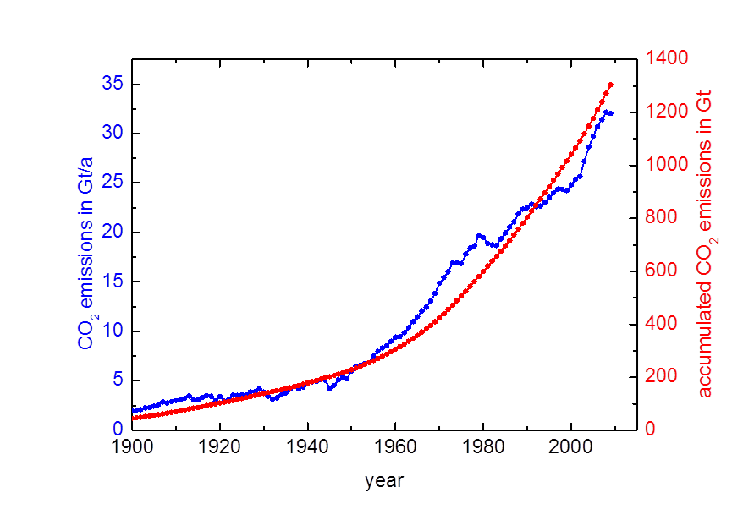
release and accumulated release

Slide 107
temperature and CO₂ according to IPCC
http://www.ipcc.ch/graphics/ar4-wg3/jpg/spm8.jpg
with kind permission: Based on Climate Change 2007: Mitigation of Climate Change. Working Group III Contribution to the Fourth Assessment Report of the Intergovernmental Panel on Climate Change, Figure SPM.8. Cambridge University Press.

Slide 108
temperature and CO₂ according to IPCC
http://www.ipcc.ch/graphics/ar4-wg3/jpg/spm8.jpg
today‘s level
with kind permission: Based on Climate Change 2007: Mitigation of Climate Change. Working Group III Contribution to the Fourth Assessment Report of the Intergovernmental Panel on Climate Change, Figure SPM.8. Cambridge University Press.

Slide 109
temperature and CO₂ according to IPCC
http://www.ipcc.ch/graphics/ar4-wg3/jpg/spm8.jpg
+2°C-society
today‘s level
with kind permission: Based on Climate Change 2007: Mitigation of Climate Change. Working Group III Contribution to the Fourth Assessment Report of the Intergovernmental Panel on Climate Change, Figure SPM.8. Cambridge University Press.

Slide 110
temperature and CO₂ according to IPCC
http://www.ipcc.ch/graphics/ar4-wg3/jpg/spm8.jpg
projection 2050
+2°C-society
today‘s level
with kind permission: Based on Climate Change 2007: Mitigation of Climate Change. Working Group III Contribution to the Fourth Assessment Report of the Intergovernmental Panel on Climate Change, Figure SPM.8. Cambridge University Press.

Slide 111
retreat: Briksdal glacier, Norway
http://commons.wikimedia.org/w/index.php?title=File:Briksdalsbreen_Norway_2003_&_2008.JPG

Slide 112
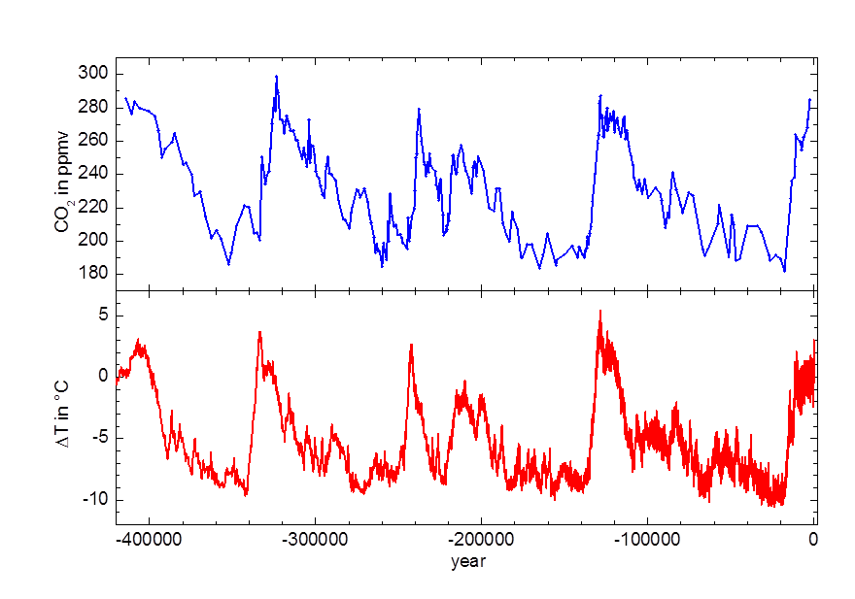
data from ice cores
ΔCO₂ = 70 ppmv
ΔT = 7°C
http://doi.pangaea.de/10.1594/PANGAEA.55501
http://doi.pangaea.de/10.1594/PANGAEA.683655

Slide 113
temperature and CO₂ according to IPCC
http://www.ipcc.ch/graphics/ar4-wg3/jpg/spm8.jpg
1°C = 10 ppmv
with kind permission: Based on Climate Change 2007: Mitigation of Climate Change. Working Group III Contribution to the Fourth Assessment Report of the Intergovernmental Panel on Climate Change, Figure SPM.8. Cambridge University Press.

Slide 114
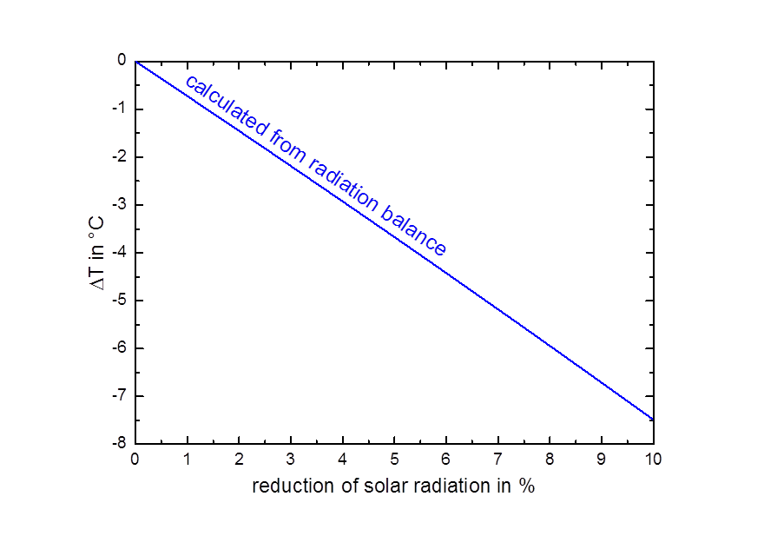
reduced solar radiation: global dimming
estimated reduction due to air pollution today

Slide 115
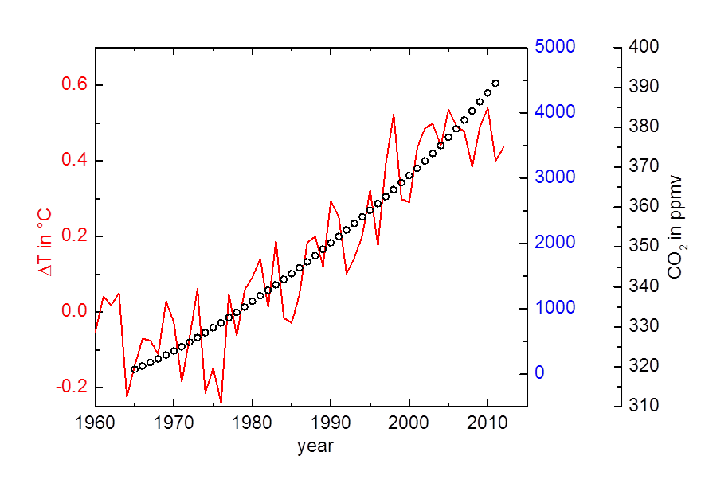
influence on temperature?

Slide 116
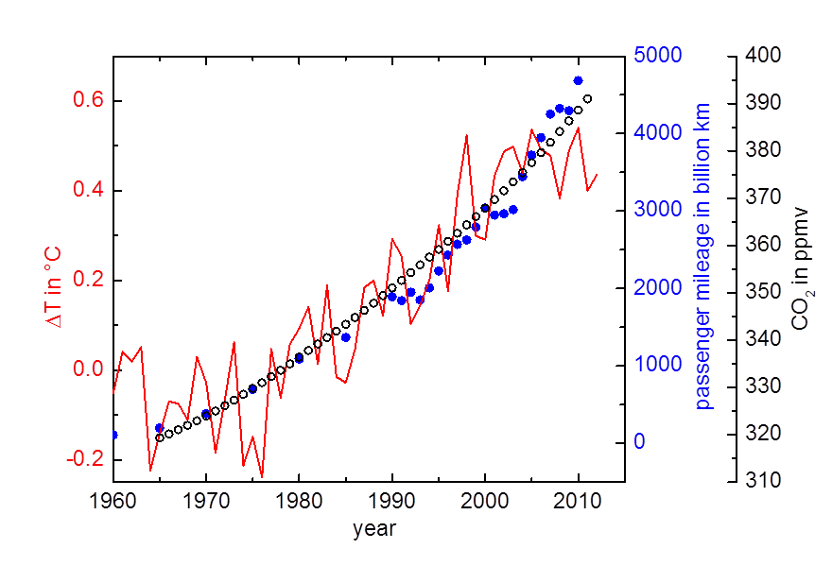
influence on temperature?

Slide 117
summing up 3
CO₂ and +2°C-limit are critical
global dimming
system little understood (ignorance)

Slide 118
agenda
1 motivation
2 balances
3 where are we today?
4 where do we go?
4.1 fossil energy carriers, world population, standard of living
4.2 atmosphere, carbon dioxide, climate
4.3 land area, bio-energy, nutrition
4.4 options for sustainable energy supply
5 what does this mean for us?
6 conclusions

Slide 119
Balances as guides towards a sustainable future
Andreas Pfennig Institute of Chemical Engineering and Environmental Technology TU Graz http://www.sustainicum.at/ http://www.vision3000.eu http://ceet.tugraz.at
Copyright: Creative-Commons-Licence by-nc-sa, where not with others

Slide 120
agenda
1 motivation
2 balances
3 where are we today?
4 where do we go?
4.1 fossil energy carriers, world population, standard of living
4.2 atmosphere, carbon dioxide, climate
4.3 land area, bio-energy, nutrition
4.4 options for sustainable energy supply
5 what does this mean for us?
6 conclusions

Slide 121
food vs. fuel
Misereor warns against extended use of biofuel
Aachener Nachrichten 20.02.2009

Slide 122
food vs. fuel
DER TAGESSPIEGEL
Threat of a ''global desaster''?
Exploding prices for food, starvation, bloody riots about food as well as water shortage – dramatic challenges for millions of people.
02.06.2008

Slide 123
nutrition
plant-based:
produced 4257 kcal/(capita day)
at consumer 2330 kcal/(capita day)
animal-based:
at consumer 501 kcal/(capita day)
land area:
arable land & permanent crops 2200 m²/capita
pastures & meadows 4800 m²/capita

Slide 124
“static” scenario per capita
2011 2050
low medium high
m² m² m² m²
agriculture 7 000 6 050 5250 4 600
of this: arable 2 200 1 900 1 650 1 450
of this: pasture 4 800 4 150 3 600 3 150
forest 5 800 4 950 4 300 3 800
kcal/d kcal/d kcal/d kcal/d
nutrition 2 831 2 434 2 122 1 860

Slide 125
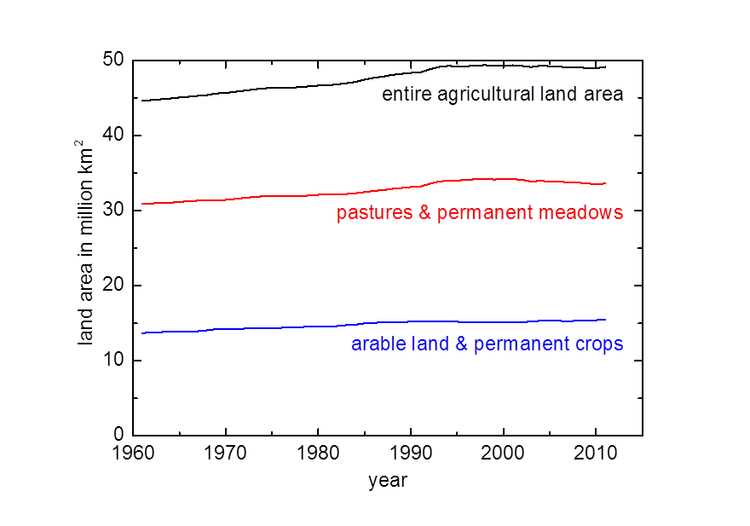
agricultural land area
http://faostat.fao.org/

Slide 126
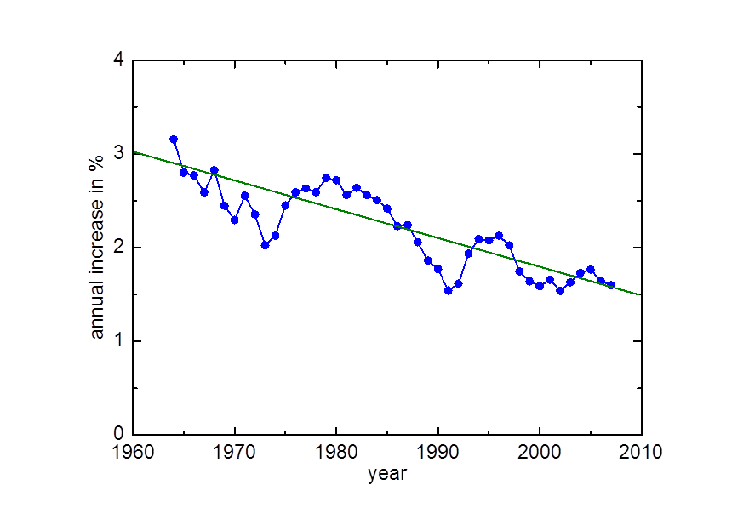
end-kcal per agricultural land area
http://faostat.fao.org/

Slide 127
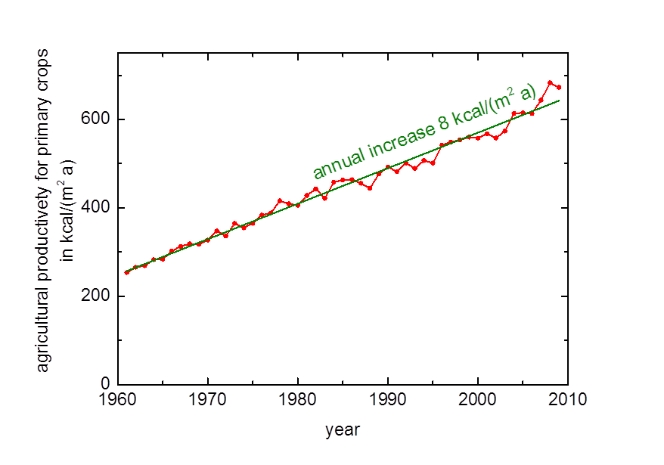
primary crops productivity

Slide 128

contribution of animal-based food
http://faostat.fao.org/

Slide 129

development of nutrition
today

Slide 130
ecological scenario per capita
per capita 2011 2050
low medium high m² m² m² m²
agriculture 7 000 6 050 5 250 4 600
of this arable 1 500 1 500 1 500 1 500
for bioenergy 4 550 3 800 3 100 3 150
forst 5 800 4 950 4 300 3 800
kWh/a kWh/a kWh/a kWh/a
bioenery 13 850 11 400 9 450 7 800
at 2.5 kWh/(m² a)

Slide 131
solar energy in Germany
solar radiation ca. 1000 kWh/(m² a)
biodiesel 1.5 kWh/(m² a)
biogas 2.5 kWh/(m² a)
biomass to liquid (BtL) 3 kWh/(m² a)
photovoltaic today >95 kWh/(m² a)

Slide 132
potential for bioenergy in 2050
bioenergy potential in GJ/(ha a)
with kind permission: WBGU – Wissenschaftlicher Beirat Globale Umweltveränderungen (2009): Factsheet 1/2009: Bioenergie. Berlin: WBGU.
http://www.wbgu.de/fileadmin/templates/dateien/veroeffentlichungen/factsheets/fs2009-fs1/wbgu_factsheet_1.pdf

Slide 133
summing up 4
nutrition is not a problem of the future, already today unevenly distributed and scarce
problem: sumptuous living vs. hunger
bioenergie no appreciable option
but: biomass for biobased materials

Slide 134
agenda
1 motivation
2 balances
3 where are we today?
4 where do we go?
4.1 fossil energy carriers, world population, standard of living
4.2 atmosphere, carbon dioxide, climate
4.3 land area, bio-energy, nutrition
4.4 options for sustainable energy supply
5 what does this mean for us?
6 conclusions

Slide 135
sustainability
Humanity has the ability to make development sustainable to ensure that it meets the needs of the present without compromising the ability of future generations to meet their own needs.
Brundtland report: Our Common Future, 1987
Gro Harlem Brundtland, Oslo, Norway, March 20, 1987

Slide 136
possible alternatives
nuclear fission
nuclear fusion
fossil with CCS: Carbon Capture and Sequestration
wave and tidal powerplant
hydropower
wind energy
geothermal energy
biomass
solar thermal power
photovoltaics
...

Slide 137

solarthermal powerplant Andasol 1
http://en.wikipedia.org/wiki/File:12-05-08_AS1.JPG

Slide 138
cost comparison for renewable electricity
production cost for electricity
Euro/kWh
photovoltaics, small devices 0.14 - 0.16
photovoltaics, open field, Germany 0.13 - 0.14
photovoltaics, open field, Spain 0.10
onshore wind energy 0.06 - 0.08
offshore wind energy 0.11 - 0.16
solarthermal energy Spain 0.18 - 0.24
Kost et al., 2012: Studie Stromgestehungskosten Erneuerbare Energien, Version: 30. MAI 2012

Slide 139
learning curve: basic equation
exponential relation between cost and cumulated market:
price at a start time
cumulated market at start time
price at a later time
cumulated market at this later time
positive learning factor

Slide 140

learning curve for photovoltaic modules
20% price reduction at doubling of installed power
after: Photovoltaics Report, Fraunhofer ISE, version of November 7, 2013 http://www.ise.fraunhofer.de/de/downloads/pdf-files/aktuelles/photovoltaics-report-in-englischer-sprache.pdf

Slide 141

future development
s. auch: Fayyaz, Frenzel, Köster, et al.: Wie können wir zukünftig ausreichend Energie nachhaltig bereitstellen? CLB Chemie in Labor und Biotechnik, 60. Jahrgang, Heft 01-02/2009, S. 32-39

Slide 142
summing up 5
promote/support solar energy
break even possible in few years
fate of fossil energy carriers then remains open

Slide 143
agenda
1 motivation
2 balances
3 where are we today?
4 where do we go?
4.1 fossil energy carriers, world population, standard of living
4.2 atmosphere, carbon dioxide, climate
4.3 land area, bio-energy, nutrition
4.4 options for sustainable energy supply
5 what does this mean for us?
6 conclusions

Slide 144
Balances as guides towards a sustainable future
Andreas Pfennig Institute of Chemical Engineering and Environmental Technology TU Graz http://www.sustainicum.at/ http://www.vision3000.eu http://ceet.tugraz.at
Copyright: Creative-Commons-Licence by-nc-sa, where not with others

Slide 145
agenda
1 motivation
2 balances
3 where are we today?
4 where do we go?
4.1 fossil energy carriers, world population, standard of living
4.2 atmosphere, carbon dioxide, climate
4.3 land area, bio-energy, nutrition
4.4 options for sustainable energy supply
5 what does this mean for us?
6 conclusions

Slide 146
fertility and gross domestic product
2011, 2012
http://data.un.org/

Slide 147

development in China
http://data.un.org/

Slide 148
reasons for the decline
Jared Diamond, 2005: Collapse: How Societies Choose to Fail or Survive
five essential points:
• environmental destruction
• climate change
• hostile neighbours
• friendly trading partners (dependencies, complex system)
• inadequate societal answer to challenges
solution: • couragius and looking-ahead reaction to problems realized • also painful correction of values

Slide 149
living style
with kind permission:
PETA Deutschland e.V. People for the Ethical Treatment of Animals

Slide 150

nutrition: www.in-form.de
when my colleagues told me that I just did not have a burger but a veggie burger, I thought: thats crazy, that was really delicious
with kind permission:
IN FORM - Deutschland Initiative für gesunde Ernährung und mehr Bewegung
ehemaliges Layout Dezember 2008 bis August 2012

Slide 151
personal energy consumption
world average per year 20 500 kWh
per day 56 kWh
Austria per year 44 000 kWh
per day 120 kWh
intensive cooking 0.5 h 1.5 kWh
laundry A+++, 60°, full 1.0 kWh
refrigerator A++, 200 l, 24 h 0.5 kWh
freezer A++, 200 l, 24 h 0.75 kWh
short hot shower 50 l, 35°C 1.5 kWh
hot bath 200 l, 35°C 6.0 kWh
60W light bulb 4 h 0.24 kWh
24 h 1.44 kWh
car 7 l / 100 km 40 km 25 kWh
short trip to Barcelona 2 450 km 700 kWh
vacation in New York 13 600 km 4 000 kWh
fuel oil 1000 l 10 700 kWh 1000 l/a 30 kWh /day

Slide 152
questions for a sustainable future
questioning all paradigms:
plant-based nutrition?
right for how many children?
alternative to religion for defining environmental values and ethics?
socially accepted reward for achievements that are environmentally friendly
how can we fulfill all human needs? ↔ how can we close recycle loops?
which measures really make sense?
justice between nations, generations and across transition
how are the burdens for saving the environment distributed?
how are the burdens for development distributed?
how will trading of food and energy be organized in the future?
how are violations against environmental rigths are penalized?
quick and strong actions!

Slide 153
UN declaration of human rights
All human beings are born free and equal in dignity and rights.
Everyone has the right to freedom of thought, conscience and religion.
Men and women of full age ... have the right to marry and to found a family.
Everyone ... has the right to social security and is entitled to realization ... of the economic, social and cultural rights indispensable for his dignity and the free development of his personality.
Everyone has the right to a standard of living adequate for the health and well-being of himself and of his family, including food, clothing, housing and medical care and necessary social services...
Everyone is entitled to a social and international order ...

Slide 154
human rights
standard of living, food
free personal development
founding a family
freedom of religion

Slide 155
summing up 6
human rights?
seriously question old habits
no taboo..., ask one step further
saving where it is really relevant
most urgent problem: number of people second urgent problem: development of people

Slide 156
agenda
1 motivation
2 balances
3 where are we today?
4 where do we go?
4.1 fossil energy carriers, world population, standard of living
4.2 atmosphere, carbon dioxide, climate
4.3 land area, bio-energy, nutrition
4.4 options for sustainable energy supply
5 what does this mean for us?
6 conclusions

Slide 157
summary
fossil resources: - available but price will further increase - CO₂ from combustion is detrimental to climate
two simultaneous challenges: energy and climate
central problem: number of people!
expensive energy = faster population growth
land area is scarce
bioenergy is at most partial solution
long term: photovoltaics & solar thermal energy are cheap, safe, sustainable
sustainable energy mix: solar, wind, hydro, rest-biomass, geothermal
seek a holistic view, balances may help to this end as well as regarding complete recycles
nutrition: today we accept that others are hungry.
main variable factors and those under our direct control: behaviour and habits of each of us

Slide 158
agenda
1 motivation
2 balances
3 where are we today?
4 where do we go?
4.1 fossil energy carriers, world population, standard of living
4.2 atmosphere, carbon dioxide, climate
4.3 land area, bio-energy, nutrition
4.4 options for sustainable energy supply
5 what does this mean for us?
6 conclusions

Slide 159
Balances as guides towards a sustainable future
Andreas Pfennig Institute of Chemical Engineering and Environmental Technology TU Graz http://www.sustainicum.at/ http://www.vision3000.eu http://ceet.tugraz.at
Copyright: Creative-Commons-Licence by-nc-sa, where not with others

