Slide 1
The South Limburg candidate site for the Einstein telescope:
Geological and seismotectonic setting
A. Demoulin
Senior Research Associate FSR-FNRS
Physical Geography and Quaternary, ULiege
« The Einstein telescope project » - Liege – January 31, 2018

Slide 2
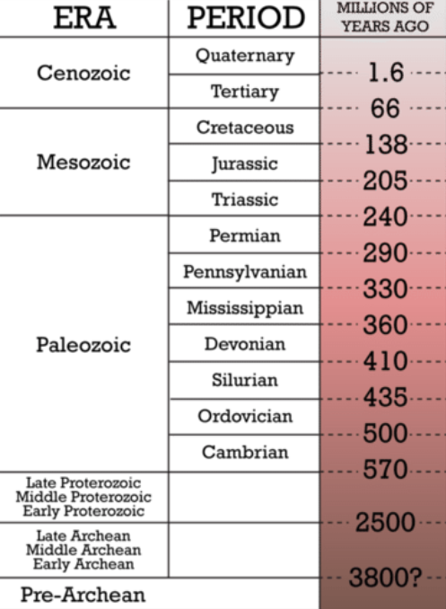
The NW European scale: geological setting
S Limburg area
ECRIS –
LRE
Anglo-Belgian Basin
Rhenish Shield
2
Paris Basin
ECRIS - URG
The Alps
« The Einstein telescope project » - Liege – January 31, 2018

Slide 3
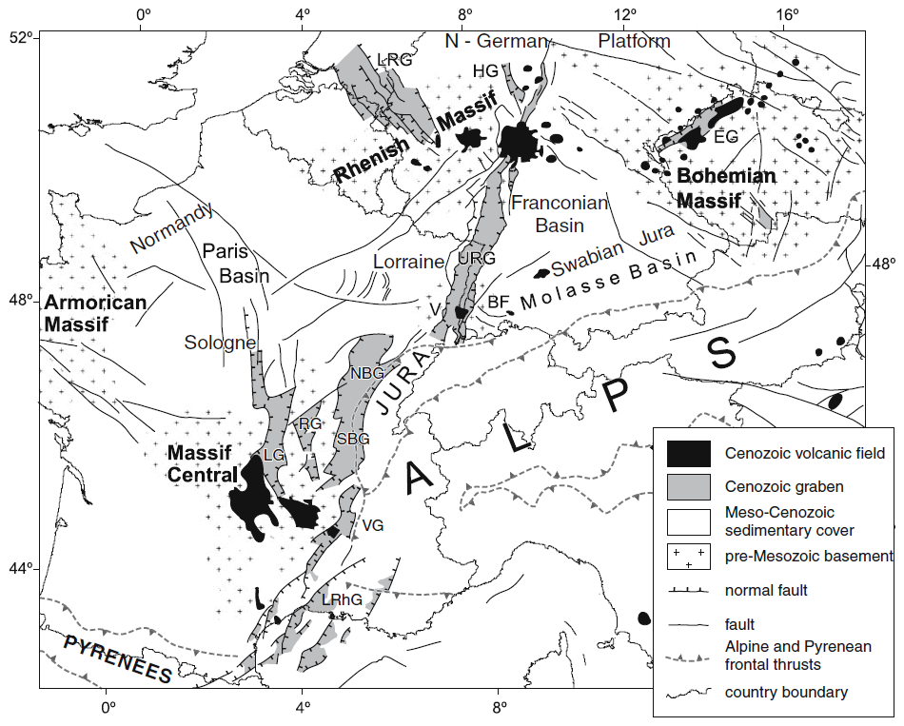
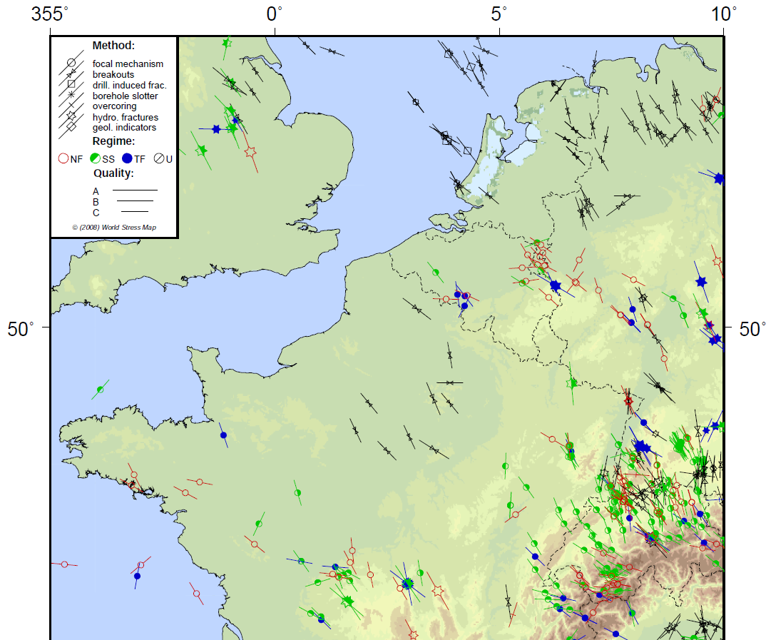
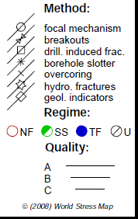
The NW European scale: tectonic setting
Stress map (Heidbach et al., 2016)
(after Dèzes et al., 2004)
« The Einstein telescope project » - Liege – January 31, 2018

Slide 4
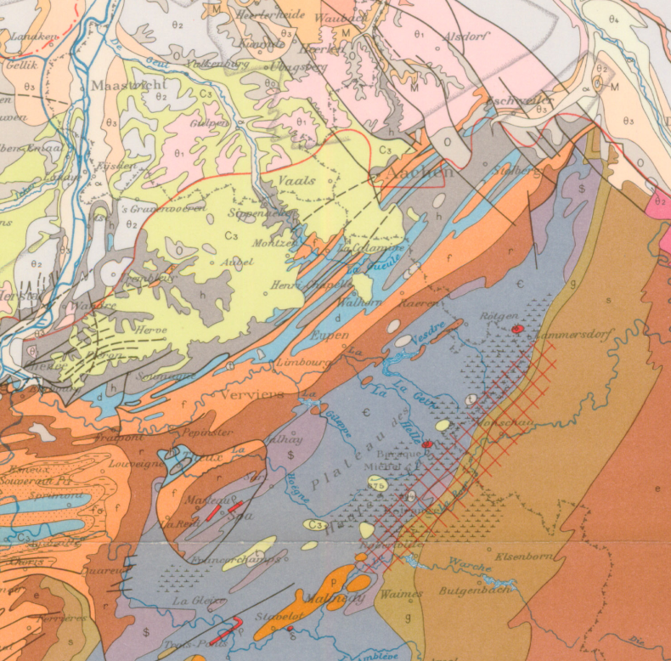
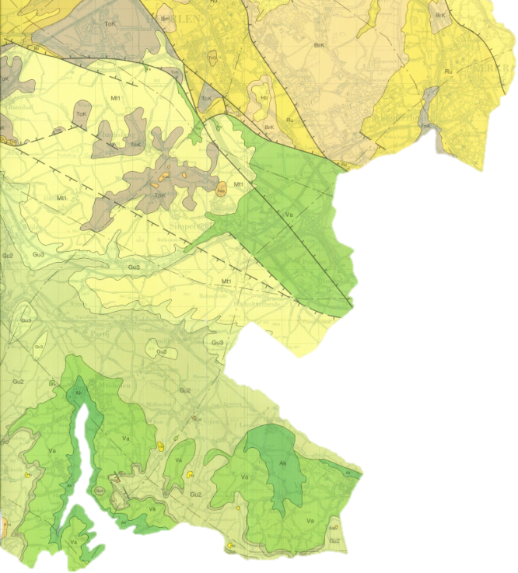
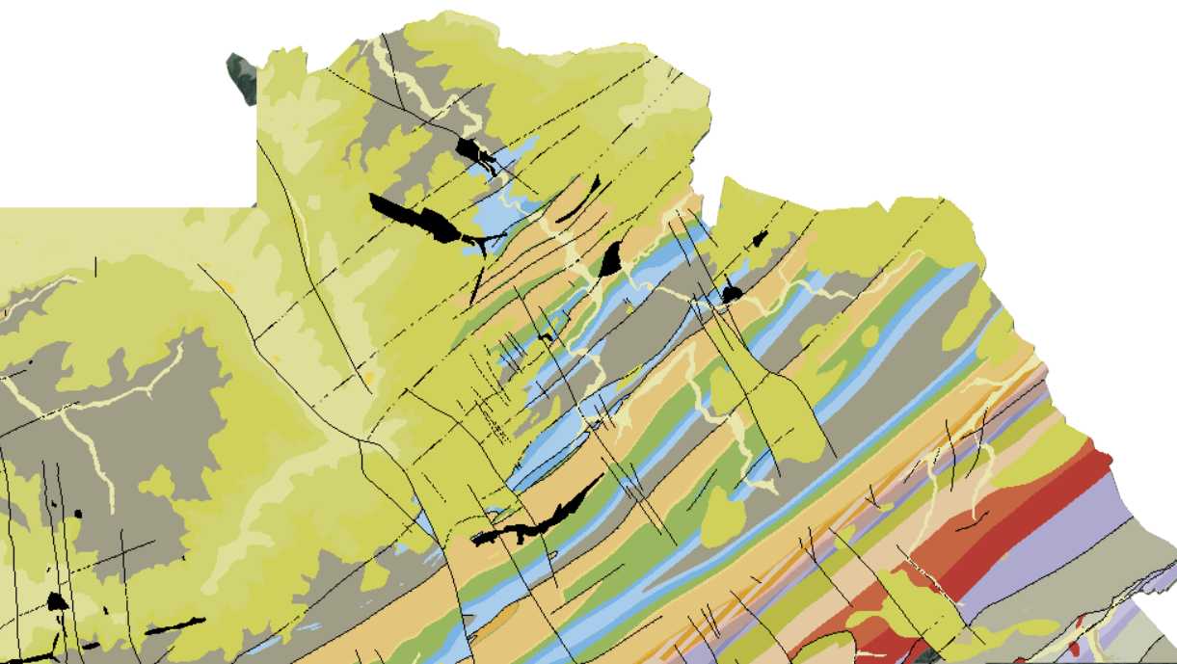
The regional scale: lithology
(Geologische Dienst Nederland
o
0 5 km
10 km
(geological map of Wallonia, http://geoportail.wallonie.be/walonmap)
« The Einstein telescope project » - Liege – January 31, 2018

Slide 5

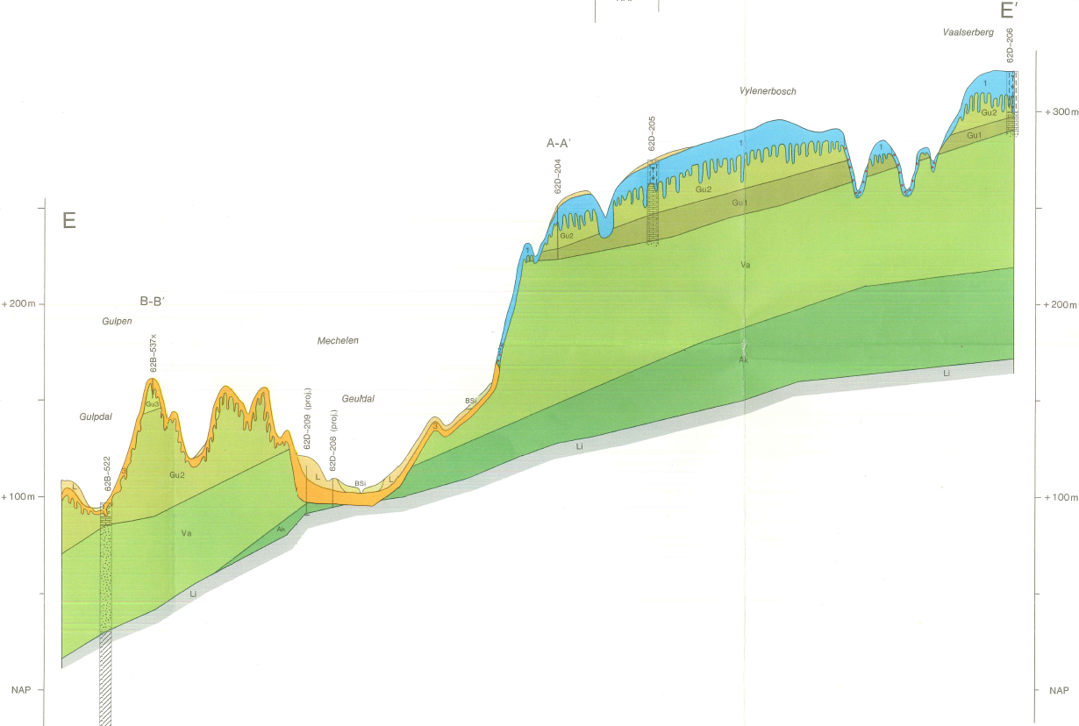

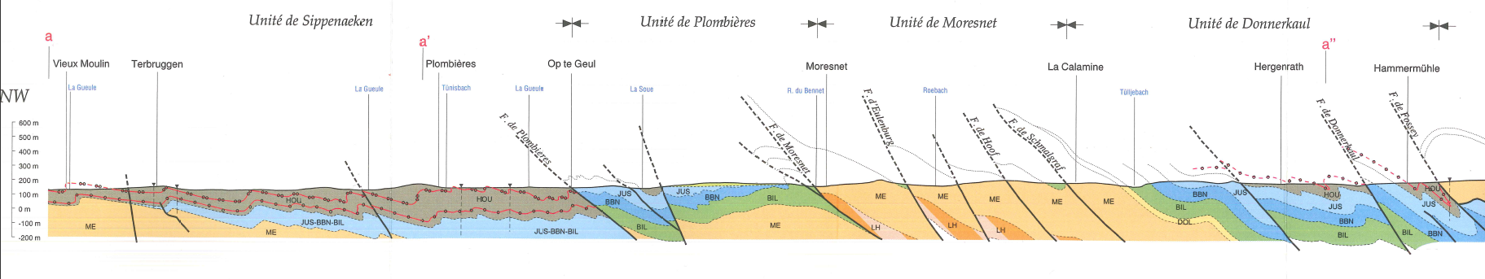
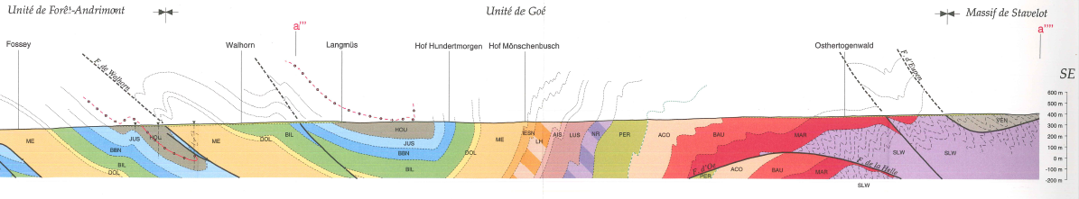
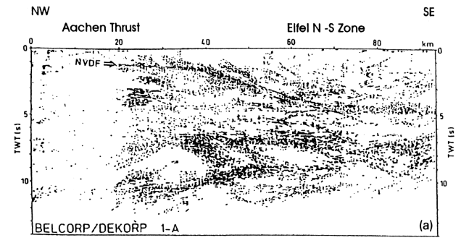
The regional scale: structural/lithologic cross-section
NW SE
A
Vaalserberg
A’
A
Gulpen
+300
+200
+100
0
B
A’
+200
+100
0
Gueule R.
0 4 km
B’
Liege Unit Herve Unit V e s d r e U n i t Stavelot M.
NW SE
Plombières
Kelmis
Walhorn
B’
B
+400
+300
+200
+100
0
-100
-200
+200
+100
0
-100
-200
(vertical exaggeration: x4)
flattens at 3-4 km depth
(= Eifel, or Aachen thrust,
≈ décollement)
« The Einstein telescope project » - Liege – January 31, 2018
(Meissner, 1999)

Slide 6

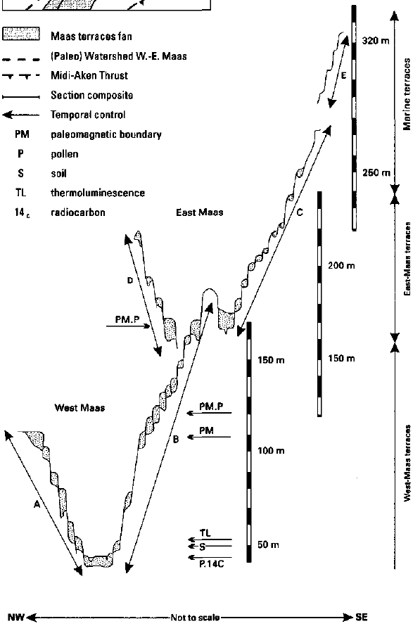
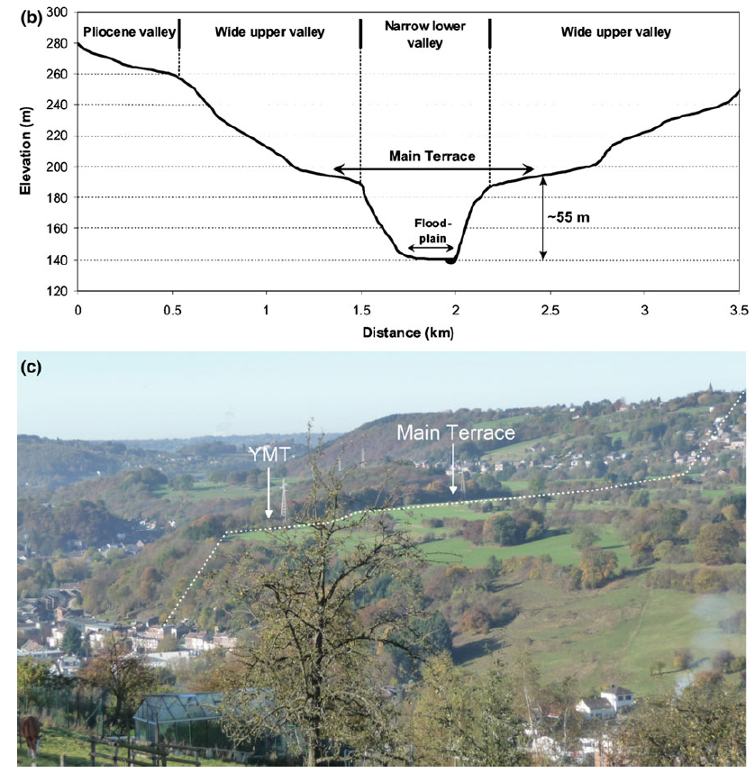
Plio-Quaternary tectonics – regional uplift and subsidence
Geomorphic indicators of tectonic deformation:
incised valleys and river terrace staircases
increased incision rate = response
to a pulse of accelerated uplift at
~0.7 Ma
(Van den Berg, 1996)
(a)
(b)
(a)
~10 Ma
0.003 m/ky
~5 Ma
~2.6 Ma
0.05 m/ky
~1 Ma
acceler.
0.3 m/ky
0.05 m/ky
« The Einstein telescope project » - Liege – January 31, 2018
(Rixhon & Demoulin, 2018)

Slide 7
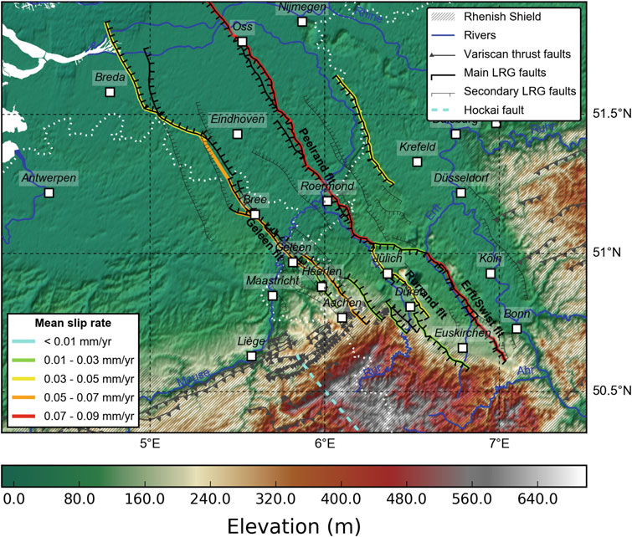
Plio-Quaternary tectonics – active faulting
1. Fault slip rates
Long-term fault slip rates inferred from:
displaced river terraces
offset in the base of alluvial deposits
(tectonic scarps)
2. Seismic vs aseismic fault motion
Predominant seismic behaviour indicated by:
the correspondence between long-term geologic and shorter-term (10⁴ y) paleoseismic slip rates
morphotectonic and sedimentary features at fault traces
(Vanneste et al., 2018)
Bree segment of the Geleen fault:
- displaced base of the ~740-ky-old Meuse terrace
→ geologic slip rate of 0.04-0.07 mm/y
- paleoearthquake record of the last ~100 ky
→ paleoseismic slip rate of 0.03-0.06 mm/y
« The Einstein telescope project » - Liege – January 31, 2018

Slide 8
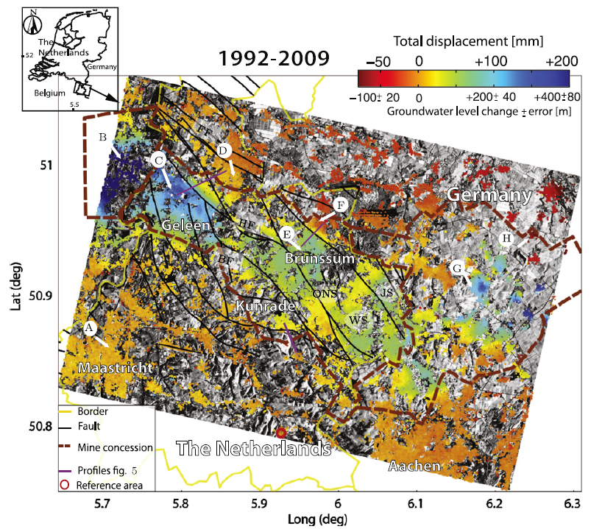
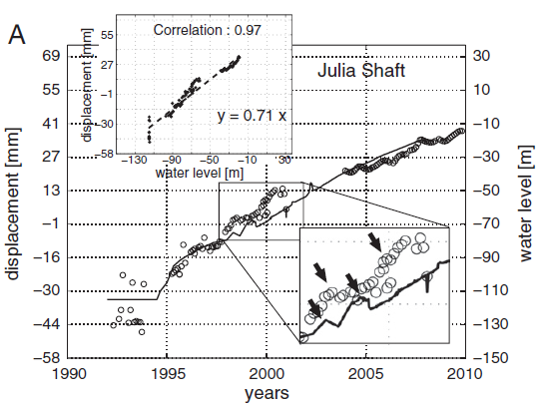
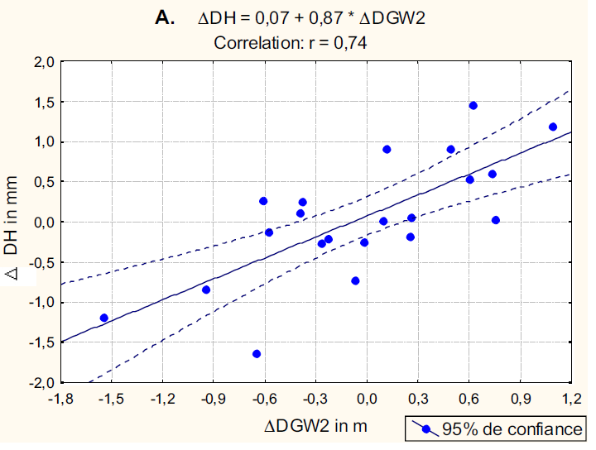
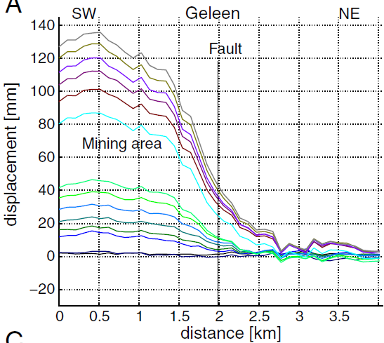
Present-day ground deformation – geodetic data
(A) Feldbiss fault zone – PS-InSAR + levelling – the aftermath of coal mining + GW seasonal oscillations
(Caro Cuenca et al., 2013)
Δż ≈ 7.5 mm/y
(Demoulin, 2006)
« The Einstein telescope project » - Liege – January 31, 2018

Slide 9
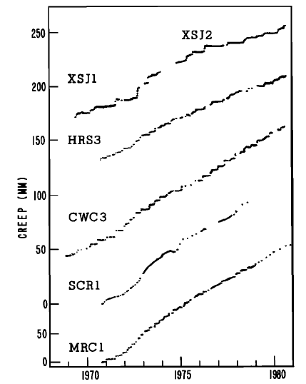
Present-day ground deformation – geodetic data
A
(B) Northern margin of the Hautes Fagnes massif – levelling –
random fault creep event
B
A
B
(Demoulin, 2004)
Stockem fault
A Δz(1998-99) 3.5 mm ≈ Δ_{m}z(<1998->1999) 3.6 mm
B Δz(1998-99) 3.0 mm ≈ Δ_{m}z(<1998->1999) 3.2 mm
Creep records along a creeping segment of the San Andreas fault (Schulz et al., 1982)
« The Einstein telescope project » - Liege – January 31, 2018

Slide 10
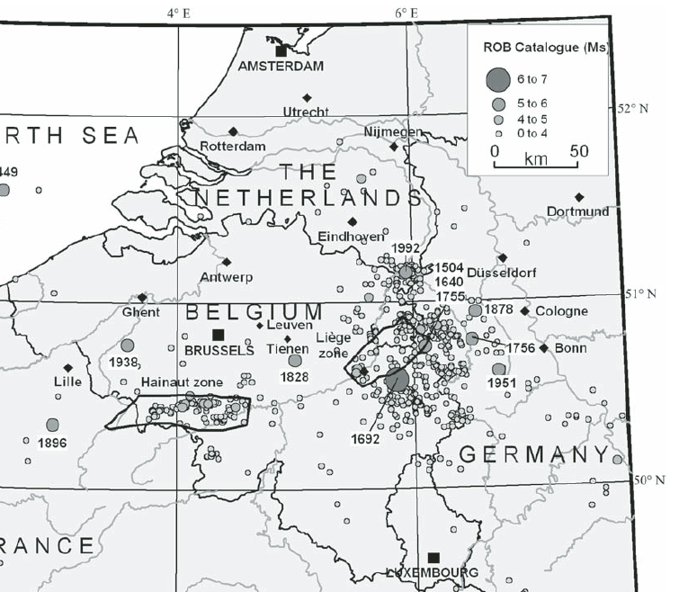
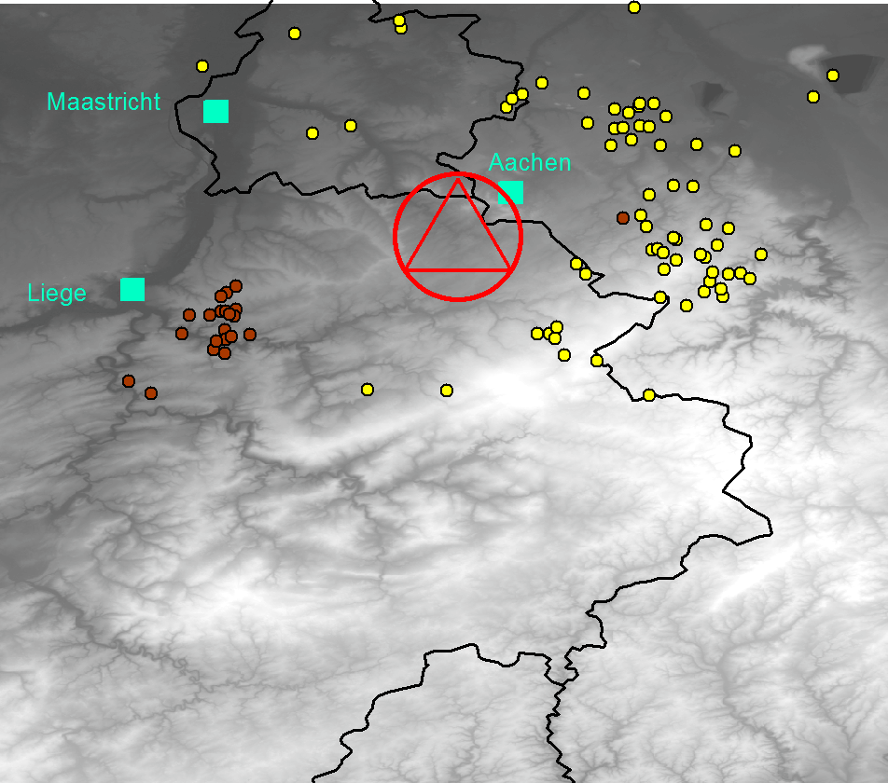
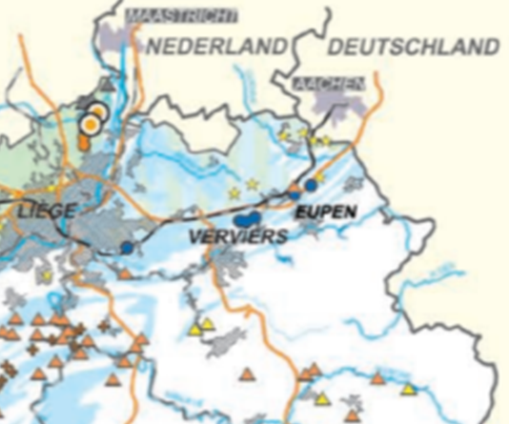
Present-day ground motion – microseismicity
Microseismicity 26.01.2016 – 26.01.2018
earthquake
quarry blast (0.8 ≤ M_{L} ≤ 2.0)
(data 50.5-51.0°N - 5.5-6.5°E from http://www.seismologie.be/fr/seismologie/sismicite-en-belgique/banque-de-donnees-en-ligne
(Camelbeeck et al., 2007)
(SPWallonie -DGO4 - SDER) – active quarries
M_{L} = 0.0 M_{L} = 2.0
At 10 km distance A_{max} ≈ 32 µm A_{max} ≈ 3.2 mm
30 km A_{max} ≈ 8 µm A_{max} ≈ 0.8 mm
« The Einstein telescope project » - Liege – January 31, 2018

Slide 11
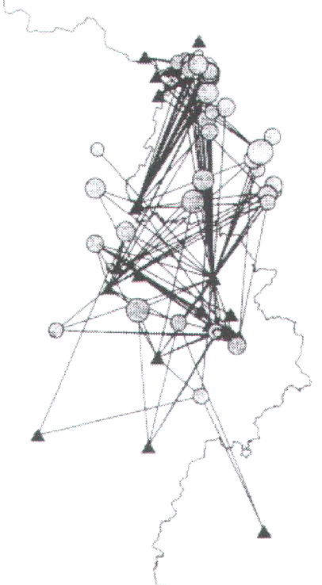
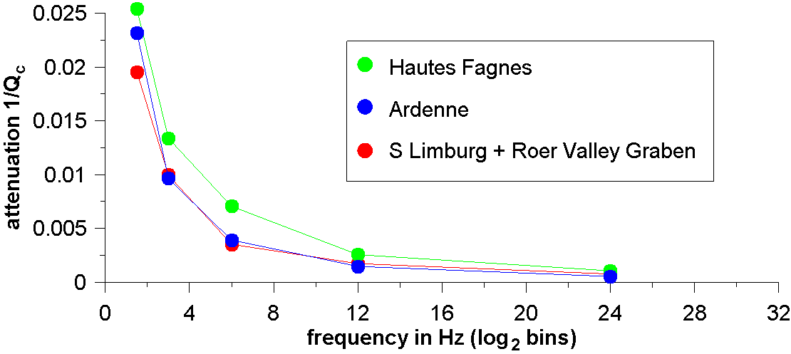
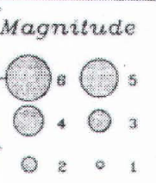
Ground motion – seismic attenuation - the geological as primary seismic isolator?
Source-station couples used for Q_{c} estimates in E Belgium and S Limburg
Hautes Fagnes: Q_{c} = 17.0 f^{1.16}
Ardenne: Q_{c} = 21.2 f^{1.37}
S Limburg – RVG: Q_{c} = 26.9 f^{1.2}
(El Bouch et al., 2002)
« The Einstein telescope project » - Liege – January 31, 2018

Slide 12
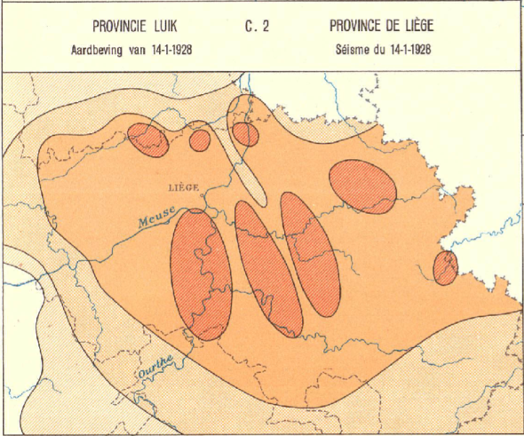
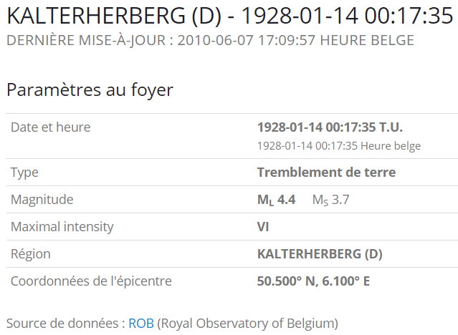
Ground motion – seismic shaking and site effects
Seismic wave amplification in the damage zone of NNW-SSE faults
http://www.seismologie.be/fr/seismologie/tremblements-de-terre-en-
belgique/ny2rwlmq4
+ soft-sediment to moderately indurated Cretaceous cover
+ propagation of surface waves along the numerous thrust faults
+ vulnerability of abandoned mines to seismic shaking
(1st Atlas of Belgium, 1950-72)
« The Einstein telescope project » - Liege – January 31, 2018

Slide 13
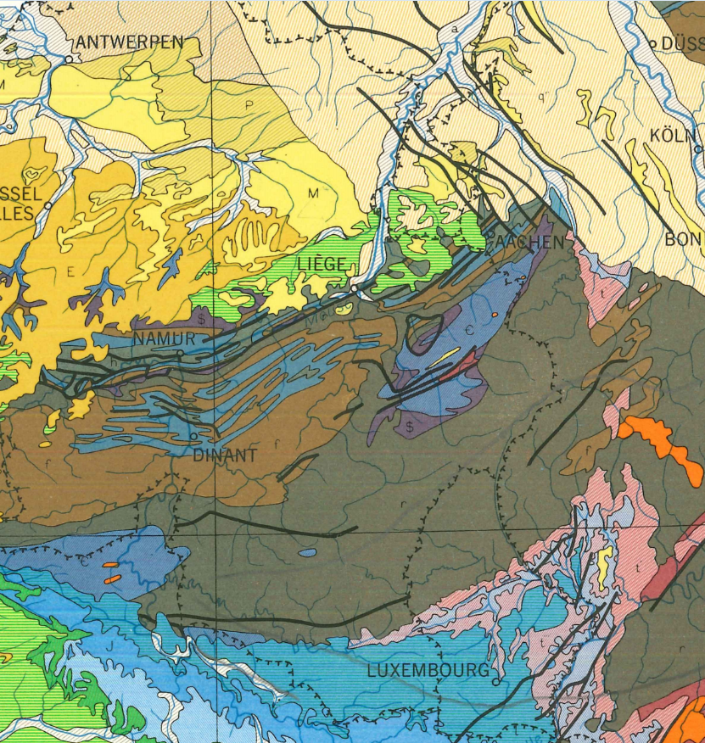
Conclusion: South Limburg versus other nearby potential ET sites
Mol
S Limburg
Hautes Fagnes
Famenne
Redu

Slide 14
Conclusion: South Limburg versus other nearby potential ET sites
 | S Limburg | Mol (Campine) | Hautes Fagnes | Redu (central Ardenne) | Famenne
high-tech environment | + | + | 0 | + | 0
building cost | - | + | - | - | 0-+
active fault density | - - | - | 0 | + | +
(micro)seismicity level | - | - | - | + | +
human-induced seismicity (quarries) | 0 | ++ | 0 | + | 0
other human seismic noise (big cities, industry) | - | - | ++ | ++ | ++
seismic attenuation | - | ? | + | 0 | ?
thrust faults as propagators of surface noise | - | + | + | +-0 | +
lithologic/structural uniformity allowing simpler noise modelling | - - | 0 | 0 | + | +
mine GW-induced ground deformation | - | - | + | + | +
seasonal GW-induced ground deformation | 0 | 0 | - | 0 | 0
ground deformation from load variations (open pit mines in Germany, lakes) | - | + | - | + | +
« The Einstein telescope project » - Liege – January 31, 2018

Slide 15
Thank you
« The Einstein telescope project » - Liege – January 31, 2018

