Slide 1
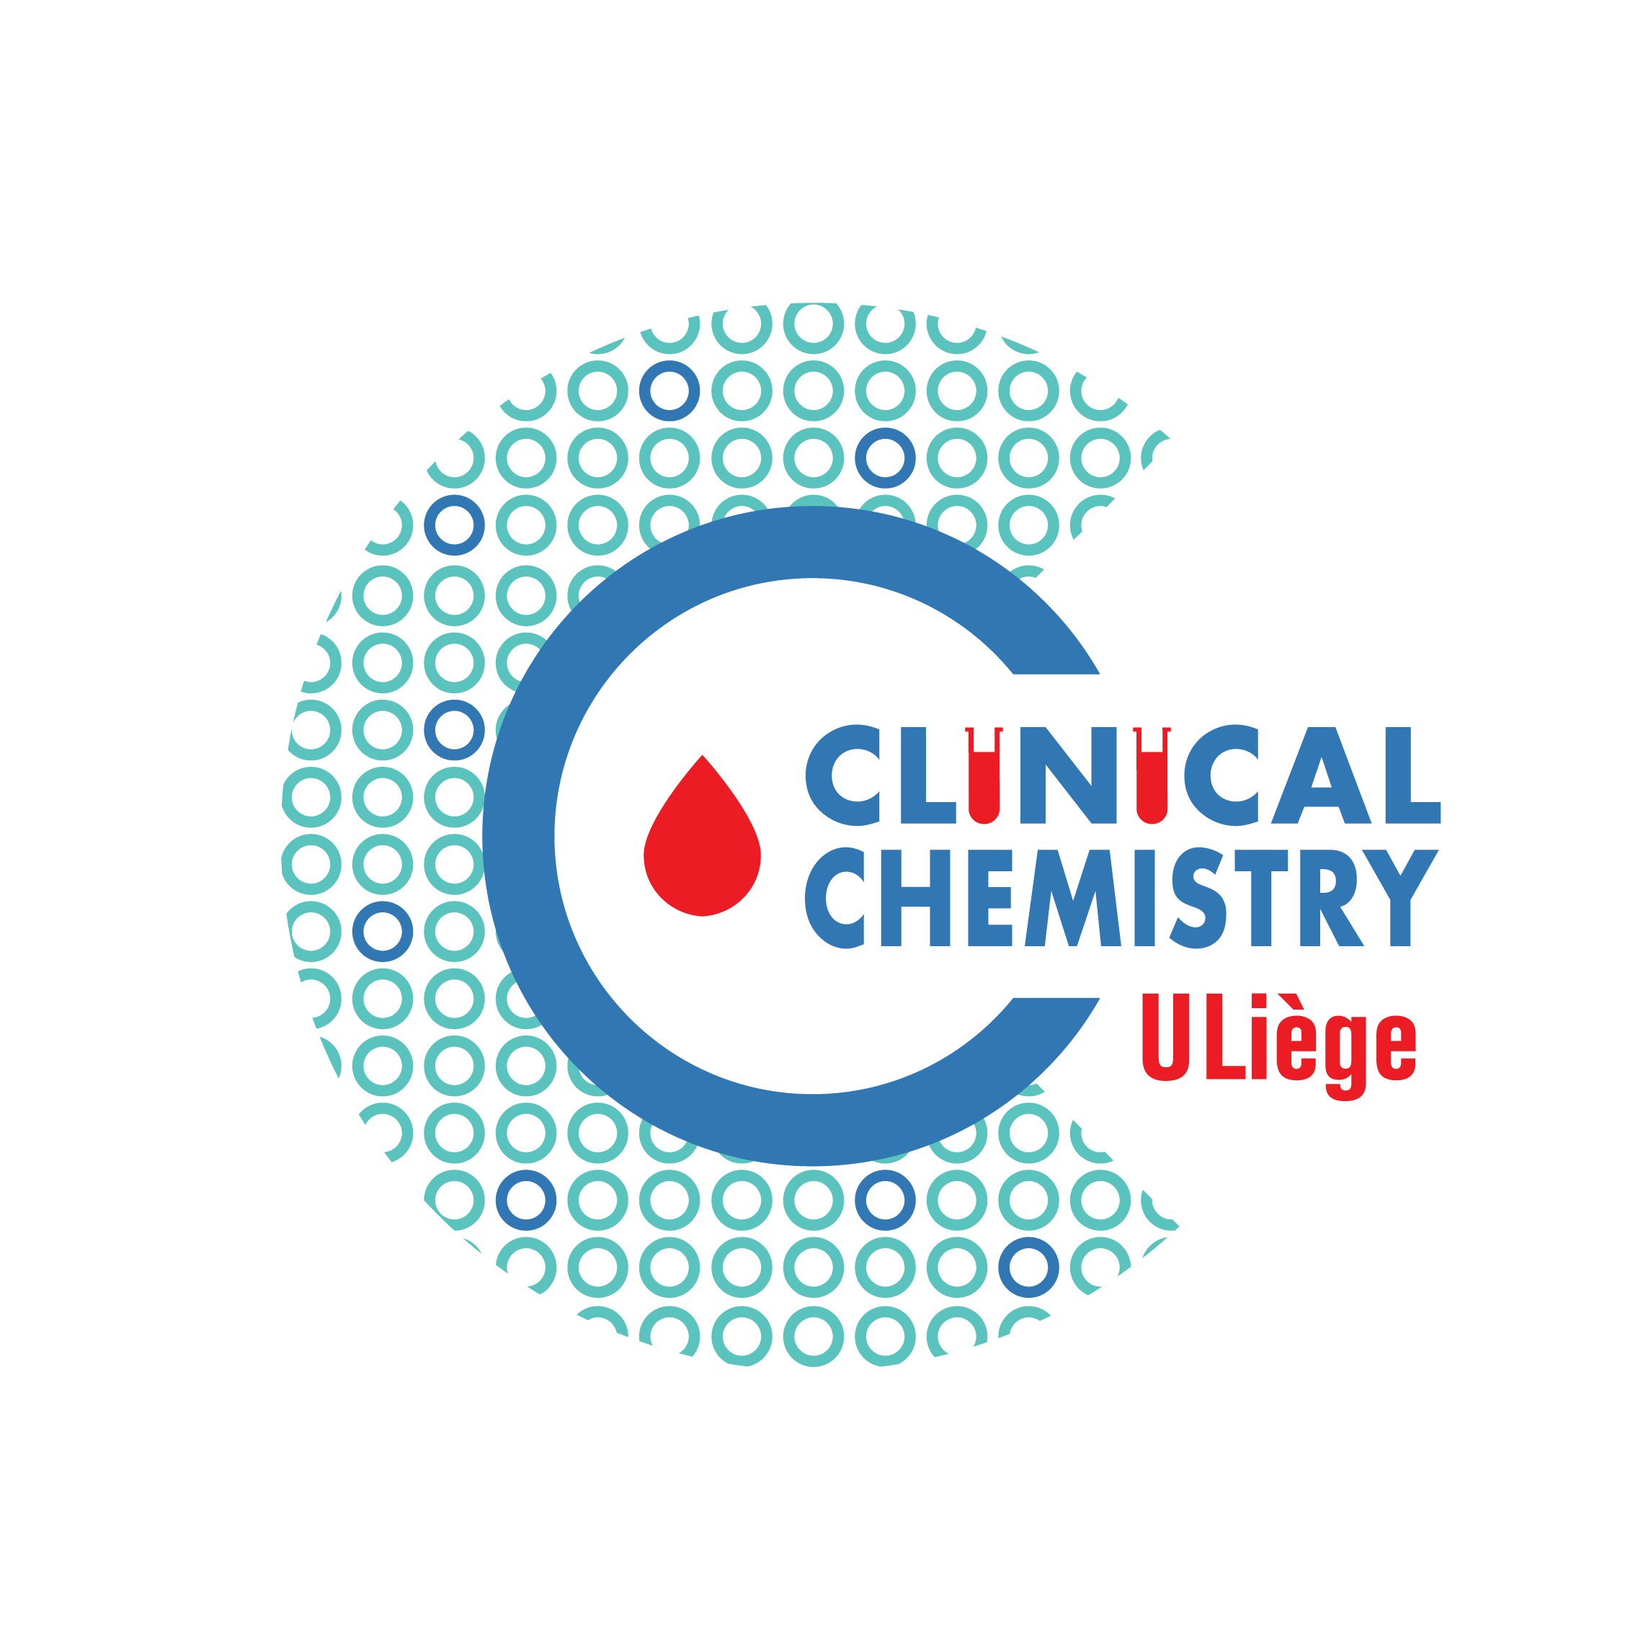
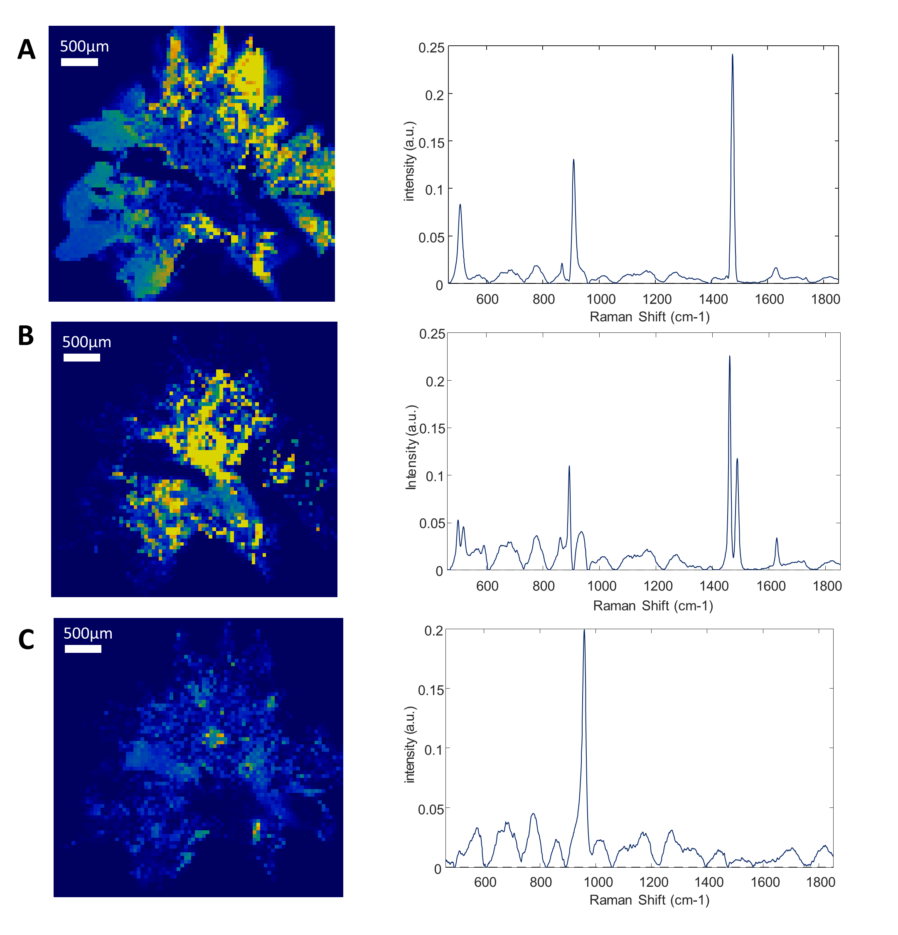
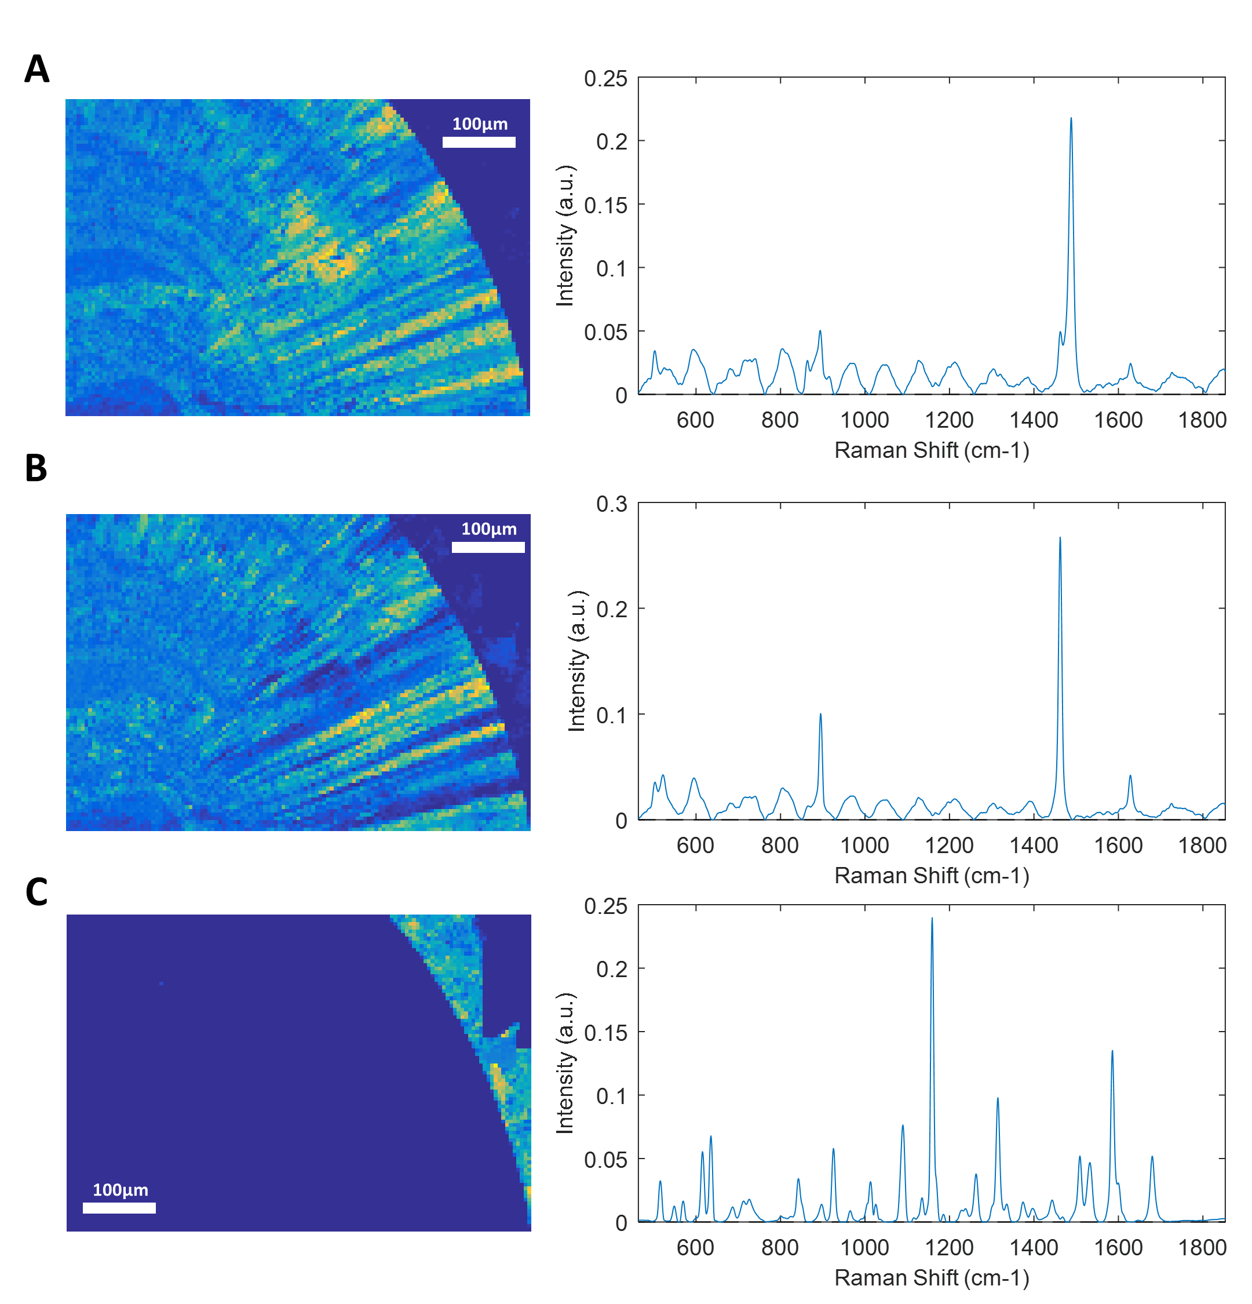
Raman chemical imaging in kidney stone analysis
Vincent Castiglione¹, Pierre-Yves Sacré², Etienne Cavalier¹, Philippe Hubert², Romy Gadisseur¹, Eric Ziemons²
V.Castiglione@doct.uliege.be
1 Department of Clinical Chemistry, CHU of Liège, University of Liège, Belgium
² University of Liege (ULiege), CIRM, VibraSante Hub, Laboratory of Pharmaceutical Analytical Chemistry, University of Liège, Belgium.
Introduction:
Material and Methods:
The kidney stone’s structure might provide clinical information in addition to the sole stone composition. The Raman chemical imaging is a method providing two-dimension maps of the constituents’ distribution in samples. We aimed at determining the use of Raman chemical imaging in urinary stone analysis.
Fourteen calculi were analyzed by Raman chemical imaging and by Fourier Transform infrared as gold-standard method. They were selected according to their heterogeneous composition and morphology.
Fourier Transform infrared (FTIR): Calculi were first examined with a microscope (magnification 64x) for structure description. Stones were sliced in two equal parts in order to observe their section and nucleus. One half of the stone was analyzed by FTIR while the other part was studied by RCI. Selected fragments were ground in an agate mortar to realize pellets for the FTIR analysis. Potassium bromide was added. The final powder was homogenized and then passed into a press to make 3mm diameter pellets. Spectra were recorded between 4000 and 400 cm⁻¹ (resolution 2cm⁻¹) for 120 scans with Alpha FT-IR spectrophotometer (Bruker, Germany), and compared to the OPUS reference library, version 6.5 (Bruker Optics Inc). Semi-quantitative results were recorded in percentage.
Raman Chemical Imaging (RCI): Confocal Raman experiments were performed with a Labram HR Evolution (Horiba scientific, France) equipped with a two-dimensional EMCCD detector (1600 × 200 pixels’ sensor) (Andor Technology Ltd.), a Leica 50x LWD Fluotar (NA: 0.55) objective and a 785 nm laser (XTRA II, Toptica Photonics AG, Germany). The spectra were collected with the LabSpec 6 (Horiba Scientific) software. First, the stones were sliced and milled before RCI analysis, in order to obtain a smooth surface. The spectra were acquired over the spectral range of 464-1853 cm⁻¹ with a 300 gr/mm grating. The laser power was reduced to 35mW at sample to preserve sample from burning. Seven accumulations of 2 seconds and a confocal hole set at 200µm were used. A step size of 5 to 50µm was used according to samples.
Pure spectra of the general map were resolved using MCR-ALS [1].
Results:
Table 1 : Stone composition according to Fourier transform infrared and Raman chemical imaging
Raman chemical imaging succeeded in identifying almost all the chemical components of each sample, including monohydrate and dihydrate calcium oxalate, anhydrous and dihydrate uric acid, apatite, struvite, brushite, and rare chemicals like whitlockite, ammonium urate and drugs (Table 1). However, proteins couldn’t be detected because of the huge autofluorescence background and the small concentration of these poor Raman scatterers. Carbapatite and calcium oxalate were correctly detected even when they represented less than 5% of the whole stones.
Moreover, Raman chemical imaging provided the distribution of components within the stones: nuclei were accurately identified, as well as thin layers of other components. Conversion of dihydrate to monohydrate calcium oxalate was observed in the centre of one sample (fig 1). The calcium oxalate monohydrate had different Raman spectra according to its localization, providing information about it’s organization (fig 2).
Sample | Fourier transform infrared | Raman chemical imaging | Sample | Fourier transform infrared | Raman chemical imaging
1 | Calcium oxalate monohydrate (100%) | Calcium oxalate monohydrate | 8 | Brushite (90%) Calcium oxalate dihydrate (10%) | Brushite Calcium oxalate dihydrate
2 | Calcium oxalate monohydrate (60%) Ammonium urate (30%) Proteins (10%) | Calcium oxalate monohydrate Ammonium urate | 9 | Brushite (25%) Whitlockite (25%) Apatite (25%) Proteins (20%) Calcium oxalate dihydrate (5%) | Brushite Whitlockite Apatite Calcium oxalate dihydrate
3 | Calcium oxalate dihydrate (80%) Calcium oxalate monohydrate (15%) Apatite (5%) | Calcium oxalate dihydrate Calcium oxalate monohydrate Apatite | 10 | Apatite (40%) Struvite (35%) Ammonium urate (20%) Calcium oxalate monohydrate (5%) | Apatite Struvite Ammonium urate Calcium oxalate monohydrate
4 | Anhydrous uric acid (100%) | Anhydrous uric acid | 11 | Apatite (30%) Calcium oxalate dihydrate (20%) Calcium oxalate monohydrate (20%) Proteins (15%) Glycosaminoglycans (15%) | Apatite Calcium oxalate dihydrate Calcium oxalate monohydrate
5 | Uric acid dihydrate (90%) Anhydrous uric acid (10%) | Uric acid dihydrate Anhydrous uric acid | 12 | Calcium oxalate monohydrate (80%) N-Acetyl-Sulfamethoxazole (20%) | Calcium oxalate monohydrate N-Acetyl-Sulfamethoxazole
6 | Apatite (80%) Calcium oxalate monohydrate (20%) | Apatite Calcium oxalate monohydrate | 13 | Calcium oxalate monohydrate (100%) Triamterene and metabolites (traces) | Calcium oxalate monohydrate Apatite
7 | Struvite (95%) Proteins (5%) | Struvite | 14 | Calcium oxalate monohydrate (70%) Atazanavir (30%). | Calcium oxalate monohydrate Atazanavir
Fig 1: Raman mapping of sample 3
Fig 2: Raman mapping of sample 12
Raman mapping of the calcium oxalate dihydrate (A), calcium oxalate monohydrate (B) and apatite core (C) and their correspondent Raman spectra. Step size: 50 μm. The yellow to dark blue scale represents the high density of a component or its absence. The peripheral spikes of the stones are mainly made of calcium oxalate dihydrate, while its center has turned into calcium oxalate monohydrate.
Raman mapping of calcium oxalate monohydrate with main absorption peak at 1487 (A) or at 1462 (B) and N-Acetyl-Sulfamethoxazole external deposit (C) and their correspondent Raman spectra. Step size: 5µm. The yellow to dark blue scale represents the high density of a component or its absence. The difference in main absorption peak of calcium oxalate monohydrate reveals a radial structure of the stone.
Conclusions:
Raman chemical imaging showed a good accuracy in comparison with infrared spectroscopy in identifying components of kidney stones. This analysis was also useful in determining the organization of components within stones, which help locating constituents in low quantity, such as nuclei. Therefore, RCI can provide tumor tissue mapping that is useful for the management of cancers. RCI has even been used during brain surgery to differentiate tumor-infiltrated tissues from non-infiltrated tissues [2]. However, this analysis is time-consuming, an is more suitable for research studies rather than routine analysis.
Acknowledgments:
The authors wish to thank HORIBA FRANCE SAS (Palaiseau, France) for kindly providing the EasyNav package that was used for the topological analyses.
References:
[1] Felten J, Hall H, Jaumot J, Tauler R, de Juan A, Gorzsás A. Vibrational spectroscopic image analysis of biological material using multivariate curve resolution–alternating least squares (MCR-ALS). Nat Protoc. Nature Research; 2015;10: 217–240.
[2] Hollon T, Lewis S, Freudiger CW, Sunney Xie X, Orringer DA. Improving the accuracy of brain tumor surgery via Raman-based technology. Neurosurg Focus. 2016;40: E9.

