Slide 1
Worldwide spatio-temporal patterns of symbiotic specificity between Peltigera and its Nostoc partners
N. Magain, J. Miadlikowska, J. Lu, B. Goffinet, E. Sérusiaux, F. Lutzoni
Future Arctic Workshop, Forêt Montmorency, May 25th, 2017

Slide 2
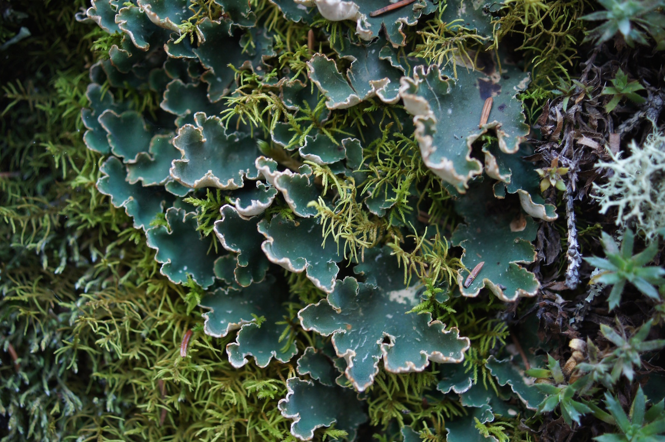
The genus Peltigera (Peltigerales, Lecanoromycetes)
Lichenized fungi
Macrolichens
Associated with Nostoc ( N₂ fixating-cyanobacterium)
Ca. 80 described species
Abundant in boreal forests, and high altitude tropical forests

Slide 3
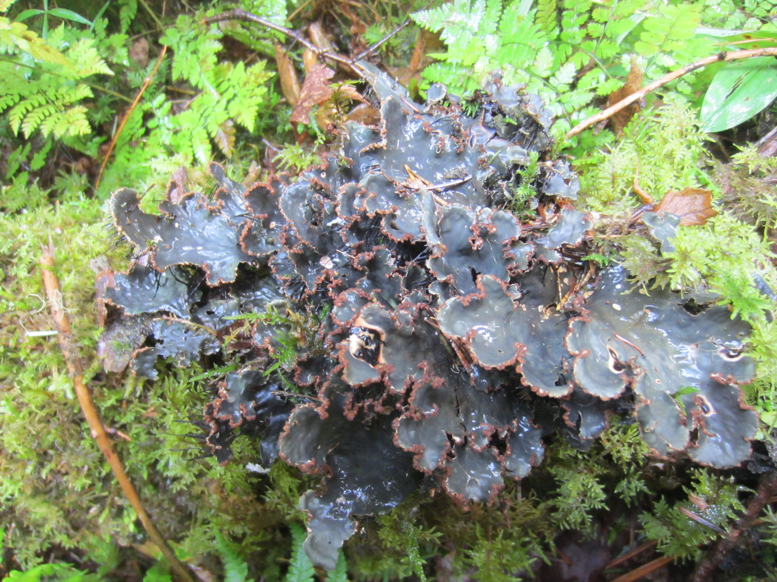
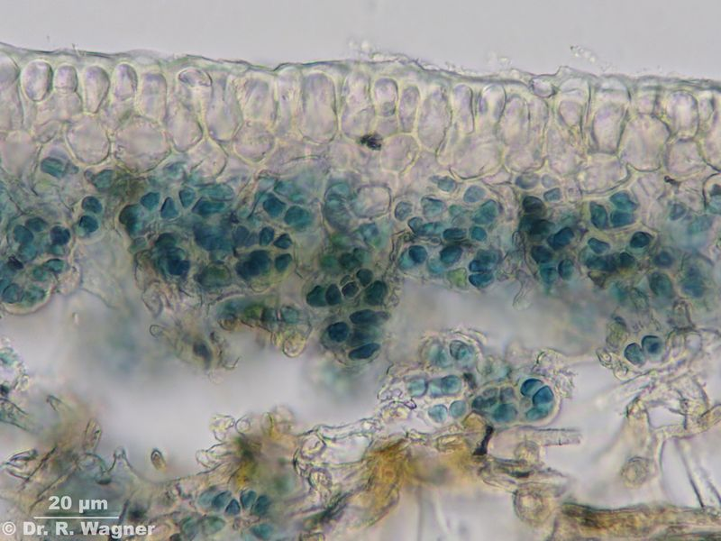
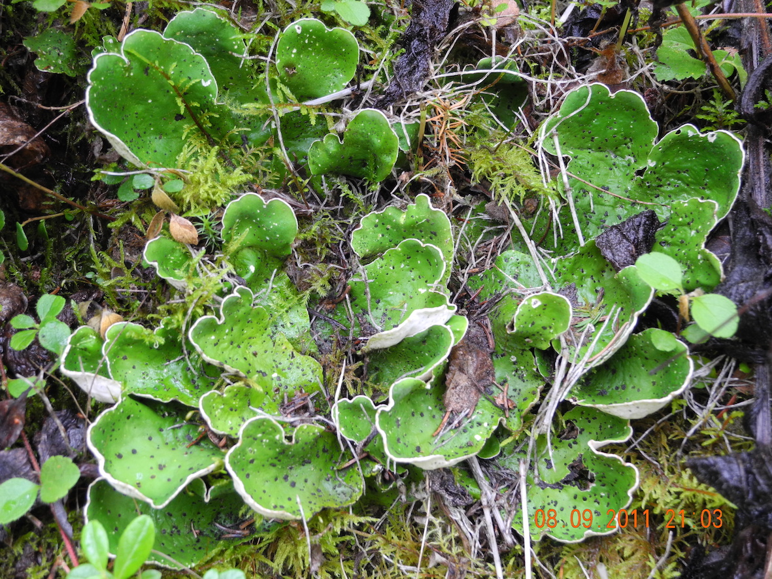
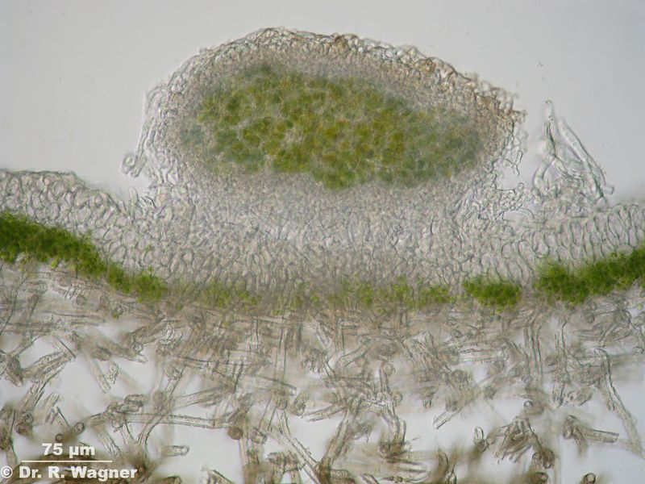
Trimembered thalli (Peltigera, Coccomyxa and Nostoc)
Bimembered thalli
(Peltigera with Nostoc)

Slide 4
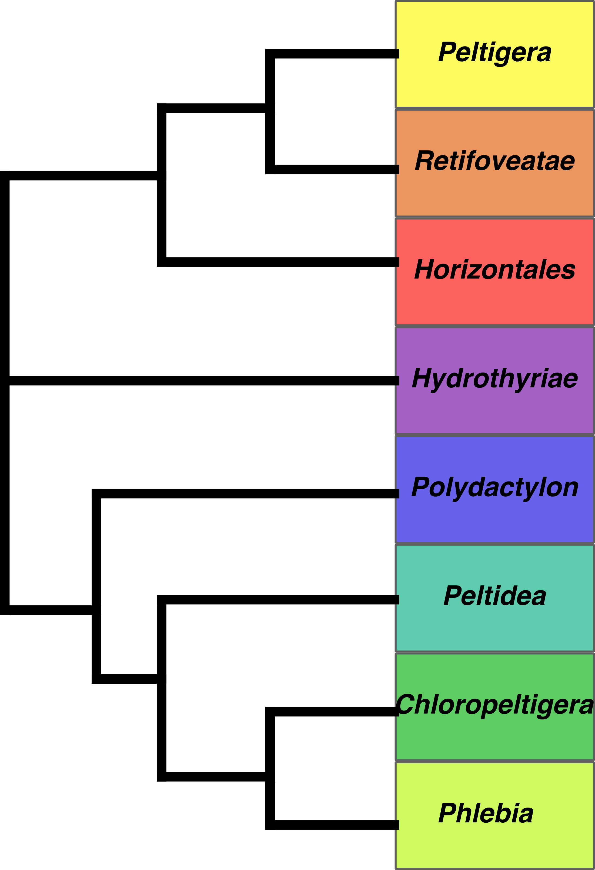
No. sp.
Miadlikowska & Lutzoni (2000): 8 sections
Peltigera project:
Taxonomic revision
of the whole genus
73

Slide 5
Taxonomic revision of Peltigera
Thousands of specimens examined (loans and field trips)
Sequenced 8 loci of the mycobiont
2 ribosomal: ITS and LSU, 3 protein-coding genes: RPB1, ß-tubulin, EFT2.1 (AFTOL2), 3 new markers: COR1b, COR3, COR16
ITS amplified for over 2000 specimens (~900 unique haplotypes)
- Multilocus data for ~ 500 specimens

Slide 6
Taxonomic revision of Peltigera
Sequenced 8 loci of the mycobiont
Reconstructed the phylogeny of the genus and sections (RaxML, MrBayes, BEAST)
Used species discovery (Structurama, bGMYC, bPTP) and species validation methods (spedeSTEM, bPP) to delimit species

Slide 7
No. sp.
Many new species from
poorly sampled regions of the
world
But many well-studied, well-sampled
species are also split in several
lineages
73→172

Slide 8
Patterns of specificity between Nostoc and Peltigera: the example of section Polydactylon
Section Polydactylon: ca. 40 species after phylogenetic species delimitation, only associated with Nostoc
196 thalli (Peltigera + Nostoc)
We sequenced the rbcLX of Nostoc, and delimited 25 phylogroups
N Magain, J Miadlikowska, B Goffinet, E Sérusiaux, F Lutzoni (2017), Macroevolution of specificity in cyanolichens of the genus Peltigera section Polydactylon (Lecanorales, Ascomycota). Systematic Biology 66 (1), 74-99

Slide 9
Phylogeny of the mycobiont (Peltigera)
39 putative species
Notes:
So first here is the phylogeny of the mycobiont, so the fungus, it is based on 5 loci, 3 protein coding genes and 2 ribosomal loci.(((( We’ve inferred the phylogeny using RaxML for ML inferences, MrBayes for bayesian inferences, and also PICS-ORD to recode ambiguously aligned regions.)))) You can see that the group is composed of many species and that there are a lot of biogeographic patterns in the group. The colors of the bars correspond to the geographic origin of the specimens according to the map on the top left. The section is divided in three main clades, called the dolichorhizoid, polydactyloid and scabrosoid clades (after doli, poly and scabrosa). we can see that some species are restricted to some biogeographic regions, like these ones to asia, these ones to australasia, this one to south america while others have a panboreal distribution, present in all boreal zones, like this this and this, we can also see that this clade of species is mainly present in south america. There are also a few species endemics to pacific northwest like this one, this one and this one because the conditions there are very good. We can also see that while species are well defined in these parts of the tree, with long branches separating them, this part of the tree is composed of many short branches, consisting of a worldwide radiation of this group and the species delimitation is especially tricky in this group. Finally, if some described morphological species seem to represent good phylogenetic species, composed of a well-supported monophyletic group, such as P. hymenina, P. occidentalis, P. scabrosella, P. chilensis … Some others are para or polyphyletic like P. neopolydactyla, composed of at least 6 different lineages in different clades, or scabrosa, 4 lineages, Pulverulenta. Which means that the grou pcontains many new species.

Slide 10
Phylogeny of the mycobiont (Peltigera)
39 putative species
Notes:
So first here is the phylogeny of the mycobiont, so the fungus, it is based on 5 loci, 3 protein coding genes and 2 ribosomal loci.(((( We’ve inferred the phylogeny using RaxML for ML inferences, MrBayes for bayesian inferences, and also PICS-ORD to recode ambiguously aligned regions.)))) You can see that the group is composed of many species and that there are a lot of biogeographic patterns in the group. The colors of the bars correspond to the geographic origin of the specimens according to the map on the top left. The section is divided in three main clades, called the dolichorhizoid, polydactyloid and scabrosoid clades (after doli, poly and scabrosa). we can see that some species are restricted to some biogeographic regions, like these ones to asia, these ones to australasia, this one to south america while others have a panboreal distribution, present in all boreal zones, like this this and this, we can also see that this clade of species is mainly present in south america. There are also a few species endemics to pacific northwest like this one, this one and this one because the conditions there are very good. We can also see that while species are well defined in these parts of the tree, with long branches separating them, this part of the tree is composed of many short branches, consisting of a worldwide radiation of this group and the species delimitation is especially tricky in this group. Finally, if some described morphological species seem to represent good phylogenetic species, composed of a well-supported monophyletic group, such as P. hymenina, P. occidentalis, P. scabrosella, P. chilensis … Some others are para or polyphyletic like P. neopolydactyla, composed of at least 6 different lineages in different clades, or scabrosa, 4 lineages, Pulverulenta. Which means that the grou pcontains many new species.

Slide 11
Phylogeny of the mycobiont (Peltigera)
39 putative species
Notes:
So first here is the phylogeny of the mycobiont, so the fungus, it is based on 5 loci, 3 protein coding genes and 2 ribosomal loci.(((( We’ve inferred the phylogeny using RaxML for ML inferences, MrBayes for bayesian inferences, and also PICS-ORD to recode ambiguously aligned regions.)))) You can see that the group is composed of many species and that there are a lot of biogeographic patterns in the group. The colors of the bars correspond to the geographic origin of the specimens according to the map on the top left. The section is divided in three main clades, called the dolichorhizoid, polydactyloid and scabrosoid clades (after doli, poly and scabrosa). we can see that some species are restricted to some biogeographic regions, like these ones to asia, these ones to australasia, this one to south america while others have a panboreal distribution, present in all boreal zones, like this this and this, we can also see that this clade of species is mainly present in south america. There are also a few species endemics to pacific northwest like this one, this one and this one because the conditions there are very good. We can also see that while species are well defined in these parts of the tree, with long branches separating them, this part of the tree is composed of many short branches, consisting of a worldwide radiation of this group and the species delimitation is especially tricky in this group. Finally, if some described morphological species seem to represent good phylogenetic species, composed of a well-supported monophyletic group, such as P. hymenina, P. occidentalis, P. scabrosella, P. chilensis … Some others are para or polyphyletic like P. neopolydactyla, composed of at least 6 different lineages in different clades, or scabrosa, 4 lineages, Pulverulenta. Which means that the grou pcontains many new species.

Slide 12
Distribution of cyanobiont (Nostoc) phylogroups
Very strong climatic and geographic patterns in the Nostoc distribution
Notes:
Then there is a very strong geographic and climatic pattern in the Nostoc distribution. So here is the distribution of the different nostoc phylotypes, colors are based on the previous graph, in the different regions so for instance here I’ve found these phylotypes; and what we can see is that a few phylotypes are restricted to boreal regions, these 4 ones here, then a few are present in these tropical regions, others are temperate, some are almost cosmopolitan, some are found only in one region, or in all eastern regions for instance…

Slide 13
Distribution of cyanobiont (Nostoc) phylogroups
Boreal phylogroups
Notes:
Then there is a very strong geographic and climatic pattern in the Nostoc distribution. So here is the distribution of the different nostoc phylotypes in the different regions so for instance here I’ve found these phylotypes; and what we can see is that a few phylotypes are restricted to boreal regions, these 4 ones here, then a few are present in these tropical regions, others are temperate, some are almost cosmopolitan, some are found only in one region, or in all eastern regions for instance…

Slide 14
Distribution of cyanobiont (Nostoc) phylogroups
Tropical phylogroups
Notes:
Then there is a very strong geographic and climatic pattern in the Nostoc distribution. So here is the distribution of the different nostoc phylotypes in the different regions so for instance here I’ve found these phylotypes; and what we can see is that a few phylotypes are restricted to boreal regions, these 4 ones here, then a few are present in these tropical regions, others are temperate, some are almost cosmopolitan, some are found only in one region, or in all eastern regions for instance…

Slide 15
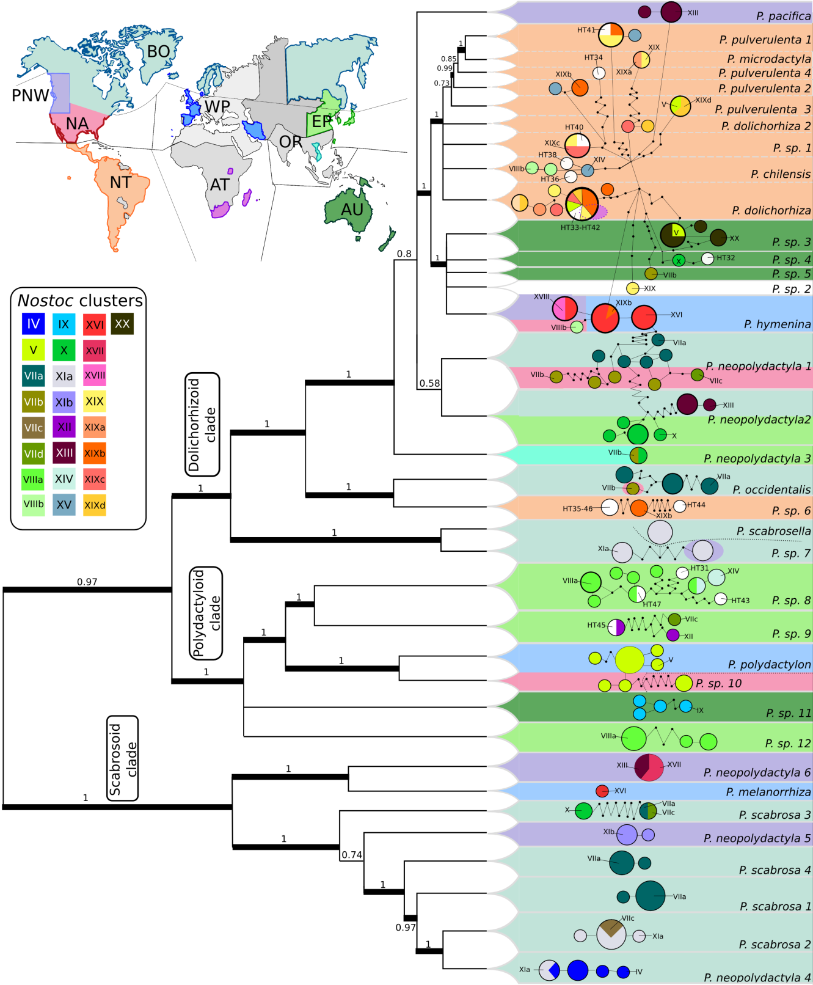
Specificity of the symbionts
Different mycobiont profiles, from strict specialist to generalist
Cases of local mycobiont specialists with cyanobiont switches
Possible influence of time, with old mycobiont specialist species and recent generalists
Radiation of mycobiont correlated with generalism
Mycobiont specialists have usually less haplotypes than generalists
Notes:
Then to compare the two symbionts this is a figure with on the left a chronogram of the fungus obtained with BEAST and on the right an haplotype network also of the fungus obtained with TCS. The circles represent the fungal haplotypes, and the little dots the numbers of steps (mutations or indels) between each haplotype. The size of the circle is proportional to the number of specimens, and the color in the circles represent the identity of the Nostoc involved in the association according to the phylotypes defined earlier. Then the background color corresponds to the geographic origins of specimens. So what we can see is that there are several species that are strict specialist, associating with only one photobiont. Like these ones and these ones mainly in those two clades, and these specialist species are often restricted to a single region, like these ones in pacific northwest or these ones in boreal regions, or these ones in asia or australasia. On the other hand this clade here for instance that has a cosmopolitan distribution taken as a whole have some generalist species that can associate with a lot of different phylotypes. We can also see a few interesting cases where species show strong specificity in a region, but then switch to another nostoc in a different region like this one which associates with this dark green nostoc in boreal zones and with this brownish one in south of the usa, or this one that associates with this dark red one in boreal regions, but with this green one in temperate Asia. This fits very well with the geographic mosaic of coevolution theory stating that long-term dynamics of coevolution may occur over large geographic ranges rather than within local populations and based on the observation that a species may adapt and become specialized to another species differently in separate regions.
There is also selectivity, meaning that for instance all these Peltigera species were found in the same localities of Norway, Russia and Canada, but in all 3 continents this one was always with the grey Nostoc , these ones with the green one and this one with the red one, even though the other nostoc were present so it’s not just association with any Nostoc present. We can also see that specialists species are mostly on long branches, meaning they most probably represent species existing for a long time while generalist species are on very short branches, suggesting recently differentiated species. That would suggest that species have a trend to acquire specialisation through time. We might also correlate this radiation here with generalism. Then finally let’s also note that species using different phylotypes have many fungal ITS haplotypes while specialist one have only a few, suggesting less genetic diveristy in the specialiszed one.

Slide 16
Specificity of the symbionts
Different mycobiont profiles, from strict specialist to generalist
Cases of local mycobiont specialists with cyanobiont switches
Possible influence of time, with old mycobiont specialist species and recent generalists
Radiation of mycobiont correlated with generalism
Mycobiont specialists have usually less haplotypes than generalists
Notes:
Then to compare the two symbionts this is a figure with on the left a chronogram of the fungus obtained with BEAST and on the right an haplotype network also of the fungus obtained with TCS. The circles represent the fungal haplotypes, and the little dots the numbers of steps (mutations or indels) between each haplotype. The size of the circle is proportional to the number of specimens, and the color in the circles represent the identity of the Nostoc involved in the association. Then the background color corresponds to the geographic origins of specimens. So what we can see is that there are several species that are strict specialist, associating with only one photobiont. Like these ones and these ones mainly in those two clades, and these specialist species are often restricted to a single region, like these ones in pacific northwest or these ones in boreal regions, or these ones in asia or australasia. On the other hand this clade here for instance that has a cosmopolitan distribution taken as a whole have some generalist species that can associate with a lot of different phylotypes. We can also see a few interesting cases where species show strong specificity in a region, but then switch to another nostoc in a different region like this one which associates with this dark green nostoc in boreal zones and with this brownish one in south of the usa, or this one that associates with this dark red one in boreal regions, but with this green one in temperate Asia. This fits very well with the geographic mosaic of coevolution theory stating that long-term dynamics of coevolution may occur over large geographic ranges rather than within local populations and based on the observation that a species may adapt and become specialized to another species differently in separate regions.
There is also selectivity, meaning that for instance all these species were found in the same localities of Norway, Russia and Canada, but in all 3 continents this one was always with the grey one, these ones with the green one and this one with the red one, even though the other nostoc were present so it’s not just association with any Nostoc present. We can also see that specialists species are always on a long branch, meaning they most probably represent species existing for a long time while generalist species are on very short branches, suggesting recent species. That would suggest that species have a trend to acquire specialisation through time. We might also correlate this radiation here with generalism. Then finally let’s also note that species using different phylotypes have many haplotypes while specialist one have only a few, suggesting more genetic stability in the specialiszed one.

Slide 17
Specificity of the symbionts
Different mycobiont profiles, from strict specialist to generalist
Cases of local mycobiont specialists with cyanobiont switches
Possible influence of time, with old mycobiont specialist species and recent generalists
Radiation of mycobiont correlated with generalism
Mycobiont specialists have usually less haplotypes than generalists
Notes:
Then to compare the two symbionts this is a figure with on the left a chronogram of the fungus obtained with BEAST and on the right an haplotype network also of the fungus obtained with TCS. The circles represent the fungal haplotypes, and the little dots the numbers of steps (mutations or indels) between each haplotype. The size of the circle is proportional to the number of specimens, and the color in the circles represent the identity of the Nostoc involved in the association. Then the background color corresponds to the geographic origins of specimens. So what we can see is that there are several species that are strict specialist, associating with only one photobiont. Like these ones and these ones mainly in those two clades, and these specialist species are often restricted to a single region, like these ones in pacific northwest or these ones in boreal regions, or these ones in asia or australasia. On the other hand this clade here for instance that has a cosmopolitan distribution taken as a whole have some generalist species that can associate with a lot of different phylotypes. We can also see a few interesting cases where species show strong specificity in a region, but then switch to another nostoc in a different region like this one which associates with this dark green nostoc in boreal zones and with this brownish one in south of the usa, or this one that associates with this dark red one in boreal regions, but with this green one in temperate Asia. This fits very well with the geographic mosaic of coevolution theory stating that long-term dynamics of coevolution may occur over large geographic ranges rather than within local populations and based on the observation that a species may adapt and become specialized to another species differently in separate regions.
There is also selectivity, meaning that for instance all these species were found in the same localities of Norway, Russia and Canada, but in all 3 continents this one was always with the grey one, these ones with the green one and this one with the red one, even though the other nostoc were present so it’s not just association with any Nostoc present. We can also see that specialists species are always on a long branch, meaning they most probably represent species existing for a long time while generalist species are on very short branches, suggesting recent species. That would suggest that species have a trend to acquire specialisation through time. We might also correlate this radiation here with generalism. Then finally let’s also note that species using different phylotypes have many haplotypes while specialist one have only a few, suggesting more genetic stability in the specialiszed one.

Slide 18
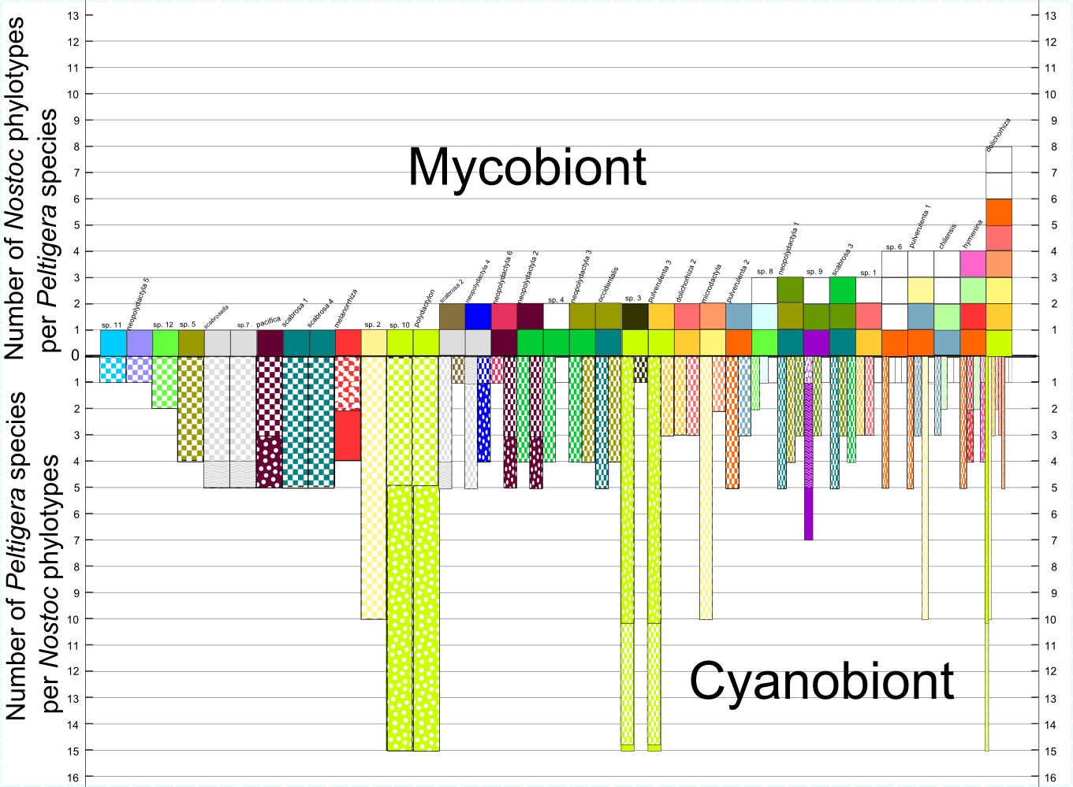
Specificity of the symbionts
Mycobiont (Peltigera) profile
1 phylogroup
2 phylogroups
3 phylogroups
4 phylogroups
Cyanobiont (Nostoc) profile
In average, 2 phylogroups per Peltigera species, 3.4 species (of Peltigera) per Nostoc phylogroup.
The mycobiont is more specialized than the cyanobiont.
Notes:
Another question was is the nostoc or the peltigera more specialized. Here you can see that almost 75% of peltigera species associate with one or 2 phylotypes while almost half of the nostoc phylotypes associate with at least 4 species of peltigera and it would be more if we considered species from other genera so it seems that the Peltigera, the fungus, is definitely more specialized than the Nostoc, which is more generalist.
Then here I’ve plotted above the line the number of phylotypes of nostoc used by each peltigera species, and below the line, the number of species these Nostoc associate with. What we can see is that Nostoc usually associate with more species than peltigera, peltigera usually associate with one or two while nostoc usually associate with 5 and up to 10 or so. It is also rarely a case of specialist with specialist, we only have two cases here, or generalist with generalist, but we can have a specialist with a generalist for instance.

Slide 19
Specificity of the symbionts
Mycobiont (Peltigera) profile
1 phylogroup
2 phylogroups
3 phylogroups
4 phylogroups
Cyanobiont (Nostoc) profile
In average, 2 phylogroups per Peltigera species, 3.4 species (of Peltigera) per Nostoc phylogroup.
The mycobiont is more specialized than the cyanobiont.
Notes:
Another question was is the nostoc or the peltigera more specialized. Here you can see that almost 75% of peltigera species associate with one or 2 phylotypes while almost half of the nostoc phylotypes associate with at least 4 species of peltigera and it would be more if we considered species from other genera so it seems that the Peltigera, the fungus, is definitely more specialized than the Nostoc, which is more generalist.
Then here I’ve plotted above the line the number of phylotypes of nostoc used by each peltigera species, and below the line, the number of species these Nostoc associate with. What we can see is that Nostoc usually associate with more species than peltigera, peltigera usually associate with one or two while nostoc usually associate with 5 and up to 10 or so. It is also rarely a case of specialist with specialist, we only have two cases here, or generalist with generalist, but we can have a specialist with a generalist for instance.

Slide 20
Specificity of the symbionts
Mycobiont (Peltigera) profile
1 phylogroup
2 phylogroups
3 phylogroups
4 phylogroups
Cyanobiont (Nostoc) profile
In average, 2 phylogroups per Peltigera species, 3.4 species (of Peltigera) per Nostoc phylogroup.
The mycobiont is more specialized than the cyanobiont.
Notes:
Another question was is the nostoc or the peltigera more specialized. Here you can see that almost 75% of peltigera species associate with one or 2 phylotypes while almost half of the nostoc phylotypes associate with at least 4 species of peltigera and it would be more if we considered species from other genera so it seems that the Peltigera, the fungus, is definitely more specialized than the Nostoc, which is more generalist.
Then here I’ve plotted above the line the number of phylotypes of nostoc used by each peltigera species, and below the line, the number of species these Nostoc associate with. What we can see is that Nostoc usually associate with more species than peltigera, peltigera usually associate with one or two while nostoc usually associate with 5 and up to 10 or so. It is also rarely a case of specialist with specialist, we only have two cases here, or generalist with generalist, but we can have a specialist with a generalist for instance.

Slide 21
Specificity of the symbionts
Mycobiont (Peltigera) profile
1 phylogroup
2 phylogroups
3 phylogroups
4 phylogroups
Cyanobiont (Nostoc) profile
In average, 2 phylogroups per Peltigera species, 3.4 species (of Peltigera) per Nostoc phylogroup.
The mycobiont is more specialized than the cyanobiont.
Notes:
Another question was is the nostoc or the peltigera more specialized. Here you can see that almost 75% of peltigera species associate with one or 2 phylotypes while almost half of the nostoc phylotypes associate with at least 4 species of peltigera and it would be more if we considered species from other genera so it seems that the Peltigera, the fungus, is definitely more specialized than the Nostoc, which is more generalist.
Then here I’ve plotted above the line the number of phylotypes of nostoc used by each peltigera species, and below the line, the number of species these Nostoc associate with. What we can see is that Nostoc usually associate with more species than peltigera, peltigera usually associate with one or two while nostoc usually associate with 5 and up to 10 or so. It is also rarely a case of specialist with specialist, we only have two cases here, or generalist with generalist, but we can have a specialist with a generalist for instance.

Slide 22
Specificity of the symbionts
Different mycobiont profiles, from strict specialist to generalist
Cases of local mycobiont specialists with cyanobiont switches
Possible influence of time, with old mycobiont specialist species and recent generalists
Radiation of mycobiont correlated with generalism
Mycobiont specialists have usually less haplotypes than generalists
Notes:
Then to compare the two symbionts this is a figure with on the left a chronogram of the fungus obtained with BEAST and on the right an haplotype network also of the fungus obtained with TCS. The circles represent the fungal haplotypes, and the little dots the numbers of steps (mutations or indels) between each haplotype. The size of the circle is proportional to the number of specimens, and the color in the circles represent the identity of the Nostoc involved in the association. Then the background color corresponds to the geographic origins of specimens. So what we can see is that there are several species that are strict specialist, associating with only one photobiont. Like these ones and these ones mainly in those two clades, and these specialist species are often restricted to a single region, like these ones in pacific northwest or these ones in boreal regions, or these ones in asia or australasia. On the other hand this clade here for instance that has a cosmopolitan distribution taken as a whole have some generalist species that can associate with a lot of different phylotypes. We can also see a few interesting cases where species show strong specificity in a region, but then switch to another nostoc in a different region like this one which associates with this dark green nostoc in boreal zones and with this brownish one in south of the usa, or this one that associates with this dark red one in boreal regions, but with this green one in temperate Asia. This fits very well with the geographic mosaic of coevolution theory stating that long-term dynamics of coevolution may occur over large geographic ranges rather than within local populations and based on the observation that a species may adapt and become specialized to another species differently in separate regions.
There is also selectivity, meaning that for instance all these species were found in the same localities of Norway, Russia and Canada, but in all 3 continents this one was always with the grey one, these ones with the green one and this one with the red one, even though the other nostoc were present so it’s not just association with any Nostoc present. We can also see that specialists species are always on a long branch, meaning they most probably represent species existing for a long time while generalist species are on very short branches, suggesting recent species. That would suggest that species have a trend to acquire specialisation through time. We might also correlate this radiation here with generalism. Then finally let’s also note that species using different phylotypes have many haplotypes while specialist one have only a few, suggesting more genetic stability in the specialiszed one.

Slide 23
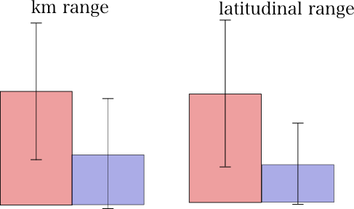
Correlation between specificity and geographical range (mycobiont)
Average range of a non-specialist species: 7720 km and 27.5° of latitude
Average range of a specialist species: 3340 km and 8.5° of latitude
Notes:
Another question is: is a generalist more widespread than a specialist, does using several phylotypes allow you to have a wider range, which would make sense if we think that using diffenrent Nostoc which have different distrubtions would allow to develop in more regions; so i’ve compared the non-specialist (in red) and the specialist (in blue) peltigera species using their kilometric range, which is the maximum distance in km between two thalli of the same species, to account for their ability to colonize a wide range, and their latitudinal range to account for their ability to grow under different climates And indeed it seems that assicoting with more nostoc phylotypes can give you a wider range both in terms of km and latitude. Especially if you compare the average range of a specialist with a non-specialist, it is about twice more in terms of km and 3 times more in terms of latitude

Slide 24
Specificity of the symbionts
Different mycobiont profiles, from strict specialist to generalist
Cases of local mycobiont specialists with cyanobiont switches
Possible influence of time, with old mycobiont specialist species and recent generalists
Radiation of mycobiont correlated with generalism
Mycobiont specialists have usually less haplotypes than generalists
Notes:
Then to compare the two symbionts this is a figure with on the left a chronogram of the fungus obtained with BEAST and on the right an haplotype network also of the fungus obtained with TCS. The circles represent the fungal haplotypes, and the little dots the numbers of steps (mutations or indels) between each haplotype. The size of the circle is proportional to the number of specimens, and the color in the circles represent the identity of the Nostoc involved in the association. Then the background color corresponds to the geographic origins of specimens. So what we can see is that there are several species that are strict specialist, associating with only one photobiont. Like these ones and these ones mainly in those two clades, and these specialist species are often restricted to a single region, like these ones in pacific northwest or these ones in boreal regions, or these ones in asia or australasia. On the other hand this clade here for instance that has a cosmopolitan distribution taken as a whole have some generalist species that can associate with a lot of different phylotypes. We can also see a few interesting cases where species show strong specificity in a region, but then switch to another nostoc in a different region like this one which associates with this dark green nostoc in boreal zones and with this brownish one in south of the usa, or this one that associates with this dark red one in boreal regions, but with this green one in temperate Asia. This fits very well with the geographic mosaic of coevolution theory stating that long-term dynamics of coevolution may occur over large geographic ranges rather than within local populations and based on the observation that a species may adapt and become specialized to another species differently in separate regions.
There is also selectivity, meaning that for instance all these species were found in the same localities of Norway, Russia and Canada, but in all 3 continents this one was always with the grey one, these ones with the green one and this one with the red one, even though the other nostoc were present so it’s not just association with any Nostoc present. We can also see that specialists species are always on a long branch, meaning they most probably represent species existing for a long time while generalist species are on very short branches, suggesting recent species. That would suggest that species have a trend to acquire specialisation through time. We might also correlate this radiation here with generalism. Then finally let’s also note that species using different phylotypes have many haplotypes while specialist one have only a few, suggesting more genetic stability in the specialiszed one.

Slide 25
Specificity of the symbionts
Different mycobiont profiles, from strict specialist to generalist
Cases of local mycobiont specialists with cyanobiont switches
Possible influence of time, with old mycobiont specialist species and recent generalists
Radiation of mycobiont correlated with generalism
Mycobiont specialists have usually less haplotypes than generalists
Notes:
Then to compare the two symbionts this is a figure with on the left a chronogram of the fungus obtained with BEAST and on the right an haplotype network also of the fungus obtained with TCS. The circles represent the fungal haplotypes, and the little dots the numbers of steps (mutations or indels) between each haplotype. The size of the circle is proportional to the number of specimens, and the color in the circles represent the identity of the Nostoc involved in the association. Then the background color corresponds to the geographic origins of specimens. So what we can see is that there are several species that are strict specialist, associating with only one photobiont. Like these ones and these ones mainly in those two clades, and these specialist species are often restricted to a single region, like these ones in pacific northwest or these ones in boreal regions, or these ones in asia or australasia. On the other hand this clade here for instance that has a cosmopolitan distribution taken as a whole have some generalist species that can associate with a lot of different phylotypes. We can also see a few interesting cases where species show strong specificity in a region, but then switch to another nostoc in a different region like this one which associates with this dark green nostoc in boreal zones and with this brownish one in south of the usa, or this one that associates with this dark red one in boreal regions, but with this green one in temperate Asia. This fits very well with the geographic mosaic of coevolution theory stating that long-term dynamics of coevolution may occur over large geographic ranges rather than within local populations and based on the observation that a species may adapt and become specialized to another species differently in separate regions.
There is also selectivity, meaning that for instance all these species were found in the same localities of Norway, Russia and Canada, but in all 3 continents this one was always with the grey one, these ones with the green one and this one with the red one, even though the other nostoc were present so it’s not just association with any Nostoc present. We can also see that specialists species are always on a long branch, meaning they most probably represent species existing for a long time while generalist species are on very short branches, suggesting recent species. That would suggest that species have a trend to acquire specialisation through time. We might also correlate this radiation here with generalism. Then finally let’s also note that species using different phylotypes have many haplotypes while specialist one have only a few, suggesting more genetic stability in the specialiszed one.

Slide 26
Specificity of the symbionts
Different mycobiont profiles, from strict specialist to generalist
Cases of local mycobiont specialists with cyanobiont switches
Possible influence of time, with old mycobiont specialist species and recent generalists
Radiation of mycobiont correlated with generalism
Mycobiont specialists have usually less haplotypes than generalists
Notes:
Then to compare the two symbionts this is a figure with on the left a chronogram of the fungus obtained with BEAST and on the right an haplotype network also of the fungus obtained with TCS. The circles represent the fungal haplotypes, and the little dots the numbers of steps (mutations or indels) between each haplotype. The size of the circle is proportional to the number of specimens, and the color in the circles represent the identity of the Nostoc involved in the association. Then the background color corresponds to the geographic origins of specimens. So what we can see is that there are several species that are strict specialist, associating with only one photobiont. Like these ones and these ones mainly in those two clades, and these specialist species are often restricted to a single region, like these ones in pacific northwest or these ones in boreal regions, or these ones in asia or australasia. On the other hand this clade here for instance that has a cosmopolitan distribution taken as a whole have some generalist species that can associate with a lot of different phylotypes. We can also see a few interesting cases where species show strong specificity in a region, but then switch to another nostoc in a different region like this one which associates with this dark green nostoc in boreal zones and with this brownish one in south of the usa, or this one that associates with this dark red one in boreal regions, but with this green one in temperate Asia. This fits very well with the geographic mosaic of coevolution theory stating that long-term dynamics of coevolution may occur over large geographic ranges rather than within local populations and based on the observation that a species may adapt and become specialized to another species differently in separate regions.
There is also selectivity, meaning that for instance all these species were found in the same localities of Norway, Russia and Canada, but in all 3 continents this one was always with the grey one, these ones with the green one and this one with the red one, even though the other nostoc were present so it’s not just association with any Nostoc present. We can also see that specialists species are always on a long branch, meaning they most probably represent species existing for a long time while generalist species are on very short branches, suggesting recent species. That would suggest that species have a trend to acquire specialisation through time. We might also correlate this radiation here with generalism. Then finally let’s also note that species using different phylotypes have many haplotypes while specialist one have only a few, suggesting more genetic stability in the specialiszed one.

Slide 27
Specificity of the symbionts
Different mycobiont profiles, from strict specialist to generalist
Cases of local mycobiont specialists with cyanobiont switches
Possible influence of time, with old mycobiont specialist species and recent generalists
Radiation of mycobiont correlated with generalism
Mycobiont specialists have usually less haplotypes than generalists
Notes:
Then to compare the two symbionts this is a figure with on the left a chronogram of the fungus obtained with BEAST and on the right an haplotype network also of the fungus obtained with TCS. The circles represent the fungal haplotypes, and the little dots the numbers of steps (mutations or indels) between each haplotype. The size of the circle is proportional to the number of specimens, and the color in the circles represent the identity of the Nostoc involved in the association. Then the background color corresponds to the geographic origins of specimens. So what we can see is that there are several species that are strict specialist, associating with only one photobiont. Like these ones and these ones mainly in those two clades, and these specialist species are often restricted to a single region, like these ones in pacific northwest or these ones in boreal regions, or these ones in asia or australasia. On the other hand this clade here for instance that has a cosmopolitan distribution taken as a whole have some generalist species that can associate with a lot of different phylotypes. We can also see a few interesting cases where species show strong specificity in a region, but then switch to another nostoc in a different region like this one which associates with this dark green nostoc in boreal zones and with this brownish one in south of the usa, or this one that associates with this dark red one in boreal regions, but with this green one in temperate Asia. This fits very well with the geographic mosaic of coevolution theory stating that long-term dynamics of coevolution may occur over large geographic ranges rather than within local populations and based on the observation that a species may adapt and become specialized to another species differently in separate regions.
There is also selectivity, meaning that for instance all these species were found in the same localities of Norway, Russia and Canada, but in all 3 continents this one was always with the grey one, these ones with the green one and this one with the red one, even though the other nostoc were present so it’s not just association with any Nostoc present. We can also see that specialists species are always on a long branch, meaning they most probably represent species existing for a long time while generalist species are on very short branches, suggesting recent species. That would suggest that species have a trend to acquire specialisation through time. We might also correlate this radiation here with generalism. Then finally let’s also note that species using different phylotypes have many haplotypes while specialist one have only a few, suggesting more genetic stability in the specialiszed one.

Slide 28
Specificity of the symbionts
Different mycobiont profiles, from strict specialist to generalist
Cases of local mycobiont specialists with cyanobiont switches
Possible influence of time, with old mycobiont specialist species and recent generalists
Radiation of mycobiont correlated with generalism
Mycobiont specialists have usually less haplotypes than generalists
Notes:
Then to compare the two symbionts this is a figure with on the left a chronogram of the fungus obtained with BEAST and on the right an haplotype network also of the fungus obtained with TCS. The circles represent the fungal haplotypes, and the little dots the numbers of steps (mutations or indels) between each haplotype. The size of the circle is proportional to the number of specimens, and the color in the circles represent the identity of the Nostoc involved in the association. Then the background color corresponds to the geographic origins of specimens. So what we can see is that there are several species that are strict specialist, associating with only one photobiont. Like these ones and these ones mainly in those two clades, and these specialist species are often restricted to a single region, like these ones in pacific northwest or these ones in boreal regions, or these ones in asia or australasia. On the other hand this clade here for instance that has a cosmopolitan distribution taken as a whole have some generalist species that can associate with a lot of different phylotypes. We can also see a few interesting cases where species show strong specificity in a region, but then switch to another nostoc in a different region like this one which associates with this dark green nostoc in boreal zones and with this brownish one in south of the usa, or this one that associates with this dark red one in boreal regions, but with this green one in temperate Asia. This fits very well with the geographic mosaic of coevolution theory stating that long-term dynamics of coevolution may occur over large geographic ranges rather than within local populations and based on the observation that a species may adapt and become specialized to another species differently in separate regions.
There is also selectivity, meaning that for instance all these species were found in the same localities of Norway, Russia and Canada, but in all 3 continents this one was always with the grey one, these ones with the green one and this one with the red one, even though the other nostoc were present so it’s not just association with any Nostoc present. We can also see that specialists species are always on a long branch, meaning they most probably represent species existing for a long time while generalist species are on very short branches, suggesting recent species. That would suggest that species have a trend to acquire specialisation through time. We might also correlate this radiation here with generalism. Then finally let’s also note that species using different phylotypes have many haplotypes while specialist one have only a few, suggesting more genetic stability in the specialiszed one.

Slide 29
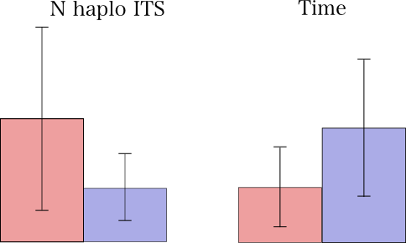
Genetic diversity and evolution of specificity through time
No. haplo ITS
Time
In average, less genetic variation in specialist (3.2 haplo) vs generalist (7.4) mycobiont species
Trend of increased specialization with time (specialists on branches in average 2.1 times longer)
Notes:
I’ve also tested factors such as time and genetic diversity because I’ve noticed that specialists species had a tendancy to have less haplotypes than generalist ones, and you can see that it seems that fungal species that use several Nostoc phylotypes have usually more ITS fungal haplotypes. I’ve also compared the average pairwise genetic distance inside species of peltigera and nostoc involved in these species, to eliminate the subjective definition of phylotypes, and we can see the same trend. Then I compared this with the time since those species are thought to have diverged based on the chronogram, to confirm this trend that species seems to be more generalist when they are recent and more specialized with time and indeed it seems that there is a tendancy, there is also a tendancy to have less its haplotypes through time, suggesting that specialization favor the presence of less haplotypes, probably because only the one that are best adapted to their partner and therefore optimize the symbiosis are positively selected. Indeed it is probably better for fungal species to specialize only on one phylotype of Nostoc to better adapt to it, and then only the haplotypes that would be optimal will be selected. These results fit well with the Law & Lewis Paradigm, that suggest that there should be positive selection on the most widespread/best adapted symbiont and therefore reduced diversity so that one partner only have to deal with one partner an can better adapt to it. This reduced genetic diversity and this apparent stability of specialized species with time could also be linked to the Red King hypothesis, that suggest that as the two partners need to find an equilibrium for the symbiosis, the slowest evolving partner might gain benefits by being the slowest to adapt on the way to the equilibrium and therefore the one which can stay more selfish, while the other one will have to become more generous, favoring slow evolution of the partners, unlike to the Red Queen Hypothesis in parasitic or competing species.

Slide 30
Impact of specialization on speciation rate
BiSSE: comparing specialists (1 Nostoc phylogroup only) and non-specialists Peltigera species:
a) speciation rates significantly higher in generalists
b) switching rate generalist => specialist significantly higher than specialist => generalist
Notes:
I’ve also run a few analyses to test if the speciation rates where correlated with the specialist or generalist profile of the species. I’ve first run a BISSE analysis, it takes a look at the speciation and extinction rates based on a binary character, I’ve used specialist (only one phylotype) or non-specialist (found with at least 2 phylotypes) as the character. The BISSE analysis gave us two interesting results. First,the speciation rate is way more important in non-specialists than in specialists, and second that the rate of switching from generalist to specialist is way higher than switchinf from specialist to generalist. This suggests that we would first have a state where the mycobiont is generalist, using different Nostoc, and speciating during this period, and then through time, the different species would specialize through time on a specific Nostoc, but speciating way less frequently when specialized. Second, we did a MEDUSA analysis, this is also analysing speciation rates, but it tests models with different numbers of significant switches in speciation rates to maximize the likelihood, and the best model is one with one switch, at the base of the neo/doli/hym group, this group being mostly generalist, it could also suggest that the switch to generalism triggers speciation.

Slide 31
Impact of specialization on speciation rate
2) MEDUSA: significant shift in speciation rates at the base of the big cosmopolitan radiation
=> possible link with generalism
Notes:
I’ve also run a few analyses to test if the speciation rates where correlated with the specialist or generalist profile of the species. I’ve first run a BISSE analysis, it takes a look at the speciation and extinction rates based on a binary character, I’ve used specialist (only one phylotype) or non-specialist (found with at least 2 phylotypes) as the character. The BISSE analysis gave us two interesting results. First,the speciation rate is way more important in non-specialists than in specialists, and second that the rate of switching from generalist to specialist is way higher than switchinf from specialist to generalist. This suggests that we would first have a state where the mycobiont is generalist, using different Nostoc, and speciating during this period, and then through time, the different species would specialize through time on a specific Nostoc, but speciating way less frequently when specialized. Second, we did a MEDUSA analysis, this is also analysing speciation rates, but it tests models with different numbers of significant switches in speciation rates to maximize the likelihood, and the best model is one with one switch, at the base of the neo/doli/hym group, this group being mostly generalist, it could also suggest that the switch to generalism triggers speciation.

Slide 32
Ecological networks analysis
Chagnon, Magain, Miadlikowska & Lutzoni. Network analyses reveal anti-nestedness and high specificity in lichen symbiosis, even at a very fine taxonomic scale (in review)
Interaction matrix (frequency of interactions between 225 Peltigera-Nostoc pairs)
Anti-nestedness (specialists are not using a subset of generalists partners but have distinct symbionts)
Interactions better explained by the identity of the partner than the geographic origin of the thallus
At the global scale: interactions mostly symmetric (but some mycobionts highly dependent on Nostoc)
More assymetric at more local scale (usually one or two dominant Nostoc phylogroups in a locality)

Slide 33
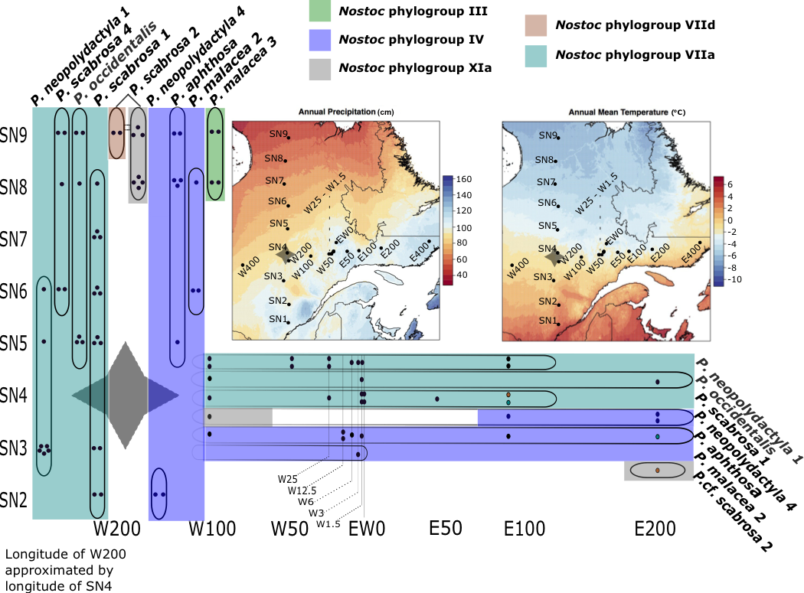
3) Local scale
∂∂∂
∂∂∂
Sampling across the boreal forest in Québec
∂∂∂
Study by undergraduate Jade Lu
East-West and South-North gradients in the boreal forest of Québec
ITS of Peltigera (9 species) and rbcLX of Nostoc for 90 specimens
∂∂∂

Slide 35
- Most Peltigera species highly specialized
- Most species associate with one of the two common phylogroups of Nostoc
-Relatively high turnover of Peltigera species (S-N transect)
-The phylogroups have larger ranges than their Peltigera symbionts
-Distribution of Peltigera not only dependent on Nostoc
-More Nostoc phylogroups in the Northern sites

Slide 36
Acknowledgments
-All collaborators and herbaria that sent us material, collaborators
who helped us during field trips
-Advisors: Emmanuël Sérusiaux, Jolanta Miadlikowska, François Lutzoni,
Bernard Goffinet
-Orvo Vitikainen, Trevor Goward, Camille Truong, Ko Hsuan Chen, Pierre-Luc Chagnon, Romain Darnajoux
-Students: Carlos Pardo, Jade Lu, Antoine Simon

