Slide 1
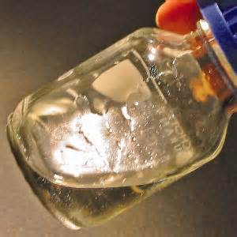
Projet CENZYNC
Sandrine Bouquillon, URCA ICMR
Marie Laure Fauconnier, Ulg GxABT

Slide 2
Ionic Liquids ?
Ionic Liquids (ILs) : organic cation + anion
Properties
mp < 100°C
High solubilization power
Thermal and chemical stability
Low vapor tension (≠ COV)
Large diversity of structures
T. Welton, Chem. Rev. 1999, 99, 2071-2083
S. T. Handy, Chem. Eur. J. 2003,9, 2938-2944
Inorganic
Halides: Br ⁻, Cl ⁻
Fluoride anions: BF₄⁻, PF₆⁻, CF₃SO₃⁻ …
Organic: R-OSO₃⁻, R-COO⁻
Applications
Organic synthesis
Catalysis
Separation
Complexation
Electrochemistry
L. C. Branco et coll. Chem. Eur. J. 2002, 8, 3671-3677
C. Chiappe. et coll. J. Phys. Org. Chem. 2005, 18, 275-297
S. T. Handy, Chem. Eur. J. 2003, 9, 2938-2944

Slide 3
Biosourced ionic Liquids - Synthesis
H. Ohno et al,
J. Am. Chem. Soc.
2005, 2398-2399
R-COOH | Path / Yield / Aspect | IL
 | A / 97 % / oil | TBA L-lactate
 | A / 98 % / oil | TBA L-tartrate
 | A / 99 % / wax | TBA malonate
 | A / 98 % / wax | TBA succinate
 | A / 97 % / gelly | TBA L-malate
 | A / 93 % / oil | TBA pyruvate
 | B / 80 % / solid (mp < 100°C) | TBA D-glucuronate
 | B / 77 % / solid (mp < 100°C) | TBA D-galacturonate
Tetrahedron 2013, 69(30), 6150-6161

Slide 4
Biosourced ionic Liquids - Properties
IL | Viscosity (cP) |  | Tg (°C) | Tdec (°C)
 | 25°C | 80°C
TBA L-lactate | 409.1 | 17.9 | - 59.0 | 201.4
TBA L-tartrate | - | 3689 | - 31.0 | 212.6
TBA malonate | - | 2803 | - 34.8 | 170.1
TBA succinate | - | 106 | - 38.6 | 212.6
TBA L-malate | > 40 000 | 266 | - 34.4 | 230.0
TBA pyruvate | 220 | 17.2 | - 59.3 | 192.2
TBA D-glucuronate | - | - | - 20.5 | 136.1
TBA D-galacturonate | - | - | 18.3 | -
- : not defined
Collaboration Dr A. N Guyen Van Hien, M. Courty, Amiens, France
Tetrahedron 2013, 69(30), 6150-6161

Slide 5
Biosourced ionic Liquids - Toxicity
EC₅₀ (mM) on several strains
IL | E. Coli | P. fluorescens | P. putida (KT2440)
TBA Br | 3.13-6.25 | 3.13-6.25 | 12.50-25.00
TBA OH | 6.25-12.50 | 12.50-25.00 | 12.50-25.00
TBA L-lactate | 12.50-25.00 | 12.50-25.00 | 12.50-25.00
TBA succinate | 12.50-25.00 | 12.50-25.00 | 12.50-25.00
TBA malonate | 12.50-25.00 | 6.25-12.50 | 12.50-25.00
TBA succinate | 12.50-25.00 | 6.25-12.50 | 12.50-25.00
TBA L-tartrate | 6.25-12.50 | 3.13-6.25 | 12.50-25.00
TBA L-malate | 6.25-12.50 | 3.13-6.25 | 3.13-6.25
TBA D-glucuronate | 6.25-12.50 | 25.00-50.00 | 25.00-50.00
TBA D-galacturonate | 12.50-25.00 | 25.00-50.00 | 25.00-50.00
Synthesized ILs generally less toxic than commercial ones !
Collaboration Dr. N. Gathergood, Dublin, Ireland
Tetrahedron 2013, 69(30), 6150-6161

Slide 6
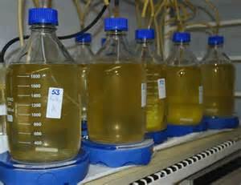
Biodegradable Ionic Liquids ?
Studies of the biodegradability (bottle closed test):
usual ionic liquids are few or not biodegradable
Closed bottle test OECD 301
O₂ consomption, CO₂ production
OECD 301A is used for non-volatile and soluble (100 mg/l) substances.
In the 301A the degree of biodegradation is measured by the change
in DOC over a 28-Days period.
Moreover, usual ionic liquids are eco-toxic !
N. Gathergood, M.T. Garcia and P. J. Scammells
Green Chem. 2004, 6, 166-175; Green Chem. 2005, 7, 9-14; Green Chem. 2006, 8, 156-160.

Slide 7
Biosourced ionic Liquids - Biodegradability
Closed Bottle Test (OECD 301D) after 28 days
Synthesized ILs more biodegradable than commercial ones
but unfortunately no biodegradable ( > 60%)
Collaboration Dr. N. Gathergood, Dublin, Ireland
Tetrahedron 2013, 69(30), 6150-6161

Slide 8
Biosourced ionic Liquids - Synthesis
Extension to P⁺ cations
RSC Advances, 2016, 6, 113583 – 113595
Molecular Catalysis, 2017, 437, 121–129

Slide 9
Biosourced ionic Liquids - Synthesis
R-COOH | Path / Yield / Aspect | IL
 | A / 99 % / oil | TBP L-lactate
 | A / 94 % / wax | TBP L-tartrate
 | A / 99 % / wax | TBP malonate
 | A / 98 % / viscous oil | TBP succinate
 | A / 96 % / gelly | TBP L-malate
 | B / 96 % / oil | TBP pyruvate
 | C / 93 % / solid (mp < 100°C) | TBP D-glucuronate
 | C / 92 % / solid (mp < 100°C) | TBP D-galacturonate
 | A / 97% / oil | TBP S-prolinate

Slide 10
Biosourced ionic Liquids - Properties
ILs | Viscosity (cP) 80°C | Tg (°C) | T dec. (°C)
TBP L-Lactate | 21 | - | -
TBP S-Prolinate | 47 | -56.8 | 315.1
TBP Pyruvate | 165 | -59.3 | 129.8
TBP L-Tartrate | 268 | -20 | 166.6
TBP L-Malonate | - | -9.8 | 287.7
TBP L-Succinate | 125 | -49.3 | 276.8
TBP L-Malate | 105 | -40.2 | 202.6
TBP D-Glucuronate | - | -8.7 | 141.8
TBP D-Galacturonate | 617 | -22.5 | 148.7
Mono-acids
Di-acids
sugars
→ Thermofluidifying ILs
→ Low Tg
*Collaboration University Picardie Jules Verne-Amiens, Dr. A. Nguyen Van Nhien

Slide 11
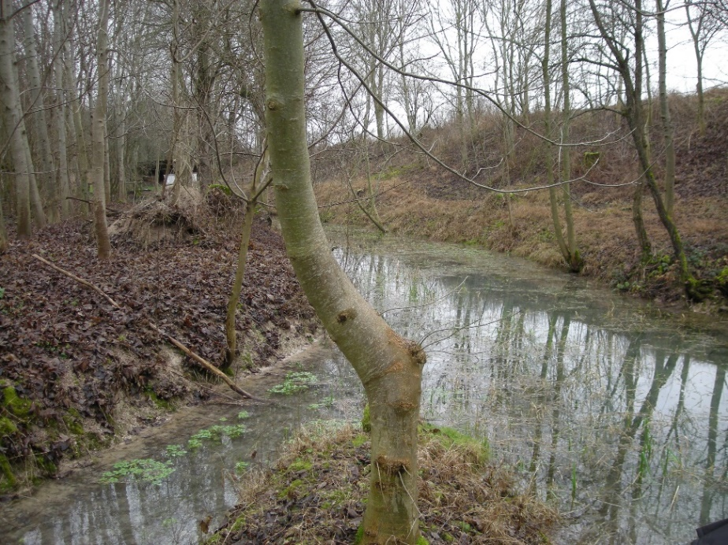
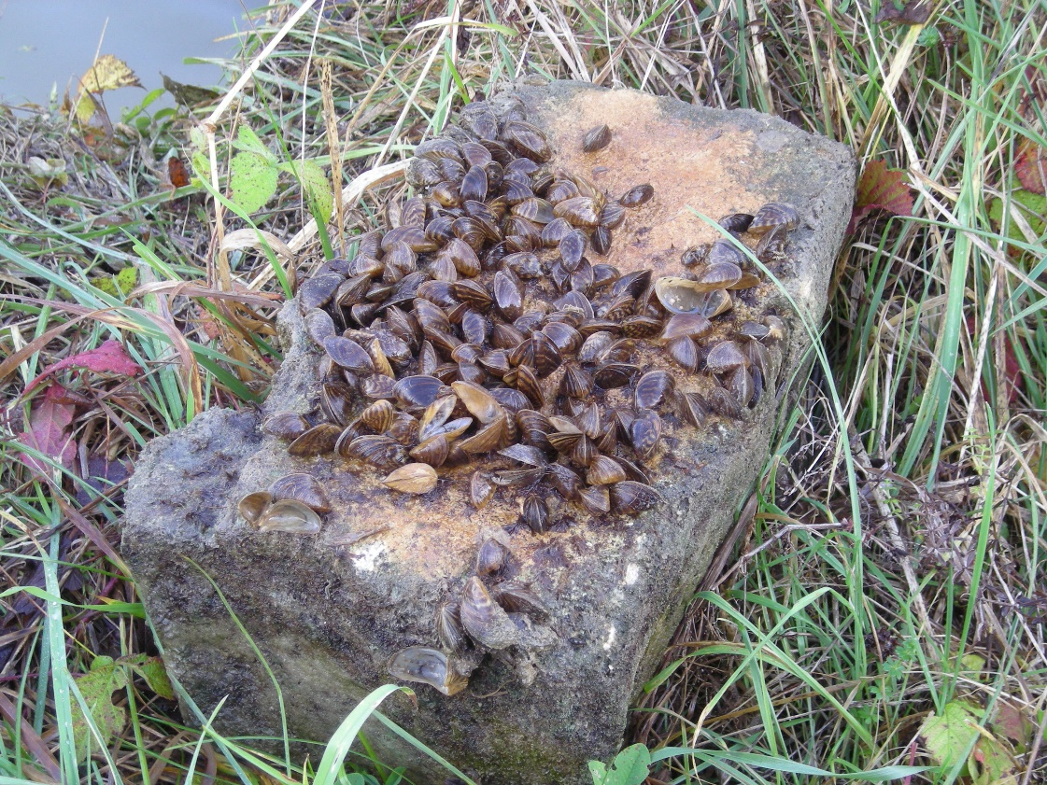
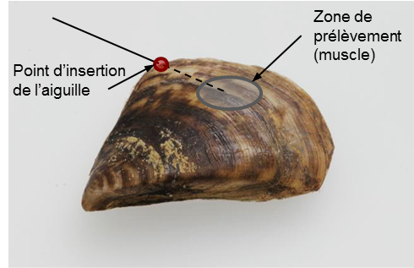
Evaluation of the toxicity of the Ils
towards haemocytes from zebra mussels
using flow cytometry
Collaboration Dr. I. Barjhoux, Pr. A. Geffard, SEBIO Laboratory, Reims France

Slide 12
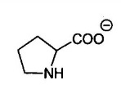
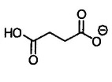
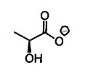
Evaluation of the toxicity of phosphonium ILs
Cytotoxicity
Test: 9 ILs C= 10 mM (4h exposition), 2 series
Positive control for cytotoxicity: CdCl₂ 60 mM
Tetrabutyl Phosphonium (TBP)
+
S-Prolinate
(#1)
D-Glucoronate
(#2)
Succinate
(#3)
Lactate
(#4)
Pyruvate
(#5)
Tartrate
(#6)
Malate
(#7)
Malonate
(#8)
Bromide [T+]
(#9)

Slide 13
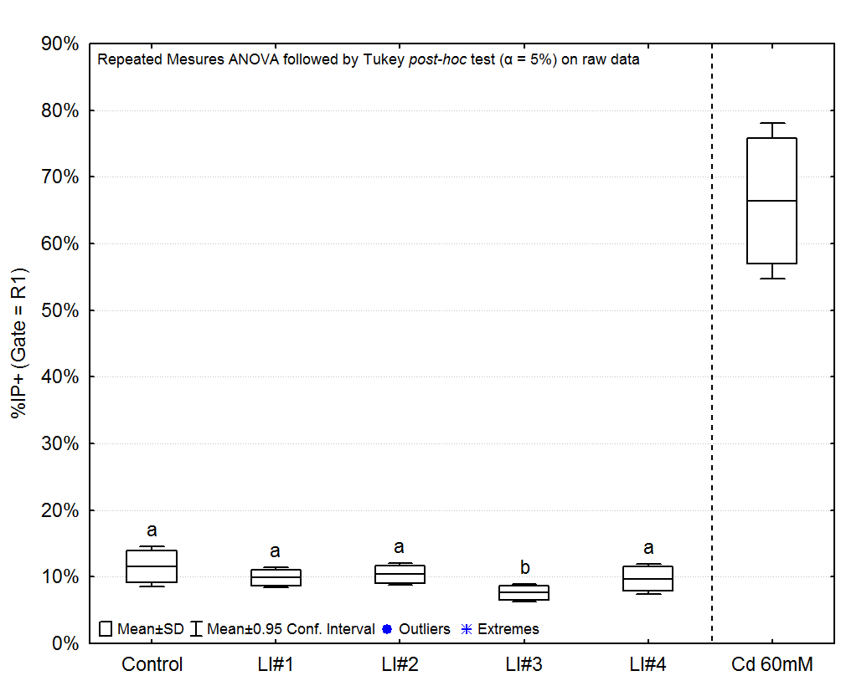
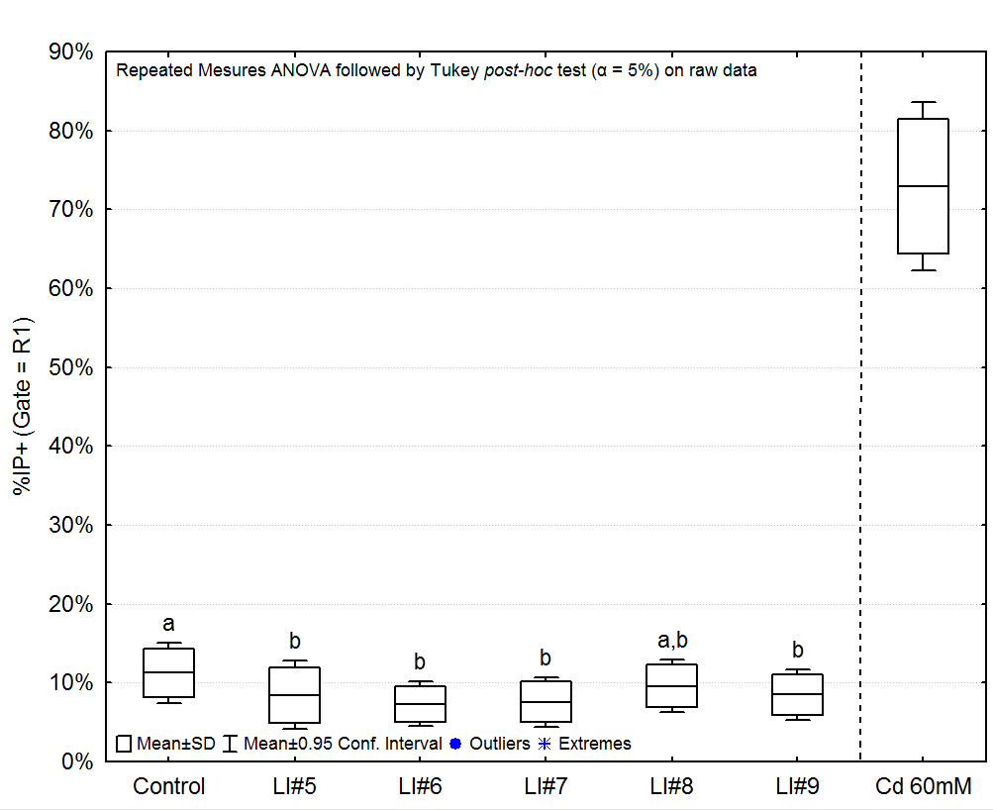
Cytotoxicity (% IP)
S-Prolinate
Succinate
Lactate
D-Glucuronate
Pyruvate
Malate
Bromide
No cytotoxicity in our exposition
conditions on our model
Tartrate
Malonate

Slide 14
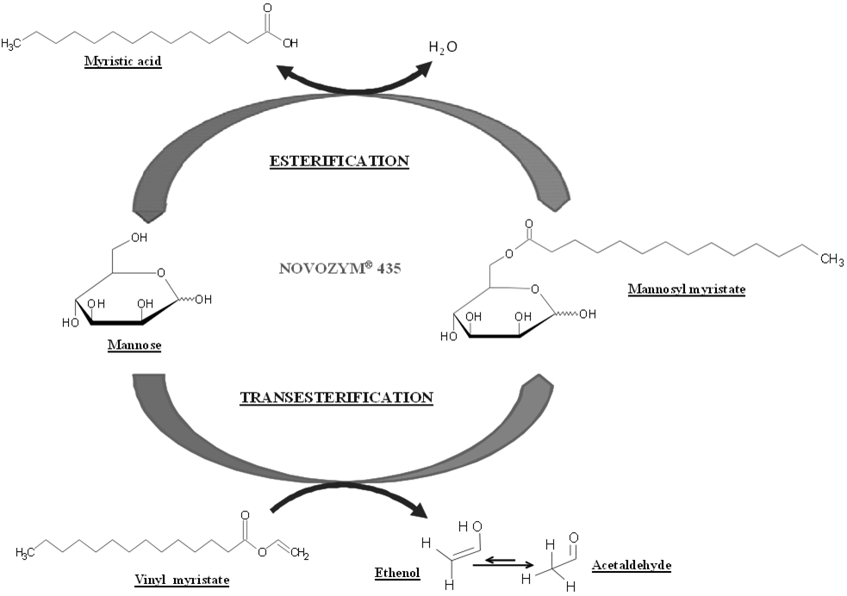
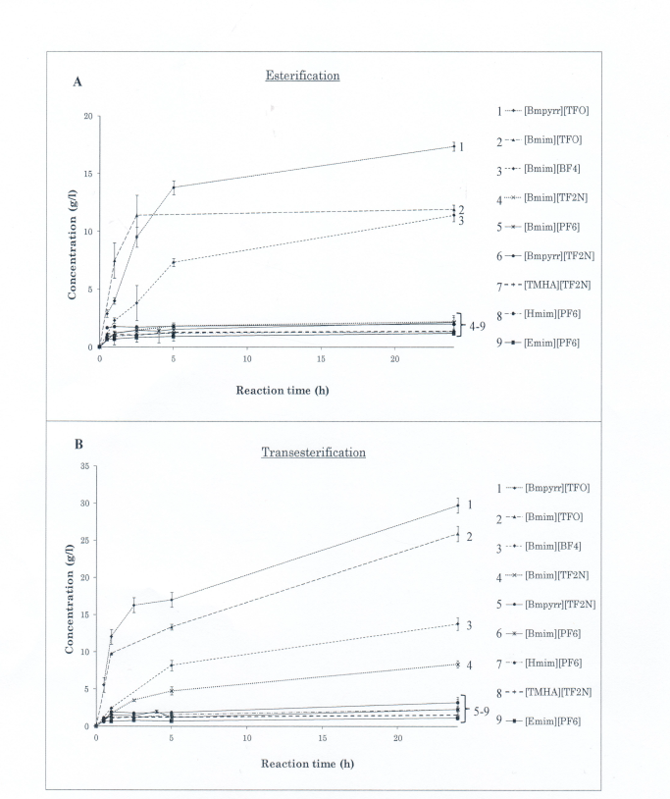
Synthesis of mannosyl myristate in pure LIs
Best results with
Transesterification
In [Bmpyrr][TFO]

Slide 15
Optimization of mannosyl myristate synthesis in [Bmpyrr][TFO]
Optimal conditions
80◦C,
substrate molar ratio of 1/10
total substrate quantity of 0.26 mmol
24 h yield : 72.2 %
Reusability of Novozym 435 : > 5 cycles

Slide 16
Encapsulation d’huiles essentielles
Huiles essentielles : bio-herbicides.
Grande volatilité
Techniques innovantes pour encapsuler les huiles essentielles pour un relargage lent.
Liquide ionique | Tr (%) 4 mL de LI/15 mg d’huile essentielle de citronnelle | Tr (%) 100 mg de LI/15 mg d’huile essentielle de citronnelle
TBP lévulinate | -10,91 | -35,90
TBA lévulinate | -45,25 | -43,71
BMIM lévulinate | -105,29 | -40,93
Choline lévulinate | -110,42 | -63,74
Taux d’encapsulation négatifs : effet « salting out »
Analyses de composés organiques volatils (COVs) présents dans des matrices complexes fragiles : ajout de liquides ioniques pour favoriser le déplacement de l’équilibre de cette phase vers la phase gazeuse où les COVs peuvent être piégés par la technique du head space dynamique puis analysés.

Slide 17
Thanks!
Dr Safa Hayouni
Dr. Jean Pierre Mbakidi
Dr. Nadège Ferlin
Chloe Maes
Collaborations
Dr. Jean Pierre Mbakidi
Dr. Nadège Ferlin
Dr. Nick Gathergood (Dublin, DCU – Tallinn University)
Matthieu Courty (Amiens, UPJV)
Dr. Albert N’guyen Van Nhien (Amiens, UPJV)
Dr Iris Barjhoux (Reims, SEBIO INERIS)
€ € € University of Reims Champagne-Ardenne / CNRS / Ministère de l’Enseignement et de la Recherche / Collectivités territoriales et régionales (CPER-Pentoraf) / FEDER

Slide 18
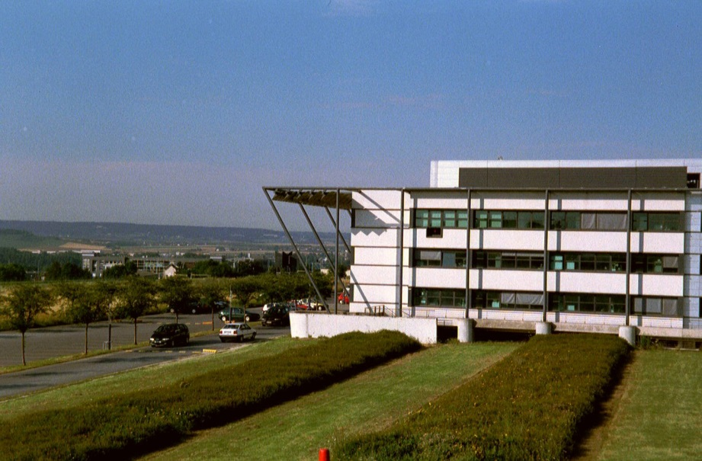
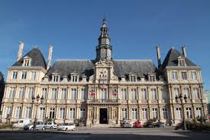
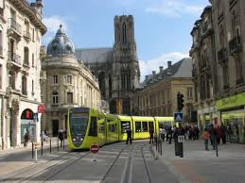
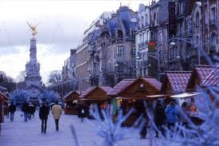
Thank you for your attention !!!

