Slide 1


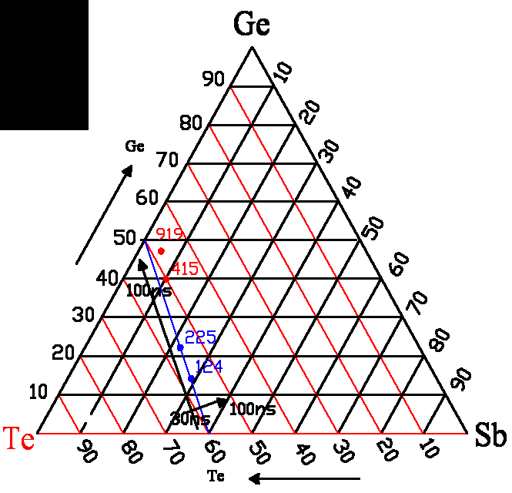
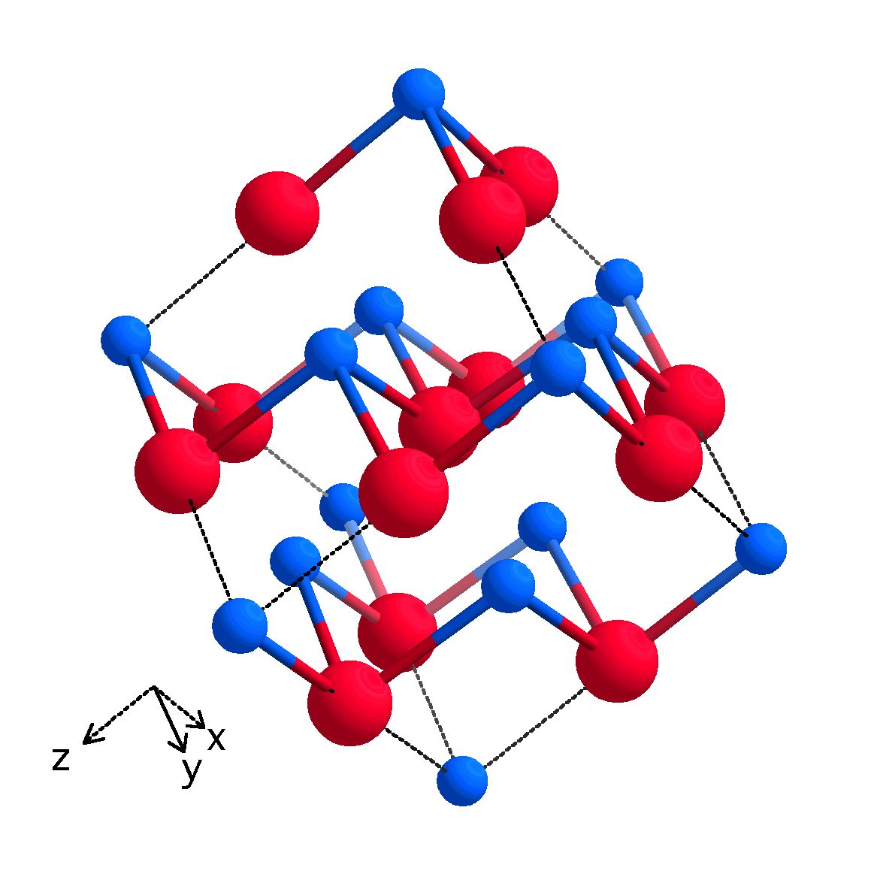
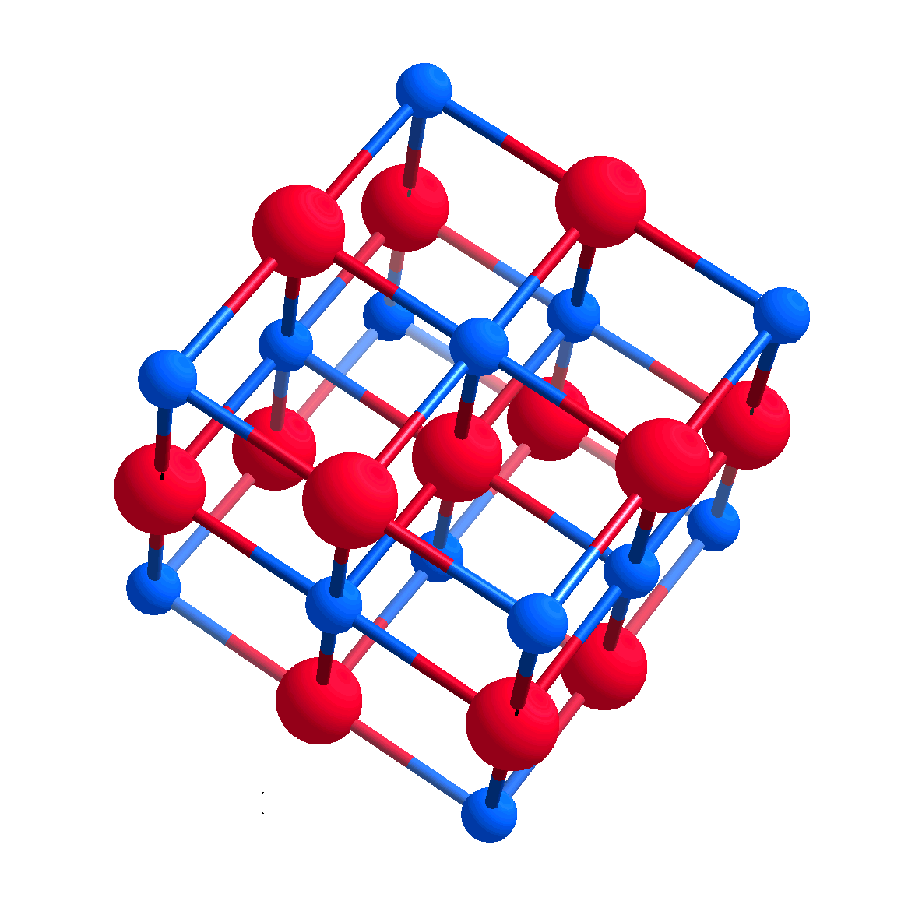
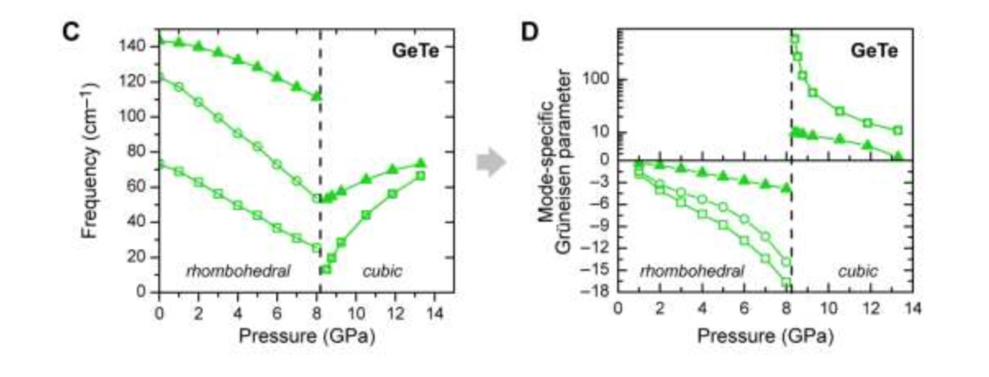
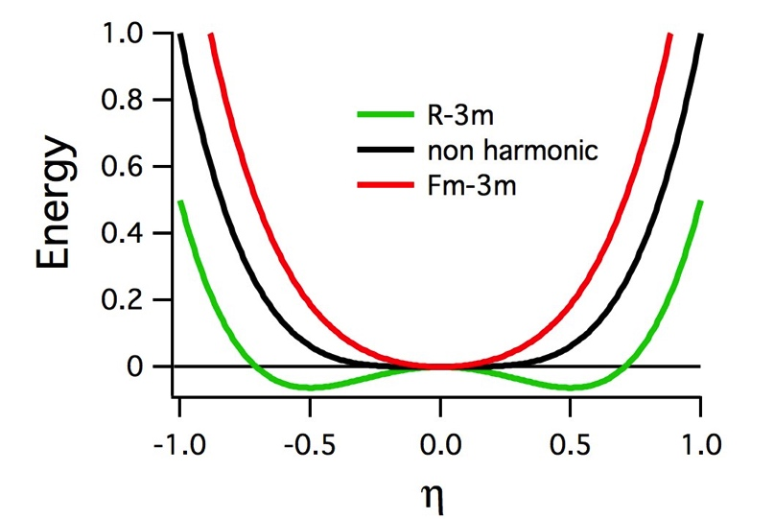
Bonding mechanism of Phase Change Materials (PCM):
the role a non-harmonic deformation potential.
Jean-Pierre Gaspard^{1,2}
¹ILL, Grenoble, France, ²Physics Department, University of Liège, Sart-Tilman Belgium
jp.gaspard@uliege.be
Introduction.
Phase change materials are covalent materials that may store the information by optical or electrical contrast as they can switch between
an amorphous semiconducting phase (ON state) and
a crystalline metallic phase (OFF state). [1]
We show that these materials have an anomalous mode-specific Grüneisen parameter related to a non-harmonic deformation potential.
2. Composition of PCM :
Covalent elements, e. g. Te
with low coordination number
Ge₂Sb₂Te₅ is the reference
composition
- weak ionic character
Prototypical case : GeTe. Two phases R-3m (rhombohdral) and Fm-3m (cubic)
3. Specificity of PCM :
(iono-)covalent bonding
Anomalous Grüneisen mode-specific parameter ( )
Symmetry breaking mechanism electronically driven
Coordination change (Z _{Ge} =3(+3) & Z _{T e} = 3(+3) => Z _{G e}= 6 & Z _{T e} = 6)
4. Models of PCM mechanism:
Umbrella flipping
Resonant bonding ?
Peierls distortion (see below)
Low T< 705 K
High T> 705 K
α-GeTe
β-GeTe
R-3m
Z=3 (+3)
r₁ = 2.84 Å
r₂/r₁ = 1.11
Fm-3m
Z = 6
r₁ = 3.00 Å
r₁ =r₂
5. Theoretical model
One dimensional model of ppσ interactions
assuming that the (x, y, z) directions are decoupled
Tight binding approximation
Effective pairwise repulsive interaction
Distortion parameter
semiconductor | transition | metallic
Peierls distorted | Non-harmonic | Non-distorted
Rhombohedral (a<0) | p=2q a=0 | Cubic (a>0)
Grüneisen γ< 0 | γ diverge | Grüneisen γ< 0
Left : Vibration frequencies as a function of pressure on the GeTe alloy.
Right: Grüneisen parameter as a function of pressure. At the transition pressure (8 GPa) γ diverges and changes sign.
Distortion parameter
Definition of a mode specific Grüneisen parameter
Volume variation of the vibrational frequency.
Singular behavior of the mode specific Grüneisen parameter.
Conclusions.
Role of the Peierls distortion (absent= metal/present = semiconductor) in Phase Change Materials
Anomalous Grünensen mode-specific parameter γ_{i}
Condition for PCM :
  Non-harmonic deformation potential
  p=2q in a tight binding model
[1] M. Wuttig, N. Yamada, Phase-change materials for rewriteable data storage. Nat. Mater. 6, 824–832 (2007).

