Slide 1
Near-death experiences Are they self-defining?
Helena Cassol^{1*}, Arnaud D'Argembeau², Vanessa Charland-Verville¹, Steven Laureys^{1*} & Charlotte Martial^{1*}
¹Coma Science Group, GIGA-Consciousness, University of Liège, Belgium ²Research unit of Psychology & Neuroscience of Cognition, Department of Psychology, University of Liège, Belgium
*These authors contributed equally to this work

Slide 2
Introduction
Near-death experiences (NDEs)
Self-defining memories (SDMs)
Profound psychological events
Transcendental/mystical elements
Impending death
Highly emotional/self-related content
Significant consequences on NDE experiencers’ lives
Building blocks of identity
Sense of self-continuity
Highly emotional/vivid memories
Clear memory of an important and personally experienced event
Objectives
Are NDEs self-defining?
Is it due to phenomenological content or circumstances of appearance ?
Blagov & Singer, 2004; Conway et al., 2004; Greyson, 2000; Noyes, 1980

Slide 3
Methods
PARTICIPANTS
48 “real NDE experiencers” and 23 “NDE experiencers-like” (i.e., absence of life threat)
Screened using Greyson NDE scale: identify an NDE (cut-off=7) and quantify its richness (scores from 0 to 32)
TASK
Step 1: “Real NDEs” vs. “NDEs-like”
Describe 2 main SDMs
Complete the Centrality of Event Scale (CES) for each SDM
20-item scale (scores from 0 to 100) assessing how central the event is to their identity
Differences in the % of “real NDE experiencers” and “NDEexperiencers-like” recalling their NDE (Pearson’s chi square test)
Step 2: "NDE recalled" subgroup (no matter the context of occurrence)
CES total scores: NDE memory vs. other SDM (Student’s t-test)
Associative strength between CES and Greyson NDE scale total scores (Spearman’s correlation )
Berntsen & Rubin, 2006; Cassol et al., under review; Greyson, 1983

Slide 4
Results & Discussion (1)
No difference in the proportion of NDE experiencers who recalled their NDE (p=0.24)
⇨ The self-defining aspect of the experience could be explained by its phenomenological content rather than its context of occurrence

Slide 5
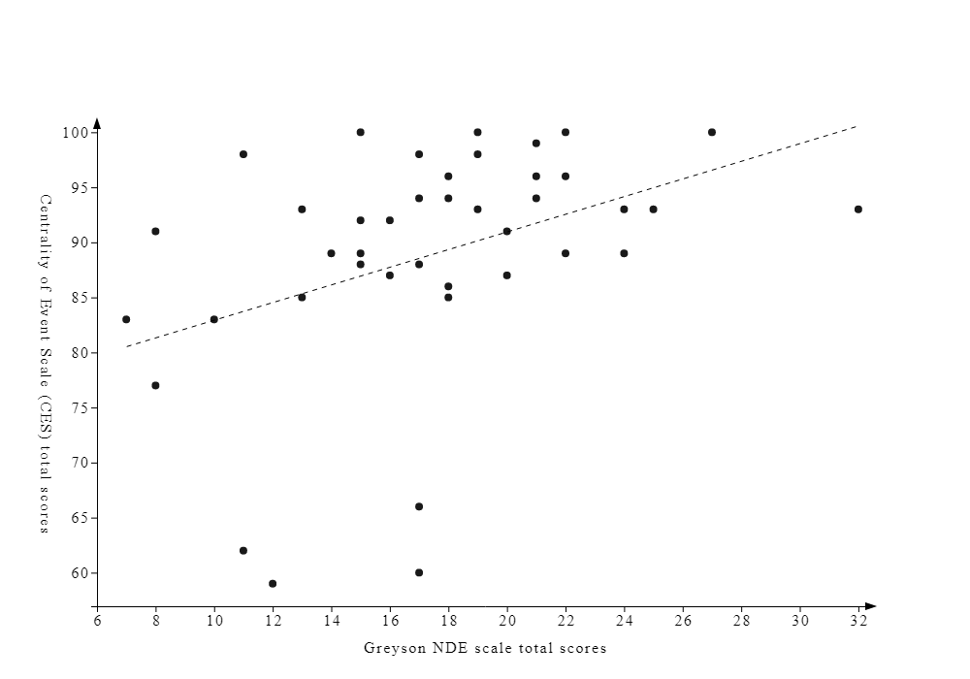
Results & Discussion (2)
“NDE recalled” subgroup (n=41) rated the NDE memory as more central (89±11) to their identity as compared to the other SDM (71±19; p<0.001)
Richness of the NDE memory (Greyson NDE scale scores) was positively associated to its centrality (CES scores; Fig. 1)
TAKE HOME MESSAGE
NDE memories = SDMs
Crucial to NDErs’ personal identities
Highlights importance for clinicians to facilitate their integration within the self
Centrality of Event scale total scores
Greyson NDE scale total scores
Fig. 1. Association between CES total scores and Greyson NDE scale total scores within the NDE recalled subgroup (rs = 0.48, p=0.001).
hcassol@uliege.be

