Slide 1
University Certificate in Clinical Trials CIRM 15th November 2018
Régis Radermecker MD Phd

Slide 2
Minister's position
The Pact for the Future "for the patient and with the pharmaceutical industry", signed in July 2015 by the Minister of Public Health Maggie De Block and the pharmaceutical industry in Belgium, sets clear actions to maintain the global leadership of the pharmaceutical industry. Belgium in the evaluation and execution of clinical trials in view of the new European regulatory framework. There is a strong political will to continue to invest in our country as a world center for clinical trials, and thus to ensure that the Belgian population has access to the latest and most advanced treatments.
Minister of Public Health Maggie De Block in the Pact for the Future: "In terms of clinical trials, we will develop a strategic plan in consultation with hospitals, the FAMHP and industry in order to keep our 'yellow jersey' on a European scale. "

Slide 3
The Belgian situation
The number of applications to launch clinical trials in Belgium increased by 6% in 2015.
In our country, some 1578 clinical studies were in progress in 2014.
Belgium ranks 2nd in the European ranking of clinical trials per capita

Slide 4
The advantages for the world of research in Belgium
Clinical trials contribute to the development of scientific knowledge and innovation in Belgium. Belgian researchers and research centers thus remain at the forefront of innovative treatments against diseases such as cancer, diabetes and diseases of the central nervous system.
The advantages for the Belgian economy
The Belgian pharmaceutical industry is one of the most intensive R & D sectors in Belgium. Despite the economic and financial crisis since 2008, the pharma sector in our country has always continued to invest in R & D. Clinical trials create jobs in research centers, universities and hospitals. In Belgium, more than 5,800 researchers are active in the pharmaceutical industry.

Slide 5
Benefits for the University of Liège and the University Hospital
No certificate in clinical trials in Belgium
Expertise in the field
ATC Pharma and Pharmaceutical Industries Synergies
CTC Creation (Clinical Trial Center)
Innovative treatments for patients

Slide 6
Goals
To familiarize students with the complex issues of clinical trials conducted for the evaluation of new drugs before they are placed on the market
Must raise awareness among all stakeholders

Slide 7
Concerned public
Doctor
Veterinary
Pharmacist
Dentist
Holder of a Master in Biomedical Sciences
Hospital nurse, dietician, .... (VAE)

Slide 8
Certificate structure
The training consists of 15 ECTS: 10 ECTS in class (82 teaching hours), 2 ECTS for the internship (40 hours), and 3 ECTS for the completion of a personal work at the end of training. The whole is organized on an academic year.

Slide 9
Programme des cours (1)
Introduction au déroulement du certificat et présentation des stages et du TFE (4h)
Rappel de principes élémentaires adaptés à la thématique des essais cliniques
Principes de toxicologie (4h)
Principes de pharmacologie (PK/PD,….) (6h)
Principes des analyses biologiques dans les essais cliniques (notions d’analyses standardisées/centralisation des analyses pour éviter les biais/ définition de valeurs de référence/…) (4h)
Principes de base statistique adaptés aux essais cliniques (calcul de puissance, réduction de risque relatif et absolu, odds ratio, interprétation des résultats d’un essai,…) (8h)

Slide 10
Programme des cours (2)
Conception d’un essai clinique
Introduction à la recherche pré-clinique : rappel des notions de recherche pré-clinique et des données issues de celles-ci pour concevoir un essai chez l’être humain (phase 1) (6h)
Conception d’un essai clinique depuis l’implémentation des données pré-cliniques, validation à chaque étape (stop or go) jusqu’à la stratégie de mise sur le marché (10h)
Fonctionnement d’une unité de recherche clinique : rôles des différents intervenants (8h)
Intérêt d’un Clinical Trial Center ou CTC (4h)
Aspects réglementaires et légaux (AFMPS, Comité d’éthique, Assurance) (6h)
Good Manufacturing Practices ou GMP (2h)
Good Clinical practices ou GCP (2h)

Slide 11
Programme des cours (3)
Méthodologie des essais cliniques (16h)
Publications des résultats et Evidence Based Medicine (EBM) aboutissant aux recommandations (guidelines) scientifiques mais aussi à l’orientation stratégique du devenir du médicament (6h)

Slide 12
Knowledge assessment
The assessment of knowledge will be done according to written modalities chosen by each teacher but must be identical for both sessions (multiple choice questions or open questions)
Written notes: teachers will make available the course notes or slides available to students

Slide 13
Internships (1)
The internships must be provided in a center concerned by clinical trials: hospital unit, CTC, pharmaceutical industry. They will be adapted to the preliminary training of the student and will be the object of a convention

Slide 14
Internships (2)
The student will have to perform his / her internship consecutively (and not one day per week for example) per half-day minimum in order to get involved in his project in an efficient way. The internship being 40 hours, this will correspond to 5 days of 8 hours or 10 half-days of 4 hours of mandatory presence (except exception granted by the sponsor for logistical reasons).
If the student works in a structure concerned by clinical trials, his internship can be realized in this same structure on the condition that the work to be done as part of his internship is not the same as that of his usual work

Slide 15
Internships (3)
The student will sign a commitment on the honor
The internship supervisor will specify in advance the purpose of the internship and the expected personal involvement of the student. It is on this basis that the certificate coordinator will accept or not the location of the course.
The training supervisor will provide a document containing the program and the objectives of the internship, which will be co-signed with the student
The tutor will give an evaluation at the end of the internship

Slide 16
Commitment on honor (internship)

Slide 17
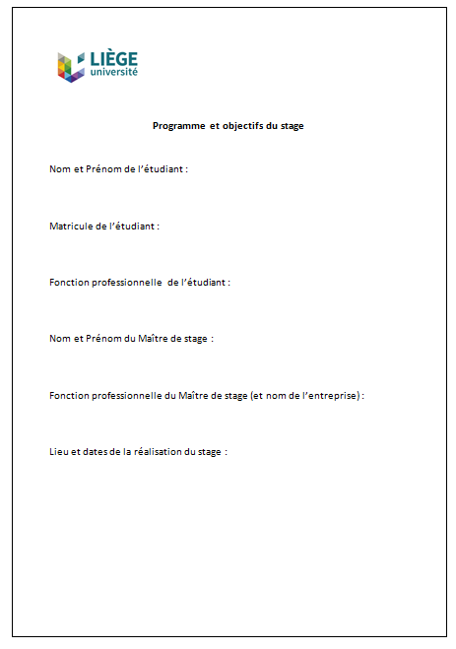
Program and objectives of the internship

Slide 18
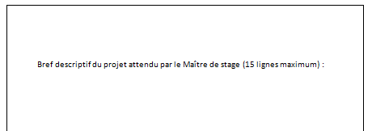
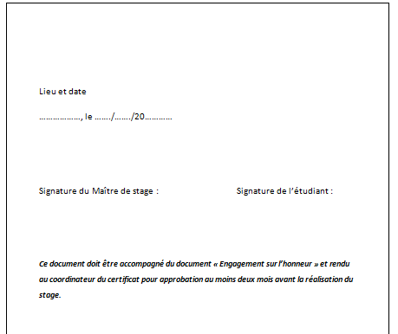
Program and objectives of the internship

Slide 19
Final work (TFE)
The graduation work (TFE) will be a handwritten report of the activity of the internship to be submitted to the jury of 3 teachers within a set time. This work will be presented by the student in front of a jury of 3 teachers. The presentation will be for 15 minutes with 10 minutes of questions

Slide 20
Weighting
Course: 60%
Internships: 20%
TFE: 20%

Slide 21
Current situation
10 candidates
We need at least 6
Teachers: B Boinem, C Charlier, E Cavalier, AF Donneau, P Drion, R Marini, R Radermecker, A Scheen, MN Thomas-Englebert, V Seutin, A Volders

Slide 22
Partnership with Janssen
Promote the certificate
Organization of a visit of their site accompanied by a conference
Accept trainees

Slide 23
https://www.uliege.be/cms/c_10321636/fr/certificat-universitaire-en-essais-cliniques
regis.radermecker@chuliege.be

