Slide 1
Land and agrarian reforms in Rwanda: Organic farming perspective
Mireille MIZERO, Ph.D Student, Université de Liège, Faculté de Gembloux Agro-Bio Tech, Department of Economy and Rural Development, Belgium
Co-autors
Antoine KARANGWA, Ph.D, University of Rwanda, School of Agriculture and Food Sciences, Department of Rural Development and Agricultural Economics, Rwanda
Philippe Burny, Ph.D.¹
Michel Baudouin, Ph.D.¹
Philippe Lebailly, Ph.D.¹
.

Slide 2
Presentation
What
Where
Why
How

Slide 3
Land reform
land reform policy is critical to provide a framework for optimal use of available and predictable land resources
It required a well conceived legal and institutional changes,
Overcome land-related conflict and inequity,
Avoid discrimination in land access and ensure equity in inheritance as well as transparency in land transaction.

Slide 4
Land and agrarian reform implementation in Rwanda
2004 until now
Land policy and land laws change
Consists in systematic registration and regularization of land use right
Facilitate land and incorporated assets transaction
Garantee land use efficiency by regional specialisation and land consolidation
Promoting collective or individual agribusiness

Slide 5
Land reform for increasing land value
Organic material improve structure and texture of the soil for long term
Need garantee that the ownership or usefruct are insured for long time
Anhence investment in agriculture, livestock and agroforestry
Adding value based on its potential fertility

Slide 6
What is organic agriculture
“Organic farming operates without pesticides, herbicides and inorganic fertilizers, and usually with a more diverse crop rotation.” (Bengstson et al., 2005)
use of organic fertilizers, manure and ley is the recognized as incentive in organic farming
Some pesticides are allowed when they are not selective.

Slide 7
Organic farming is not
Unproductive farming
Subsistance agriculture
Extensive agriculture
Unprofitable business
Necessarily environmentally friendly farming

Slide 8
Research question and objective
Can the agrarian system in Rwanda set up entirely on organic or inorganic fertilizers exclusively?
Is the rotation of pyrethrum and potatoes a good farming system to limit excessive use of mineral fertilizers and pesticides?

Slide 9
Objective
To analyse how organic agriculture can coexist with conventional agriculture and allow agriculture operators or investors to benefit of the market liberalisation

Slide 10
Methodology
Study area Northern province, Kinigi sector Virunga mountains
Extension (Nyabihu, Musanze, Burera and Rubavu districts)>1500 m to 3000 altitude, 20 to 22°C
Literature review,
Unstructured survey and intervews
Observation during the field work in august

Slide 11
Results and discussion

Slide 12
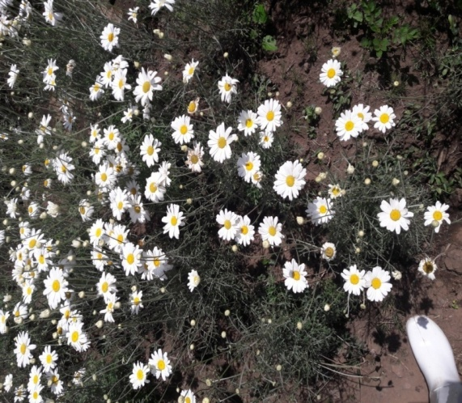
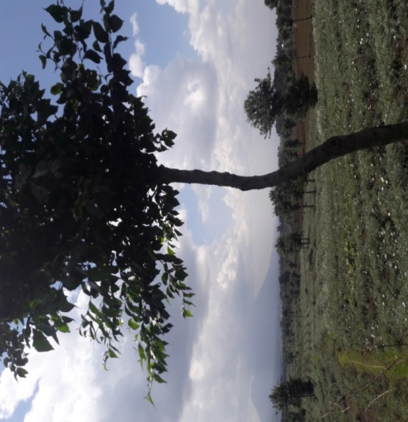
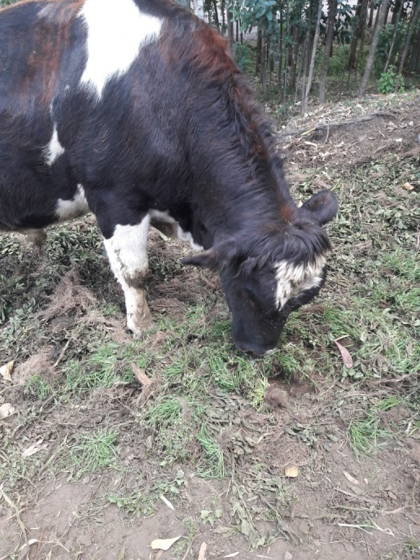
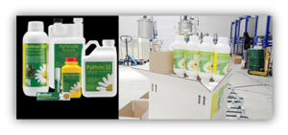
Over 10,000 organized in seven (7) cooperatives. NAEB (2013)
approximately 15 % of the world market share. NAEB (2013)

Slide 13
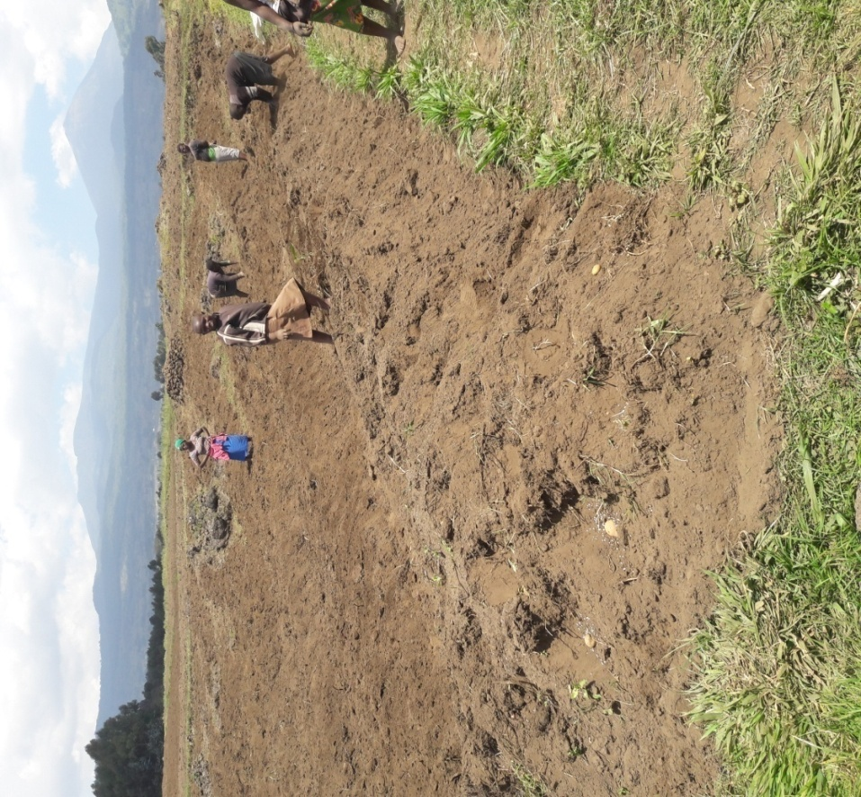
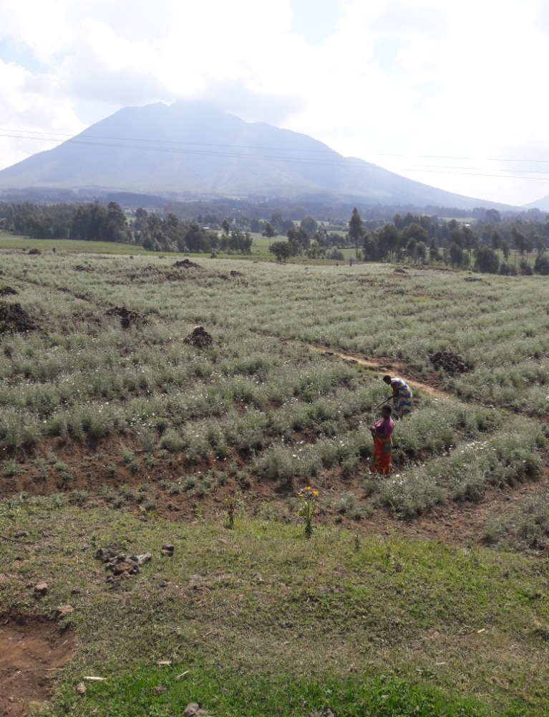
Manual Labor in PPFS

Slide 14
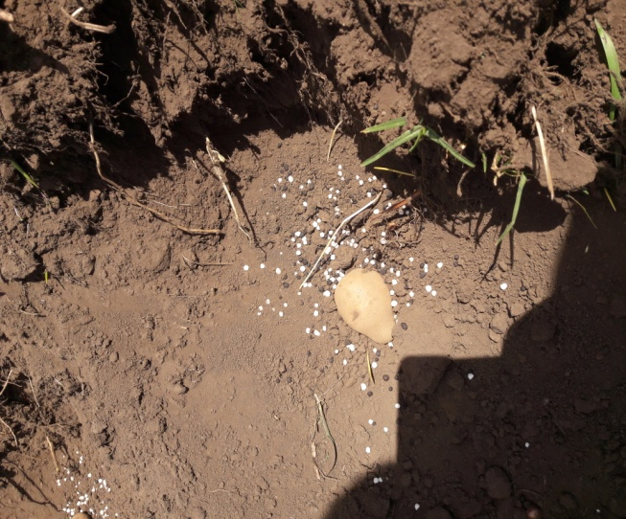
Types of fertilizers used in Rwanda agrarian system
Marginal usage of chemical fertizers

Slide 15
Pirethrum vs others export crops
Source : Author from statistics reported by NAEB (National Agricultural Export Development Board, 2012)

Slide 16
Organic insecticides
SOPYRWA AGROPY Ltd
ECOCERT under European Union regulations EC No. 834/2007 & 889/2008 for Pyrethrum 5EW.

Slide 17
PPFS+Agroforestry= profitable & social farming system
Increasing income
Market oriented production & food supply
Social &Human capital
Land &Credit access
Networking of farmers between and within cooperative
National level
Regional level
International level
FECOPPORWA 9,796 members
RDC, Burundi, Uganda
Agriterra AgriProFocus, NEDATO

Slide 18
Conclusion et perspective

Slide 19
Positives aspects of land access regulation
Secure tenure
Access to credit both informal and formal
Organic farming investiment for long time

Slide 20
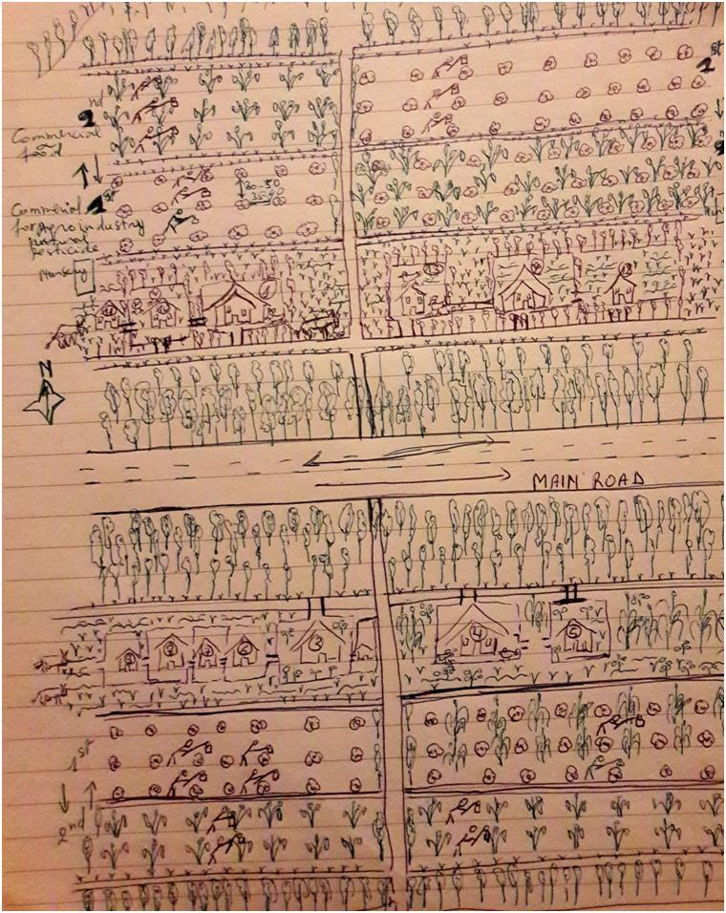
Paysannat land management and use
1936 Congo
1945 Burundi
1953 Rwanda
2ha/nuclear family
EEC& Belgium
Certificate of use&habitation
Cooperative

Slide 21
Challenges for pyrethrum
The crop production is still low because the inputs are also still low.
Lack of appropriate drying materials.
Lack of adequate crop husbandry among farmers.

Slide 22
Challenge for pyrethrum
Production has continued to drop due to management problems.
It is difficult to deliver the products from the farms to the factory.
Poor infrastructures more especially in rural areas.
Lack of information about international market for the small farmers

Slide 23
Thank you very much for your attention

