Slide 1
Semantic Effects In Verbal Short-term Memory: Where Do They Come From?
Kowialiewski Benjamin
Majerus Steve

Slide 2
Introduction
Verbal short-term memory: temporary storage of verbal information
« Recall »

Slide 3
Introduction
Semantic knowledge has a dramatic influence on vSTM span.
A
A
A
B
B
B
Related
A
B
C
D
E
F
Unrelated

Slide 4
Introduction
Semantic similarity effect
A
A
A
B
B
B
Ex: leaf – tree – branch – arm – leg – hand
A
B
C
D
E
F
Ex: lake – hand – road – flute – mask – dress

Slide 5
Introduction
A
A
A
B
B
B
High imageability words
A
B
C
D
E
F
Low imageability words

Slide 6
Introduction
Imageability effect
A
A
A
B
B
B
Ex: pork – waffel – leg – pencil – ball – cage
A
B
C
D
E
F
Ex: stress – wave – tax – glory – gender – smart

Slide 7
Introduction
Martin, Saffran, & Dell (1996)
Cowan (2001)
Oberauer (2002)
Majerus (2013)
Long-term memory
Focus of attention

Slide 8
Introduction
Martin, Saffran, & Dell (1996)
Cowan (2001)
Oberauer (2002)
Majerus (2013)

Slide 9
Introduction
Martin, Saffran, & Dell (1996)
Cowan (2001)
Oberauer (2002)
Majerus (2013)

Slide 10
Introduction
Martin, Saffran, & Dell (1996)
Cowan (2001)
Oberauer (2002)
Majerus (2013)

Slide 11
Dell (1986)
Martin, Saffran & Dell (1996)
Introduction
DOG
CAT
MAT
RAT
LOG
FOG

Slide 12
Dell (1986)
Martin, Saffran & Dell (1996)
Introduction: the semantic similarity effect
DOG
CAT
MAT
RAT
LOG
FOG

Slide 13
Dell (1986)
Martin, Saffran & Dell (1996)
Introduction: the semantic similarity effect
DOG
CAT
MAT
RAT
LOG
FOG

Slide 14
Dell (1986)
Martin, Saffran & Dell (1996)
Introduction: the semantic similarity effect
DOG
CAT
MAT
RAT
LOG
FOG

Slide 15
Dell (1986)
Martin, Saffran & Dell (1996)
Introduction: the semantic similarity effect
DOG
CAT
MAT
RAT
LOG
FOG
Decay!

Slide 16
Introduction
Interactive activations should continue to occur when the focus of attention is taken away from linguistic representations.

Slide 17
Dell (1986)
Martin, Saffran & Dell (1996)
Introduction: the semantic similarity effect
DOG
CAT
MAT
RAT
LOG
FOG

Slide 18
Experiment 1

Slide 19
Method: Experiment 1
Ex: leaf – tree – branch – arm – leg – hand
Ex: lake – hand – road – flute – mask – dress

Slide 20
Method: Experiment 1
Ex: leaf – tree – branch – arm – leg – hand
Ex: lake – hand – road – flute – mask – dress

Slide 21
Method: Experiment 1
Recall
Interference
Recall
Recall
Interference
Recall
Interference
Recall
Recall

Slide 22
Method: Experiment 1
5 seconds
Interference
45
45… 42… 39…

Slide 23
Method: Experiment 1
DOG
CAT
MAT
RAT
LOG
FOG

Slide 24
Method: Experiment 1
DOG
CAT
MAT
RAT
LOG
FOG

Slide 25
Results: Experiment 1
Interference x Semantic:
BF₁₀ = 4688
N = 30

Slide 26
Experiment 2a

Slide 27
Method: Experiment 2a
Imageability effect
A
A
A
B
B
B
Ex: pork – waffel – leg – pencil – ball – cage
A
B
C
D
E
F
Ex: stress – wave – tax – glory – gender – smart

Slide 28
Method: Experiment 2a
DOG
CAT
MAT
RAT
LOG
FOG

Slide 29
Results: Experiment 2a
Interference x Imageability:
BF₀₁ = 1.93
N = 30

Slide 30
Experiment 2b

Slide 31
Method: Experiment 2b
Recall
Interference
Recall
Recall
Interference
Recall
Interference
Recall
Recall

Slide 32
Method: Experiment 2b
Recall
Recall
Recall
Interference
Recall
Interference
Recall
Interference
Recall

Slide 33
Results: Experiment 2b
Interference x Imageability:
BF₀₁ = 3.98
N = 30

Slide 34
Discussion
The semantic similarity effect was stronger under interference.
This was not observed as regards the imageability effect.

Slide 35
Discussion
DOG
CAT
MAT
RAT
LOG
FOG

Slide 36
Discussion
CAT
LOG

Slide 37
Discussion
CAT

Slide 38
Discussion
CAT

Slide 39
Discussion
CAT

Slide 40
Discussion
Imageability effect
Normal pace
Slow pace
Campoy, Castellà, Provencio, Hitch, & Baddeley (2015)

Slide 41
Discussion
Kowialiewski & Majerus (2018), JML

Slide 42
Conclusion
Interactive activation can occur automatically, when attention is driven away from vSTM content.
This is not the case as regards high imageability words, whose semantic features require deeper activation within the linguistic system.

Slide 43
Thank you for your attention

Slide 44
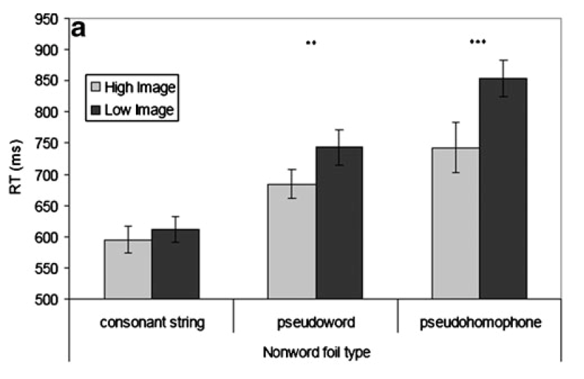
Discussion
Evans, Lambon Ralph, & Woollams (2012)

Slide 45
Dell (1986)
Martin, Saffran & Dell (1996)
Introduction
DOG
CAT
MAT
RAT
LOG
FOG
M
C
D
A
O
G
T

Slide 46
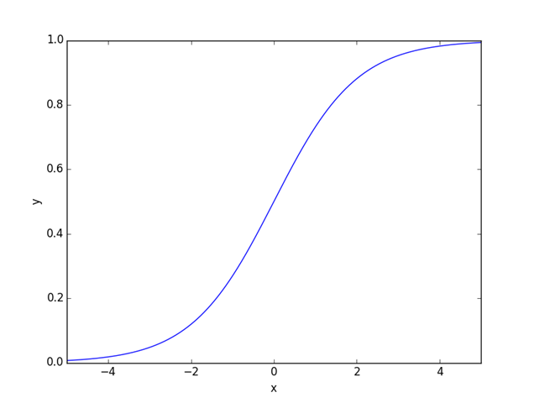
Discussion
CAT

Slide 47
Discussion
CAT

