Slide 1
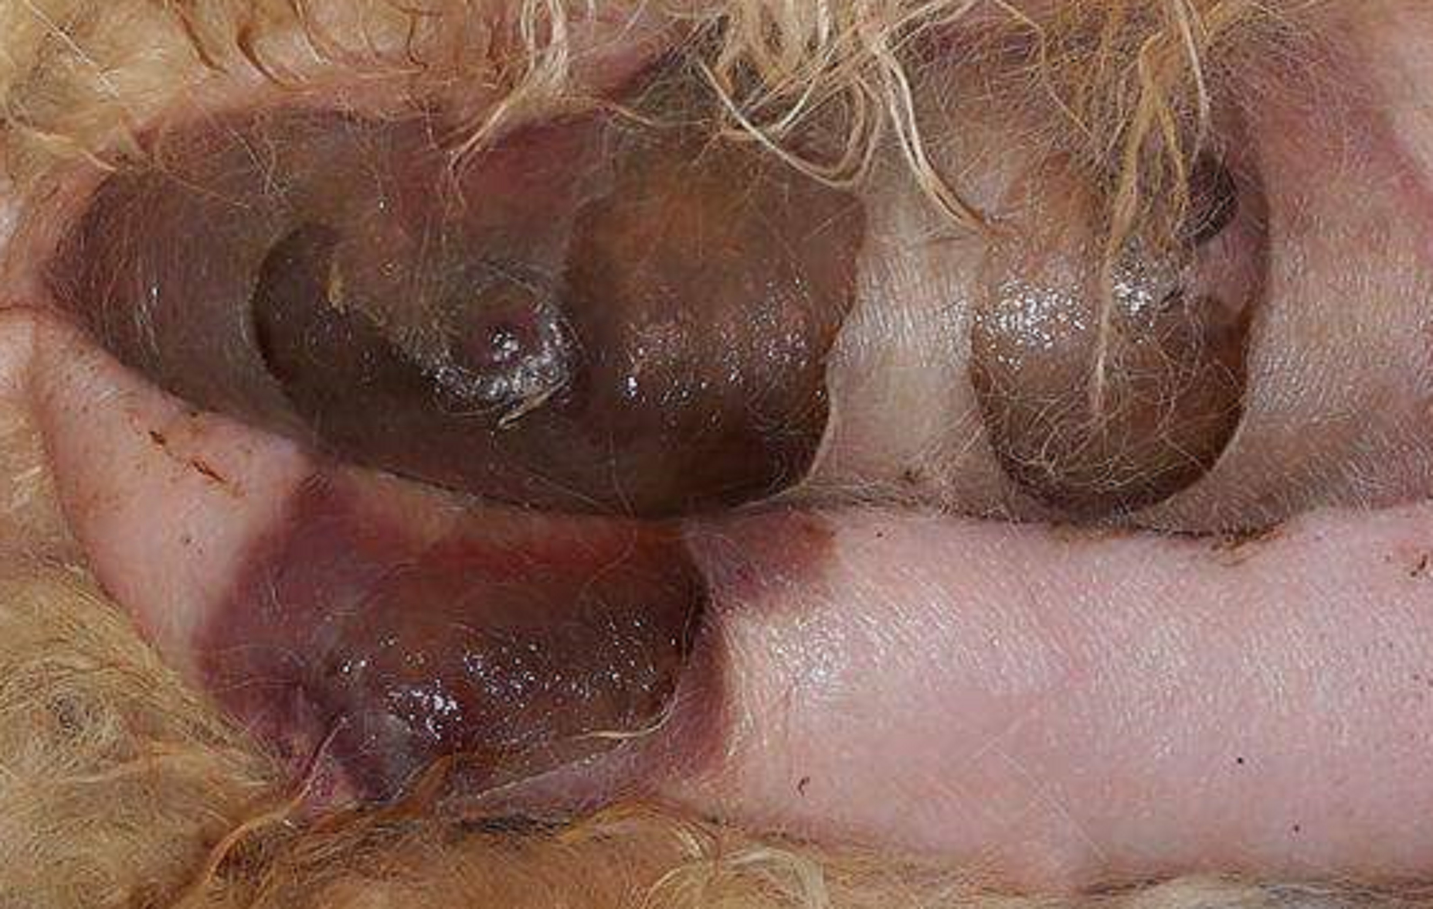
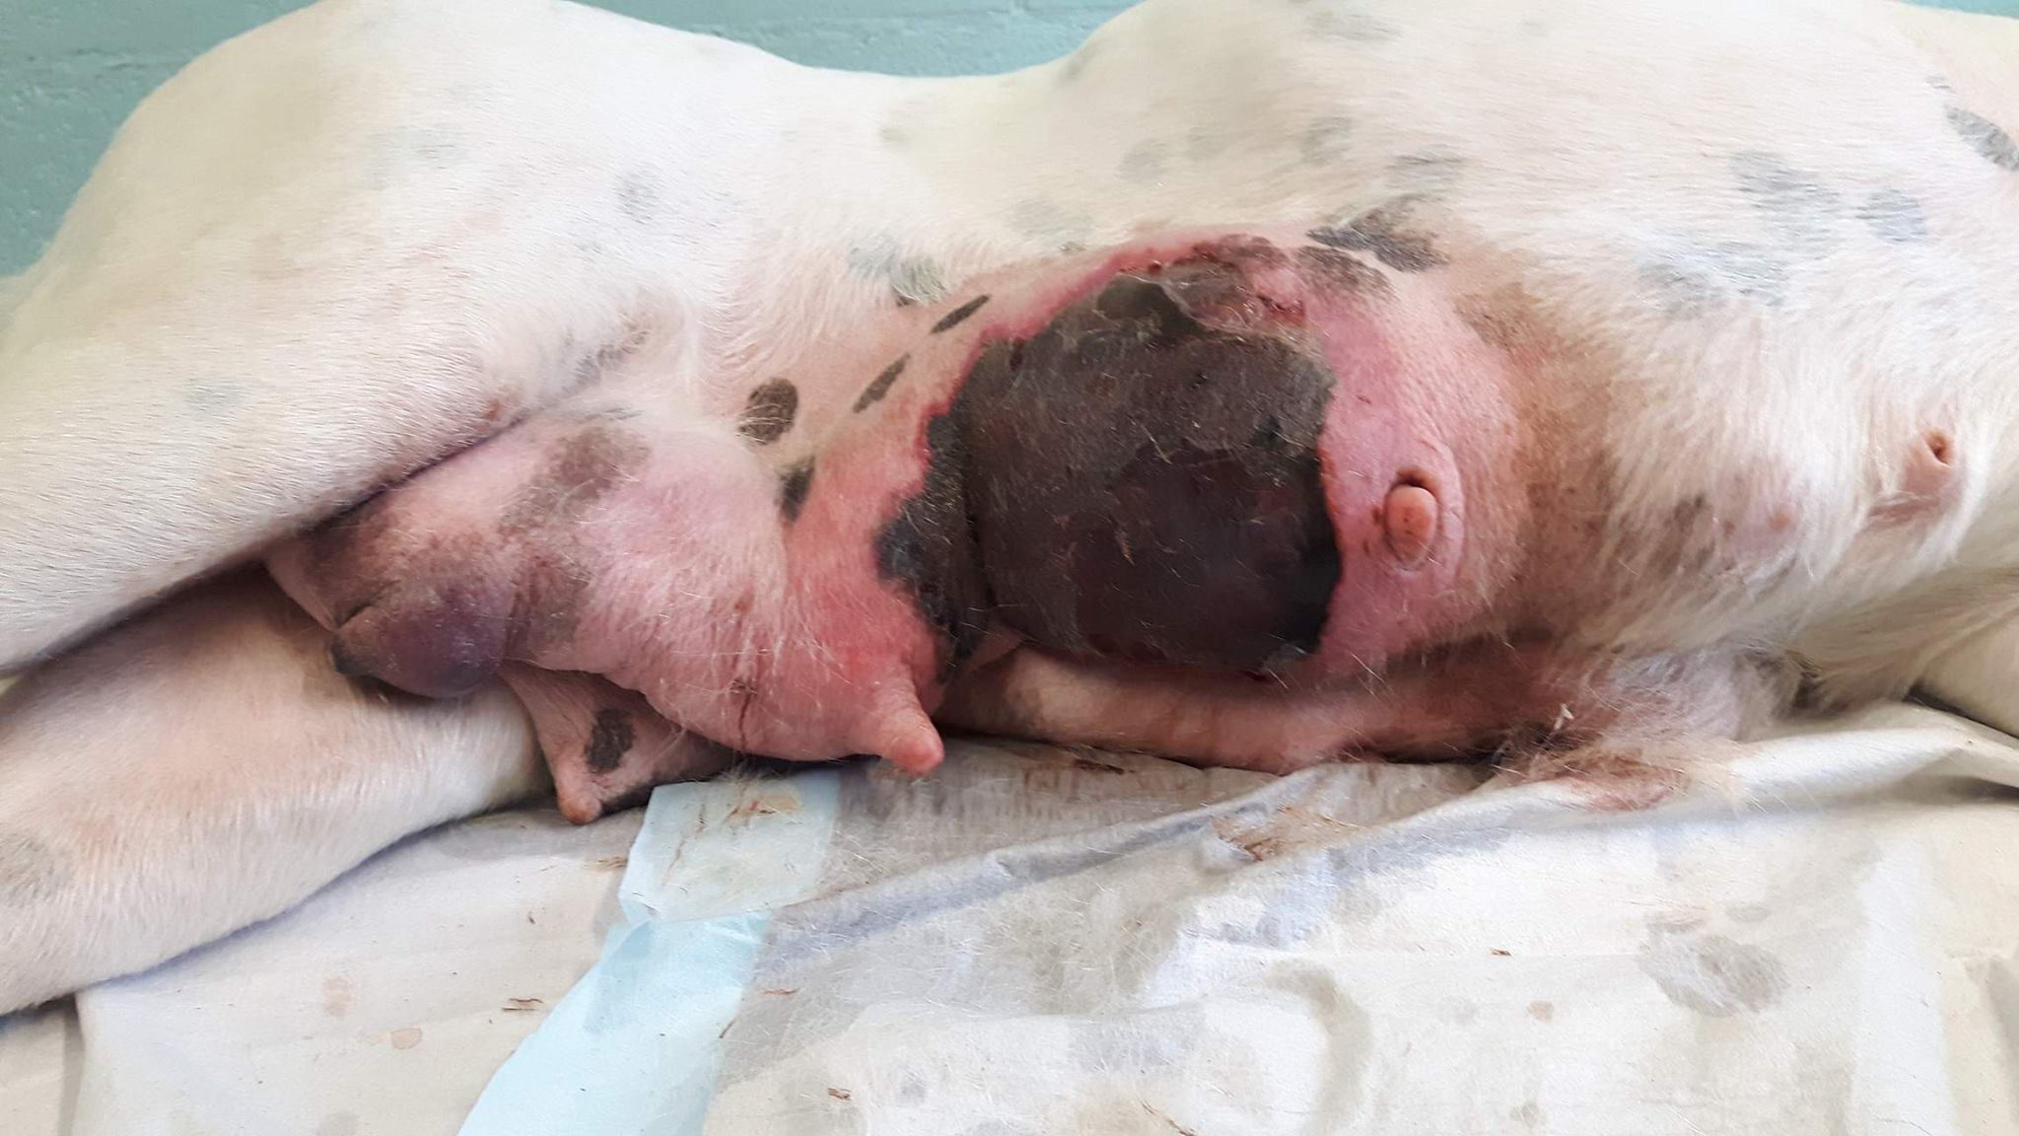
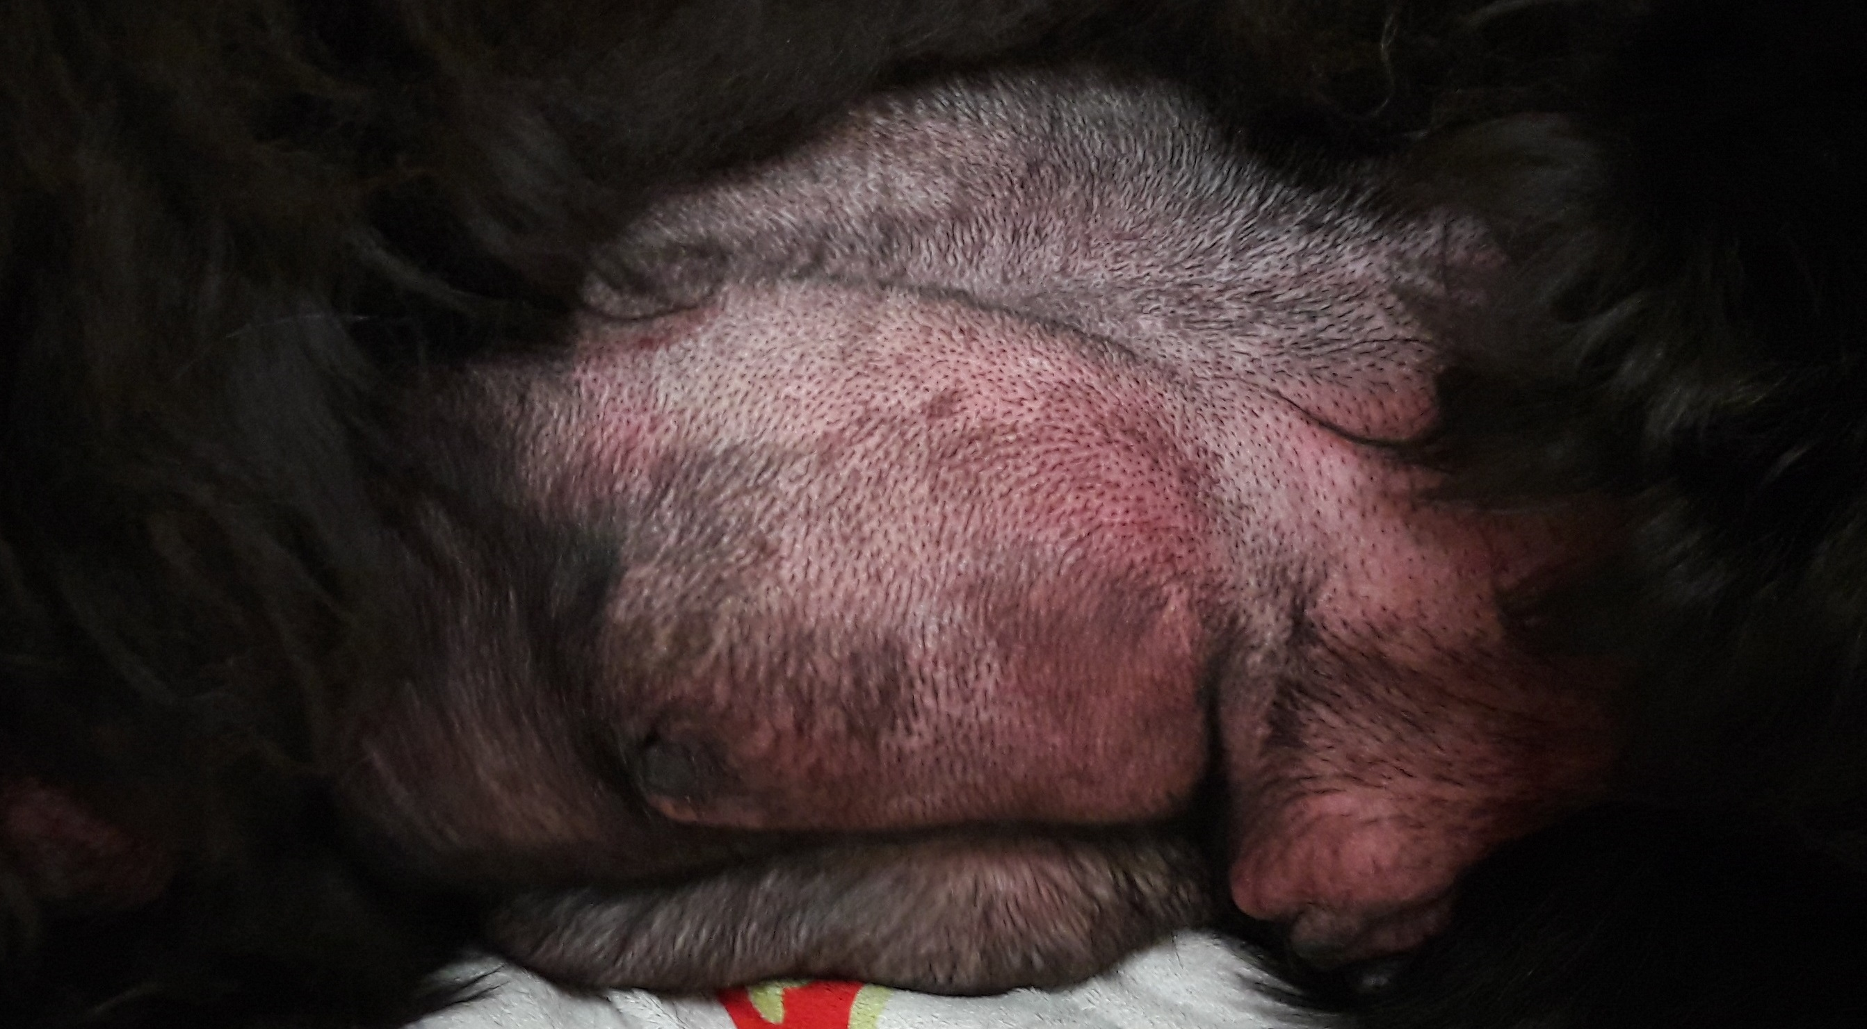
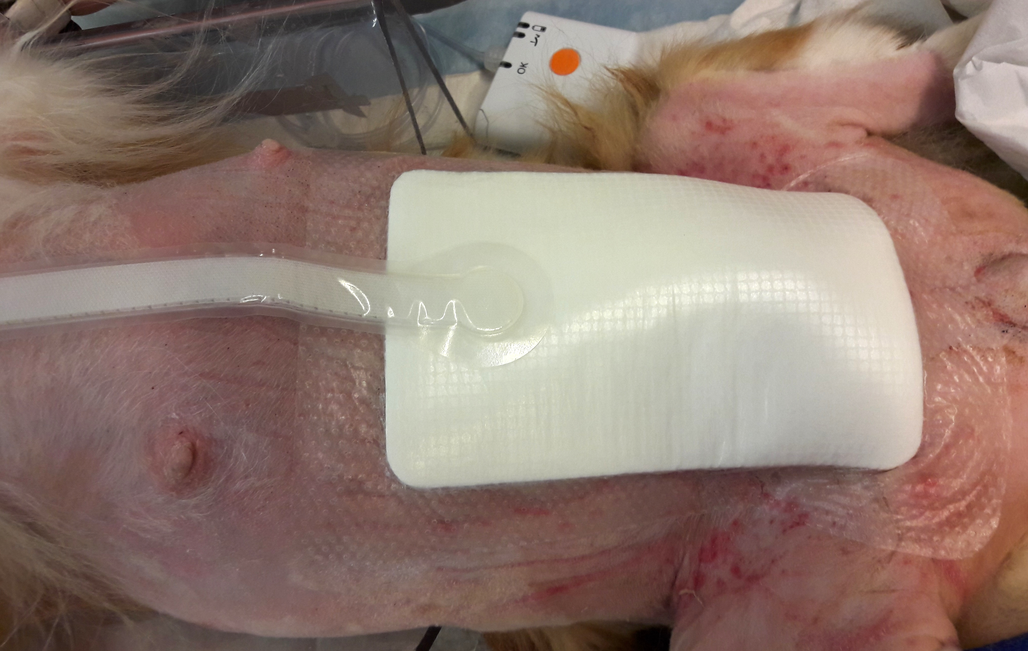
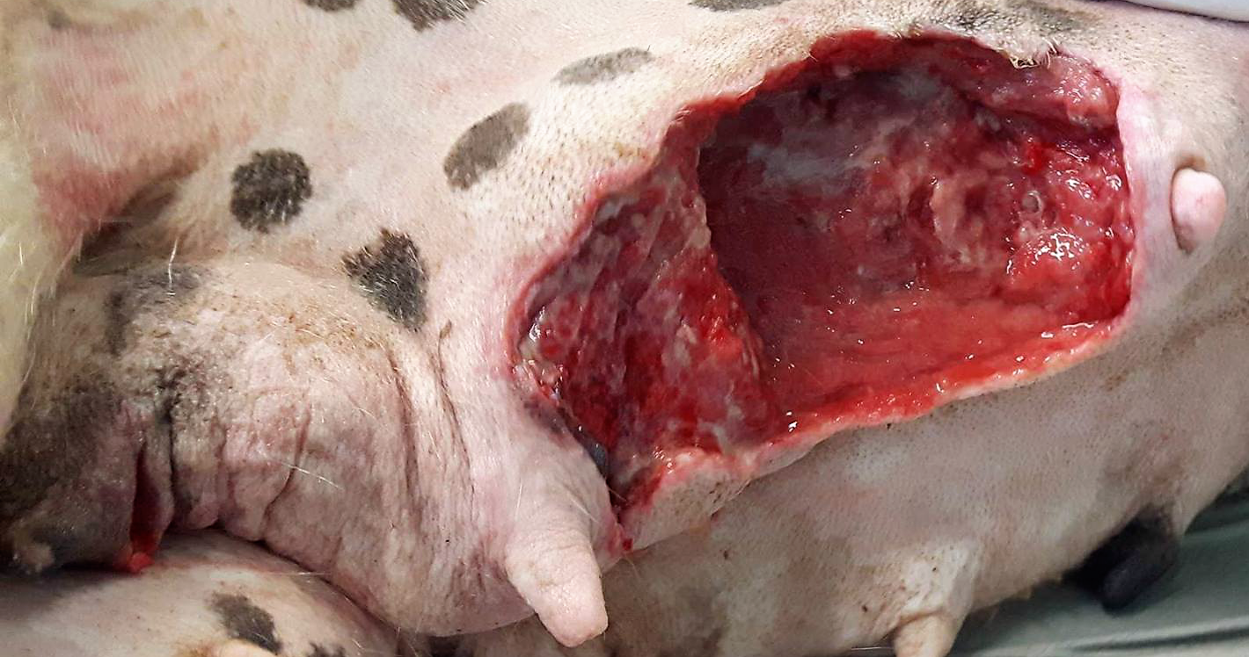
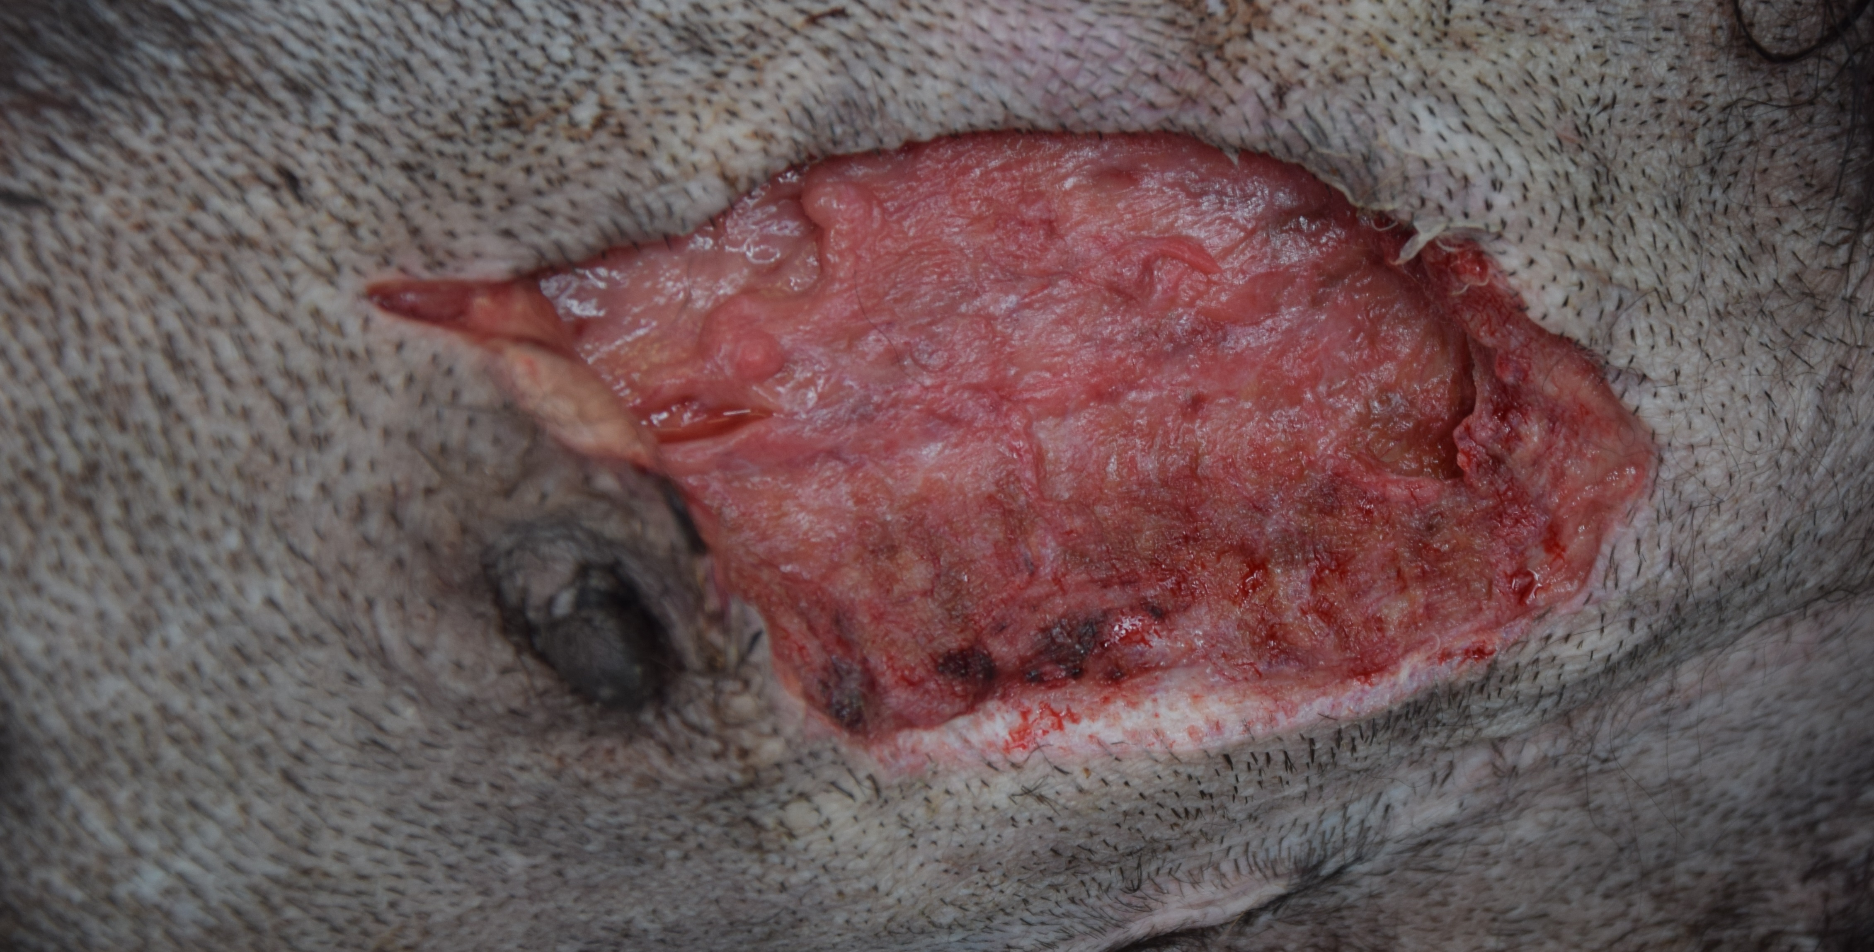
CANINE GANGRENOUS MASTITIS : SERIES OF THREE PATIENTS
S EGYPTIEN, N SHIMIZU, G ROBITEAU, L GUIEU, M LEFEBVRE, S DELEUZE
Department of Clinical Sciences, Clinique Vétérinaire Universitaire, University of Liège, Belgium
Purpose and Diagnosis
To describe and compare the clinical presentations and treatments, of three bitches with fulminant mastitis with gangrenous involvement.
3-y old neutered Sheltie
36 hours post ovariohysterectomy on four dead puppies
Referred under amoxicillin-acid clavulanic and enrofloxacin
At admission :
severe hypotension
septic decompensated shock
2-y old intact Boxer
1 month post partum
healthy litter
Referred under amoxicillin-acid clavulanic
At admission :
prostrated
extremely painful mammary tissue
3-y old intact New Foundland
2 weeks post partum (C-section)
3 out of 6 puppies passed away within 3 days of birth due to agalactia
Referred under cefazoline
At admission :
alert
hyperthermia
Figure 1: at presentation: mammary glands: extremely swollen, not painful
Figure 3: at presentation: open necrotized mammary gland
Figure 5: at presentation: mammary glands: purplish, indurated, painful
Figure 2, day 7: Negative Pressure Wound Therapy device after extensive debridement
Figure 4, day 3: After 2 partials debridements. A redon’s drain was placed at surgical closure of the wound
Figure 6, day 7: after partial debridement and alginate-honey patches
Negative Pressure Wound Therapy
- Indications:
open wound management
infection control
stimulating granulation
Advantages compared to standard bandages:
increases contraction
shorter closure rate
cost is comparable
only one change
earlier surgical closure
Complication:
vacuum loss: surgeon’s experience dependant
Common treatments
Aggressive fluidotherapy
Continuation of initial antibiotherapy
Progressive debridement
Bandages:
wet-to-dry
alginate-honey patches
Extensive debridement under anaesthesia
Surgical closure of the wound
Gangrenous mastistis
more prevalent in ruminants while rare in the bitch
mostly Staphylococcus aureus (Gram +, Catalase +)
alpha haemolysin binding to ADAM10 leads to necrosis and gangrene by:
➔ pores membrane ➔calcium inflow ➔ acute inflammation ➔ severe edema
cleavage of E-cadherin
Conclusion
Treatment choice depends on :
Number of mammary glands involved
Shock status
Evolution of necrosis

